Slide 1
Talking about activities and events
gelb
Follow ups 1-5
Term 3 Week 5
Notes:
Artwork by Steve Clarke. Pronoun pictures from NCELP (www.ncelp.org). All additional pictures selected from Pixabay and are available under a Creative Commons license, no attribution required.
Phonics: [-g] [-d] [-b] Tag [111] und [2] gelb [1446] Berg [934] Zug [675] Lied [1733] Freund [273] Lieblings- [n/a] siebzehn [>5000]
Vocabulary: fahren [215] möcht-, ich möchte, du möchtest [n/a]
Revisit 1: arbeiten [234] Grund [249] Idee [451] mit [13]
Revisit 2: brauchen [179] bekommen [212] machen [58] schreiben [184] Brief [838] Geschichte [262] Hilfe [481] ich weiß (es) nicht [n/a] wie sagt man…? [n/a]
Jones, R.L & Tschirner, E. (2019). A frequency dictionary of German: Core vocabulary for learners. London: Routledge.
The frequency rankings for words that occur in this PowerPoint which have been previously introduced in these resources are given in the SOW and in the resources that first
introduced and formally re-visited those words.
For any other words that occur incidentally in this PowerPoint, frequency rankings will be provided in the notes field wherever possible.
Note that the first three lessons of the year teach language that can be continuously recycled as lesson routine every lesson in Y3/4.
The idea would be that the class teacher (whether or not s/he teaches the class German can re-use the language as part of the daily routine with the class.

Slide 2
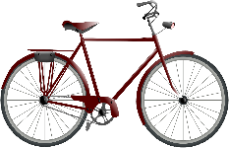
Follow up 1
[-g] [-d] [-b]
aussprechen
When g, d, b come at the end of a word or before a consonant they sound like k, t, p and you don’t use your vocal chords.
When g, d, b come before a vowel, they are like English hard g, d and b and your vocab chords vibrate.
E.g., Frage, da, bin.
Flug
Flüge
Ausflug
Ausflüge
Fahrrad
Fahrräder
England
Engländer
Urlaub
Urlaube
Korb
Körbe
Notes:
Timing: 5 minutes
Aim: to practise spoken production of the SSC [-g], [-d] and [-b] and to contrast them with their voiced equivalents.
Procedure:
Click to bring up the callouts reminding pupils when g, d, and b are voiced and unvoiced.
Click to bring up examples of each SSC.
Pupils practise saying each word, paying attention to g, d, and b. In this exercise we have arranged each example under the correct callout so pupils can focus all their attention on producing the different sounds.

Slide 3
Follow up 2
Was ist richtig? Was ist falsch?
lesen
1
brauchen
3
bekommen
Ich möchte in die Schweiz
Ich möchte
Hilfe
schreiben
fahren
fahren
besuchen
bekommen
arbeiten
5
fahren
Ich möchte eine Liste
machen
2
fahren
4
arbeiten
Du möchtest einen Brief
Du möchtest zu Hause
benutzen
bekommen
bleiben
schreiben
arbeiten
machen
schreiben
spielen
Notes:
Timing: 5 minutes
Aim: to practise recognition of verbs and vocabulary from this and previous weeks.
Procedure:
Explain to pupils that they need to decide which verbs could be correct enders to each of the 5 sentence starters, based on their meaning. Sometimes all verbs might make sense.
Pupils discuss in pairs and write down 1-5 and the verbs they think work for each sentence.
Elicit answers and click for ticks to appear next to correct verbs. Discuss meanings of each sentence as you correct.
In the audio version, correct sentences are spoken with the answer ticks. Pupils can be encouraged to join in with the audio.
Note: Ensure pupils know the meanings of the sentence starters in red boxes, as without this knowledge they will struggle to access the task. Additional task suggestions: 1. Pupils make up their own sense and nonsense sentences, and their partner or the class must decide whether or not they make sense.

Slide 4
Follow up 3
Ich möchte…
sprechen
Was möchtest du machen?
Ich möchte Lias besuchen.
Ich möchte Lias besuchen und zu Hause bleiben.
Ich möchte Lias besuchen, zu Hause bleiben und in die Schweiz fahren.
eine Geschichte
in die Schweiz
zu Hause
einen Grund
Hilfe
Lias
to visit
eine Karte
mit Oma
Gitarre
Notes:
Timing: 10 minutes
Aim: to practise using ‘ich möchte’, focusing on correct word order with the infinitive verb at the end of each clause.
Procedure:
Explain that pupils are going to play a memory game.
Model how this will work by clicking through the example.
Pupils work in pairs. Pupil A chooses a phrase from the 9 options on the slide at random. They start with ‘ich möchte…’. Pupil B then repeats what pupil A has said and then adds a second phrase. Pupils continue adding to each other’s sentences until they have used all 9 options.
Note: a simplified version can be found on the following slide, where students only have to use the verbs.

Slide 5
Follow up 3
Ich möchte…
sprechen
Was möchtest du machen?
Ich möchte besuchen.
Ich möchte besuchen und bleiben.
Ich möchte besuchen, bleiben und fahren.
to visit
Notes:
Timing: 10 minutes
Aim: to practise using ‘ich möchte’ with WO2.
Procedure:
Explain that pupils are going to play a memory game.
Model how this will work by clicking through the example.
Pupils work in pairs. Pupil A chooses one of the 9 verbs on the slide at random. They start with ‘ich möchte…’. Pupil B then repeats what pupil A has said and then adds a second verb. Pupils continue adding to each other’s sentences until they have used all 9 verbs.
Note: a more complex version can be found on the previous slide, where pupils add extra details to phrases to help them practise word order that is different in German.

Slide 6
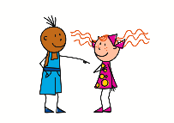
Yes/no questions
Remember! In German we swap verb and subject (e.g., I, you) to make a yes/no question:
?
Remember! There is no word for ‘do’ in German yes/no questions.
Ich fahre.
Fahre ich?
I go.
Do I go?
Note that the verb möchte swaps with the subject ich.
Questions with möchten work like this:
Ich möchte fahren.
Möchte ich fahren?
?
?
Du möchtest fahren.
Möchtest du fahren?
Notes:
Timing: 2 minutes
Aim: to recap the formation of yes/ no questions by swapping the subject and verb and to introduce the formation of yes/ no questions with ‘möcht-’.
Procedure:
Click through the animations to recap the formation of yes/no questions and to learn the formation of yes/ no questions with ‘möcht-’.
6

Slide 7
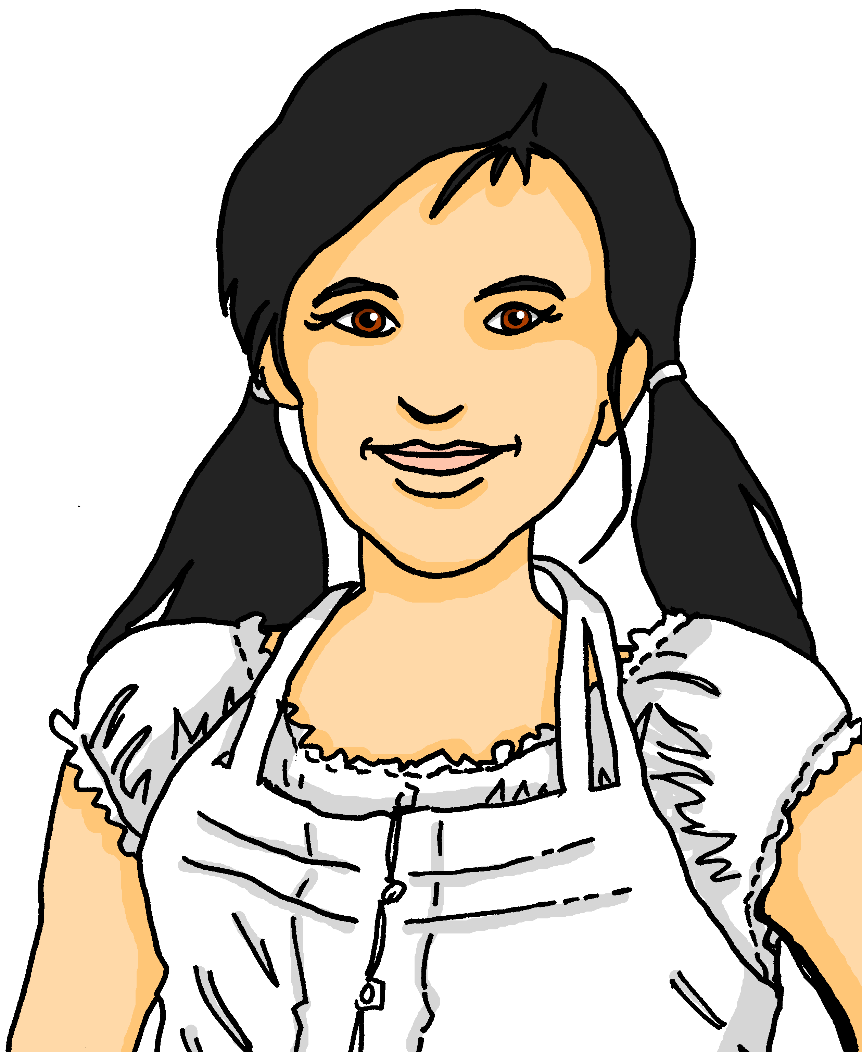
Follow up 4
Möchtest du…?
Partnerarbeit: Auf Deutsch sprechen.
sprechen
Möchtest du eine Geschichte schreiben?
Ja, ich möchte eine Geschichte schreiben.
Möchtest du zu Hause arbeiten?
Nein.
Notes:
Timing: 5 minutes
Aim: to practise asking and answering questions in 2-verb structures using möcht- in the first and second persons.
Procedure:
Pupils work in pairs. They are going to play a game of spot the difference.
Model the activity using the conversation between Lias and Ronja.
Pupils are going to ask each other questions to work out the differences between their handouts. Pupils must keep their handout hidden from their partner!

Slide 8
Follow up 5:

Schreib auf Englisch.
Can you get at least 15 points?
Wörter
 | brauchen | bekommen | machen
 | schreiben | Ich weiß (es) nicht | Wie sagt man…?
 | der Brief | die Geschichte | die Hilfe
 | arbeiten | der Grund | mit
 | fahren | ich möchte | du möchtest
Vokabeln
to receive, receiving
to do, make, doing, making
to need, needing
x3
to write, writing
I don’t know
How do you say…?
(the) letter
(the) story
(the) help
x2
to work, working
(the) reason
with
x1
to go (transport)
I would like
you would like
Notes:
Timing: 5 minutes
Aim: to practise written comprehension of vocabulary from this and revisited weeks.
Procedure: 1. Give pupils a blank grid. They fill in the English meanings of any of the words they know, trying to reach 15 points in total.
Note: The most recently learnt and practised words are pink, words from the previous week are green and those from week 1 are blue, thus more points are awarded for them, to recognise that memories fade and more effort (heavy lifting!) is needed to retrieve them.

Slide 9
Follow up 5:

Schreib auf Deutsch.
Can you get at least 15 points?
Wörter
 | (the) story | (the) letter | to need, needing
 | (the) help | to write, writing | to receive, receiving
 | How do you say…? | I don’t know | to do, make, doing, making
 | with | to work, working | the reason
 | I would like | you would like | to go (transport)
Vokabeln
die Geschichte
der Brief
brauchen
x3
die Hilfe
schreiben
bekommen
Wie sagt man…?
Ich weiß (es) nicht
machen
x2
mit
arbeiten
der Grund
x1
ich möchte
du möchtest
fahren
Notes:
Timing: 5 minutes
Aim: to practise written production of vocabulary from this and revisited weeks.
Procedure: 1. Give pupils a blank grid. They fill in the German meanings of any of the words they know, trying to reach 15 points in total.
Note: The most recently learnt and practised words are pink, words from the previous week are green and those from week 1 are blue, thus more points are awarded for them, to recognise that memories fade and more effort (heavy lifting!) is needed to retrieve them.

Slide 10
Tschüss!
gelb
Notes:
10

Slide 11
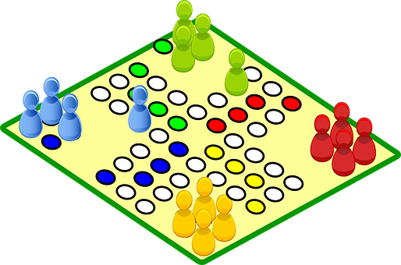
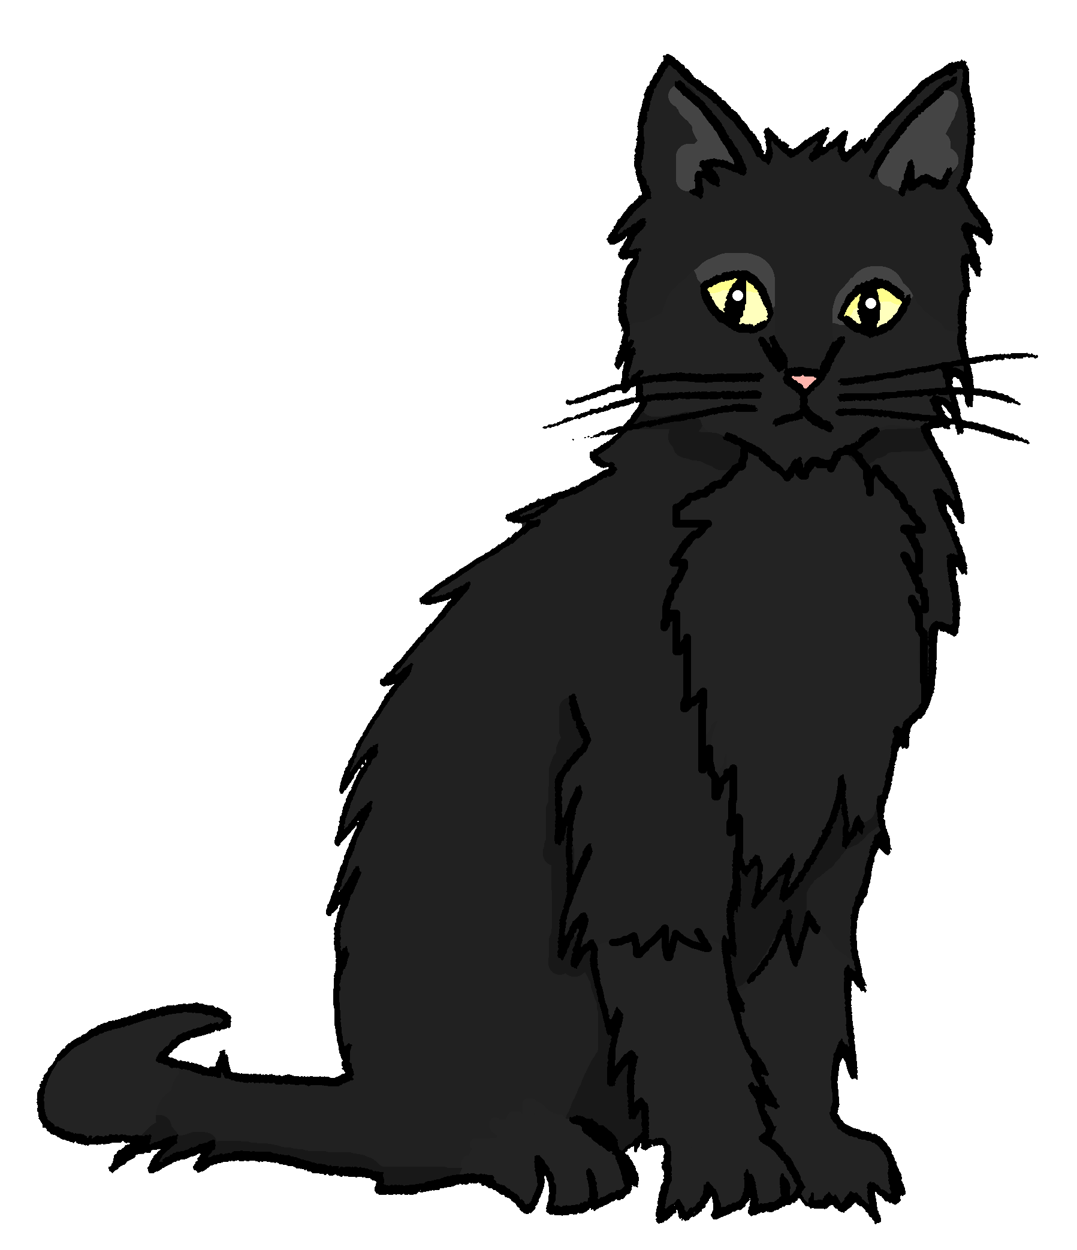
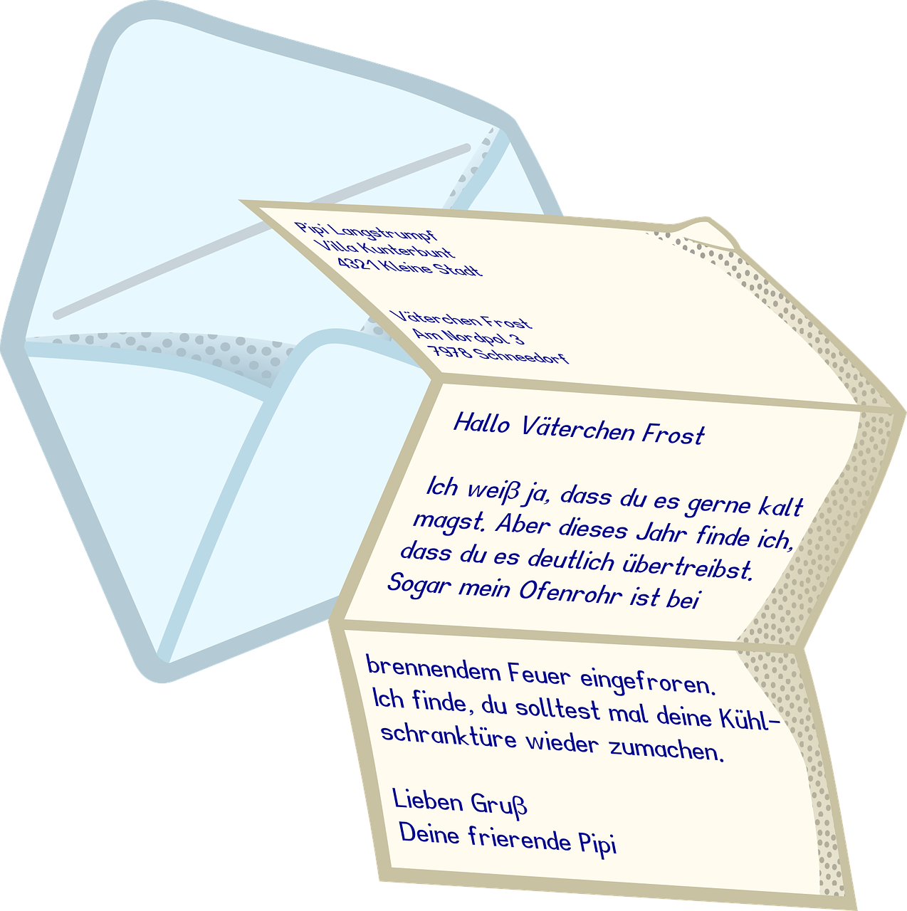
Partner A
Partner B
to visit
to visit
Notes:
HANDOUT
To be cut in half

Slide 12
Follow up 5:

Schreib auf Englisch.
Can you get at least 15 points?
Wörter
 | brauchen | bekommen | machen
 | schreiben | Ich weiß (es) nicht | Wie sagt man…?
 | der Brief | die Geschichte | die Hilfe
 | arbeiten | der Grund | mit
 | fahren | ich möchte | du möchtest
Vokabeln
x3
x2
x1
Notes:
HANDOUT

Slide 13
Follow up 5:

Schreib auf Deutsch.
Can you get at least 15 points?
Wörter
 | (the) story | (the) letter | to need, needing
 | (the) help | to write, writing | to receive, receiving
 | How do you say…? | I don’t know | to do, make, doing, making
 | with | to work, working | the reason
 | I would like | you would like | to go (transport)
Vokabeln
x3
x2
x1
Notes:
HANDOUT

