Slide 1
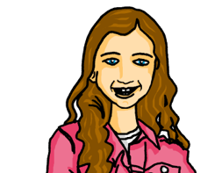
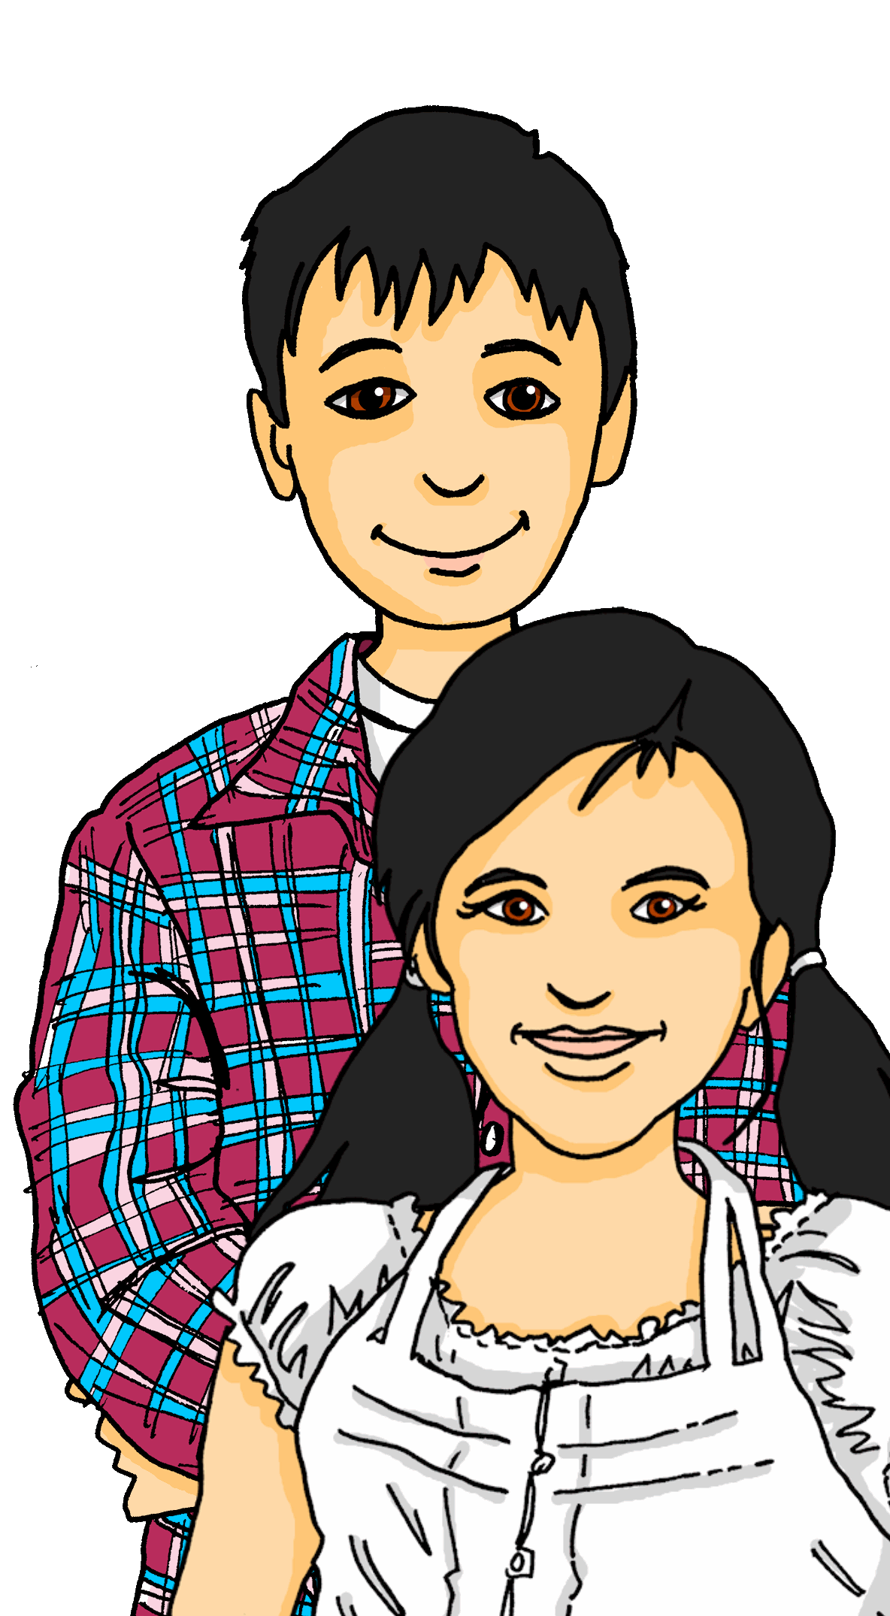
Exploring
Talking to cousins in Germany
grün
Present tense – du vs ihr
WO2 after adverbs of time
SSC [ö] v. [a]
Term 2 Week 2
Notes:
Artwork by Steve Clarke. Pronoun pictures from NCELP (www.ncelp.org). All additional pictures selected from Pixabay and are available under a Creative Commons license, no
attribution required.
Phonics: [ö] vs. [o]
long [ö] König [1087] Österreich [707] Wörter [194]
short [ö] Köpfe [279] öffnen [508] zwölf [1080]
long [o] wo? [94] wohnen [380] Million [206]
short [o] Kopf [279] offen [382] kommen [61]
Vocabulary: benutzen [1119] lernen [288] machen [58] singen [1063] spielen [205] Computer [1252] Fußball [1277] Opa [2776] Song [3373] normalerweise [2062] zu Hause [n/a]
Revisit am + days of the week (am Montag) and adverbs (montags)
Jones, R.L & Tschirner, E. (2019). A frequency dictionary of German: Core vocabulary for learners. London: Routledge.
The frequency rankings for words that occur in this PowerPoint which have been previously introduced in these resources are given in the SOW and in the resources that first
introduced and formally re-visited those words.
For any other words that occur incidentally in this PowerPoint, frequency rankings will be provided in the notes field wherever possible.
Remember that at the start of the course (first three lessons of Rot/Gelb) pupils learnt language (for greetings and register taking) that can still be part of the lesson routines in upper KS2 (Blau/Grün). They are not re-taught, as we anticipate that teachers have built these in from early in lower KS2.
1

Slide 2
aussprechen
long [o]
…
wohnen
wo
Million
Notes:
Timing: 1 minute
Aim: to consolidate the SSC long [o].
Procedure:
Re-present the SSC and the source word ‘wo’ (with gesture, if using).
Click to bring on the picture and get pupils to repeat the word ‘wo’ (with gesture, if using).
Present the cluster words in the same way, bringing on the picture and getting pupils to pronounce the words.
Word frequency (1 is the most frequent word in German): Million [206]] ohne [119] wo? [94] wohnen [380]
Jones, R.L & Tschirner, E. (2019). A frequency dictionary of German: Core vocabulary for learners. London: Routledge.

Slide 3
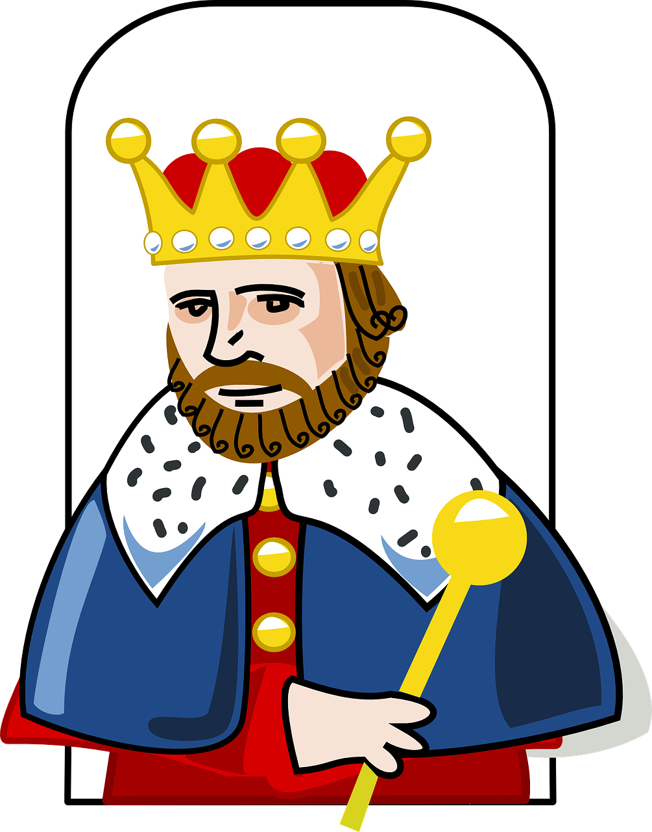
aussprechen
[ö]
…
Österreich
König
Wörter
[Austria]
[king]
[words]
Notes:
Timing: 1 minute
Aim: to introduce the SSC [ö].
Procedure:
Re-present the SSC and the source word ‘König’ (with gesture, if using).
Click to bring on the picture and get pupils to repeat the word ‘König’ (with gesture, if using).
Present the cluster words in the same way, bringing on the picture and getting pupils to pronounce the words.
König [1087] Österreich [707] Wörter [194]
Jones, R.L & Tschirner, E. (2019). A frequency dictionary of German: Core vocabulary for learners. London: Routledge.
3

Slide 4
aussprechen
short [o]
…
kommen
Kopf
offen
kommen – to come
Notes:
Timing: 1 minute
Aim: to consolidate the SSC short [o].
Procedure:
Re-present the SSC and the source word ‘Kopf’ (with gesture, if using).
Click to bring on the picture and get pupils to repeat the word ‘Kopf’ (with gesture, if using).
Present the cluster words in the same way, bringing on the picture and getting pupils to pronounce the words.
Word frequency (1 is the most frequent word in German): kommen [61] Kopf [279] offen [382]
Jones, R.L & Tschirner, E. (2019). A frequency dictionary of German: Core vocabulary for learners. London: Routledge.
4

Slide 5
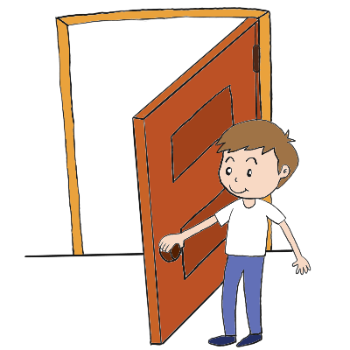
aussprechen
short [ö]
All vowels in German can be long or short, including [ö]. [ö] is usually short when followed by two consonants.
…
12
öffnen
Köpfe
zwölf
[to open]
Notes:
Timing: 1 minute
Aim: to introduce the SSC short [ö].
Procedure:
Present the SSC and the source word ‘Köpfe’ (with gesture, if using).
Click to bring on the picture and get pupils to repeat the word ‘Köpfe’(with gesture, if using).
Present the cluster words in the same way, bringing on the picture and getting pupils to pronounce the words.
Gesture: pupils put their hands to their head but tap twice for the two syllables to suggest more than one, and to reinforce the two syllable plural form.
Kopf [279] öffnen [508] zwölf [1080]
Jones, R.L & Tschirner, E. (2019). A frequency dictionary of German: Core vocabulary for learners. London: Routledge.
5

Slide 6
aussprechen
[ö] oder [o]?
Hör zu und schreib [ö] oder [o].
…
 |  | [ö] | [o]
 |  |  | Form
 |  | schön
 |  |  | rot
 |  |  | Ort
 |  | zwölf
 |  |  | toll
 |  | können
 |  | Österreich
1
2
3
4
5
6
7
8
Notes:
Timing: 1 minute
Aim: to consolidate the SSC [ö] and differentiate it from [o].
Procedure:
Click on the audio buttons for items 1-8. Pupils decide whether they hear [o] or [ö] and write it down for each item 1-8. Images are provided as clues.
Click to reveal answer ticks and the whole word item by item.
Transcript:
Form
schön
rot
Ort
zwölf
toll
können
Österreich
6

Slide 7
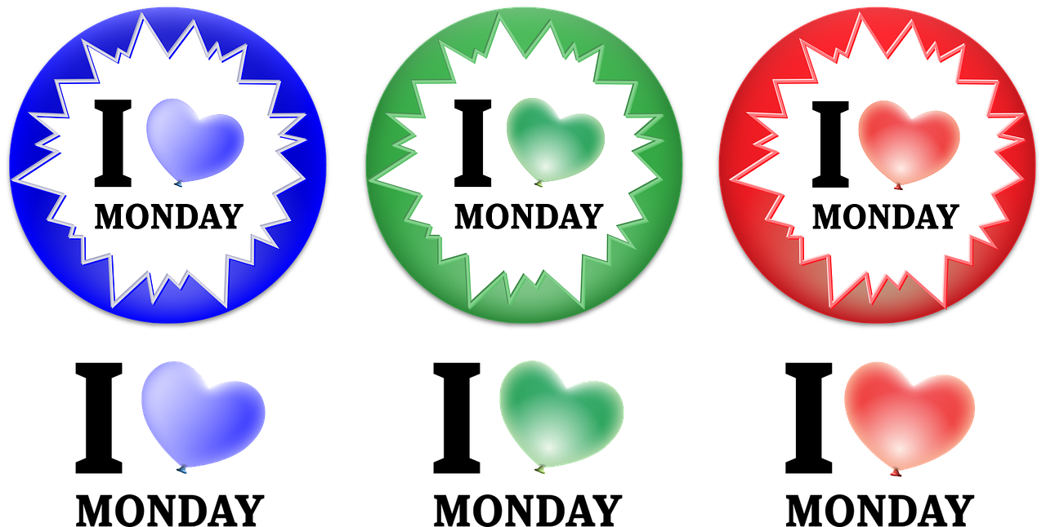
Vokabeln
Hör zu und sag das Wort.
Wörter
You already know how to say the days of the week in German:
Montag
montags
Dienstag
dienstags
Mittwoch
mittwochs
Donnerstag
donnerstags
Freitag
freitags
Samstag
samstags
Sonntag
sonntags
The German word for Monday is:
am Montag → on Monday|this Monday
montags → on Mondays | every Monday
Montag
Now add the words for every day of the week in the box at the top!
Notes:
Timing: 5 minutes
Aim: to present and practise written comprehension and read aloud of the new vocabulary for this week.
Procedure: 1. Click through the animations to present known days of the week and new way of saying EVERY Monday, Tuesday etc.
2. Elicit ’montags’ , ‘dienstags’ etc.
7

Slide 8
Vokabeln
Sort these days of the week in order from Monday, Mondays; Tuesday, Tuesdays etc.
Wörter
on…, this…
Montag
Dienstag
Mittwoch
Donnerstag
Freitag
Samstag
Sonntag
montags
dienstags
mittwochs
donnerstags
freitags
samstags
sonntags
every…
mittwochs
Montag
Dienstag
dienstags
Mittwoch
freitags
Freitag
Donnerstag
montags
donnerstags
Sonntag
Samstag
sonntags
samstags
Notes:
Timing: 5 minutes
Aim: to present and practise written comprehension and read aloud of the new vocabulary for this week.
Procedure: 1. Explain that the task is to put the days of the week in order and sort into on this …day, and every …day. The order is Monday, Mondays. Tuesday, Tuesdays etc.
2. Click for each day of the week in turn to move to the timeline in order of frequency.
8

Slide 9
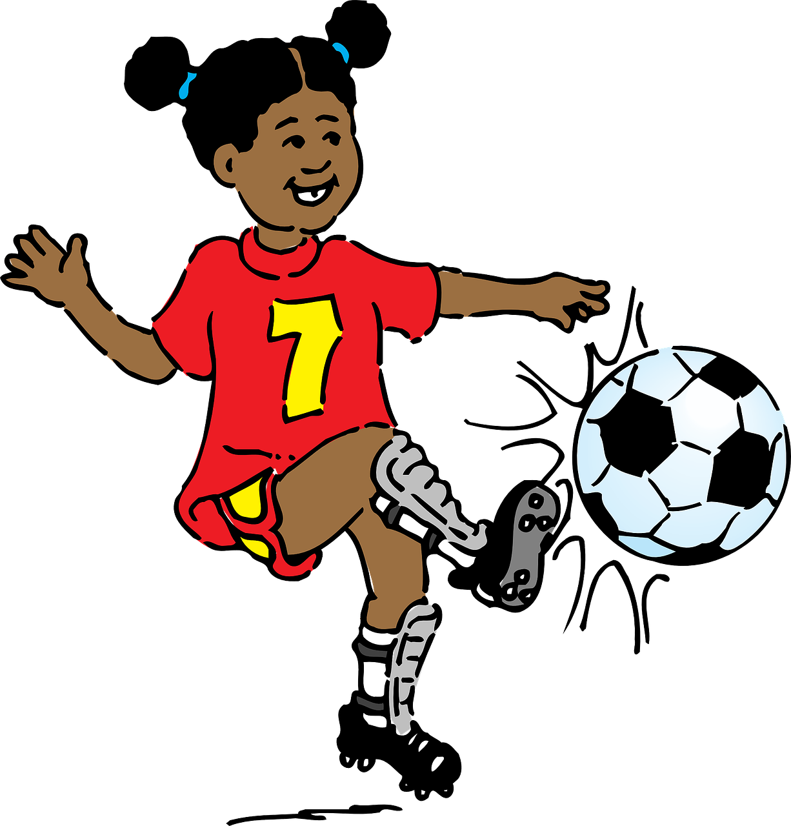
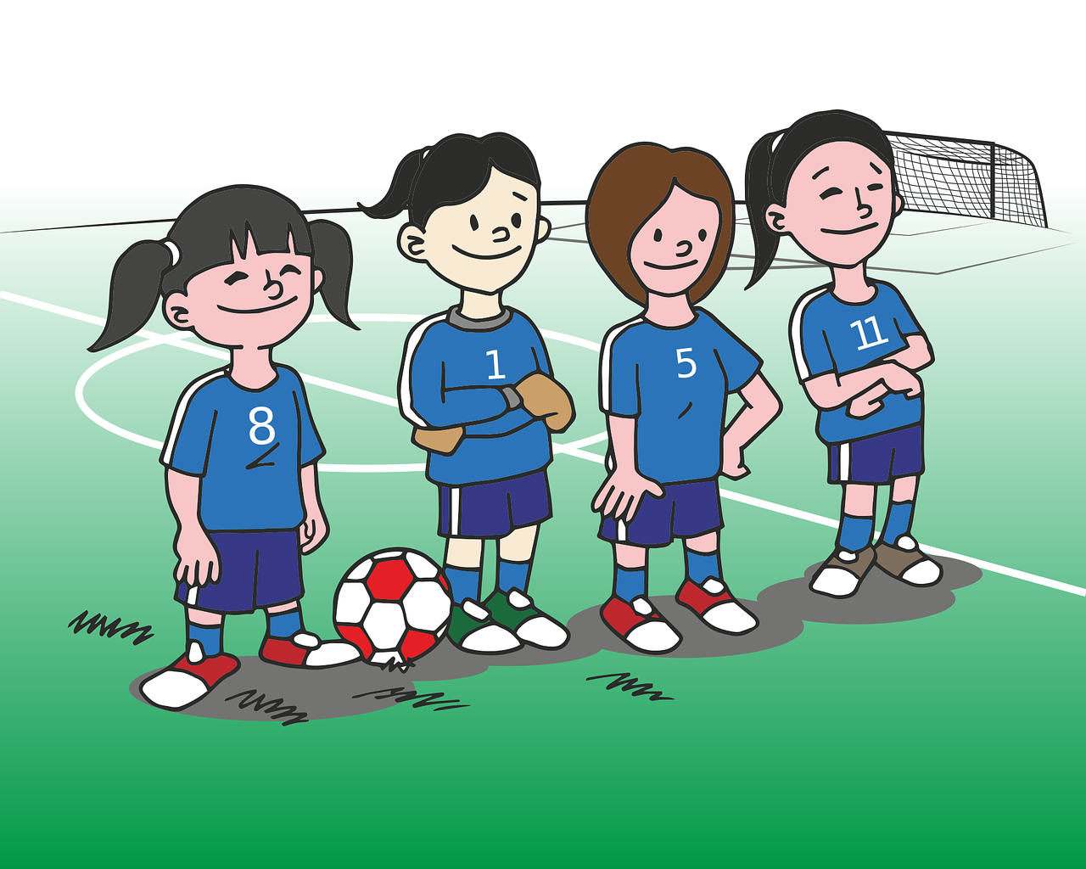
Present tense: du (you) | ihr (you all)
Remember! English has two present tenses, but German only has one!
Remember! To mean ‘you’ to one person, use du:
Du spielst Fußball.
You play football.
You are playing football.
The time adverb in English suggests which present tense to use. E.g., Mondays you … play|are playing football.
To mean ‘you all’ or ‘you both’, use ihr:
Ihr spielt Fußball.
You (all) play football.
You (all) are playing football.
Notes:
Timing: 2 minutes
Aim: to recap the 2nd person singular (‘you) and plural form (‘you all’) of regular present tense.
Procedure:
Click through the animations to present the information.
Elicit English translation for the German examples provided.
Callouts drawing attention to the two present tenses in English (play/ are playing) are coming up as part of the presentation.
9

Slide 10
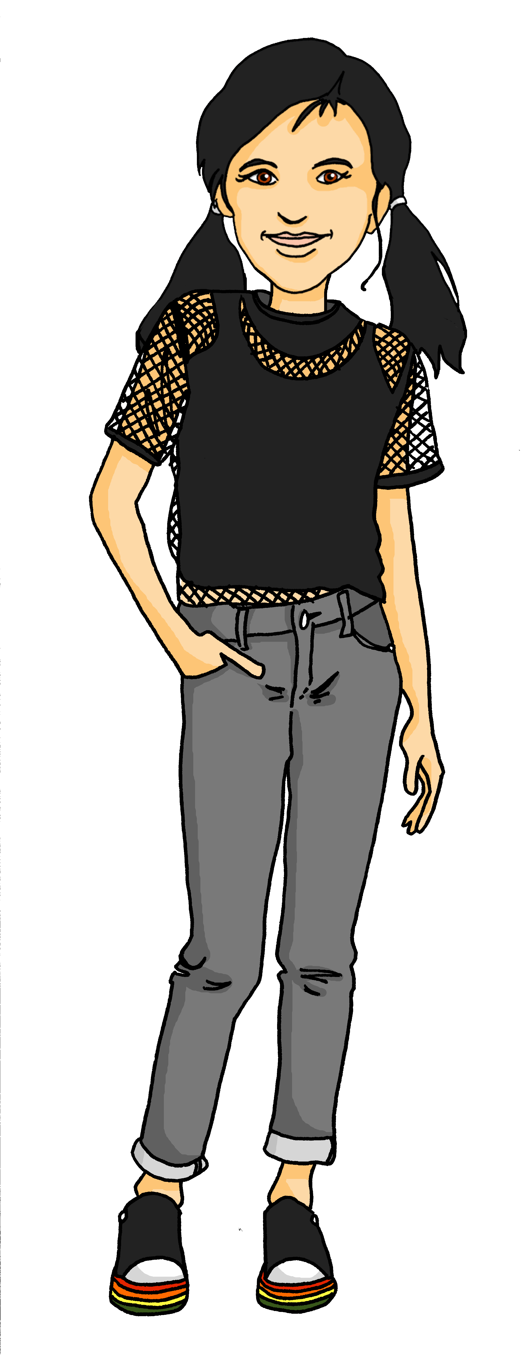
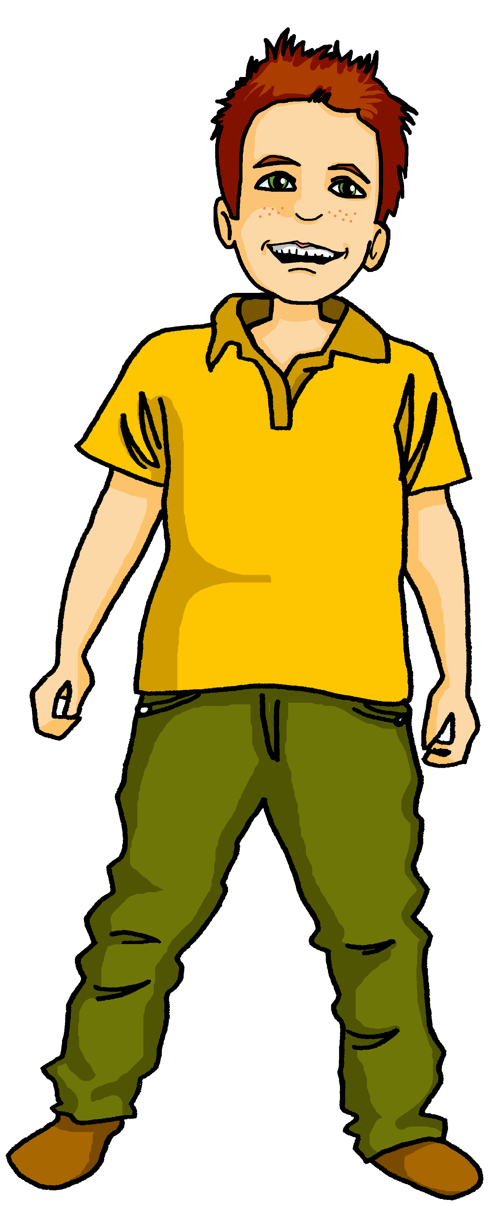
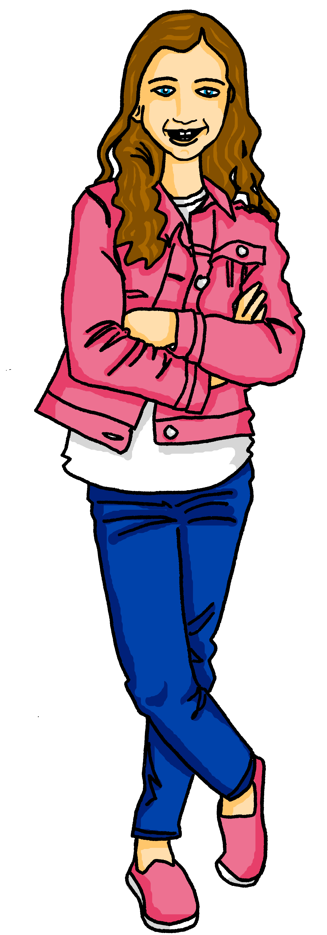
hören
Lias und Ronja fragen* die Cousins Moritz und Johanna in Dortmund.
Hör zu. Was sagen Lias und Ronja? ‘Du’ oder ‘ihr’?
du | ihr | was?
 |  | _{often need the computer}
 |  | do nothing on Sunday
 |  | bring money
 |  | play football on Wednesdays
 |  | learn English at school
 |  | go through villages
 |  | sing songs at home
B.
1
2
3
4
5
6
fragen – to ask
Notes:
Timing: 5 minutes
Aim: to practise aural distinction between WO1 and WO2 (es gibt / gibt es).
Procedure:
Lias and Ronja, who live in Switzerland, are talking to their cousins Moritz and Johanna in Germany. Are they asking one person or both of them?
Play the example with the pronoun bleeped out. Pupils select the correct pronoun.
Click to elicit and confirm the answer.
Elicit the English meaning of the question.
Click to elicit and confirm the answer.
Continue for items 1-6.
Transcript:
Beispiel: Braucht [ihr] oft den Computer?
1. Machst [du] am Sonntag nichts?
2. Bringst [du] Geld mit?
3. Spielt [ihr] mittwochs Fußball?
4 . Lernt [ihr] in der Schule Englisch?
5. Fährst [du] normalerweise durch Dörfer?
6. Singt [ihr] zu Hause Songs?
10

Slide 11
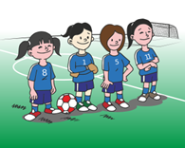
Order of words in a sentence
You know we can start a German sentence with the place adverb to emphasize it.
When we do this, the adverb and subject swap places.
This works with time adverbs too.
Montags
spielt ihr
Fußball.
Word order
2
TIME ADVERB
VERB + SUBJECT
OBJECT
Mondays
you (all) play
football.
The verb position stays the same – just the adverb and subject swap around!
English hardly ever changes word order like this, and only in phrases like: “And so say all of us!”
Notes:
Timing: 3 minutes
Aim: to explain the order of words in a German sentence, and how this is affected by an initial adverb of time.
Procedure:
Click to present the information.
Elicit the English meaning of the words in the sentence.
Ensure that pupils understand that this change is for emphasis – the essential meaning of the sentence remains the same. It’s also important to point out (with the callout) that we hardly ever do this in English, just in phrases like ‘And so say all of us’! Pupils already know this from adverbs of place.
11

Slide 12
lesen
Ronja stellt* Johanna und Moritz Fragen
Fragen stellen – to ask/put questions
Johanna and Moritz make some typing mistakes. Is A or B the right word order ?
Wann holt ihr Opa? Holt ihr Opa sonntags?
Was macht ihr?
1
A
2
A
Ja, sonntags wir holen wir Opa.
Am Sonntag wir singen wir Songs mit Opa.
B
B
3
A
4
A
Was macht ihr mittwochs?
Am Mittwoch wir reden wir mit Freunden in der Schule.
Aber mittwochs wir sitzen wir auch am Computer.
B
B
A
B
Bleibt ihr samstags normalerweise zu Hause? Oder was macht ihr?
5
Ja, wir machen wir samstags Hausaufgaben zu Hause.
6
Aber am Samstag Johanna spielt Johanna Fußball.
A
B
Notes:
Timing: 8 minutes (two slides)
Aim: to distinguish between Word Order 1 or 2, and the different meanings of am Abend / abends in the present tense: once or repeated action.
Procedure:
Explain the scenario: Ronja is asking Moritz and Johanna questions. Read the messages left to right row by row – Ronja asking, Johanna and Moritz answering.
Read Ronjas ’s first questions with the class.
Pupils identify the correct choice for item one, A or B.
Click for the wrong word order to be removed.
Continue with items 2-6.
Click to correct and move on to the next slide.
Note: a comprehension task for the same texts is on the next slide.
Vocabulary: Fragen stellen [N/A]
Jones, R.L & Tschirner, E. (2019). A frequency dictionary of German: Core vocabulary for learners. London: Routledge.
12

Slide 13
lesen
Ronja stellt* Johanna und Moritz Fragen
What do they answer? Does it happen once, or repeatedly?
answers | once | repeated
1
Ja, sonntags holen wir
Opa.
Am Sonntag singen wir Songs mit Opa.
1
We fetch Opa on Sundays.
2
We are singing songs with Opa on Sunday.
2
On Wednesday we are talking with friends at school.
3
Am Mittwoch reden wir
mit Freunden in der Schule. Aber mittwochs sitzen wir auch am Computer.
4
But Wednesdays we also sit at the computer.
3
5
We do homework at home on Saturdays .
4
6
But on Saturday Johanna is playing football.
Remember! The time adverb is the clue. E.g. I do homework on Saturdays. (repeated) I am doing homework this Saturday. (once)
5
Ja wir machen samstags Hausaufgaben zu Hause. Aber am Samstag spielt Johanna Fußball.
6
Notes:
Procedure:
Click to bring up the callout to remind pupils how to distinguish between simple and continuous in the present tense.
Pupils translate each sentence (they can do this chorally or write the answers down) and decide if the action is repeated or once.
Elicit oral translations of each message.
Click to reveal and decide if the events / actions are being repeated or happen only once.
13

Slide 14
Tschüss!
grün
Notes:
14

