Slide 1
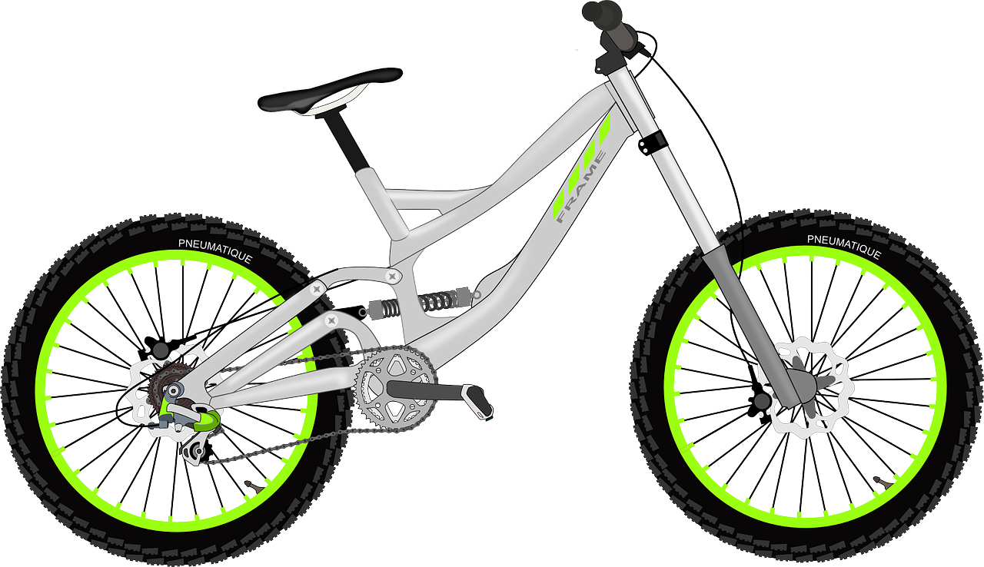
Experiences of home and away
Ein Fahrradunfall
grün
Follow ups 1-5
Term 3 Week 1
Notes:
Artwork by Steve Clarke. Pronoun pictures from NCELP (www.ncelp.org). All additional pictures selected from Pixabay and are available under a Creative Commons license, no attribution required.
Phonics: [v] vier [200] vergessen [584] Vater [232] positiv [516] viel [56]
Vocabulary: Angst (vor) [392] Bein [884] Glück [641] Kopf [250] Prüfung [1827] Recht [242] Schmerzen [1483] Unfall [1955] froh [1424] krank [1321] bitte [471] danke [877]
Revisit 1: gehen [66] sein [3] Laden [1675] Museum [1078] Park [2141] Restaurant [1802] Schwimmbad [n/a] Schule [359] Stadt [204] Wohin? [1811]
Revisit 2: benutzen [1119] brauchen [179] lernen [288] machen [58] singen [1063] spielen [205] Computer [1252] Fußball [1277] Opa [2776] Song [3373] normalerweise [2062] zu Hause [n/a] Revisit am + days of the week (am Montag) and adverbs (montags)
Jones, R.L & Tschirner, E. (2019). A frequency dictionary of German: Core vocabulary for learners. London: Routledge.
The frequency rankings for words that occur in this PowerPoint which have been previously introduced in these resources are given in the SOW and in the resources that first
introduced and formally re-visited those words.
For any other words that occur incidentally in this PowerPoint, frequency rankings will be provided in the notes field wherever possible.
Remember that at the start of the course (first three lessons of Rot/Gelb) pupils learnt language (for greetings and register taking) that can still be part of the lesson routines in upper KS2 (Blau/Grün). They are not re-taught, as we anticipate that teachers have built these in from early in lower KS2.

Slide 2
aussprechen
[v]
…
vier
Notes:
Timing: 1 minute
Aim: to introduce the SSC [v].
Procedure:
Introduce the SSC and present the source word ‘vier’ (with gesture, if using).
Click to bring on the picture and get pupils to repeat the word ‘vier’ (with gesture, if using).
Note:
a gesture for ‘vier’ might be to hold 4 fingers up.
2

Slide 3
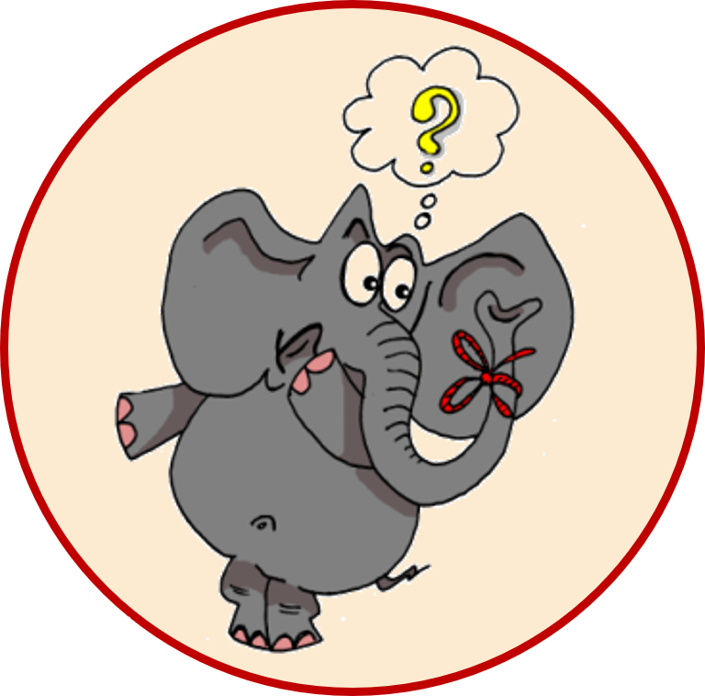
aussprechen
[v]
…
vergessen
Vater
vier
4
[to forget]
positiv
viel
[a lot, much]
Notes:
Timing: 1 minute
Aim: to consolidate the SSC [v].
Procedure:
Re-present the SSC and the source word ‘vier’ (with gesture, if using).
Click to bring on the picture and get pupils to repeat the word ‘vier’ (with gesture, if using).
Present the cluster words in the same way, bringing on the picture and getting pupils to pronounce the words.
Frequency:
vier [200] vergessen [584] Vater [232] positiv [516] viel [56]
Jones, R.L & Tschirner, E. (2019). A frequency dictionary of German: Core vocabulary for learners. London: Routledge.

Slide 4
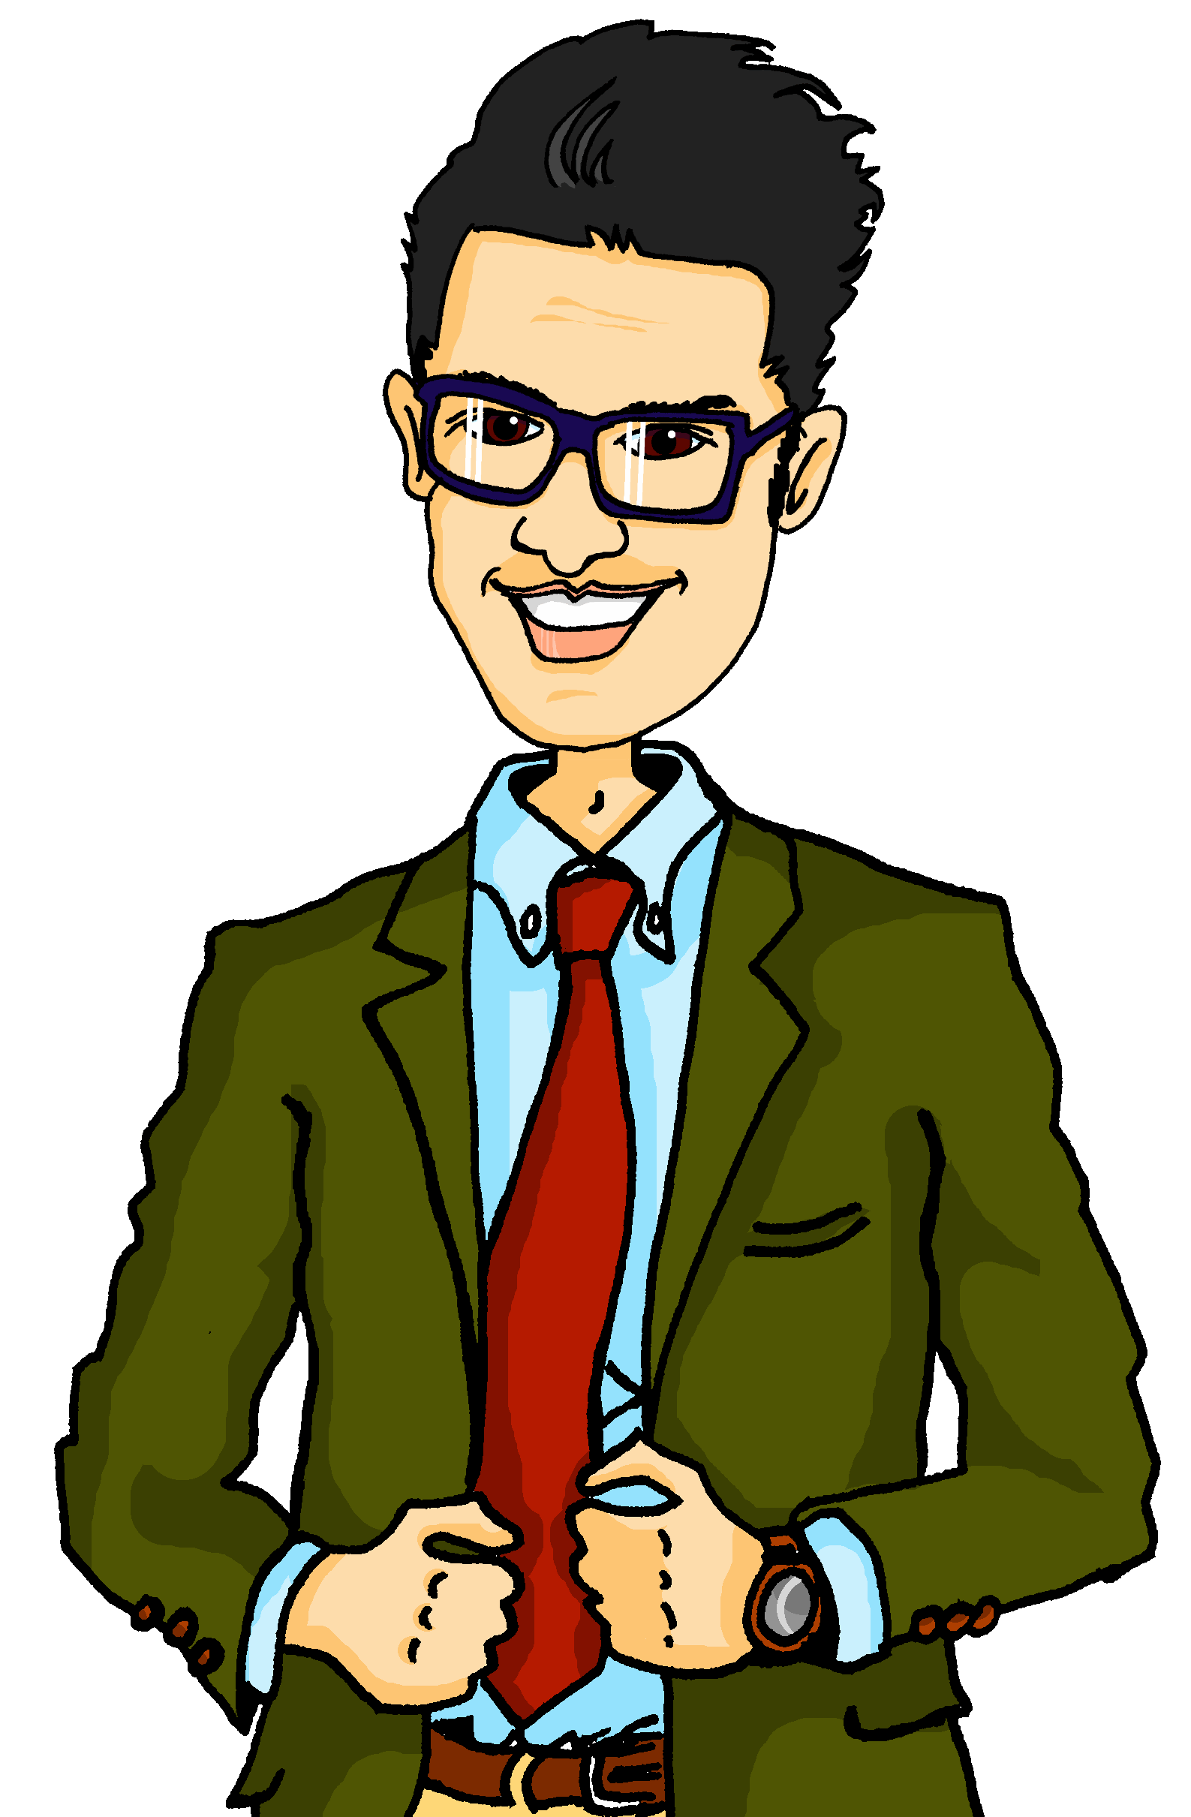
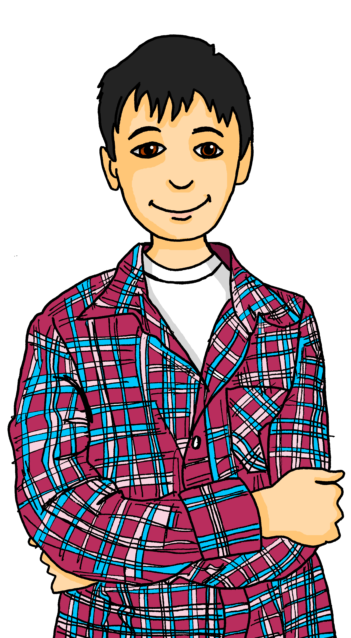
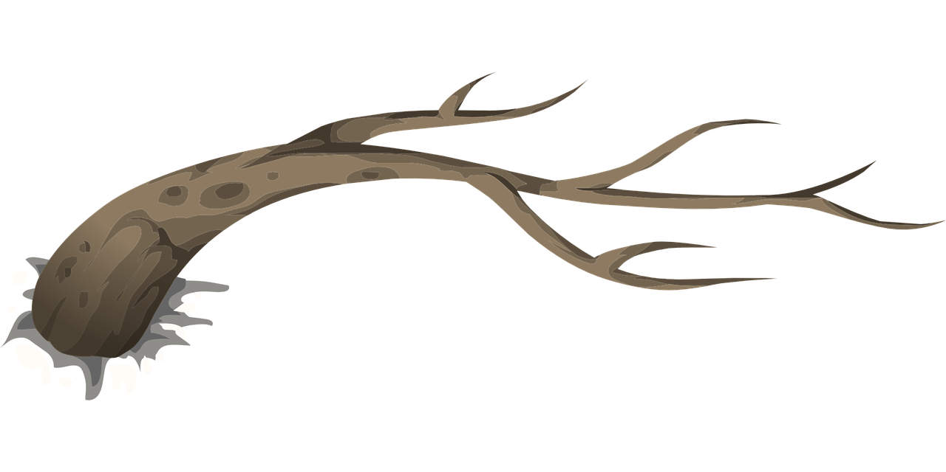
Follow up 1:
Was ist das?.
Ich sehe was*…
Was ist das?
rot
blau
gelb
groß [big]
klein [small]
treffen?
Das ist rot…
weinen?
Falsch!
Richtig!
was – what?, something
Waffel
treffen
Vertrag
Zweig
Vogel
früh
]
verbessern
tief
weinen
wild
Notes:
Timing: 5 minutes
Aim: to practise distinguishing between [v]/[f] (where [v] usually sounds like [f]), and [w] (pronounced like English [v]).
Procedure: 1. Point out that the words are all red, blue, yellow, big or small, and that there is a key to help them with the German for these words. They are going to play a speaking game like I spy with the words. Explain that Ich sehe means ‘I see’ or here, ‘I spy’. 2. Click to bring up the example conversation between the teacher, Herr Weber, and Lias. Explain that the pupils will take on Lias’ role first of all, and you will be the teacher. 3. Play the game as a class, with you saying the teacher role and the pupils guessing the word, based on whether you say rot/gelb/blau/groß/klein. Check that pupils are applying the pronunciation rules for [v]/[f] and [w] in each word. Repeat a few times with different words.
4. Pupils can then play in pairs, with one pupil taking on the teacher role and choosing a word and the other guessing the word.
Vocabulary: Waffel (waffle) [N/A] treffen (to meet) [259] Vertrag (contract) [969] Zweig (branch, twig) [4718] Vogel (bird) [1701] früh (early) [366] verbessern (to improve, correct) [1194] tief (deep) [442] weinen (to cry) [1556] wild (wild) [1634]
Source: Jones, R.L. & Tschirner, E. (2019). A frequency dictionary of German: core vocabulary for learners. Routledge

Slide 5
Follow up 2:

Schreib auf Englisch.
Can you get at least 15 points?
Wörter
 | benutzen | lernen | am Donnerstag
 | normalerweise | zu Hause | spielen
 | gehen | das Museum | wohin?
 | der Laden | das Restaurant | das Schwimmbad
 | (die) Angst (vor) | krank | das Bein
 | das Glück | der Unfall | die Schmerzen
 | recht | der Kopf | die Prüfung
to use, using
to learn, learning
on Thursday
Vokabeln
x3
normally
at home
to play, playing
to go, going
(the) museum
where (to)?
x2
(the) shop
(the) restaurant
(the) swimming pool
(the) fear (of)
sick, ill
(the) leg
(the) luck
(the) accident
(the) pain(s)
x1
right
(the) head
(the) exam
Notes:
Timing: 5 minutes
Aim: to practise written comprehension of vocabulary from this and revisited weeks.
Procedure: 1. Give pupils a blank grid. They fill in the English meanings of any of the words they know, trying to reach 15 points in total.
Note: The most recently learnt and practised words are pink, words from the previous week are green and those from week 1 are blue, thus more points are awarded for them, to recognise that memories fade and more effort (heavy lifting!) is needed to retrieve them.

Slide 6
Follow up 2:

Schreib auf Deutsch.
Can you get at least 15 points?
Wörter
 | on Thursday | normally | at home
 | to use, using | to play, playing | to learn, learning
 | where (to)? | (the) swimming pool | (the) shop
 | to go, going | (the) restaurant | (the) museum
 | (the) exam | (the) fear (of) | sick, ill
 | right | (the) pain(s) | (the) head
 | (the) leg | (the) luck | (the) accident
am Donnerstag
normalerweise
zu Hause
Vokabeln
x3
benutzen
spielen
lernen
wohin?
das Schwimmbad
der Laden
x2
gehen
das Restaurant
das Museum
die Prüfung
(die) Angst (vor)
krank
recht
die Schmerzen
der Kopf
x1
das Bein
das Glück
der Unfall
Notes:
Timing: 5 minutes
Aim: to practise written production of vocabulary from this and revisited weeks.
Procedure: 1. Give pupils a blank grid. They fill in the German meanings of any of the words they know, trying to reach 15 points in total.
Note: The most recently learnt and practised words are pink, words from the previous week are green and those from week 1 are blue, thus more points are awarded for them, to recognise that memories fade and more effort (heavy lifting!) is needed to retrieve them.

Slide 7
Follow up 3:

Schreib die Wörter auf Deutsch und auf Englisch.
Am Mittwoch ______ ___ eine Prüfung.
____ ___ Angst vor Herrn Weber?
___ ____ dienstags oft mit Opa im Schwimmbad.
Herr Weber und Herr Lehmann sind heute nicht in der Schule. ___ ____ krank.
Frau Wolf, ______ ___ viel Glück beim Lottospielen?
Frau Vogel, _______ Lehrer immer _______?
___ ____________ we have an ________.
Are you _______ __ Mr Weber?
We are often in the __________ ____ with grandad ___ _________.
Mr Weber and Mr Lehmann are not in school today. They are ___.
Ms Wolf, are you very ______when you play the lottery?
Ms Vogel, are ________ always right?
On Wednesday
haben wir
exam
schreiben
Habt ihr
scared of
Wir sind
swimming pool
on Tuesdays
Sie sind
ill
haben Sie
lucky
haben
recht
teachers
Notes:
Timing: 5-10 minutes
Aim: to practise written production of this week’s two verb forms, new vocabulary and written comprehension of other new and revisited vocabulary.
This is a jigsaw translation task.
Procedure:
Students write the missing words in both German and English to complete the sentences.
Teacher clicks to provide the written answers.
Differentiation: 1. For a different challenge (i.e. to practise spelling rather than full written recall of the missing German words), the task could be completed as a transcription task initially, by listening to the full sentences and writing the words.
2. Then pupils could complete the English part of the jigsaw.

Slide 8
Yes / no questions
You know to swap verb and subject to make a yes/no question:
Statement
Du hast Kopfschmerzen.
= You have a headache.
Question
Hast du Kopfschmerzen?
= Do you have a headache?
Remember! German has no word for ‘do’ in questions.
Note that when you hear questions, you get an extra clue from the intonation, and when you read, you see the question mark.
Notes:
Timing: 3 minutes Aim: to revisit the formation of closed questions.
Procedure: 1. Click to animate the explanation.
2. Highlight that German does not have a word for do/does, or the continuous equivalent are/is, and that inversion must be used to translate these.
3. Ensure pupils’ understanding at each stage.
8

Slide 9
Follow up 4:
Lias redet im Schlaf*. Was sagt er?
Hör zu. Frage (?) oder Satz (.) ?
hören
 | ? oder . | Englisch?
 |  | They / You (formal) are in the town.
 |  | Are you glad/happy?
 |  | You (all) are scared of exams.
 |  | Are we lucky?
 |  | You (all) are in the sports shop.
 |  | She doesn’t have a / has no computer.
1
.
2
?
3
.
Zzzz
?
4
.
5
Zzzz
.
6
der Schlaf - sleep
Notes:
Timing: 3 minutes
Aim: to identify questions/statements based on word order (following on from the previous slide), and to translate plural forms of haben/sein.
Procedure:
Explain the context: Lias is talking in his sleep - he is saying lots of things but they don’t hang together coherently! The pupils should work out what he’s saying in each case and decide whether it’s a statement or a question.
Play the audio button for item 1. Pupils decide whether this is a question or a statement, based on word order. Elicit the answer.
Click to bring up the answer.
Continue for items 2-6.
Now click on the audio buttons again for a second round of listening. Pupils listen out for the meaning.
Elicit the translation and click to bring up the answers.
Extra: Ask pupils if they can guess what Lias was dreaming about based on what he said. The more unusual, the better!
Transcript:
Sie sind in der Stadt.
Seid ihr froh?
Ihr habt Angst vor Prüfungen.
Haben wir Glück?
Ihr seid im Sportladen.
Sie hat keinen Computer.
Vocabulary
Schlaf [2344]
Source: Jones, R.L. & Tschirner, E. (2019). A frequency dictionary of German: core vocabulary for learners. Routledge

Slide 10
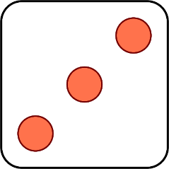
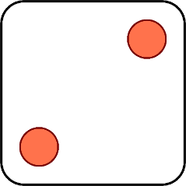
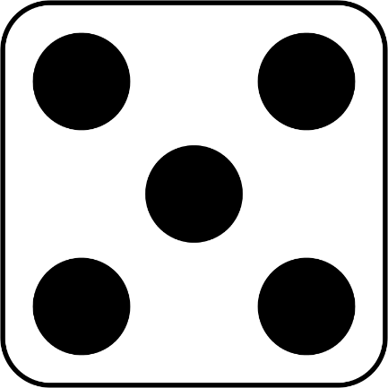
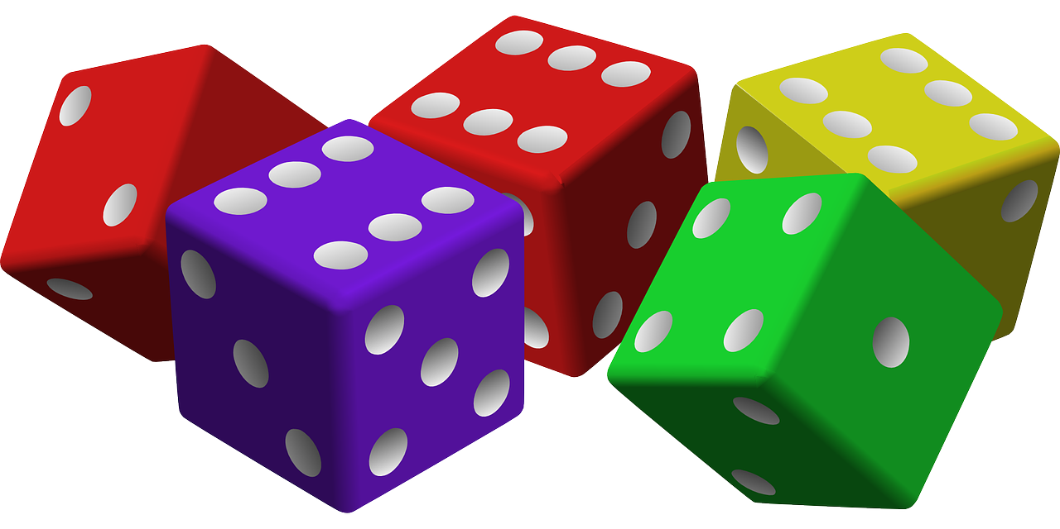
Follow up 5:
Wer hat oder ist was?
Ist sie froh?
sprechen
Ist sie im Park?
Bin ich krank?
Er hat recht.
Hast du Schmerzen?
Du hast Angst.
1 | I am
2 | You are
3 | He is
4 | Am I?
5 | Are you?
6 | Is she?
1 | sick, ill
2 | right
3 | happy, glad
4 | in pain
5 | in the park
6 | scared
Notes:
Timing: 5 minutes
Aim: to practise oral production of singular person forms of haben and sein in statements and questions.
Procedure: 1. Remind pupils how verbs change their ending depending who is ‘doing’ the verb and how the syntax changes for a question.
2. Click to ‘roll’ the 2 dice.
3. Pupils translate the pronouns and verbs into German according to the numbers on the 2 dice.
4. Click to reveal the correct verb phrase/question.
5. Repeat until all six dice combinations have been used.
Additional task suggestions:
If pupils have their own dice, they could continue in pairs, rolling the dice and making sentences. If they don’t have dice, their partner could give them two numbers and they have to make a sentence.

Slide 11
Tschüss!
grün
Notes:
11

Slide 12
Follow up 2:

Schreib auf Englisch.
Can you get at least 15 points?
Wörter
 | benutzen | lernen | am Donnerstag
 | normalerweise | zu Hause | spielen
 | gehen | das Museum | wohin?
 | der Laden | das Restaurant | das Schwimmbad
 | (die) Angst (vor) | krank | das Bein
 | das Glück | der Unfall | die Schmerzen
 | recht | der Kopf | die Prüfung
Vokabeln
x3
x2
x1
Notes:
HANDOUT

Slide 13
Follow up 2:

Schreib auf Deutsch.
Can you get at least 15 points?
Wörter
 | on Thursday | normally | at home
 | to use, using | to play, playing | to learn, learning
 | where (to)? | (the) swimming pool | (the) shop
 | to go, going | (the) restaurant | (the) museum
 | (the) exam | (the) fear (of) | sick, ill
 | right | (the) pain(s) | (the) head
 | (the) leg | (the) luck | (the) accident
Vokabeln
x3
x2
x1
Notes:
HANDOUT

