Slide 1
Experiences at home and away
Viel Glück!
Wie sagt man...?
grün
Follow ups 1-5
Term 3 Week 2
Notes:
Artwork by Steve Clarke. Pronoun pictures from NCELP (www.ncelp.org). All additional pictures selected from Pixabay and are available under a Creative Commons license, no attribution required.
Phonics:
consonantal [r] rot [477] drei [106] rechts [829] Frage [157] warum? [192]
vocalic [r] Ort [341] Uhr [348] lernen [288] Antwort [522] Farbe [1079]
Vocabulary: werden, werde, wirst, wird [8] Frohe Weihnachten [n/a] Gute Besserung [n/a] Herzlichen Glückwunsch zum Geburtstag [n/a] viel Glück [n/a]
Revisit 1: einkaufen [2877] gehen [66] kommen [62] schwimmen [1863]sein [3] Land2 [134] Markt [476] Straße [391] auf [16] nach Hause [n/a]
Revisit 2: Revisit language from Term 1 & Term 2 Week 2
Jones, R.L & Tschirner, E. (2019). A frequency dictionary of German: Core vocabulary for learners. London: Routledge.
The frequency rankings for words that occur in this PowerPoint which have been previously introduced in these resources are given in the SOW and in the resources that first introduced and formally re-visited those words.
For any other words that occur incidentally in this PowerPoint, frequency rankings will be provided in the notes field wherever possible.
Remember that at the start of the course (first three lessons of Rot/Gelb) pupils learnt language (for greetings and register taking) that can still be part of the lesson routines in upper KS2 (Blau/Grün). They are not re-taught, as we anticipate that teachers have built these in from early in lower KS2.

Slide 2
aussprechen
[r]
…
[r] before a vowel is a roll from the back of your throat. Open your mouth, tongue flat, lips still and growl ‘rrrr’.
Touch your throat and feel the vibration!
rot
Notes:
Timing: 1 minute
Aim: to revisit the SSC [r] before a vowel.
Procedure:
Introduce the SSC and present the source word ‘rot’ (with gesture, if using).
Click to bring on the picture and get pupils to repeat the word ‘rot’ (with gesture, if using).
Note:
a gesture for ‘rot’ might be to hold up some red classroom tems e.g. a pen/book/flag/clothing
2

Slide 3
aussprechen
[r]
…
3
Why?
warum?
drei
rot
?
Frage
rechts
[question]
Notes:
Timing: 1 minute
Aim: to consolidate the SSC [r] before a vowel.
Procedure:
Re-present the SSC and the source word ‘rot’ (with gesture, if using).
Click to bring on the picture and get pupils to repeat the word ‘rot’ (with gesture, if using).
Present the cluster words in the same way, bringing on the picture and getting pupils to pronounce the words.
Word frequency: rot [477] drei [106] rechts [829] Frage [157] warum? [192]
Jones, R.L & Tschirner, E. (2019). A frequency dictionary of German: Core vocabulary for learners. London: Routledge.
3

Slide 4
aussprechen
[r]
…
[r] after a vowel sounds like ‘uh’!
Ort
[place]
Notes:
Timing: 1 minute
Aim: to revisit the SSC [r] after a vowel.
Procedure:
Re-present the SSC and the source word ‘Ort’ (with gesture, if using).
Click to bring on the picture and get pupils to repeat the word ‘Ort’ (with gesture, if using).
Note:
a gesture for ‘Ort’ might be to point to a particular place on a map.

Slide 5
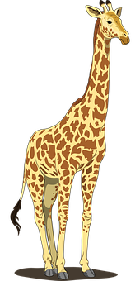
aussprechen
[r]
…
Farbe
lernen
Ort
[place]
When ‘h’ follows a vowel, it makes a long vowel sound.
Uhr
Tier
[clock, watch, o’clock]
Notes:
Timing: 1 minute
Aim: to consolidate the SSC [r] after a vowel
Procedure:
Re-present the SSC and the source word ‘Ort’ (with gesture, if using).
Click to bring on the picture and get pupils to repeat the word ‘Ort’ (with gesture, if using).
Present the cluster words in the same way, bringing on the picture and getting pupils to pronounce the words.
Note: ‘Uhr’ is a slight exception as the ‘r’ does not directly follow the vowel. However, ‘h’ following a vowel makes a long vowel sound, so the ‘r’ sound here is the same as after a vowel.
Word frequency: Ort [341] Uhr [348] Tier [614] lernen [288] Farbe [1079]
Jones, R.L & Tschirner, E. (2019). A frequency dictionary of German: Core vocabulary for learners. London: Routledge.

Slide 6
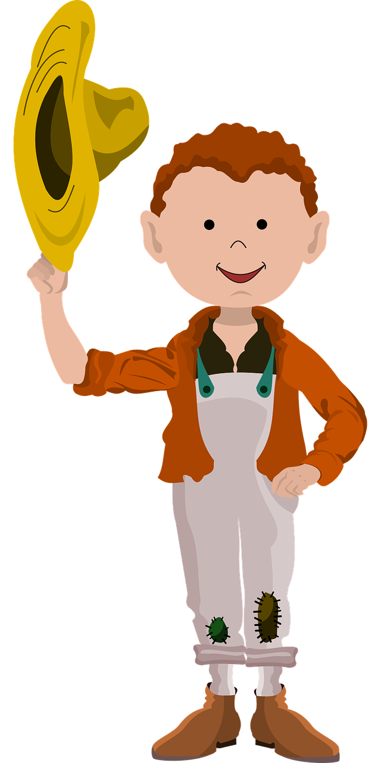
Follow up 1
Wie viele [r] hörst du?
1
Rechts neben dem Riesen stehen drei riesigen Ratten.
aussprechen
On the right next to the giant stand three giant rats.
 | [r] before vowel | [r] after vowel
1 | 5
2 |  | 5
3 | 9
2
Der Bauer geht barfuß durch den Bauernhof.
The farmer walks barefoot through the farm.
3
Rosa bringt dreiunddreißig rote Rettiche in den regnerischen Regenwald.
Rosa brings 33 red radishes into the rainy rainforest.
Notes:
Timing: 5 minutes
Aim: to practise aural comprehension and pronunciation of [r] before a vowel and [r] after a vowel.
Procedure:
Click on the audio button to play the recording of the first tongue twister, without revealing the written form.
Pupils count how many [r]’s they hear and what type (before or after a vowel). NB each tongue twister only contains one type of [r].
Click to reveal the answer.
Continue for 2 and 3.
Then click to reveal the written forms of the tongue twisters, and the English translations.
Pupils practise the tongue twisters themselves, in pairs.

Slide 7
Follow up 2
Hör zu. Ist das you (all) oder you?
hören
 | you (all) | you | English?
1
Do you (all) need tickets?
2
Are you (all) learning German?
3
Are you singing my favourite song?
4
Do you go (in)to the park on Saturdays?
5
Are you (all) seeing the film today?
6
Are you giving grandad a flower?
Notes:
Timing: 5 minutes Aim: to practise comprehension of questions and differentiating between the ihr and du forms of strong and weak verbs.
Procedure:
1. Pupils write down 1-6. 2. Click on the audio buttons to play each item 1-6.
3. Pupils write down you (all) or you, depending on which pronoun and verb form they hear.
4. Pupils listen again to each question and try to translate the question into English. 5. Elicit answers and click to display answers.
Transcript:
Braucht [ihr] Karten?
Lernt [ihr] Deutsch?
Singst [du] meinen Lieblingssong?
Gehst [du] samstags in den Park?
Seht [ihr] heute den Film?
Gibst [du] Opa eine Blume?

Slide 8
Follow up 3
Hör zu.
C Take turns to say the following German words out loud.
werden
Frohe Weihnachten
Käse
Feier
zwanzig
erklären
fertig
A Listen. Write the word that is mentioned.
B
be | have | become/ get
hören
Viel Glück
schön
Häuser
sechzehn
Gute Besserung
kennen
Geld
1
shop | bring with | take with
Partner A
Partner B
…
2
often | a lot | normally
sprechen
3
Tuesday | Thursday | Monday
4
warm | weather | which (nt)
5
sea | lake | mountain
B Write the number of the matching word.
D Ping Pong translation in pairs
Round 1: Challenge each other by testing whether you can translate the new German words into English.
Round 2: Now challenge your partner by asking for the German words.
4
3
welches ____ 4. Dienstag ____
einkaufen ___ 5. Meer ____
werden ____ 6. normalerweise ____
1
5
B
2
Notes:
Timing: 5 minutes
Aim: to practise aural comprehension of this week’s new vocabulary; written comprehension
Procedure:
A: Click to listen. Pupils write down 1,2 or 3 to correspond to which answer they think is correct. Click for answers.
B: Pupils refer to their listening table, and write the corresponding numbers into the gaps in Section B.
Click to reveal answers.
C: Pupils take turn to pronounce the words. Click to remove the green splats and hear the pronunciation.
D: Pupils take turns translating the words.
Transcript: Beispiel. Das Essen wird kalt. 1. Ich kaufe auf dem Markt ein. 2. Ihr bleibt sonntags normalerweise zu Hause.
3. Was machst du am Donnerstag? 4. Das Wetter wird schön. 5. Wir sehen den Berg.

Slide 9
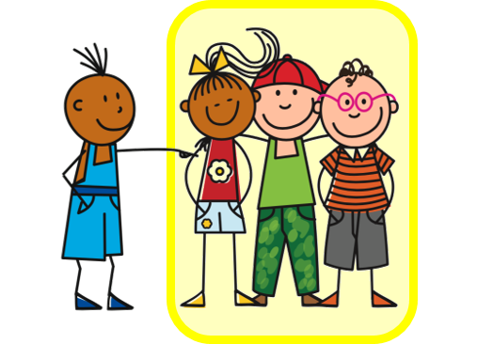
Follow up 4
Rede mit deinem Partner/deiner Partnerin.
sprechen
Beispiel:
I
A
B
Siehst du?
1 | Do you see? Are you seeing?
2 | ……….. ……….
I
A
Notes:
Example slide.
Timing: 5 minutes (two slides)
Aim: to practise asking questions using du and ihr forms of you.
Procedure:
Click through the animations to explain the task. Person A says Siehst du?
Person B chooses the correct letter from two and writes down the letter.
Person A continues to ask the remaining eight questions in Round 1.
At the end, Person B will have a nine-letter phrase to read out to Person A who should recognise and translate it.
Then pupils swap and repeat the task. Person B will now make the questions using Round 2.

Slide 10
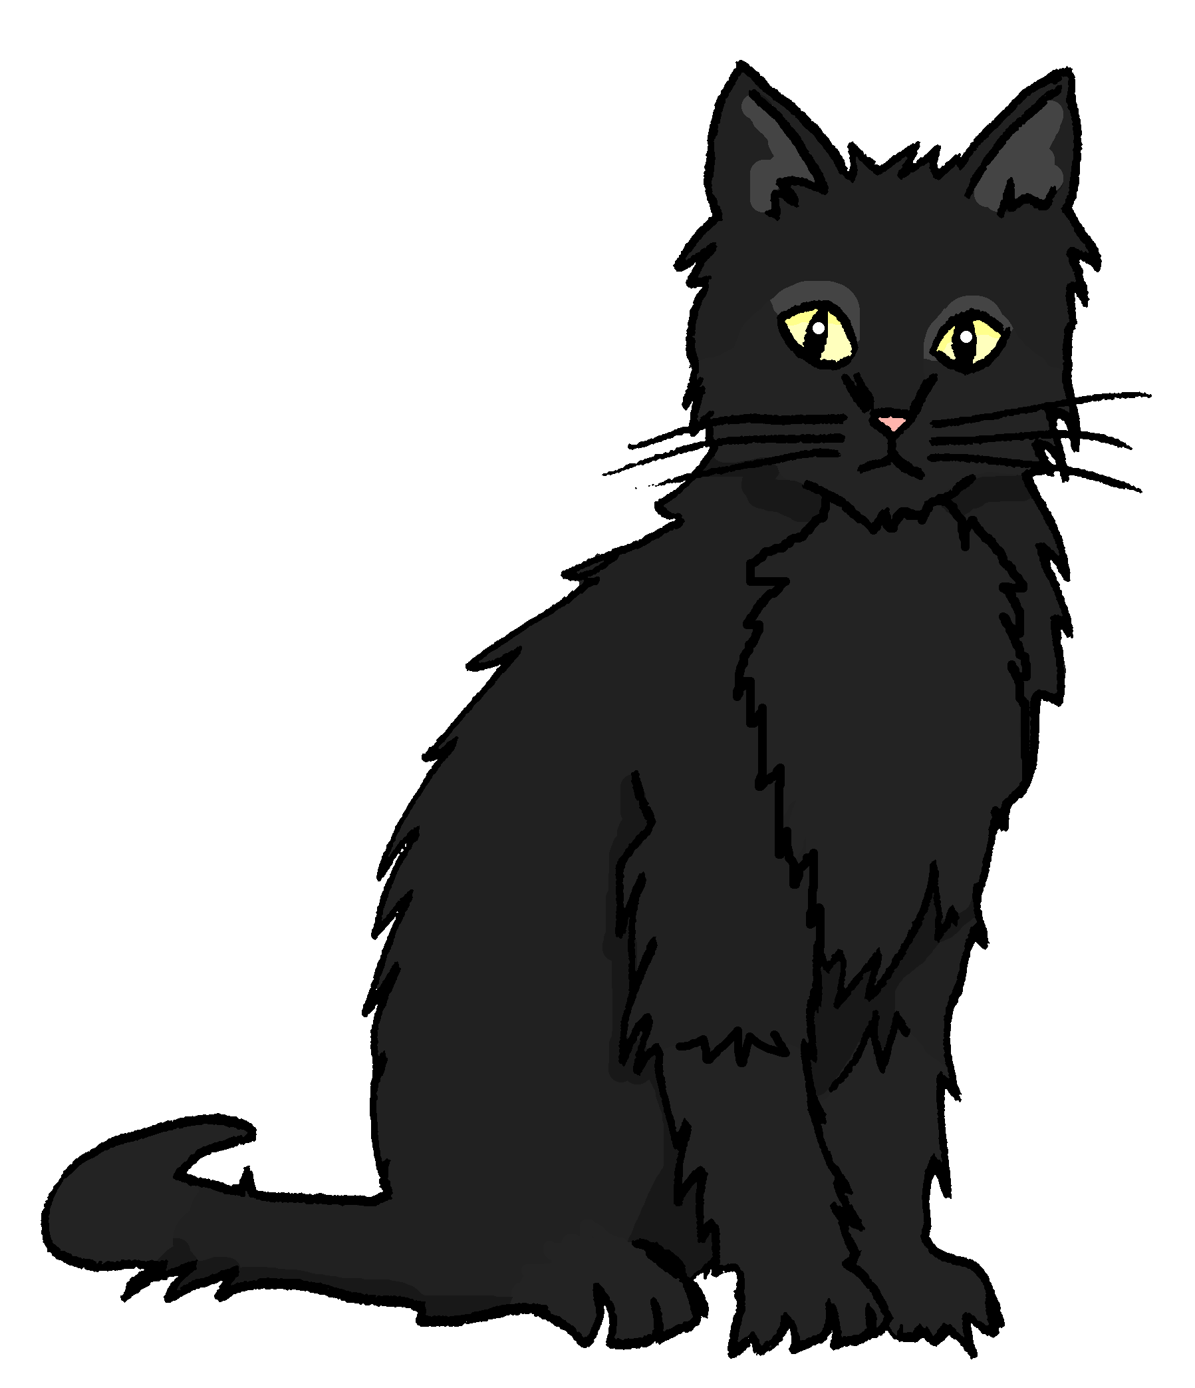
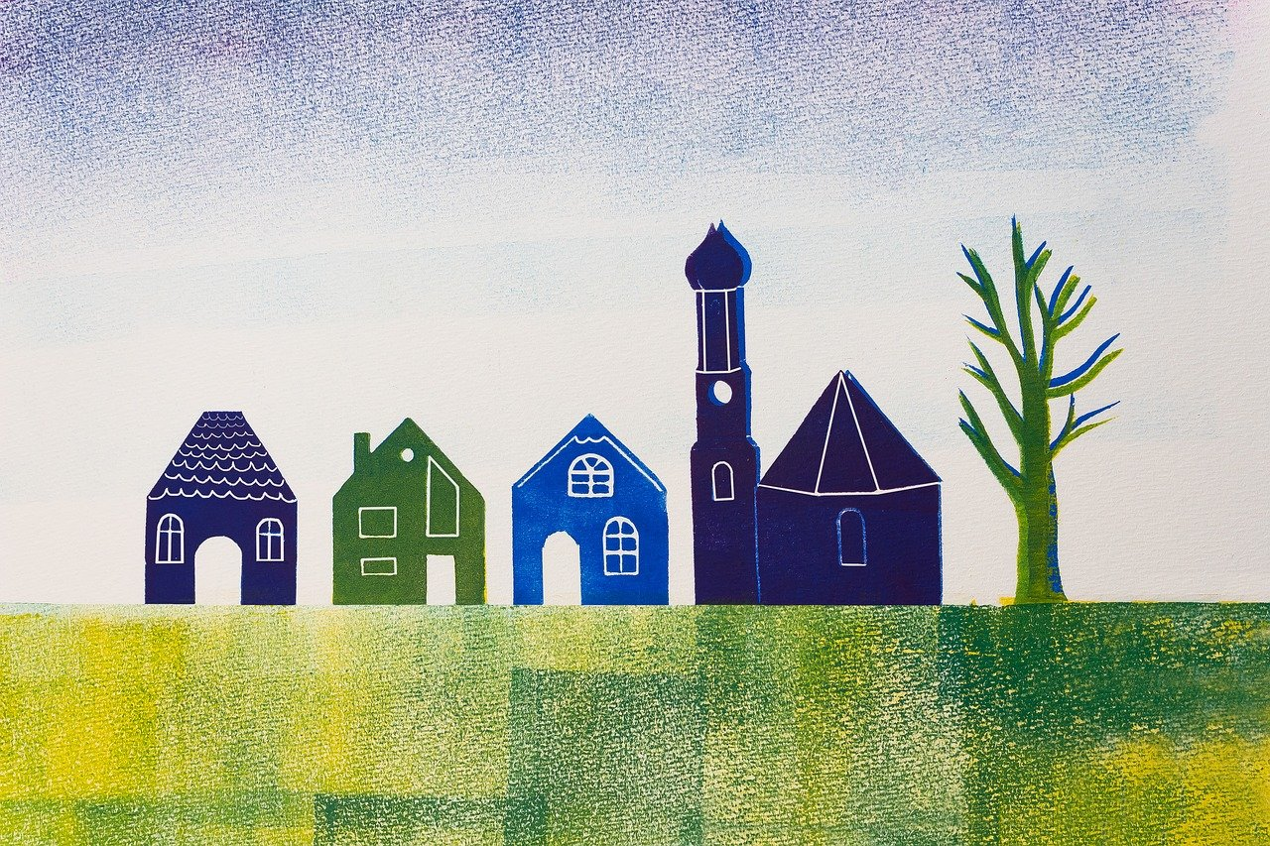
Follow up 4
Rede mit deinem Partner/deiner Partnerin.
1
2
3
sprechen
V
W
I
I
R
E
4
5
6
L
S
G
I
N
L
7
8
9
G
Ü
E
C
K
N
Notes:
Timing: 5 minutes
Aim: to practise asking questions using du and ihr forms of you.
Procedure:
Give out handouts to pupils. Both face the board. Display this slide.
Pupil A translates English prompts into German questions, working in numerical order from 1 – 9.
Pupils B identifies the correct letter according to his/her understanding of what A says.
After all nine questions have been asked by Pupil A, Pupil B reads aloud the sentence/message produced by the answer letters.
It should read ‘Viel Glück’.
Pupils swap roles and repeat the activity. Pupil A’s sentence should read: ‘Wir singen’.
Check answers (below and attached to letter circles in audio version)
Round 1
Esst ihr Kuchen? (V)
Wirst du krank? (I)
Besucht ihr das Land? (E)
Kommst du nach Hause? (L)
Schwimmst du im Meer? (G)
Benutzt ihr den Computer? (L)
Siehst du meine Katze? (Ü)
Holst du das Papier? (C)
Seid ihr im Dorf? (K)
Round 2
Isst du Kuchen? (W)
Werdet ihr krank? (I)
Besuchst du das Land? (R)
Kommt ihr nach Hause? (S)
Schwimmt ihr im Meer? (I)
Benutzt du den Computer? (N)
Seht ihr meine Katze? (G)
Holt ihr das Papier? (E)
Bist du im Dorf? (N)

Slide 11
Follow up 5:

Schreib auf Englisch.
Can you get at least 15 points?
Wörter
 | spielen | zu Hause | die Länder
 | die Dörfer | mittwochs | am Freitag
 | einkaufen | nach Hause | gehen
 | die Straße | ihr seid | der Markt
 | sie wird | viel Glück | du wirst
 | Frohe Weihnachten | Herzlichen Glückwunsch zum Geburtstag | ich werde
 | Gute Besserung | werden | ihr werdet
to play, playing
at home
the countries
x3
(the) villages
on Wednesdays
on Friday
to shop, shopping
(to) home
to go, going
x2
(the) street
you (all) are
(the) market
she becomes/gets
good luck
you become/get
Happy Christmas
Happy Birthday
I become/get
x1
Get better soon
to become/get
you (all) become/get
Notes:
Timing: 5 minutes
Aim: to practise written production of vocabulary from this and revisited weeks.
Procedure: 1. Give pupils a blank grid. They fill in the English meanings of any of the words they know, trying to reach 15 points in total.
Note: The most recently learnt and practised words are pink, words from the previous week are green and those from week 1 are blue, thus more points are awarded for them, to recognise that memories fade and more effort (heavy lifting!) is needed to retrieve them.

Slide 12
Follow up 5:

Schreib auf Deutsch.
Can you get at least 15 points?
Wörter
 | on Wednesdays | (the) villages | at home
 | to play, playing | on Friday | (the) countries
 | (the) market | you (all) are | to shop, shopping
 | (to) home | to go, going | (the) street
 | Get well soon | Happy Birthday | I become/get
 | Happy Christmas | to become/get | you become/get
 | she becomes/gets | good luck | you (all) become/get
mittwochs
die Dörfer
zu Hause
x3
spielen
am Freitag
die Länder
der Markt
ihr seid
einkaufen
x2
nach Hause
gehen
die Straße
Gute Besserung
Herzlichen Glückwunsch zum Geburtstag
ich werde
Frohe Weihnachten
werden
du wirst
x1
sie wird
viel Glück
ihr werdet
Notes:
Timing: 5 minutes
Aim: to practise written production of vocabulary from this and revisited weeks.
Procedure: 1. Give pupils a blank grid. They fill in the German meanings of any of the words they know, trying to reach 15 points in total.
Note: The most recently learnt and practised words are pink, words from the previous week are green and those from week 1 are blue, thus more points are awarded for them, to recognise that memories fade and more effort (heavy lifting!) is needed to retrieve them.

Slide 13
Tschüss!
grün
Notes:
13

Slide 14
Follow up 4
Follow up 4
Round 1
Round 2
A
…
B
…
1 | Do you (all) eat cake? / Are you (all) eating cake?
2 | Do you get ill? / Are you getting ill?
3 | Do you (all) visit the country? / Are you (all) visiting the country?
4 | Do you come home? Are you coming home?
5 | Do you swim in the sea? / Are you swimming in the sea?
6 | Do you (all) use the computer? / Are you (all) using the computer?
7 | Do you see my cat?
8 | Do you fetch/get the paper? / Are you fetching/getting the paper?
9 | Are you (all) in the village?
1 | Do you eat cake? / Are you eating cake?
2 | Do you (all) get ill? / Are you (all) getting ill?
3 | Do you visit the country? / Are you visiting the country?
4 | Do you (all) come home? Are you (all) coming home?
5 | Do you (all) swim in the sea? / Are you (all) swimming in the sea?
6 | Do you use the computer? / Are you using the computer?
7 | Do you (all) see my cat?
8 | Do you (all) fetch/get the paper? / Are you (all) fetching/getting the paper?
9 | Are you in the village?
Notes:
HANDOUT

Slide 15
Follow up 5:

Schreib auf Englisch.
Can you get at least 15 points?
Wörter
 | spielen | zu Hause | die Länder
 | die Dörfer | mittwochs | am Freitag
 | einkaufen | nach Hause | gehen
 | die Straße | ihr seid | der Markt
 | sie wird | viel Glück | du wirst
 | Frohe Weihnachten | Herzlichen Glückwunsch zum Geburtstag | ich werde
 | Gute Besserung | werden | ihr werdet
x3
x2
x1
Notes:
HANDOUT

Slide 16
Follow up 5:

Schreib auf Deutsch.
Can you get at least 15 points?
Wörter
 | on Wednesdays | (the) villages | at home
 | to play, playing | on Friday | (the) countries
 | (the) market | you (all) are | to shop, shopping
 | (to) home | to go, going | (the) street
 | Get well soon | Happy Birthday | I become/get
 | Happy Christmas | to become/get | you become/get
 | she becomes/gets | good luck | you (all) become/get
x3
x2
x1
Notes:
HANDOUT

