Slide 1
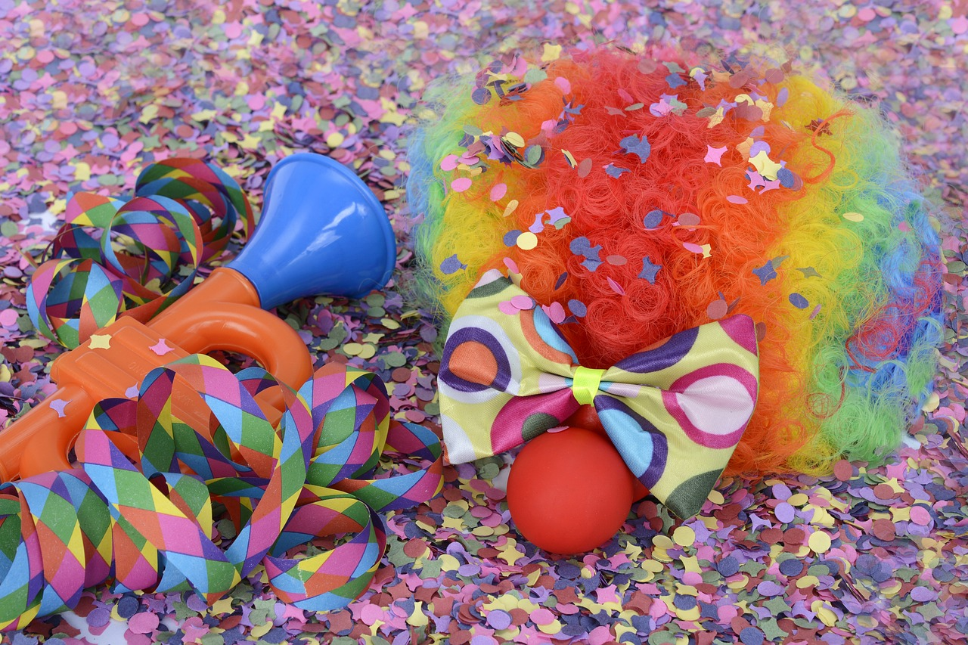
Experiences at home and away
Fasnacht
grün
Follow ups 1-5
Term 3 Week 3
Notes:
Artwork by Steve Clarke. Pronoun pictures from NCELP (www.ncelp.org). All additional pictures selected from Pixabay and are available under a Creative Commons license, no
attribution required.
Phonics:
[er-] er [20] fertig [n/a] Konzert [2350] schwer [256] wer? [173]
[-er] wieder [74] aber [31] oder [35] Oktober [1223] wunderbar [1603]
Vocabulary: essen [323] gehen [66] sehen [79] singen [1063] tanzen [1497] tragen [271] man [32] (Party)Kleidung [2820] dann [41]
Revisit 1: language from Term 2
Revisit 2: finden [103] Sie [7] Kunst [554] Müll [4506] Projekt [720]
Jones, R.L & Tschirner, E. (2019). A frequency dictionary of German: Core vocabulary for learners. London: Routledge.
The frequency rankings for words that occur in this PowerPoint which have been previously introduced in these resources are given in the SOW and in the resources that first
introduced and formally re-visited those words.
For any other words that occur incidentally in this PowerPoint, frequency rankings will be provided in the notes field wherever possible.
Remember that at the start of the course (first three lessons of Rot/Gelb) pupils learnt language (for greetings and register taking) that can still be part of the lesson routines in upper KS2 (Blau/Grün). They are not re-taught, as we anticipate that teachers have built these in from early in lower KS2.
1

Slide 2
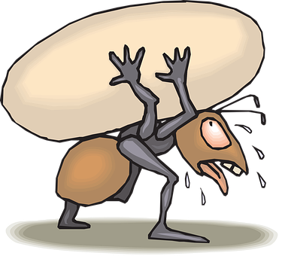
aussprechen
[er]
In all of these words, the [er] is part of the stressed syllable. This means it is emphasised or stronger than the other part of the word.
…
schwer
fertig
[heavy, difficult]
[ready, finished]
er
Konzert
wer?
Notes:
Timing: 2 minutes
Aim: to introduce/consolidate SSC [er]
Procedure:
Introduce and elicit the pronunciation of the individual SSC [er] and then the source word again ‘er’ (with gesture, if using).
Then present and elicit the pronunciation of the five cluster words.
The cluster words have been chosen for their high-frequency, from a range of word classes, with the SSC (where possible) positioned within a variety of syllables within the words (e.g. initial, 2nd, final etc.). Additionally, we have tried to use words that build cumulatively on previously taught SSCs (see the Phonics Teaching Sequence document) and do not include new SSCs. Where new SSCs are used, they are often consonants which have a similar symbol-sound correspondence in English.
Word frequency (1 is the most frequent word in German): er [15] fertig [n/a] Konzert [2350] schwer [256] wer? [173]
Source: Jones, R.L. & Tschirner, E. (2006). A frequency dictionary of German: core vocabulary for learners. Routledge

Slide 3
aussprechen
[er]
In all of these words, a different part of the word is the stressed syllable, not the [er] sound.
…
aber
Oktober
[but]
wieder
?
Wonderful!
[again]
oder
wunderbar
[or]
Notes:
Timing: 2 minutes
Aim: To introduce/consolidate SSC [er]
Procedure:
Introduce and elicit the pronunciation of the individual SSC [er] and then the source word again ‘wieder’ (with gesture, if using).
Then present and elicit the pronunciation of the four cluster words.
Word frequency (1 is the most frequent word in German): wieder [74] aber [31] oder [35] Oktober [1223] wunderbar [1603] Source: Jones, R.L. & Tschirner, E. (2006). A frequency dictionary of German: core vocabulary for learners. Routledge

Slide 4
Follow up 1
Sag die Sätze und hör zu.
1. Der Winter in Bern ist kälter als in Barcelona.
aussprechen
1. The winter in Bern is colder than in Barcelona.
2. Er arbeitet als Lehrer an einer Schule in Berlin.
2. He works as a teacher in a school in Berlin.
3. Mein Bruder, Alexander, liest gerne Abenteuerbücher und
Bücher über Erdkunde.
3. My brother Alexander likes reading adventure books and books about geography.
4. Erhard will Rockmusiker werden, aber er spielt kein Instrument
und singt nicht gern.
4. Erhard wants to become a rock musician but he doesn’t play an instrument and doesn’t like singing.
5. Frau Weber erzählt uns über ihre ersten Erfahrungen in Algerien.
5. Mrs Weber tells us about her first experiences in Algeria.
Notes:
Handout at end of presentation
Timing: 5 minutes
Aim: to practise applying knowledge of [er] in stressed and unstressed syllables.
Procedure: 1. Each pupil will need a copy of the handout at the end of the presentation to annotate.
2. Click to bring up the first sentence. As a class, identify and underline the stressed [er] syllables and circle the unstressed [er] syllables in the sentence. Listen to the sentence to check, then click bring up the answers.
3. Elicit the translation, then click to reveal the English written form.
3. Click to bring up items 2-5. Ask pupils to read the sentences aloud in pairs and 1) underline the stressed [er] syllable and 2) circle the unstressed [er] in each sentence. You could encourage them to clap the syllables in the [er] words if you did this in the main lesson.
3. Listen to sentences 2-5 to allow pupils to check their answers. It is ok for them to change their mind now they have listened!
4. Click to bring up answers and translations.
5. Encourage pupils to read aloud again now that they have the answers, clapping if appropriate.
Word frequency:
Abenteuer [3634] Algerien [>5000] Erdkunde [>5000] Erfahrung [619] erzählen [263] gern [278] über [47]

Slide 5
You already know the difference between ‘sie’ (they) and ‘man’ (people/you in general):
To say they + verb in German: use they + verb ending –en.
Sie gehen auf die Party.
They are going to the party.
Use ‘man’ + verb ending –t to mean people/you in general:
Man geht auf die Party.
People/ you in general are going to the party.
Remember this question:
Wie sagt man das auf Deutsch / Englisch? (How do you say that in German/English?) This is not a question just to you. It means ‘how do people/you in general say that in German / English?
Notes:
Timing: 2 minutes (two slides)
Procedure:
Click through the animations to remind pupils of the difference between sie and man, and the vowel change in the stem for strong verbs.
Elicit English translation for the German examples provided.
The last text section reminds pupils that they know a question with ‘man’ already.
5

Slide 6
grammar
Remember also: strong verbs (e.g. tragen, essen, sehen, werden) change the vowel in the stem for 2nd and 3rd persons singular:
Ich trage eine Maske.
I wear / am wearing a mask.
Du trägst eine Maske.
You wear / are wearing a mask.
Er/sie trägt eine Maske.
He/she wears / is wearing a mask.
Man trägt eine Maske.
People/you in general are wearing a mask.
Notes:
[2/2]
6

Slide 7
Follow up 2
Hör zu. Wer macht was?
 | they | people (you, in general) | Englisch?
hören
1
People celebrate in the street.
2
They eat and sing in restaurants.
3
They put on / give concerts.
4
People wear party clothes and costumes.
5
They buy or make masks.
6
People sing in the street.
7
People see lots of people.
8
They dance to (the) music.
zu - to
Notes:
Timing: 4 minutes
Aim: to practise aural comprehension of ‘man’ and ‘sie (they)’ verb forms and vocabulary from this week.
Procedure:
Tell pupils that they will hear the sentence without the pronoun ‘man’ or ‘sie’
Click to listen. Pupils write ‘they’ or ‘you in general’.
Listen again and focus on the remainder of the sentence. What is happening? Pupils write in English.
Transcript:
[Man] feiert auf der Straße.
[Sie] essen und singen in Restaurants.
[Sie] geben Konzerte.
[Man] trägt Partykleidung und Kostüme.
[Sie] kaufen oder machen Masken.
[Man] singt auf der Straße.
[Man] sieht viele Leute.
[Sie] tanzen zur Musik.

Slide 8
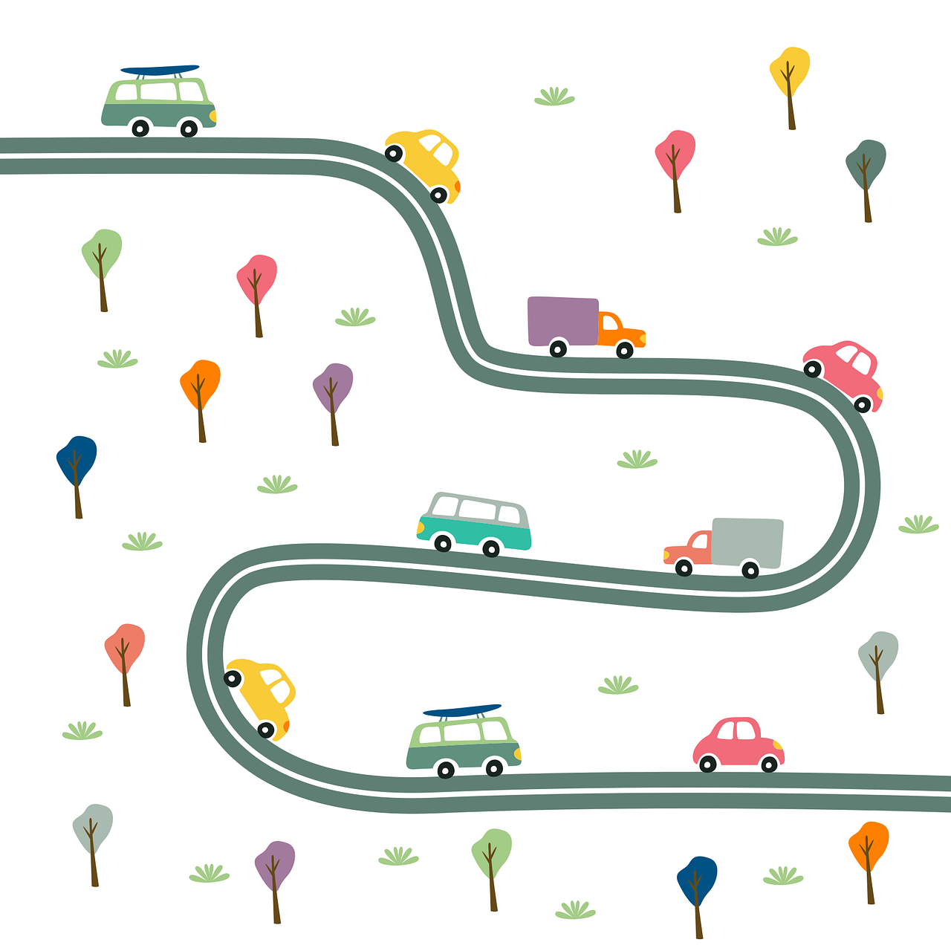
Follow up 3: Fasnacht in Basel
dann...
Wie feiert man Fasnacht in Basel? Schreib 5 Sätze.
schreiben
Kostüme
Konfetti
Lichter
Masken
singen | gehen | tanzen | sagen | essen | tragen | sehen | werden
Notes:
Timing: 5-10 minutes
Aim: to experience the famous Basel Fasnacht and link it to the vocabulary learnt this lesson.
Procedure: 1. Explain to students that one of the most famous Fasnacht celebrations is in Basel.
2. Ask them to watch the video (also at https://youtu.be/w5qh-C3QBkA?feature=shared) and see how people celebrate Fasnacht in Basel.
3. Then ask them to say what they saw using the vocabulary they learnt in the lesson – some suggestions are included on the slide. The verbs in red are strong verbs.
4. Finally, ask students to write 5 sentences about how people in Basel celebrate Fasnacht using ‘man’ and ‘sie’ and some of the key words on the screen, including ‘dann’.

Slide 9
Follow up 4
Sprich mit einem Partner/eine Partnerin…
…
Person A spricht.
Person B identifiziert* das richtige Bild.
sprechen
Person A
They sing songs in the street.
[A] [B]
Sie singen Lieder auf der Straße.
They sing songs in the street.
A
identifizieren - to identify
B
Notes:
Timing: 5-10 minutes
Aim: to practise receptive and productive knowledge of ‘man’ and ‘sie’ verb forms in present tense.
Procedure: 1. Use this slide to model the task.
2. Pupil A produces the sentence in German.
3. Pupil B identifies the correct picture – A or B and then writes the English down.
4. Complete items 1-5.
5. Then pupils swap roles and repeat the task. 6. See next slides for answers, and handouts at the end of the presentation.
Vocabulary
identifizieren [2420]
Jones, R.L & Tschirner, E. (2019). A frequency dictionary of German: Core vocabulary for learners. London: Routledge.

Slide 10
Round 1
…
A
B
Person A
1) People get tired.
……………………………….
2) They play instruments.
……………………………….
3) They listen to music.
……………………………….
4) People buy party clothes.
……………………………….
5) They eat in restaurants or on the street.
………………………………..
Person B
sprechen
[A] [B]
Man wird müde.
People get tired.
Sie spielen Instrumente.
They play instruments.
Sie hören Musik.
They listen to music.
Man kauft Partykleidung.
People buy party clothes.
They eat in restaurants or on the street.
Sie essen in Restaurants oder auf der Straße.
B
A
Notes:
ANSWERS ROUND 1

Slide 11
Round 2
…
A
B
Person A
1) They dance at the party.
……………………………….
2) They sing on the street.
……………………………….
3) People eat “Fasnachtschüechli”.
……………………………….
4) People walk through the town.
……………………………….
5) People wear party clothes.
………………………………..
Person B
sprechen
[A] [B]
Sie tanzen auf der Party.
They dance at the party.
Sie singen auf der Straße.
They sing on the street.
People eat “Fasnachtschüechli.”
Man isst Fasnachtschüechli.
People walk through the town.
Man geht durch die Stadt.
Man trägt Partykleidung.
People wear party clothes.
A
Notes:
ANSWERS ROUND 2

Slide 12
Follow up 5:

Schreib auf Englisch.
Can you get at least 15 points?
Wörter
 | finden | das Projekt | Sie
 | der Müll | die Kunst | Sie werden
 | montags | spät | der Markt
 | nach Hause | zu Hause | lernen
 | essen | dann | gehen
 | sehen | (die) (Party)Kleidung | singen
 | man | tanzen | tragen
to find, finding
(the) project
you (formal)
Vokabeln
x3
(the) rubbish
(the) art
you (formal) become/get
on Mondays
late
(the) market
x2
(to) home
at home
to learn, learning
to eat, eating
then
to go, going
to see, seeing
(the) (party) clothes
to sing, singing
x1
you (general), people
to dance, dancing
to wear, wearing
Notes:
Timing: 5 minutes
Aim: to practise written production of vocabulary from this and revisited weeks.
Procedure: 1. Give pupils a blank grid. They fill in the English meanings of any of the words they know, trying to reach 15 points in total.
Note: The most recently learnt and practised words are pink, words from the previous week are green and those from week 1 are blue, thus more points are awarded for them, to recognise that memories fade and more effort (heavy lifting!) is needed to retrieve them.

Slide 13
Follow up 5:

Schreib auf Deutsch.
Can you get at least 15 points?
Wörter
 | (the) project | to find, finding | (the) rubbish
 | you (formal) | you (formal) become/get | (the) art
 | late | (the) market | to learn, learning
 | at home | on Mondays | (to) home
 | (the) (Party) clothes | to wear, wearing | then
 | to sing, singing | to eat, eating | you (general), people
 | to go, going | to see, seeing | to dance, dancing
das Projekt
finden
der Müll
Vokabeln
x3
Sie
Sie werden
die Kunst
spät
der Markt
lernen
x2
zu Hause
montags
nach Hause
(die) (Party)Kleidung
tragen
dann
singen
essen
man
x1
gehen
sehen
tanzen
Notes:
Timing: 5 minutes
Aim: to practise written production of vocabulary from this and revisited weeks.
Procedure: 1. Give pupils a blank grid. They fill in the German meanings of any of the words they know, trying to reach 15 points in total.
Note: The most recently learnt and practised words are pink, words from the previous week are green and those from week 1 are blue, thus more points are awarded for them, to recognise that memories fade and more effort (heavy lifting!) is needed to retrieve them.

Slide 14
Tschüss!
grün
Notes:
14

Slide 15
Follow up 1
1. Der Winter in Bern ist kälter als in Barcelona.
2. Er arbeitet als Lehrer an einer Schule in Berlin.
3. Mein Bruder, Alexander, liest gerne Abenteuerbücher und
Bücher über Erdkunde.
4. Erhard will Rockmusiker werden, aber er spielt kein Instrument
und singt nicht gern.
5. Frau Weber erzählt uns über ihre ersten Erfahrungen in Algerien.
Notes:
Handout at end of presentation
Timing: 5 minutes
Aim: to practise applying knowledge of [er] in stressed and unstressed syllables.
Procedure: 1. Each pupil will need a copy of the handout at the end of the presentation to annotate.
2. Click to bring up the first sentence. As a class, identify and underline the stressed [er] syllables and circle the unstressed [er] syllables in the sentence. Listen to the sentence to check, then click bring up the answers.
3. Elicit the translation, then click to reveal the English written form.
3. Click to bring up items 2-5. Ask pupils to read the sentences aloud in pairs and 1) underline the stressed [er] syllable and 2) circle the unstressed [er] in each sentence. You could encourage them to clap the syllables in the [er] words if you did this in the main lesson.
3. Listen to sentences 2-5 to allow pupils to check their answers. It is ok for them to change their mind now they have listened!
4. Click to bring up answers and translations.
5. Encourage pupils to read aloud again now that they have the answers, clapping if appropriate.
Word frequency:
Erbse Erdbeere ernten

Slide 16
Follow up 4 Person A
…
Round 1
Round 2
Person A
1) People get tired.
……………………………….
2) They play instruments.
……………………………….
3) They listen to music.
……………………………….
4) People buy party clothes.
……………………………….
5) They eat in restaurants or on the street.
………………………………..
Person B
sprechen
[A] [B]
______________
______________
______________
______________
______________
B
A
Notes:
HANDOUT PERSON A

Slide 17
Follow up 4 Person B
…
Round 1
Round 2
Person B
Person A
1) They dance at the party.
……………………………….
2) They sing on the street.
……………………………….
3) People eat “Fasnachtschüechli”.
……………………………….
4) People walk through the town.
……………………………….
5) People wear party clothes.
………………………………..
sprechen
[A] [B]
______________
______________
______________
______________
______________
B
A
Notes:
HANDOUT PERSON B

Slide 18
Follow up 5:

Schreib auf Englisch.
Can you get at least 15 points?
Wörter
 | finden | das Projekt | Sie
 | der Müll | die Kunst | Sie werden
 | montags | spät | der Markt
 | nach Hause | zu Hause | lernen
 | essen | dann | gehen
 | sehen | (die) (Party)Kleidung | singen
 | man | tanzen | tragen
Vokabeln
x3
x2
x1
Notes:
HANDOUT

Slide 19
Follow up 5:

Schreib auf Deutsch.
Can you get at least 15 points?
Wörter
 | (the) project | to find, finding | (the) rubbish
 | you (formal) | you (formal) become/get | (the) art
 | late | (the) market | to learn, learning
 | at home | on Mondays | (to) home
 | (the) (Party) clothes | to wear, wearing | then
 | to sing, singing | to eat, eating | you (general), people
 | to go, going | to see, seeing | to dance, dancing
Vokabeln
x3
x2
x1
Notes:
HANDOUT

