Slide 1
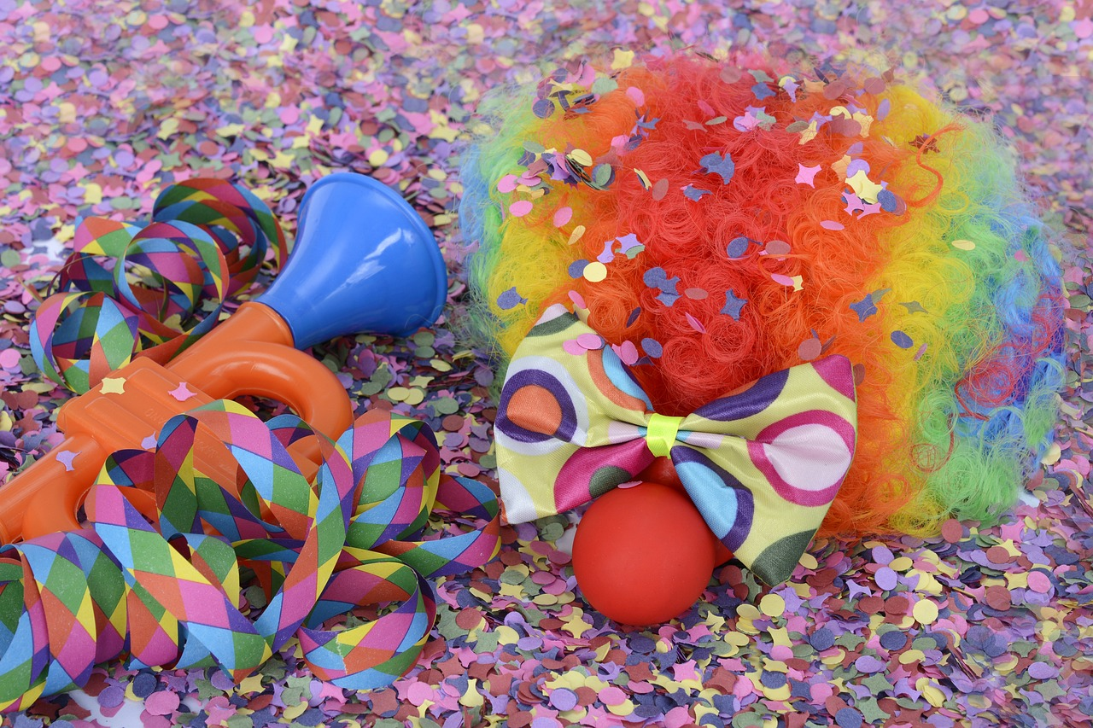
Experiences at home and away
Fasnacht
grün
Present tense – man and sie (they)
SSC [er-] [-er]
Term 3 Week 3
Notes:
Artwork by Steve Clarke. Pronoun pictures from NCELP (www.ncelp.org). All additional pictures selected from Pixabay and are available under a Creative Commons license, no
attribution required.
Phonics:
[er-] er [20] fertig [n/a] Konzert [2350] schwer [256] wer? [173]
[-er] wieder [74] aber [31] oder [35] Oktober [1223] wunderbar [1603]
Vocabulary: essen [323] gehen [66] sehen [79] singen [1063] tanzen [1497] tragen [271] man [32] (Party)Kleidung [2820] dann [41]
Revisit 1: language from Term 2
Revisit 2: finden [103] Sie [7] Kunst [554] Müll [4506] Projekt [720]
Jones, R.L & Tschirner, E. (2019). A frequency dictionary of German: Core vocabulary for learners. London: Routledge.
The frequency rankings for words that occur in this PowerPoint which have been previously introduced in these resources are given in the SOW and in the resources that first
introduced and formally re-visited those words.
For any other words that occur incidentally in this PowerPoint, frequency rankings will be provided in the notes field wherever possible.
Remember that at the start of the course (first three lessons of Rot/Gelb) pupils learnt language (for greetings and register taking) that can still be part of the lesson routines in upper KS2 (Blau/Grün). They are not re-taught, as we anticipate that teachers have built these in from early in lower KS2.
1

Slide 2
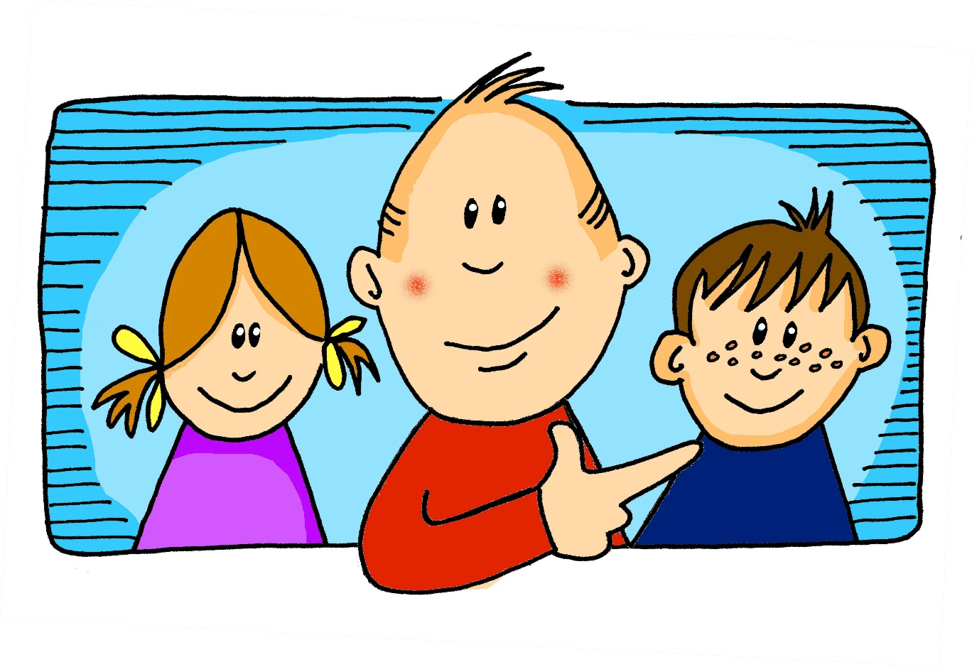
aussprechen
[er]
…
er
When the [er] is the stressed syllable, it usually sounds like two short syllables: e-uh
Remember, words are made up of different parts called syllables. A stressed syllable means the part of the word that is most emphasised when you say it aloud.
Notes:
Timing: 1 minute
Aim: to introduce/consolidate SSC [er]
Procedure: 1. Present the letter(s) and say the [er] sound first, on its own. Students repeat it with you. 2. Bring up the word ”er” on its own, say it, students repeat it, so that they have the opportunity to focus all of their attention on the connection between the written word and its sound.
3. A possible gesture for this would be to point to an imaginary ‘he’, using your index finger, thumb point upwards (to make the gesture more exaggerated), as per the image.
4. Roll back the animations and work through 1-3 again, but this time, dropping your voice completely to listen carefully to the students saying the [er] sound, pronouncing ”er” and, if using, doing the gesture. Word frequency (1 is the most frequent word in German): er [15] Source: Jones, R.L. & Tschirner, E. (2006). A frequency dictionary of German: core vocabulary for learners. Routledge
2

Slide 3
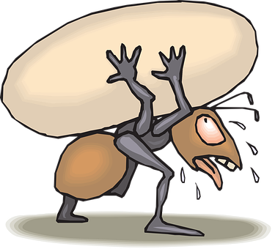
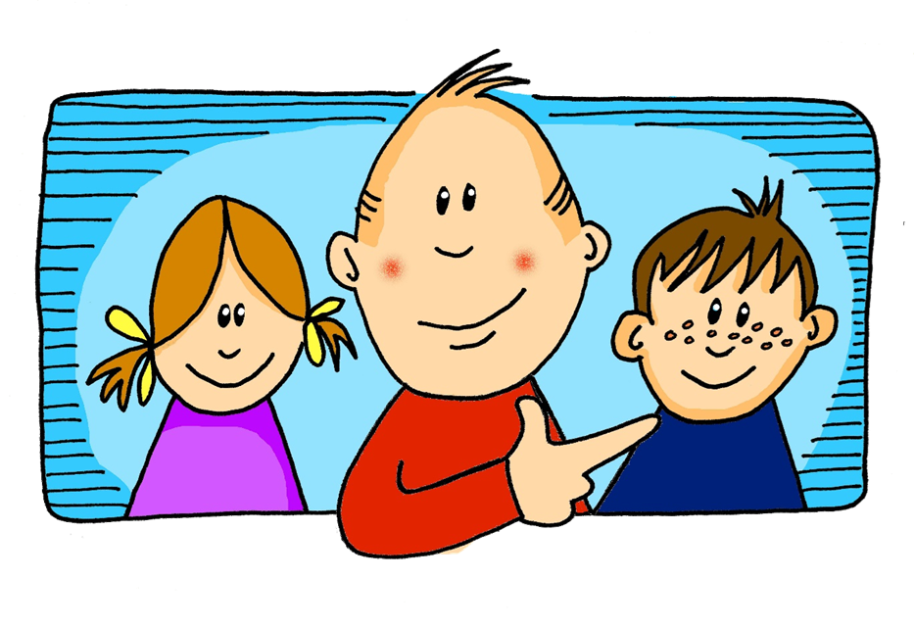
aussprechen
[er]
In all of these words, the [er] is part of the stressed syllable. This means it is emphasised or stronger than the other part of the word.
…
schwer
fertig
[heavy, difficult]
er
Konzert
wer?
Notes:
Timing: 2 minutes
Aim: to introduce/consolidate SSC [er]
Procedure:
Introduce and elicit the pronunciation of the individual SSC [er] and then the source word again ‘er’ (with gesture, if using).
Then present and elicit the pronunciation of the five cluster words.
The cluster words have been chosen for their high-frequency, from a range of word classes, with the SSC (where possible) positioned within a variety of syllables within the words (e.g. initial, 2nd, final etc.). Additionally, we have tried to use words that build cumulatively on previously taught SSCs (see the Phonics Teaching Sequence document) and do not include new SSCs. Where new SSCs are used, they are often consonants which have a similar symbol-sound correspondence in English.
Word frequency (1 is the most frequent word in German): er [15] fertig [n/a] Konzert [2350] schwer [256] wer? [173]
Source: Jones, R.L. & Tschirner, E. (2006). A frequency dictionary of German: core vocabulary for learners. Routledge

Slide 4
aussprechen
[er]
…
As you know [er] can also sound like ‘uh’. This is when the syllable is unstressed, most often at the end of the word.
wieder
[again]
Notes:
Timing: 1 minute
Aim: To introduce/consolidate SSC [er]
Procedure: 1. Present the letter(s) and say the [er] sound first, on its own. Students repeat it with you. 2. Bring up the word ”wieder” on its own, say it, students repeat it, so that they have the opportunity to focus all of their attention on the connection between the written word and its sound.
3. A possible gesture for this would be to roll your hands over in the air, clockwise. Your hands are in front of your body.
4. Roll back the animations and work through 1-3 again, but this time, dropping your voice completely to listen carefully to the students saying the [er] sound, pronouncing ”wieder” and, if using, doing the gesture. Word frequency (1 is the most frequent word in German): wieder [74] Source: Jones, R.L. & Tschirner, E. (2006). A frequency dictionary of German: core vocabulary for learners. Routledge
4

Slide 5
aussprechen
[er]
In all of these words, a different part of the word is the stressed syllable, not the [er] sound.
…
aber
Oktober
[but]
wieder
?
Wonderful!
[again]
oder
wunderbar
[or]
Notes:
Timing: 2 minutes
Aim: To introduce/consolidate SSC [er]
Procedure:
Introduce and elicit the pronunciation of the individual SSC [er] and then the source word again ‘wieder’ (with gesture, if using).
Then present and elicit the pronunciation of the five cluster words.
The cluster words have been chosen for their high-frequency, from a range of word classes, with the SSC (where possible) positioned within a variety of syllables within the words (e.g. initial, 2nd, final etc.). Additionally, we have tried to use words that build cumulatively on previously taught SSCs (see the Phonics Teaching Sequence document) and do not include new SSCs. Where new SSCs are used, they are often consonants which have a similar symbol-sound correspondence in English.
Word frequency (1 is the most frequent word in German): wieder [74] aber [31] oder [35] Oktober [1223] wunderbar [1603] Source: Jones, R.L. & Tschirner, E. (2006). A frequency dictionary of German: core vocabulary for learners. Routledge

Slide 6
hören
[er]
Listen to and read the 8 words. Can you find the stressed syllable?
Is the [er] stressed or unstressed?
Hör zu.
 |  | stressed [er] | unstressed [er]
1 | über
2 | der
3 | welcher
4 | Mutter
5 | werden
6 | Unterricht
7 | erst
8 | Wasser
Can you clap the syllables in each word, clapping louder for the stressed syllables?
Notes:
Timing: 5 minutes
Aim: to consolidate the SSC [er] by identifying the stressed and unstressed syllables in known and unknown words.
Procedure:
1. Explain that pupils are going to hear words with [er]. On first listening they need to highlight/circle/jot down the syllable of the word they hear that is stressed/emphasised.
2. Play number one and click to show the syllable they should have highlighted. Then discuss as a class whether it is a stressed or unstressed [er].
3. Repeat for items 2-8.
4. Try clapping through the words together as a class, clapping louder for the stressed syllable in each word.
Transcript:
über
der
welcher
Mutter
werden
Unterricht
erst
Wasser
Word frequency:
erst [132] über [47]
6

Slide 7
Vokabeln
Vokabeln
Finde die Verbindung.*
die Verbindung – connection
Wörter
1
2
3
4
5
6
places
der Berg
der Laden
das Dorf
links
oben
dort
directions
am Dienstag
um vier Uhr
spät
days and times
werden
liegen
benutzen
verbs
welche
wohin
wer
question words
Rad fahren
die Kunst
der Fußball
hobbies
days and times
places
verbs
hobbies
question words
directions
Notes:
Timing: 2 minutes
Aim: to practise written comprehension of previously taught words by associating them with a broader theme.
Procedure: 1. Explain the task. Pupils can volunteer answers for any line in any order.
2. To volunteer a connection, pupils say the three German words followed by the English category word they suggest.
3. Teacher clicks on the English category – it will reappear next to the correct row of German words that it links to.
Vocabulary
der Berg (the mountain, hill)
der Laden (the shop)
das Dorf (the village)
links (left)
oben (up, above)
dort (there)
am Dienstag (on Tuesday)
um vier Uhr (at 4 o’clock)
spät (late)
werden (to become, get)
liegen (to lie, to be located)
benutzen (to use)
welche (which)
wohin (where (to))
wer (who)
Rad fahren (cycling)
die Kunst (art)
der Fußball (football)
7

Slide 8
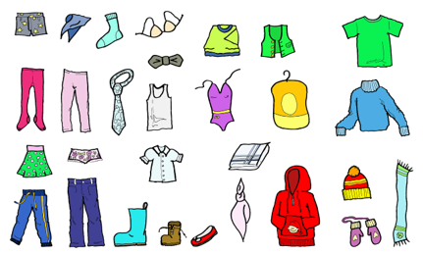
Vokabeln
Vokabeln
Was ist das auf Deutsch?
Wörter
tanzen
tragen
man
die Kleidung
dann
then
to wear, wearing
people, you (in general)
(the) clothing
to dance, dancing
then
Notes:
Timing: 4 minutes
Aim: to present and practise written comprehension and read aloud of the new vocabulary for this week, and to revise previous vocabulary.
Procedure: 1. Click for an English prompt.
2. Elicit the German word from pupils where they can recognise and read it aloud. Or say the word for pupils to repeat.
3. Continue until all 5 items have been seen and heard.
8

Slide 9
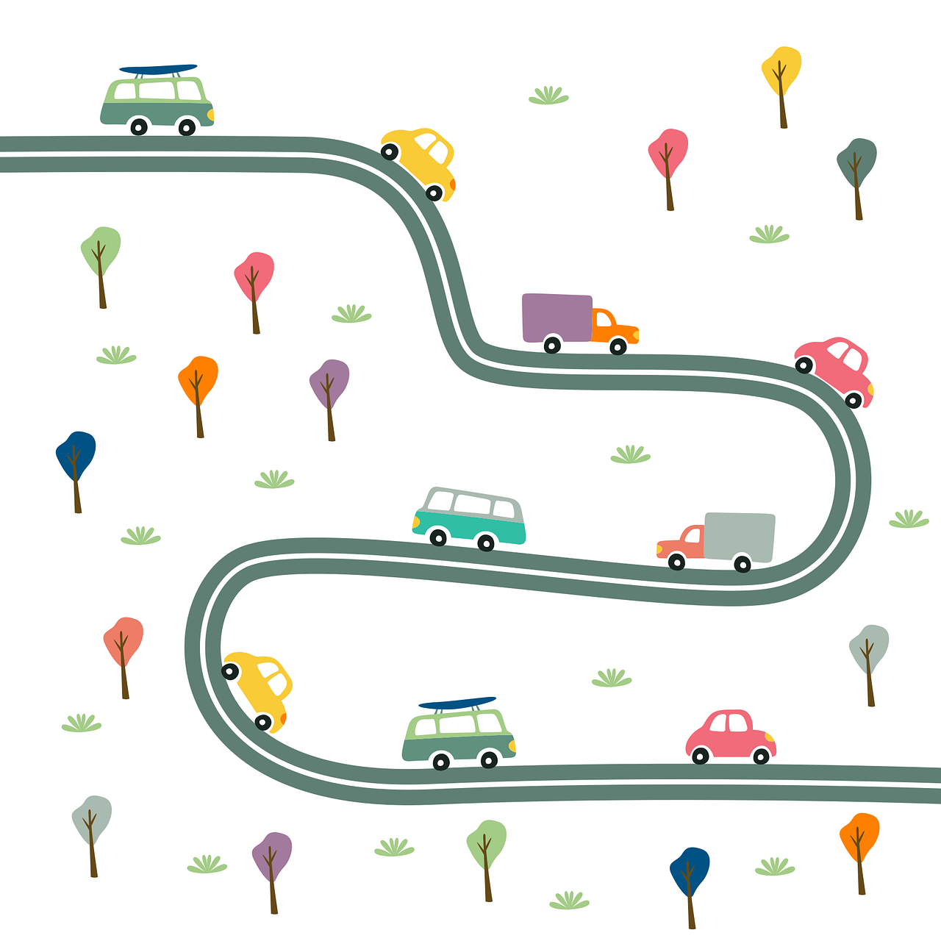
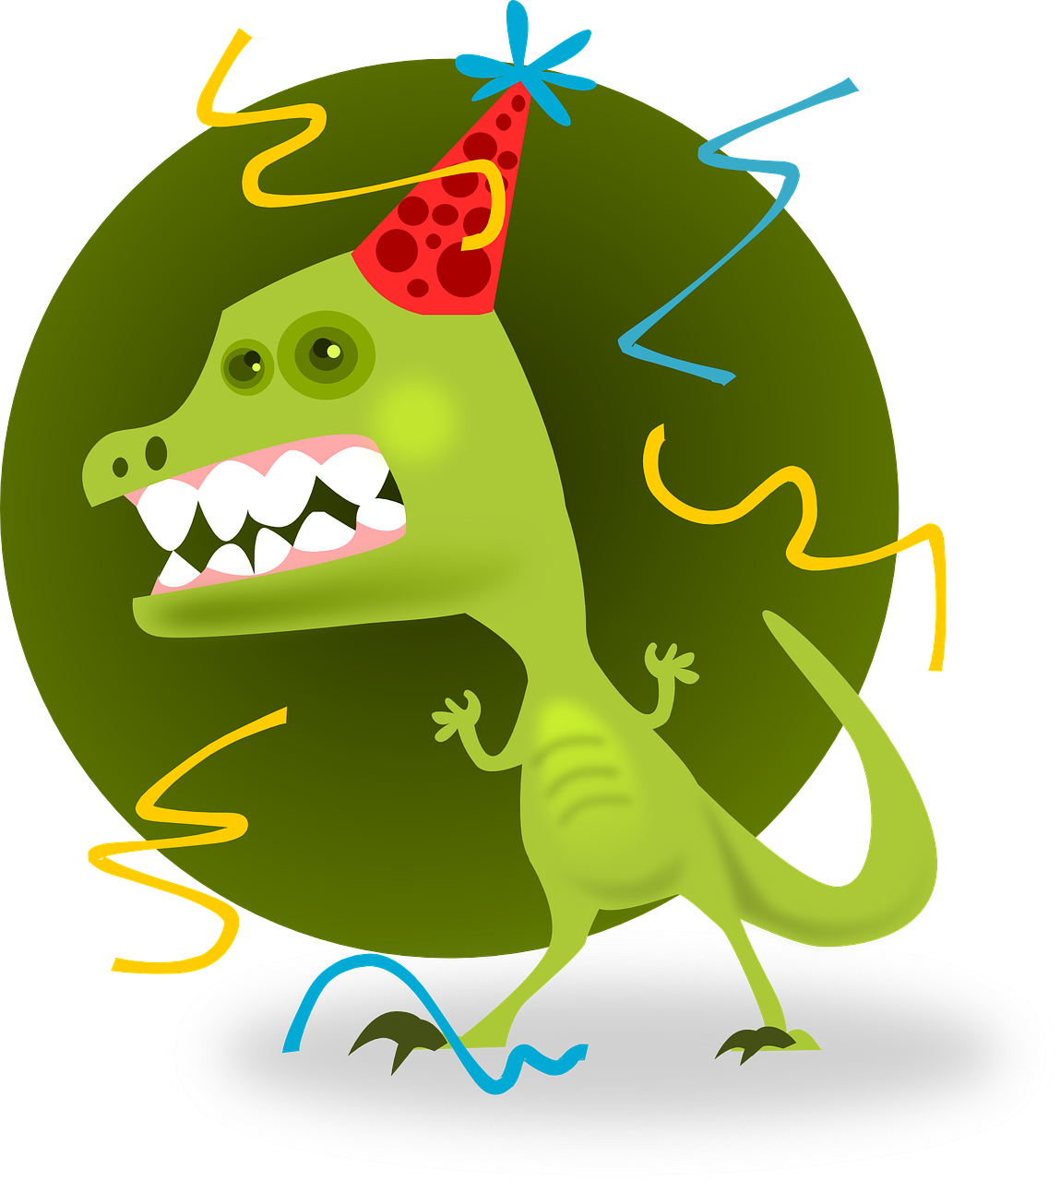
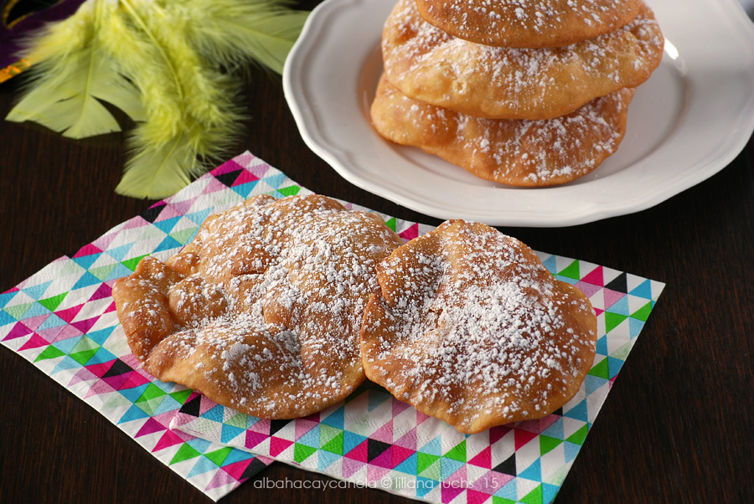
hören
Fasnacht
Hör zu. Schreib auf Englisch.
 | auf Englisch?
B.
dance in the street
1
become/get cold
2
sing songs in restaurants
3
go to a party
4
see lots of great masks
5
eat “Fasnachtschüechli”
6
need party clothes
Fasnachtschüechli – carnival fritters
Notes:
Timing: 5 minutes
Aim: to practise aural comprehension of the new vocabulary for this week and from previously, in short phrases.
Procedure:
1. Click to listen.
2. Pupils write or say the English meaning.
3. Click to correct.
Transcript:
Beispiel: auf der Straße tanzen
kalt werden
in Restaurants Lieder singen
auf eine Party gehen
viele tolle Masken sehen
Fasnachtschüechil essen
Partykleidung brauchen
“Fasnachtschüechli” by Liliana Fuchs is licensed under CC BY-NC-ND 2.0
9

Slide 10
‘Sie’ (they) and ‘man’ (people/you in general)
To say they + verb in German: use sie + verb ending –en.
Sie gehen auf die Party.
They go/ are going to the party.
Use man + verb ending –t to mean people/you in general:
Man geht auf die Party.
People/ you in general go/ are going to the party.
Careful! ‘Man’ does NOT mean man in English!
Notes:
Timing: 2 minutes
Procedure:
Click through the animations to present the new information.
Elicit English translation for the German examples provided.
10

Slide 11
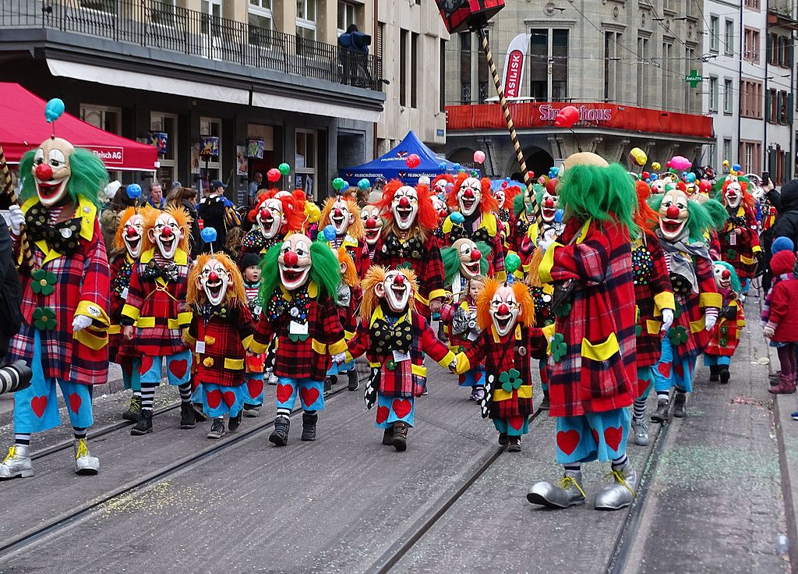
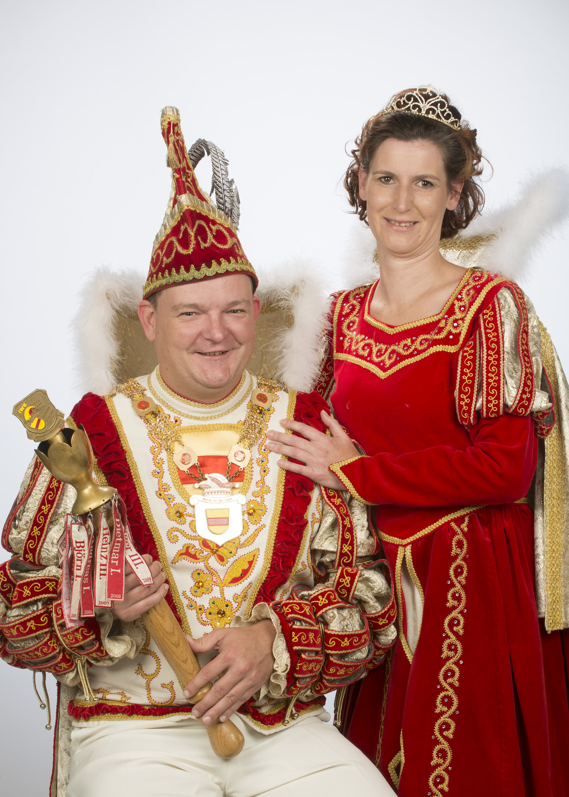
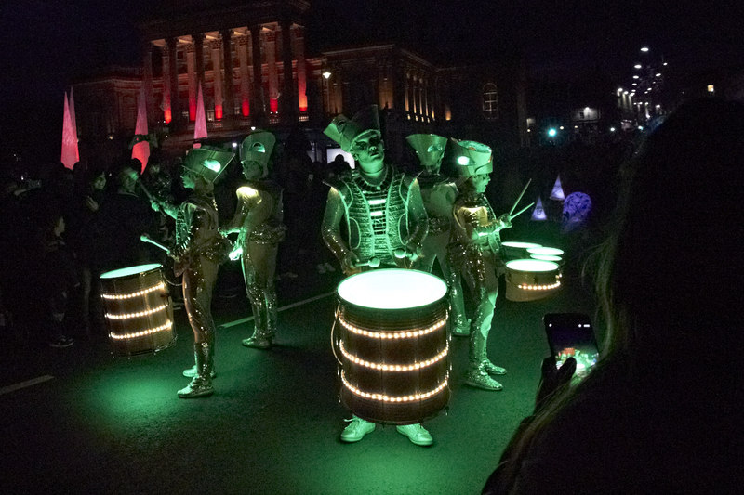
Kultur
Fasnacht in Biel
Kannst du die richtigen Bilder finden?
Am Donnerstag gibt der Stadtpräsident* ”Prinz Carnaval” den Stadtschlüssel*.
Am Freitag um 20.30 Uhr geht man durch die Straßen. Man trägt Kostüme mit Lichtern*.
Am Samstag gibt es ein ‘Kinder-Monster-Konzert’. Dann gibt es eine Kinderdisco mit Konfettischlacht*.
Am Sonntag gehen Leute in Kostümen durch die Straßen. Dann gibt es eine große Party!
Warum? Was denkst du?
der Stadtpräsident – mayor
der Schlüssel – key
das Licht – light
die Schlacht – fight
Notes:
Timing: 5 minutes
Aim: to present some cultural information on this week’s theme, Fasnacht, and what this looks like in the town where Lias and Ronja are from – Biel. The descriptions are based on the timetable of the 2023 carnival from the official website https://faschingszunft.ch/
Procedure:
Read through the text, or play the recordings. Make sure the meaning is clear. Translations are included below.
Ask pupils to match the first box with the right picture.
Click to bring up the question of why they think the mayor gives the key to the town to the carnival prince. Pupils can answer in English. The reason is that for the carnival time, the prince is in charge, not the mayor! The prince is usually a citizen from the town and is chosen each year to lead the carnival proceedings. He gives the key back at the end of the carnival.
Continue matching the other boxes and pictures, clicking to reveal the answers.
Translation
1. On Thursday the mayor gives the key to the town to ”Prince Carnaval” (the carnival prince). The word ‘carnaval’ is French as Biel/Bienne is a bilingual town.
2. On Friday at 8:30pm people walk through the streets . People wear costumes with lights. (You can mention that this is a night parade).
3. On Saturday there is a “Children’s Monster Concert”. Then there is a children’s disco with a confetti fight.
4. On Sunday people in costumes walk through the streets (You can mention this is a parade). Then there is a big party!
“2015/2016 Werne” by Bund Ruhr – Karneval e.V. is licensed under CC BY-NC-ND 2.0
“Basler Fasnacht 2017, Kinderumzug” by -jkb- is licensed under CC BY-SA 3.0
“Paisley 2016 Halloween parade” by david cameron photographer is licensed under CC BY-SA 2.0
11

Slide 12
lesen
Fasnacht
Ronja und Lias lieben Fasnacht!
Is it Ronja and Lias (sie-they), or people in general (man)?
 |  | sie (they) | man (people, you in general)
1 | … geht auf ein Konzert.
2 | … singen auf einer Party.
3 | … trägt Partykleidung.
4 | … sieht Freunde in Kostümen.
5 | … essen auf der Straße.
6 | … machen Masken aus Müll.
7 | … tanzt auf der Straße.
8 | … spielen Instrumente in einer Musikgruppe.
Fasnacht in Biel
1
2
3
4
5
6
7
8
Notes:
Timing: 5 minutes
Aim: to practise written comprehension of ‘man’ and ‘sie’ and vocabulary associated with Fasnacht.
Procedure:
1. Students write 1-8 and sie (they) or man (people, you in general) according to whether the verb is singular or plural.
2. Answers are revealed on a mouse click.
3. Move on to the next slide for a comprehension task based on the same text.
12

Slide 13
lesen
Fasnacht
Ronja und Lias lieben Fasnacht!
Was ist das auf Englisch?
1 | …. geht auf ein Konzert.
2 | …. singen auf einer Party.
3 | …. trägt Partykleidung.
4 | …. sieht Freunde in Kostümen.
5 | …. essen auf der Straße.
6 | …. machen Masken aus Müll.
7 | …. tanzt auf der Straße.
8 | …. spielen Instrumente in einer Musikgruppe.
Fasnacht in Biel
1
People/you (general) go to a concert.
2
They sing at a party.
3
People/you (general) wear party clothes.
4
People/you see friends in costumes.
5
They eat on the street.
6
They make masks out of rubbish.
7
People/you dance on the street.
8
They play instruments in a music group.
Notes:
Timing: 5 minutes
Aim: to practise written comprehension of ‘man’ and ‘sie’ and vocabulary associated with Fasnacht.
Procedure:
Pupils volunteer English meanings of each sentence.
Teacher clicks to reveal written answers.
If desired, click the buttons to play full sentence audio.
13

Slide 14
Tschüss!
grün
Notes:
14

