Slide 1
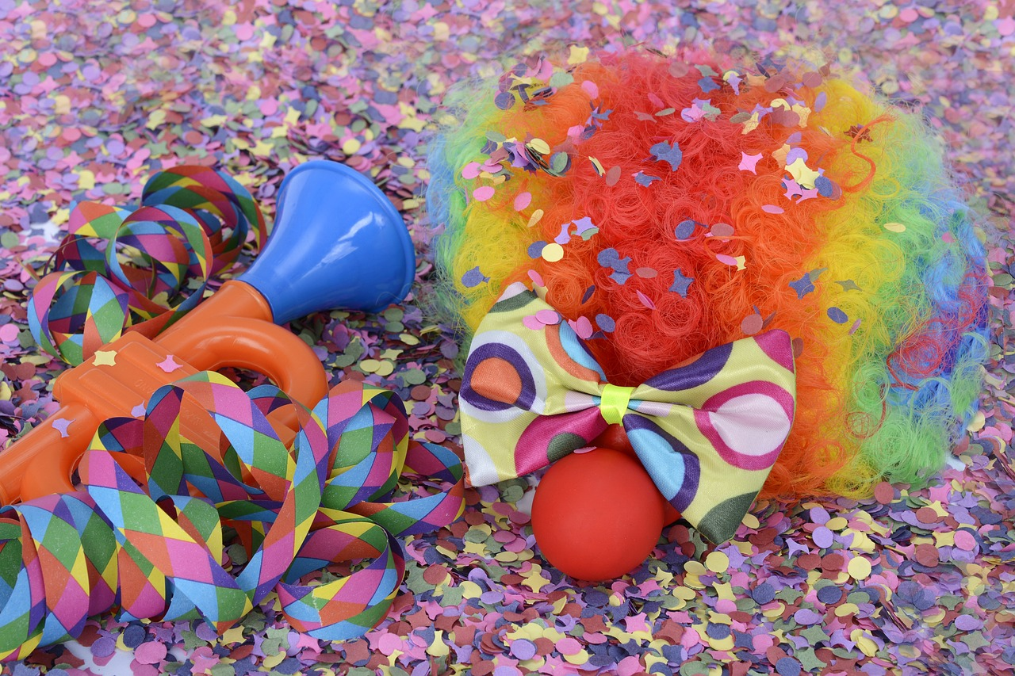
Experiences at home and away
Fasnacht²
grün
Follow ups 1-5
Term 3 Week 4
Notes:
Artwork by Steve Clarke. Pronoun pictures from NCELP (www.ncelp.org). All additional pictures selected from Pixabay and are available under a Creative Commons license, no
attribution required.
Phonics:
[-ig] richtig [177] dreißig [2046] fertig [n/a] ruhig [911] wichtig [144]
Vocabulary: laufen [252] lesen [288] schlafen [679] sehen [79] sprechen [161]
Revisit 1: Angst (vor) [392] Bein [884] Glück [641] Kopf [250] Prüfung [1827] Recht [242] Schmerzen [1483] Unfall [1955] froh [1424] krank [1321] bitte [471] danke [877]
Revisit 2: kaufen [506] laufen [252] machen [58] Rad fahren [n/a] tragen [271] (Sport)Kleidung [2820]
Jones, R.L & Tschirner, E. (2019). A frequency dictionary of German: Core vocabulary for learners. London: Routledge.
The frequency rankings for words that occur in this PowerPoint which have been previously introduced in these resources are given in the SOW and in the resources that first introduced and formally re-visited those words.
For any other words that occur incidentally in this PowerPoint, frequency rankings will be provided in the notes field wherever possible.
Remember that at the start of the course (first three lessons of Rot/Gelb) pupils learnt language (for greetings and register taking) that can still be part of the lesson routines in upper KS2 (Blau/Grün). They are not re-taught, as we anticipate that teachers have built these in from early in lower KS2.

Slide 2
aussprechen
[-ig]
…
The [-ig] sound is mostly found at the end of words.
richtig
Notes:
Timing: 1 minute
Aim: To introduce/consolidate SSC [-ig]
Procedure: 1. Present the letter(s) and say the [-ig] sound first, on its own. Students repeat it with you. 2. Bring up the word ”richtig” on its own, say it, students repeat it, so that they have the opportunity to focus all of their attention on the connection between the written word and its sound.
3. A possible gesture for this would be to mime ‘correct’ by tracing a tick in the air with the index finger on your right hand.
4. Roll back the animations and work through 1-3 again, but this time, dropping your voice completely to listen carefully to the students saying the [-ig] sound, pronouncing ”richtig” and, if using, doing the gesture. Word frequency (1 is the most frequent word in German): richtig [177]
Source: Jones, R.L. & Tschirner, E. (2019). A frequency dictionary of German: core vocabulary for learners. Routledge
2

Slide 3
aussprechen
[-ig]
…
30
fertig
dreißig
richtig
[ready, finished]
ruhig
wichtig
[quiet, calm]
[important]
Notes:
Timing: 2 minutes
Aim: To introduce/consolidate SSC [-ig]
Procedure:
Introduce and elicit the pronunciation of the individual SSC [-ig] and then the source word again ‘richtig’ (with gesture, if using).
Then present and elicit the pronunciation of the five cluster words.
The cluster words have been chosen for their high-frequency, from a range of word classes, with the SSC (where possible) positioned within a variety of syllables within the words (e.g. initial, 2nd, final etc.). Additionally, we have tried to use words that build cumulatively on previously taught SSCs (see the Phonics Teaching Sequence document) and do not include new SSCs. Where new SSCs are used, they are often consonants which have a similar symbol-sound correspondence in English.
Word frequency (1 is the most frequent word in German): richtig [177] dreißig [2046] fertig [n/a] ruhig [911] wichtig [144] Source: Jones, R.L. & Tschirner, E. (2019). A frequency dictionary of German: core vocabulary for learners. Routledge

Slide 4
Partnerarbeit: Sag die Sätze.
Follow up 1
How many –ig sounds are there? Where are the speakers likely to be from?
The German [-ig] is the equivalent of the English [-y] at the end of adjectives.
Can you pronounce these [-ig] words like Moritz, and then like Lias?
aussprechen
[ich]
[ik]
 | Lies diese Sätze laut. | wie viele [-ig] ? | Northern | Southern
A | Die Hausaufgabe ist schwierig aber wichtig. | 2
 | The homework is difficult but important.
A | Die Katze ist winzig, neugierig und schmutzig. | 3
 | The cat is tiny, curious and dirty.
B | Die Antworten sind richtig aber nervig. | 2
 | The answers are correct but annoying.
B | Der Film ist großartig und lustig aber auch traurig. | 3
 | The film is great and funny but also sad.
A
A
B
B
Notes:
Timing: 5 minutes
Aim: a paired read-aloud to practise pronouncing unknown words with the SSC [-ig]
Procedure:
Explain that pupils will work in pairs. One pupil will read out a sentence with either [ik] or [ich] pronounciation. The other pupil will turn around and tally up how many [–ig] sounds they hear, and whether it is the [ik] or [ich] pronounciation. (NB. Only one type of pronounciation per sentence.)
Pupil B turns away from the board.
Click to reveal the sentence and its English meaning, and which pronounciation pupil A should use in their read-aloud.
Pupil A reads aloud the sentence. Pupil B tallies up how many [–ig] sounds, and which pronunciation. Pupil A repeats with sentence 2.
Pupil B turns around to check their answers.
Now Pupil A turns away from the board to do sentences 3 and 4. Repeat steps 3 – 6.
Click audio buttons to listen and join in with the audio one more time.
Word frequency:
schwierig [580] wichtig [144] winzig [2219] neugierig [3040] schmutzig [3869] richtig [177] nervig [N/A] großartig [2254] lustig [1973] traurig [1752] Source: Jones, R.L. & Tschirner, E. (2019). A frequency dictionary of German: core vocabulary for learners. Routledge

Slide 5
Vokabeln
Follow up 2:
die Freundschaft - friendship
…
Remember that learning languages is about making friends.
sprechen
You show kindness when you learn even a few words in another language.
Let’s remember some of the friendship sentences we have learnt already!
Hallo!
Guten Tag!
_ _ _ _ _!
_ _ _ _ _ _ _’_?
_ _ _ _ _ _ _ _!
Wie geht’s?
Get well soon!
Gute Besserung!
Good luck!
Viel Glück!
Can you say other kind or caring things?
Brauchst du Hilfe?
Bitte!
Do you need help?
Please!
Danke!
Bist du müde?
Hast du Angst?
Thank you!
Are you tired?
Are you scared?
I’m happy. And you?
Ich bin froh. Und du?
Notes:
Timing: 3 minutes
Aim: to revisit the idea that learning other languages opens the door to new friendships, and that a few kind words go a long way; to revisit some previously-taught language from this term that fits our category of ‘friendship sentences’. This is an idea we return to now and then during the course.
Procedure:
Click to present the information on the slide.
Elicit the German from pupils for the English greetings and friendly statements.
Allow pupils a few moments to turn to those around them and greet them and say something kind about their work or about them themselves.
Remind pupils that we all need to hear kind words every day, in whatever language!
5

Slide 6
Follow up 3:

Schreib auf Deutsch. Dann sprich auf Deutsch.
Choose three images. Write a sentence choosing either er or sie to describe each one.
Say your sentences. Your partner will try to draw the images. Swap roles.
schreiben
sprechen
Beispiel: Sie trägt Partykleidung
8:00
+
Notes:
Timing: 5-10 minutes
Aim: to practise oral production of sentences with strong verbs in the 3rd person singular.
Procedure:
Make sure pupils understand what each of the pairs of pictures mean in English. E.g. the bottom right one is ‘He/she helps Lias’.
Pupils have approximately three minutes to choose three images from the screen and plan one sentence to describe each. They must keep their choices and sentences hidden from their partners. Note: explain that the gender symbol means they choose either er or sie for any of the pictures.
Once the preparation time is over, click to cover the pictures on the screen.
Pupils then take it in turns to read their sentences to their partner, who attempts to draw the images being described. When the partner draws ‘he’ or ‘she’ they could use the correct gender symbol or annotate their picture with ‘she’ or ‘he’ (rather than more stereotyped ways of drawing ‘he’ with short hair/trousers and ‘she’ with long hair/a dress etc.).
Click to reveal the images on screen again for pupils to compare their drawings.
Example sentences (left to right, top to bottom): Er/Sie sieht Musiker.
Er/Sie wird müde.
Er/Sie trägt Partykleidung.
Er/Sie isst im Restaurant.
Er/Sie spricht Englisch und Deutsch.
Er/Sie schläft um acht Uhr. Er/Sie liest die Liste. Er/Sie läuft nach Hause.
Er/Sie hilft Lias.

Slide 7
Order of words in a sentence
You know we can start a German sentence with the place adverb to emphasize it.
When we do this, the adverb and subject swap places.
This works with time adverbs and days/times too.
Am Samstag
singt man
Fasnachtslieder
Word order
2
TIME
VERB + SUBJECT
OBJECT
On Saturday
people sing
carnival songs.
The verb position stays the same – just the adverb and subject swap around!
Notes:
Timing: 3 minutes
Aim: to recap the order of words in a German sentence, and how this is affected by an initial adverb of time.
Procedure:
Click to present the information.
Elicit the English meaning of the words in the sentence.
Ensure that pupils understand that this change is for emphasis – the essential meaning of the sentence remains the same.
7

Slide 8
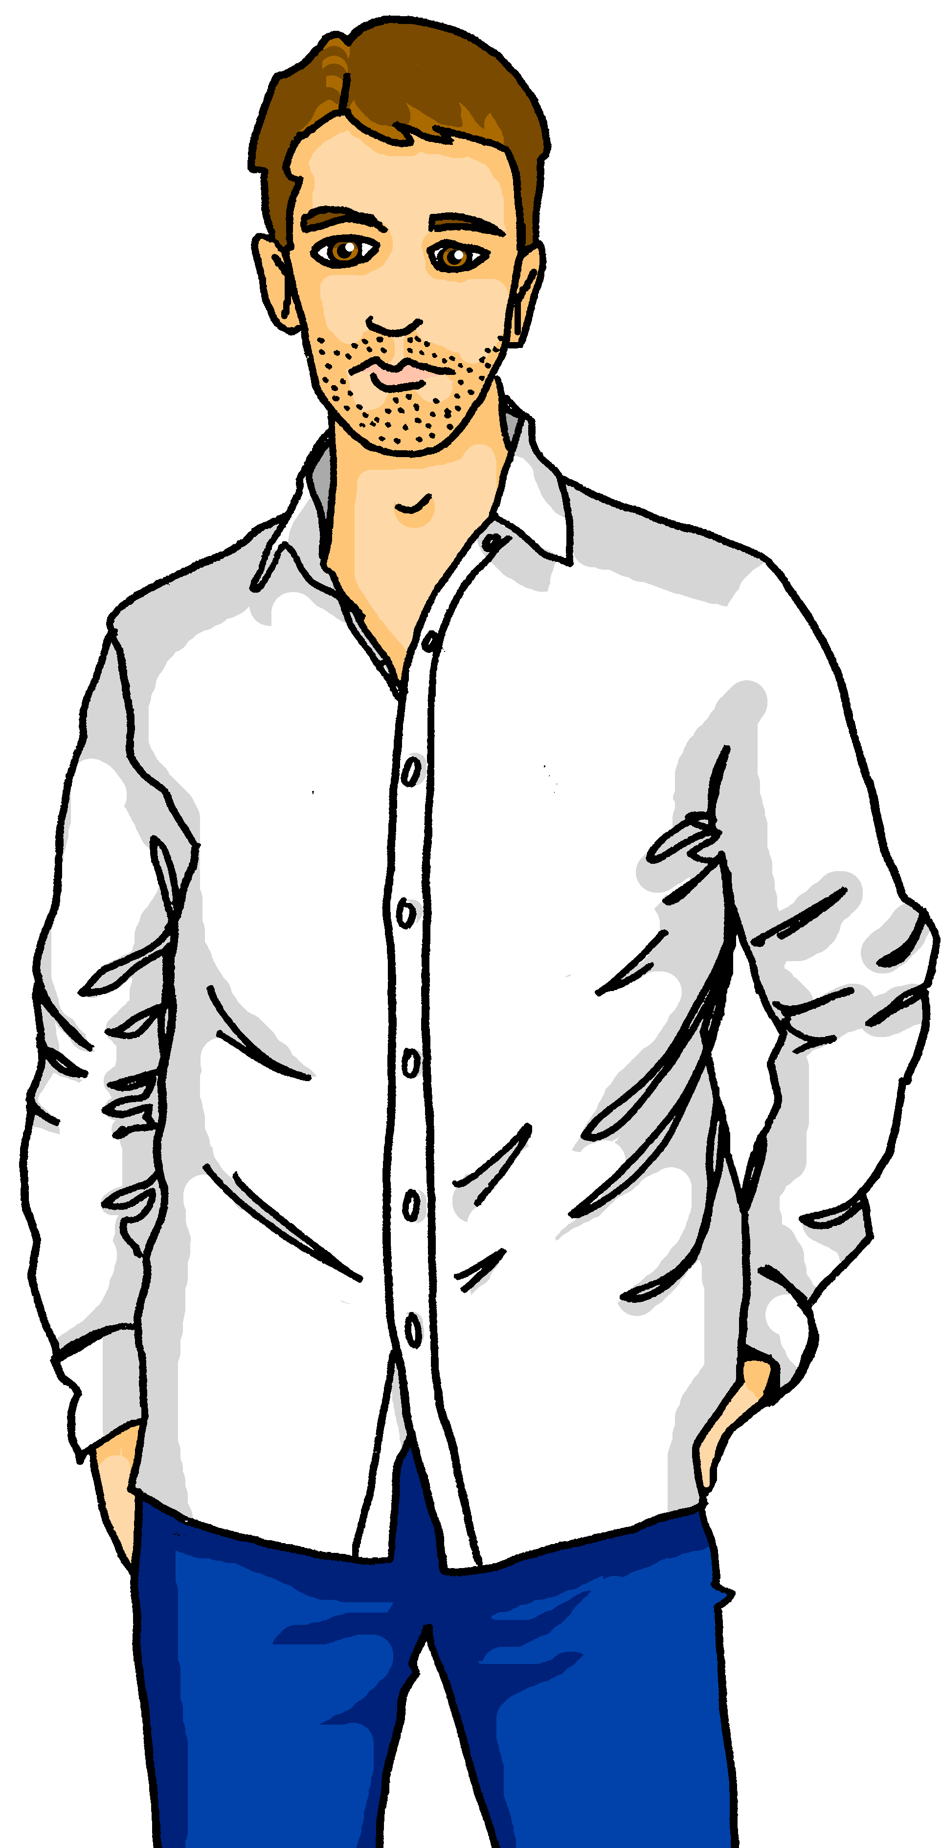
Follow up 4:
Lothar ist nicht in Basel. Was macht er?
laufen
schlafen
lesen
sehen
sprechen
tragen
 | 1 | 2 | 3 | 4 | 5 | 6
A _____
B Am Montag...
C Dann…
D Am Dienstag...
E Am Mittwoch...
hören
1
5
2
6
3
7
4
8
bis – until
wieder - again
Notes:
Timing: 8 minutes (two slides)
Aim slide 1: to practise listening to WO1 and WO2 using this week’s verbs in the third person singular.
Procedure:
Pupils listen to eight statements talking about what Lothar is doing. Ask them to pay attention the word order, too.
Click to play the first recording. Pupils identify the square, e.g., C3 and write down the coordinate. Elicit the answer.
Click for the answer to appear.
Click for the next recording and continue until all eight recordings are played.
Additional task suggestions: Elicit English translations and Word order: WO1 for row A, WO2 for rows B-E.
Transcript:
Am Montag schläft er bis sieben Uhr. (B2).
Er liest seine Emails. (A3).
Am Mittwoch spricht er mit der Familie am Telefon (E5).
Er trägt Jeans und ein T-shirt (A6).
Am Dienstag trägt er Sportkleidung (D6).
Dann läuft er durch die Stadt (C1).
Er liest eine Textnachricht von Ronja (A3).
Dann sieht er seine Familie wieder. Er ist froh! (C6).
Translation
On Monday he sleeps/is sleeping until 7 o’clock.
He reads/is reading his emails.
On Wednesday he speaks/is speaking with the family on the phone.
He wears/is wearing jeans and a t-shirt.
On Tuesday he wears/is wearing sports clothes.
Then he runs/is running through the town.
He reads/is reading a text message from Ronja.
Then he sees his family again. He is happy/glad.
Vocabulary
bis [77] wieder [74]
Jones, R.L & Tschirner, E. (2019). A frequency dictionary of German: Core vocabulary for learners. London: Routledge.

Slide 9
Follow up 4:
Schatzsuche*
Schatzsuche – treasure hunt
laufen
schlafen
lesen
sehen
sprechen
tragen
 | 1 | 2 | 3 | 4 | 5 | 6
A _____
B In the morning…
C Then…
D In the afternoon
E In the evening…
sprechen
Such den Schatz!
Notes:
slide 2 of 2
Aim slide 2: to practise speaking in the treasure-hunt format, using the vocabulary from the previous slide’s listening task.
Procedure:
Pupils pick a square and make up a sentence relating to that square, using ideas and phrases from the previous slide’s listening.
If they get it right, click on the relevant square to reveal what’s underneath. Is there a treasure underneath?!
Continue until all the squares have been revealed.
Vocabulary:
Schatz [2649] Suche [1508]
Jones, R.L & Tschirner, E. (2019). A frequency dictionary of German: Core vocabulary for learners. London: Routledge.

Slide 10
Follow up 5:

Schreib auf Englisch.
Can you get at least 15 points?
Wörter
 | kaufen | die (Sport)Kleidung | tragen
 | machen | Rad fahren | man trägt
 | die Schmerzen | krank | das Bein
 | der Kopf | die Prüfung | der Unfall
 | laufen | sprechen | lesen
 | sehen | schlafen | man spricht
to buy, buying
(the) (sports) clothes
to wear, wearing
Vokabeln
x3
to make, making
cycling
people/you wear
(the) pain(s)
sick, ill
(the) leg
x2
(the) head
(the) exam, test
(the) accident
to run, running
to speak, speaking
to read, reading
x1
to see, seeing
to sleep, sleeping
people/you speak
Notes:
Timing: 5 minutes
Aim: to practise written comprehension of vocabulary from this and revisited weeks.
Procedure: 1. Give pupils a blank grid. They fill in the English meanings of any of the words they know, trying to reach 15 points in total.
Note: The most recently learnt and practised words are pink, words from the previous week are green and those from week 1 are blue, thus more points are awarded for them, to recognise that memories fade and more effort (heavy lifting!) is needed to retrieve them.

Slide 11
Follow up 5:

Schreib auf Deutsch.
Can you get at least 15 points?
Wörter
 | people/you wear | to wear, wearing | to buy, buying
 | cycling | (the) (sports) clothes | to make, making
 | (the) exam, test | (the) accident | (the) head
 | sick, ill | (the) leg | (the) pain(s)
 | to see, seeing | people/you speak | to sleep, sleeping
 | to read, reading | to speak, speaking | to run, running
Vokabeln
man trägt
tragen
kaufen
x3
Rad fahren
die (Sport)Kleidung
machen
die Prüfung
der Unfall
der Kopf
x2
krank
das Bein
die Schmerzen
sehen
man spricht
schlafen
x1
lesen
sprechen
laufen
Notes:
Timing: 5 minutes
Aim: to practise written production of vocabulary from this and revisited weeks.
Procedure: 1. Give pupils a blank grid. They fill in the German meanings of any of the words they know, trying to reach 15 points in total.
Note: The most recently learnt and practised words are pink, words from the previous week are green and those from week 1 are blue, thus more points are awarded for them, to recognise that memories fade and more effort (heavy lifting!) is needed to retrieve them.

Slide 12
Tschüss!
grün
Notes:
12

Slide 13
Follow up 5:

Schreib auf Englisch.
Can you get at least 15 points?
Wörter
 | kaufen | die (Sport)Kleidung | tragen
 | machen | Rad fahren | man trägt
 | die Schmerzen | krank | das Bein
 | der Kopf | die Prüfung | der Unfall
 | laufen | sprechen | lesen
 | sehen | schlafen | man spricht
Vokabeln
x3
x2
x1
Notes:
HANDOUT

Slide 14
Follow up 5:

Schreib auf Deutsch.
Can you get at least 15 points?
Wörter
 | people/you wear | to wear, wearing | to buy, buying
 | cycling | (the) (sports) clothes | to make, making
 | (the) exam, test | (the) accident | (the) head
 | sick, ill | (the) leg | (the) pain(s)
 | to see, seeing | people/you speak | to sleep, sleeping
 | to read, reading | to speak, speaking | to run, running
Vokabeln
x3
x2
x1
Notes:
HANDOUT

