Slide 1
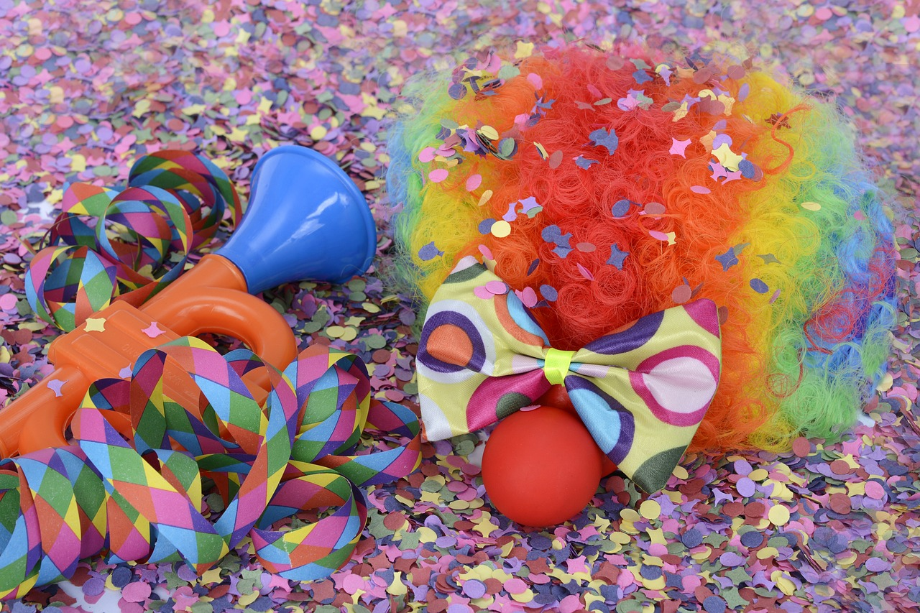
Experiences at home and away
Fasnacht²
grün
Present tense – weak and strong
SSC [-ig]
Term 3 Week 4
Notes:
Artwork by Steve Clarke. Pronoun pictures from NCELP (www.ncelp.org). All additional pictures selected from Pixabay and are available under a Creative Commons license, no
attribution required.
Phonics:
[-ig] richtig [177] dreißig [2046] fertig [n/a] ruhig [911] wichtig [144]
Vocabulary: laufen [252] lesen [288] schlafen [679] sehen [79] sprechen [161]
Revisit 1: Angst (vor) [392] Bein [884] Glück [641] Kopf [250] Prüfung [1827] Recht [242] Schmerzen [1483] Unfall [1955] froh [1424] krank [1321] bitte [471] danke [877]
Revisit 2: kaufen [506] laufen [252] machen [58] Rad fahren [n/a] tragen [271] (Sport)Kleidung [2820]
Jones, R.L & Tschirner, E. (2019). A frequency dictionary of German: Core vocabulary for learners. London: Routledge.
The frequency rankings for words that occur in this PowerPoint which have been previously introduced in these resources are given in the SOW and in the resources that first introduced and formally re-visited those words.
For any other words that occur incidentally in this PowerPoint, frequency rankings will be provided in the notes field wherever possible.
Remember that at the start of the course (first three lessons of Rot/Gelb) pupils learnt language (for greetings and register taking) that can still be part of the lesson routines in upper KS2 (Blau/Grün). They are not re-taught, as we anticipate that teachers have built these in from early in lower KS2.
1

Slide 2
aussprechen
[-ig]
…
The [-ig] sound is mostly found at the end of words.
richtig
Notes:
Timing: 1 minute
Aim: To introduce/consolidate SSC [-ig]
Procedure: 1. Present the letter(s) and say the [-ig] sound first, on its own. Students repeat it with you. 2. Bring up the word ”richtig” on its own, say it, students repeat it, so that they have the opportunity to focus all of their attention on the connection between the written word and its sound.
3. A possible gesture for this would be to mime ‘correct’ by tracing a tick in the air with the index finger on your right hand.
4. Roll back the animations and work through 1-3 again, but this time, dropping your voice completely to listen carefully to the students saying the [-ig] sound, pronouncing ”richtig” and, if using, doing the gesture. Word frequency (1 is the most frequent word in German): richtig [177]
Source: Jones, R.L. & Tschirner, E. (2019). A frequency dictionary of German: core vocabulary for learners. Routledge
2

Slide 3
aussprechen
[-ig]
…
30
fertig
dreißig
richtig
[ready, finished]
ruhig
wichtig
[quiet, calm]
[important]
Notes:
Timing: 2 minutes
Aim: To introduce/consolidate SSC [-ig]
Procedure:
Introduce and elicit the pronunciation of the individual SSC [-ig] and then the source word again ‘richtig’ (with gesture, if using).
Then present and elicit the pronunciation of the five cluster words.
The cluster words have been chosen for their high-frequency, from a range of word classes, with the SSC (where possible) positioned within a variety of syllables within the words (e.g. initial, 2nd, final etc.). Additionally, we have tried to use words that build cumulatively on previously taught SSCs (see the Phonics Teaching Sequence document) and do not include new SSCs. Where new SSCs are used, they are often consonants which have a similar symbol-sound correspondence in English.
Word frequency (1 is the most frequent word in German): richtig [177] dreißig [2046] fertig [n/a] ruhig [911] wichtig [144] Source: Jones, R.L. & Tschirner, E. (2019). A frequency dictionary of German: core vocabulary for learners. Routledge

Slide 4
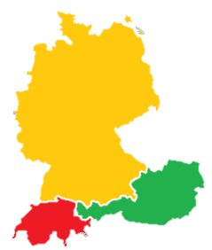
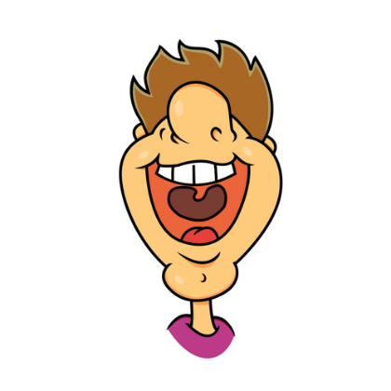
[ig]
Hör zu und wiederhole.
In Germany, Austria and Switzerland, there are lots of dialects.
In Southern Germany, Austria and Switzerland, where I live, [-ig] is pronounced like [-ik].
In Northern Germany, where I live, [-ig] is pronounced like [-ich].
1
dreißig _{[thirty]} wenig _{[few]} häufig _{[often]} völlig _{[completely]} schwierig _{[difficult]} gleichzeitig _{[at the same time]}
1
dreißig _{[thirty]} wenig _{[few]} häufig _{[often]} völlig _{[completely]} schwierig _{[difficult]} gleichzeitig _{[at the same time]}
2
Deutschland
2
3
3
4
4
Österreich
Whether you pronounce [-ig] as [ich] as in North Germany or [ik] as in Switzerland, you don’t use your vocal chords.
5
Schweiz
5
6
6
Notes:
Timing: 5 minutes
Aim: to consolidate the SSC [ig] and to introduce pupils to the idea of regional variation in pronunciation.
Procedure:
Click to bring up Moritz and speech bubble, then Lias and speech bubble, to introduce the idea of regional variation.
Click to bring up the two sets of the identical 6 words.
Click each number to hear the two versions of each word. Pupils listen and repeat. Which do they prefer?
Click to bring up the call-out to point out that we don’t use our vocal chords for either pronunciation of [ig]. This means that both are ‘unvoiced’ sounds, that pupils feel at the back of their throats but not in vibrations in the neck.
Extension activity: pupils turn away from the board or close their eyes. Click on a number – pupils listen and identify whether it was Moritz [-ich] or Lias [-ik]. Repeat as many times as appropriate.
Transcript:
dreißig
wenig
häufig
völlig
schwierig
gleichzeitig
Word frequency:
wenig (few) [102] häufig (often) [407] völlig (completely, absolutely) [515] schwierig (difficult, hard, tough) [580] gleichzeitig (simultaneous, at the same time) [637] Source: Jones, R.L. & Tschirner, E. (2019). A frequency dictionary of German: core vocabulary for learners. Routledge

Slide 5
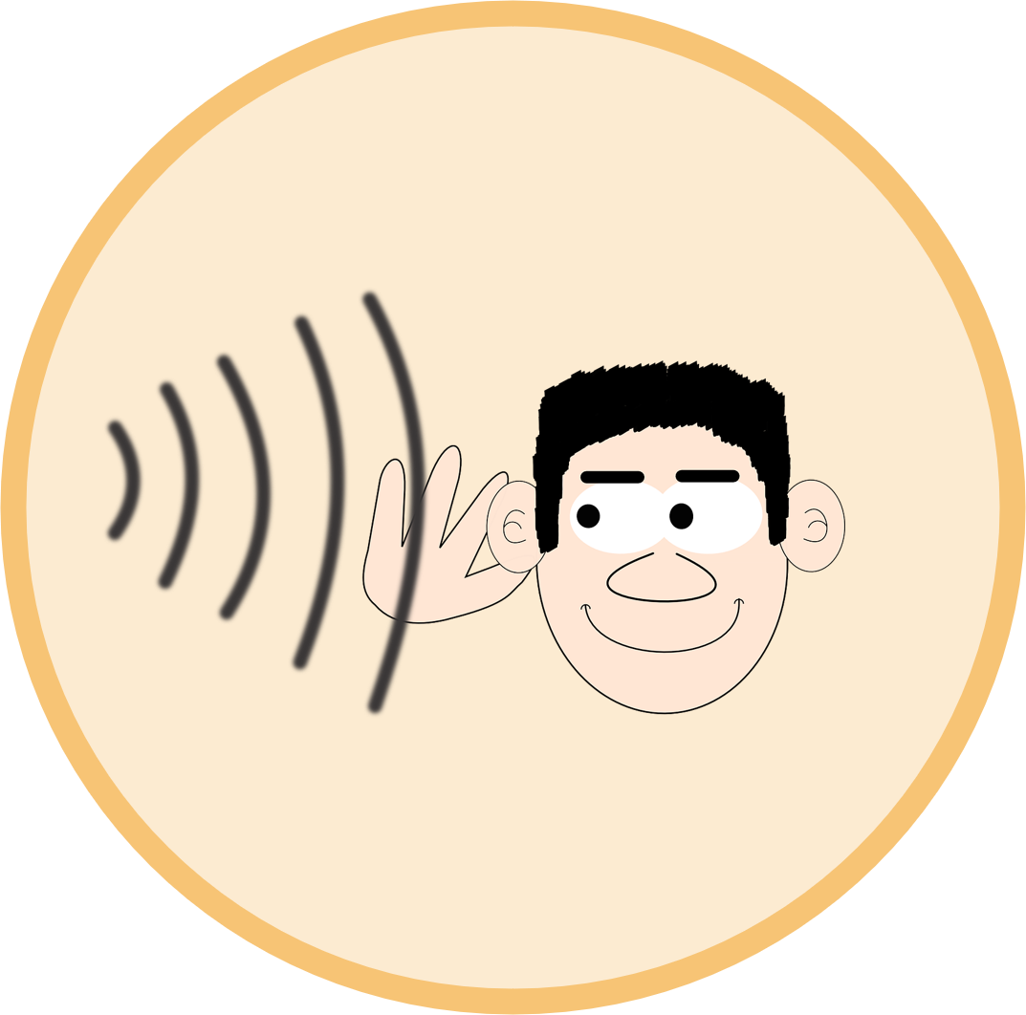
Vokabeln
Vokabeln lernen
Was heißt das auf Deutsch?
Wörter
Welche Verben sind neu?
lesen
werden
kaufen
hören
gehen
trinken
tanzen
schlafen
machen
sprechen
laufen
sehen
tragen
singen
Notes:
Timing: 5 minutes
Aim: to revisit and practise written recognition and pronunciation of 14 previously taught infinitive verbs.
Procedure:
Ask pupils to look at all the verbs on the screen. Most of them they have seen before in the lessons but there are two that are new – can they find which ones? (schlafen and sprechen)
Click to bring up a symbol.
Pupils choose one of the German verbs – elicit which one. For the new verbs, highlight them as they come up (to sleep/sleeping and to speak/speaking) and repeat the German a couple of times with the class.
Click for the answer (correct verb turns green).
Click for next symbol and carry on until all the verbs have been identified.
Note: the task will gradually get easier as the correctly identified verbs stay green and can therefore be ruled out as a choice.
5

Slide 6
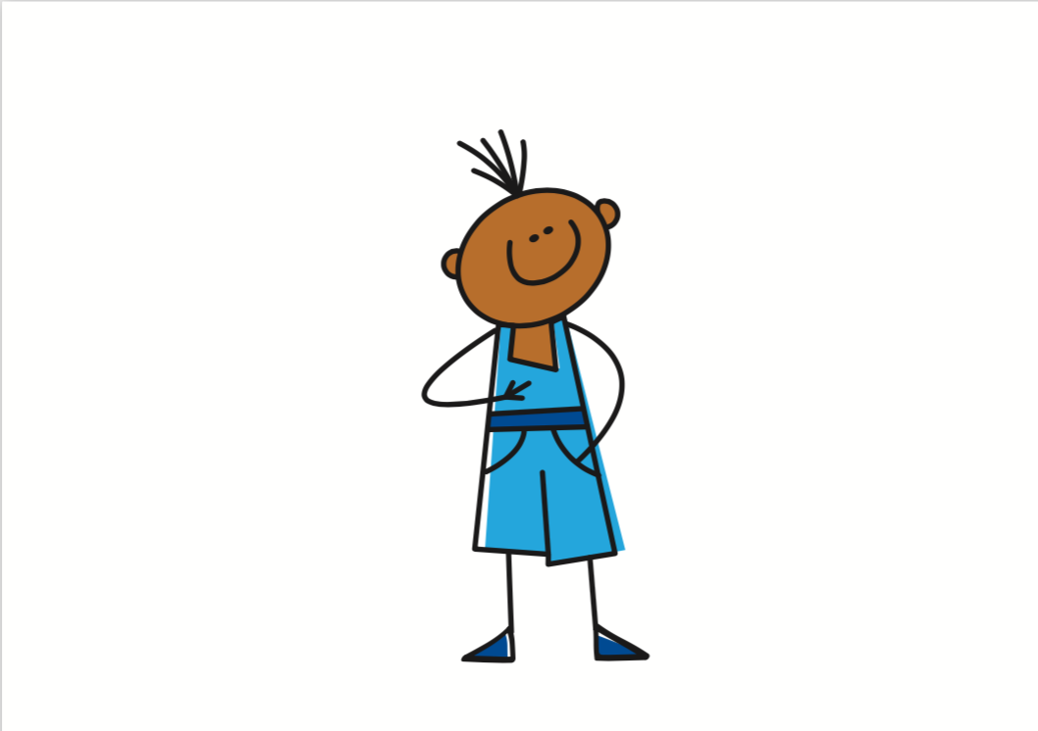
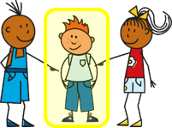
Grammatik
Remember that strong verbs (e.g. laufen, sehen, werden) change the vowel in the stem for 2nd and 3rd persons singular:
Ich schlafe im Bett.
I sleep/am sleeping in (the) bed.
Usually we would add the ending ‘st’ for du. But because the stem already ends in s, we don’t need to add another s. So it’s:
du liest, not du liesst.
Du schläfst im Bett.
You sleep/are sleeping in (the) bed.
Er/sie schläft im Bett.
S/he sleeps/is sleeping in (the) bed.
Ich lese ein Buch.
I read/am reading a book.
Du liest ein Buch.
You read/are reading a book.
Er/sie liest ein Buch.
S/he reads/is reading a book.
Ich spreche Deutsch.
I speak/ am speaking German.
Du sprichst Deutsch.
You speak/ are speaking German.
Er/sie spricht Deutsch.
S/he speaks/ is speaking German.
Notes:
Timing: 2 minutes
Procedure:
Point out that the two new verbs they have just learnt are also examples of strong verbs.
Click through the animations to remind pupils of the vowel change in the stem for strong verbs.
Elicit English translation for the German examples provided.
6

Slide 7
Vokabeln
Weak or strong? Sortiere die Verben.
Wörter
sehen
lesen
weak
strong
trinken
schlafen
werden
singen
schlafen
hören
gehen
hören
sprechen
gehen
laufen
machen
machen
tragen
kaufen
trinken
tanzen
sehen
laufen
kaufen
werden
tanzen
singen
lesen
tragen
sprechen
Notes:
Timing: 5 minutes
Aim: to practise sorting taught verbs into weak and strong categories.
Procedure:
Each item is triggered, allowing the teacher to elicit answers in any order from pupils.
When pupils say a verb with its correct category, e.g. weak, the teacher clicks on the word and the animation sees it slot into the correctly labelled box.
3. Repeat for all 14 verbs.
7

Slide 8
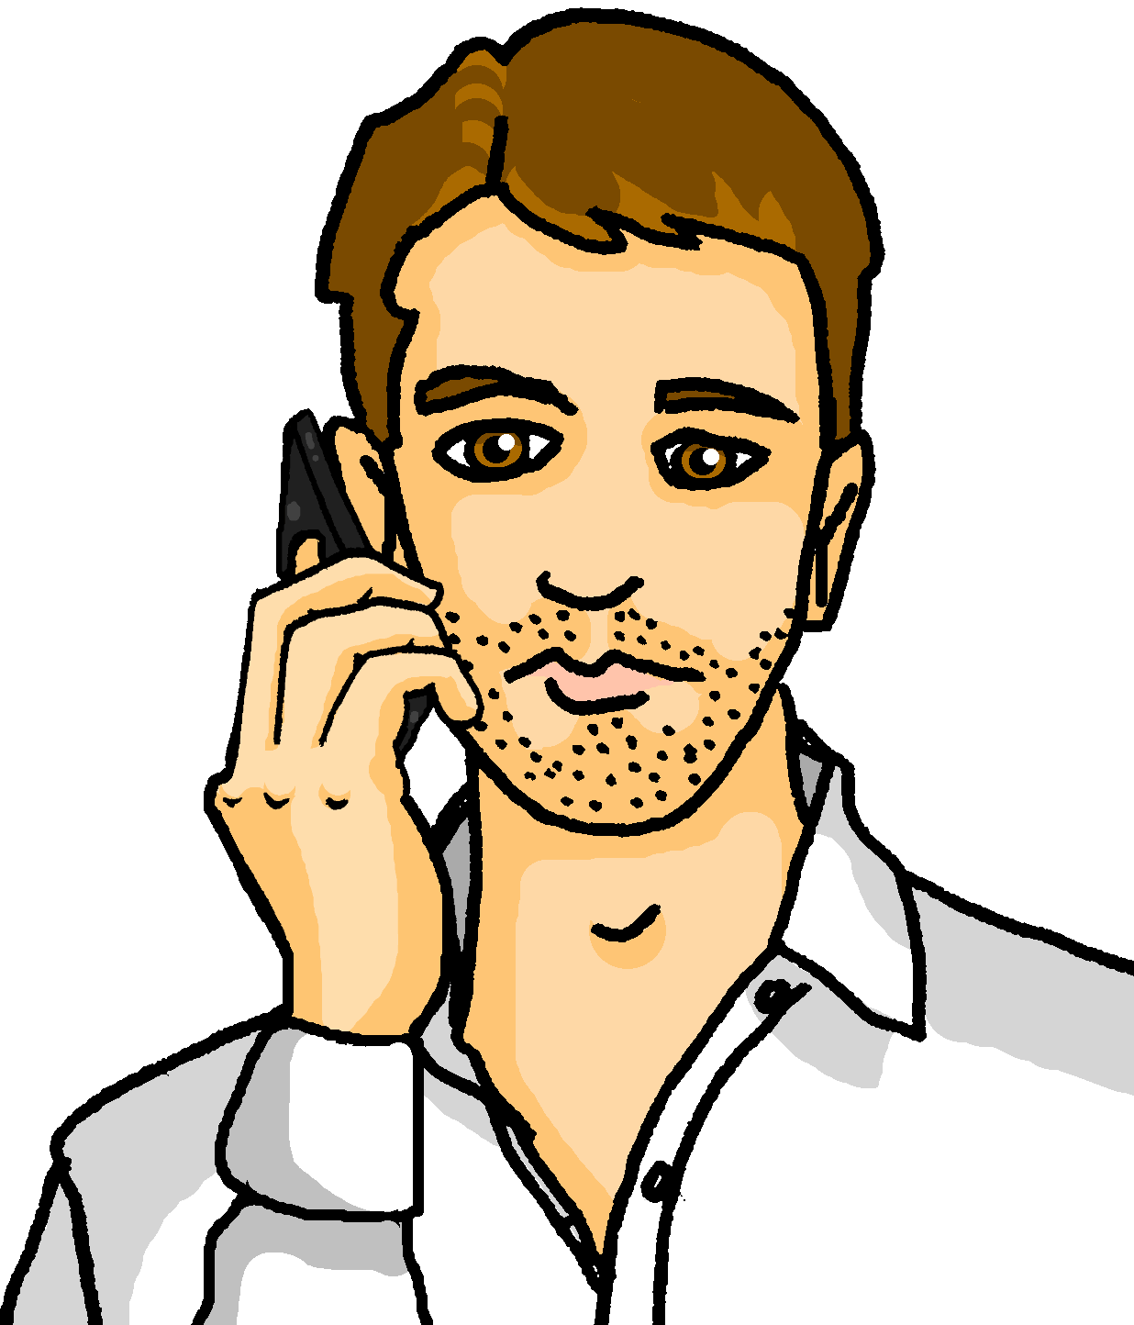
hören
Ronja und Leonie sind beim Fasnachtsumzug* in Basel. Ronja spricht am Telefon mit Papa Lothar.
Wer macht was? Leonie (sie) oder Ronja (ich)?
 | Auf Englisch?
 | I am not wearing party clothes.
 | She is running to a friend (f).
 | It’s late but I’m not sleeping.
 | I am speaking on the phone.
 | She is reading a book about Fasnacht in Basel.
 | I see lots of musicians with masks.
 | She is getting tired. It’s a long day!
Leonie:
sie
Ronja:
ich
B.
1
zu - to
2
3
4
über - about
5
6
der Umzug - parade
Notes:
Timing: 5 minutes
Aim: to practise aural distinction between verb endings 1st and 3rd person singular.
Procedure:
1. Explain the scenario. Based on the verb endings, pupils listen out for whether Ronja is talking about herself (ich) or her mum, Leonie (sie).
2. Click on the sound button for the example. Elicit the answer. Explain that usually when you go to see a carnival procession, a lot of people wear fancy dress but in Basel it is usual for people just to wear their normal clothes!
3. Click to reveal the answer tick. Click on sound button again – pupils listen out for the meaning. Elicit the meaning in English.
4. Click to reveal the English meaning. Note that the German present tense translates two ways into English – both answers can be correct, depending on context (e.g., I’m not sleeping / I don’t sleep). Ensure pupils know that the two translations are possible, here.
5. Continue for 1-6.
Transcript:
Beispiel: [Ich] trage keine Partykleidung.
[Sie] läuft zu einer Freundin.
Es ist spät aber [ich] schlafe nicht.
[Ich] spreche am Telefon.
[Sie] liest ein Buch über Fasnacht in Basel.
[Ich] sehe viele Musiker mit Masken.
[Sie] wird müde. Es ist ein langer Tag!
Vocabulary
zu [21] über [47] Umzug [4954]
Jones, R.L & Tschirner, E. (2019). A frequency dictionary of German: Core vocabulary for learners. London: Routledge.
8

Slide 9
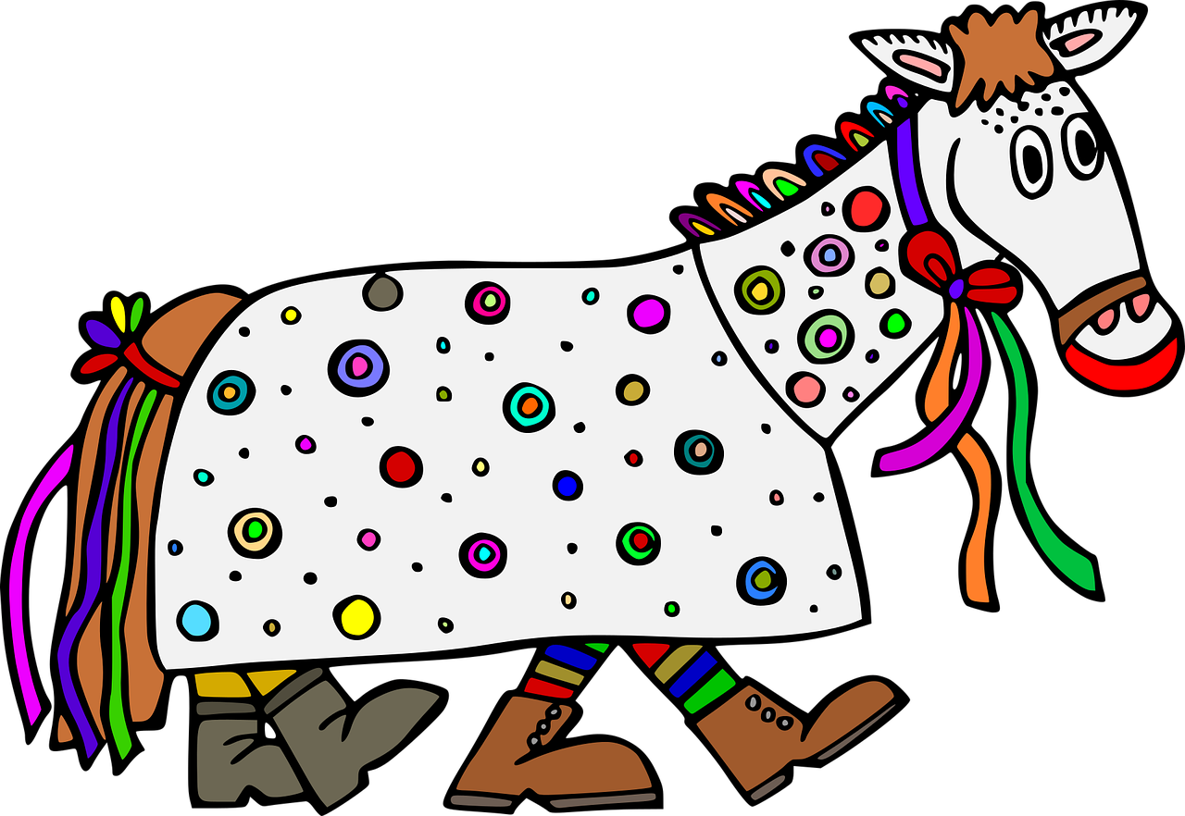
lesen
Lias ist auch da. Er textet Papa Lothar.
Wer macht was? Lias (ich) oder Ronja (sie)?
Ronja:
sie
Lias:
ich
 | ich.../sie...
1 | Ich höre viel Musik.
2 | Ich laufe durch die Straße.
3 | Sie spricht mit Karo. Sie ist Ronjas Freundin.
4 | Sie trinkt Kinderpunsch.* .
5 | Ich bin müde, aber ich schlafe später*!
6 | Es wird kalt und sie trägt meine Jacke!
1
2
3
4
der Kinderpunsch – children’s punch
5
später - later
6
Notes:
Timing: 6 minutes
Aim: to practise written comprehension of the first versus the third person singular verb endings.
Procedure:
Explain the scenario – Lias is also at the carnival parade with Leonie and Ronja. He is texting his dad.
Pupils read the items 1-6 and decide, based on the verb endings, whether Lias is talking about himself (ich) or about Ronja (sie).
Click to reveal the answers in turn.
Elicit English sentence meanings, orally.
Translations
I hear lots of music.
I am running through the street.
She is speaking with Karo. She is Ronja’s friend.
She is drinking children’s punch (a hot, sweet drink popular in the wintertime as an alcohol-free version of Glühwein/mulled wine)
I’m tired but I’ll sleep later! (Although this is the present tense, it is used to talk about the future, as is common in German)
It is getting cold and she is wearing my jacket!
9

Slide 10
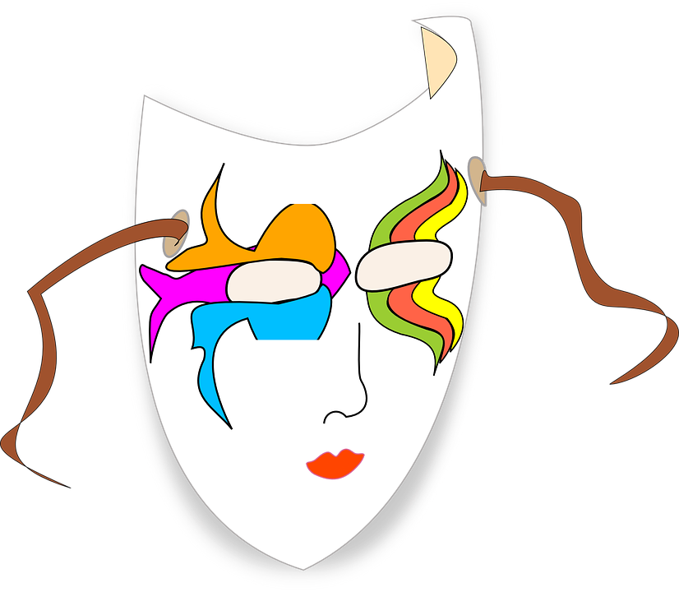
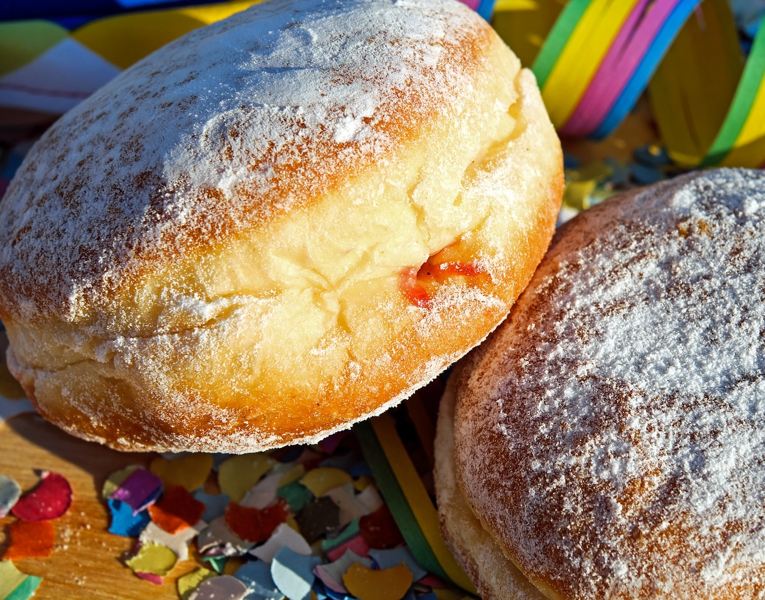
Kultur
Hör zu und sing mit!
Fasnacht, Fasching, Karneval
Fasnacht, Fasching, Karneval
Jetzt geht die Party los.
Bei Jung und Alt und überall
da ist die Freude groß.
Es wird gesungen und getanzt,
die Krapfen schmecken gut. Konfetti fliegen durch die Luft,
und landen auf ‘nem* Hut.
Konfetti fliegen durch die Luft, und landen auf ‘nem Hut.
Carnival, carnival, carnival
Now the party is starting
Young and old and everywhere
people are full of joy
There‘s singing and dancing,
the doughnuts taste good
Confetti flies through the air
and lands on a hat
Confetti flies through the air
and lands on a hat
‘nem = einem - a
Notes:
Timing: 5 minutes
Link to Youtube video: https://youtu.be/qxOjweHEh7o?feature=shared (linked on the slide if you click on the mask)
Aim: to present some cultural information about carnival and have fun by joining in with a song and dance.
Procedure:
Explain that although Fasnacht is what carnival is called in Switzerland, Austria and southern Germany, carnival is also called Karneval and Fasching in other areas of Germany.
If desired, go over the first stanza of the song on the slide, reading it out or playing the recording. Explain that doughnuts are another common carnival food. Can they find the word for doughnuts in the song? (Krapfen). Point out the ‘nem is a shortened version of einem so just means ‘a’. If time, ask pupils if they can see any words that look the same in German as they do in English, or any words that look similar (e.g. Karneval - carnival, Party - party, Jung - young, Konfetti – confetti, landen – to land, Hut – hat)
Play the Youtube video via the link in these underslide notes or by clicking on the mask, pupils join in with the words and actions.
Note: The full lyrics are in the Youtube notes if you click ‘Show more’.
Approximate/creative translation of first stanza:
Carnival, carnival, carnival
Now the party is starting
Young and old and everywhere
people are full of joy
There‘s singing and dancing,
the doughnuts taste good
Confetti flies through the air
and lands on a hat
Confetti flies through the air
and lands on a hat
Note Ingrid Hofer has a number of other songs in German on her YouTube channel with easy actions for children to follow along. You can return to these if you would like pupils to have a few minutes of movement during German (or other!) lessons. https://www.youtube.com/@ingrid.hofer.artist Songs with actions are a good way of learning and consolidating vocabulary.
10

Slide 11
Tschüss!
grün
Notes:
11

