Slide 1
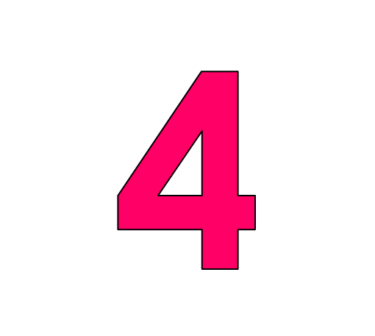
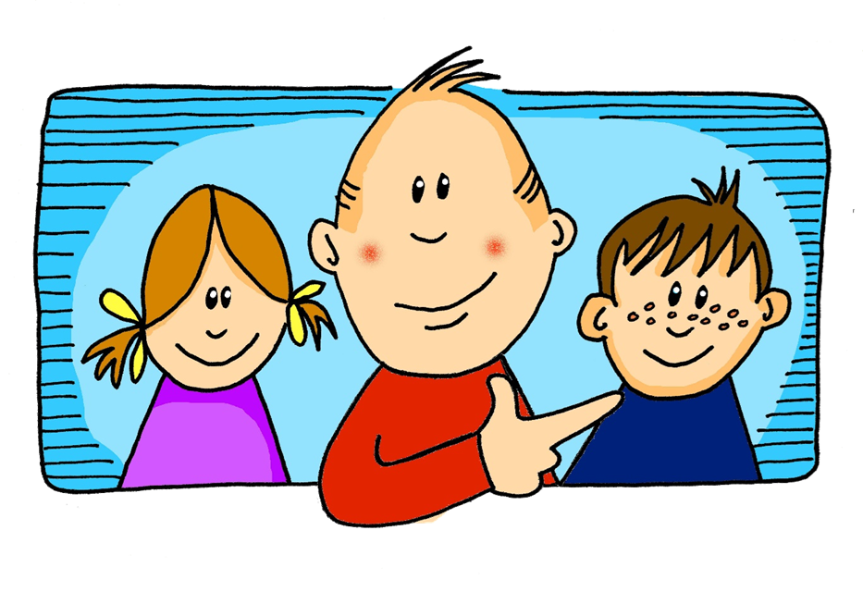
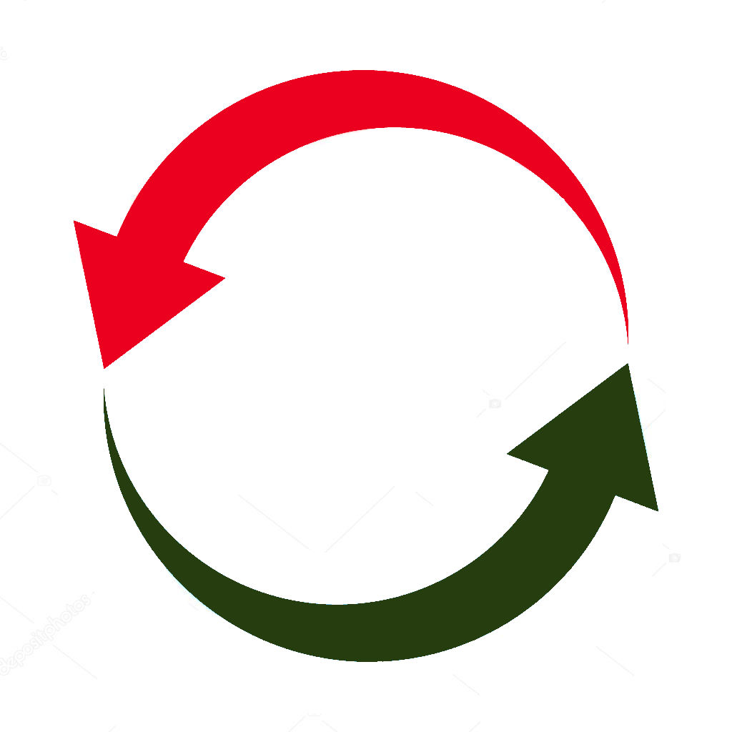
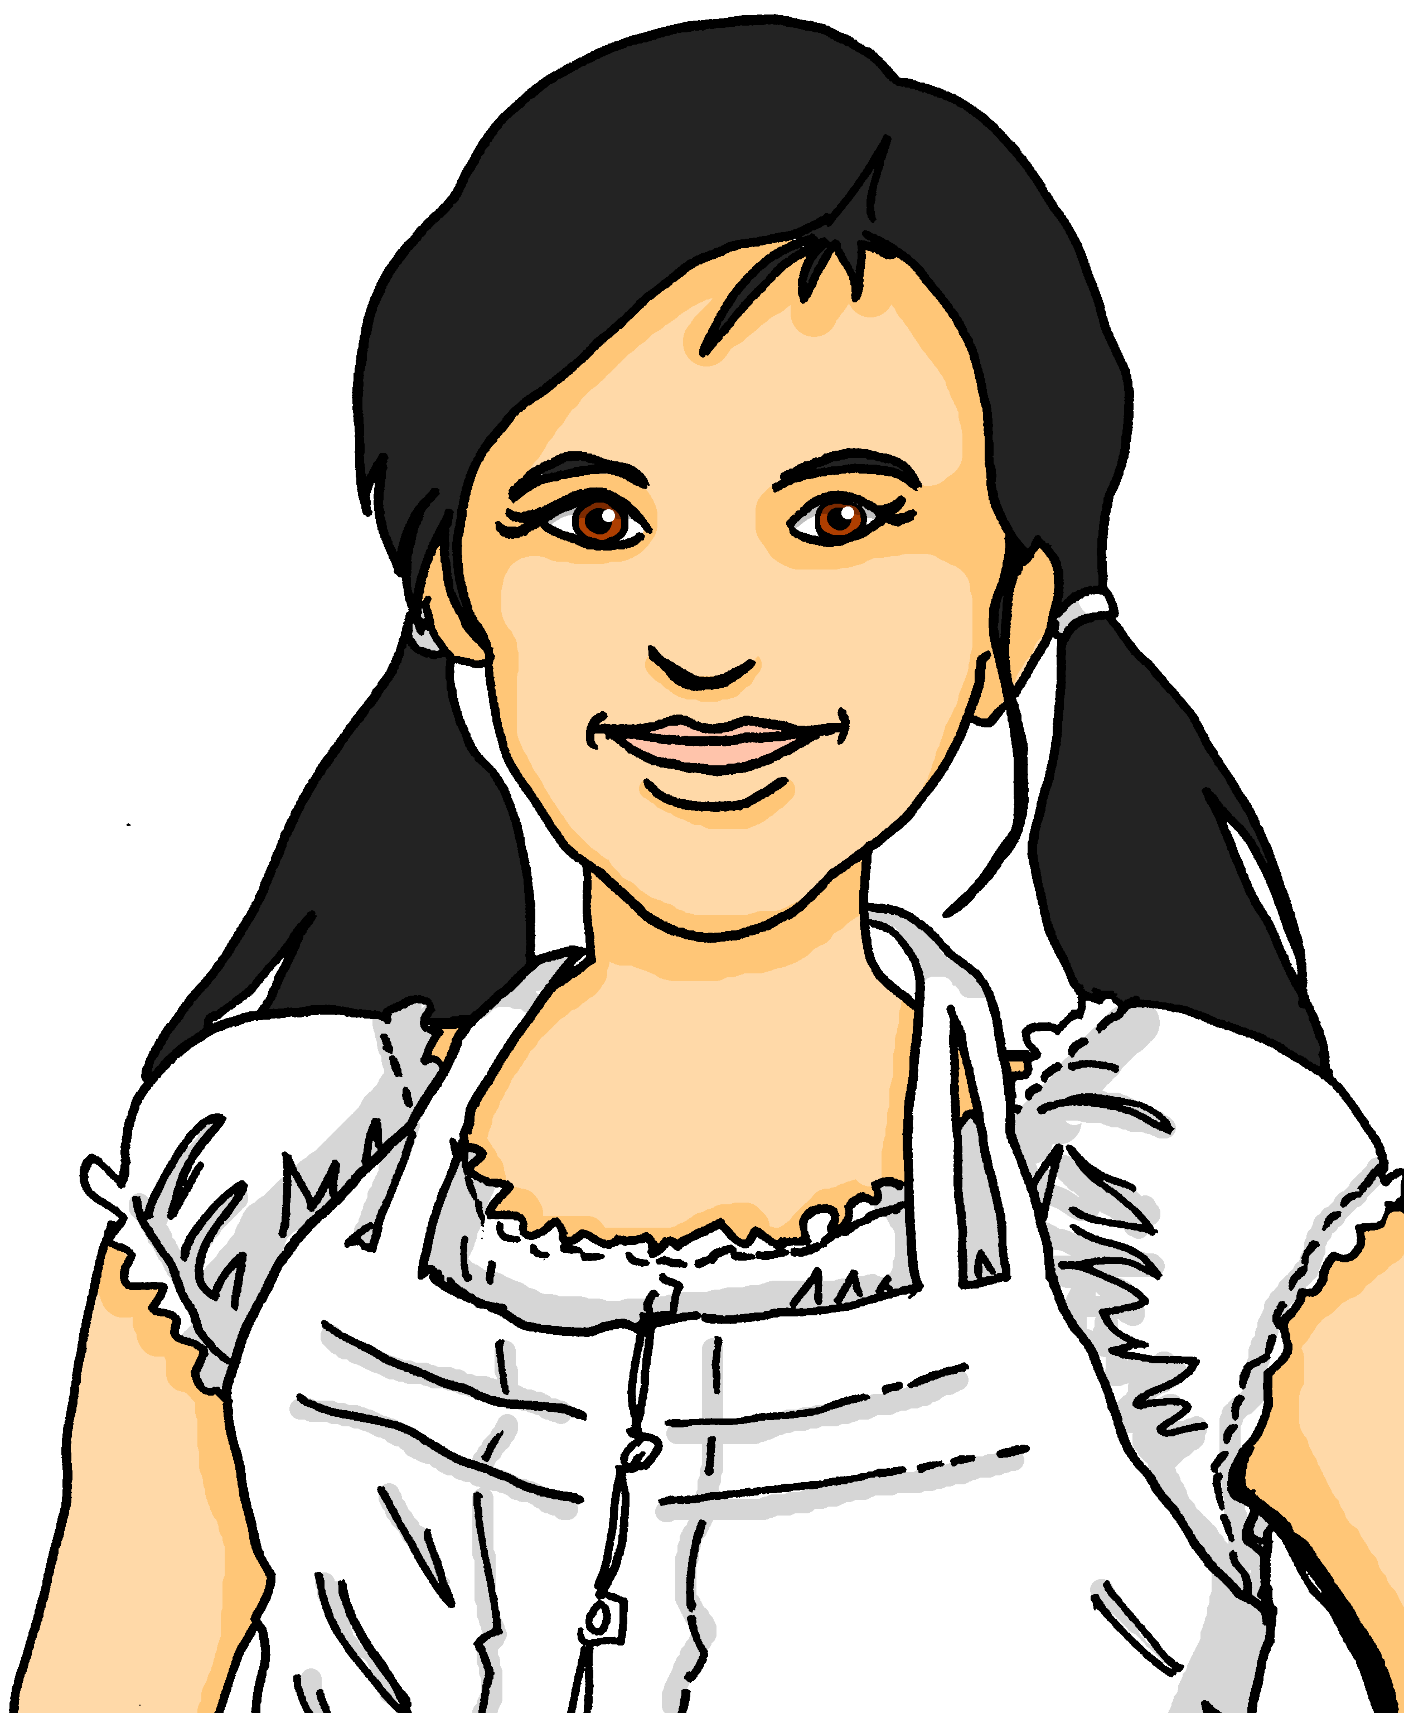
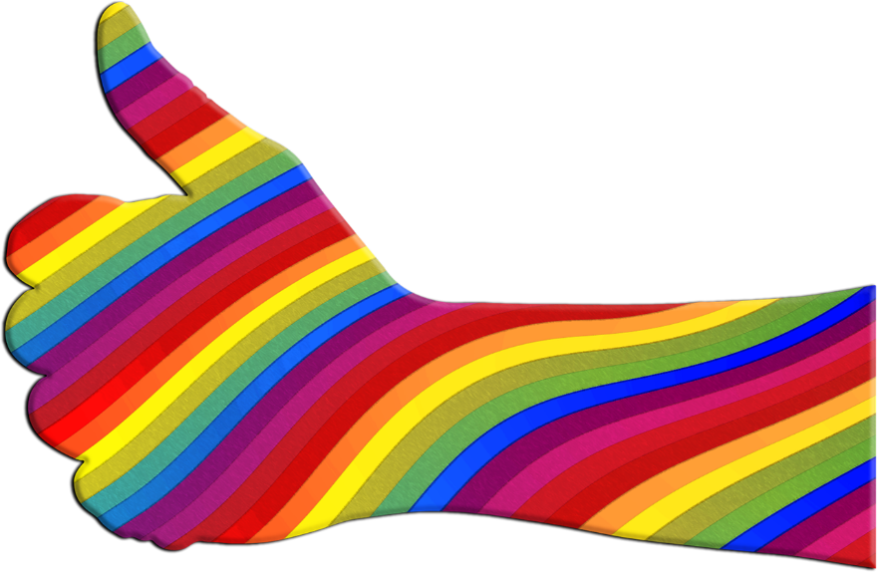
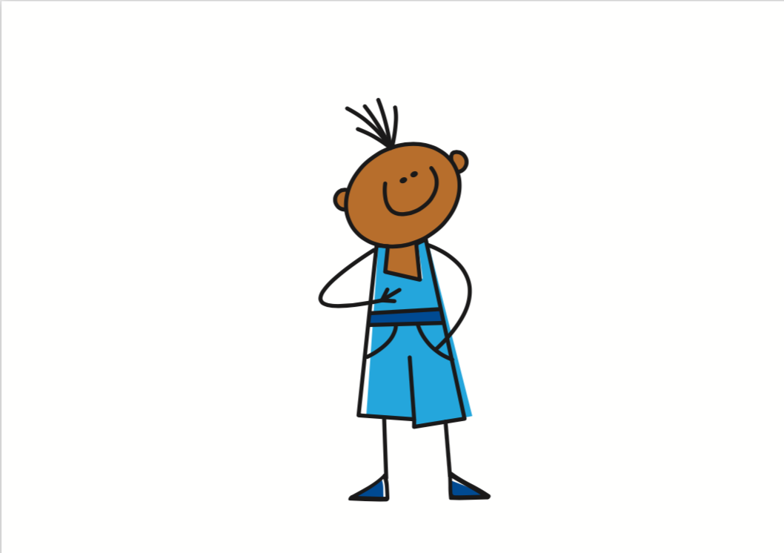
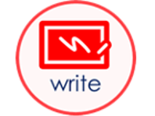
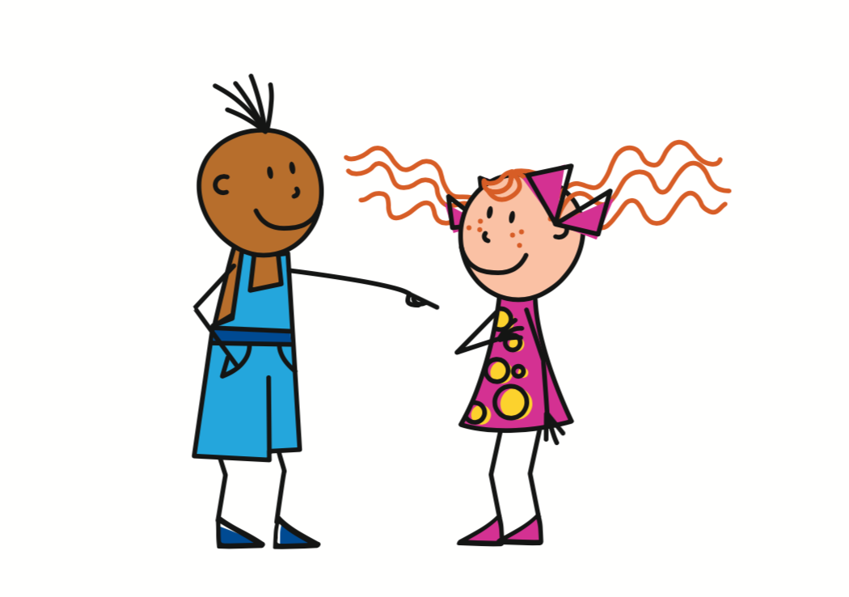
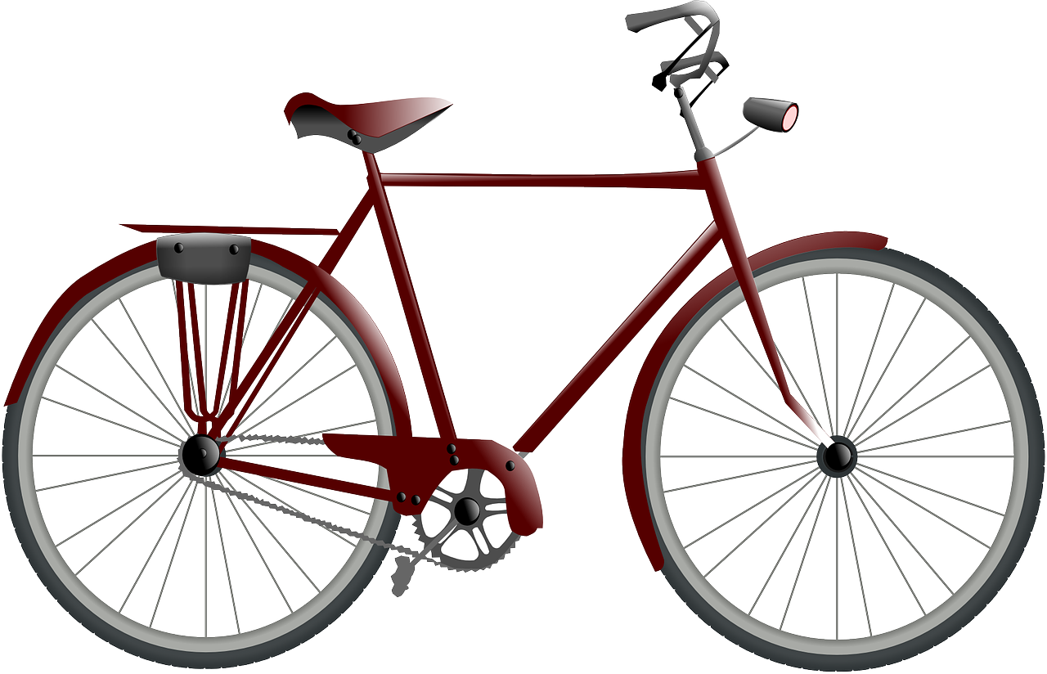
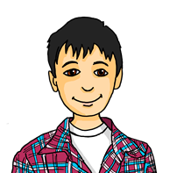
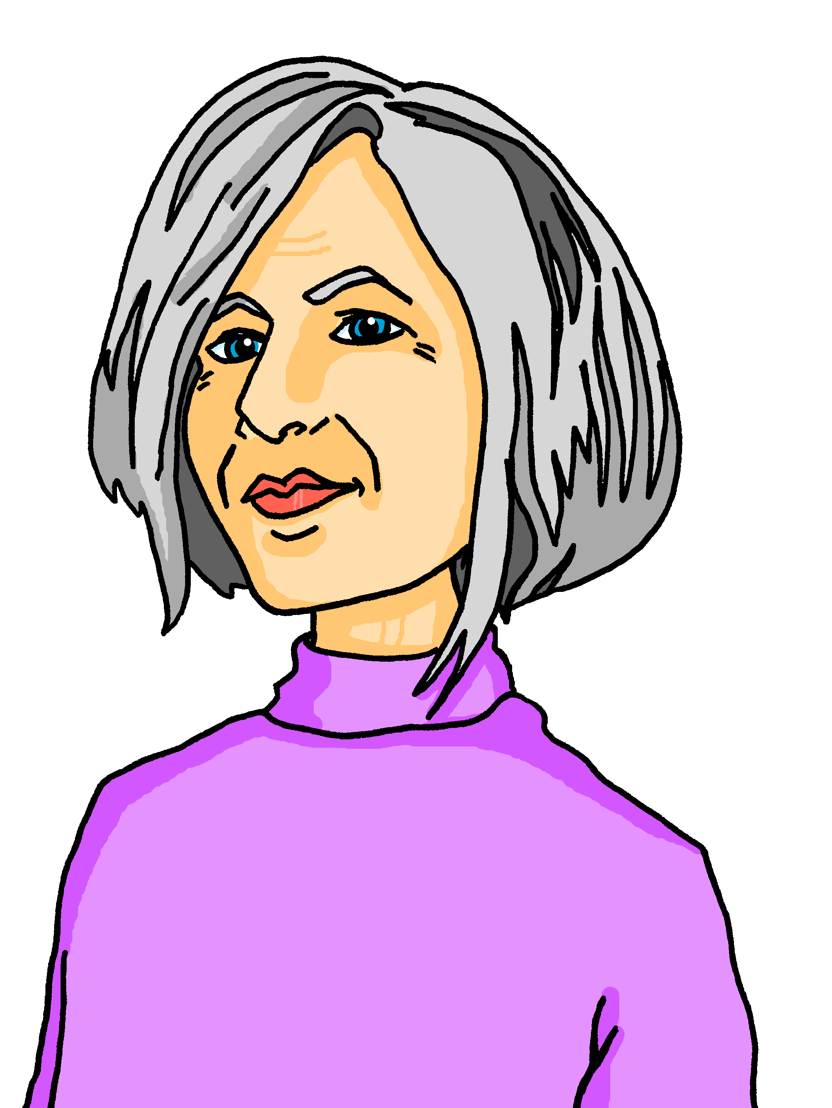
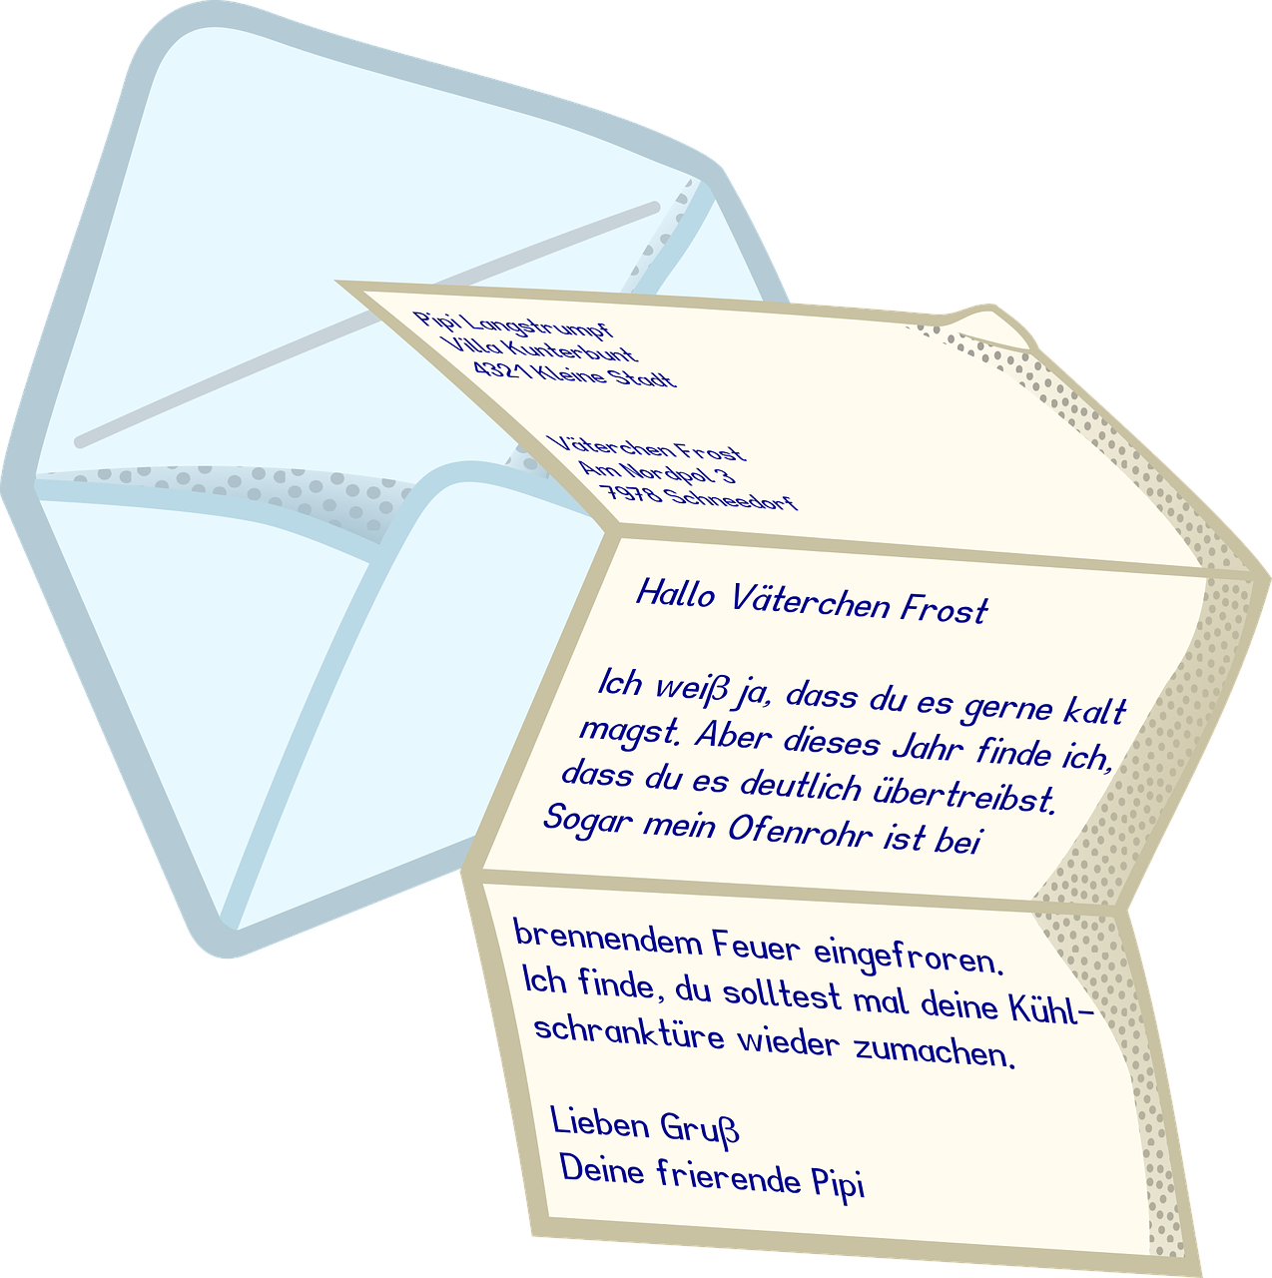
gelb Knowledge Organiser - Summer Term A
Monate
Januar – January
Februar - February
März – March
April – April
Mai – May
Juni – June
Juli – July
August – August
September – September
Oktober – October
November – November
Dezember – December
Tage
Montag – Monday
Dienstag – Tuesday
Mittwoch – Wednesday
Donnerstag – Thursday
Freitag – Friday
Samstag – Saturday
Sonntag – Sunday
Things and people
der Grund – reason (m)
der Monat – month (m)
der Plan – plan (m)
der Tag – day (m)
die Gitarre – guitar (f)
die Oma – Grandma (f)
die Woche – week (f)
Useful words
arbeiten – to work, working
besuchen – to visit, visiting
bleiben – to stay, staying
heute – today
morgen – tomorrow
wann? – when?
mit – with
Phonics
 | [v] | [w] | consonantal [r] | vocalic [r]
…
vier
Welt
rot
Ort
stressed [er] | unstressed [er] | [-ig]
er
Many German-speaking children learn which months have 31 days by using their knuckles!
wieder
richtig
Mai (31)
März (31)
April
Juni
Oktober (31)
Februar
Juli (31)
September
November
Januar (31)
August (31)
Dezember (31)
Present tense German has one present tense, but English has two: Ich schreibe einen Grund. I write a reason. I am writing a reason. | Time adverbs The time adverb suggests which English present tense to use: Ich arbeite montags mit Lias. I work with Lias on Mondays. Du arbeitest heute mit Lias. You are working with Lias today. | Word order In German the time adverb often comes straight after the verb.
Nicht + verb We use nicht after a verb to say what we don’t do: | Nicht + verb/noun phrases When nicht negates a whole phrase, it goes to the end of the phrase: | Wann questions
Du benutzt donnerstags das Fahrrad.
In English, the time adverb often comes at the end of the sentence.
Grüezi, Oma!
You use the bike on Thursdays.
Guten Tag, Lias!
Ich spreche* Schweizerdeutsch zu Hause!
Use wann to ask when:
Wann besucht Oma die Schweiz?
Ich arbeite nicht.
Ich schreibe den Brief nicht.
When is Grandma visiting Switzerland?
Aber ich spreche* Hochdeutsch!
*sprechen – to speak
Oma besucht im Juni die Schweiz.
I don’t work.
I don’t write the letter.
In Switzerland, people often speak Swiss German (Schweizerdeutsch) at home. In Germany, people normally speak Standard German (Hochdeutsch).
Swiss people understand Standard German, though, because they use it for reading and writing.
Grandma is visiting Switzerland in June.
Note the word order difference between English and German!
Again, note the word order difference between English and German!
Use im for ‘in’ with months.

Slide 2
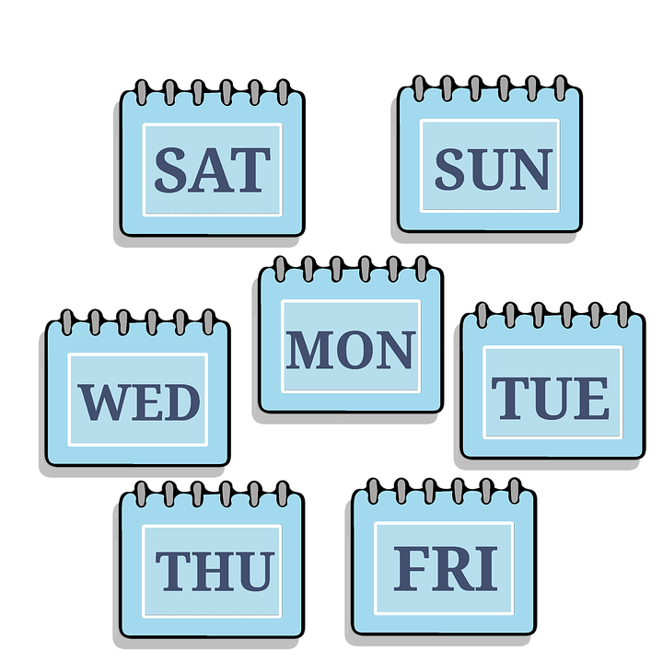
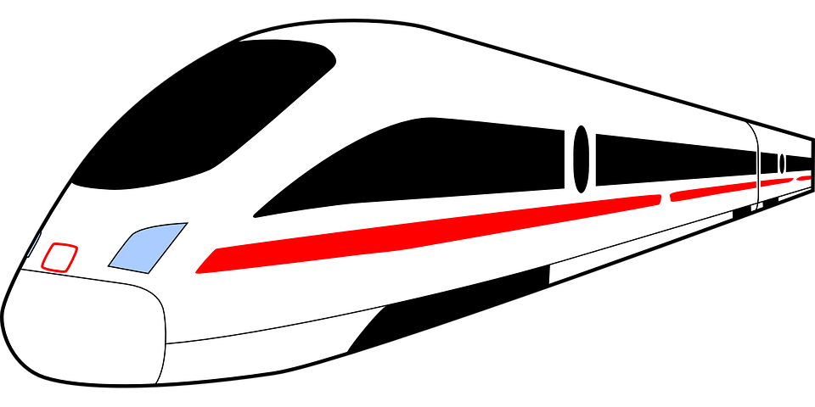
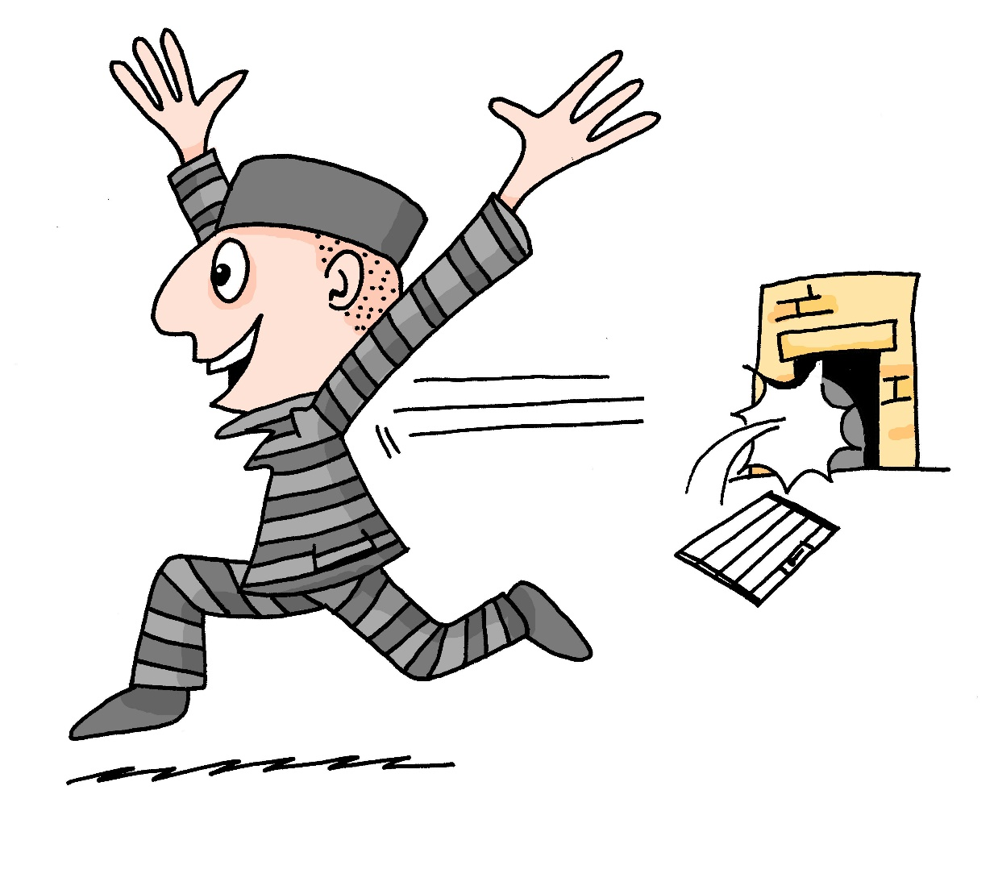
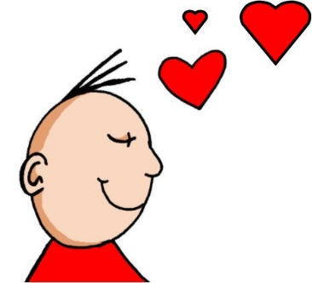
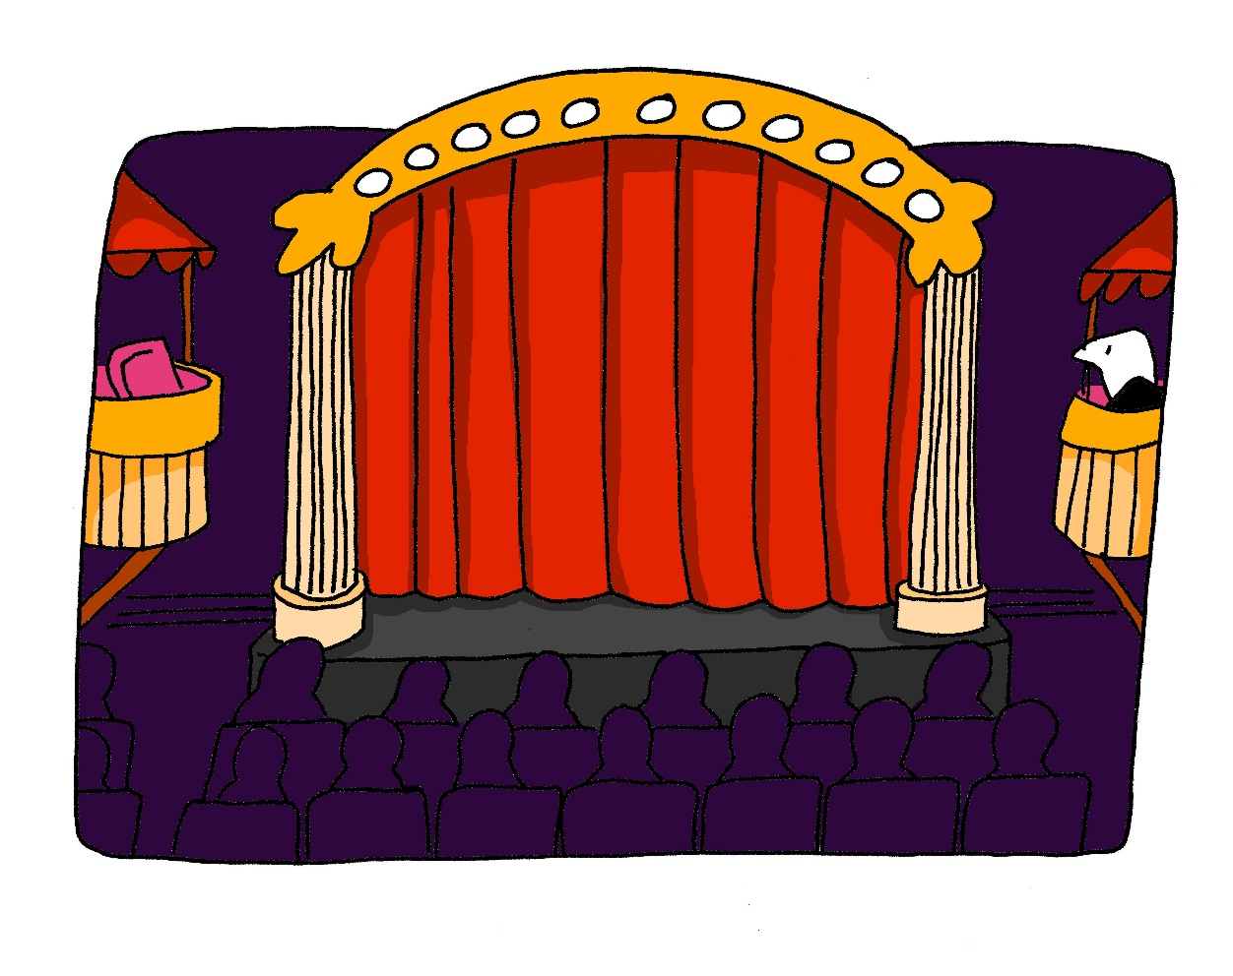
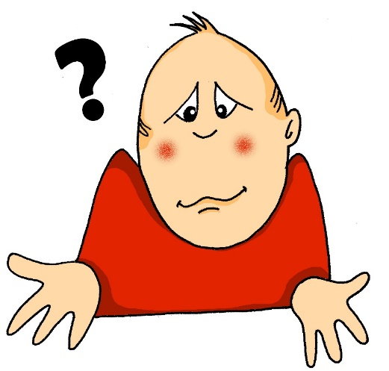
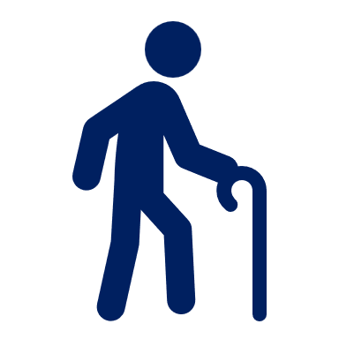
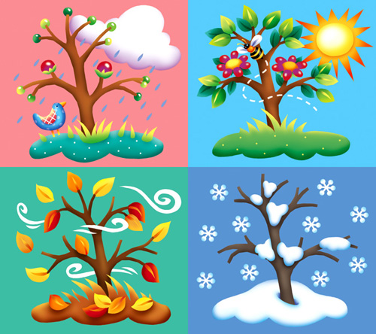
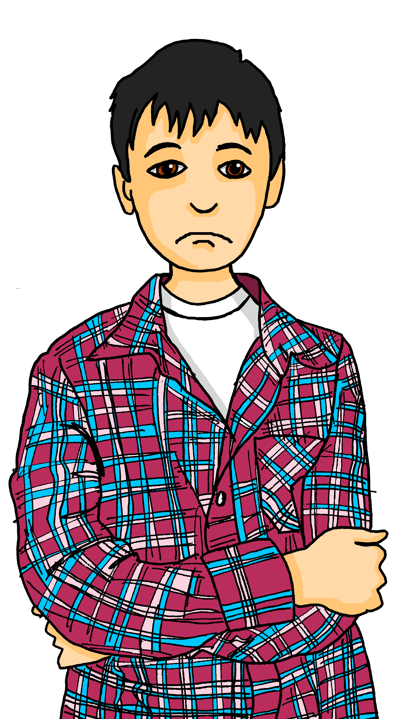
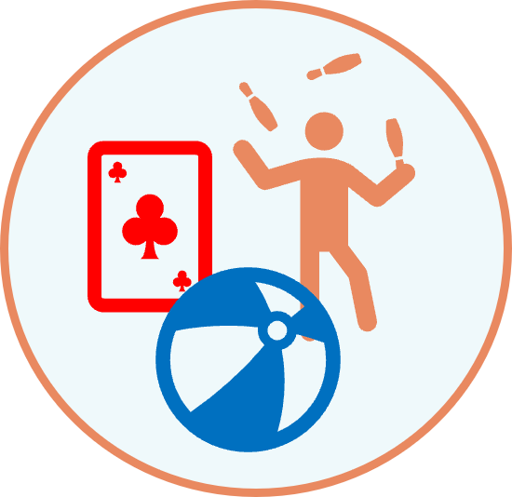
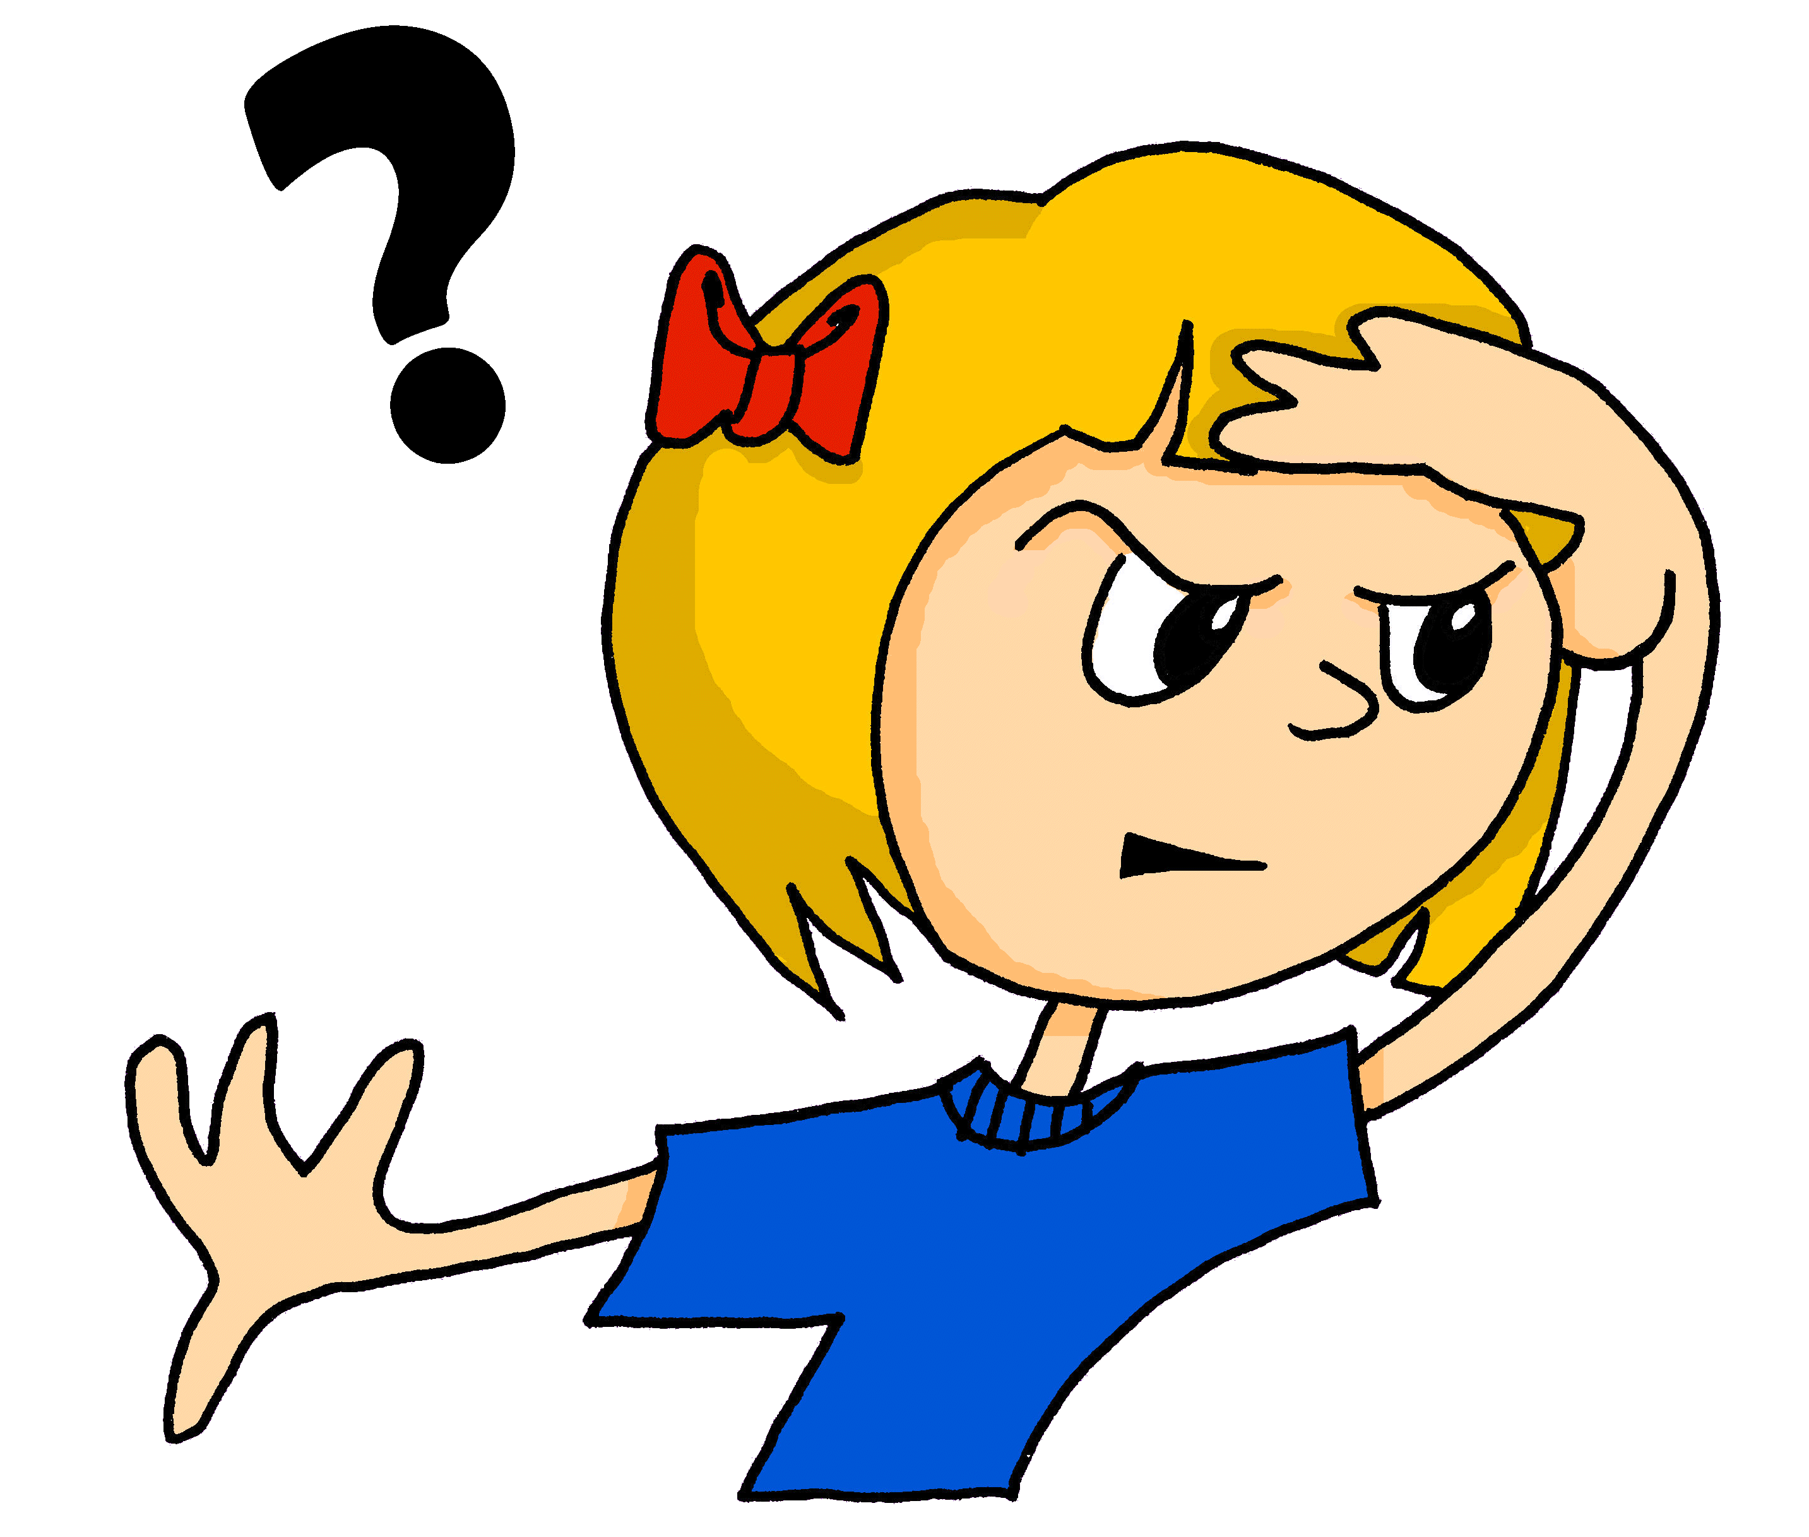
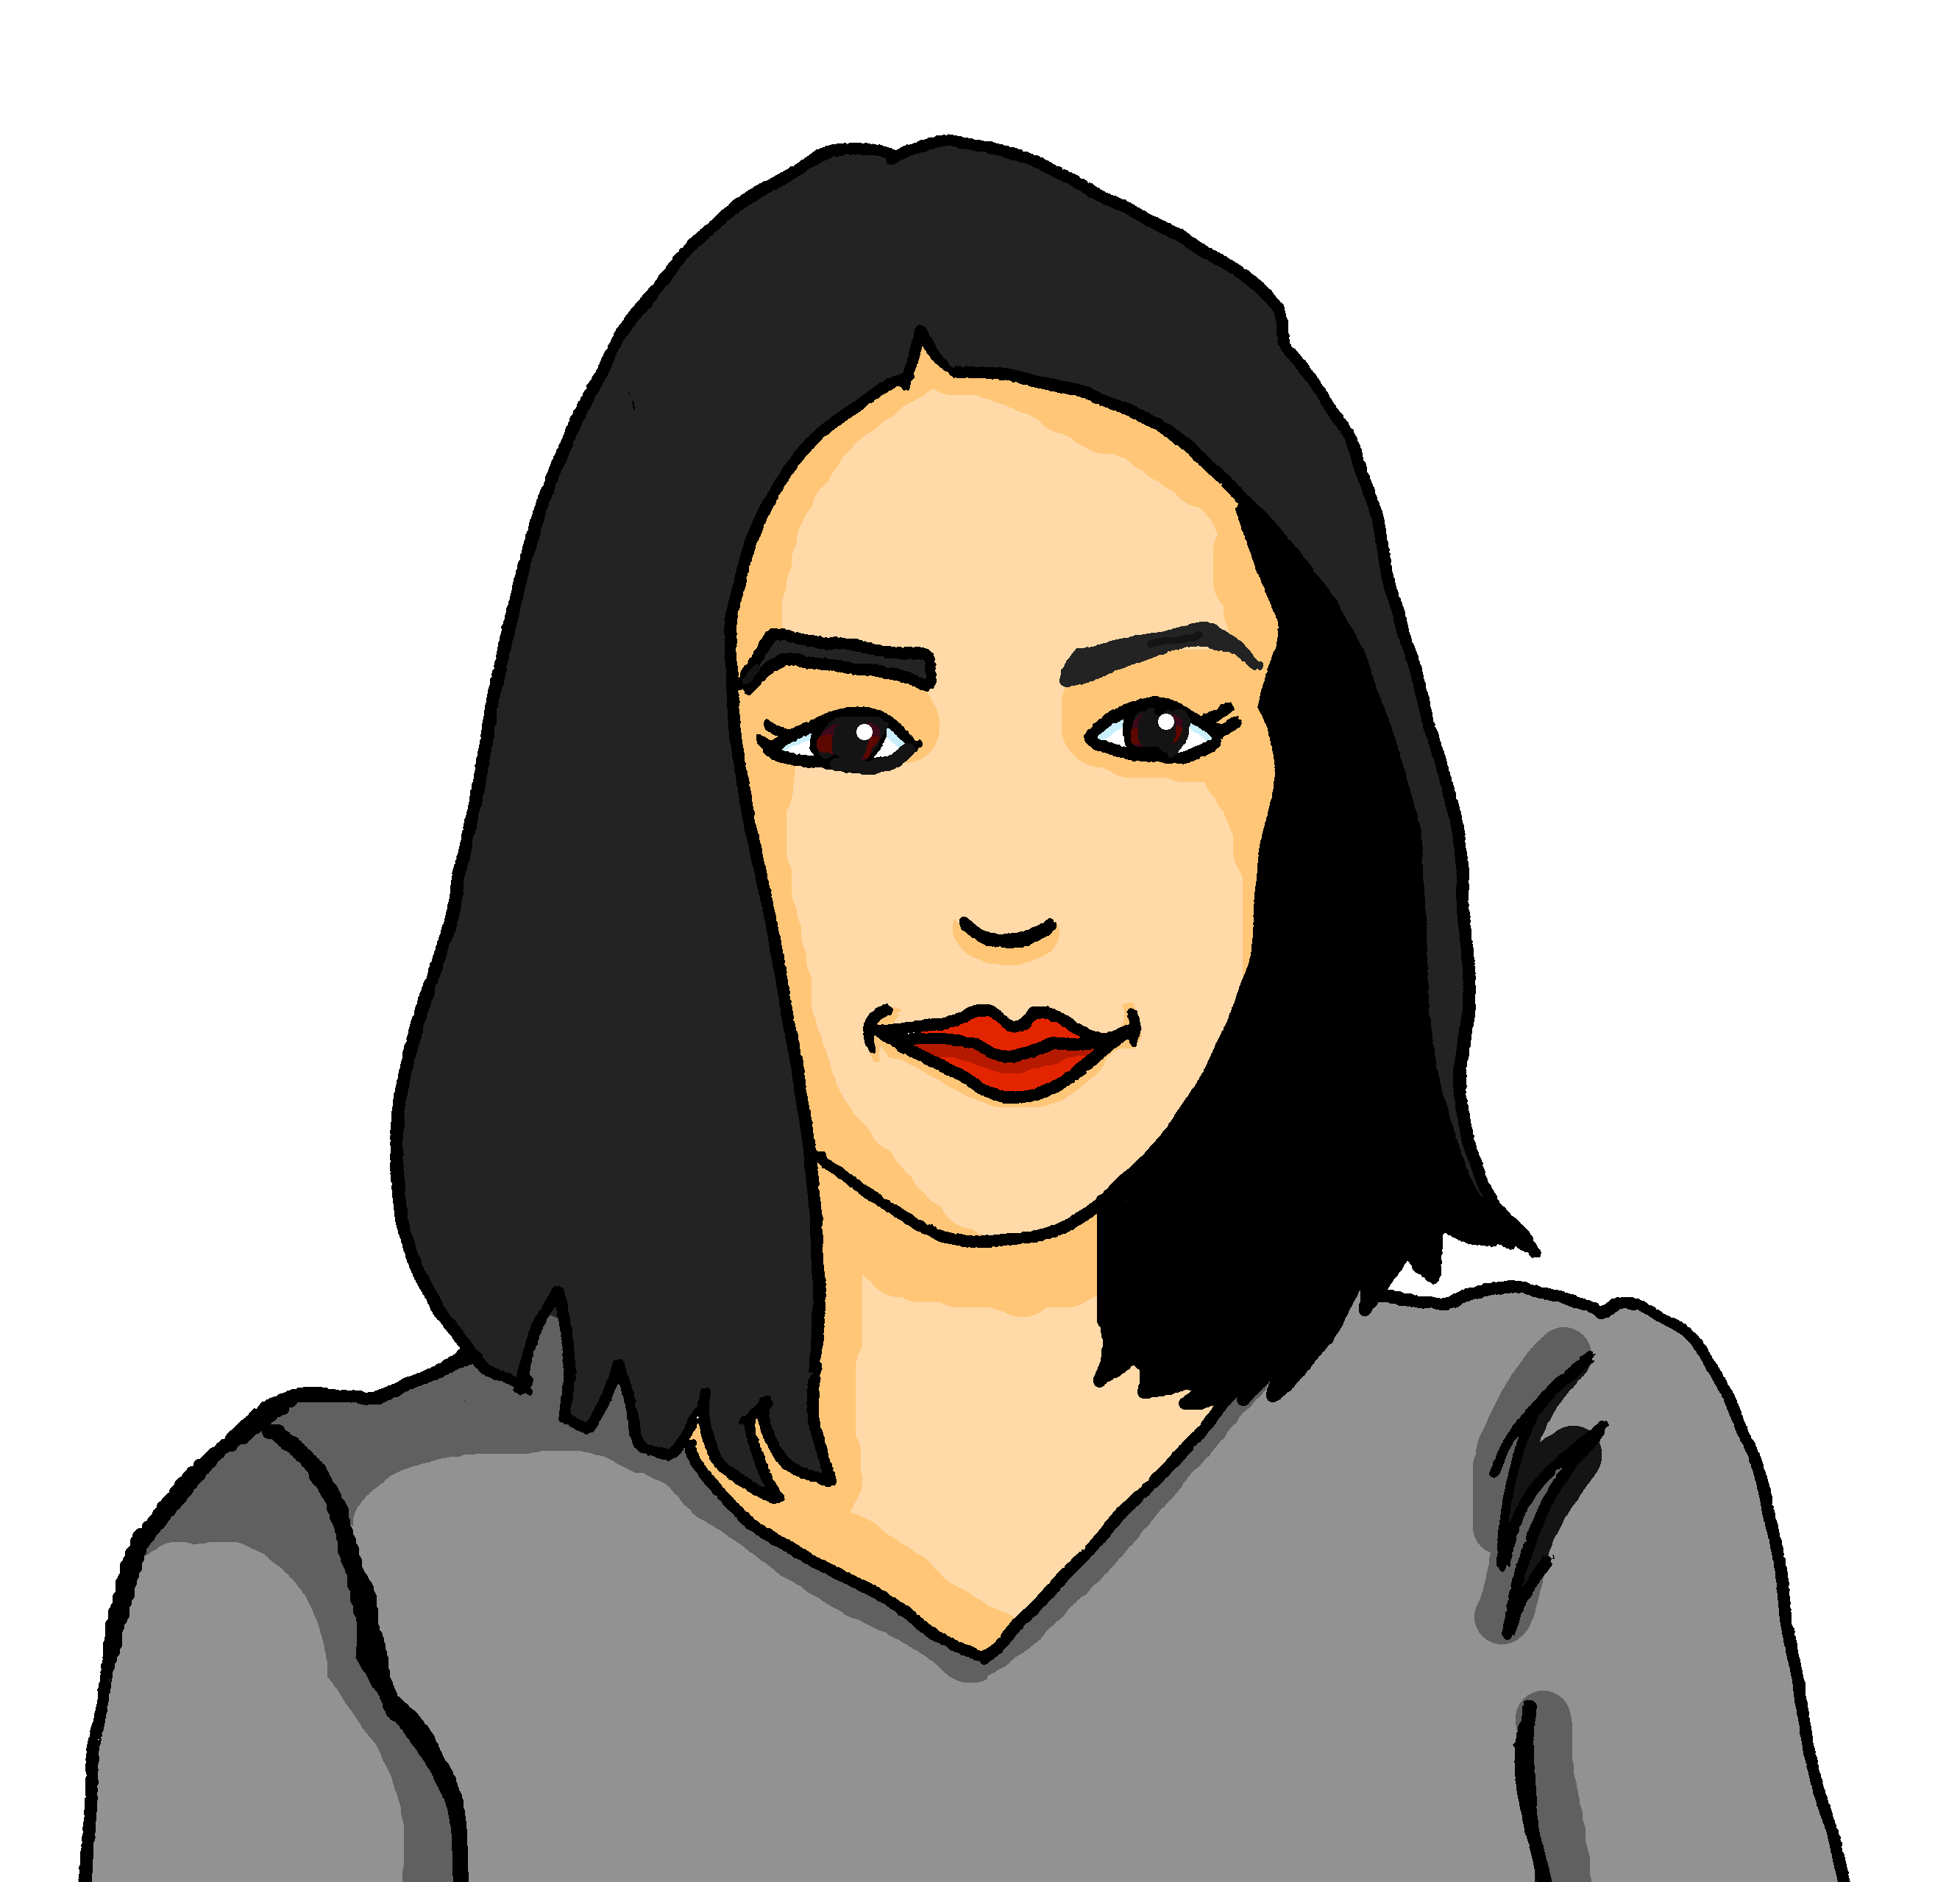
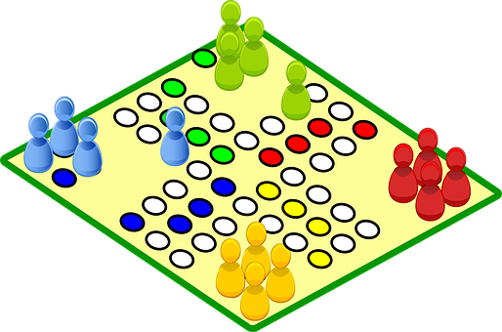
gelb Knowledge Organiser - Summer Term B
More useful words
fahren – to go, going (transport)
heißen – to be called
möcht- – would like
ich möchte – I would like
du möchtest – you would like
er möchte – he would like
sie möchte – she would like
es möchte – it would like
wohnen – to live, living
People and things
der Opa – grandad (m)
der Vater – father (m)
die Familie – family (f)
die Minute – minute (f)
die Mutter – mother (f)
die Stunde – hour (f)
das Jahr – year (n)
Describing things
ihr - her
sein - his
jung – young
lieb – kind, dear
müde – tired
ruhig – quiet, calm
Phonics
[-g] | [-d] | [-b] | [-tion] | [z]
Tag
and
gelb
Information
und
Zug
[ei] | [ie] | [th]
frei
Liebe
Theater
To ask someone how old they are in German say ‘wie alt bist du?’
To say how old you are in German say ‘ich bin xxx Jahre alt’
Ich bin vier Jahre alt.
I am four years old.
Saying what you woud like to do with möcht- | Using möcht- To say what you would like to do use the verb möcht- and a 2nd verb in the infinitive form. Ich möchte fahren. I would like to go. The 2nd verb always goes to the end of the sentence: Ich möchte in die Schweiz fahren. I would like to go to Switzerland. | Möcht- and yes/ no questions We can swap the subject and verb to ask a question. We do the same with möcht-.
ich möchte
Du möchtest fahren.
You would like to go.
es möchte
du möchtest
In Switzerland, children have 12 weeks’ holiday a year. That’s one week less than you!
The summer holidays start in early July, and children are back to school by mid August!
möcht-
Note that the verb möchtest swaps with the subject du.
Möchtest du fahren?
Would you like to go?
sie möchte
er möchte
In Biel, people speak German and French. We can see this in some of our characters’ names.
Möcht- and information questions We also swap the subject and verb with information questions. | Möcht-, nicht, kein To say what you wouldn’t like to do use nicht before the 2nd verb. | Possessive adjectives sein|ihr To say ‘his’ use sein or seine. To say ‘her’ use ihr or ihre:
Ich heiße Gabriel. Mein Name ist französisch*.
Ich möchte im Juli Oma besuchen.
Er möchte nicht spielen.
masculine
feminine
neuter
Ich heiße Ronja. Mein Name ist deutsch.
He wouldn’t like to play.
ihr
ihre
ihr
Wo möchtest du spielen?
sein
seine
sein
But remember that to negate nouns you need kein instead:
The words ‘sein’ (his) and ‘ihr’ (her) must agree with the gender of the noun that follows. E.g.:
Ich möchte nicht im August in die Schule gehen*.
Ich heiße Lias. Mein Name ist deutsch.
Where would you like to play?
Er möchte kein Spiel spielen.
He wouldn’t like to play a game.
ihre Mutter (f)
* Französisch - French
her mother

