Slide 1
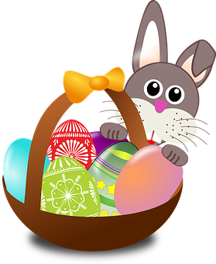
Talking about things and things to do
gelb
Phonics quiz
Easter activities
Term 2 Week 11
Notes:
Word frequency (1 is the most frequent word in German):
Jones, R.L & Tschirner, E. (2019). A frequency dictionary of German: Core vocabulary for learners. London: Routledge.
The frequency rankings for words that occur in this PowerPoint which have been previously introduced in these resources are given in the SOW and in the resources that first introduced and formally re-visited those words. For any other words that occur incidentally in this PowerPoint, frequency rankings will be provided in the notes field wherever possible.
1

Slide 2
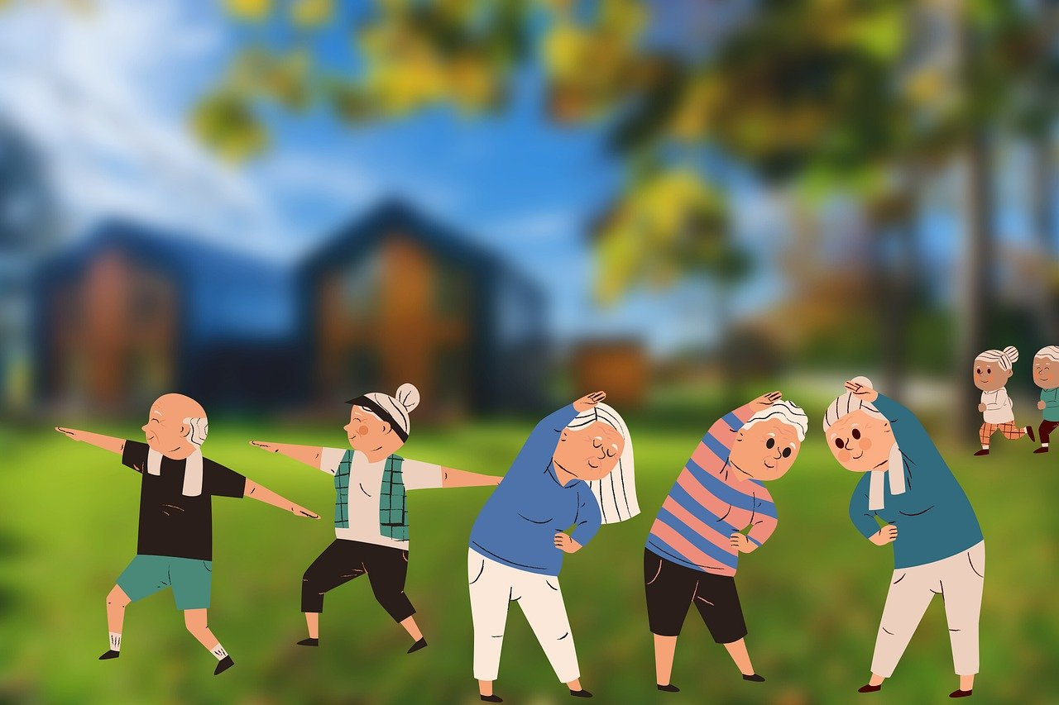
long [ä]
long [ü]
aussprechen
aussprechen
Aktivität
süden
Notes:
Phonics quiz
Timing: flexible during Week 11 Procedure:
Print out one set of these 14 phonics cards.
Working with one pupil at a time, elicit the pronunciation of each word.
Say: You have not learnt these words, but you have learnt how to read aloud these sounds, so just have a go at reading each word aloud.
Focus only on the accurate pronunciation of the target SSC and tolerate any other inaccuracies.
Use the pupil scoring sheet at the end of this presentation to assess SSC knowledge and give feedback.
Note: Whilst working with individual children, others can be doing the Easter activities at the end of this presentation.
2

Slide 3
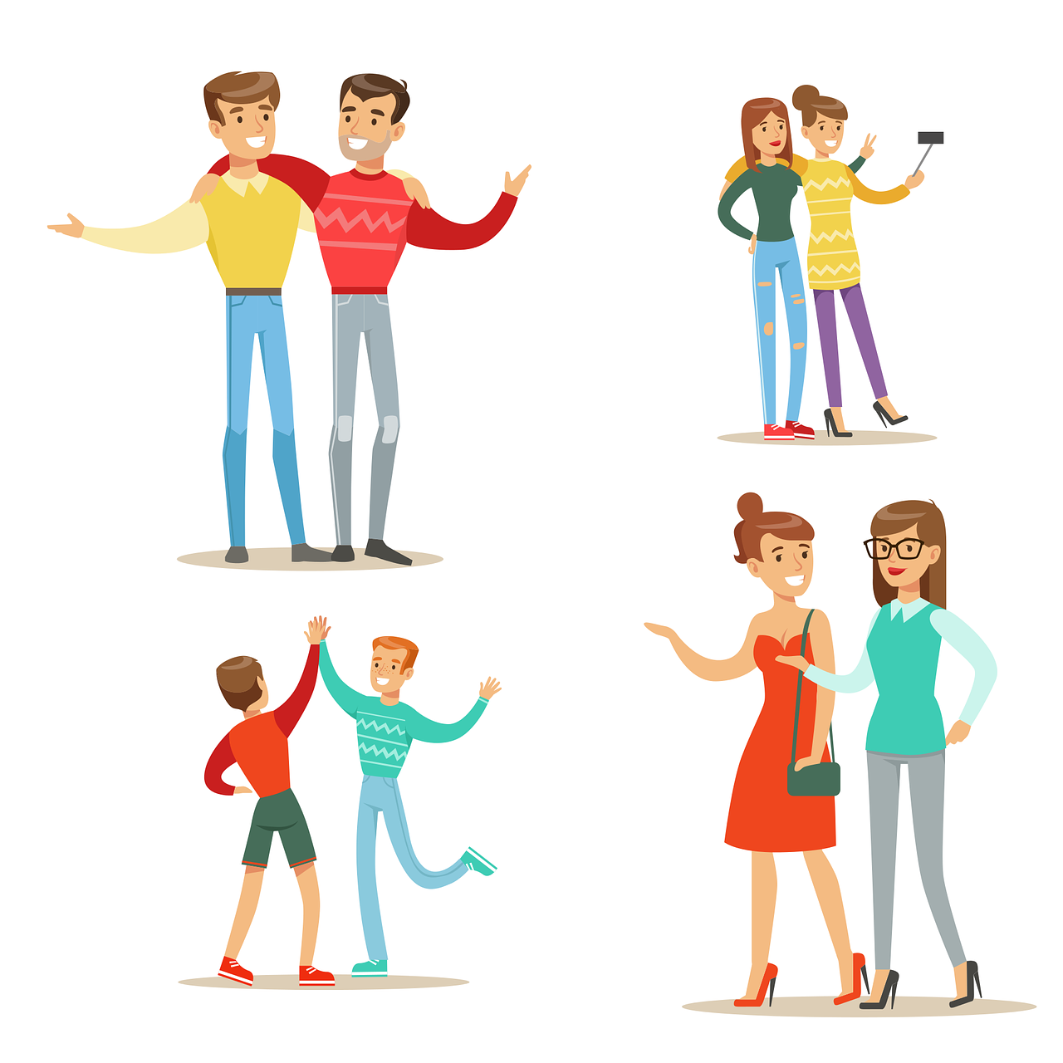
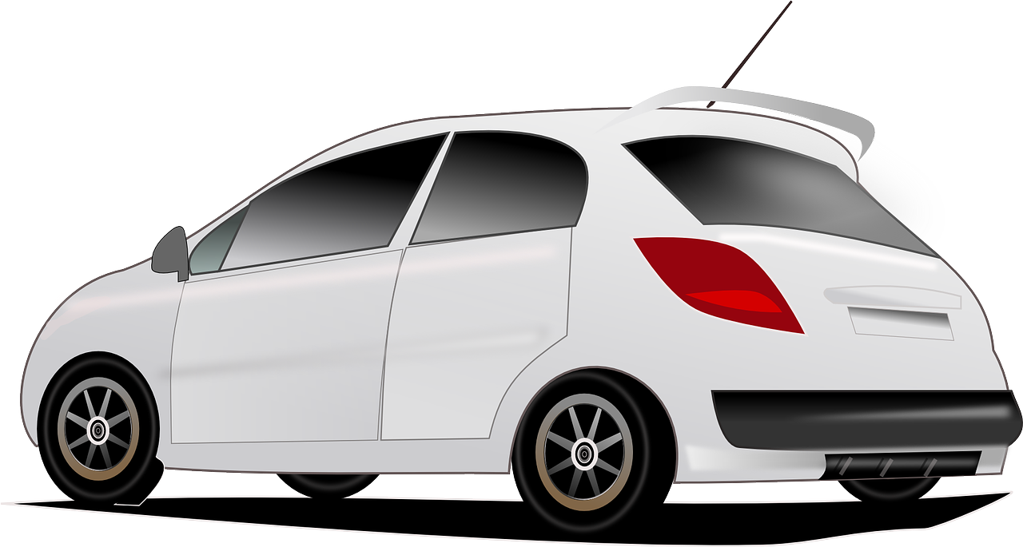
[au]
[eu]
aussprechen
aussprechen
Auto
Leute
Notes:
Phonics quiz
Timing: flexible during Week 11 Procedure:
Print out one set of these 14 phonics cards.
Working with one pupil at a time, elicit the pronunciation of each word.
Say: You have not learnt these words, but you have learnt how to read aloud these sounds, so just have a go at reading each word aloud.
Focus only on the accurate pronunciation of the target SSC and tolerate any other inaccuracies.
Use the pupil scoring sheet at the end of this presentation to assess SSC knowledge and give feedback.
Note: Whilst working with individual children, others can be doing the Easter activities at the end of this presentation.
3

Slide 4
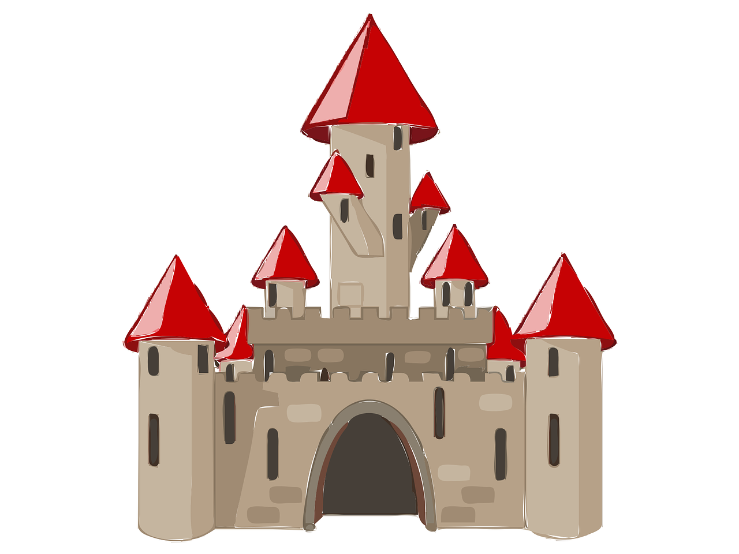
[äu]
[sch]
aussprechen
aussprechen
häufig
Schloss
Notes:
Phonics quiz
Timing: flexible during Week 11 Procedure:
Print out one set of these 14 phonics cards.
Working with one pupil at a time, elicit the pronunciation of each word.
Say: You have not learnt these words, but you have learnt how to read aloud these sounds, so just have a go at reading each word aloud.
Focus only on the accurate pronunciation of the target SSC and tolerate any other inaccuracies.
Use the pupil scoring sheet at the end of this presentation to assess SSC knowledge and give feedback.
Note: Whilst working with individual children, others can be doing the Easter activities at the end of this presentation.
4

Slide 5
[st]
[s-]
aussprechen
aussprechen
Stoff
Rucksack
Notes:
Phonics quiz
Timing: flexible during Week 11 Procedure:
Print out one set of these 14 phonics cards.
Working with one pupil at a time, elicit the pronunciation of each word.
Say: You have not learnt these words, but you have learnt how to read aloud these sounds, so just have a go at reading each word aloud.
Focus only on the accurate pronunciation of the target SSC and tolerate any other inaccuracies.
Use the pupil scoring sheet at the end of this presentation to assess SSC knowledge and give feedback.
Note: Whilst working with individual children, others can be doing the Easter activities at the end of this presentation.
5

Slide 6
[ss]
hard [ch]
aussprechen
aussprechen
Klasse
Nacht
Notes:
Phonics quiz
Timing: flexible during Week 11 Procedure:
Print out one set of these 14 phonics cards.
Working with one pupil at a time, elicit the pronunciation of each word.
Say: You have not learnt these words, but you have learnt how to read aloud these sounds, so just have a go at reading each word aloud.
Focus only on the accurate pronunciation of the target SSC and tolerate any other inaccuracies.
Use the pupil scoring sheet at the end of this presentation to assess SSC knowledge and give feedback.
Note: Whilst working with individual children, others can be doing the Easter activities at the end of this presentation.
6

Slide 7
long [a]
short [u]
aussprechen
aussprechen
fahren
Grund
Notes:
Phonics quiz
Timing: flexible during Week 11 Procedure:
Print out one set of these 14 phonics cards.
Working with one pupil at a time, elicit the pronunciation of each word.
Say: You have not learnt these words, but you have learnt how to read aloud these sounds, so just have a go at reading each word aloud.
Focus only on the accurate pronunciation of the target SSC and tolerate any other inaccuracies.
Use the pupil scoring sheet at the end of this presentation to assess SSC knowledge and give feedback.
Note: Whilst working with individual children, others can be doing the Easter activities at the end of this presentation.
7

Slide 8
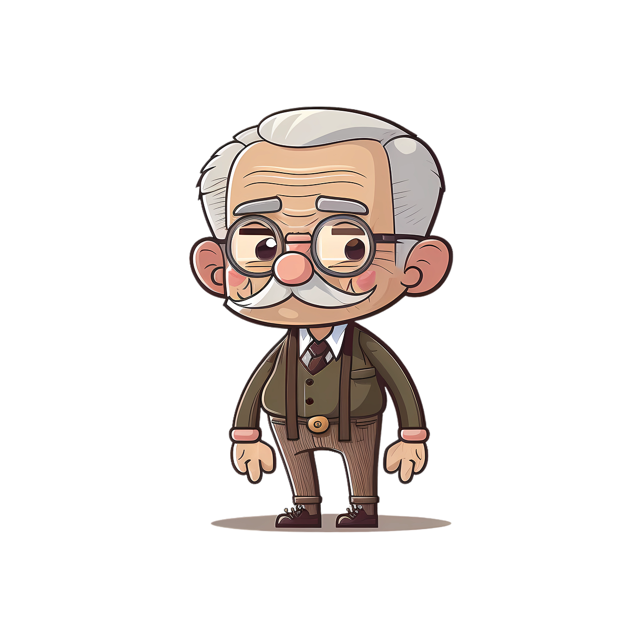
long [o]
short [e]
aussprechen
aussprechen
Opa
Fest
Notes:
Phonics quiz
Timing: flexible during Week 11 Procedure:
Print out one set of these 14 phonics cards.
Working with one pupil at a time, elicit the pronunciation of each word.
Say: You have not learnt these words, but you have learnt how to read aloud these sounds, so just have a go at reading each word aloud.
Focus only on the accurate pronunciation of the target SSC and tolerate any other inaccuracies.
Use the pupil scoring sheet at the end of this presentation to assess SSC knowledge and give feedback.
Note: Whilst working with individual children, others can be doing the Easter activities at the end of this presentation.
8

Slide 9
Pupil name:
Pupil name:
SSC and word | px
Aktivität
süden
Auto
Leute
häufig
Schloss
Stoff
Rucksack
Klasse
Nacht
fahren
Grund
Opa
Fest
SSC and word | px
Aktivität
süden
Auto
Leute
häufig
Schloss
Stoff
Rucksack
Klasse
Nacht
fahren
Grund
Opa
Fest
Notes:
Pupil feedback and assessment sheet
9

Slide 10
Teacher audio version
SSC and word | px
Aktivität
süden
Auto
Leute
häufig
Schloss
Stoff
SSC and word | px
Rucksack
Klasse
Nacht
fahren
Grund
Opa
Fest
Notes:
Teacher audio version for preparation
10

Slide 11
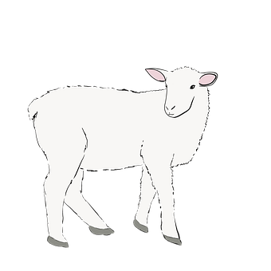
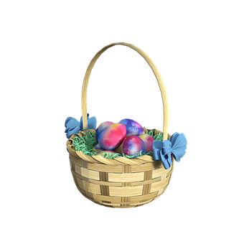
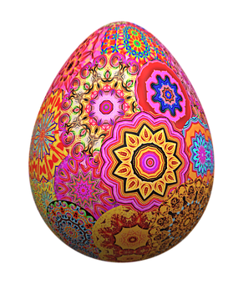
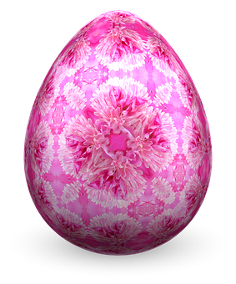
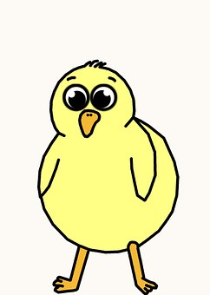
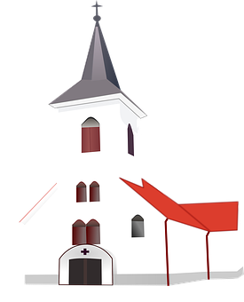
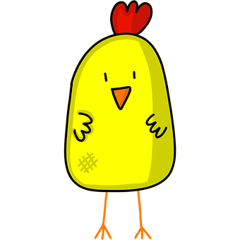
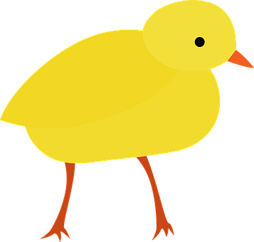
Ostern
1. Eiertütschen! Which egg will win? Circle the biggest number.
3. Count the Easter pictures and write how many you see.
Was? | Wie viele?
Küken
Lämmer
Osterkörbe
Osterglocken
Osterhasen
Kirchen
Ostereier
zehn
drei
vier
acht
zwei
sechs [6]
eins
elf
fünf
sechs
neun
fünf [5]
2. Match each chick to an egg. Write the English translations below.
eins [1]
A
B
elf [11]
benutze
macht
schreibst
spiele
hat
brauchst
zwölf [12]
drei [3]
ich
du
sie
sieben [7]
er
ich
du
I use
You need
He does
I play
She has
You write
Notes:
Timing: 10-15 mins (independent)
Aim: to provide written practice of German numbers 1-12 and reading comprehension of singular verb endings and meanings.
This activity is designed as a worksheet for pupils to complete independently after completing assessments. Worksheet at end of this presentation. Answers on this slide. It should be used in conjunction with the next slide for activity 3.
Pupils circle the highest number.
Pupils match a chick to an appropriate egg by looking at the pronouns and verb endings. They then write the English translation below each chick.
Pupils count up the number of each type of Easter picture on the next slide in a kind of ‘I spy’ activity and write the number in German.

Slide 12
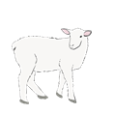
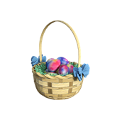
Ich sehe was, was du nicht siehst…
Notes:
‘I spy’ slide to be used for Activity 3 on previous slide/ worksheet.

Slide 13
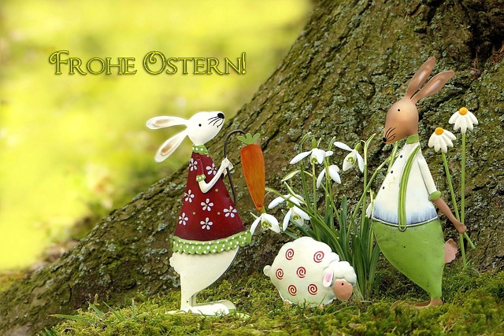
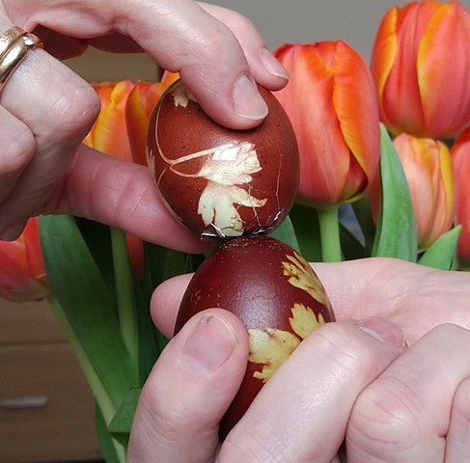
Was schreibt Olivia? Wie schreibt man das auf Deutsch?
Olivia is writing to Ronja over Easter. She isn’t sure of some German words. Help her out!
schreiben
Es ist Ostern! Ich bekomme drei Eier! Und ich habe einen Brief und zwei Spiele ☺
Wie geht’s? Du hast vier Osterkarten, nicht wahr? Schreibst du eine Geschichte?
Und Lias? Was macht er? Spielt er Eiertütschen?
[am receiving three]
[have a letter]
[two games]
[have four]
[cards]
[write]
[a]
[is he doing]?
[is he playing]
Notes:
Timing: 5-10 minutes
Aim: to practise written recognition and production of the verb haben, indefinite articles (Row 2 accusative), plural noun patterns, weak verbs and numbers.
NOTE: This task would be best attempted once pupils are familiar with some Easter vocab e.g. Oster and Eiertütschen, though they are never asked here to produce those words.
Procedure:
Students write the missing words in German to complete the sentences. You may want to write a checklist of things for pupils to think about (see aims of task).
Teacher clicks to provide the written answers. Click on the mp3 player to hear the whole text.

Slide 14
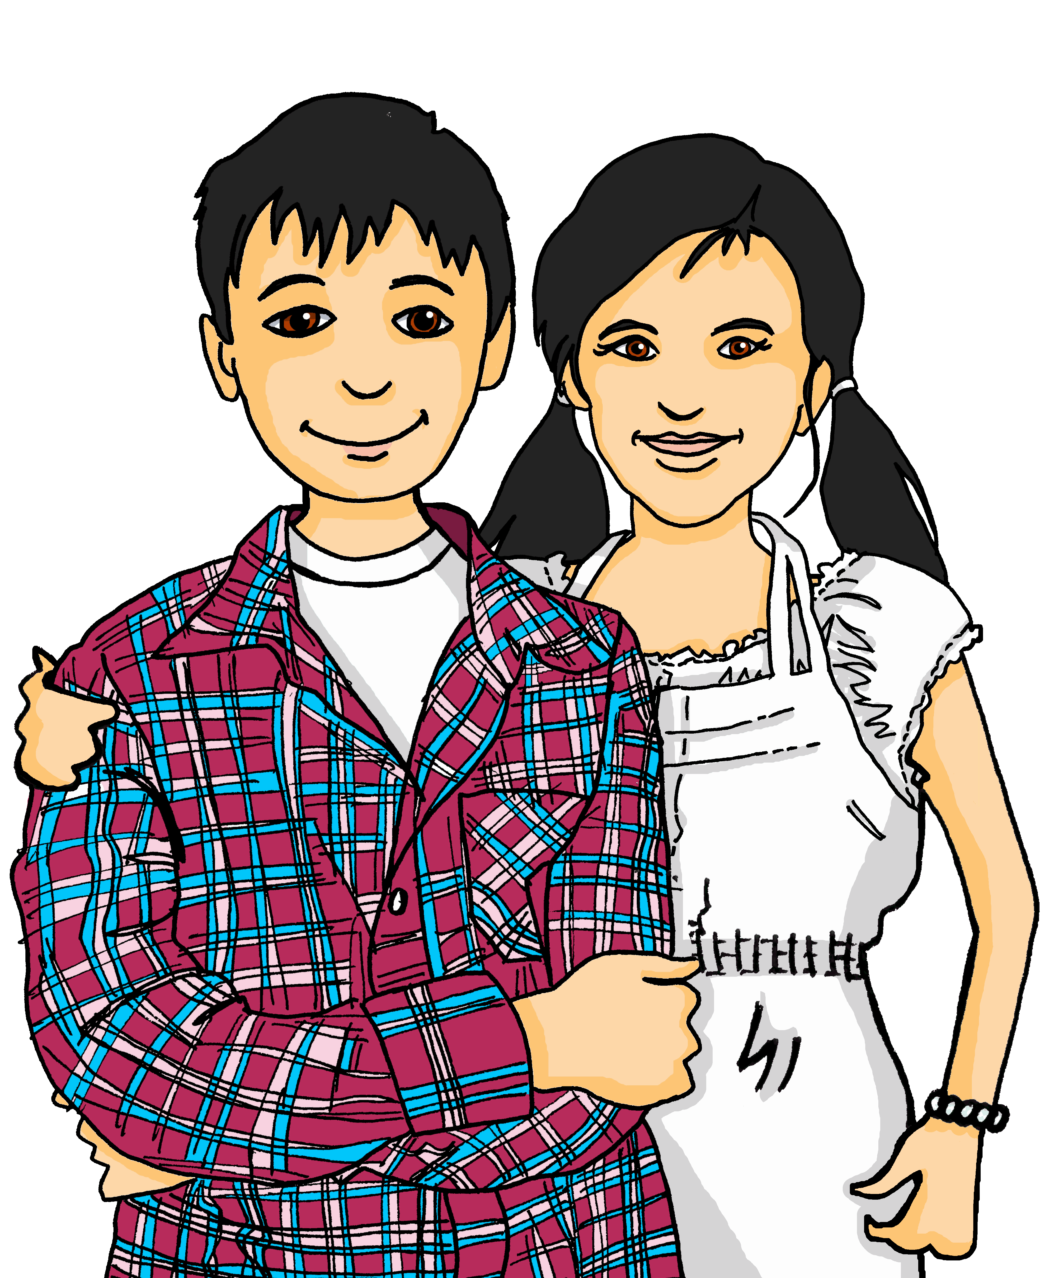
Vokabeln
What do Lias and Ronja like eating at Easter?
?
Wörter
Schreib auf Deutsch:
A. house
B. school
C. Mr
D. song
E. cat
F. sport
G. to play, playing
H. to need, needing
I. three
J. not a, no (m,nt)
 |  | H | A | U | S
 |  |  |  | S | C | H | U | L | E
 |  |  |  |  | H | E | R | R
 |  |  |  | S | O | N | G
 |  |  |  |  | K | A | T | Z | E
 |  |  | S | P | O | R | T
 | S | P | I | E | L | E | N
 |  |  | B | R | A | U | C | H | E | N
 |  |  |  |  | D | R | E | I
 |  |  |  | K | E | I | N
Chocolate!
Notes:
Timing: 10-15 minutes (independent)
Aim: to practise written recall of previously learnt vocabulary and to learn about Lias and Ronja’s favourite Easter treat!
Procedure:
Pupils fill in the crossword (handout at the end of this presentation) by translating the English words on the left into German.
Once they have finished, they read down the shaded column to find out what Lias and Ronja’s favourite Easter treat is. Note – pupils aren’t expected to know what this word means, but they could have a go at guessing!
As a class, click to reveal the answers and the English translation.

Slide 15
Poem
Frohe Ostern
1.

Slide 16
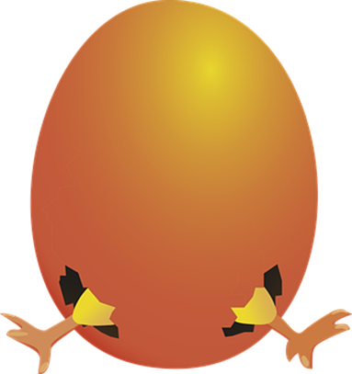
Tschüss!
gelb
Notes:
16

Slide 17
Ostern
1. Eiertütschen! Which egg will win? Circle the biggest number.
3. Count the Easter pictures and write how many you see.
Was? | Wie viele?
Küken
Lämmer
Osterkörbe
Osterglocken
Osterhasen
Kirchen
Ostereier
zehn
drei
vier
acht
zwei
eins
elf
fünf
sechs
neun
2. Match each chick to an egg. Write the English translations below.
A
B
benutze
macht
schreibst
spiele
hat
brauchst
ich
du
sie
er
ich
du
_________
_________
________
_________
_____________
__________
Notes:
HANDOUT

Slide 18
Was schreibt Olivia? Wie schreibt man das auf Deutsch?
Olivia is writing to Ronja over Easter. She isn’t sure of some German words. Help her out!
schreiben
Es ist Ostern! Ich __________ _____ Eier! Und ich ____ _____ _____ und _____ ______ ☺
Wie geht’s? Du ____ ____ Oster______, nicht wahr? _________ du ____ Geschichte?
Und Lias? Was _____ __? ______ __ Eiertütschen?
Notes:
HANDOUT

Slide 19
Vokabeln
What do Lias and Ronja like eating at Easter?
?
Wörter
Schreib auf Deutsch:
A. house
B. school
C. Mr
D. song
E. cat
F. sport
G. to play, playing
H. to need, needing
I. three
J. not a, no (m,nt)
Chocolate!
Notes:
HANDOUT

