Slide 1
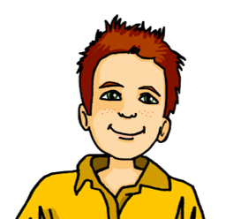
Talking about activities and events
gelb
möcht-, ich möchte, du möchtest
SSC [-g] [-d] [-b]
Term 3 Week 5
Notes:
Artwork by Steve Clarke. Pronoun pictures from NCELP (www.ncelp.org). All additional pictures selected from Pixabay and are available under a Creative Commons license, no attribution required.
Phonics: [-g] [-d] [-b] Tag [111] und [2] gelb [1446] Berg [934] Zug [675] Lied [1733] Freund [273] Lieblings- [n/a] siebzehn [>5000]
Vocabulary: fahren [215] möcht-, ich möchte, du möchtest [n/a]
Revisit 1: arbeiten [234] Grund [249] Idee [451] mit [13]
Revisit 2: brauchen [179] bekommen [212] machen [58] schreiben [184] Brief [838] Geschichte [262] Hilfe [481] ich weiß (es) nicht [n/a] wie sagt man…? [n/a]
Jones, R.L & Tschirner, E. (2019). A frequency dictionary of German: Core vocabulary for learners. London: Routledge.
The frequency rankings for words that occur in this PowerPoint which have been previously introduced in these resources are given in the SOW and in the resources that first
introduced and formally re-visited those words.
For any other words that occur incidentally in this PowerPoint, frequency rankings will be provided in the notes field wherever possible.
Note that the first three lessons of the year teach language that can be continuously recycled as lesson routine every lesson in Y3/4.
The idea would be that the class teacher (whether or not s/he teaches the class German can re-use the language as part of the daily routine with the class.
1

Slide 2
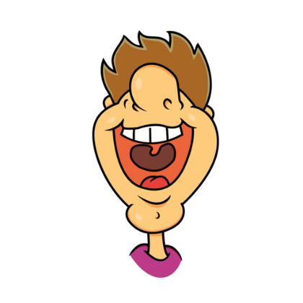
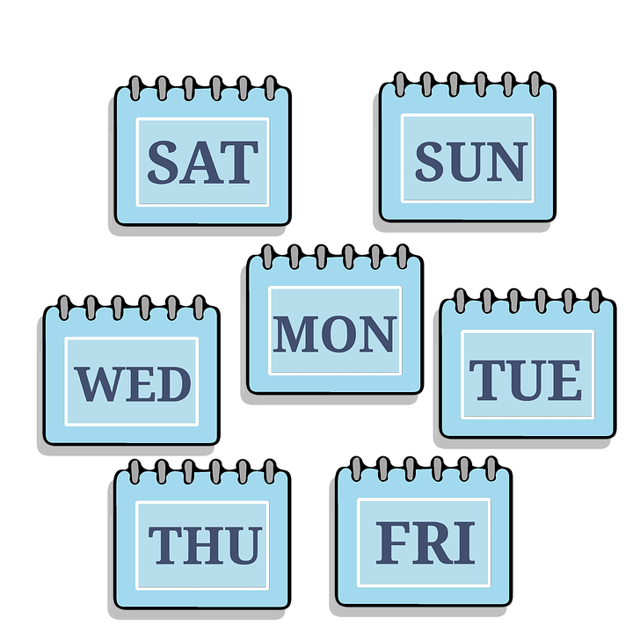
aussprechen
[-g]
[-d]
[-b]
When g, d, b come at the end of a word or before a consonant they sound like k, t, p and you don’t use your vocal chords.
…
and
Tag
und
gelb
Notes:
Timing: 2 minutes
Aim: To introduce/consolidate SSC [-g]
Procedure: 1. Present the letter(s) and say the final [-g] sound first, on its own. Pupils repeat it with you. Do the same with final [-d] and final [-b].
2. Click to bring up the callout to explain when these letters sound like this: i.e., g = k, d = t, b = p. 3. Bring up the word “Tag” on its own, say it, pupils repeat it, so that they have the opportunity to focus all of their attention on the connection between the written word and its sound.
4. A possible gesture for this would be to use the British Sign Language (BSL) sign for day, as here: https://www.signbsl.com/sign/day.
5. Click to bring up the image and say the word “Tag” again with pupils.
6. Click to bring up the word “und”. One gesture is to make the plus sign with two index fingers. Alternatively, the BSL sign for “and” is here: https://www.signbsl.com/sign/and
7. Click to bring up the image and say the word “und” again. 8. Finally, click to bring up the word “gelb”. BSL is here: https://www.signbsl.com/sign/yellow
9. Click to bring up the image and say the word again.
Word frequency (1 is the most frequent word in German): gelb [1446] Tag [111] und [2] Source: Jones, R.L. & Tschirner, E. (2019). A frequency dictionary of German: core vocabulary for learners. Routledge
2

Slide 3
aussprechen
[-g]
…
Tag
Berg
Zug
Notes:
Timing: 3 minutes (three slides)
Aim: To introduce/consolidate SSC [-g]
Procedure:
Introduce and elicit the pronunciation of the individual SSC [-g] and then the source word again ‘Tag’ (with gesture, if using).
Then present and elicit the pronunciation of the two cluster words.
The cluster words have been chosen for their high-frequency, from a range of word classes, with the SSC (where possible) positioned within a variety of syllables within the words (e.g. initial, 2nd, final etc.). Additionally, we have tried to use words that build cumulatively on previously taught SSCs (see the Phonics Teaching Sequence document) and do not include new SSCs. Where new SSCs are used, they are often consonants which have a similar symbol-sound correspondence in English.
Word frequency (1 is the most frequent word in German): Berg [] Tag [] Zug [] Source: Jones, R.L. & Tschirner, E. (2019). A frequency dictionary of German: core vocabulary for learners. Routledge

Slide 4
aussprechen
[-d]
…
and
und
Lied
Freund
Notes:
[2/3]
Aim: To introduce/consolidate SSC [-d]
Procedure:
Introduce and elicit the pronunciation of the individual SSC [-d] and then the source word again ‘und’ (with gesture, if using).
Then present and elicit the pronunciation of the two cluster words.
The cluster words have been chosen for their high-frequency, from a range of word classes, with the SSC (where possible) positioned within a variety of syllables within the words (e.g. initial, 2nd, final etc.). Additionally, we have tried to use words that build cumulatively on previously taught SSCs (see the Phonics Teaching Sequence document) and do not include new SSCs. Where new SSCs are used, they are often consonants which have a similar symbol-sound correspondence in English.
Word frequency (1 is the most frequent word in German): und [] Freund [] Lied [] Source: Jones, R.L. & Tschirner, E. (2019). A frequency dictionary of German: core vocabulary for learners. Routledge

Slide 5
aussprechen
[-b]
…
gelb
Lieblings-
siebzehn
Notes:
[3/3]
Aim: To introduce/consolidate SSC [-b]
Procedure:
Introduce and elicit the pronunciation of the individual SSC [-b] and then the source word again ‘gelb’ (with gesture, if using).
Then present and elicit the pronunciation of the two cluster words.
The cluster words have been chosen for their high-frequency, from a range of word classes, with the SSC (where possible) positioned within a variety of syllables within the words (e.g. initial, 2nd, final etc.). Additionally, we have tried to use words that build cumulatively on previously taught SSCs (see the Phonics Teaching Sequence document) and do not include new SSCs. Where new SSCs are used, they are often consonants which have a similar symbol-sound correspondence in English.
Word frequency (1 is the most frequent word in German): gelb [] Lieblings-[] siebzehn
Source: Jones, R.L. & Tschirner, E. (2019). A frequency dictionary of German: core vocabulary for learners. Routledge

Slide 6
[-g] [-d] [-b]
Hör zu. Ist es [-g], [-d] oder [-b]?
 |  | [-g] | [-d] | [-b]
1 | England
2 | Dienstag
3 | rund
4 | Flug
5 | lieb
6 | Fahrrad
7 | halb
8 | Ausflug
9 | Urlaub
Remember! At the end of words or before consonants, [-g] sounds like k [-d] sounds like t
[-b] sounds like p
Notes:
Timing: 5 minutes
Aim: to consolidate the SSC [-g] [-d] and [-b].
Procedure:
Click each audio button to hear the word.
Pupils listen and decide which SSC they hear. Note that these items are all unvoiced versions of the letters. In the follow ups, we will contrast voiced and unvoiced sounds.
Click to reveal answers.
Transcript:
England
Dienstag
rund
Flug
lieb
Fahrrad
halb
Ausflug
Urlaub
Word frequency:
Ausflug [4014] Flug [2220] halb [443] lieb [897] Urlaub [1570] Source: Jones, R.L. & Tschirner, E. (2019). A frequency dictionary of German: core vocabulary for learners. Routledge

Slide 7
Vokabeln
Vokabeln lernen
Wörter
Sag die Wörter
möcht-
du möchtest
[would like]
[you would like]
would like
fahren
ich möchte
[to go (transport)]
[I would like]
Notes:
Timing: 5 minutes
Aim: to present and practise new vocabulary for this week
Procedure:
Click for each new word to appear, then again for the supporting picture and English to appear.
Practise repeating the words as a whole class.
7

Slide 8
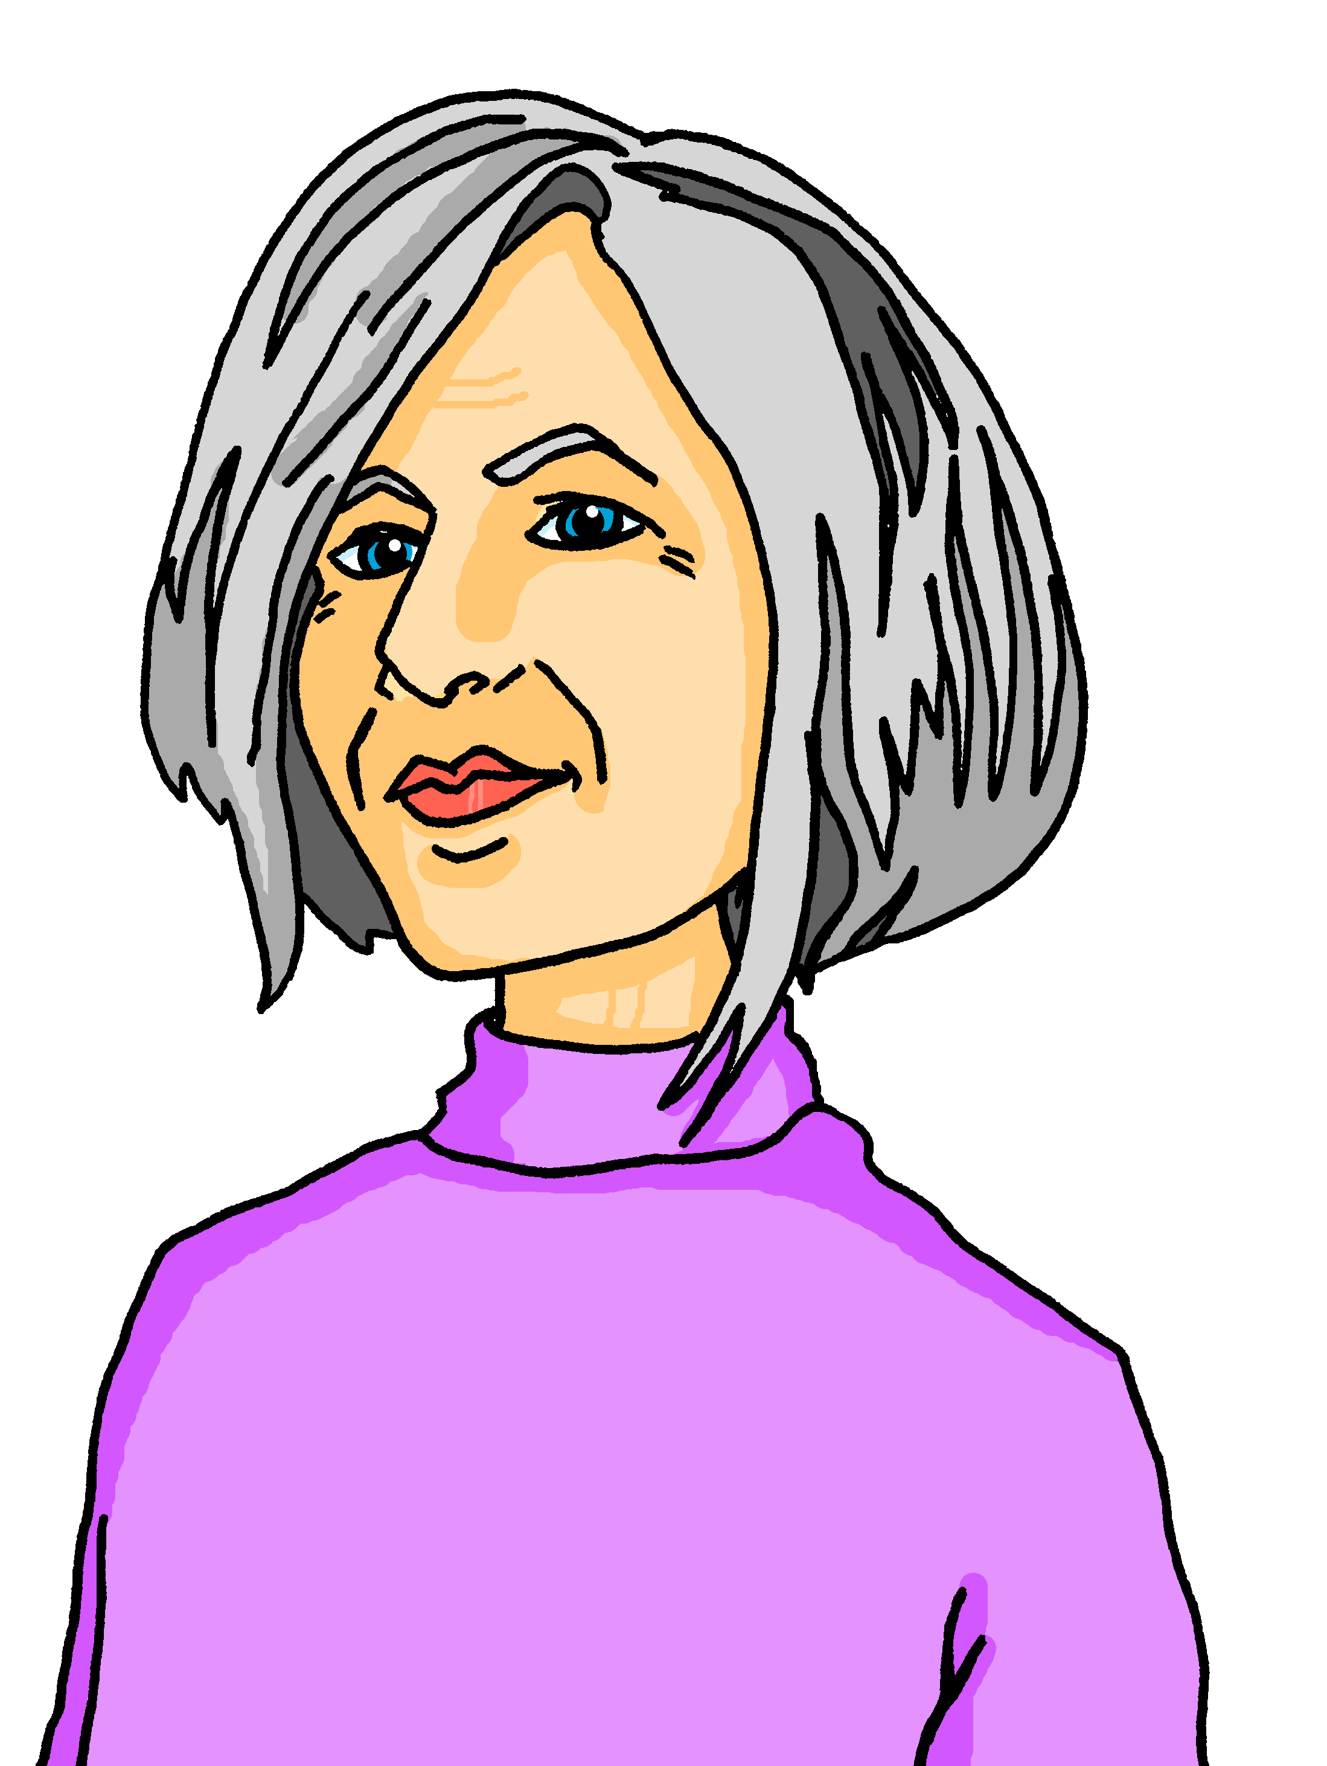
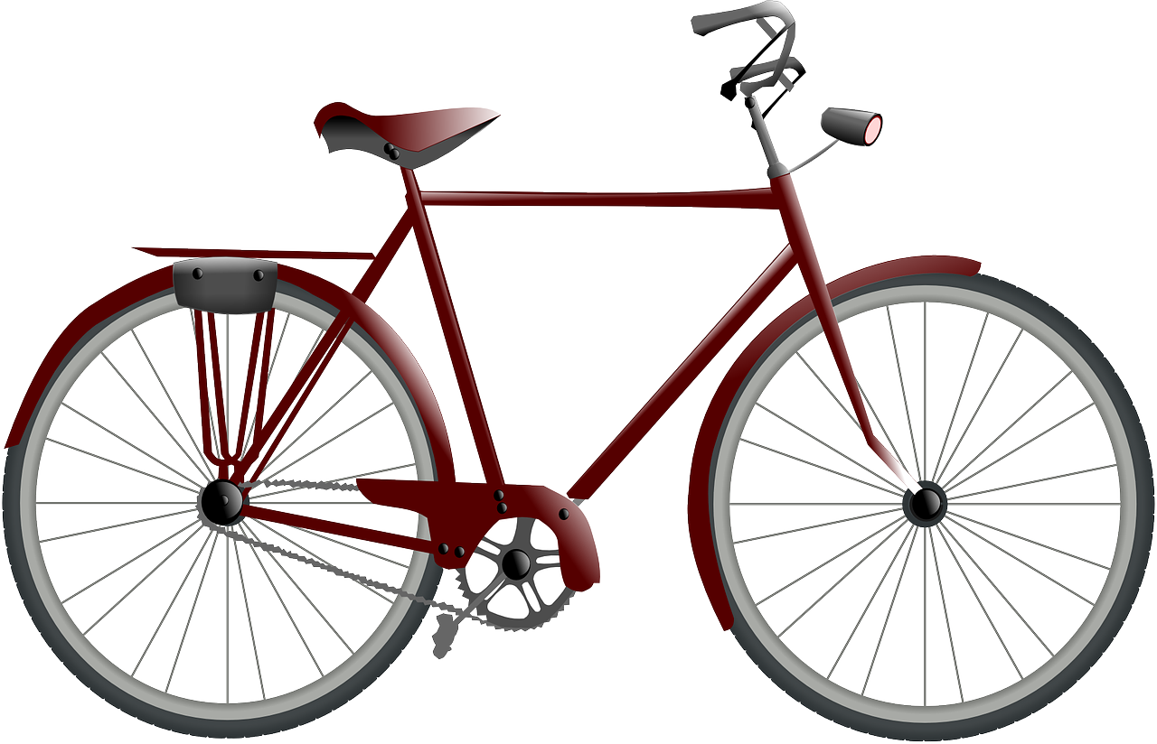
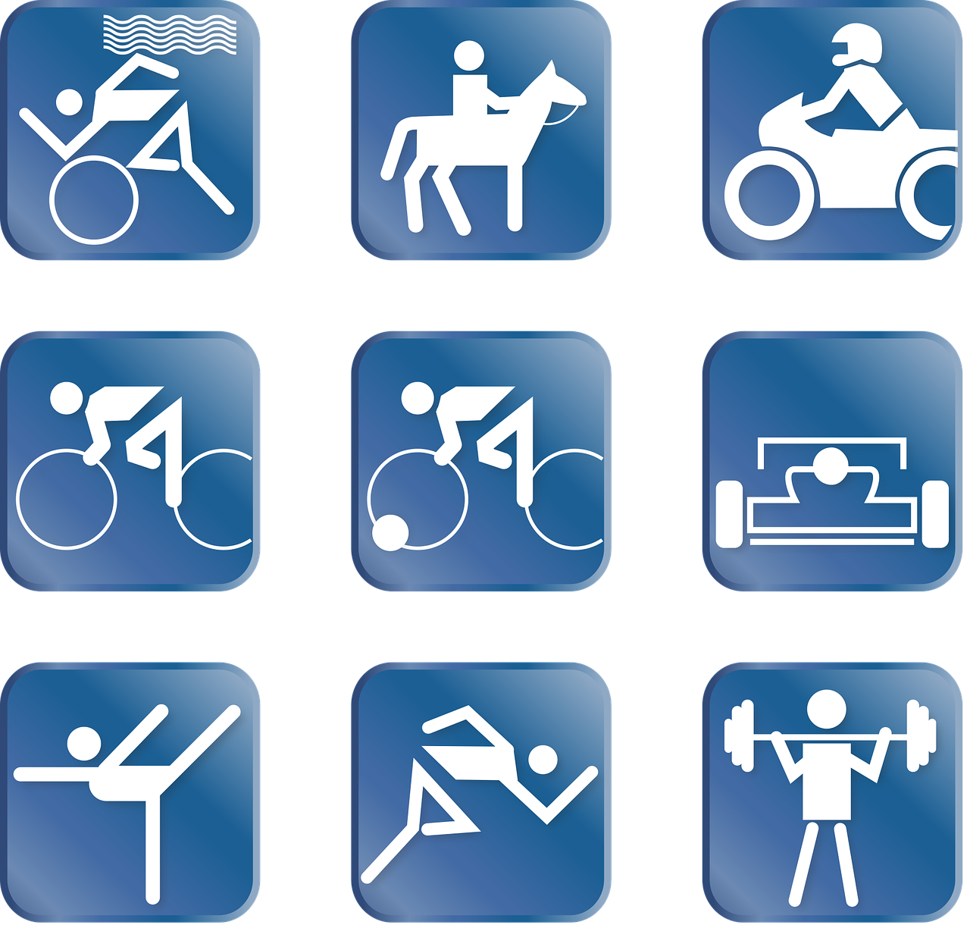
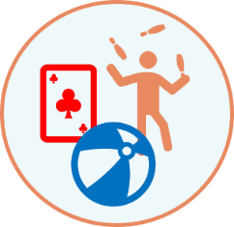
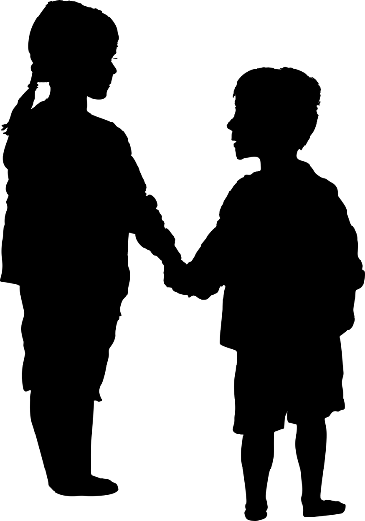
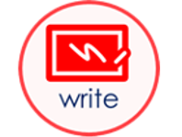
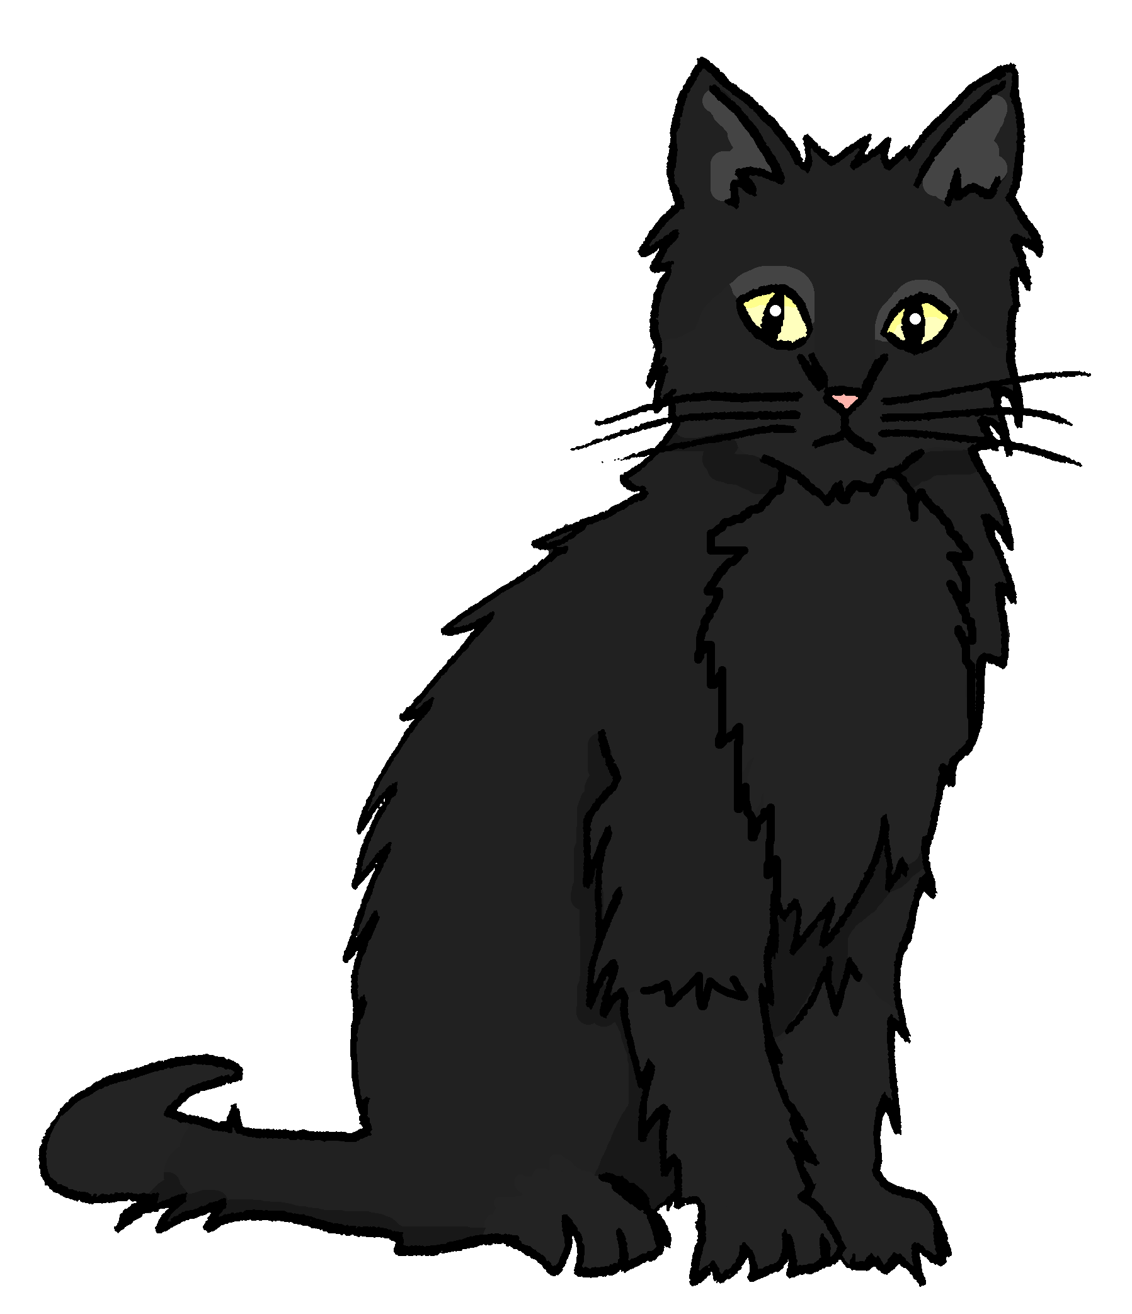
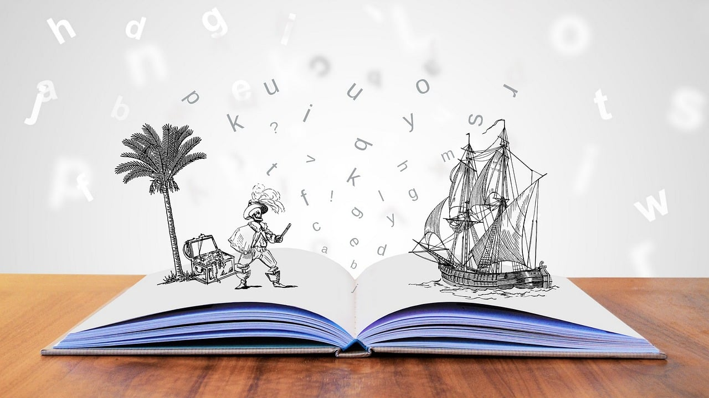
Ich möchte…
hören
Hör zu. Welches Bild ist das? Wie sagt man das auf Englisch?
1
F
2
I
A
E
I
3
K
to visit
4
A
5
C
B
F
J
6
D
7
H
8
J
C
G
K
9
G
10
B
11
L
D
H
L
12
E
1. ein Instrument lernen 2. ein Lied singen 3. ein Spiel gewinnen 4. einen Satz wiederholen
5. ein Bild machen
6. neben Moritz sitzen
7. dienstags schwimmen
8. heute tanzen
9. etwas spielen
10. Fragen und Antworten verstehen
11. denken: “ich weiß es nicht!”
12. Geburtstag haben
This uses almost all of the revisited and new words and we’re in our context of ‘Was kannst du in der Schule machen?
other verbs we have = hören
1. ein Instrument lernen 2. ein Lied singen 3. ein Spiel gewinnen 4. einen Satz wiederholen
5. ein Bild machen
6. neben Moritz sitzen
7. dienstags schwimmen
8. heute tanzen
9. etwas spielen
10. Fragen und Antworten verstehen
11. denken: “ich weiß es nicht!”
12. Geburtstag haben
Notes:
Timing: 5 minutes
Aim: to revisit vocabulary for this week.
Procedure:
Click on each audio button to hear a short infinitive phrase in German.
Students look carefully at the pictures on the right and decide which picture the phrase refers to. They write down the corresponding letter.
Click to reveal answers.
Transcript:
1. in die Schweiz fahren 2. Oma besuchen 3. Hilfe bekommen 4. heute bleiben
5. Sport machen
6. eine Geschichte schreiben
7. eine Katze haben
8. zu Hause arbeiten
9. mit Ronja spielen
10. ein Fahrrad benutzen
11. einen Grund brauchen
12. einen Brief haben
8

Slide 9
möcht- would like
To say what you would like to do use the verb möcht- and a 2nd verb in the infinitive form.
Ich möchte fahren.
I would like to go.
Du möchtest schreiben.
You would like to write.
The 2nd verb always goes to the end of the sentence:
Ich möchte in die Schweiz fahren.
I would like to go to Switzerland.
Du möchtest einen Brief schreiben.
You would like to write a letter.
The word order is different from English.
Notes:
Timing: 2 minutes
Procedure:
Click through the animations to present the new information.
Elicit English translation for the German examples provided.
9

Slide 10
hören
Oma is telling Lias and Ronja’s cousins, Johanna and Moritz, about her trip to Switzerland. Now they want to go too!
Hör zu. Ist das Johanna (ich) oder Moritz (du)?
Hör zu.
 |  | Johanna (ich) | Moritz (du)
 | Ich möchte in die Schweiz fahren.
 | Ich möchte in Biel bleiben.
 | Du möchtest Lias besuchen.
 | Ich möchte mit Ronja spielen.
 | Du möchtest einen Brief schreiben.
 | Du möchtest eine Karte bekommen.
1
2
3
4
5
6
Notes:
Timing: 5 minutes
Aim: to practise aural identification and comprehension of möcht- in first and second persons singular.
Procedure:
Explain the task. Oma has returned to Germany and she is telling Lias and Ronja’s German cousins (Johanna and Moritz) about her trip. They are very keen and talk about how they would like to go to Switzerland.
Click on the audio buttons to hear the sentences. Pupils listen carefully to the ending of möcht- to decide whether the bleeped pronoun is ich or du. Johanna is speaking, so ich will be her, and du will be Moritz.
Transcript:
[Ich] möchte in die Schweiz fahren.
[Ich] möchte in Biel bleiben.
[Du] möchtest Lias besuchen.
[Ich] möchte mit Ronja spielen.
[Du] möchtest einen Brief schreiben.
[Du] möchtest eine Karte bekommen.
10

Slide 11
lesen
Ronja and Johanna are texting each other. Are they talking about what they’re doing now, or what they would like to do if Johanna visits Switzerland?
Schreib 1-6 und ‘möchte(st)’ oder ‘x’.
Ich schreibe einen Brief.
Du möchtest in die Schweiz fahren.
Ja, und ich möchte mit Minze spielen.
Ich spiele mit Oma.
Du möchtest Sport machen.
Ich möchte das Fahrrad benutzen.
Notes:
Timing: 5 minutes
Aim: to practise written comprehension of 2-verb structures and contrast them with 1-verb structures in first and second persons singular.
Procedure:
Explain the task. Ronja and Johanna are texting each other and are using lots of emojis. Sometimes they’ve accidentally covered up möcht- with emojis! Sometimes there’s nothing under the emojis.
Using their knowledge of 2-verb structures, pupils need to determine whether there is a möcht- under the emojis or not. If there is a verb in the infinitive at the end of the sentence, there must be a möcht-. Pupils could write a tick or cross, and more advanced pupils could also try to write the correct form of möcht- based on the pronoun they see.
Click to reveal answers.
11

Slide 12
Hör zu und sing mit!
Tschüss, Tschüss, Tschüss, Tschüss,
Tschüss, Tschüss, Auf Wiedersehen!
Bis bald, bis bald, bis bald, bis bald.
Tschüss, Tschüss, Tschüss, Tschüss, Auf Wiedersehen!
Bis bald! = See you soon!
Notes:
Timing: 3 minutes
Aim: to revisit the goodbye song (to the tune of ‘Hi ho Hi ho it’s off to work we go’.)
Procedure: If there’s time, why not remind pupils about their German goodbye song and sing it through to finish the lesson.

Slide 13
Tschüss!
gelb
Notes:
13

