Slide 1


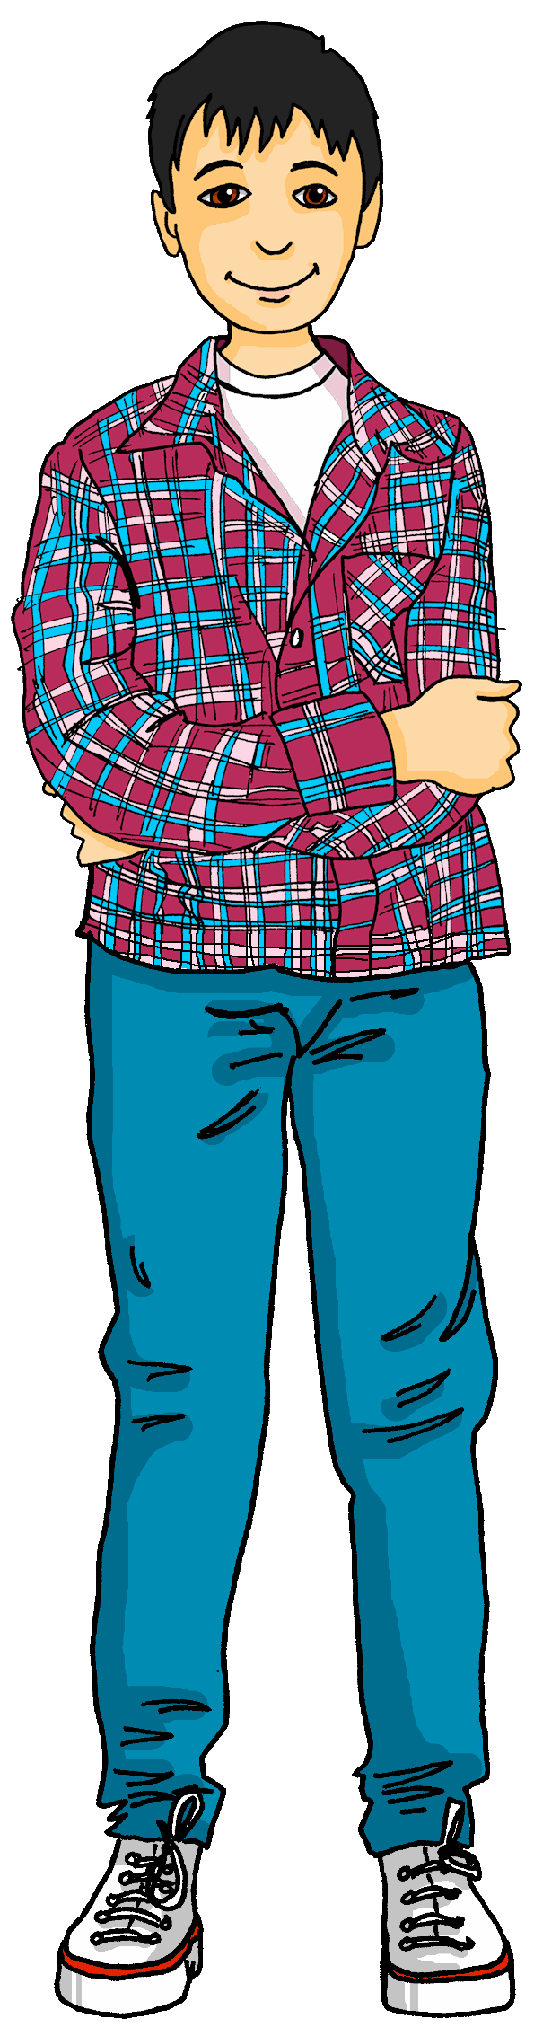
Talking about activities and events
gelb
Follow ups 1-5
Term 3 Week 6
Notes:
Artwork by Steve Clarke. Pronoun pictures from NCELP (www.ncelp.org). All additional pictures selected from Pixabay and are available under a Creative Commons license, no attribution required.
Phonics:
[-tion] Information [465] Tradition [1650] Position [944] international [426] funktionieren [677]
Vocabulary: er/sie/es möchte [n/a]
Revisit 1: besuchen [820] bleiben [113] Gitarre [n/a] Oma [2175]
Revisit 2: benutzen [1119] spielen [205] Sport [945] zu Hause [n/a]
Jones, R.L & Tschirner, E. (2019). A frequency dictionary of German: Core vocabulary for learners. London: Routledge.
The frequency rankings for words that occur in this PowerPoint which have been previously introduced in these resources are given in the SOW and in the resources that first
introduced and formally re-visited those words.
For any other words that occur incidentally in this PowerPoint, frequency rankings will be provided in the notes field wherever possible.
Note that the first three lessons of the year teach language that can be continuously recycled as lesson routine every lesson in Y3/4.
The idea would be that the class teacher (whether or not s/he teaches the class German can re-use the language as part of the daily routine with the class.

Slide 2



Follow up 1
[-tion]
Sag die Wörter.
The [t] in [-tion] sounds like German [z]. It’s like the –ts at the end of the English word boots.
aussprechen
60
international
zwei
Position
Platz
S
Zug
rational
Dezember
Emotion
‘c’ in English is often ‘k’ in German.
‘c’ in English is often ‘k’ in German.
Konzert
0
Schweiz
Rezeption
funktional
START
Notes:
Timing: 5 minutes
Aim: to practise applying knowledge of [-tion] and [z] to known and unknown words.
Procedure:
1. Start the timer. Pupil A tries to read aloud all of the words pronouncing the [tion] and [z] correctly, within the 60 seconds allowed.
2. Pupil B listens. If Pupil A makes a slip, Pupil B can direct them to start again from the beginning.
3. They swap roles and repeat the task.
4. Click to reveal a callout explaining that ‘c’ in English is often ‘k’ in German. Can pupils work out what Konzert and funktional mean in English?

Slide 3



Follow up 2:

Schreib auf Englisch.
Can you get at least 15 points?
Wörter
 | der Sport | wer? | zu Hause
 | wann? | wo? | was?
 | besuchen | die Gitarre | spielen
 | bleiben | die Oma | benutzen
 | möcht- | es möchte | sie möchte
 | er möchte | ich möchte | du möchtest
(the) sport
who?
at home
Vokabeln
x3
when?
where?
what?
to visit, visiting
(the) guitar
to play, playing
x2
to remain, stay, remaining, staying
(the) grandma
to use, using
would like
it would like
she would like
x1
he would like
I would like
you would like
Notes:
Timing: 5 minutes
Aim: to practise written production of vocabulary from this and revisited weeks.
Procedure:
1. Give pupils a blank grid. They fill in the English meanings of any of the words they know, trying to reach 15 points in total.
Note:
The most recently learnt and practised words are pink, words from the previous week are green and those from week 1 are blue, thus more points are awarded for them, to recognise that memories fade and more effort (heavy lifting!) is needed to retrieve them.

Slide 4
Follow up 2:

Schreib auf Deutsch.
Can you get at least 15 points?
Wörter
 | what? | to use, using | where?
 | when? | who? | to play, playing
 | (the) guitar | at home | (the) grandma
 | (the) sport | to visit, visiting | to remain, stay, remaining, staying
 | she would like | I would like | he would like
 | you would like | it would like | would like
was?
benutzen
wo?
Vokabeln
x3
wann?
wer?
spielen
die Gitarre
zu Hause
die Oma
x2
der Sport
besuchen
bleiben
sie möchte
ich möchte
er möchte
x1
du möchtest
es möchte
möcht-
Notes:
Timing: 5 minutes
Aim: to practise written production of vocabulary from this and revisited weeks.
Procedure:
1. Give pupils a blank grid. They fill in the German meanings of any of the words they know, trying to reach 15 points in total.
Note:
The most recently learnt and practised words are pink, words from the previous week are green and those from week 1 are blue, thus more points are awarded for them, to recognise that memories fade and more effort (heavy lifting!) is needed to retrieve them.

Slide 5

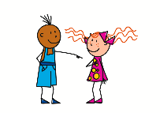

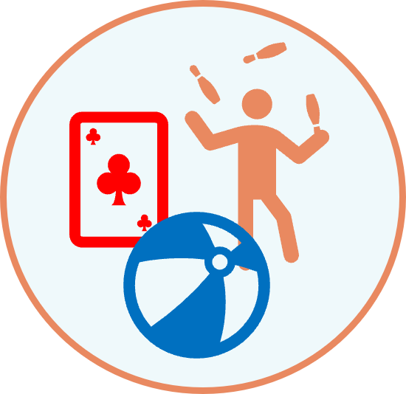





Questions
Note that the verb möchtest swaps with the subject du.
Remember how to ask yes/no questions with möchtest:
Möchtest du spielen?
?
Du möchtest spielen.
Do the same swap with information questions, too:
Wo möchtest du spielen?
Where would you like to play?
Was möchtest du spielen?
What would you like to play?
Wann möchtest du spielen?
When would you like to play?
Wer möchte spielen?
Who would like to play?
Notes:
Timing: 2 minutes
Aim: to recap the formation of yes/no questions by swapping the subject and verb and to teach the formation of information questions by swapping the subject and verb.
Procedure:
Click through the animations to recap the formation of yes/no questions and to teach the formation of information questions.
Elicit English translation for the German examples provided line by line.
5

Slide 6

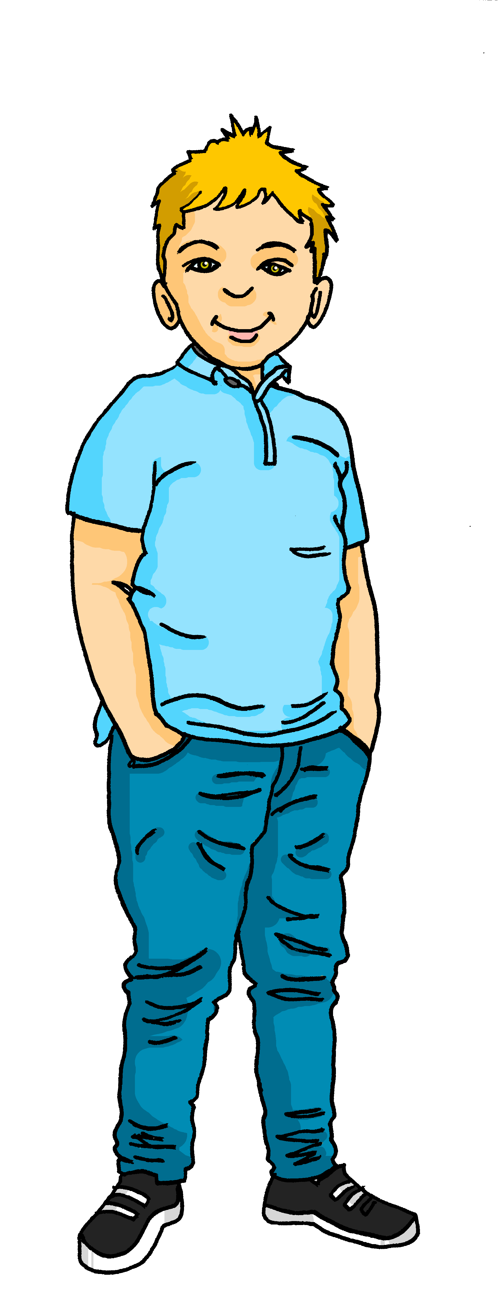

Follow up 3
Hör zu. Ist die Antwort A, B oder C richtig?
Lias is asking his friends what they would like to do over the holidays.
hören
A
Ich möchte zu Hause spielen.
B
Ich möchte mittwochs spielen.
C
Ja, ich möchte spielen.
Notes:
Timing: 5 minutes (6 slides)
Aim: to practise aural comprehension of questions using möcht-.
Procedure:
Click on the audio button to hear Lias’ question. Pupils listen carefully and decide whether option A, B or C contains the correct answer.
Click to reveal the answer.
Repeat for slides 2-6.
Transcript:
Wo möchtest du spielen?

Slide 7
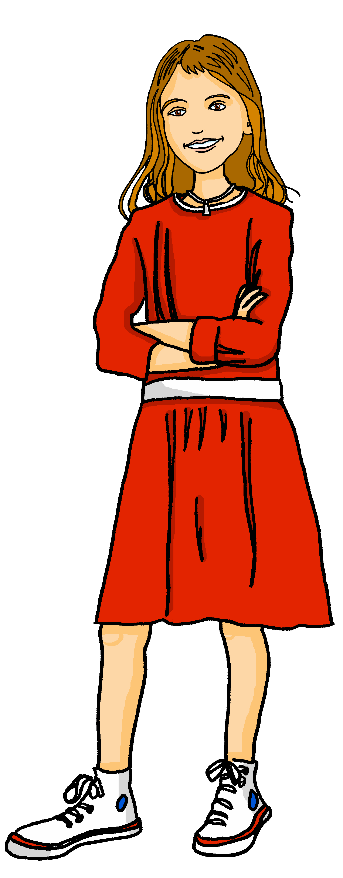
Follow up 3
Hör zu. Ist die Antwort A, B oder C richtig?
Lias is asking his friends what they would like to do over the holidays.
hören
A
Er möchte schreiben.
B
Ich möchte das montags machen.
C
Ich möchte Sport machen.
Notes:
[2/6]
Transcript:
Was möchtest du machen?

Slide 8
Follow up 3
Hör zu. Ist die Antwort A, B oder C richtig?
Lias is asking his friends what they would like to do over the holidays.
hören
A
Sie möchte heute fahren.
B
Sie möchte Gitarre spielen.
C
Ja, sie möchte fahren.
Notes:
[3/6]
Transcript:
Wann möchte Mariem fahren?

Slide 9
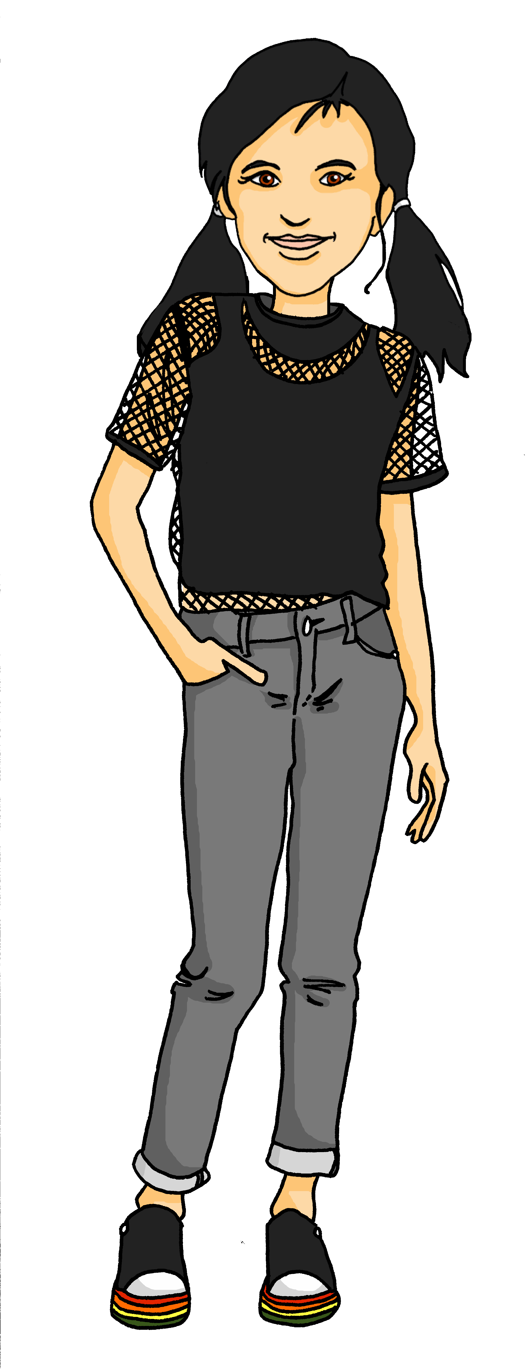
Follow up 3
Hör zu. Ist die Antwort A, B oder C richtig?
Lias is asking his friends what they would like to do over the holidays.
hören
A
Ich möchte ein Fahrrad benutzen.
B
Du möchtest Oma besuchen.
C
Jana möchte Mariem besuchen.
Notes:
[4/6]
Transcript:
Wer möchte Oma besuchen?

Slide 10
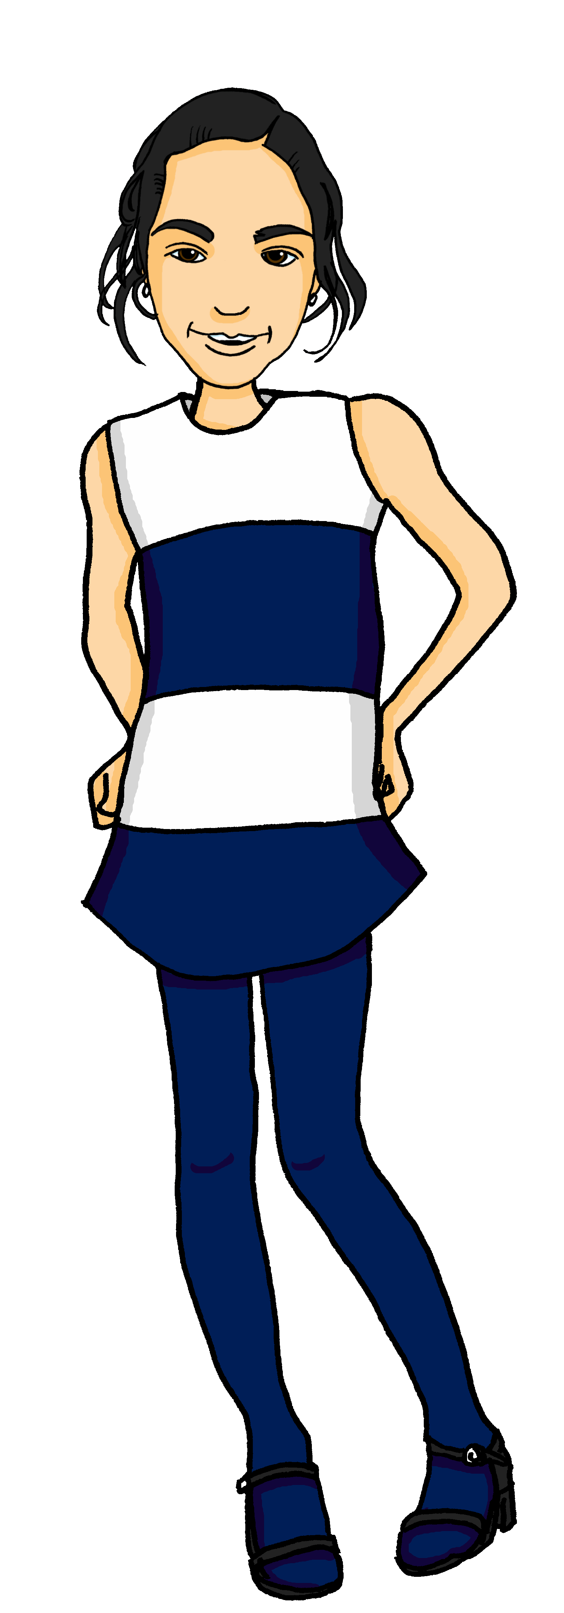
Follow up 3
Hör zu. Ist die Antwort A, B oder C richtig?
Lias is asking his friends what they would like to do over the holidays.
hören
A
Er möchte nicht bleiben.
B
Er möchte kein Spiel spielen.
C
Er möchte in Biel bleiben.
Notes:
[5/6]
Transcript:
Wo möchte Gabriel bleiben?

Slide 11
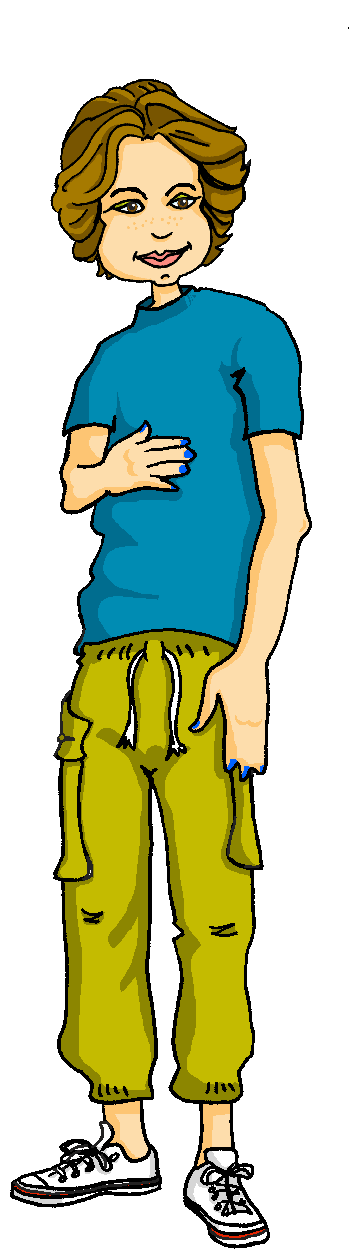
Follow up 3
Hör zu. Ist die Antwort A, B oder C richtig?
Lias is asking his friends what they would like to do over the holidays.
hören
A
Ich möchte im Juli besuchen.
B
Ich möchte mein Fahrrad benutzen.
C
Er möchte das Fahrrad benutzen.
Notes:
[6/6]
Transcript:
Was möchtest du benutzen?

Slide 12
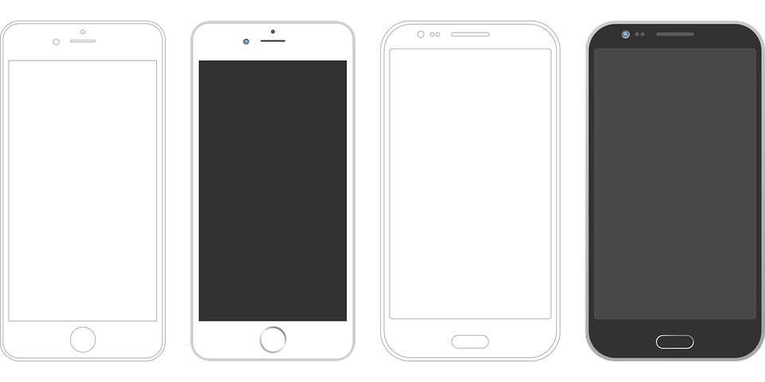
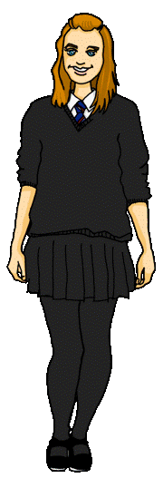

Follow up 4
Was sagt Ronja?
lesen
Hallo Olivia!
Es ist Juli! Ich möchte Oma besuchen. Und Lias möchte auch Oma besuchen.
Und er möchte mit Gabriel spielen. Aber er möchte keine Gitarre spielen. Und er möchte keinen Sport machen!
Was möchtest du machen, Olivia?
Who would like to visit Oma? Ronja and Lias would like to visit Oma.
What would Lias like to do? He would like to play with Gabriel.
What wouldn’t Lias like to do? He wouldn’t like to play a guitar or do sport.
What does Ronja ask Olivia? What she would like to do.
Notes:
Timing: 5 minutes
Aim: to practise comprehension of können, nicht, and kein in a written text.
Procedure:
Explain the task. Ronja has written to Olivia about her and Lias’ plans for the school holidays.
Pupils read the text and then answer the comprehension questions below.
Click to reveal answers and underlining under the corresponding part of the German text.

Slide 13

Follow up 5a
Möchtest du….?
* Partner work
Partnerbarbeit*!
sprechen
Ask your partner if they would like to do each of the things below.
If yes, write (✔) and their answer.
If no, write (✘).
Would you like to play guitar?
Möchtest du Gitarre spielen?
1. to play guitar?
2. to use a computer ?
3. to write?
4. to stay at home?
5. to do Sport?
6. to go to Switzerland?
Ja. Ich möchte Gitarre spielen.
Yes. I would like to play guitar.
No. I wouldn’t like to play guitar.
Nein. Ich möchte keine Gitarre spielen.
Remember! the 2nd verb in German goes to the end. Möchtest is the 1st verb.
Notes:
Timing: 5 minutes
Aim: to provide practice (speaking) in asking and answering questions using möcht-.
Procedure:
Demonstrate the conversations pupils will have using Lias and Ronja’s speech bubbles. Try to translate them into German as a class, and then click to reveal the German translations.
Give pupils time in pairs to both ask and answer all questions, noting down their partner’s answers as they go.
If time allows, hear some of the conversations as a class.
Additional task suggestions:
1. See next slide for follow up writing task.
2. Alternatively, pupils could report back to the teacher/rest of class using the 3rd person of möcht- e.g. Lucy möchte Gitarre spielen aber sie möchte nicht schreiben.

Slide 14

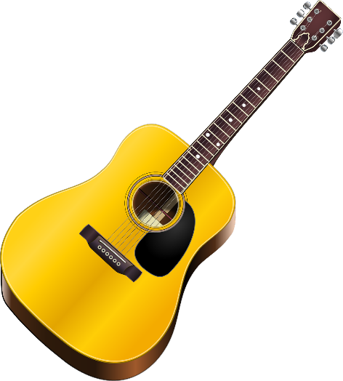




Follow up 5b
Schreib Sätze!
schreiben
Write sentences to describe what your partner would and wouldn’t like to do.
1. play guitar? | X
2. use a computer? | p
3. write? | p
Lias möchte keine Gitarre spielen.
Lias möchte einen Computer benutzen.
Lias möchte schreiben.
Notes:
Timing: 3 minutes
Aim: to provide written practice of er/sie kann in 2-verb structures.
Procedure:
Remind pupils of the conversation between Lias and Ronja and click to bring up the table showing Lias’ answers.
Click again for each example sentence to come up. Draw attention to use of keine in first sentence.
Ask pupils to write a few sentences based on their partner’s answers from the previous speaking exercise.
Hear a few sentences written by pupils and use these as an opportunity to identify errors and correct as a class.

Slide 15
Tschüss!
gelb
Notes:
15

Slide 16
Follow up 2:

Schreib auf Englisch.
Can you get at least 15 points?
Wörter
 | der Sport | wer? | zu Hause
 | wann? | wo? | was?
 | besuchen | die Gitarre | spielen
 | bleiben | die Oma | benutzen
 | möcht- | es möchte | sie möchte
 | er möchte | ich möchte | du möchtest
Vokabeln
x3
x2
x1
Notes:
HANDOUT

Slide 17
Follow up 2:

Schreib auf Deutsch.
Can you get at least 15 points?
Wörter
 | what? | to use, using | where?
 | when? | who? | to play, playing
 | (the) guitar | at home | (the) grandma
 | (the) sport | to visit, visiting | to remain, stay, remaining, staying
 | she would like | I would like | he would like
 | you would like | it would like | would like
Vokabeln
x3
x2
x1
Notes:
HANDOUT

