Slide 1
Talking about activities and events
gelb
er/sie/es möchte
nicht vs kein
SSC [-tion]
Term 3 Week 6
Notes:
Artwork by Steve Clarke. Pronoun pictures from NCELP (www.ncelp.org). All additional pictures selected from Pixabay and are available under a Creative Commons license, no attribution required.
Phonics:
[-tion] Information [465] Tradition [1650] Position [944] international [426] funktionieren [677]
Vocabulary: er/sie/es möchte [n/a]
Revisit 1: besuchen [820] bleiben [113] Gitarre [n/a] Oma [2175]
Revisit 2: benutzen [1119] spielen [205] Sport [945] zu Hause [n/a]
Jones, R.L & Tschirner, E. (2019). A frequency dictionary of German: Core vocabulary for learners. London: Routledge.
The frequency rankings for words that occur in this PowerPoint which have been previously introduced in these resources are given in the SOW and in the resources that first
introduced and formally re-visited those words.
For any other words that occur incidentally in this PowerPoint, frequency rankings will be provided in the notes field wherever possible.
Note that the first three lessons of the year teach language that can be continuously recycled as lesson routine every lesson in Y3/4.
The idea would be that the class teacher (whether or not s/he teaches the class German can re-use the language as part of the daily routine with the class.
1

Slide 2
aussprechen
[-tion]
…
Information
Notes:
Timing: 1 minute
Aim: to introduce the SSC [-tion].
Procedure:
1. Present the SSC and say the [-tion] sound first, on its own. Pupils repeat it with you.
2. Present the source word ‘Information’ on its own, say it, pupils repeat it, so that they have the opportunity to focus all of their attention on the connection between the written word and its sound.
3. A possible gesture for this would be to use the British Sign Language (BSL) sign for information, as here: https://www.signbsl.com/sign/information
4. Click to bring up the image and say the word “Information” again with pupils.
Word frequency (1 is the most frequent word in German): Information [465] Source: Jones, R.L. & Tschirner, E. (2019). A frequency dictionary of German: core vocabulary for learners. Routledge
2

Slide 3
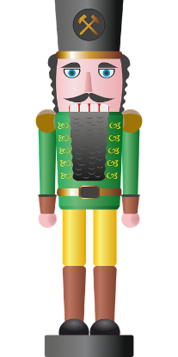
aussprechen
[-tion]
…
Tradition
Position
Information
international
funktionieren
Notes:
Timing: 1 minute
Aim: to consolidate the SSC [-tion].
Procedure:
Re-present the SSC and the source word ‘Information’ (with gesture, if using).
Click to bring on the picture and get pupils to repeat the word ‘Information’ (with gesture, if using).
Present the cluster words in the same way, bringing on the picture and getting pupils to pronounce the words.
Word frequency (1 is the most frequent word in German): Information [465] Tradition [1650] Position [944] international [426] funktionieren [677] Source: Jones, R.L. & Tschirner, E. (2019). A frequency dictionary of German: core vocabulary for learners. Routledge

Slide 4
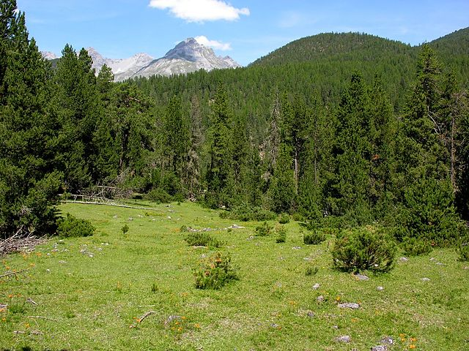
aussprechen
[-tion]
* hält – is holding
über - about
Sag die Wörter.
Lias hat keine Motivation!
Herr Lehmann hält* eine Präsentation über* einen Nationalpark. Lias schreibt die Informationen.
hören
 | Population
 | Evolution
 | Migration
 | Regulation
 | Transformation
Hör zu.
1
2
3
4
5
Notes:
Timing: 5 minutes
Aim: to consolidate the SSC [-tion] in a speaking and listening exercise.
Note: All chosen words are high-frequency cognates, so their meanings should be clear to pupils.
Procedure:
Explain the task. It is nearly the school holidays, and Lias is lacking in motivation! Pupils work in pairs and read the text to each other, taking care to pronounce –tion the German way. If they accidentally use English pronunciation, their partner can direct them to start from the beginning again.
Click to reveal the second part of the task. Explain that Lias is trying to note down what Herr Lehmann is saying, but his concentration isn’t great, so he only catches a few words.
Click on the audio buttons to hear what Herr Lehmann is saying. Pupils note down what they hear. All words used are English cognates and are spelled the same in German and English, to reinforce that although spellings are the same, the words are pronounced differently.
Click to reveal answers.
Transcript:
Population
Evolution
Migration
Regulation
Transformation
Word frequency (1 is the most frequent word in German): Evolution [4462] Information [465] Migration [4123] Motivation [3150] Nationalpark [4994] Population [4950] Präsentation [4334] Regulation [3882] Transformation [3856] Source: Jones, R.L. & Tschirner, E. (2019). A frequency dictionary of German: core vocabulary for learners. Routledge
Image attribution:
Schweizerischer Nationalpark Von Hansueli Krapf - Eigenes Werk, CC BY-SA 3.0, https://commons.wikimedia.org/w/index.php?curid=1045850

Slide 5
Vokabeln
Vokabeln lernen
Wörter
Was ist das auf Englisch?
6. arbeiten
3. benutzen
7. brauchen
8. bekommen
2. bleiben
4. spielen
11. haben
1. besuchen
5. fahren
9. machen
10. schreiben
Notes:
Timing: 5 minutes
Slide 1/2
Aim: to practise new and revisited vocabulary.
Procedure:
Click to make the words disappear one by one. Pupils write down the number and the English translation. They have 4 seconds before the word disappears completely.
2. Use the next slide to elicit and then display the English translations.
5

Slide 6
Vokabeln
Vokabeln lernen
Wörter
Was ist das auf Englisch?
1. besuchen
1. to visit, visiting
7. brauchen
8. to need, needing
2. bleiben
2. to remain, stay, remaining, staying
8. bekommen
9. to receive, receiving
3. benutzen
3. to use, using
9. machen
10. to do, make, doing, making
4. spielen
4. to play, playing
10. schreiben
11. to write, writing
5. fahren
5. to go (transport)
11. haben
12. to have, having
6. arbeiten
6. to work, working
Notes:
2/2
Procedure
Elicit and display the English translations one by one.
Click for all the German words to disappear.
Ask pupils to work in pairs to recall the words in German.
Click again for all words to reappear for pupils to check.
Click on each word to hear the audio, if required.
6

Slide 7
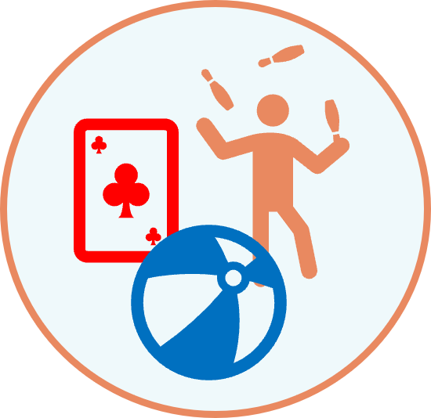
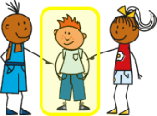
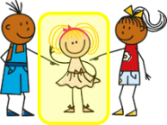
möcht- – would like
Remember how to say what you would like to do with the verb möcht-:
Ich möchte spielen.
I would like to play.
Du möchtest spielen.
You would like to play.
Note! möchte = would like for ich, er, sie and es. This is different from most German verbs you know.
To say he/she/it would like, use:
Er möchte spielen.
He would like to play.
Sie möchte spielen.
She would like to play.
Es möchte spielen.
It would like to play.
Notes:
Timing: 2 minutes
Procedure:
Click through the animations to present the new information.
Elicit English translation for the German examples provided.
7

Slide 8
möcht- – would like
Remember how to say what you would like to do with the verb möcht-:
Ich möchte spielen.
I would like to play.
To say what you wouldn’t like to do use nicht before the 2nd verb:
Er möchte nicht spielen.
He wouldn’t like to play.
But remember that to negate nouns you need kein instead:
Ich möchte ein Spiel spielen.
I would like to play a game.
Er möchte kein Spiel spielen.
He wouldn’t like to play a game.
Note that word order is different from English.
Notes:
Timing: 2 minutes
Procedure:
Click through the animations to present the new information.
Elicit English translation for the German examples provided.
8

Slide 9
lesen
It’s not long until the school holidays! Leonie is messaging Lias about what he and Ronja would like to do.
Ist das Lias (du) oder Ronja (sie)?
Möchte er/sie das machen oder nicht?
Du möchtest Oma besuchen.
??
Sie möchte nicht zu Hause bleiben.
??
Sie möchte keinen Sport machen.
??
Du möchtest einen Computer benutzen.
??
Sie möchte Gitarre spielen.
??
Du möchtest keine Hausaufgabe machen.
??
Du möchtest montags nicht arbeiten.
??
Sie möchte ein Spiel bekommen.
??
Notes:
Timing: 5 minutes
Aim: to practise written comprehension of möcht- in the second and third persons and in positive and negative sentences, contrasting möchte… and möchte ein… with möchte nicht… and möchte kein…
Procedure:
Pupils read each sentence and decide who Leonie is referring to, depending on the ending of möcht-.
Click to reveal answers.
Click to change the task instructions. Pupils read the sentences again and decide whether they refer to something Lias or Ronja would or wouldn’t like to do.
Click to reveal answers.
9

Slide 10
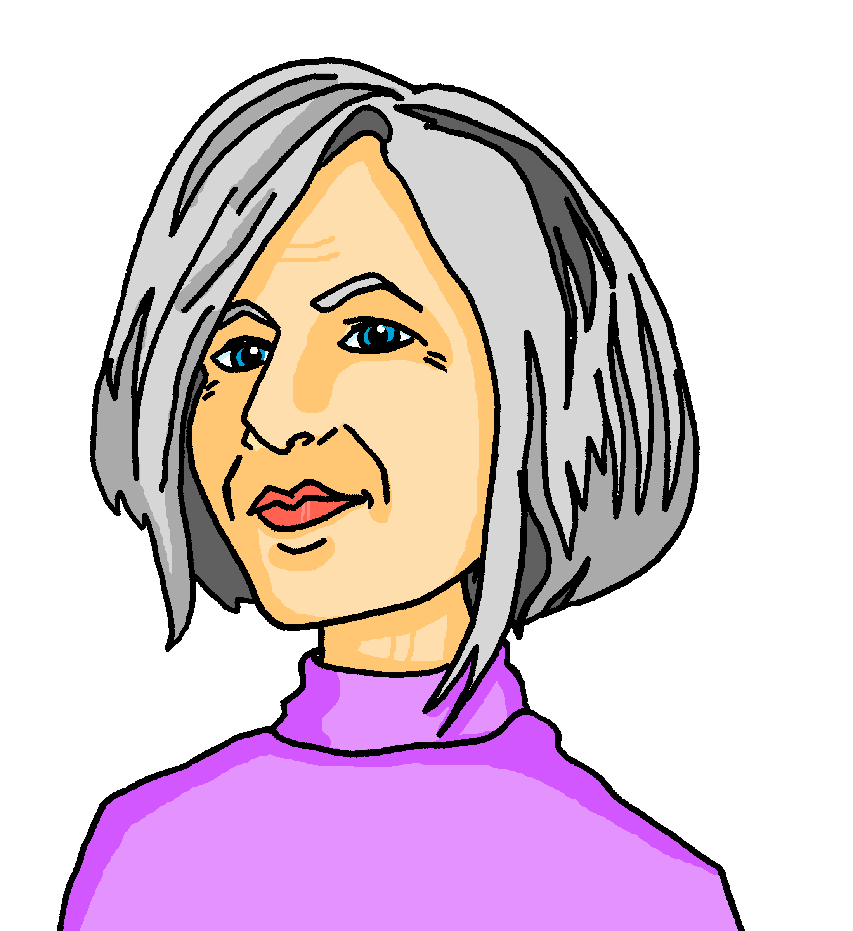
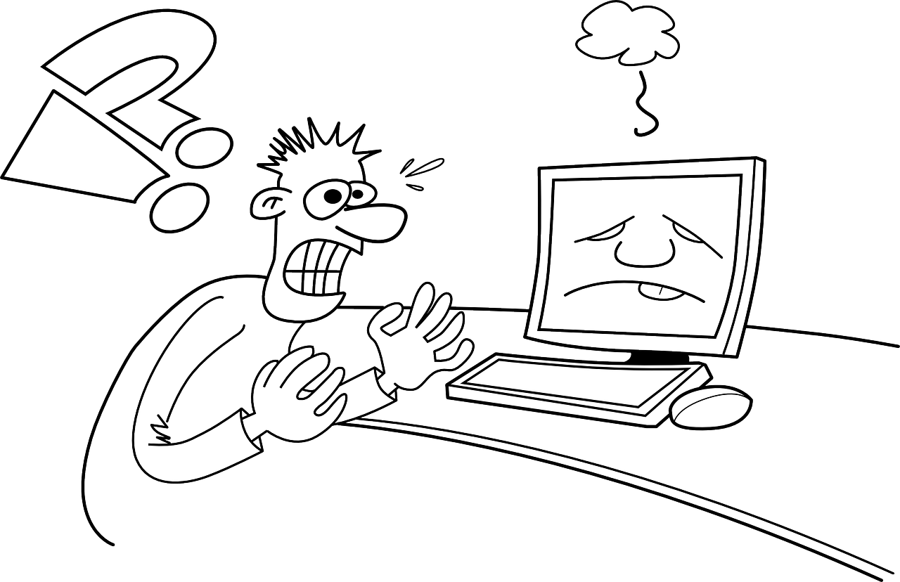
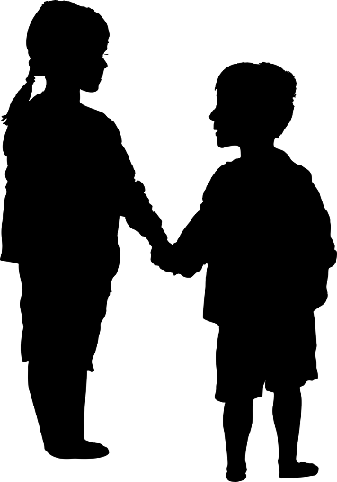
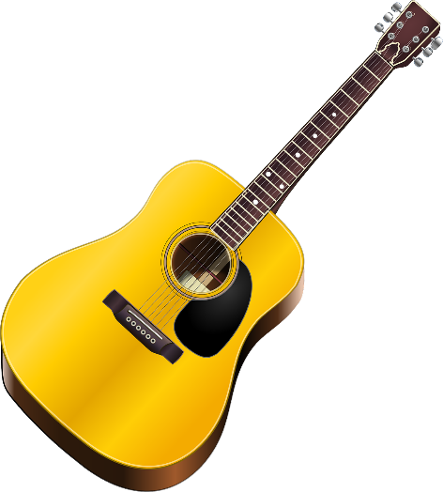
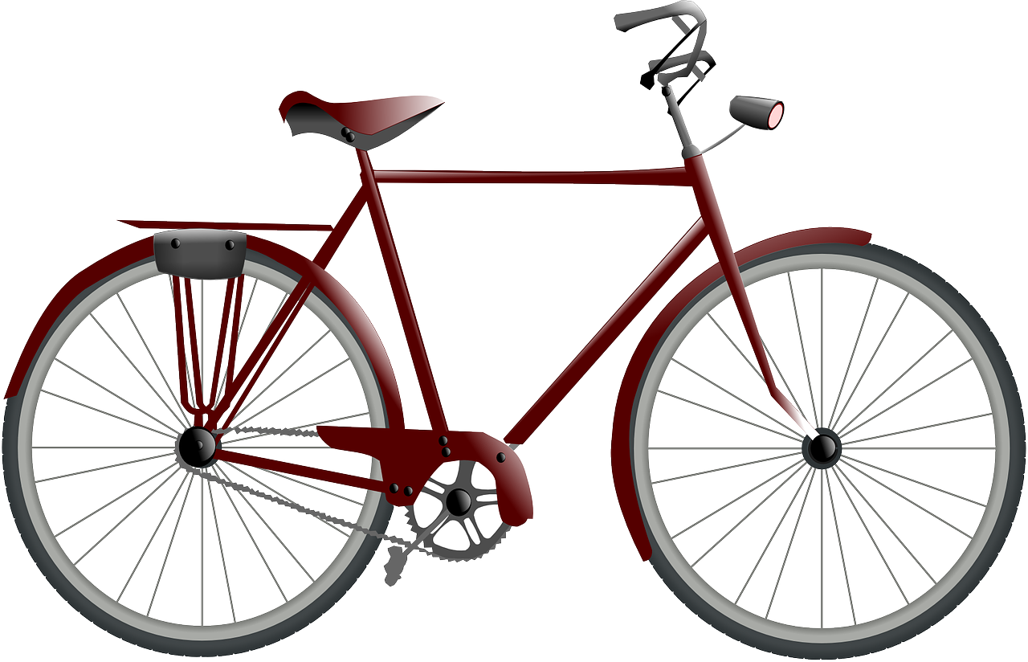
hören
Lias rings his mum back to clarify.
Hör zu. Ist das Lias (ich) oder Ronja (sie)?
 | Lias (ich), Ronja (sie) | | | do what?
 | Ronja | would like | to visit Grandma.
 | Ronja | wouldn’t like | to have a problem.
 | Lias | would like | to play with Gabriel.
 | Lias | would like | to use a list.
 | Ronja | wouldn’t like | to write.
 | Lias | wouldn’t like | to play guitar.
 | Ronja | would like | to use a bicycle.
Ex
to visit
1
2
3
4
5
6
Notes:
Timing: 5 minutes
Aim: to practise aural comprehension of möchte in the first and third persons and in positive and negative sentences, contrasting möchte… and möchte ein… with möchte nicht… and möchte kein…
Procedure:
Use the first sentence as an example. Click on the audio button to hear what Lias is saying to his mum. Based on the pronoun they hear, pupils decide who Lias is talking about, and then decide whether the sentence is positive or negative (would or wouldn’t like to). Click to play the sentence again and pupils try to understand the rest of the sentence. At the same time, by translating into English, students are reinforcing their knowledge of the two-verb rule and the difference in syntax between German and English.
Click to reveal the answers.
Repeat for the rest of the sentences.
Note: This is broken down into three columns to support understanding, and also so that less proficient students will still have a sense of achievement, even if they are not able to understand the full meaning of every sentence.
Transcript
E.g. Sie möchte auch Oma besuchen.
1. Sie möchte kein Problem haben.
2. Ich möchte mit Gabriel spielen.
3. Ich möchte eine Liste benutzen.
4. Sie möchte nicht schreiben.
5. Ich möchte keine Gitarre spielen.
6. Sie möchte ein Fahrrad benutzen.
10

Slide 11
Kultur
Holidays
* gehen – to go
Was möchte Lias machen?
In Switzerland, children have 12 weeks’ holiday a year. That’s one week less than you!
The summer holidays start in early July, and children are back to school by mid August!
Ich möchte im Juli Oma besuchen.
Ich möchte nicht im August in die Schule gehen*.
Notes:
Timing: 2 minutes
Aim: to learn about school holidays in Switzerland.
Procedure:
Pupils read through the information on the slide.
Discuss the information as a class – how would pupils feel about starting the summer holidays earlier and going back to school in mid August? Would they rather have 12 or 13 weeks’ holidays?
Note: Pupils are not expected to know all of the grammar in Lias’ second speech bubble, but they should have sufficient knowledge to infer what Lias is saying.
Information source:
https://www.biel-bienne.ch/de/schulferien.html/196
11

Slide 12
Tschüss!
gelb
Notes:
12

