Slide 1
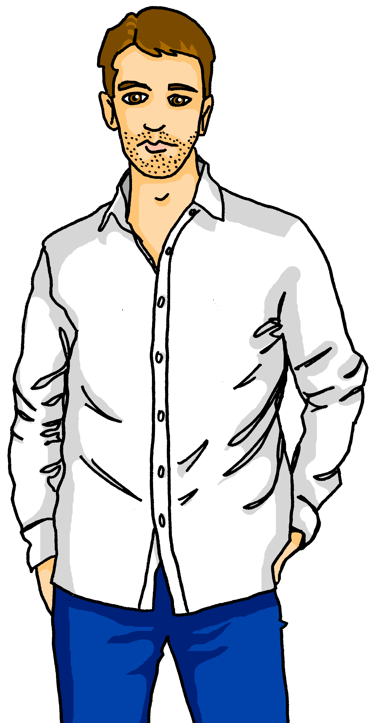
Talking about activities and events
gelb
Follow ups 1-5
Term 3 Week 7
Notes:
Artwork by Steve Clarke. Pronoun pictures from NCELP (www.ncelp.org). All additional pictures selected from Pixabay and are available under a Creative Commons license, no attribution required.
Phonics: Revisit [ie] [ei] Liebe [844] sie [7] Brief [838] frei [318] ein [5] klein [114] sein [3] allein [258]
Vocabulary: Familie [329] Mutter [218] Opa [2276] Vater [232] ihr¹ [27] lieb [897] müde [2000] ruhig [991] sein² [30]
Revisit 1: Januar [1052] Februar [1093] März [987] April [1004] Mai [1048] Juni [1148] Juli [1544] August [1929] September [1035] Oktober [1223] November [1273] Dezember [1527] Monat [316] Plan [954] wann [647]
Revisit 2: Nummer [806] null [1680] eins [774] zwei [70] drei [106] vier [200] fünf [274] sechs [428] sieben [611] acht [645] neun [1053] zehn [333] elf [1507] zwölf [1080] es gibt [n/a]
Jones, R.L & Tschirner, E. (2019). A frequency dictionary of German: Core vocabulary for learners. London: Routledge.
The frequency rankings for words that occur in this PowerPoint which have been previously introduced in these resources are given in the SOW and in the resources that first
introduced and formally re-visited those words.
For any other words that occur incidentally in this PowerPoint, frequency rankings will be provided in the notes field wherever possible.
Note that the first three lessons of the year teach language that can be continuously recycled as lesson routine every lesson in Y3/4.
The idea would be that the class teacher (whether or not s/he teaches the class German can re-use the language as part of the daily routine with the class.

Slide 2
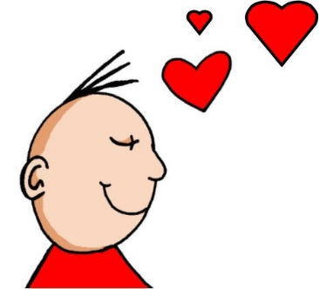
aussprechen
[ei]
[ie]
…
free
frei
Liebe
Notes:
Timing: 1 minute
Aim: to revisit the SSC [ei] and [ie].
Procedure:
Re-present the SSC [ei] and present the source word ‘frei’ (with gesture, if using).
Click to bring on the picture and get pupils to repeat the word ‘frei’ (with gesture, if using).
Note:
a gesture for frei’ might be to throw you hands up in the air and pretend to run away.
Re-present the SSC [ie] and present the source word ‘Liebe’ (with gesture, if using).
Click to bring on the picture and get pupils to repeat the word ‘Liebe’ (with gesture, if using).
Note:
A gesture for ‘Liebe’ might be to make a ‘heart’ shape with both hands approximately where your heart is in your body.
Vocabulary:
frei [318] Liebe [844]
Jones, R.L & Tschirner, E. (2019). A frequency dictionary of German: Core vocabulary for learners. London: Routledge.
2

Slide 3
Follow up 1
Ei oder ie?
Was sagt dein Partner/ deine Partnerin?
aussprechen
bl_____b
schw_____g
st_____g
tr_____b
schr_____
schr_____b
sch_____n
h_____ß
sp_____
m_____d
ie
ei
ei
ie
ei
ie
ie
ei
ei
ie
Notes:
Timing: 5 minutes
Aim: to practise spoken production and aural comprehension of [ie] and [ei]
Procedure:
Pupils work in pairs. Partner A reads the words on their handout, being careful to correctly pronounce [ie] and [ei]. Partner B fills in the gap on their handout based on what they heard.
Partners swap roles.
Click to reveal answers on this slide.
Note: All of the verbs used for this exercise have ‘ie’ in the imperfect form and ‘ei’ in the imperative form, but otherwise have the same spellings, so pupils will have to focus carefully on the phonics for this exercise.
Word frequency (1 is the most frequent word in German): heißen [126] meiden [4685] scheinen [275] schreien [1104] schweigen [973] speien [>5000] steigen [321] treiben [964] Source: Jones, R.L. & Tschirner, E. (2019). A frequency dictionary of German: core vocabulary for learners. Routledge

Slide 4
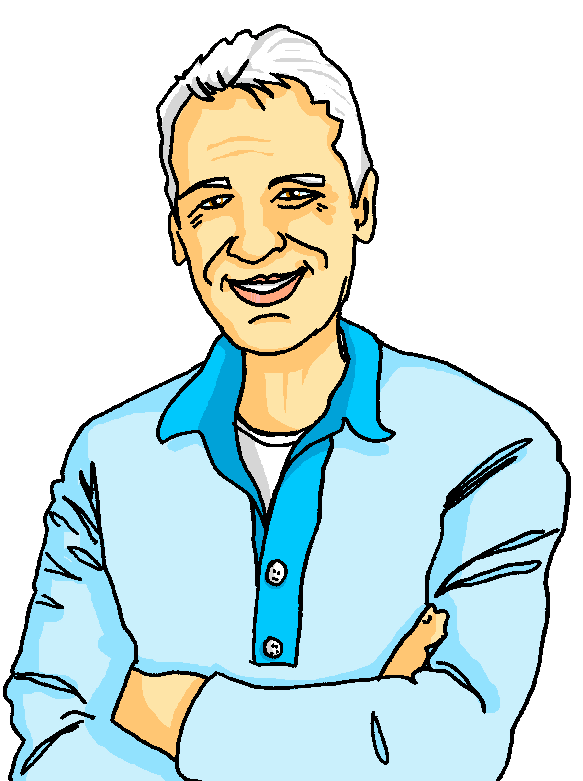
Follow up 2
Was sagt Lias?
Meine Familie
hören
Mein Vater ist Lothar. Sein Vater Dieter ist mein Opa. Er ist ruhig. Seine Lieblingsfarbe ist grün. Er spielt Computerspiele mit Oma.
1
2
lesen
3
4
 | Leonie | Dieter
Who are they? | She is Lias’s mother. | He is Lias’s granddad and Lothar’s father.
What are they like? | She is kind. | He is quiet.
Favourite thing | Her favourite cat is Minze. | His favourite colour is green.
What are they doing? | She is doing sport today. | He plays computer games with Oma.
Notes:
Timing: 10 minutes
Aim: to practise comprehension of possessive adjectives, present tense weak verbs, this week’s new and revisited vocabulary.
Procedure:
Explain the task. Lias is talking about Leonie and Dieter. Pupils fill in the table below using what they hear and read.
Click on the audio buttons to hear what Lias says about Leonie. Students fill in the table in English with the relevant information elicited in the first column. Note, the audio presents information in the same order as the table.
Students read the text next to Dieter, and fill in the table accordingly.
Click to reveal answers.
Transcript:
1. Das ist meine Mutter, Leonie.
2. Sie ist lieb.
3. Ihre Lieblingskatze ist Minze.
4. Sie macht heute Sport.

Slide 5
Follow up 3:
Wo sind* Lias, Ronja, Leonie, Lothar und Dieter?
Family
Granddad
Mother
Father
sprechen
my
your
his
her
*sind - are
Notes:
Timing: 5 minutes
Aim: to correctly use possessive adjectives with some of this week’s new vocabulary.
Procedure:
Pupils select a possessive adjective on the vertical axis with a noun along the horizontal axis.
They translate the short phrase (e.g. my – family = meine Familie) to identify the square where they think Lias, Ronja, Leonie, Lothar or Dieter is.
Click on the square to reveal what is beneath.

Slide 6
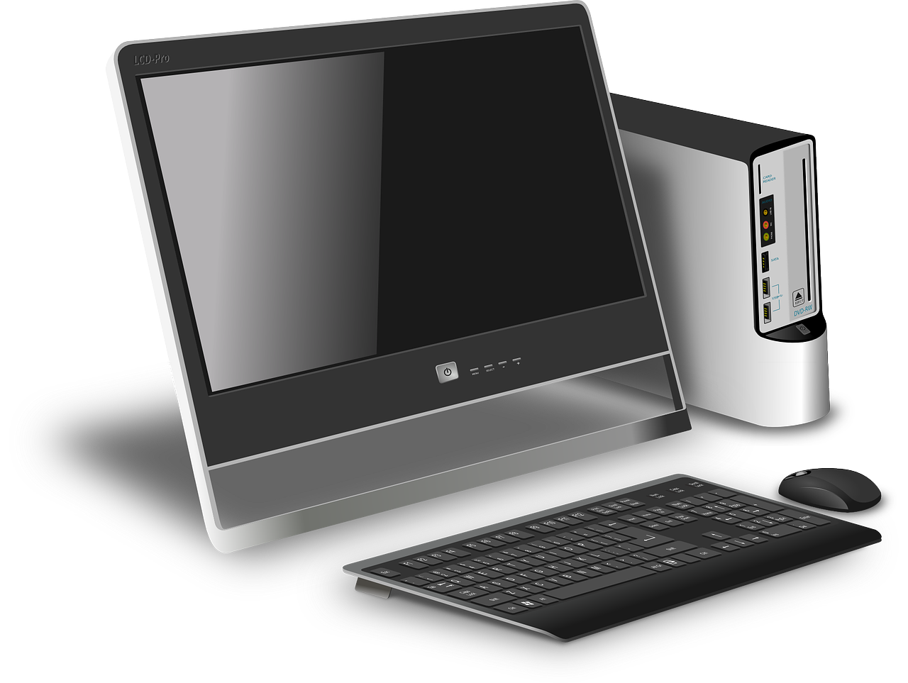
Follow up 4
Was ist ihr/ sein…?
Hör deiner Partnerin/ deinem Partner zu.
schreiben
sprechen
Ich arbeite zu Hause.

Das ist ihr Computer.
Notes:
Timing: 5 minutes (2 slides)
Aim: to practise using ihr and sein in a written context and present tense weak singular verbs in a spoken context.
Procedure:
Explain the task. Lias and Ronja have had a busy day and have left their things everywhere! Leonie and Lothar are trying to work out what belongs to whom, based on what Lias and Ronja have been up to.
Use the example on this slide to model the task. Ronja says she has been working at home. Therefore, she must have been using the computer rather than the tree. Pupils would write ‘das ist ihr Computer’.
Pupils work in pairs. One plays the role of Lias and the other Ronja. Partner A (Lias) reads a sentence from their handout. Partner B listens and then looks at the objects on the second handout. They decide which object Lias must have used for that activity, and write a sentence using ‘sein(e)’. (For objects belonging to Ronja, pupils should use ‘ihr(e)’.) Pupils alternate roles until they have finished.
Use the following slide for answers. It is possible pupils may have different answers, which is fine, so long as they can justify why!

Slide 7
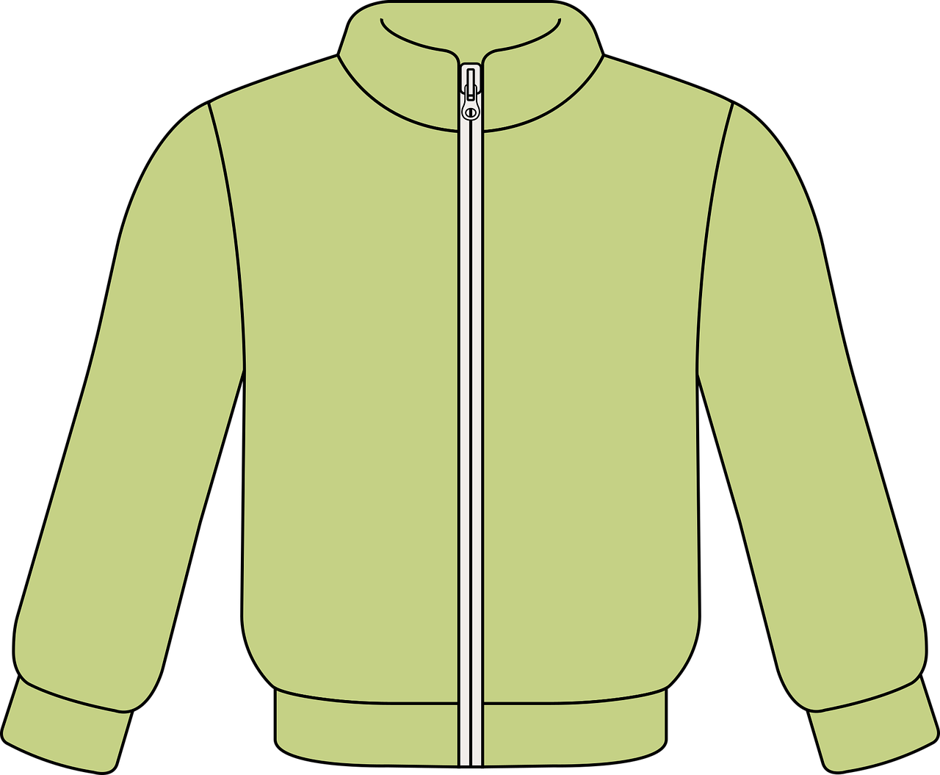
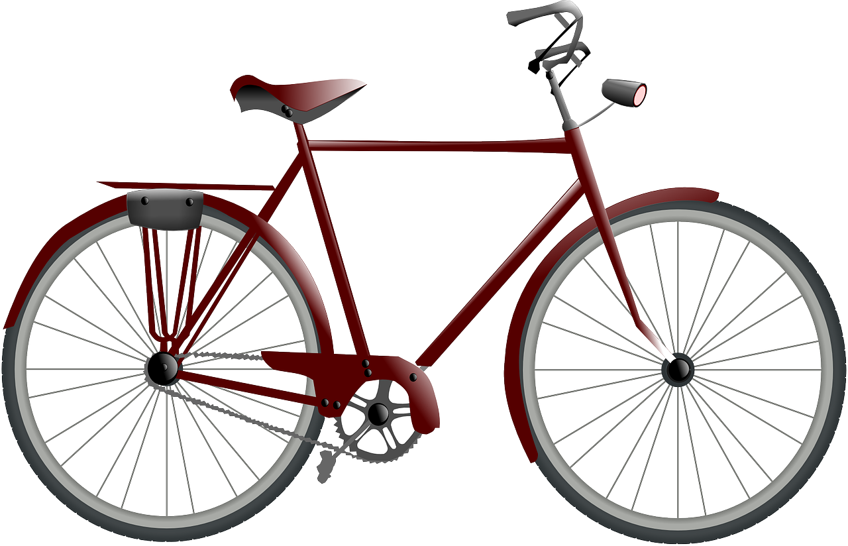
Follow up 4
Was ist ihr/ sein…?
Hör deiner Partnerin/ deinem Partner zu.
schreiben
sprechen
Das ist……………….….
Das ist……………….….
Das ist……………….….
ihr Ball.
seine Jacke.
sein Blatt.
Das ist……………….….
Das ist……………….….
Das ist……………….….
ihr Brief.
ihr Fahrrad.
sein Spiel.
Notes:
Answer slide

Slide 8
Follow up 5:

Schreib auf Englisch.
Can you get at least 15 points?
Wörter
 | die Nummer | fünf | null
 | zwölf | drei | es gibt
 | eins | sechs | sieben
 | wann? | Januar | der Plan
 | März | Juni | der Monat
 | Mai | Oktober | Dezember
 | der Opa | ihr | sein
 | der Vater | lieb | die Mutter
(the) number
five
zero
Vokabeln
x3
twelve
three
there is, there are
one
six
seven
when?
January
(the) plan
x2
March
June
(the) month
May
October
December
(the) grandad
her
his
x1
(the) father
kind, dear
(the) mother
Notes:
Timing: 5 minutes
Aim: to practise written comprehension of vocabulary from this and revisited weeks.
Procedure: 1. Give pupils a blank grid. They fill in the English meanings of any of the words they know, trying to reach 15 points in total. 2. Remind pupils that adjectives can refer to male or female persons and they should note this in their translations. E.g. pleased (f), short (m).
Note: The most recently learnt and practised words are pink, words from the previous week are green and those from week 1 are blue, thus more points are awarded for them, to recognise that memories fade and more effort (heavy lifting!) is needed to retrieve them.

Slide 9
Follow up 5:

Schreib auf Deutsch.
Can you get at least 15 points?
Wörter
 | two | eight | there is, there are
 | four | ten | zero
 | eleven | (the) number | nine
 | (the) month | April | when?
 | February | November | (the) plan
 | July | September | August
 | (the) family | his | (the) grandad
 | tired | quiet, calm | her
zwei
acht
es gibt
Vokabeln
x3
vier
zehn
null
elf
die Nummer
neun
der Monat
April
wann?
x2
Februar
November
der Plan
Juli
September
August
die Familie
sein
der Opa
x1
müde
ruhig
ihr
Notes:
Timing: 5 minutes
Aim: to practise written production of vocabulary from this and revisited weeks.
Procedure: 1. Give pupils a blank grid. They fill in the German meanings of any of the words they know, trying to reach 15 points in total. 2. Remind pupils that adjectives can refer to male or female persons and they should note this in their translations. E.g. pleased (f), short (m).
Note: The most recently learnt and practised words are pink, words from the previous week are green and those from week 1 are blue, thus more points are awarded for them, to recognise that memories fade and more effort (heavy lifting!) is needed to retrieve them.

Slide 10
Tschüss!
gelb
Notes:
10

Slide 11
Partner A
Sag die Wörter
Schreib ‘ei’ oder ‘ie’
aussprechen
1. schreib [write]
2. schien [appeared]
3. hieß [was called] 4. spei [spit] 5. mied [avoided]
bl_____b
schw_____g
st_____g
tr_____b
schr_____
Notes:
HANDOUT

Slide 12
Partner B
Sag die Wörter
Schreib ‘ei’ oder ‘ie’
aussprechen
1. blieb [stayed]
2. schweig [be silent]
3. steig [climb] 4. trieb [drove] 5. schrei [shout]
schr_____b
sch_____n
h_____ß
sp_____
m_____d
Notes:
HANDOUT

Slide 13
Follow up 4
Was ist ihr/ sein…?
Hör deine Partnerin/ deinen Partner zu.
Das ist……………….….
Das ist……………….….
Das ist……………….….
Das ist……………….….
Das ist……………….….
Das ist……………….….
Notes:
HANDOUT – one between each pair, for pupils to write their answers.

Slide 14
Partner A Du bist Lias. Dein*e Partner*in ist Ronja.
Partner B Du bist Ronja. Dein*e Partner*in ist Lias.
Ich spiele ein Spiel.
Ich bekomme Kleidung.
Ich benutze Papier.
Ich mache Sport.
Ich schreibe.
Ich besuche Jana.
Notes:
HANDOUT – to be cut in half. Partners should not show each other their half!

Slide 15
Follow up 5:

Schreib auf Englisch.
Can you get at least 15 points?
Wörter
 | die Nummer | fünf | null
 | zwölf | drei | es gibt
 | eins | sechs | sieben
 | wann? | Januar | der Plan
 | März | Juni | der Monat
 | Mai | Oktober | Dezember
 | der Opa | ihr | sein
 | der Vater | lieb | die Mutter
Vokabeln
x3
x2
x1
Notes:
HANDOUT

Slide 16
Follow up 5:

Schreib auf Deutsch.
Can you get at least 15 points?
Wörter
 | two | eight | there is, there are
 | four | ten | zero
 | eleven | (the) number | nine
 | (the) month | April | when?
 | February | November | (the) plan
 | July | September | August
 | (the) family | his | (the) grandad
 | tired | quiet, calm | her
Vokabeln
x3
x2
x1
Notes:
HANDOUT

