Slide 1

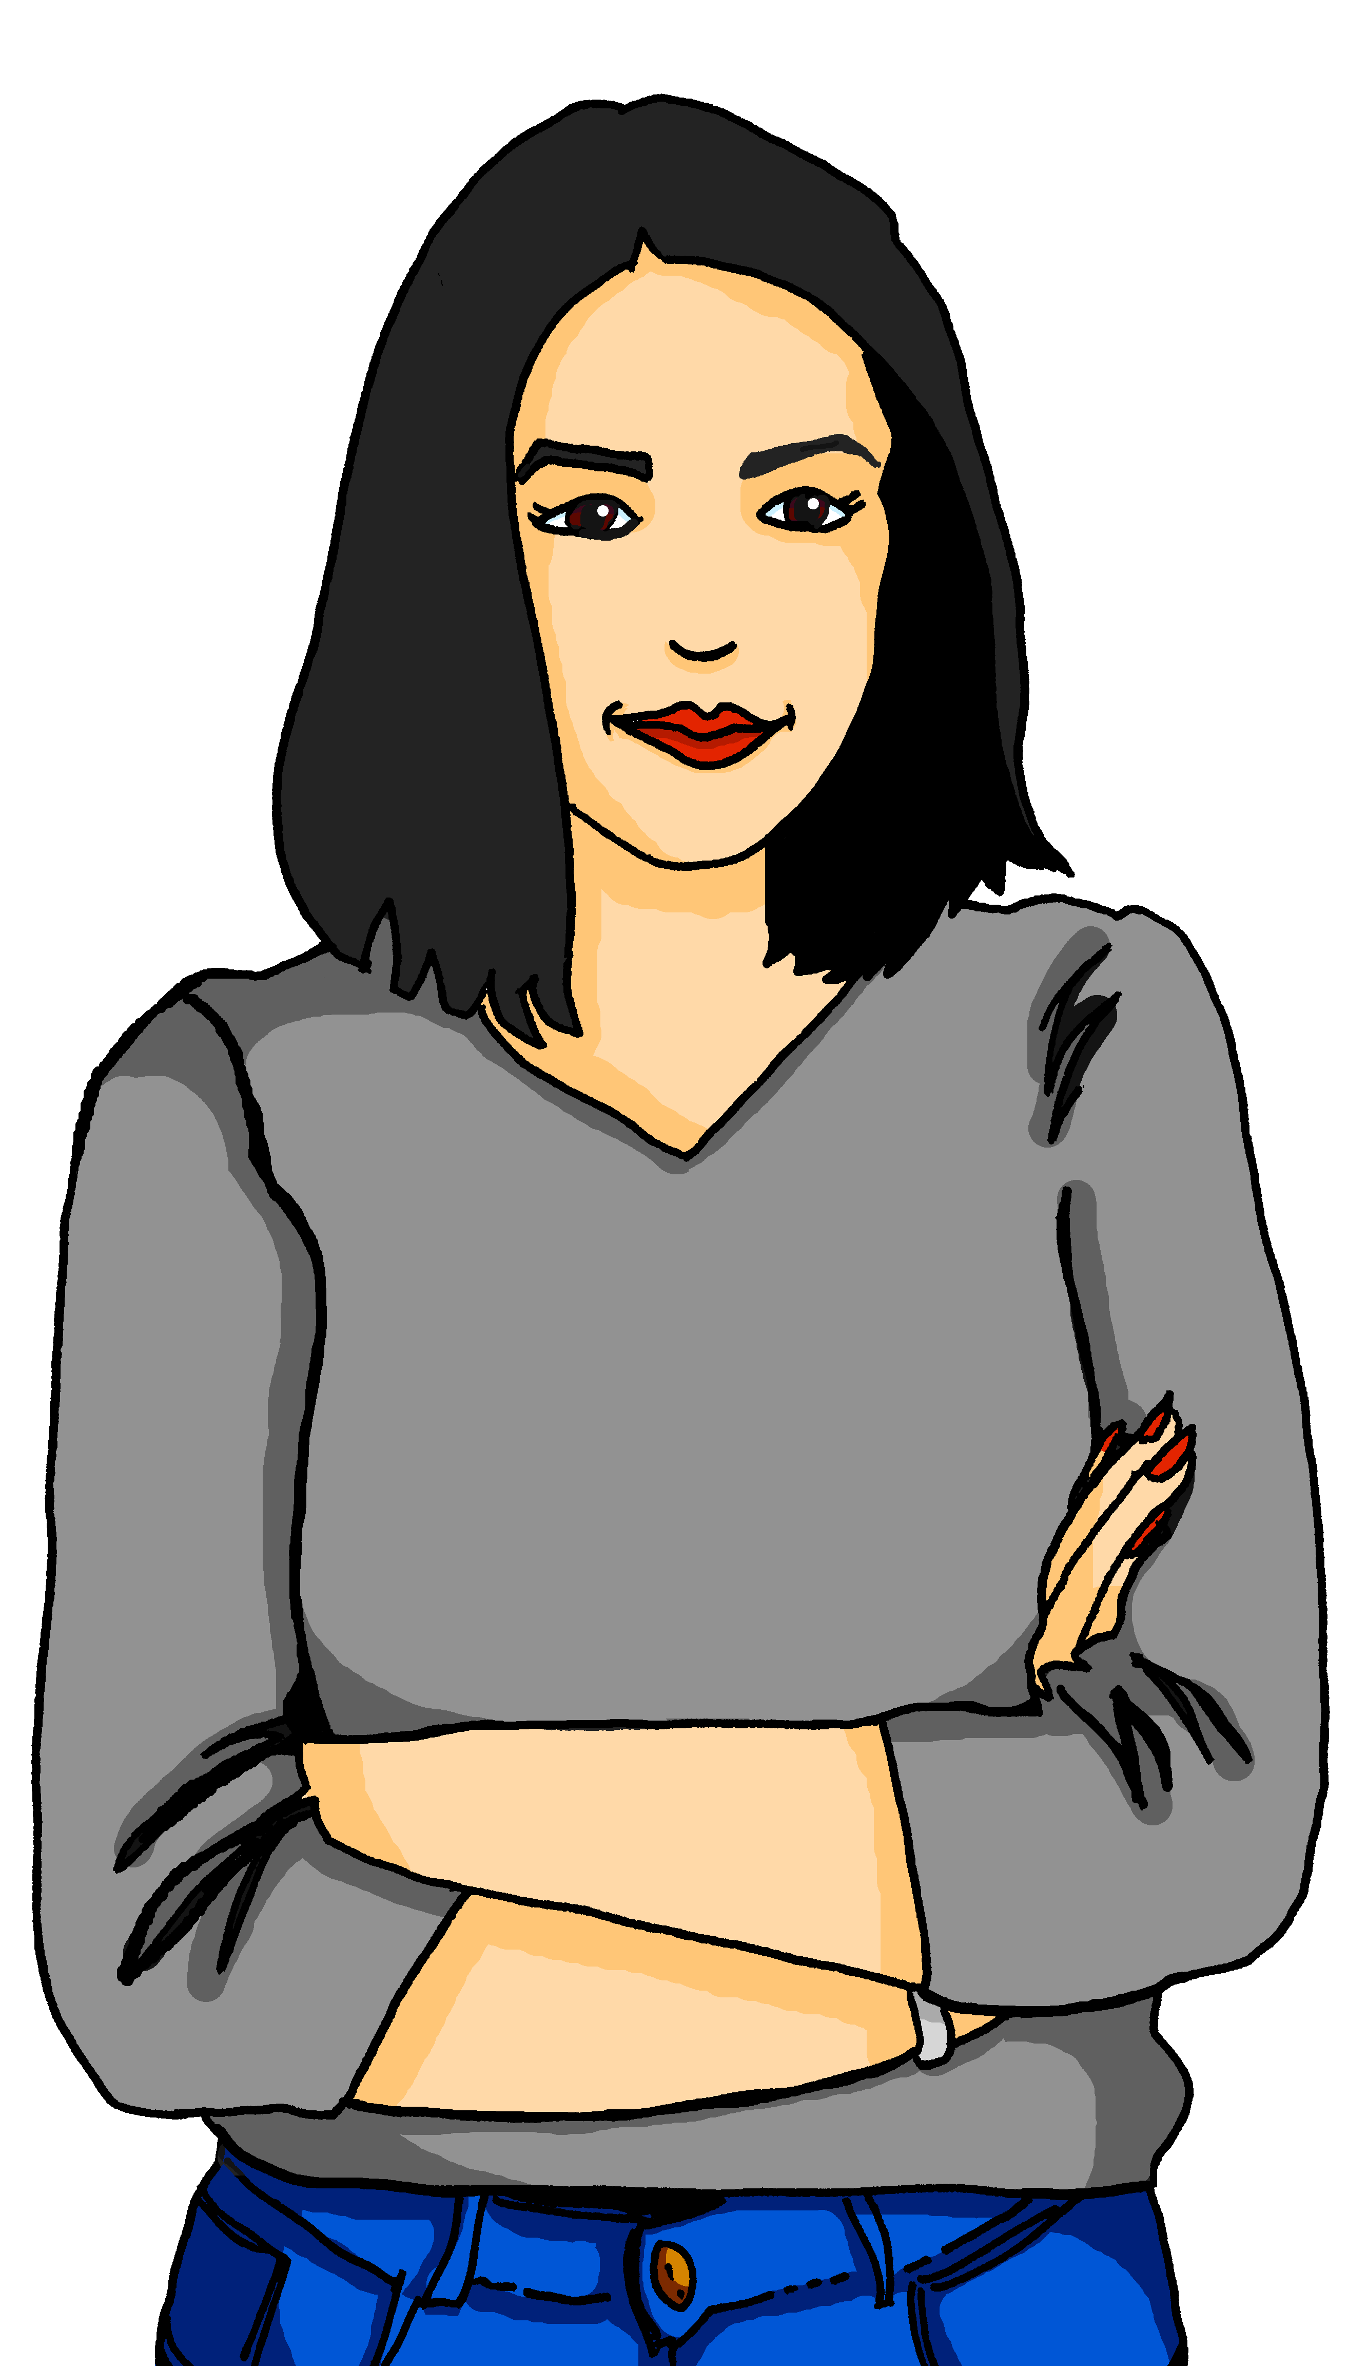
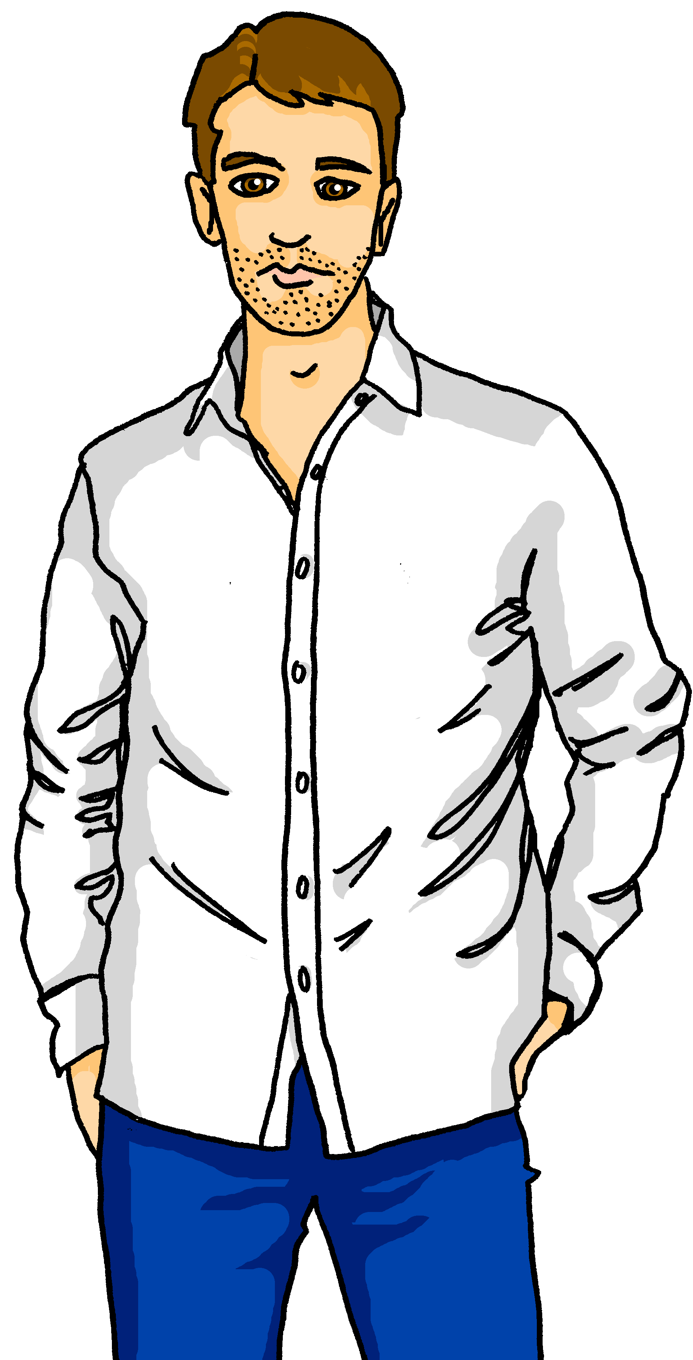
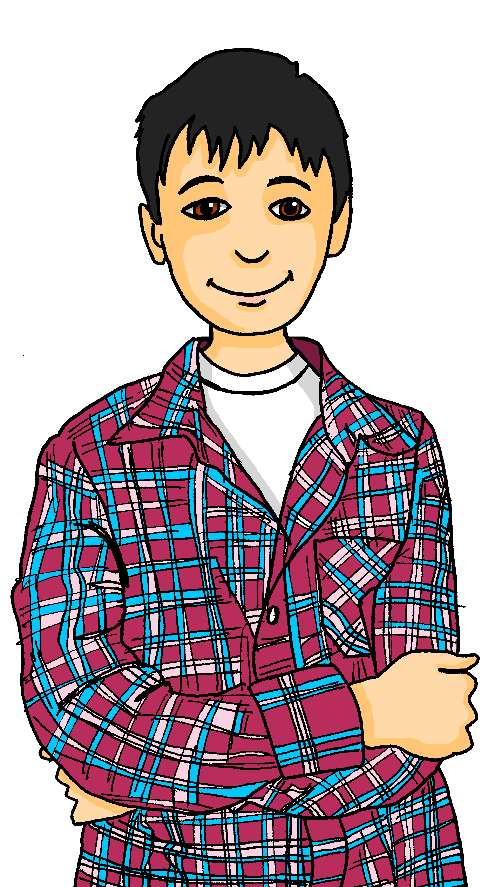
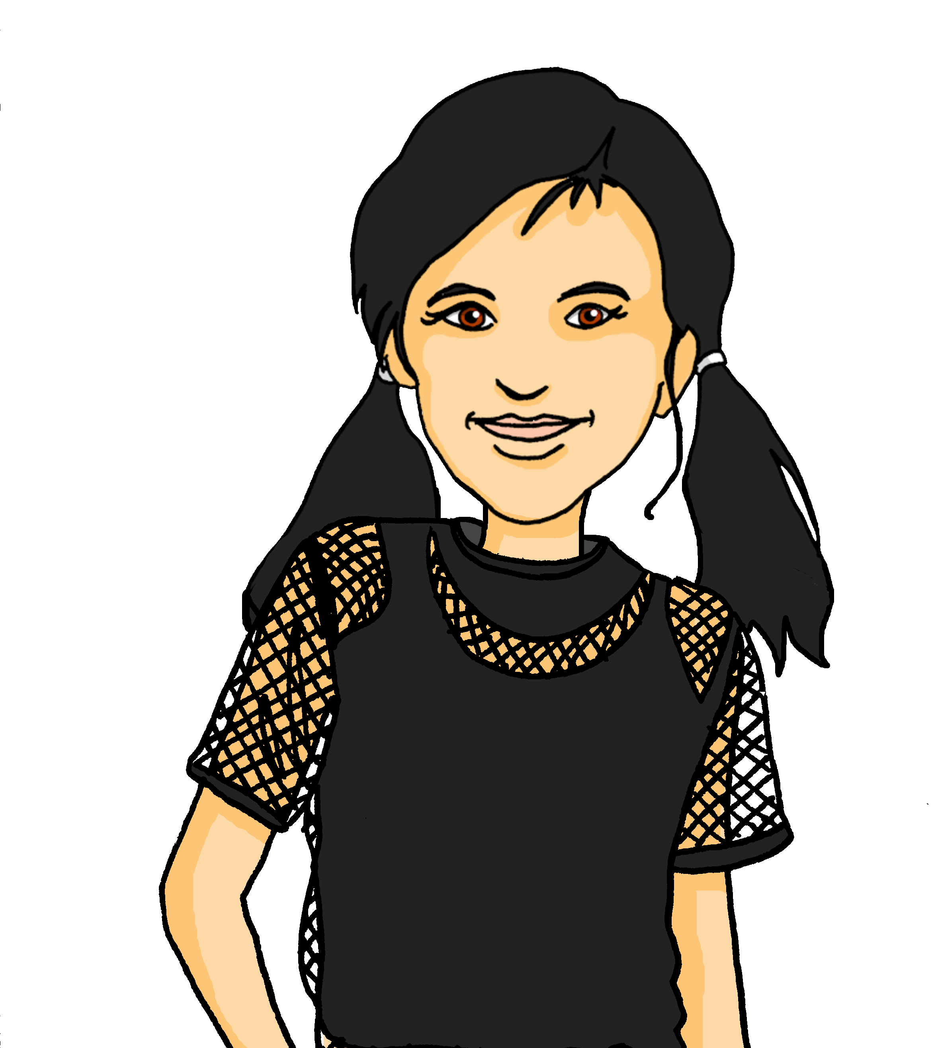
Talking about activities and events
gelb
Possessive adjectives mein, dein, sein, ihr
SSC [ei] [ie]
Term 3 Week 7
Notes:
Artwork by Steve Clarke. Pronoun pictures from NCELP (www.ncelp.org). All additional pictures selected from Pixabay and are available under a Creative Commons license, no attribution required.
Phonics: Revisit [ie] [ei] Liebe [844] sie [7] Brief [838] frei [318] ein [5] klein [114] sein [3] allein [258]
Vocabulary: Familie [329] Mutter [218] Opa [2276] Vater [232] ihr¹ [27] lieb [897] müde [2000] ruhig [991] sein² [30]
Revisit 1: Januar [1052] Februar [1093] März [987] April [1004] Mai [1048] Juni [1148] Juli [1544] August [1929] September [1035] Oktober [1223] November [1273] Dezember [1527] Monat [316] Plan [954] wann [647]
Revisit 2: Nummer [806] null [1680] eins [774] zwei [70] drei [106] vier [200] fünf [274] sechs [428] sieben [611] acht [645] neun [1053] zehn [333] elf [1507] zwölf [1080] es gibt [n/a]
Jones, R.L & Tschirner, E. (2019). A frequency dictionary of German: Core vocabulary for learners. London: Routledge.
The frequency rankings for words that occur in this PowerPoint which have been previously introduced in these resources are given in the SOW and in the resources that first
introduced and formally re-visited those words.
For any other words that occur incidentally in this PowerPoint, frequency rankings will be provided in the notes field wherever possible.
Note that the first three lessons of the year teach language that can be continuously recycled as lesson routine every lesson in Y3/4.
The idea would be that the class teacher (whether or not s/he teaches the class German can re-use the language as part of the daily routine with the class.
1

Slide 2

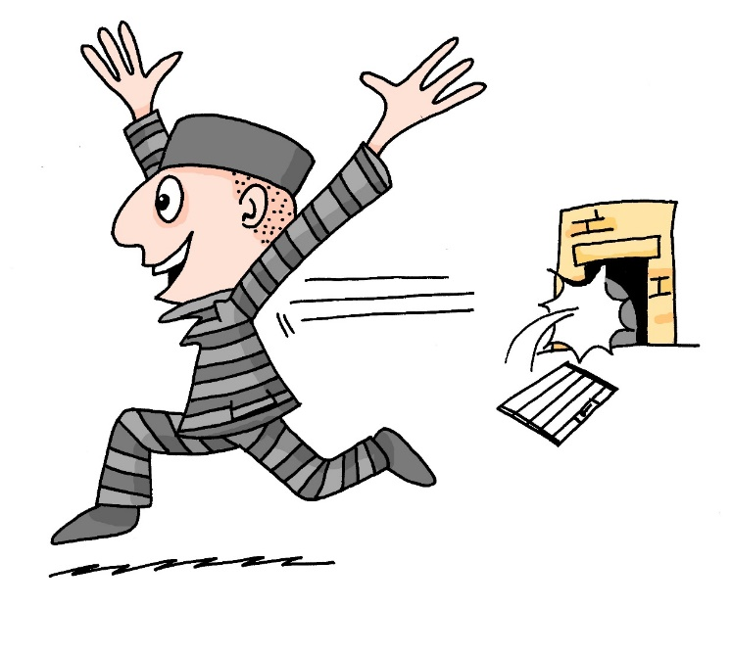
aussprechen
[ei]
…
free
frei
Notes:
Timing: 1 minute
Aim: to revisit the SSC [ei].
Procedure:
Re-present the SSC [ei] and present the source word ‘frei’ (with gesture, if using).
Click to bring on the picture and get pupils to repeat the word ‘frei’ (with gesture, if using).
Note:
a gesture for frei’ might be to throw you hands up in the air and pretend to run away.
Vocabulary: frei [318
Jones, R.L & Tschirner, E. (2019). A frequency dictionary of German: Core vocabulary for learners. London: Routledge.
2

Slide 3




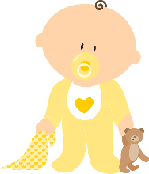

aussprechen
[ei]
…
frei
/a
sein
ein
alone
klein
allein
Notes:
Timing: 1 minute
Aim: to revisit the SSC [ei].
Procedure:
Re-present the SSC and the source word ‘frei’ (with gesture, if using).
Click to bring on the picture and get pupils to repeat the word ‘frei’ (with gesture, if using).
Present the cluster words in the same way, bringing on the picture and getting pupils to pronounce the words.
Vocabulary: frei [318] ein [5] klein [114] sein [3] allein [258]
Jones, R.L & Tschirner, E. (2019). A frequency dictionary of German: Core vocabulary for learners. London: Routledge.

Slide 4
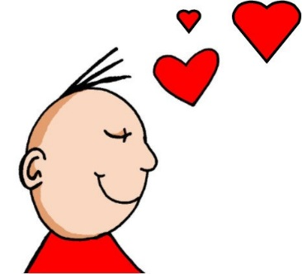
aussprechen
[ie]
…
Liebe
Notes:
Timing: 1 minute
Aim: to revisit the SSC [ie].
Procedure:
Re-present the SSC [ie] and present the source word ‘Liebe’ (with gesture, if using).
Click to bring on the picture and get pupils to repeat the word ‘Liebe’ (with gesture, if using).
Note:
A gesture for ‘Liebe’ might be to make a ‘heart’ shape with both hands approximately where your heart is in your body.
Liebe [844]
Jones, R.L & Tschirner, E. (2019). A frequency dictionary of German: Core vocabulary for learners. London: Routledge.
4

Slide 5
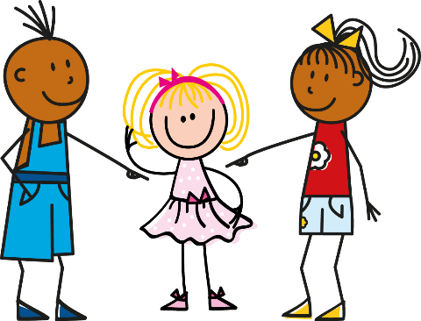

aussprechen
[ie]
…
sie
Liebe
Brief
Notes:
Timing: 1 minute
Aim: to revisit the SSC [ie].
Procedure:
Re-present the SSC and present the source word ‘Liebe’ (with gesture, if using).
Click to bring on the picture and get pupils to repeat the word ‘Liebe’ (with gesture, if using).
Present the cluster words in the same way, bringing on the picture and getting pupils to pronounce the words.
sie [7] Brief [838]
Jones, R.L & Tschirner, E. (2019). A frequency dictionary of German: Core vocabulary for learners. London: Routledge.
5

Slide 6



[ei] [ie]
Hör zu. Wie viele [ei] und [ie] hörst du?
hören
 |  | ei | ie
1 | Er spielt sein Lieblingsspiel. | I | I I I
2 | Das Papier bleibt weiß. | I I | I
3 | Sie arbeitet hier freitags und dienstags. | I I I | I I
4 | Marie schreibt einen Brief. | I I | I I
5 | Nein, das ist kein einfacher Preis. | I I I I
6 | Wie viele* Spieler? Zwei? Drei? | I I | I I I
*wie viele – how many
Notes:
Timing: 5 minutes
Aim: to consolidate the SSC [ei] and [ie] in a listening activity.
Procedure:
Explain the task. Pupils are going to hear six sentences which contain a mixture of [ei] and [ie] sounds.
For each sentence they hear, pupils count the number of times they hear each SSC, noting down their answers.
Click to reveal answers.
To aid comprehension, click to reveal a gloss box for the unknown word.
Transcript:
Er spielt sein Lieblingsspiel.
Das Papier bleibt weiß.
Sie arbeitet hier freitags und dienstags.
Marie schreibt einen Brief.
Nein, das ist kein einfacher Preis.
Wie viele Spieler? Zwei? Drei?
Word frequency (1 is the most frequent word in German):
wie viele [N/A]
Source: Jones, R.L. & Tschirner, E. (2019). A frequency dictionary of German: core vocabulary for learners. Routledge

Slide 7
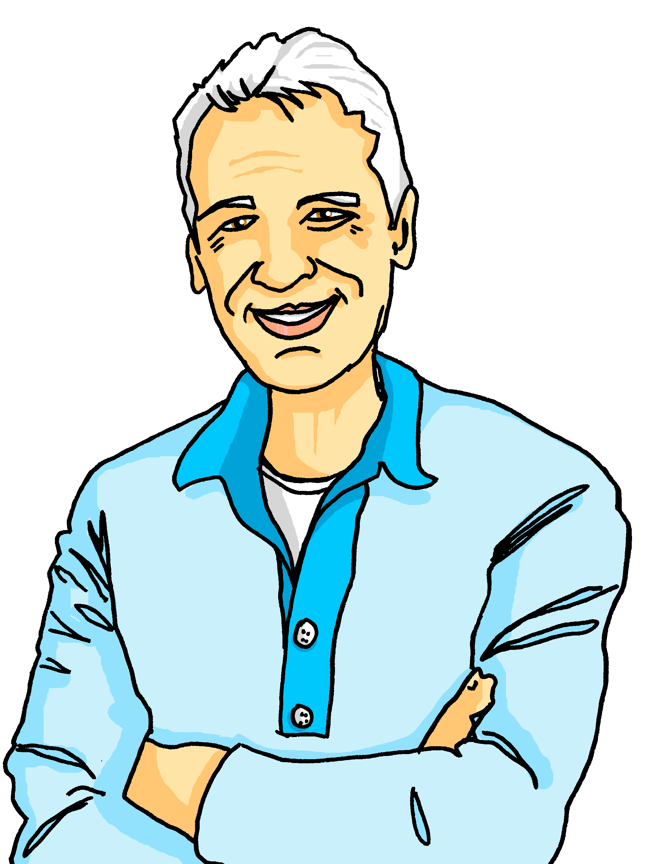
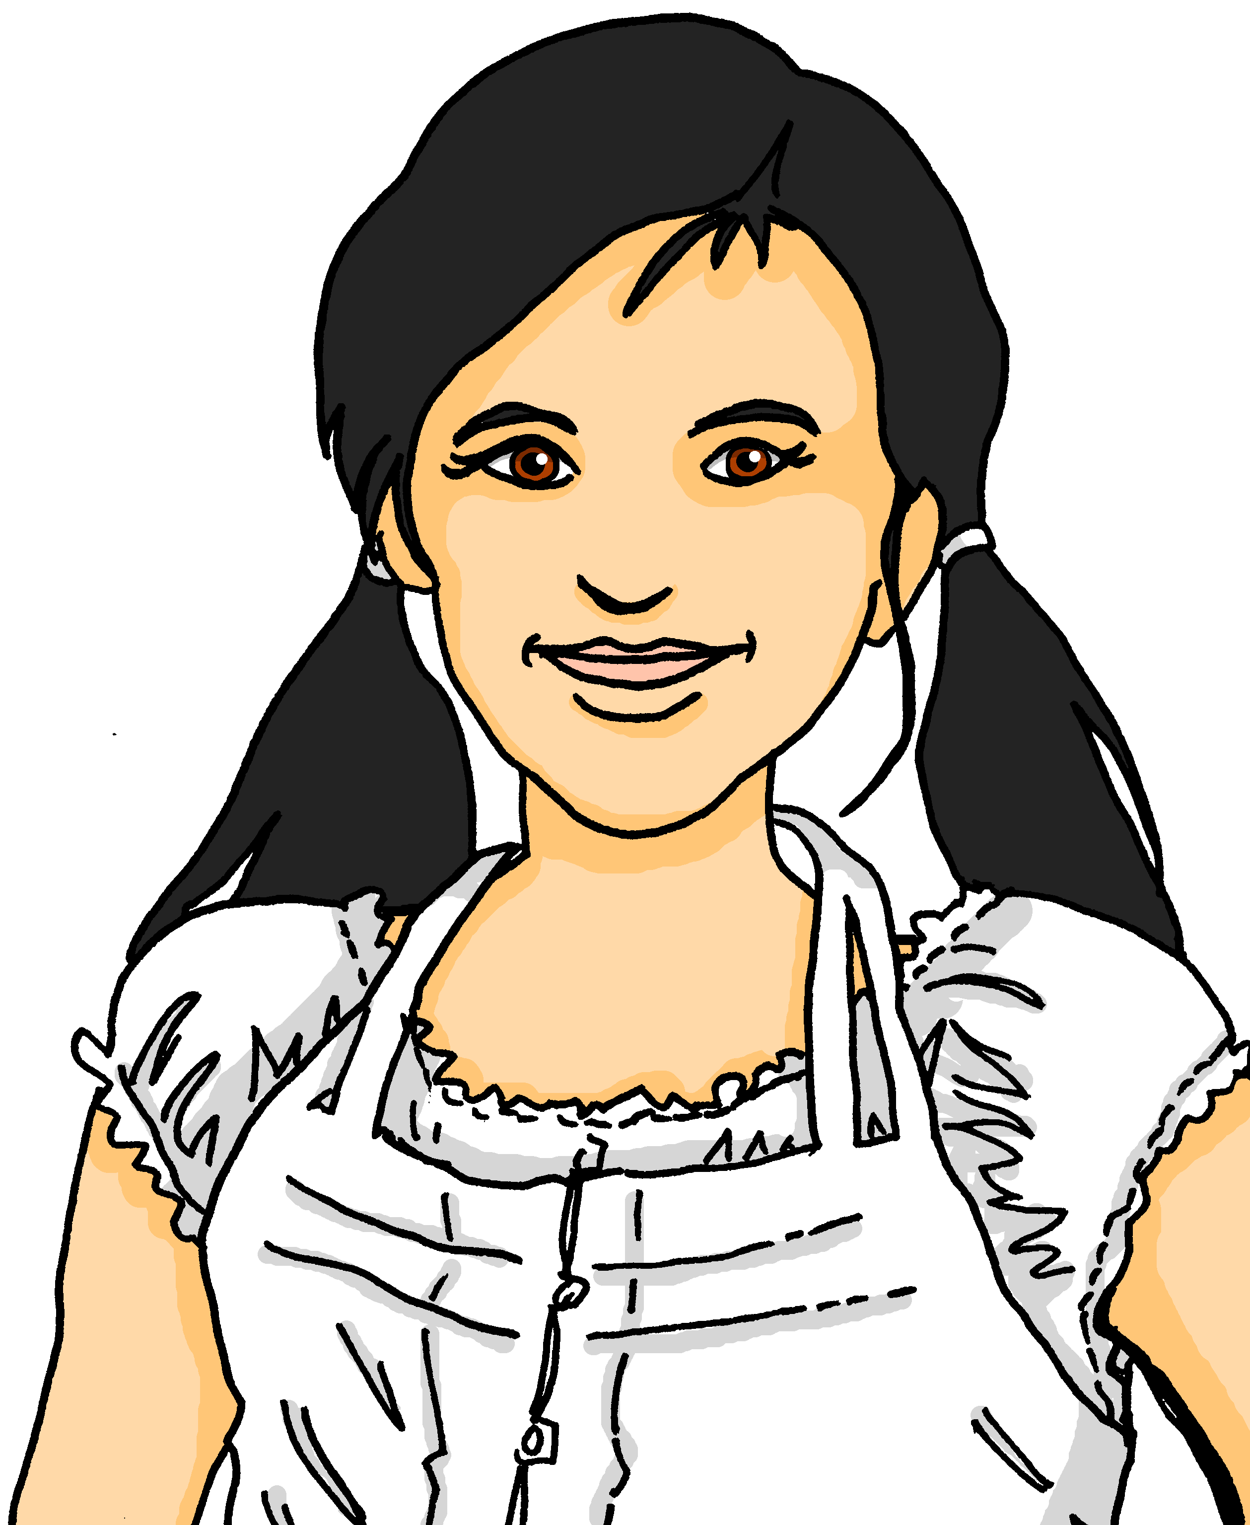
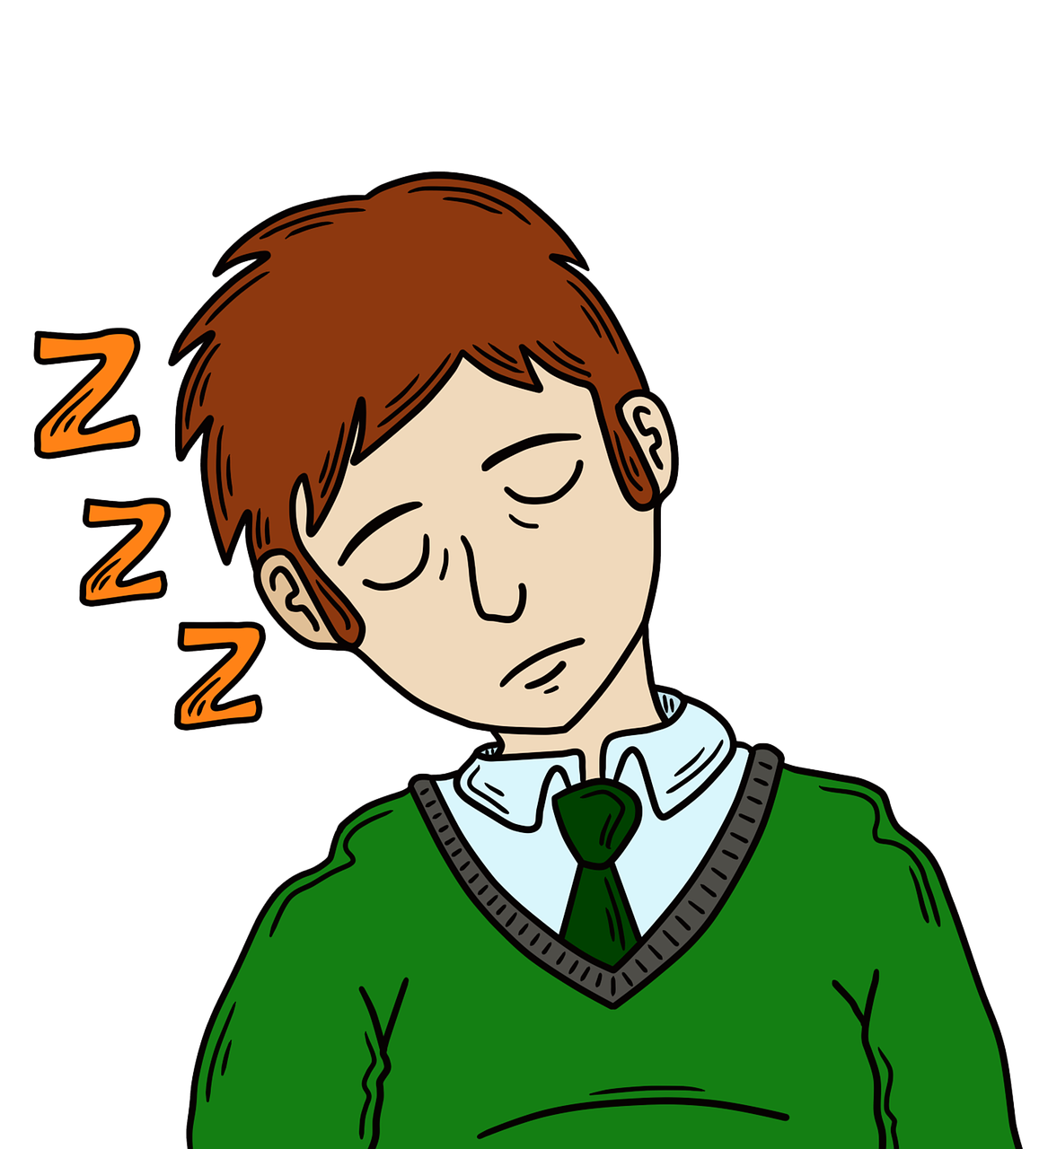


Vokabeln
Vokabeln lernen
Wörter
Hör zu und wiederhole.
the family
the mother
the father
the grandad
die Familie
die Mutter
der Vater
der Opa
kind, dear
tired
quiet, calm
lieb
müde
ruhig
Notes:
Timing: 5 minutes
Aim: to present and practise new vocabulary for this week
Procedure:
Click to reveal a German word. Click again for the English translation and picture.
Click to make each English word disappear. Pupils recall the English.
Click to make each German word disappear. Pupils recall the German.
7

Slide 8


mein | dein (possessive adjectives)
To say ‘my’ use mein or meine:
masculine
feminine
neuter
mein Plan
meine Nummer
mein Papier
e
my plan
my number
my paper
The word ‘mein’ must agree with the gender of the noun that follows. The feminine form is ‘meine’.
To say ‘your’ use dein or deine:
dein Plan
deine Nummer
dein Papier
e
your plan
your number
your paper
Notes:
Timing: 2 minutes
Aim: to recap the possessive adjectives ‘mein’ and ‘dein’.
Procedure:
Click through the animations to recap the information.
Elicit English translation for the German examples provided.
8

Slide 9

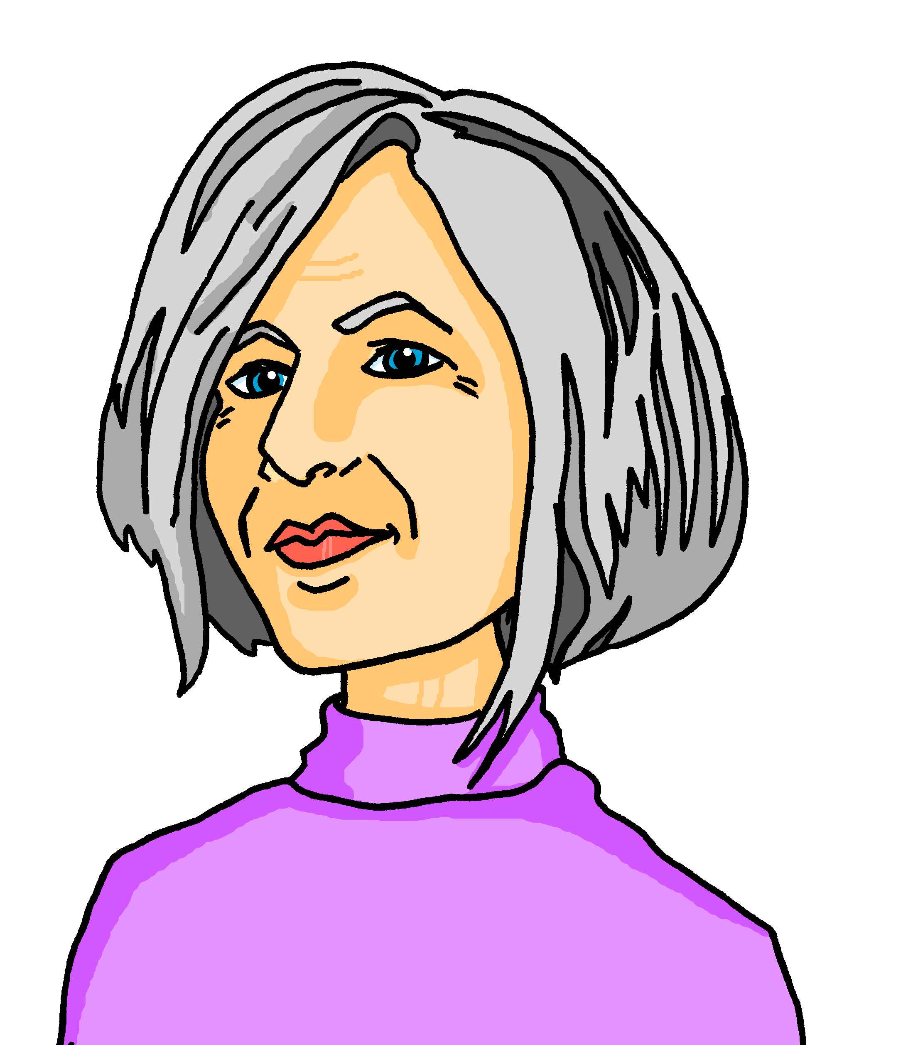
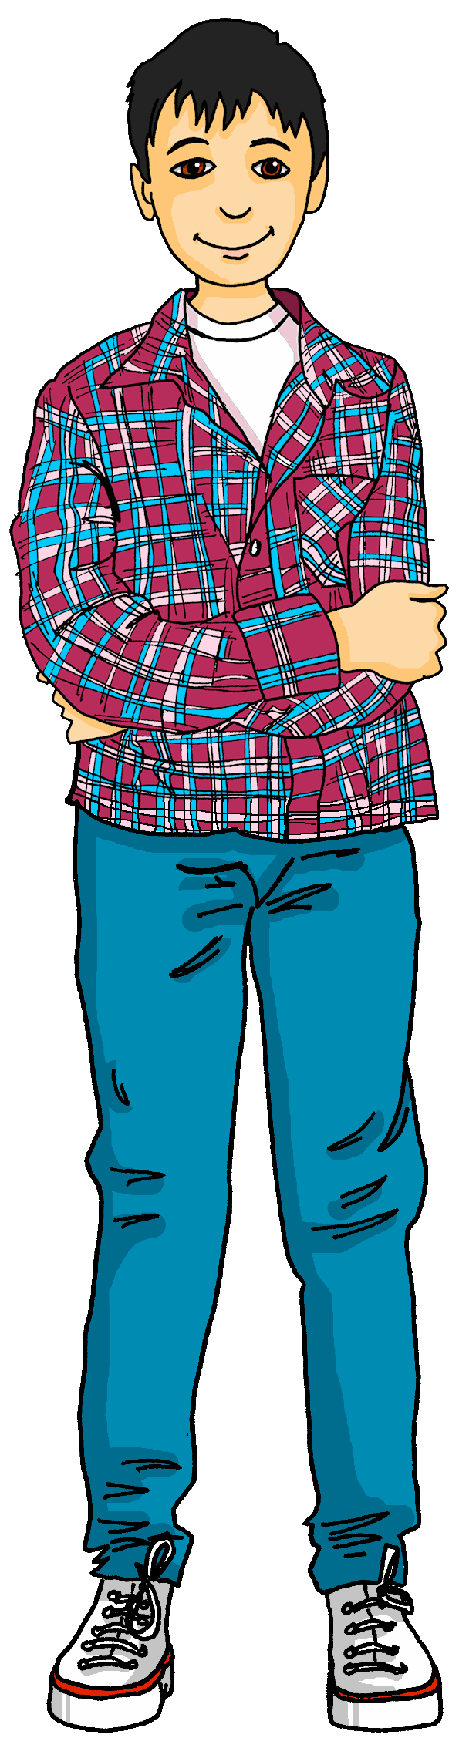
sprechen
Wer ist das?
…
Sabine
Dieter
Und sie ist deine Oma. Sie spielt Gitarre.
Und ich bin dein Opa. Ich bin ruhig.
Das ist meine Familie!
Und das ist mein Vater. Er ist heute müde.
Das ist meine Mutter. Sie ist lieb.
Lothar
Leonie
Lias
Ronja
Notes:
Timing: 5 minutes
Aim: to provide further practice of this week’s vocabulary and to recap mein and dein.
Procedure:
Explain the task. Lias and Dieter are talking about their family.
Click to bring up the first speech bubble. Click to hear what Lias says while students read along.
Repeat for a further 4 speech bubbles.
9

Slide 10
sein| ihr (possessive adjectives)
To say ‘his’ use sein or seine:
masculine
feminine
neuter
sein Vater
seine Mutter
sein Haus
e
his father
his mother
his house
The word ‘sein’ must agree with the gender of the noun that follows. The feminine form is ‘seine’.
To say ‘her’ use ihr or ihre:
ihr Vater
ihre Mutter
ihr Haus
e
her father
her mother
her house
Notes:
Timing: 2 minutes
Aim: to introduce the possessive adjectives ‘sein’ and ‘ihr’.
Procedure:
Click through the animations to present the new information.
Elicit English translation for the German examples provided.
10

Slide 11
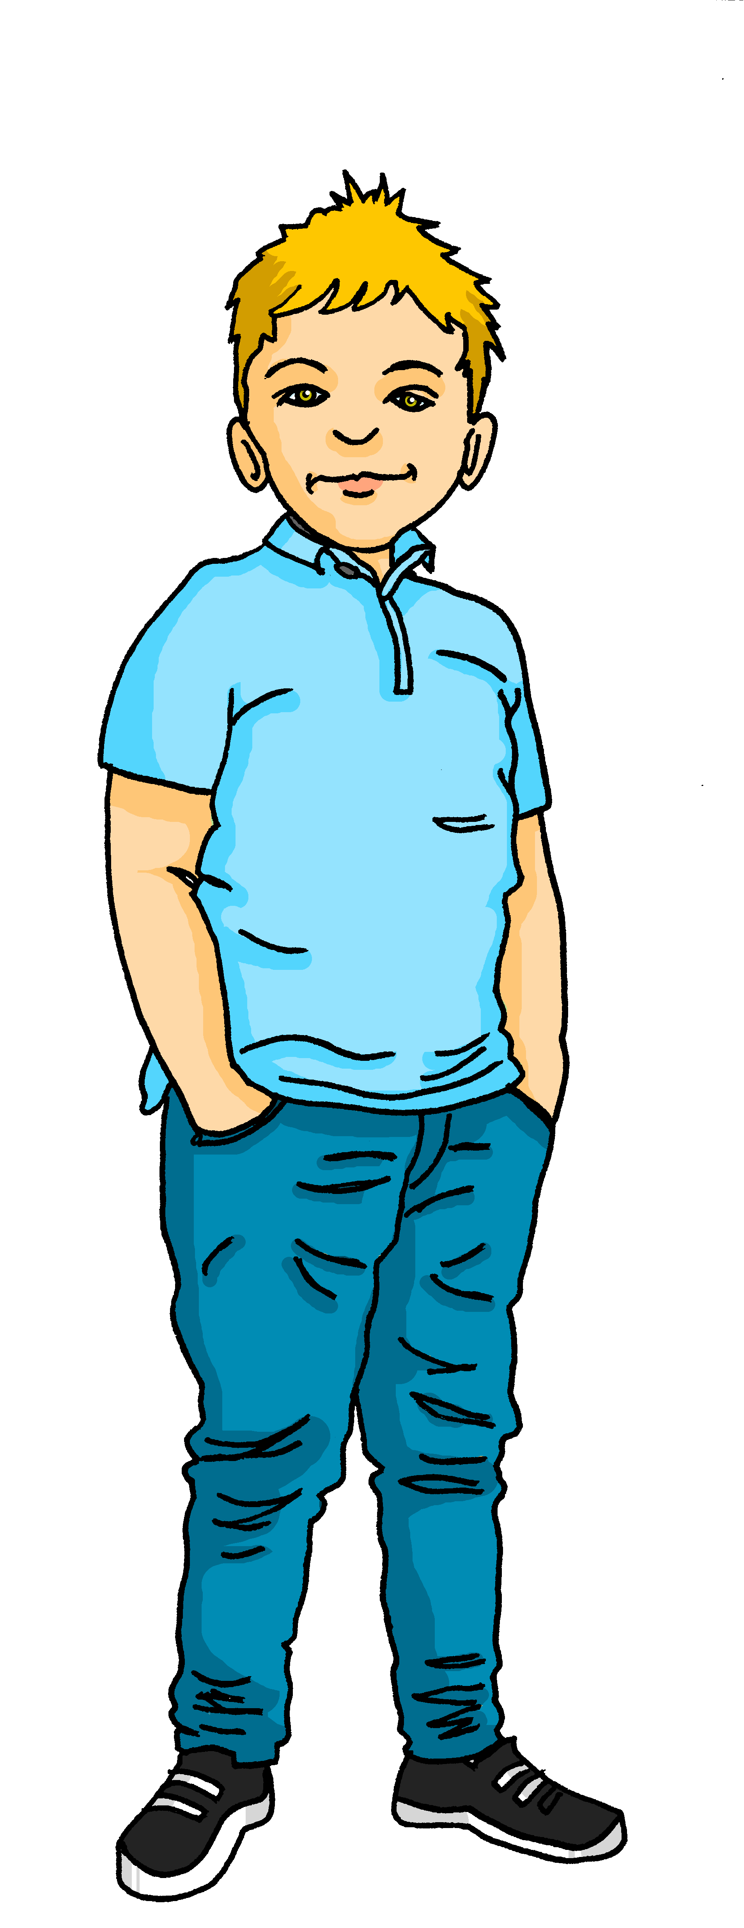
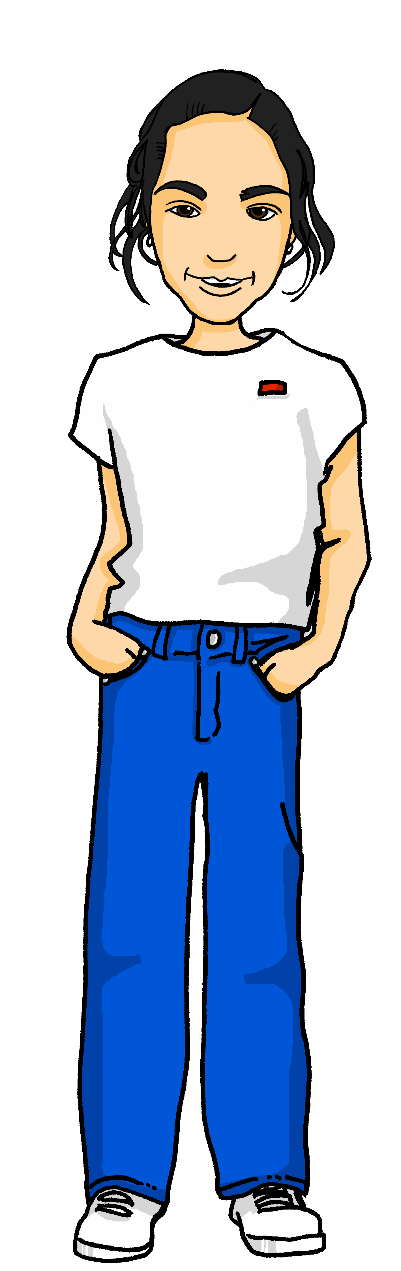
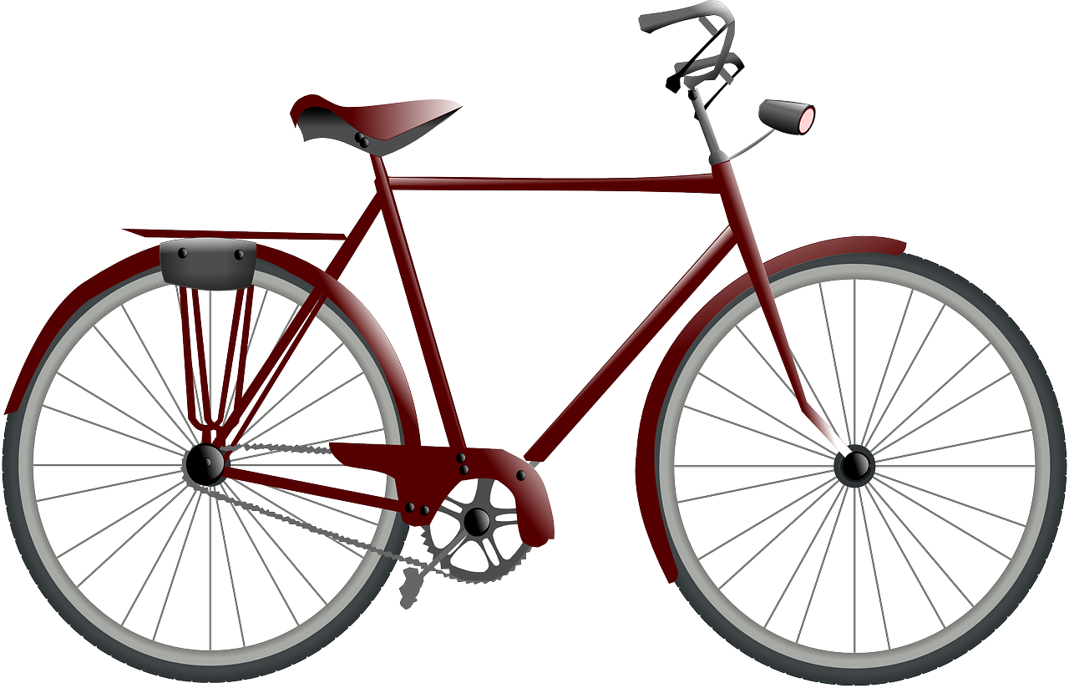

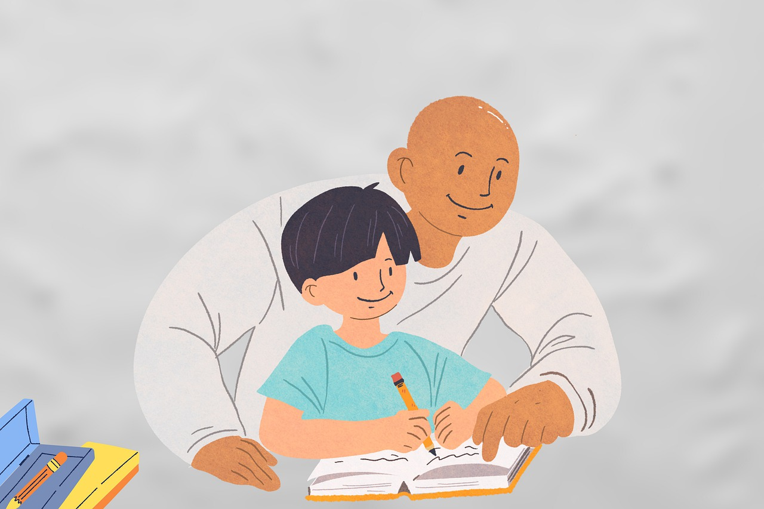




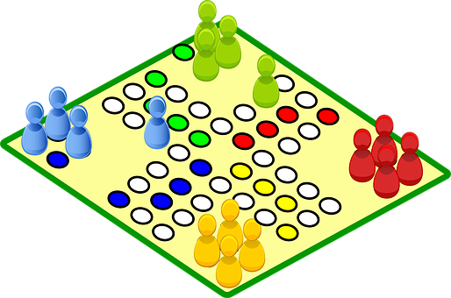


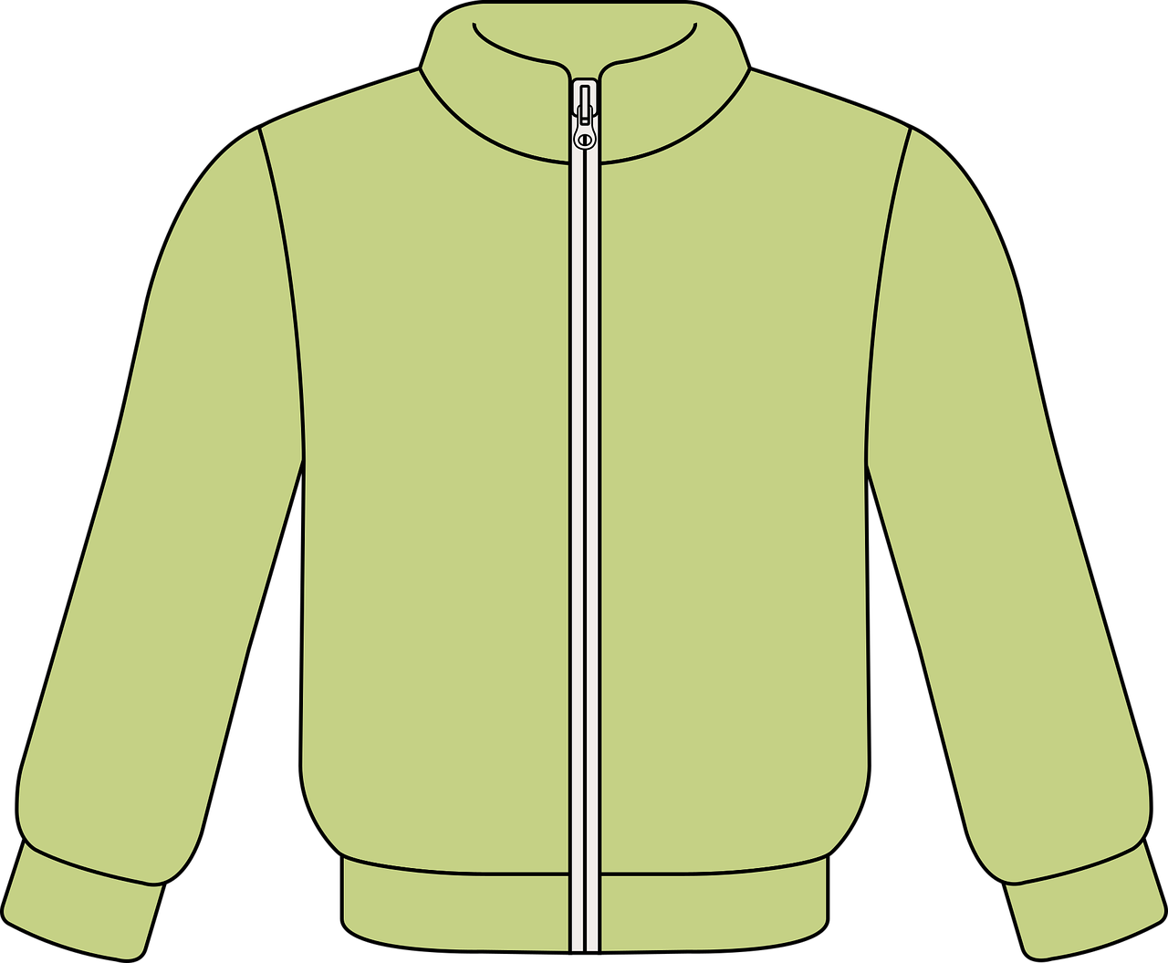





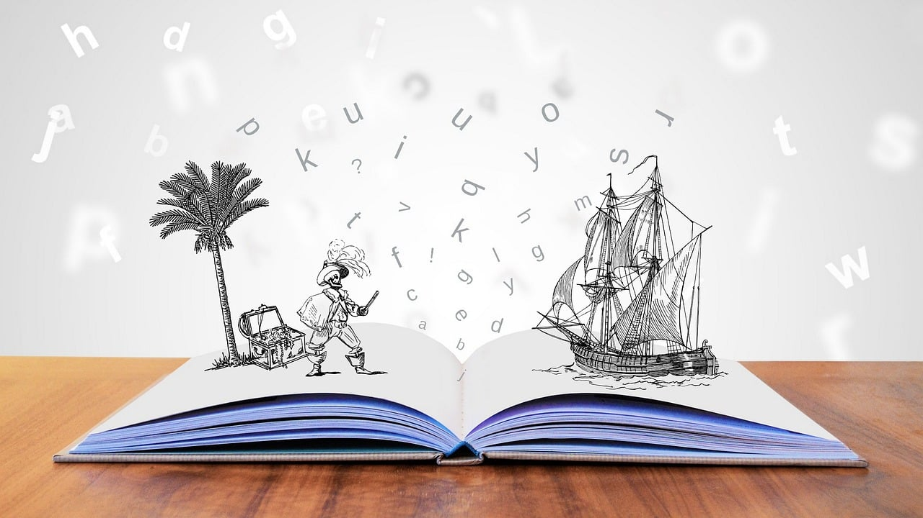
hören
Mariem und Gabriel
Hör zu. Was ist das?
Mariem and Gabriel have been round to play with Lias and Ronja, but they have left some of their things!
What have they left?
Masculine/ Neuter | Feminine
Fahrrad | Hausaufgabe
Papier | Karte
Spiel | Liste
Preis | Jacke
Plan | Uhr
Ball | Nummer
Butterbrot | Geschichte
Ex
1
2
3
4
5
6
Notes:
Timing: 5 minutes
Aim: to practise aural comprehension of ‘ihr’ and ‘ihre’ and ‘sein’ and ‘seine’ and relate them to the gender of previously taught nouns and nouns taught this lesson.
Procedure:
Explain the scenario.
Explain the pupils need to listen out for ihr/sein or ihre/seine and decide which thing Lias is talking about, based on gender.
Click on the example audio button to hear an example sentence. Click to reveal the answer.
Complete the exercise and then click to reveal the answers.
Transcript:
Das ist ihr [Fahrrad].
Und das ist ihre [Karte].
Das ist sein [Spiel].
Und das ist ihre [Jacke].
Ist es seine [Lieblingsuhr]?
Ist das ihr [Ball]?
Das ist sein [Butterbrot].
11

Slide 12


Lias is filling his parents in on Gabriel and Mariem’s families.
Was sagt Lias? Ist das Gabriel oder Mariem? Wie sagt man das auf Englisch?
lesen
‘Seine’ tells us Lias is talking about Gabriel (his).
The ‘e’ here tells us Lias needs a female noun.
Seine Mutter|Vater spielt Gitarre.
His mother plays guitar.
Notes:
Timing: 6 minutes (6 slides)
Aim: to practise written comprehension of ‘ihr’ and ‘ihre’ and ‘sein’ and ‘seine’ and relate them to the gender of previously taught nouns and nouns taught this lesson; to practise recognition of present tense weak verbs.
Procedure:
Explain the scenario and that pupils are going to make decisions about who Lias is talking about and which noun is needed to complete each sentence, and then translate each sentence.
Work through the first slide together as a class. Prompt pupils using the call-outs and click to reveal the correct person (Gabriel or Mariem) and correct noun. Elicit the translation: click to reveal the answer in the green call-out.
For the following 5 slides, pupils note down G or M for the person they think is correct and A or B for the noun they think is correct and discuss the translation of the whole sentence in pairs.
Click to reveal answers slide by slide.

Slide 13
Lias is filling his parents in on Gabriel and Mariem’s families.
Was sagt Lias? Ist das Gabriel oder Mariem? Wie sagt man das auf Englisch?
lesen
No ‘e’ here tells us Lias needs a masculine noun.
‘Ihr’ tells us Lias is talking about Mariem (her).
Ihr Mutter|Vater ist lieb.
Her father is kind.
Notes:
[2/6]

Slide 14
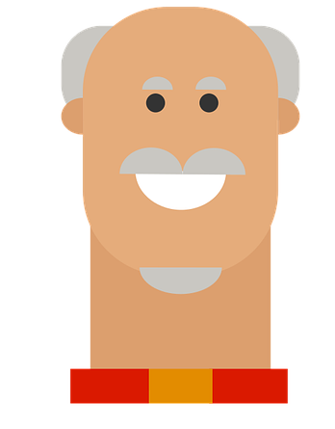
Lias is filling his parents in on Gabriel and Mariem’s families.
Was sagt Lias? Ist das Gabriel oder Mariem? Wie sagt man das auf Englisch?
lesen
Ihr Opa|Mutter schreibt Geschichten.
Her granddad writes stories.
Notes:
[3/6]

Slide 15
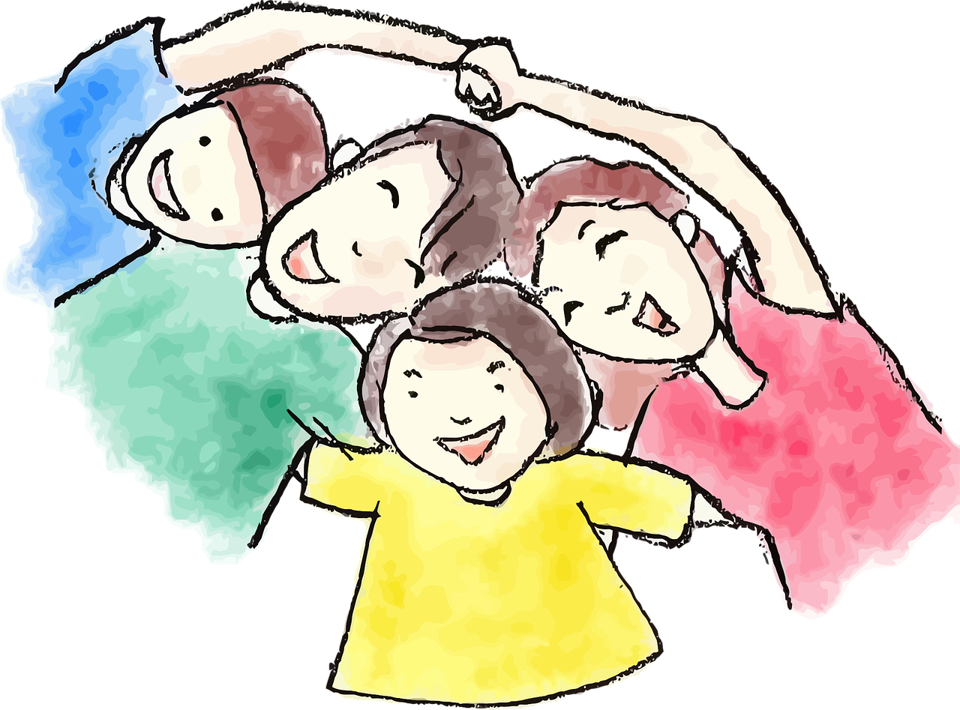
Lias is filling his parents in on Gabriel and Mariem’s families.
Was sagt Lias? Ist das Gabriel oder Mariem? Wie sagt man das auf Englisch?
lesen
Ihre Familie|Opa ist ruhig.
Her family is quiet.
Notes:
[4/6]

Slide 16
Lias is filling his parents in on Gabriel and Mariem’s families.
Was sagt Lias? Ist das Gabriel oder Mariem? Wie sagt man das auf Englisch?
lesen
Sein Familie|Opa ist müde.
His grandad is tired.
Notes:
[5/6]

Slide 17
Lias is filling his parents in on Gabriel and Mariem’s families.
Was sagt Lias? Ist das Gabriel oder Mariem? Wie sagt man das auf Englisch?
lesen
Sein Vater|Mutter arbeitet zu Hause.
His father works at home.
Notes:
[6/6]

Slide 18
Tschüss!
gelb
Notes:
18

