Slide 1


Talking about activities and events
Ich wiederhole!
gelb
Follow ups 1-5
Term 3 Week 9
Notes:
Artwork by Steve Clarke. Pronoun pictures from NCELP (www.ncelp.org). All additional pictures selected from Pixabay and are available under a Creative Commons license, no attribution required.
Phonics: Revisit SSC: [v] [w] [r] [er-] [-er] [-ig] [-g] [-d] [-b] [-tion] [z] [ei] [ie] [th]
Vocabulary: Revisit language from Term 3
Revisit 1: er/sie/es möchte [n/a]
Revisit 2: Montag [1044] Dienstag [1356] Mittwoch [1187] Donnerstag [1244] Freitag [981] Samstag [1112] Sonntag [804] Tag [111] Woche [219] heute [116] morgen [752]
Jones, R.L & Tschirner, E. (2019). A frequency dictionary of German: Core vocabulary for learners. London: Routledge.
The frequency rankings for words that occur in this PowerPoint which have been previously introduced in these resources are given in the SOW and in the resources that first introduced and formally re-visited those words.
For any other words that occur incidentally in this PowerPoint, frequency rankings will be provided in the notes field wherever possible.
Note that the first three lessons of the year teach language that can be continuously recycled as lesson routine every lesson in Y3/4.
The idea would be that the class teacher (whether or not s/he teaches the class German can re-use the language as part of the daily routine with the class.

Slide 2


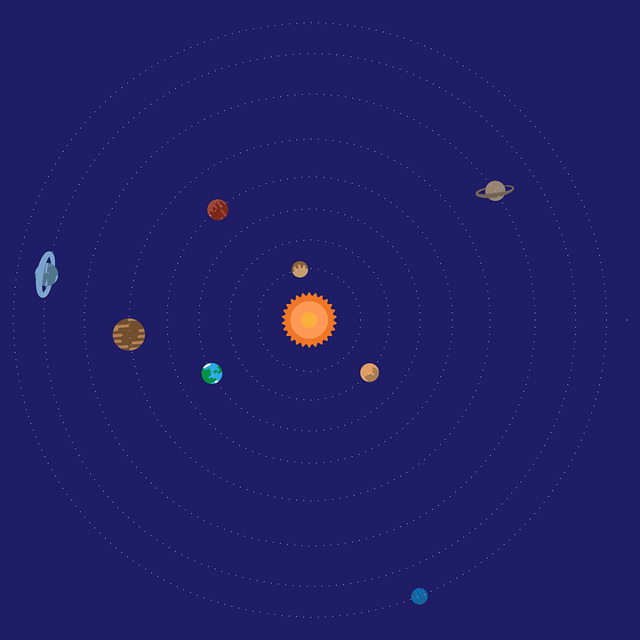

Follow up 1:
Runde 1: Person A 🗣
Person B 📝✅
…
Wie sagt man das richtig?
aussprechen
ob
Zimmer
wir
Sommer
Eis
von
waschen
werden
mag
Notes:
Timing: 5-7 minutes [3 slides]
Aim: To practise the pronunciation of words containing sounds covered in Term 3.
Procedure:
Pupils work in pairs, as Person A and Person B. One pupil will pronounce words whilst the other checks pronunciation. There are 9 words for Person A to pronounce on this slide, and 9 more words for Person B to pronounce on the next slide. There is a handout at the end of the presentation for the checker to use, or pupils can simply write 1-9 in their books and tick or cross.
Click once to make the spaceship appear (This animation is timed - don’t click again until all words have appeared). Pupil A pronounces all of the words. Pupil B ticks the words pronounced correctly.
Move to next slide for Pupil B’s turn and repeat.
Frequency of unknown words and cognates:
Eis [1874] mag [168] ob [127] Sommer [771] von [9] waschen [2315] werden [8] wir [26] Zimmer [665]
Source: Jones, R.L. & Tschirner, E. (2019). A frequency dictionary of German: core vocabulary for learners. Routledge

Slide 3
Follow up 1:
Runde 2: Person B 🗣
Person A📝✅
…
aussprechen
fertig
Kind
Aktion
nie
Thema
Durst
trinken
halb
Zukunft
Notes:
Procedure:
Pupil A now checks pronunciation, as Pupil B pronounces the 9 words.
Click to start the animation as on previous slide.
Move to slide 3 to show the ‘value’ of each word. Pupils can compare their results and see who earned the most.
Frequency of unknown words and cognates:
Aktion [1838] Durst [n/a] fertig [n/a] halb [443] Kind [133] nie [196] ob [127] Thema [298] trinken [634] Zukunft [469]
Source: Jones, R.L. & Tschirner, E. (2019). A frequency dictionary of German: core vocabulary for learners. Routledge

Slide 4


Follow up 1
…
How much are your words worth?
aussprechen
Person B
Person A
ob 💰 (whether)
Zimmer 💰💰(room)
wir 💰 (we)
Sommer 💰 (summer)
Eis 💰💰 (ice cream)
von 💰💰 (from)
waschen 💰(to wash)
werden💰(to become)
mag 💰 (like)
fertig 💰 (finished)
Kind 💰 (child)
Aktion 💰 (action)
nie 💰💰 (never)
Thema💰💰 (topic)
Durst 💰 (thirst)
trinken 💰 (to drink)
halb 💰 (half)
Zukunft 💰💰 (future)
Notes:
1. Pupils can add up and compare their results.
2. Repeat the activity with pupils swapping slides, if time allows.
3. Click on the audio buttons to check pronunciation of individual words.
Frequency of unknown words and cognates:
Aktion [1838] Durst [n/a] Eis [1874] fertig [n/a] halb [443] Hunger [2097] Kind [133] mag [168] nie [196] ob [127] Sommer [771] Thema [298] trinken [634] von [9] waschen [2315] werden [8] wir [26] Zimmer [665] Zukunft [469]
Source: Jones, R.L. & Tschirner, E. (2019). A frequency dictionary of German: core vocabulary for learners. Routledge

Slide 5
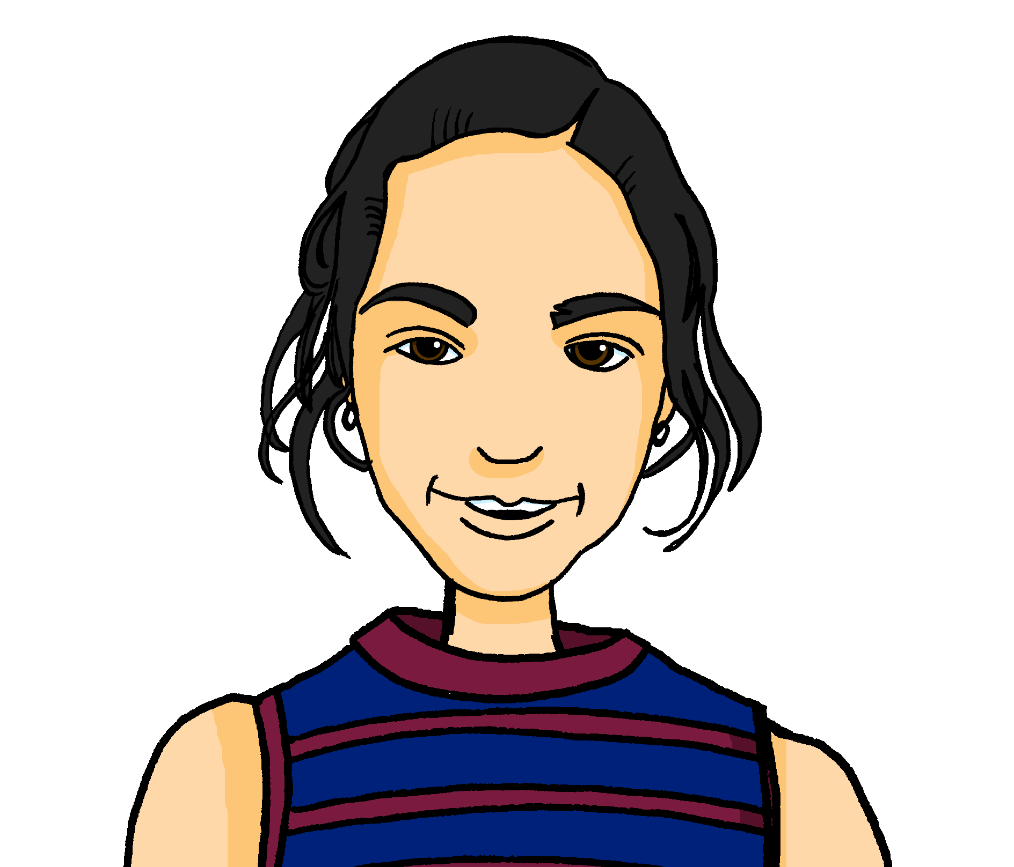


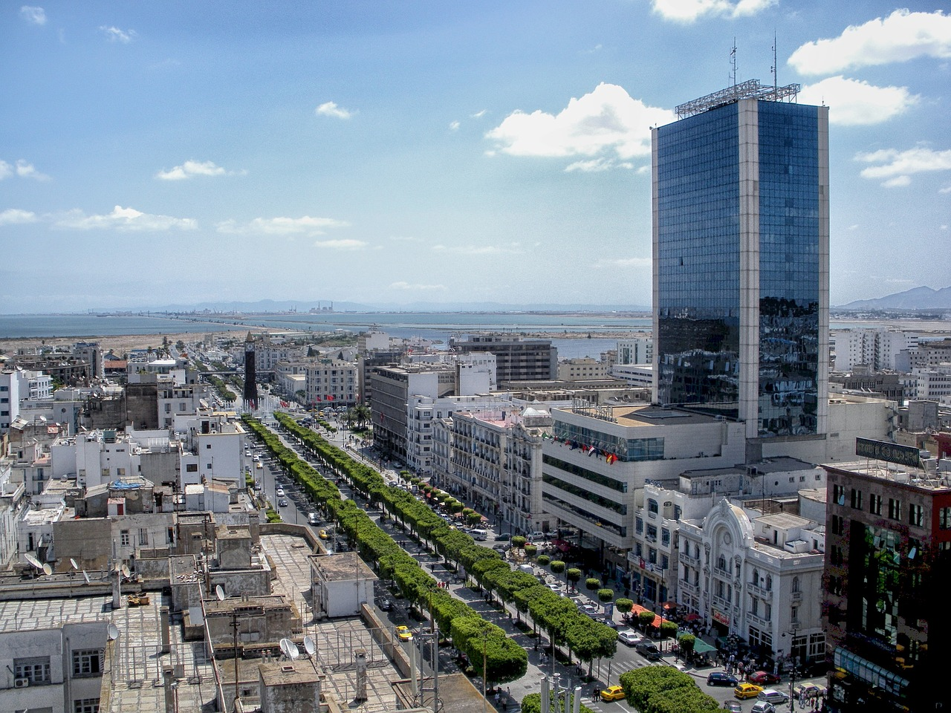

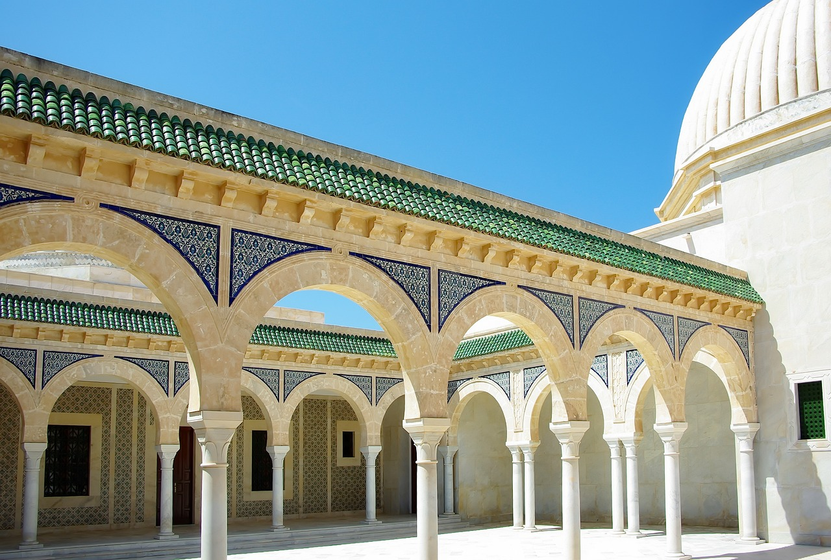
lesen
Follow up 2
Lies den Text.
Was sagt Mariem?
*Tunesier – Tunisian
Tunesien - Tunisia
Hallo! Ich heiße Mariem! Ich bin zehn Jahre alt und ich wohne in Biel. Das ist in der Schweiz. Wo wohnst du?
Das ist mein Vater. Er ist Tunesier*, aber er wohnt auch in Biel. Er heißt Tarek. Er ist ruhig und lieb.
Er hat im März Pläne. Er möchte seine Familie in Tunesien* besuchen. Ich möchte auch fahren! Ich möchte nicht zu Hause bleiben.
Heute ist Freitag. Ich bin müde, aber ich habe Pläne. Ich mache eine Karte. Wer bekommt die Karte? Meine Familie in Tunesien*!
Und du? Hast du heute Pläne?
1. What two details do we find out about Mariem?
She is 10 years old and lives in Biel in Switzerland.
2. What does Mariem say about her father? (5 details)
He is Tunisian, he lives in Biel, he is called Tarek, and he is quiet and nice.
3. What would Tarek like to do and when? .(2 details)
He has plans in March. He would like to visit his family in Tunisia.
4. What would Mariem not like to do? ….(1 detail)
Stay at home.
5. What is Mariem doing today? (2 details)
Making a card for her family in Tunisia.
6. What questions does Mariem ask? (3 details)
Where do you live?
Who is receiving the card?
Do you have plans?
Notes:
Timing: 8 minutes
Aim: to practise written comprehension of vocabulary and grammar from Term 3 in a longer text.
Procedure:
Pupils read what Mariem has written, and then answer the questions to the right in English.
Click to reveal answers.
In the audio version, click on the blue text box to hear Mariem.
Frequency of unknown words and cognates:
Tunesier [>5000] Tunesien [>5000]
Source: Jones, R.L. & Tschirner, E. (2019). A frequency dictionary of German: core vocabulary for learners. Routledge
5

Slide 6

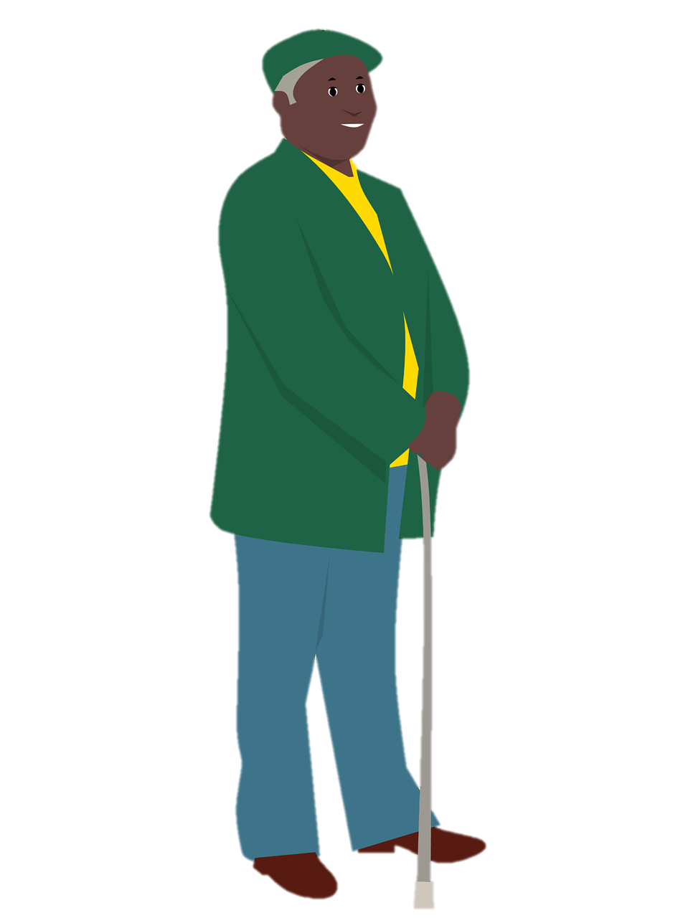

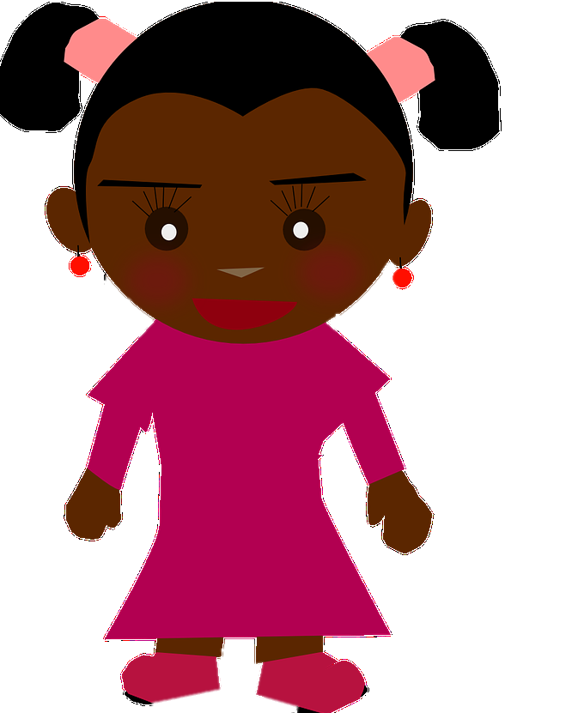

hören
Follow up 3 Meine Familie
1
2
3
4
Hör zu. Wer ist das? Schreib auf Englisch.
Thomas
Emma
Noah
Anna
Lives in Switzerland
Lives in England
11
7
Young
4
2
1
3
Would like to play guitar
Anna
Thomas
Noah
Emma
Not at home Saturdays
7 (weeks)
11 (years)
Lives in Switzerland
Lives in England
Not quiet
Young
Not at home Saturdays
Visits Grandma
Not quiet
Is getting a cat in July
Would like to play guitar
Tired
Visits Grandma
Tired
Is getting a cat in July
Notes:
Timing: 5 minutes
Aim: to practise aural comprehension of vocabulary and grammar from Term 3 in a more holistic activity.
Note: This is a simpler version of the activity, which requires pupils to decide which picture corresponds to each audio clip, and to use the prompts on the right to write about each person.
Procedure:
1. Explain the task. Pupils are going to listen to someone talking about the family on the board.
2. Click on the first audio button to hear the first sentence. Pupils listen to the description and decide who is being described. Click to play the audio again. Using the prompts on the right, pupils make notes about the person. Pupils will need to listen to each audio clip several times.
3. Repeat for sentences 2-4.
4. Click to reveal answers.
Note: Pupils haven’t learned “das Baby”, but as it is a cognate we expect pupils will understand.
Note: We have given characters German names that are also common in English, to ease cognitive load.
Transcript:
Das ist meine Mutter. Sie heißt Anna. Sie wohnt in der Schweiz. Sie hat im Juli Pläne, sie bekommt eine Katze. Wunderbar!
Und das bin ich! Ich heiße Emma und ich bin elf Jahre alt. Mein Lieblingstag ist Samstag. Ich bleibe samstags zu Hause nicht. Ich besuche Oma.
Da ist mein Opa. Er heißt Thomas. Er wohnt in England. Er möchte Gitarre spielen.
Das Baby heißt Noah. Er ist jung, er ist sieben Wochen alt. Meine Mutter ist müde! Der Grund? Noah ist nicht ruhig!
Frequency of unknown words and cognates:
Baby [2297]
Source: Jones, R.L. & Tschirner, E. (2019). A frequency dictionary of German: core vocabulary for learners. Routledge
6

Slide 7
hören
Follow up 3 Meine Familie
1
2
3
4
Hör zu. Wer ist das? Schreib auf Englisch.
4
2
1
3
Anna
Thomas
Noah
Emma
7 (weeks)
11 (years)
Lives in Switzerland
Lives in England
Young
Not at home Saturdays
Not quiet
Is getting a cat in July
Would like to play guitar
Visits Grandma
Tired
Notes:
Timing: 5 minutes
Aim: to practise aural comprehension of vocabulary and grammar from Term 3 in a more holistic activity.
Note: This is a more challenging version of the activity, which requires pupils to decide which picture corresponds to each audio clip, and to write about each person based on the audio.
Procedure:
1. Explain the task. Pupils are going to listen to someone talking about the family on the board.
2. Click on the first audio button to hear the first sentence. Pupils listen to the description and decide who is being described. Click to play the audio again. Pupils make notes about the person. Pupils will need to listen to each audio clip several times.
3. Repeat for sentences 2-4.
4. Click to reveal answers.
Note: Pupils haven’t learned “das Baby”, but as it is a cognate we expect pupils will understand.
Note: We have given characters German names that are also common in English, to ease cognitive load.
Transcript:
Das ist meine Mutter. Sie heißt Anna. Sie wohnt in der Schweiz. Sie hat im Juli Pläne, sie bekommt eine Katze. Wunderbar!
Und das bin ich! Ich heiße Emma und ich bin elf Jahre alt. Mein Lieblingstag ist Samstag. Ich bleibe samstags zu Hause nicht. Ich besuche Oma.
Da ist mein Opa. Er heißt Thomas. Er wohnt in England. Er möchte Gitarre spielen.
Das Baby heißt Noah. Er ist jung, er ist sieben Wochen alt. Meine Mutter ist müde! Der Grund? Noah ist nicht ruhig!
Frequency of unknown words and cognates:
Baby [2297]
Source: Jones, R.L. & Tschirner, E. (2019). A frequency dictionary of German: core vocabulary for learners. Routledge
7

Slide 8

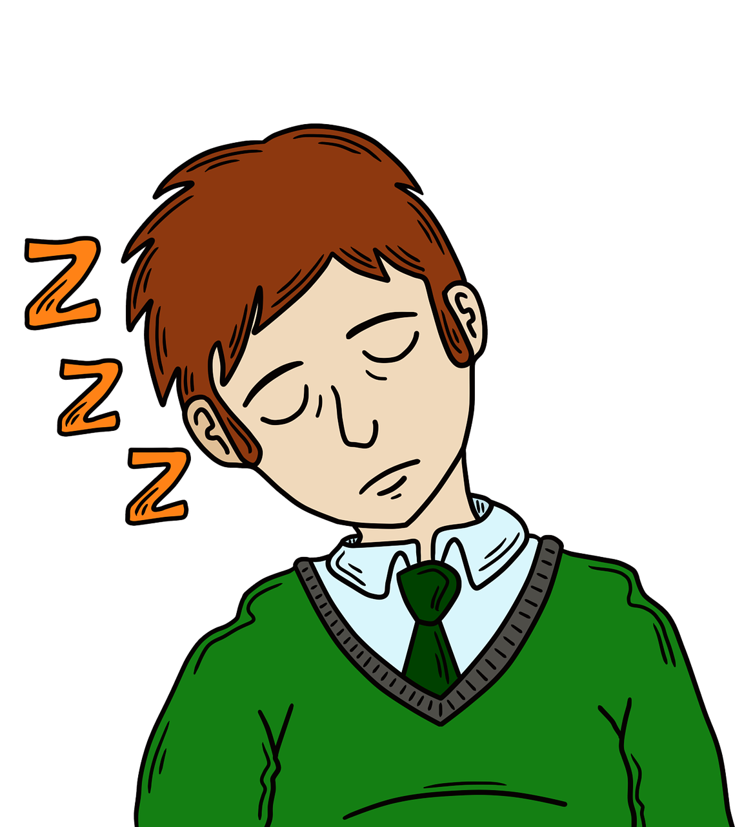
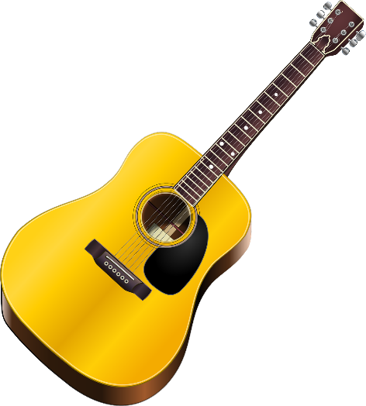
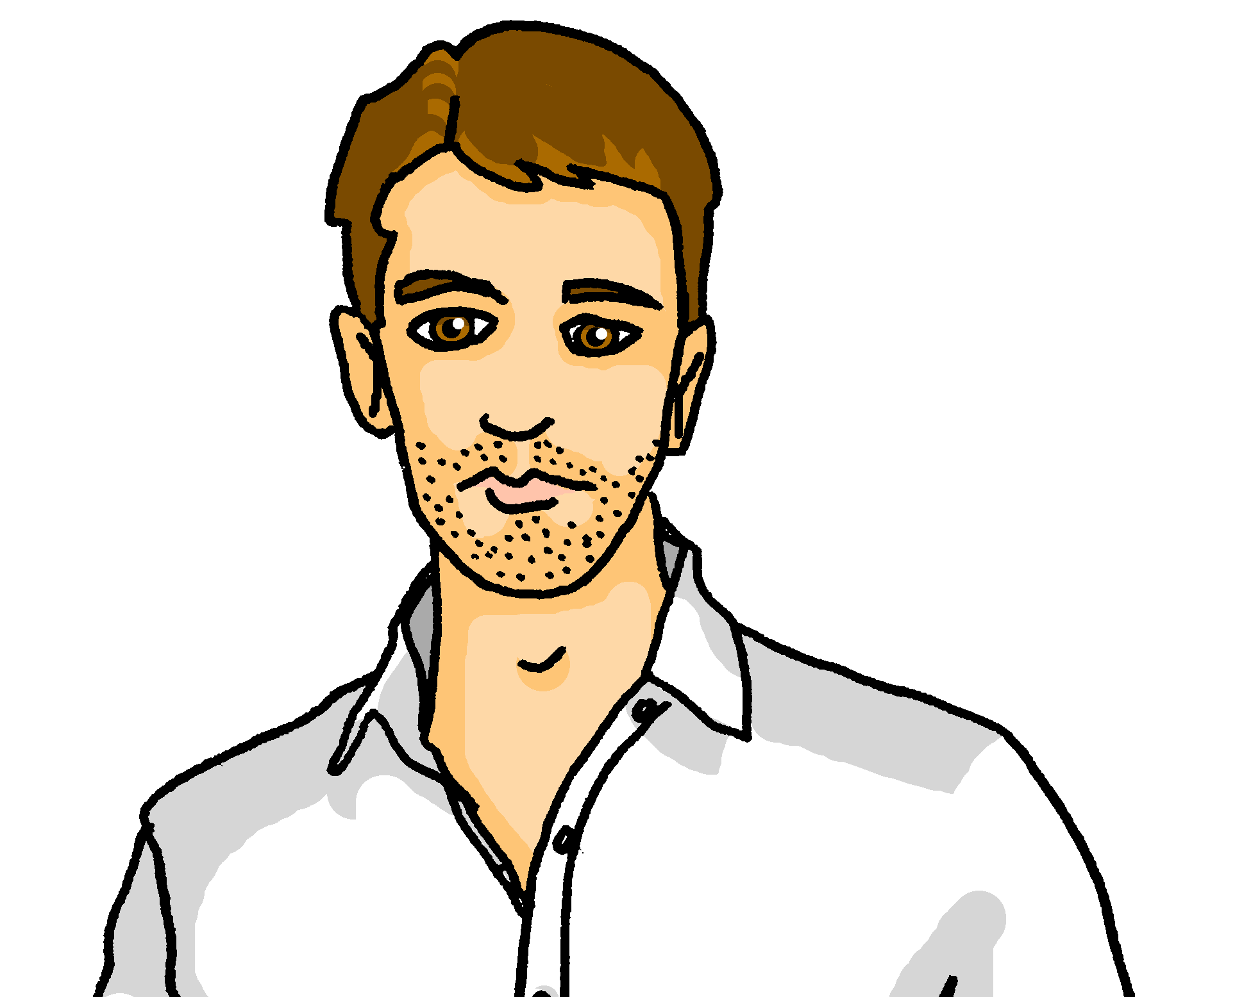
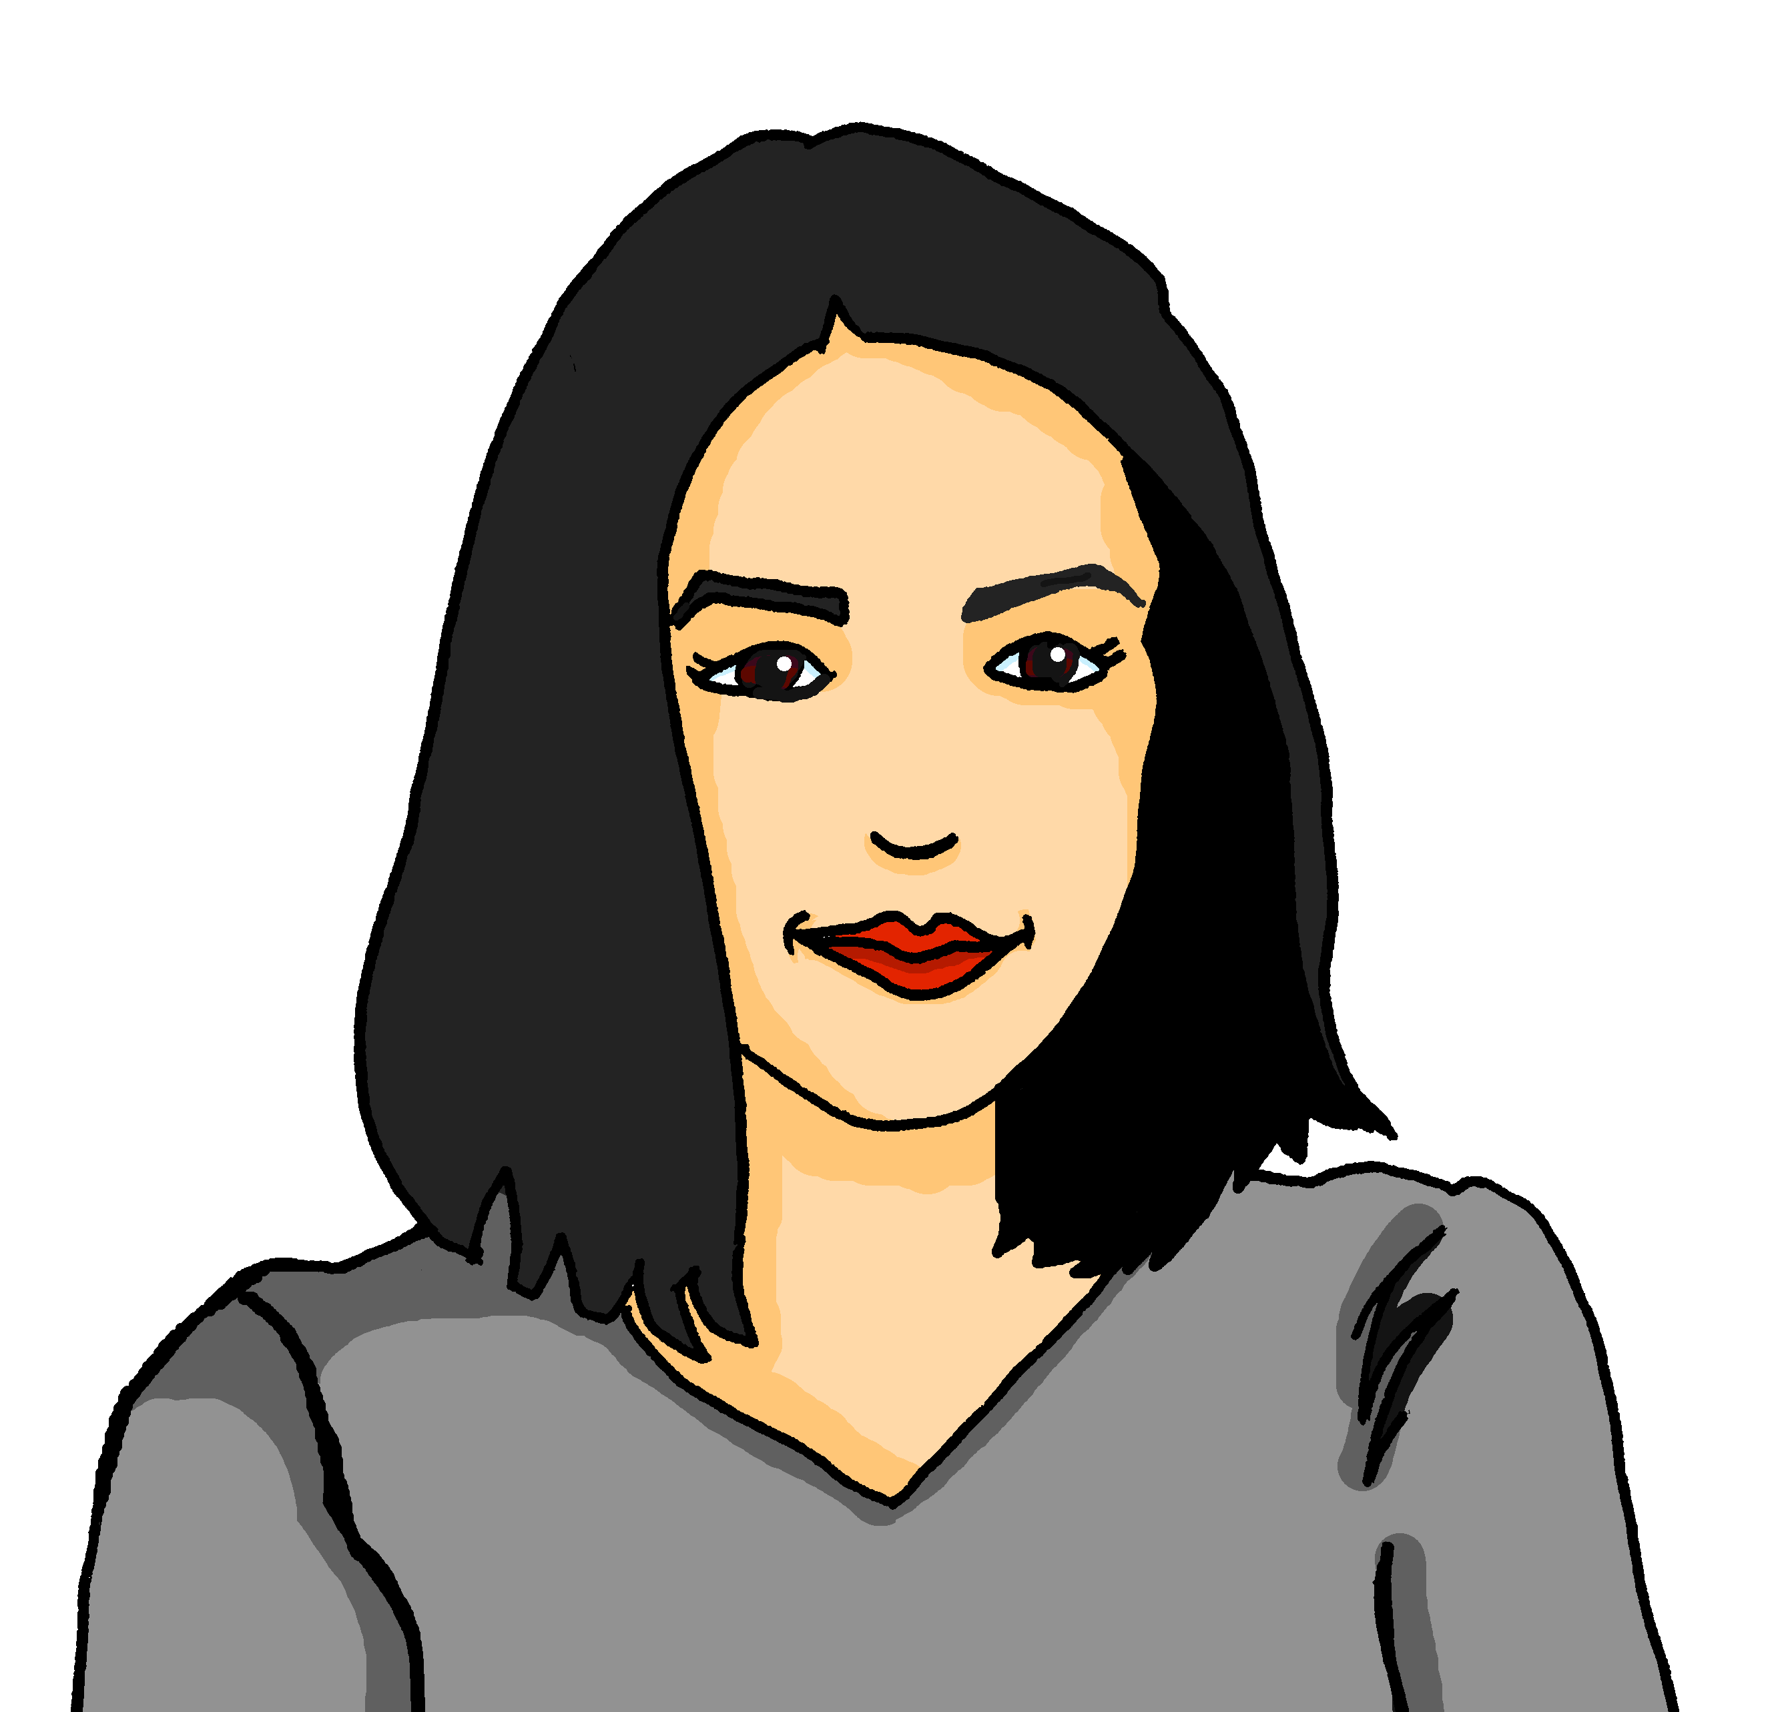


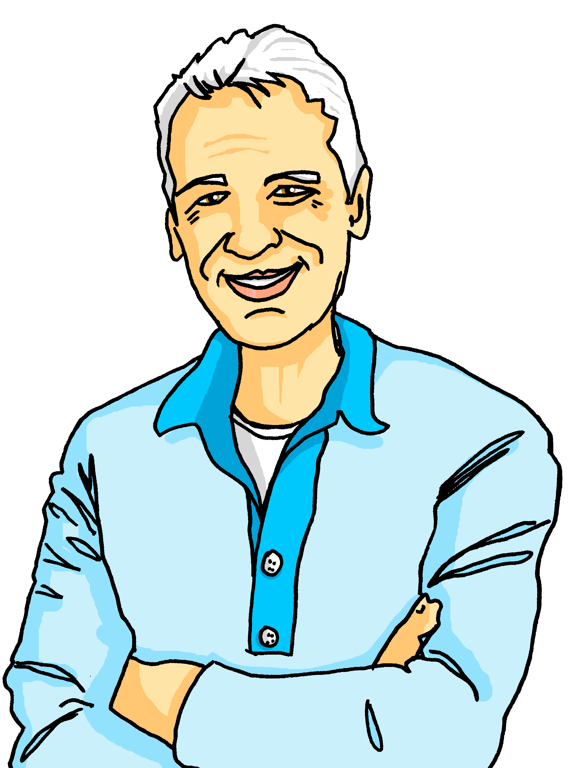


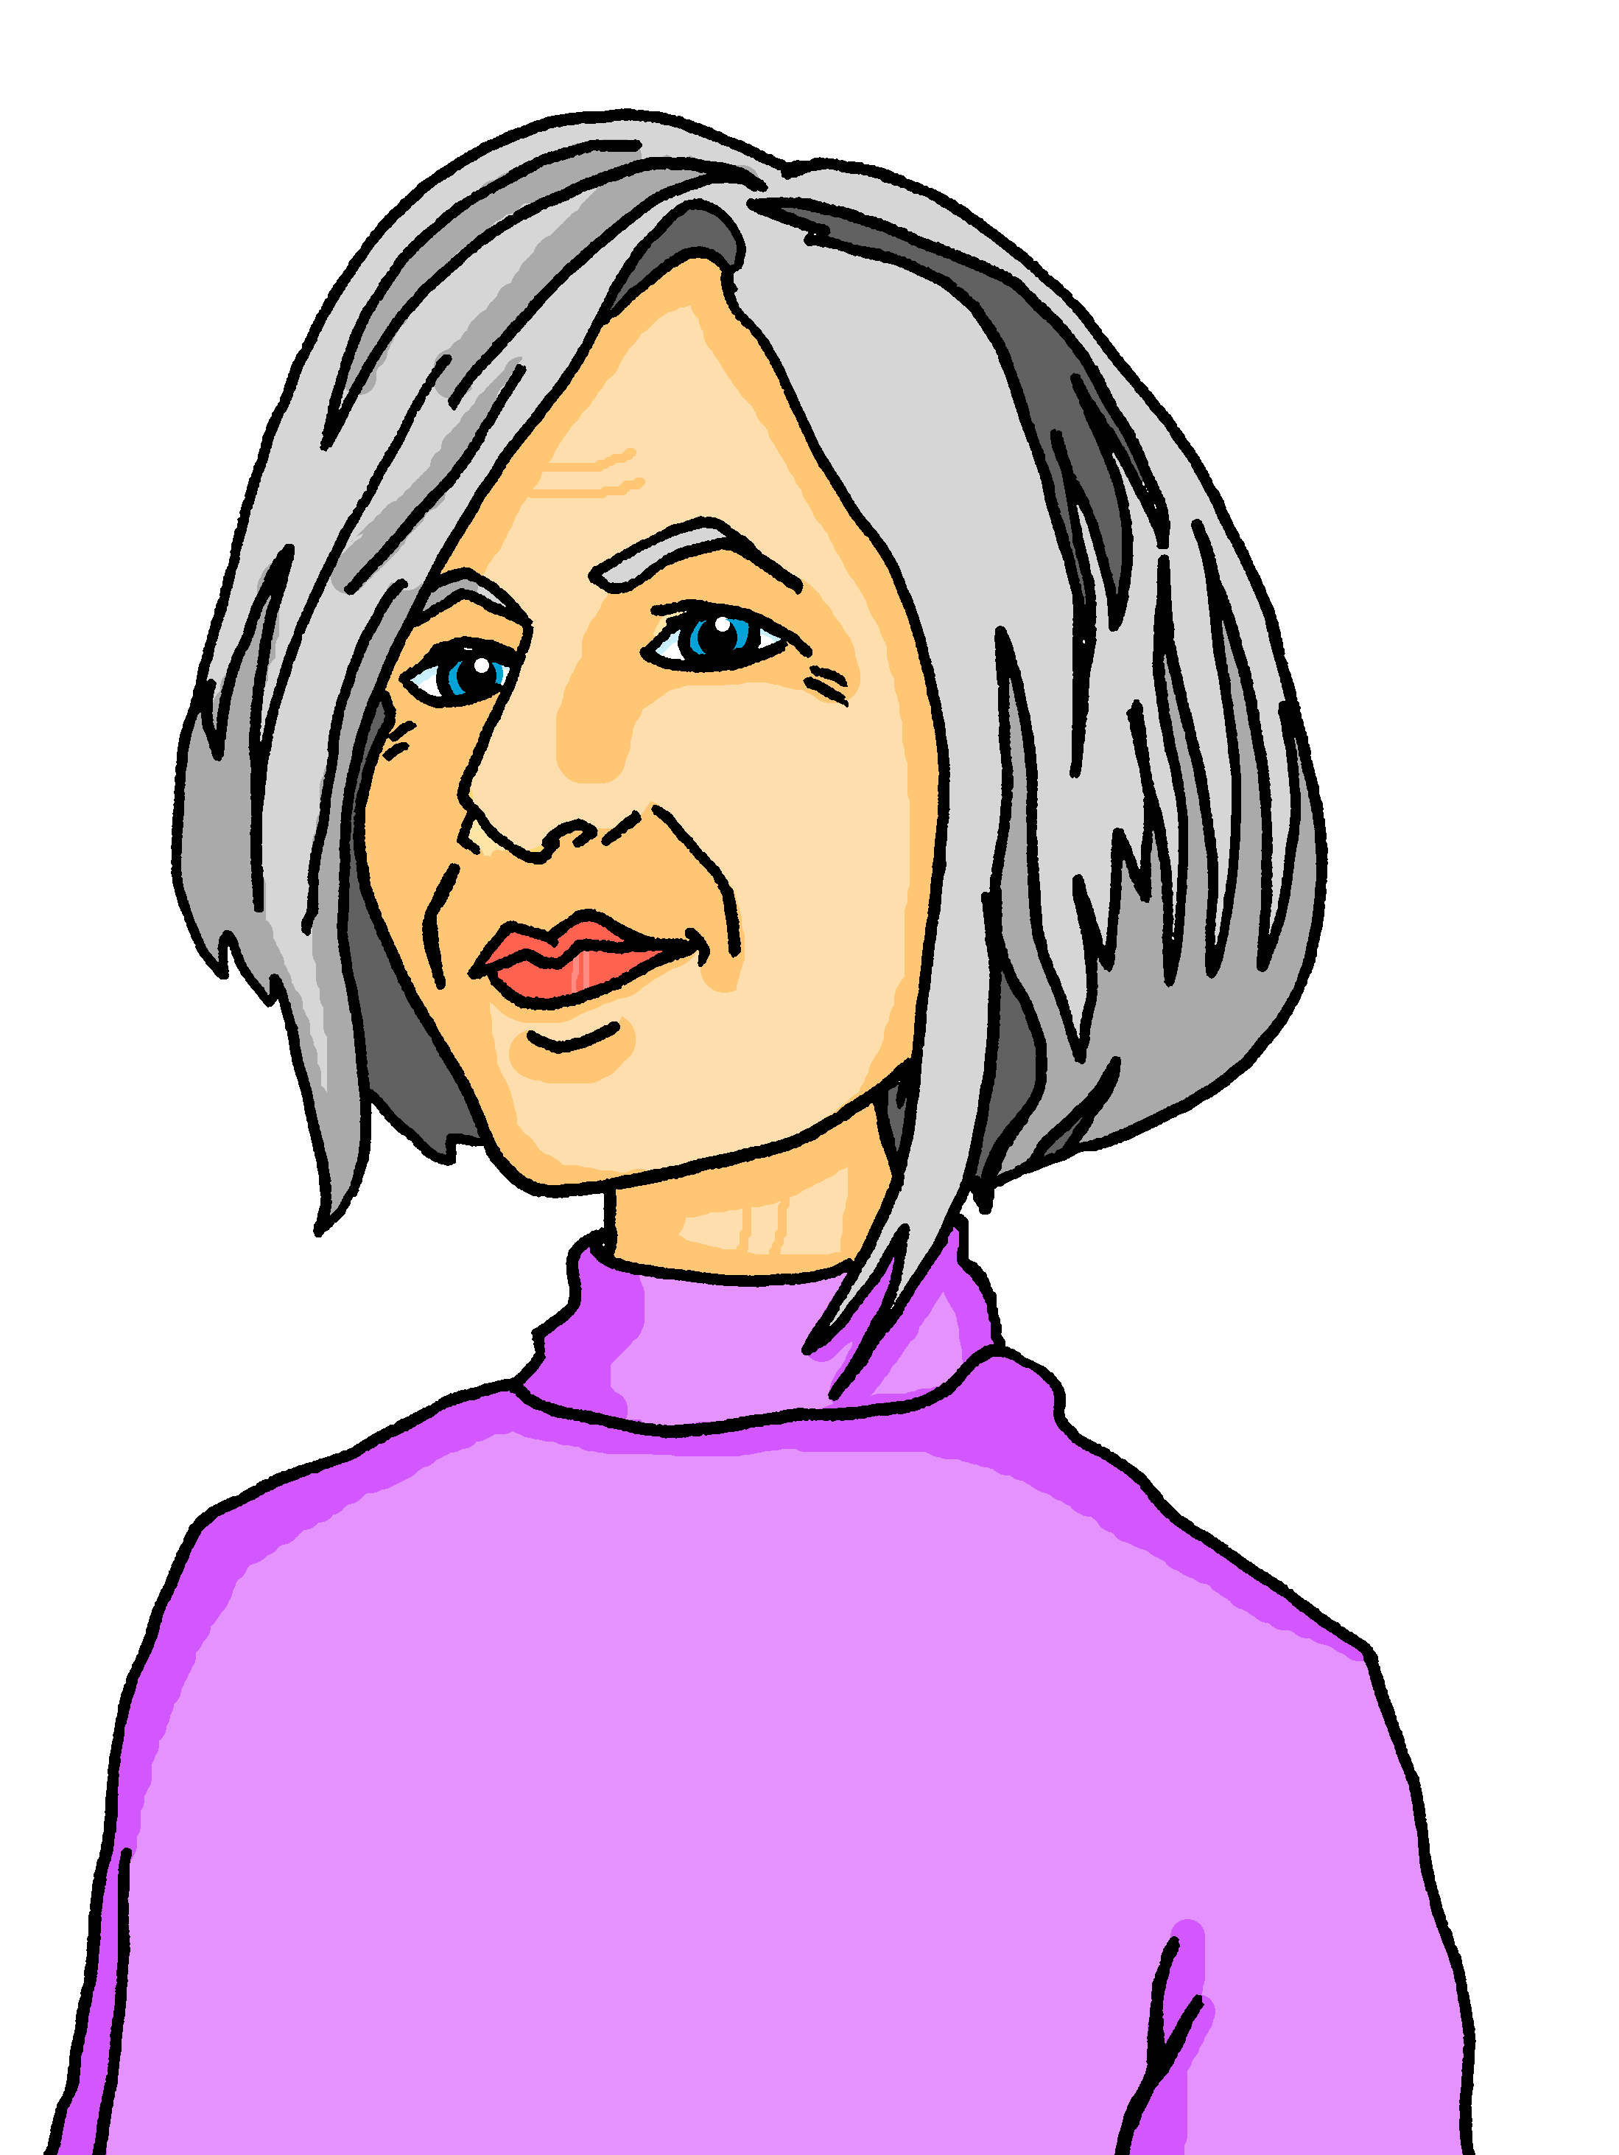

Vokabeln
Follow up 4
Wann hast du Pläne? Schreib Vokabeln auf Deutsch.
Just have a go! Write any of these English words in German. You can add different words, too.
Wörter
January | February | March | April
May | June | July | August
September | October | November | December
to visit
Notes:
Timing: 5 minutes
Aim: to practise written production of this term’s vocabulary.
Note: This is a more straightforward version of the activity, asking pupils for individual words. A more challenging version can be found on the following slide, where pupils are encouraged to write a mixture of sentences and words.
Procedure:
Pupils look at the calendar.
They use the words and pictures in the calendar as inspiration. They fill in the calendar by writing any words in German. They could use any of the words or pictures in the calendar, they could write individual months, nouns, adjectives, verbs etc. Three months have been left blank for pupils to write any other words they know.
8

Slide 9

Vokabeln
Follow up 4
Wann hast du Pläne?. Schreib auf Deutsch.
Wörter
Beispiel: Es ist Januar. Ich bin müde.
January | February | March | April
May | June | July | August
September | October | November | December
to visit
Notes:
Timing: 5 minutes
Aim: to practise written production of this term’s vocabulary.
Note: This is a more challenging version of the activity, where pupils are encouraged to write a mixture of sentences and words. A more straightforward version of the activity can be found on the previous slide, where pupils are asked to write individual words.
Procedure:
Pupils look at the calendar.
They use the words and pictures in the calendar as inspiration. They use the empty notepad on the right to write sentences or words about the year’s plans. They could use any of the words or pictures in the calendar, they could write individual months, nouns, adjectives, verbs etc. Three months have been left blank for pupils’ own ideas.
9

Slide 10



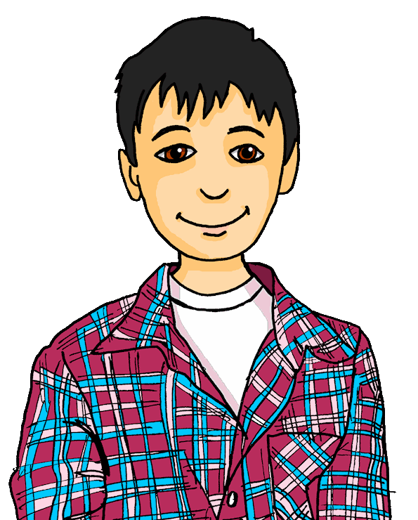
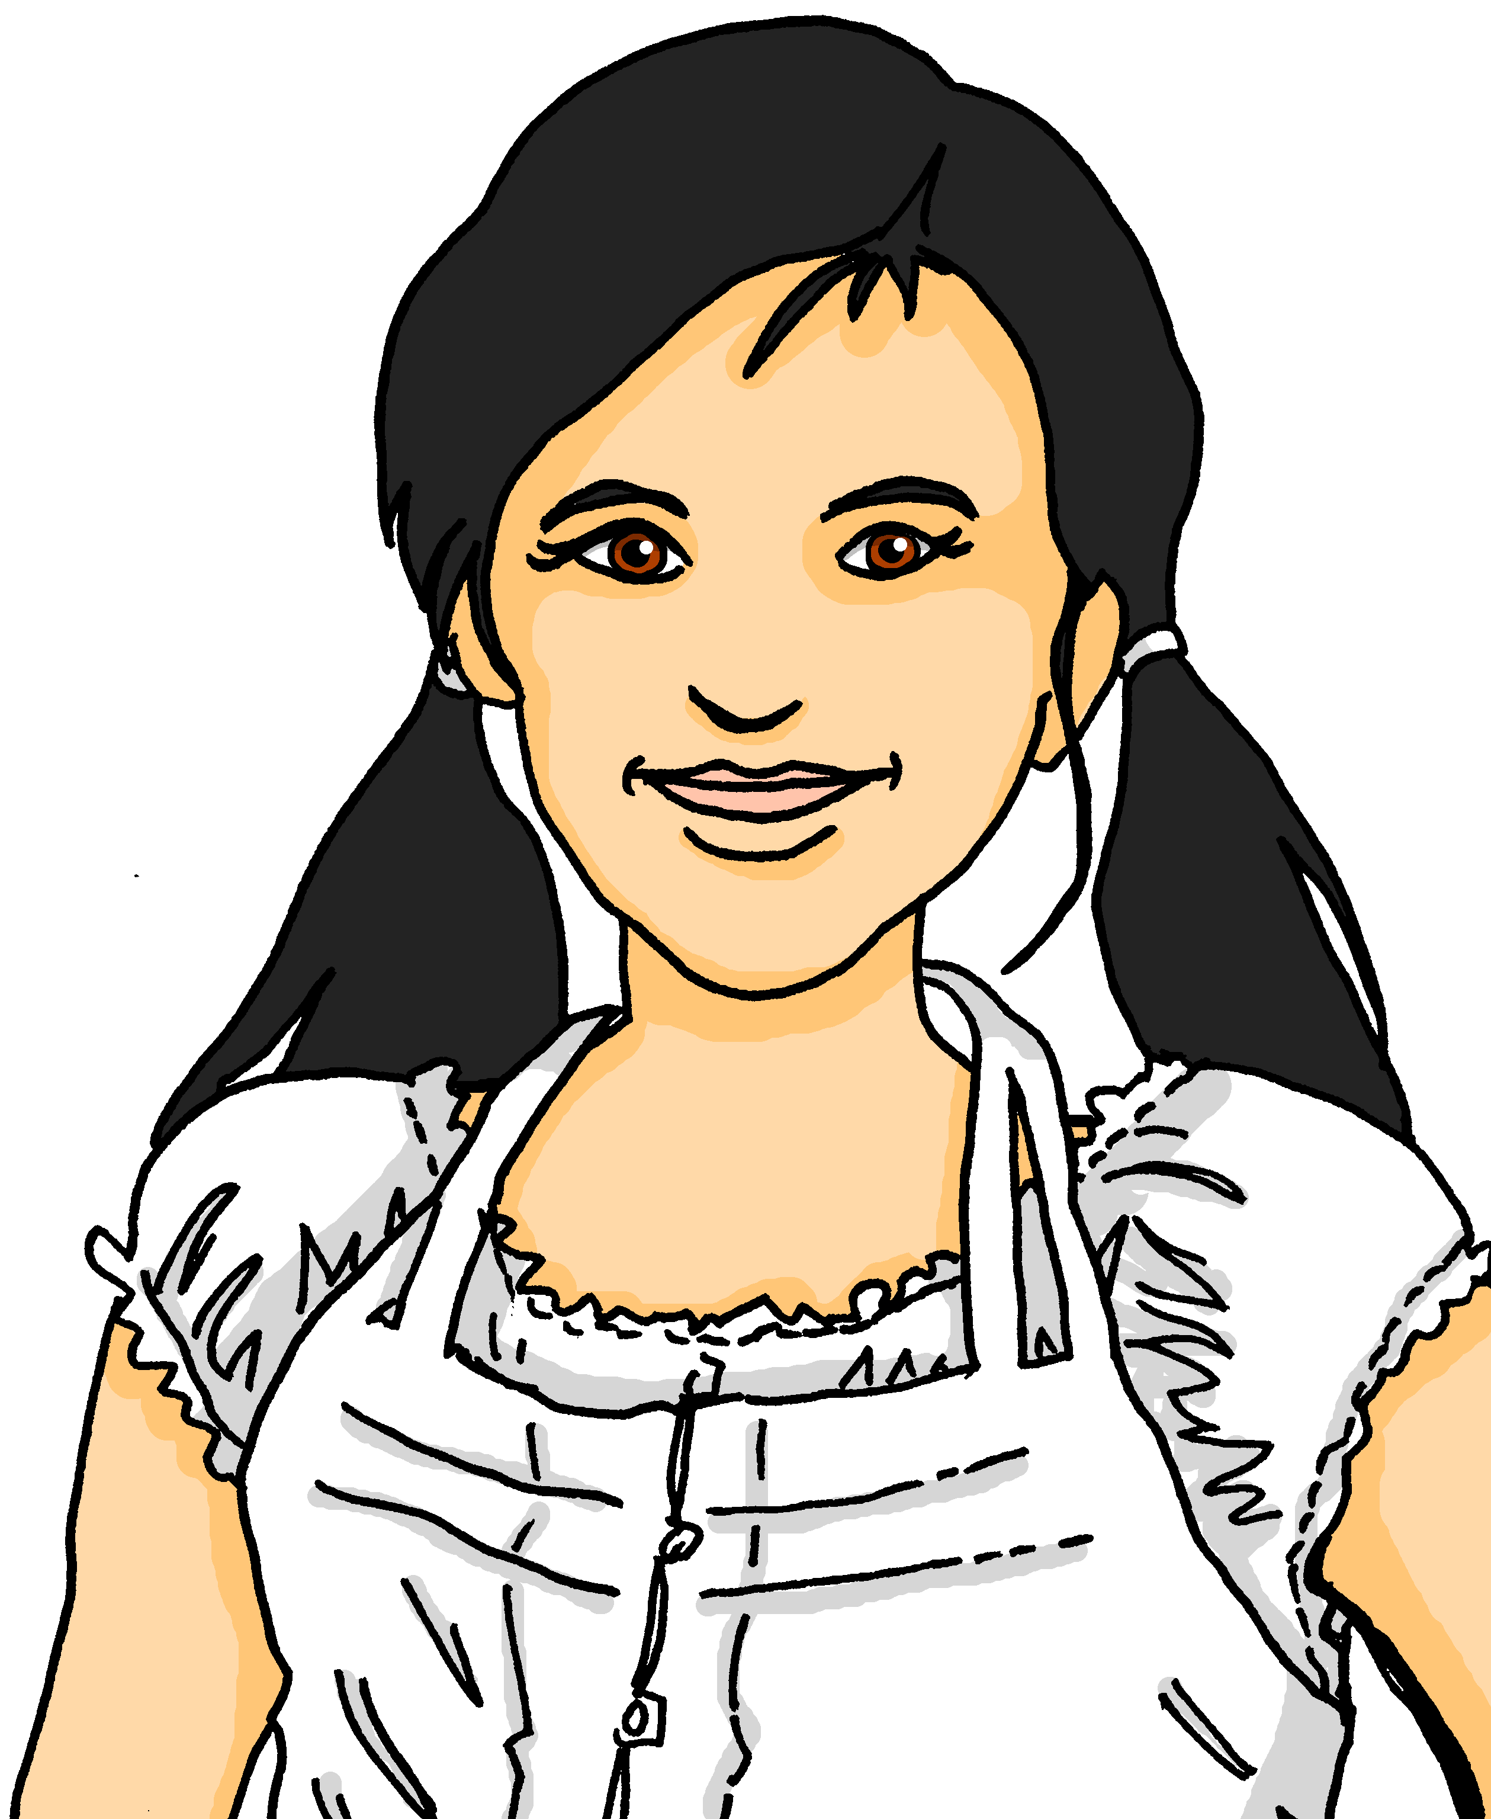






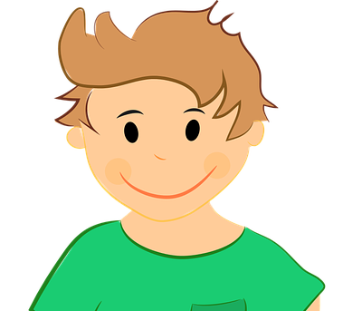
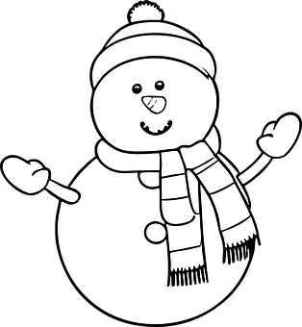
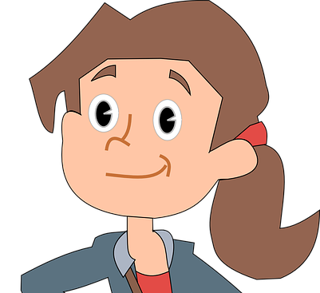
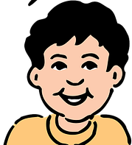


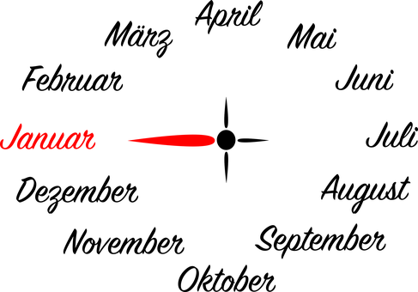
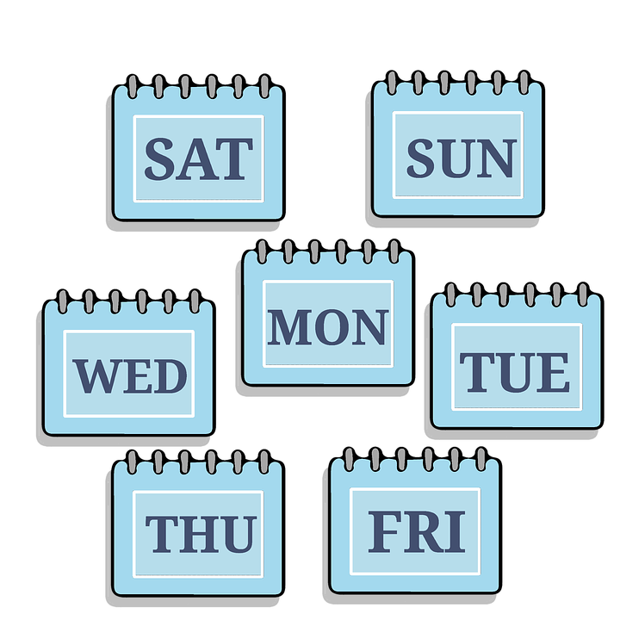

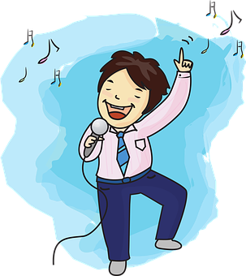
sprechen
Follow up 5
…
Wer ist dein Partner/deine Partnerin?
Ask only ‘yes|no’ questions in German. Work out who your partner has chosen to be!
Bist du Mia?
Hast du einen Lieblingssong?
Hast du einen Lieblingstag?
Bist du zwölf Jahre alt?
Wohnst du in der Schweiz?
Hast du im Januar Pläne?
Ja
Nein
Ja
Nein
Ja
Ja
Tim
Mia
Ahmet
Notes:
Timing: 8 minutes (3 slides)
Aim: to practise spoken production of yes/no questions.
Procedure:
Use this slide to model the activity. Ronja and Lias are playing a game of guess who using the characters below. Click through the animations to see the questions Ronja asks Lias.
Click to reveal the following slide.
Pupils work in pairs. Partner A chooses a character. Partner B asks a series of yes/no questions to work out who they have picked. Partners swap roles.
Click to reveal the second activity slide, pupils play the game again.
10

Slide 11

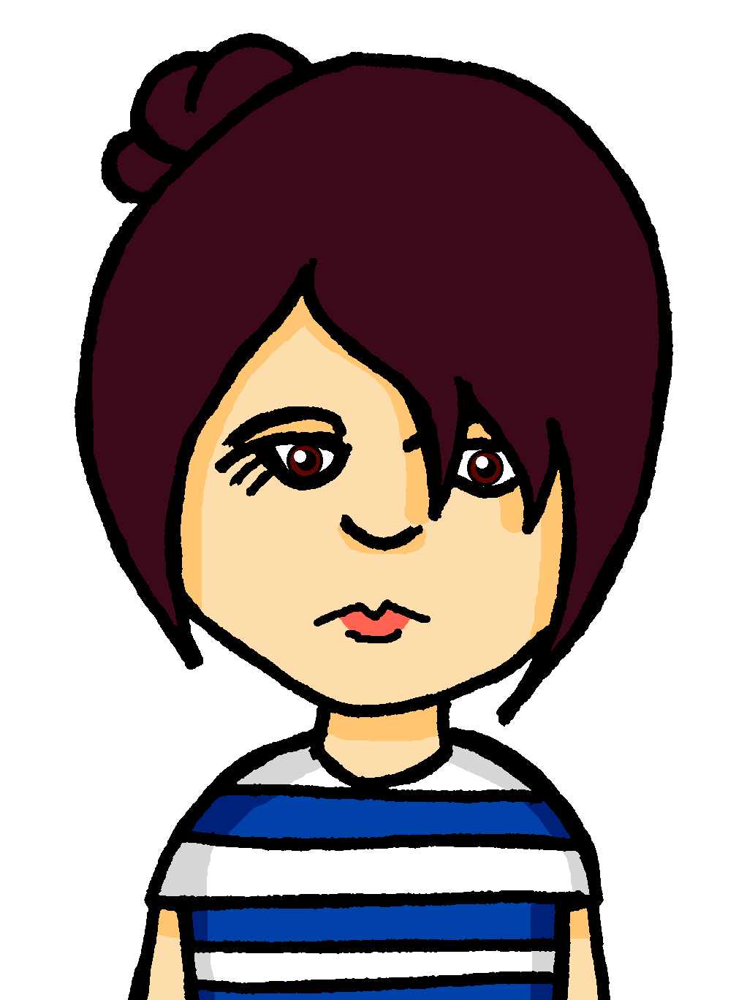

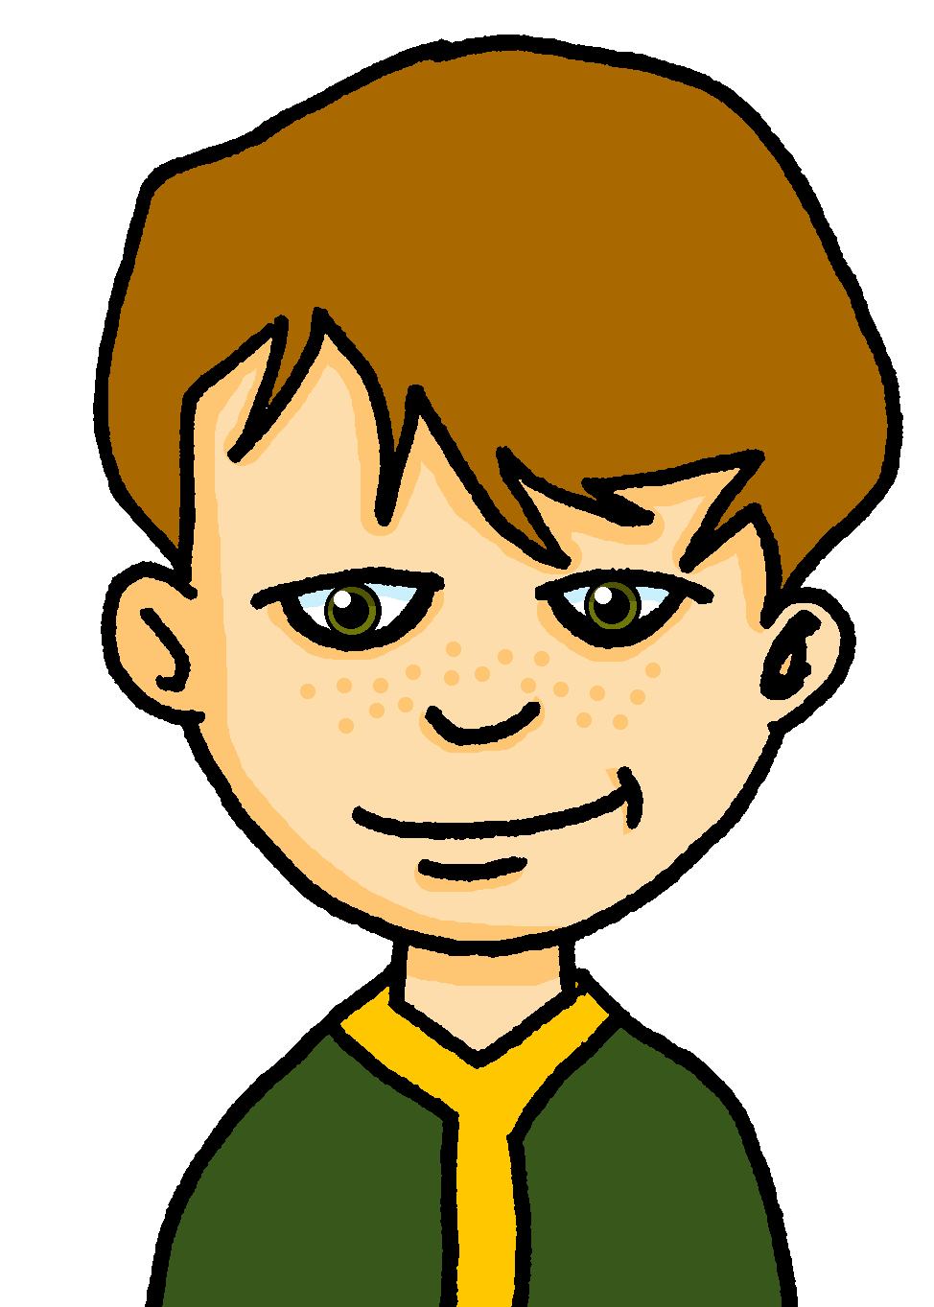
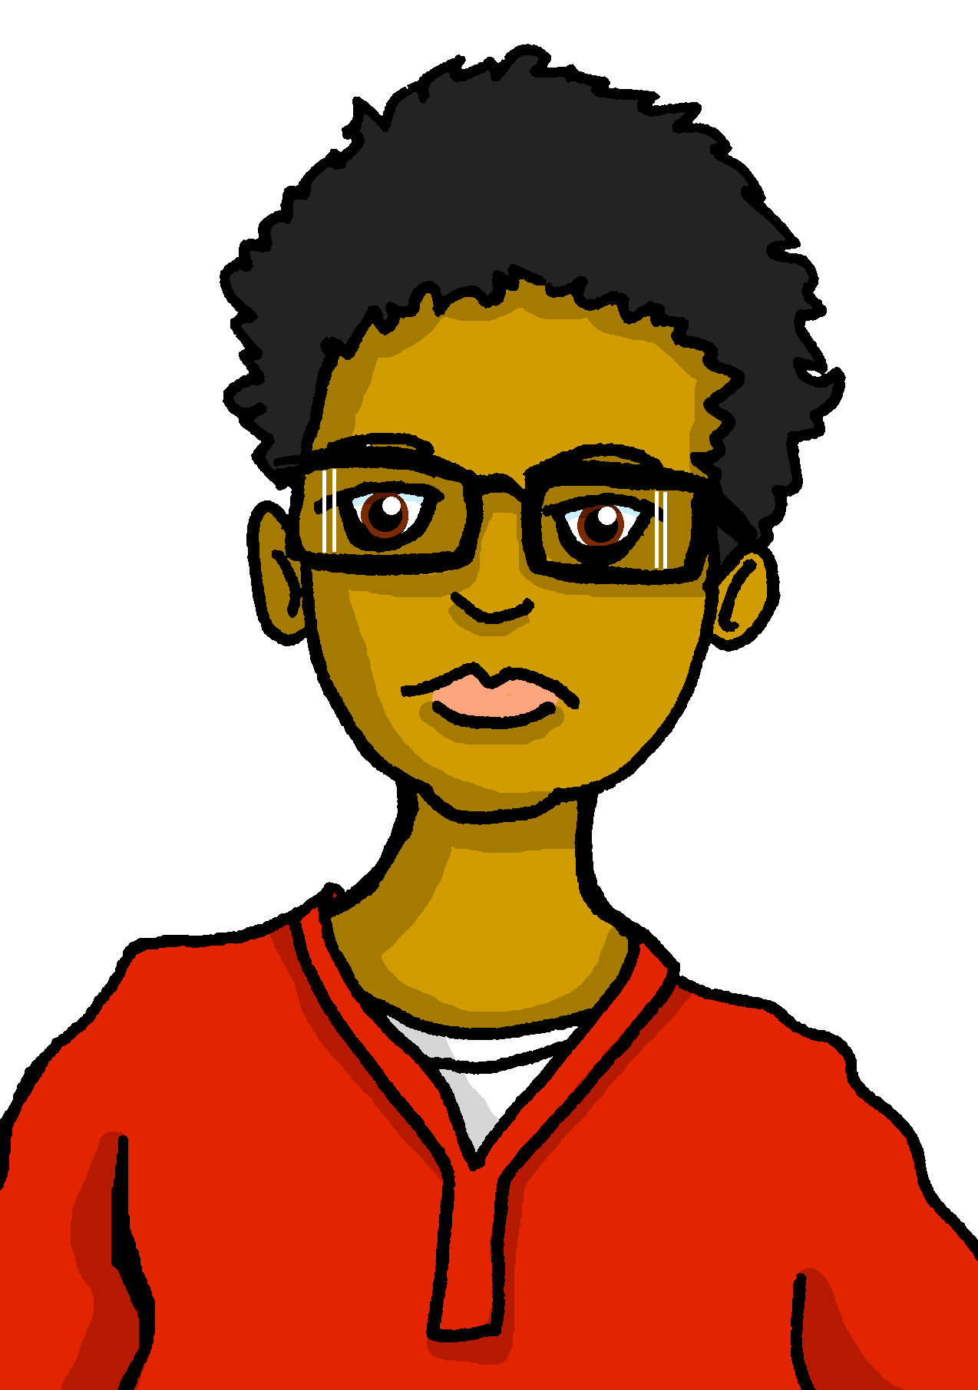
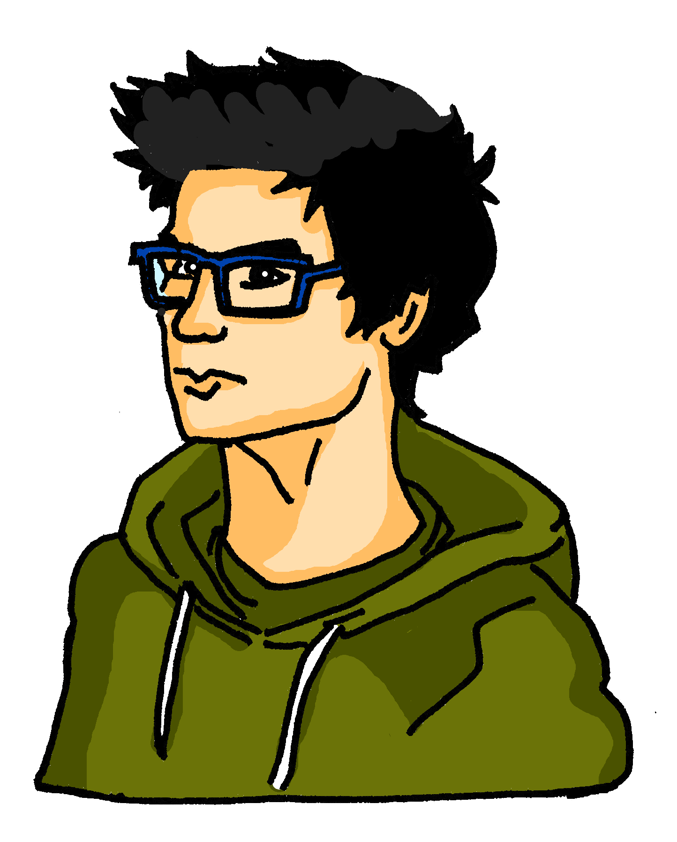
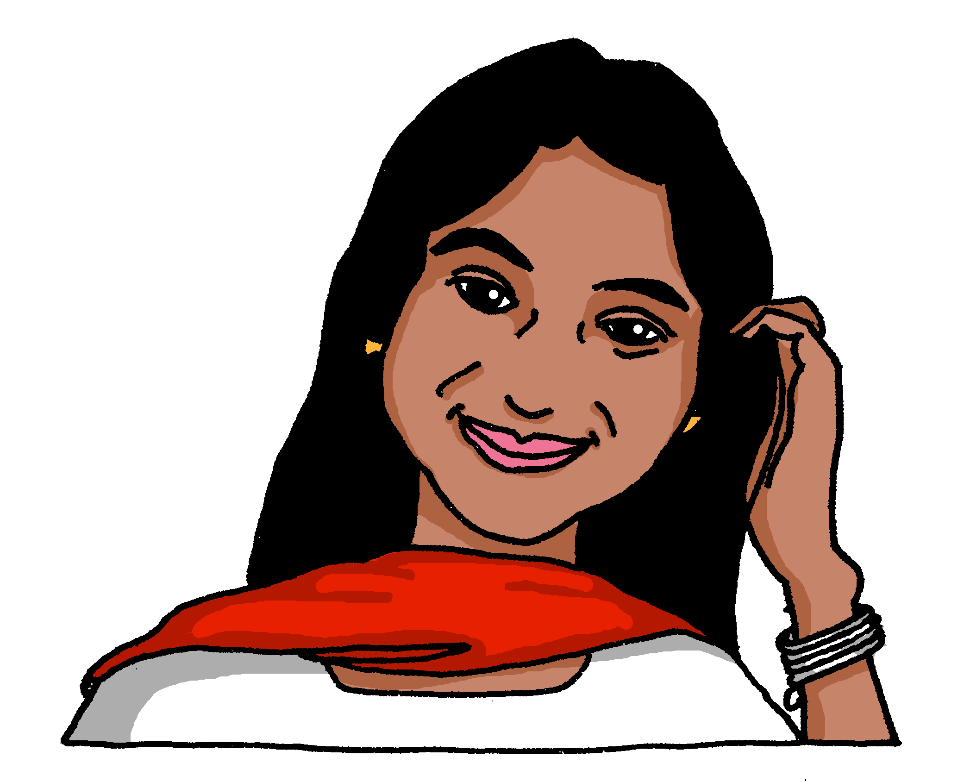
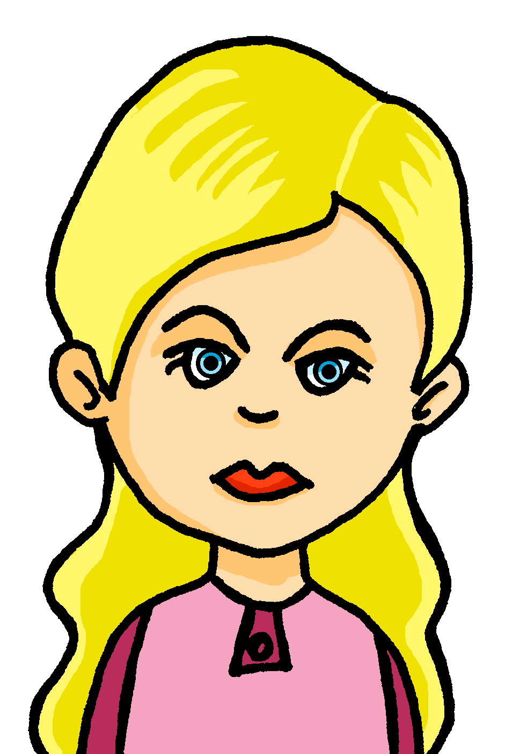
sprechen
Follow up 5
…
Wer ist dein Partner/deine Partnerin?
Ask only ‘yes|no’ questions in German. Work out who your partner has chosen to be!
Laura
Callum
Ella
Ali
Rafi
Alara
Emma
Martin
Notes:
[2/3]
The questions students need for this round are:
1. Wohnst du in England? | Wohnst du in der Schweiz?
2. Bist du neun Jahre alt? | Bist du zwölf Jahre alt?
3. Hast du im Januar Pläne? | Hast du im August Pläne?
4. Hast du einen Lieblingstag? | Hast du einen Lieblingsmonat?
5. Hast du einen Lieblingssport? | Hast du einen Lieblingssong?
11

Slide 12



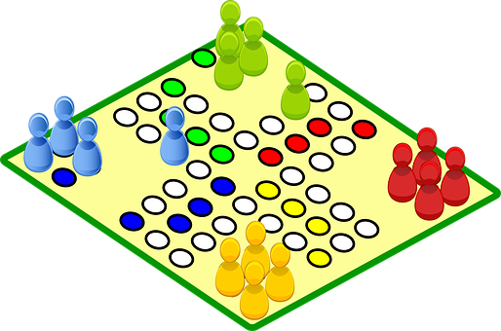


sprechen
Follow up 5
…
Wer ist dein Partner/deine Partnerin?
Ask only ‘yes|no’ questions in German. Work out who your partner has chosen to be!
Laura
Callum
Ella
Ali
to visit
to visit
to visit
to visit
Rafi
Alara
Emma
Martin
to visit
to visit
to visit
to visit
Notes:
[3/3]
The questions students need for this round are:
1. Arbeitest du mit Ben? | Arbeitest du mit Lea?
2. Besuchst du Oma? | Besuchst du Opa?
3. Möchtest du fahren? | Möchtest du bleiben?
4. Spielst du Gitarre? | Spielst du ein Spiel?
5. Bist du lieb? | Bist du ruhig?
12

Slide 13



Extra follow up:

Schreib auf Englisch.
Can you get at least 15 points?
Wörter
 | Mittwoch | Sonntag | Donnerstag
 | Montag | Freitag | Dienstag
 | Samstag | der Tag | die Woche
 | heute | morgen | er möchte
 | sie möchte | der Grund | es möchte
 | Juni | die Minute | die Stunde
 | Dezember | jung | Februar
Wednesday
Sunday
Thursday
Vokabeln
x3
Monday
Friday
Tuesday
Saturday
(the) day
(the) week
today
tomorrow
he would like
x2
she would like
reason
it would like
June
(the) minute
(the) hour
x1
December
young
February
Notes:
Timing: 5 minutes
Aim: to practise written comprehension of vocabulary from this and revisited weeks.
Note: This week, this vocabulary activity is extra. Teachers may do this activity instead of one of the others, or in addition.
Procedure:
1. Give pupils a blank grid. They fill in the English meanings of any of the words they know, trying to reach 15 points in total.
2. Remind pupils that adjectives can refer to male or female persons and they should note this in their translations. E.g. pleased (f), short (m).
Note:
The most recently learnt and practised words are pink, words from the previous week are green and those from week 1 are blue, thus more points are awarded for them, to recognise that memories fade and more effort (heavy lifting!) is needed to retrieve them.

Slide 14
Extra follow up:

Schreib auf Deutsch.
Can you get at least 15 points?
Wörter
 | Saturday | Wednesday | Sunday
 | Tuesday | (the) week | Friday
 | (the) day | Thursday | Monday
 | he would like | (the) granddad | tomorrow
 | it would like | today | she would like
 | October | her | old
 | (the) family | (the) month | his
Samstag
Mittwoch
Sonntag
Vokabeln
x3
Dienstag
die Woche
Freitag
der Tag
Donnerstag
Montag
er möchte
der Opa
morgen
x2
es möchte
heute
sie möchte
Oktober
ihr
alt
x1
die Familie
der Monat
sein
Notes:
Timing: 5 minutes
Aim: to practise written production of vocabulary from this and revisited weeks.
Procedure:
1. Give pupils a blank grid. They fill in the German meanings of any of the words they know, trying to reach 15 points in total.
2. Remind pupils that adjectives can refer to male or female persons and they should note this in their translations. E.g. pleased (f), short (m).
Note:
The most recently learnt and practised words are pink, words from the previous week are green and those from week 1 are blue, thus more points are awarded for them, to recognise that memories fade and more effort (heavy lifting!) is needed to retrieve them.

Slide 15
Tschüss!
gelb
Notes:
15

Slide 16


A
B
Richtig oder falsch?
Richtig oder falsch?
Focus on the underlined sounds. Does your partner pronounce them correctly? Tick or cross!
Focus on the underlined sounds. Does your partner pronounce them correctly? Tick or cross!
ob (whether)
Zimmer (room)
wir (we)
Sommer (summer)
Eis (ice cream)
von (from)
waschen (to wash)
werden (to become)
mag (like)
fertig (finished)
Kind (child)
Aktion (action)
nie (never)
Thema (topic)
Durst (thirst)
trinken (to drink)
halb (half)
Zukunft (future)
Notes:
HANDOUT (to be divided in half and half given to Pupil A and half to pupil B).
Note: Handout A should be given to Pupil A and has the words Pupil B will pronounce; handout B should be given to Pupil B and has the words that Pupil A will pronounce.

Slide 17
Vokabeln
Follow up 4
Wann hast du Pläne?. Schreib Vokabeln auf Deutsch.
Just have a go! Write any of these English words in German. You can add different words, too.
Wörter
January | February | March | April
May | June | July | August
September | October | November | December
to visit
Notes:
HANDOUT
17

Slide 18
Vokabeln
Follow up 4
Wann hast du Pläne?. Schreib auf Deutsch.
Wörter
Beispiel: Es ist Januar. Ich bin müde.
January | February | March | April
May | June | July | August
September | October | November | December
to visit
Notes:
HANDOUT
18

Slide 19
Extra follow up:

Schreib auf Englisch.
Can you get at least 15 points?
Wörter
 | Mittwoch | Sonntag | Donnerstag
 | Montag | Freitag | Dienstag
 | Samstag | der Tag | die Woche
 | heute | morgen | er möchte
 | sie möchte | der Grund | es möchte
 | Juni | die Minute | die Stunde
 | Dezember | jung | Februar
Vokabeln
x3
x2
x1
Notes:
HANDOUT

Slide 20
Extra follow up:

Schreib auf Deutsch.
Can you get at least 15 points?
Wörter
 | Saturday | Wednesday | Sunday
 | Tuesday | (the) week | Friday
 | (the) day | Thursday | Monday
 | he would like | (the) granddad | tomorrow
 | it would like | today | she would like
 | October | her | old
 | (the) family | (the) month | his
Vokabeln
x3
x2
x1
Notes:
HANDOUT

