Slide 1
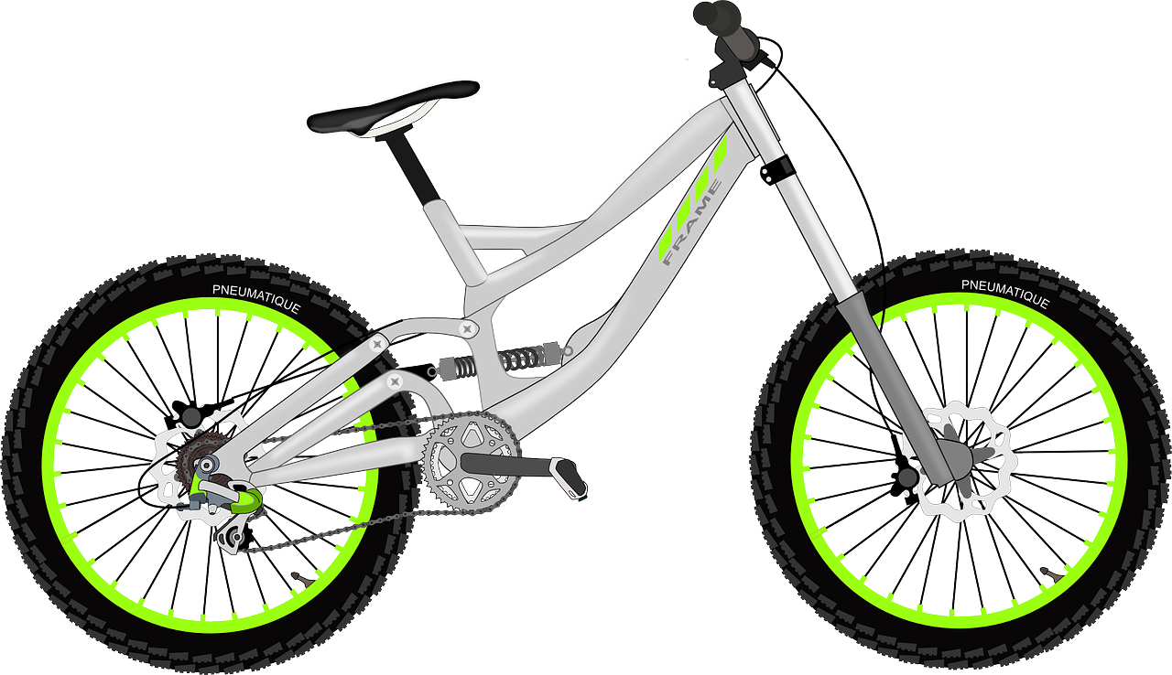
Experiences at home and away
Ein Fahrradunfall*
grün
Haben with meaning ‘be’
SSC [v] vs [w] [f]
der Unfall – accident
Term 3 Week 1
Notes:
Artwork by Steve Clarke. Pronoun pictures from NCELP (www.ncelp.org). All additional pictures selected from Pixabay and are available under a Creative Commons license, no attribution required.
Phonics: [v] vier [200] vergessen [584] Vater [232] positiv [516] viel [56]
Vocabulary: Angst (vor) [392] Bein [884] Glück [641] Kopf [250] Prüfung [1827] Recht [242] Schmerzen [1483] Unfall [1955] froh [1424] krank [1321] bitte [471] danke [877]
Revisit 1: gehen [66] sein [3] Laden [1675] Museum [1078] Park [2141] Restaurant [1802] Schwimmbad [n/a] Schule [359] Stadt [204] Wohin? [1811]
Revisit 2: benutzen [1119] brauchen [179] lernen [288] machen [58] singen [1063] spielen [205] Computer [1252] Fußball [1277] Opa [2776] Song [3373] normalerweise [2062] zu Hause [n/a] Revisit am + days of the week (am Montag) and adverbs (montags)
Jones, R.L & Tschirner, E. (2019). A frequency dictionary of German: Core vocabulary for learners. London: Routledge.
The frequency rankings for words that occur in this PowerPoint which have been previously introduced in these resources are given in the SOW and in the resources that first
introduced and formally re-visited those words.
For any other words that occur incidentally in this PowerPoint, frequency rankings will be provided in the notes field wherever possible.
Remember that at the start of the course (first three lessons of Rot/Gelb) pupils learnt language (for greetings and register taking) that can still be part of the lesson routines in upper KS2 (Blau/Grün). They are not re-taught, as we anticipate that teachers have built these in from early in lower KS2.
1

Slide 2
aussprechen
[v]
…
vier
Notes:
Timing: 1 minute
Aim: to introduce the SSC [v].
Procedure:
Introduce the SSC and present the source word ‘vier’ (with gesture, if using).
Click to bring on the picture and get pupils to repeat the word ‘vier’ (with gesture, if using).
Note:
a gesture for ‘vier’ might be to hold 4 fingers up.
2

Slide 3
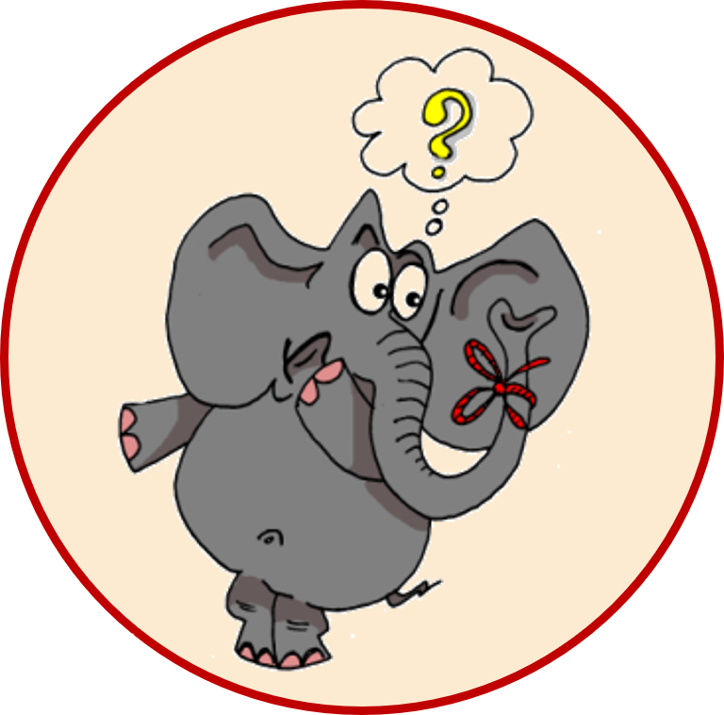
aussprechen
[v]
…
vergessen
Vater
vier
4
[to forget]
positiv
viel
[a lot, much]
Notes:
Timing: 1 minute
Aim: to consolidate the SSC [v].
Procedure:
Re-present the SSC and the source word ‘vier’ (with gesture, if using).
Click to bring on the picture and get pupils to repeat the word ‘vier’ (with gesture, if using).
Present the cluster words in the same way, bringing on the picture and getting pupils to pronounce the words.
Frequency:
vier [200] vergessen [584] Vater [232] positiv [516] viel [56]
Jones, R.L & Tschirner, E. (2019). A frequency dictionary of German: Core vocabulary for learners. London: Routledge.

Slide 4
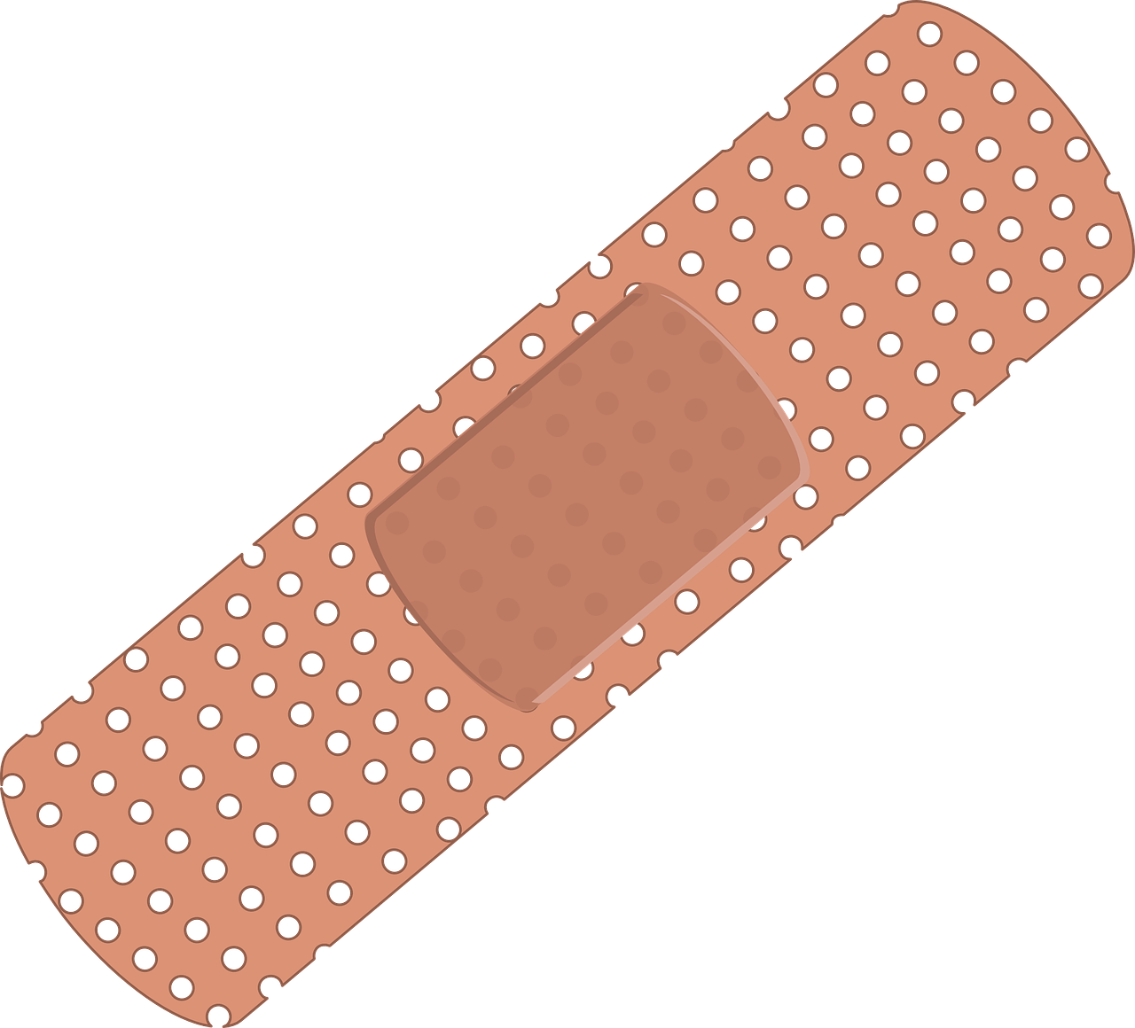
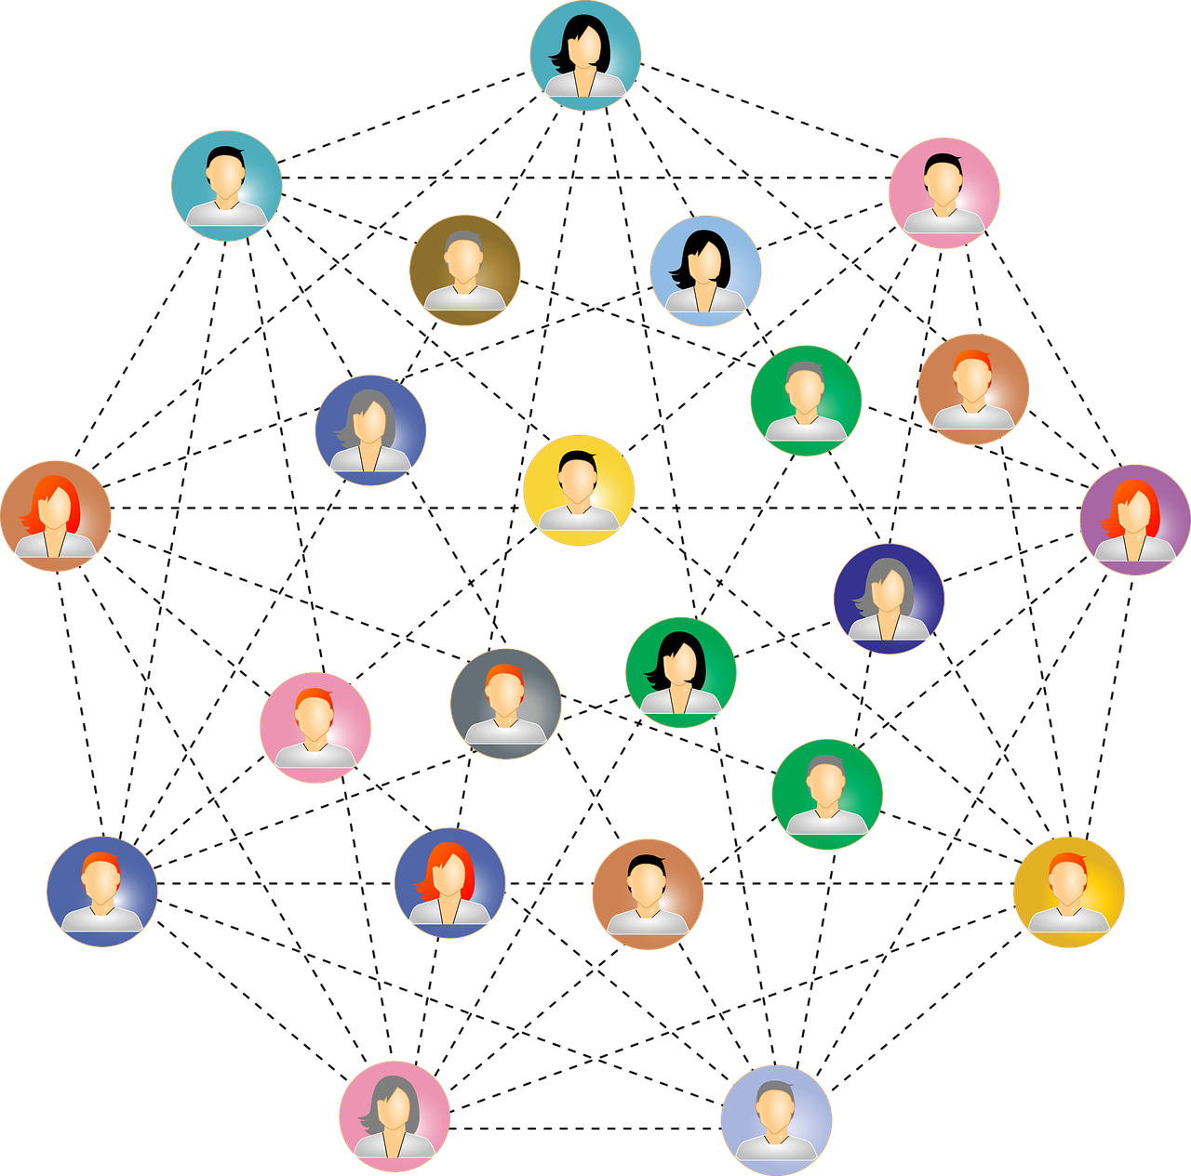
hören
[v]
[v] oder [w]?
Hör zu und schreib das Wort.
Write numbers 1-7. Turn away from the board, listen and write down the word that you hear. It will have either [v] or [w] in it!
 | Wort | English
1 | der Witz | (the) joke
2 | weich | soft
3 | negativ | negative
4 | die Wolke | (the) cloud
5 | versprechen | to promise
6 | verletzen | to injure
7 | das Netzwerk | (the) network
Notes:
Timing: 5 minutes
Aim: to consolidate aural recognition of the SSC [V] by contrasting it with the SSC [w]; to practise transcription of individual unknown words.
Procedure:
Pupils turn away from the board.
Click to bring up the written version of the words and the symbols.
Pupils write down numbers 1-8.
Play the audio by clicking the buttons 1-8.
Pupils try to transcribe the word they hear, paying particular attention to [v] or [w].
Pupils turn back round again and check their answers.
Click to reveal each German word, a picture, and click to reveal the English meanings (remembering that these are unknown words).
Transcript:
der Witz
weich
negativ
die Wolke
versprechen
verletzen
das Netzwerk
Word frequency:
Witz [2228] weich [2201] negativ [817] Wolke [2114] versprechen [1056] verletzen [1096] Netzwerk [2168]
4

Slide 5
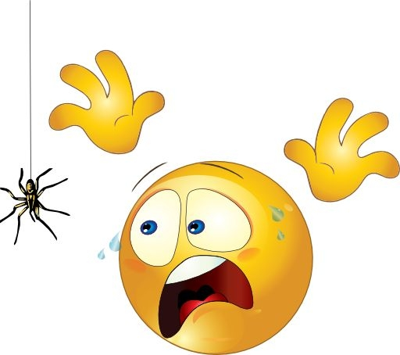
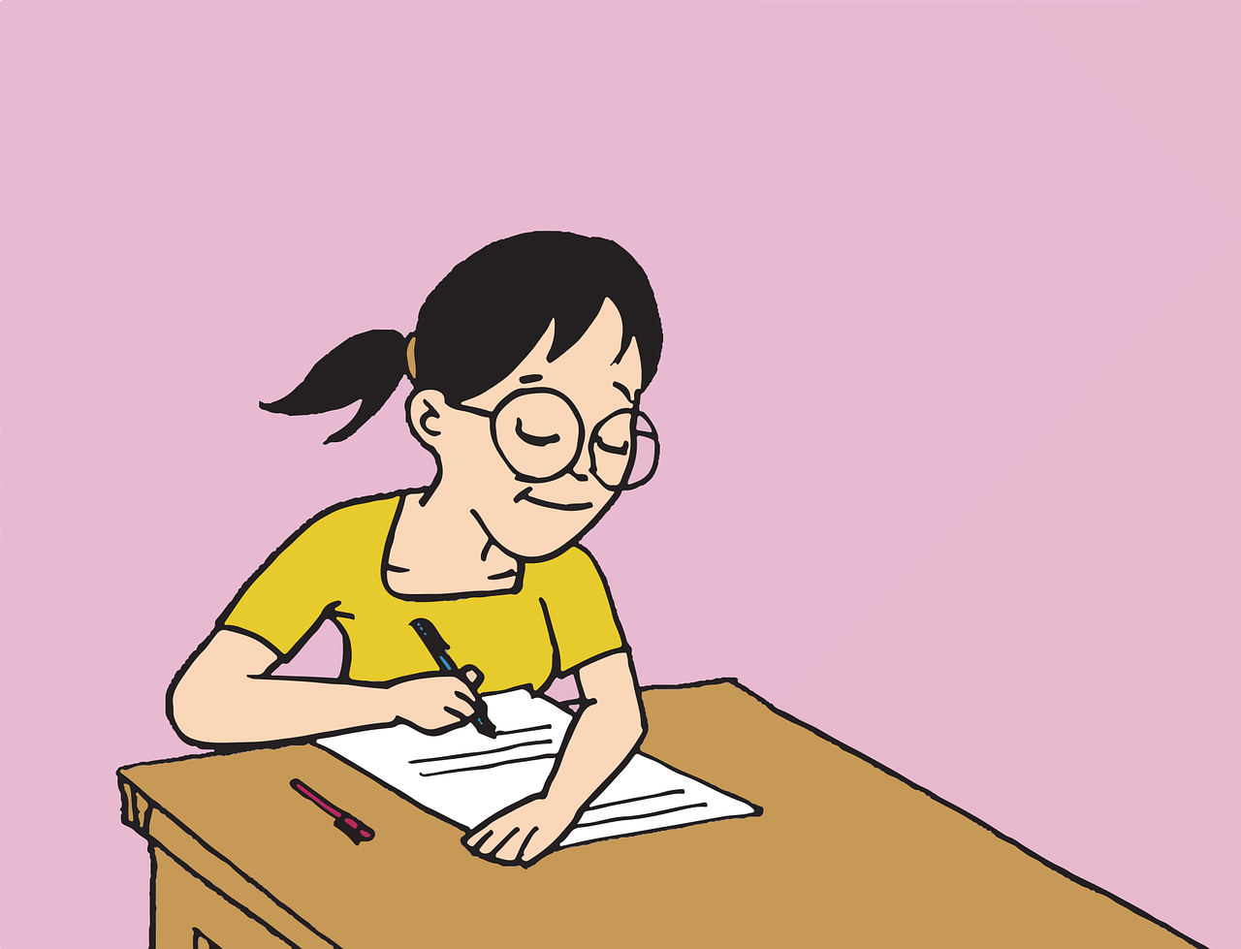
Vokabeln
Sag die Wörter.
Wörter
(die) Angst (vor)
das Glück
[fear (of)]
[luck]
froh
recht
[glad, happy]
[right]
krank
die Prüfung
[sick, ill]
[exam, test]
Notes:
[1/4]
Timing: 8 minutes (four slides)
Aim: to introduce new vocabulary.
Procedure 1. Pupils either work by themselves or in pairs, reading out the words and recapping their English meaning (1 minute).
2. Teachers elicit pronunciation from pupils, chorally. In the audio version, click on each word to hear it pronounced (1 minute). 3. Then, on the next slide, students try to recall the English orally (chorally), looking at the German (1 minute). 4. Then, on the following slide, they to recall the German meanings orally (again, chorally), looking at the English (1 minute).
Note:
Note that images/words won’t disappear and appear in this activity as in previous resources.
5

Slide 6
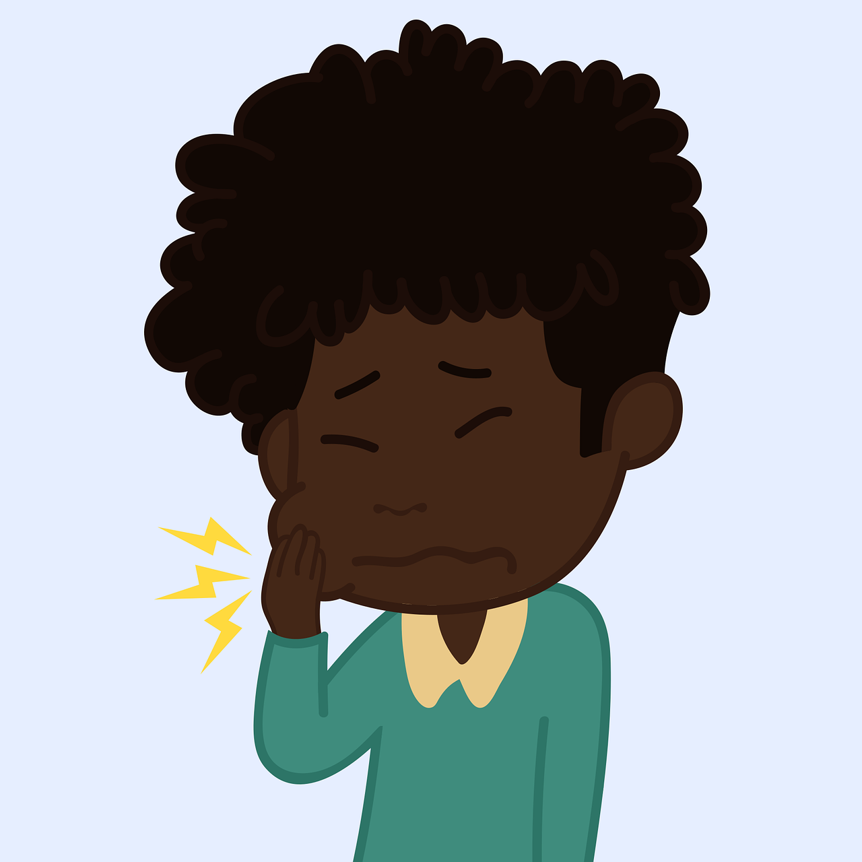
Vokabeln
Sag die Wörter.
Wörter
das Bein
die Schmerzen
[leg]
[pain(s)]
der Kopf
bitte
[head]
der Unfall
danke
[accident]
Notes:
[2/4]
Timing: 8 minutes (four slides)
Aim: to introduce new vocabulary.
Procedure 1. Pupils either work by themselves or in pairs, reading out the words and recapping their English meaning (1 minute).
2. Teachers elicit pronunciation from pupils, chorally. In the audio version, click on each word to hear it pronounced (1 minute). 3. Then, on the next slide, students try to recall the English orally (chorally), looking at the German (1 minute). 4. Then, on the following slide, they to recall the German meanings orally (again, chorally), looking at the English (1 minute).
Note:
Note that images/words won’t disappear and appear in this activity as in previous resources.
6

Slide 7
Vokabeln
Was ist das auf Englisch?
Wörter
(t_ _) f_ _ _ (o_)
(die) Angst (vor)
(the) fear (of)
(t_ _) l_ _
(the) leg
das Bein
g_ _ _ , h_ _ _ _
glad, happy
(t_ _) h_ _ _
froh
(the) head
der Kopf
s_ _ _ _ , i_ _
sick, ill
(t_ _) a_ _ _ _ _ _ _
krank
(the) accident
der Unfall
(t_ _) l_ _ _ _
(the) luck
(t_ _) p _ _ _ (s)
das Glück
(the) pain(s)
die Schmerzen
r _ _ _ _
right
p_ _ _ _ _
recht
please
bitte
(the) exam, test
(t_ _) e_ _ _, t_ _ _
thank you
die Prüfung
t_ _ _ _ y _ _
danke
Notes:
[3/4]
Timing: 8 minutes (four slides)
Procedure: 1. Students try to recall the English orally (chorally), looking at the German (1 minute). 2. Elicit answers and click to reveal
3. Then, in the following slide, they to recall the German meanings orally (again, chorally), looking at the English (1 minute).
Note: in the audio version of the resource, teachers can click on each German item to hear it pronounced.
7

Slide 8
Vokabeln
Was ist das auf Deutsch?
Wörter
(d_ _) A_ _ _ _ (v_ _)
(die) Angst (vor)
(the) fear (of)
d_ _ B_ _ _
das Bein
(the) leg
glad, happy
f_ _ _
froh
d_ _ K_ _ _
der Kopf
(the) head
k_ _ _ _
krank
d_ _ U_ _ _ _ _
sick, ill
der Unfall
(the) accident
d_ _ G_ _ _ _
das Glück
d_ _ S_ _ _ _ _ _ _ _
(the) luck
die Schmerzen
(the) pain(s)
r _ _ _ _
recht
b_ _ _ _
right
bitte
please
d_ _ P_ _ _ _ _ _
die Prüfung
(the) exam, test
d_ _ _ _
danke
thank you
Notes:
[4/4]
Timing: 8 minutes (four slides)
Procedure: 1. Students recall the German meanings orally (again, chorally), looking at the English (1 minute)
2. Click to reveal the answers.
Note: in the audio version of the resource, each German item is pronounced when the item appears.
8

Slide 9
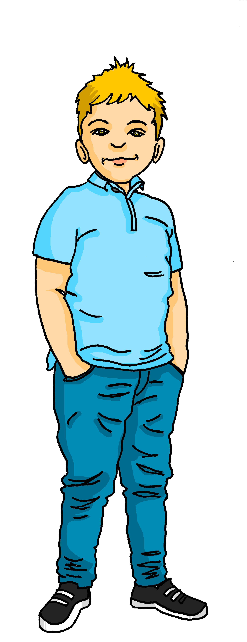
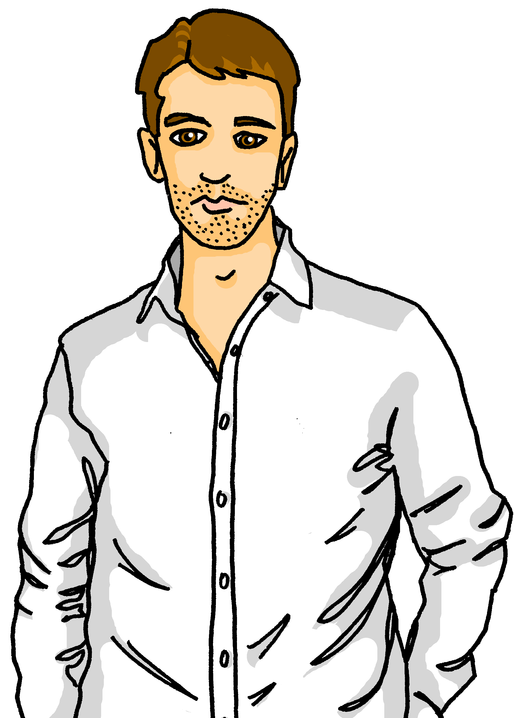
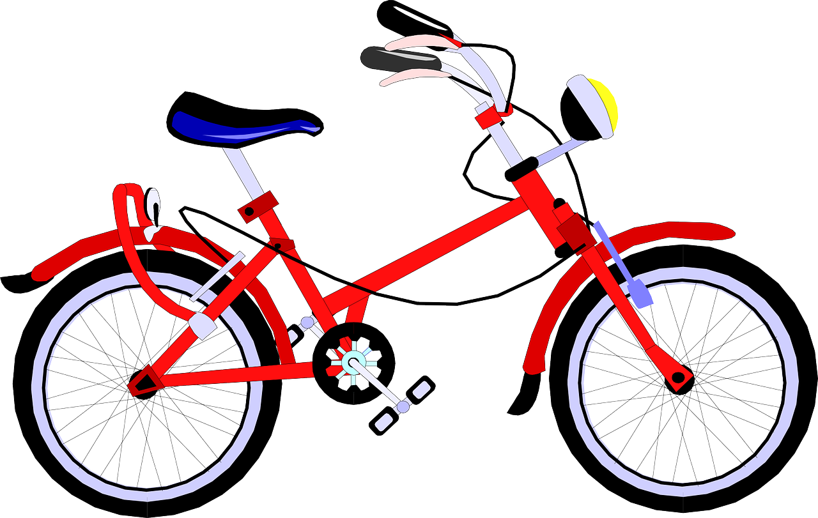
Ein Fahrradunfall
Lies den Comic.
lesen
Ronja, Lias und Gabriel fahren in die Berge. Sie fahren dort Rad. Leonie und Lothar sind auch da.
Wie findest du es hier, Gabriel?
Ich finde es gut...aber...ich habe Angst vor Radfahren. Ich finde es schwer.
Notes:
[1/4]
Timing: 1 minute
Aim: to introduce the vocabulary in context and practise reading skills.
Procedure:
Read the text with the class (or play the recording).
Elicit the meaning after each scene (four in total).
Translation:
Ronja, Lias and Gabriel are cycling in the mountains. Leonie and Lothar are also there.
Ronja: How do you find it/like it here, Gabriel?
Gabriel: I like it / I find it good...but...I’m scared (literally: I have fear) of cycling. I find it difficult.
9

Slide 10
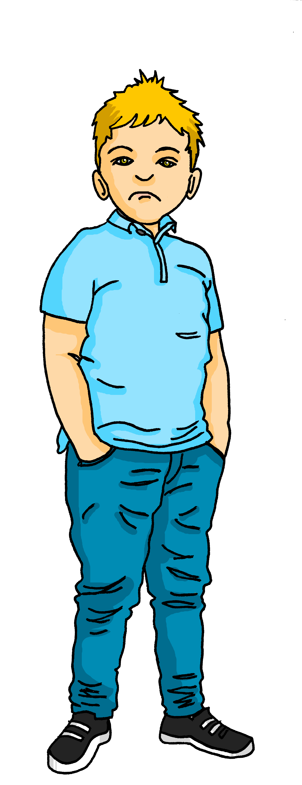
langsamer – slower, more slowly
Ein Fahrradunfall
lesen
Ronja möchte helfen.
Lias! Bitte fahr langsamer*! Gabriel hat Angst!
Was?! Warum hast du Angst, Gabriel? Radfahren ist einfach!
Notes:
[2/4]
Timing: 1 minute
Aim: to introduce the vocabulary in context and practise reading skills.
Procedure:
Read the text with the class (or play the recording).
Elicit the meaning after each scene (four in total).
Translation:
Ronja would like to help.
Ronja: Lias! Please go slower! Gabriel is scared!
Lias: What?! Why are you scared, Gabriel? Cycling is easy!
Vocabulary:
langsam [526]
Jones, R.L & Tschirner, E. (2019). A frequency dictionary of German: Core vocabulary for learners. London: Routledge.
10

Slide 11
Ein Fahrradunfall
aua! - ouch!
lesen
Oh nein! Lias hat einen Unfall!
Aua*!
Lias! Ist alles OK?
Nein... mein Bein! Ich habe Schmerzen! Aua*!
Mama! Papa! Wir brauchen Hilfe!
Notes:
[3/4]
Timing: 1 minute
Aim: to introduce the vocabulary in context and practise reading skills.
Procedure:
Read the text with the class (or play the recording).
Elicit the meaning after each scene (four in total).
Translation:
Oh no! Lias has an accident!
Lias: Ow!
Gabriel: Lias! Is everything OK?
Lias: No...my leg! I'm in pain!
Ronja: Mum! Dad! We need help!
Vocabuarly:
aua [N/A] Hilfe [481]
Jones, R.L & Tschirner, E. (2019). A frequency dictionary of German: Core vocabulary for learners. London: Routledge.
11

Slide 12
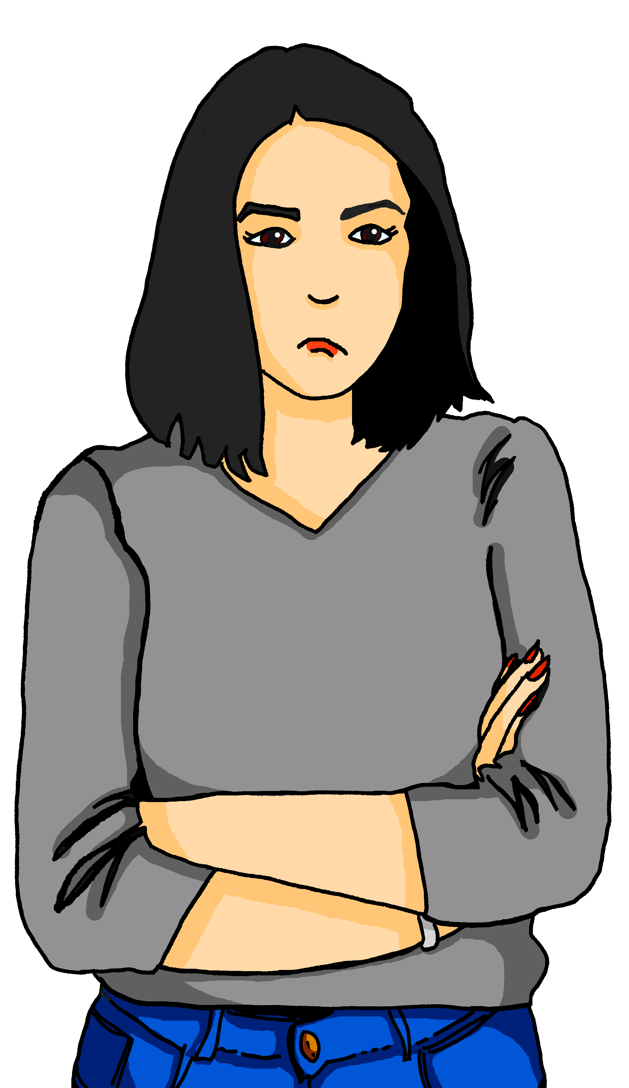
du Armer – you poor thing
zeig mir – show me
schlimm – bad
Ein Fahrradunfall
lesen
Leonie kommt.
Alles OK? Ach, du Armer*. Zeig mir* dein Bein, Lias.
Hmm...OK. Das ist nicht so schlimm*. Komm, wir gehen nach Hause.
Da hast du Glück, Lias! Bin ich froh!
Notes:
[4/4]
Timing: 1 minute
Aim: to introduce the vocabulary in context and practise reading skills.
Procedure:
Read the text with the class (or play the recording).
Elicit the meaning after each scene (four in total).
Translation:
Leonie comes / is coming.
Leonie: Is everything OK? Oh, you poor thing. Show me your leg, Lias.
Leonie: Hmm...OK. That’s not so bad. Come on, we’re going home (now).
Ronja: You’re lucky, Lias (literally: You have luck)! Am I glad!
Vocabulary:
Armer [N/A] zeigen [136] schlimm [762]
Jones, R.L & Tschirner, E. (2019). A frequency dictionary of German: Core vocabulary for learners. London: Routledge.
12

Slide 13
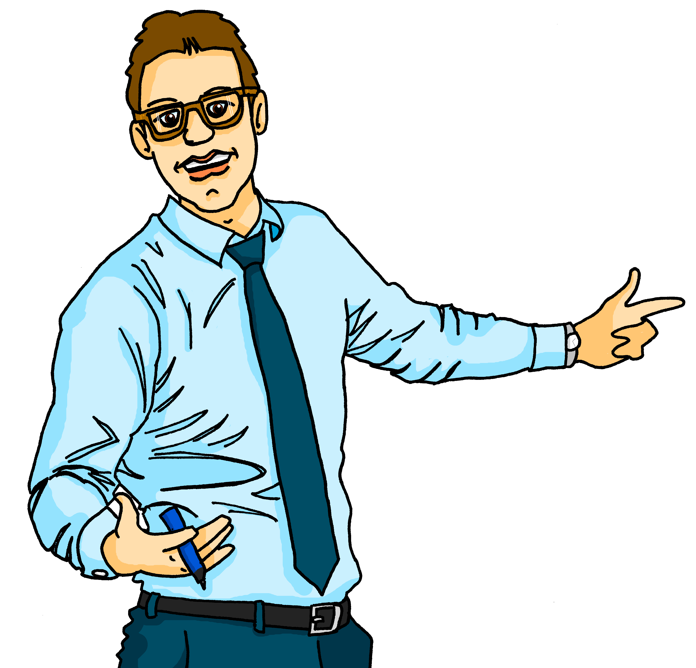
SEIN – to be, being
Remember that the verb SEIN (to be, being) is irregular:
ich bin
wir sind
Ich bin froh.
I am
Also: es ist = it is
we are
I am glad/happy.
du bist
ihr seid
Ihr seid krank.
you are
you (all) are
You (all) are sick/ill.
er ist
Sie sind
Sie sind zu Hause.
you (formal) are
You (formal) are at home
AND
they are at home.
he is
sie sind
sie ist
she is
they are
Notes:
Timing: 3 minutes
Aim: to revisit the present tense of the irregular verb sein verbs in the present tense.
Procedure: 1. Click to present the information step by step.
2. Elicit the German forms of the verbs from students.
13

Slide 14
HABEN – to have, having
Haben can sometimes mean ‘to be, being’!
Remember that the verb haben (to have, having) is irregular:
ich habe
wir haben
Ich habe Glück.
I have
Also: es hat = it has
we have
I am lucky.
du hast
ihr habt
Du hast recht.
you have
you (all) have
You are right.
er hat
Sie haben
Er hat Angst vor Prüfungen.
he has
you (formal) have
He is scared of exams.
sie hat
sie haben
she has
they have
Notes:
Timing: 3 minutes
Aim: to revisit the present tense of the irregular verb haben in the present tense, and to introduce the new idea that haben can sometimes also mean ‘to be’.
Procedure: 1. Click to present the information step by step.
2. Elicit the German forms of the verbs from students.
14

Slide 15
lesen
Gabriel schreibt Nachrichten
oder – don’t you/right?
immer noch – still
Was schreibt er?
1
4
Wir haben tolle Fahrräder.
Ronja und Leonie haben recht.
 | who | be/ have | details
1 | we | have | great bikes
2 | you | have | an exam on Monday, right?
3 | Lias (er) | has | leg pain(s)
4 | Ronja & Leonie (they) | are | right
5 | you (all) | have | a house in the mountains?
6 | I | am | still scared of cycling!
2
5
Du hast am Montag eine Prüfung, oder*?
Habt ihr ein Haus auf dem Land?
3
6
Lias hat Beinschmerzen.
Ich habe immer noch* Angst vor Radfahren!
Notes:
Timing: 8 minutes
Aim: to decide whether the meaning is ‘be’ or ‘have’, and to recognise the meanings of different parts of haben.
Procedure:
Explain the context: Gabriel is sending text messages from his trip with Lias and Ronja.
Pupils extract the following information form the chat boxes: who is the message about (grammatical person), is the meaning ‘be’ or ‘have’, and what is the message about.
Elicit answers, then click to reveal the answers in the table on the right.
Vocabulary:
oder [35] noch [33]
Jones, R.L & Tschirner, E. (2019). A frequency dictionary of German: Core vocabulary for learners. London: Routledge.
15

Slide 16
hören
Ronja und Lias sind in der Schule. Sie sind krank und telefonieren* mit Leonie.
telefonieren – to telephone/call
genug - enough
Was sagen Ronja und Leonie?
who | be/have | details
we | are | sick/ill
you (all) | are | in pain
Lias (he) | is | in pain
I | have | a headache
you (all) | have | enough water?
you (formal) | have | glasses of water
you | are | right
1
2
3
4
5
6
7
Notes:
Timing: 8 minutes
Aim: to continue the task, switching to the listening modality.
Procedure:
1. Explain that this is the same task, only now pupils have to listen rather than to extract the answers.
2. Click on the audio buttons to play the recordings. Pupils listen out for the three pieces of information.
3. Elicit the answers.
4. Click to reveal the answers in turn.
Transcript:
(Ronja) Hallo Mama. Wir sind krank.
(Leonie) Ach, habt ihr Schmerzen?
(Ronja) Ja, Lias hat Schmerzen.
(Ronja) Und ich habe Kopfschmerzen.
(Leonie) Habt ihr genug Wasser?
(Ronja) Hmm...nein. Ich frage Herrn Weber. Herrn Weber, haben Sie Gläser Wasser? Danke!
(Leonie) Also ihr bleibt in der Schule, ja? (Ronja) OK, Mama. Du hast recht.
Vocabulary:
telefonieren [3156] genug [498]
Jones, R.L & Tschirner, E. (2019). A frequency dictionary of German: Core vocabulary for learners. London: Routledge.
16

Slide 17
Tschüss!
grün
Notes:
17

