Slide 1
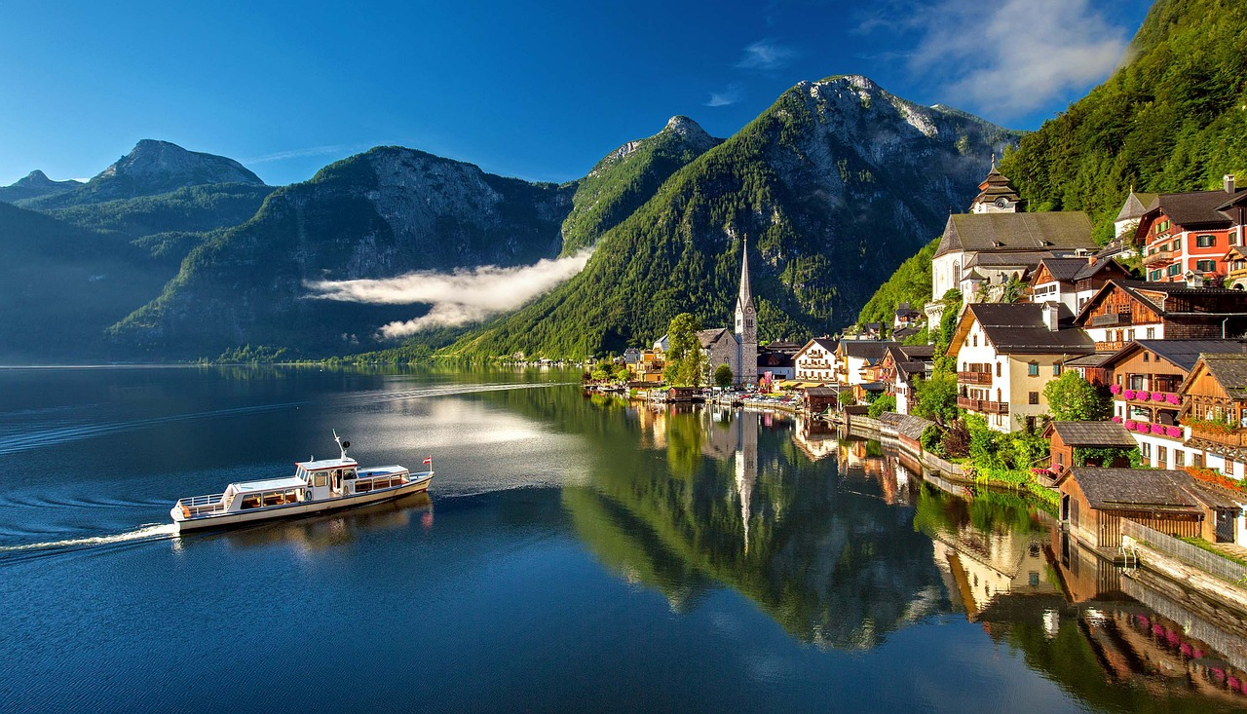
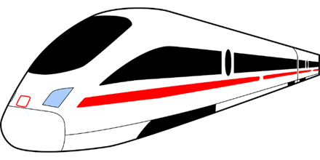
Experiences at home and away
Dieses Wochenende* fahren wir nach Österreich!
travelling ‘to’: nach |zu
present tense (future meaning)
SSC [-g] [-d] [-b]
grün
das Wochenende - weekend
Term 3 Week 5
Notes:
Artwork by Steve Clarke. Pronoun pictures from NCELP (www.ncelp.org). All additional pictures selected from Pixabay and are available under a Creative Commons license, no
attribution required.
Phonics:
[-g] Tag [111] Berg [934] Zug [675]
[-d] und [2] Lied [1733] Freund [273]
[-b] gelb [1446] Lieblings- [n/a] siebzehn [>5000]
Vocabulary: fahren [215] Berg [934] Dorf [959] Europa [294] Haus [147] Meer [854] Österreich [707] Schweiz [763] See [1317] dort [139] bald [503] nach [34] zu [21] nach Hause [n/a]
Revisit 1: werden, werde, wirst, wird [8] Frohe Weihnachten [n/a] Gute Besserung [n/a] Herzlichen Glückwunsch zum Geburtstag [n/a] viel Glück [n/a]
Revisit 2: Uhr³ [348] spät [169] um¹ [44] zusammen [533] Revisit numbers 1-12
Jones, R.L & Tschirner, E. (2019). A frequency dictionary of German: Core vocabulary for learners. London: Routledge.
The frequency rankings for words that occur in this PowerPoint which have been previously introduced in these resources are given in the SOW and in the resources that first
introduced and formally re-visited those words.
For any other words that occur incidentally in this PowerPoint, frequency rankings will be provided in the notes field wherever possible.
Remember that at the start of the course (first three lessons of Rot/Gelb) pupils learnt language (for greetings and register taking) that can still be part of the lesson routines in upper KS2 (Blau/Grün). They are not re-taught, as we anticipate that teachers have built these in from early in lower KS2.
1

Slide 2
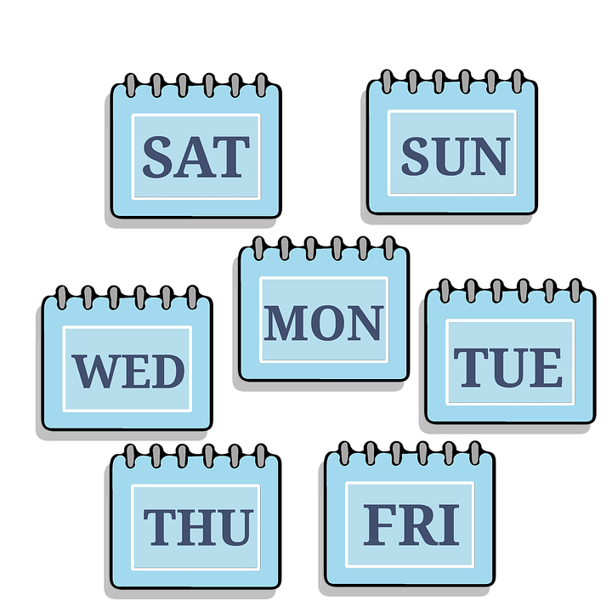
aussprechen
[-b]
[-d]
[-g]
When g, d, b come at the end of a word or before a consonant they sound like k, t, p and you don’t use your vocal chords.
…
and
Tag
und
gelb
Notes:
Timing: 2 minutes
Aim: To introduce/consolidate SSC [-g]
Procedure: 1. Present the letter(s) and say the final [-g] sound first, on its own. Pupils repeat it with you. Do the same with final [-d] and final [-b].
2. Click to bring up the callout to explain when these letters sound like this: i.e., g = k, d = t, b = p. 3. Bring up the word “Tag” on its own, say it, pupils repeat it, so that they have the opportunity to focus all of their attention on the connection between the written word and its sound.
4. A possible gesture for this would be to use the British Sign Language (BSL) sign for day, as here: https://www.signbsl.com/sign/day.
5. Click to bring up the image and say the word “Tag” again with pupils.
6. Click to bring up the word “und”. One gesture is to make the plus sign with two index fingers. Alternatively, the BSL sign for “and” is here: https://www.signbsl.com/sign/and
7. Click to bring up the image and say the word “und” again. 8. Finally, click to bring up the word “gelb”. BSL is here: https://www.signbsl.com/sign/yellow
9. Click to bring up the image and say the word again.
Word frequency (1 is the most frequent word in German): gelb [1446] Tag [111] und [2] Source: Jones, R.L. & Tschirner, E. (2019). A frequency dictionary of German: core vocabulary for learners. Routledge
2

Slide 3
aussprechen
[-g]
…
Tag
Berg
Zug
Notes:
Timing: 3 minutes (three slides)
Aim: To introduce/consolidate SSC [-g]
Procedure:
Introduce and elicit the pronunciation of the individual SSC [-g] and then the source word again ‘Tag’ (with gesture, if using).
Then present and elicit the pronunciation of the two cluster words.
The cluster words have been chosen for their high-frequency, from a range of word classes, with the SSC (where possible) positioned within a variety of syllables within the words (e.g. initial, 2nd, final etc.). Additionally, we have tried to use words that build cumulatively on previously taught SSCs (see the Phonics Teaching Sequence document) and do not include new SSCs. Where new SSCs are used, they are often consonants which have a similar symbol-sound correspondence in English.
Word frequency (1 is the most frequent word in German): Berg [934] Tag [11] Zug [675] Source: Jones, R.L. & Tschirner, E. (2019). A frequency dictionary of German: core vocabulary for learners. Routledge

Slide 4
aussprechen
[-d]
…
and
und
Lied
Freund
Notes:
[2/3]
Aim: To introduce/consolidate SSC [-d]
Procedure:
Introduce and elicit the pronunciation of the individual SSC [-d] and then the source word again ‘und’ (with gesture, if using).
Then present and elicit the pronunciation of the two cluster words.
The cluster words have been chosen for their high-frequency, from a range of word classes, with the SSC (where possible) positioned within a variety of syllables within the words (e.g. initial, 2nd, final etc.). Additionally, we have tried to use words that build cumulatively on previously taught SSCs (see the Phonics Teaching Sequence document) and do not include new SSCs. Where new SSCs are used, they are often consonants which have a similar symbol-sound correspondence in English.
Word frequency (1 is the most frequent word in German): und [2] Freund [273] Lied [1733] Source: Jones, R.L. & Tschirner, E. (2019). A frequency dictionary of German: core vocabulary for learners. Routledge

Slide 5
aussprechen
[-b]
…
gelb
Lieblings-
siebzehn
Notes:
[3/3]
Aim: To introduce/consolidate SSC [-b]
Procedure:
Introduce and elicit the pronunciation of the individual SSC [-b] and then the source word again ‘gelb’ (with gesture, if using).
Then present and elicit the pronunciation of the two cluster words.
The cluster words have been chosen for their high-frequency, from a range of word classes, with the SSC (where possible) positioned within a variety of syllables within the words (e.g. initial, 2nd, final etc.). Additionally, we have tried to use words that build cumulatively on previously taught SSCs (see the Phonics Teaching Sequence document) and do not include new SSCs. Where new SSCs are used, they are often consonants which have a similar symbol-sound correspondence in English.
Word frequency (1 is the most frequent word in German): gelb [1446] Lieblings-[N/A] siebzehn [N/A]
Source: Jones, R.L. & Tschirner, E. (2019). A frequency dictionary of German: core vocabulary for learners. Routledge

Slide 6
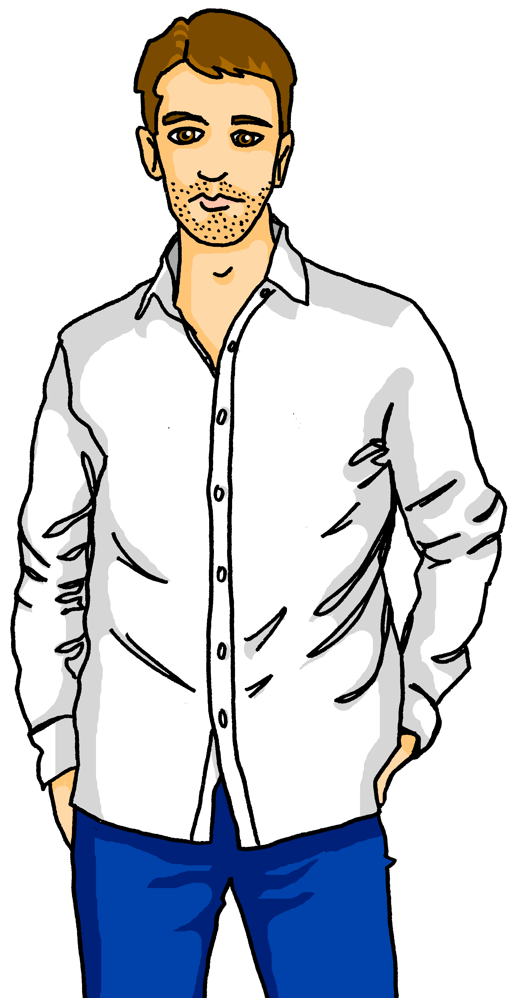
Kultur
Sie fahren nach Österreich!
Lies den Text.
Lias und Ronja Brandt wohnen in Biel in der Schweiz. Bald* fährt die Familie Brandt nach Innsbruck in Österreich. Die Fahrt* ist lang. Sie fahren 4 Stunden 25 Minuten mit dem Zug! Das sind 410 Kilometer!
Innsbruck, Österreich
Biel, die Schweiz
bald – soon
die Fahrt – the journey
Notes:
Timing: 5 minutes
Aim: to present and practise new vocabulary and context for this week.
Procedure:
Read the texts or play the recordings. Make sure the lesson’s context is clear.
Translation:
Lias, Ronja and their family live in Biel in Switzerland. Soon they’re going to Innsbruck in Austria. The journey is long. They are going to be travelling for 6 hours 25 minutes with the train! That’s/It’s 410 kilometres!
Vocabulary:
bald [503] Fahrt [1569]
Jones, R.L & Tschirner, E. (2019). A frequency dictionary of German: Core vocabulary for learners. London: Routledge.
6

Slide 7
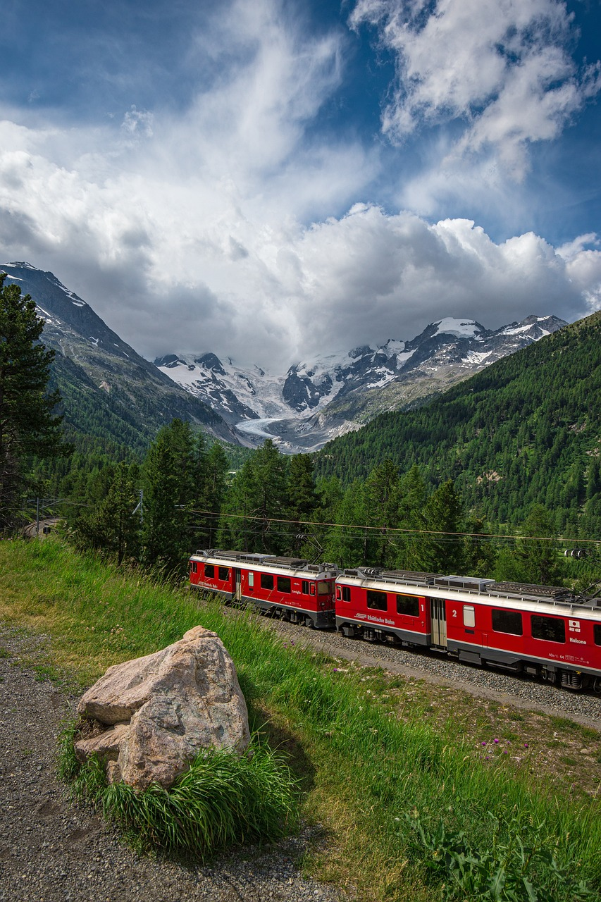
[-g] [-d] [-b]
Auf der Fahrt sehen sie Schilder*!
Hör zu. Ist es [-g], [-d] oder [-b]?
 |  | [-g] | [-d] | [-b]
1 | Meinisberg
2 | Kirchberg
3 | Gaiserwald
4 | Lutzenberg
5 | Grabs
6 | Brand
7 | Auland
8 | Bschlabs
9 | Hard
O
das Schild – sign
Notes:
Timing: 5 minutes
Aim: to consolidate the SSC [-g] [-d] and [-b].
Procedure:
Click each audio button to hear the place name. Pupils listen out particularly for the last sound of the word.
Pupils listen and decide which SSC they hear. Note that these items are all unvoiced versions of the letters.
Optional stage: listen again and pupils try transcribing the full place name (Note: pupils could do this the first time around, too, if able).
4. Click to reveal answers.
NB: the places ending in –d and –g are situated near/along the family’s train route. The places ending in –b are a bit further away – selected for phonics rather than geography! ☺
Transcript:
Meinisberg
Kirchberg
Gaiserwald
Lutzenberg
Grabs
Brand
Auland
Bschlabs
Hard
Word frequency:
Schild [3366]
Source: Jones, R.L. & Tschirner, E. (2019). A frequency dictionary of German: core vocabulary for learners. Routledge

Slide 8
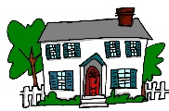
nach und zu
Nach and zu can both mean ‘to’. Nach means ‘to’ with:
City or town names
Ich fahre nach Innsbruck.
I’m going to Innsbruck.
Most countries
...and continents, e.g. ‘Wir fahren nach Europa.’ (We’re going to Europe).
I’m going to Austria.
Ich fahre nach Österreich.
Directions
Ich gehe nach links.
I’m going (to the) left.
Nach meaning ‘to’ is never followed by an article (word for ‘the’).
Exception! If you want to say ‘I go to Switzerland’ you say ‘Ich fahre in die Schweiz’.
You also know:
Ich gehe nach Hause.
I’m going (to) home.
Remember: gehen is go on foot, fahren is go by transport.
Notes:
Timing: 2 minutes
Procedure:
Click through the animations to present the new information.
Elicit English translation for the German examples provided.
8

Slide 9
Nach und zu
We shorten zu dem to zum and zu der to zur.
Use zu (to) for places and events with articles.
In this case, the words for ‘the’ (der, die, das) are:
masculine
feminine
neuter
Ich gehe…
zu dem Laden
zu der Party
zu dem Meer
… zum Laden
… zur Party
… zum Meer
I’m going…
…to the shop
…to the party
…to the sea
But… Ich bin zu Hause. I am at home.
Also use zu (to) for people:
Ich gehe zu Anna.
I’m going to Anna’s (place).
Ich gehe nach Hause. I’m going (to) home.
Notes:
Timing: 2 minutes
Procedure:
Click through the animations to present the new information.
Elicit English translation for the German examples provided.

Slide 10
lesen
Leon kommt auch. Lias und Ronja schreiben Leon und erzählen die Pläne*.
Lies die SMS. Was heißen ‘nach’ und ‘zu’ auf Englisch?
to
1
to
Wir fahren bald nach Innsbruck.
4
Am Samstag gehen wir zum Zoo.
to the
to the
In German we use future time phrases with the present to say what we are doing in the future.
(-)
(-)
2
to
5
Am Sonntag fahren wir zum ‘Obernberger See’.
to
Am Freitag fahren wir mit dem Zug. Er fährt durch die Berge nach Österreich.
to the
to the
(-)
(-)
Obernberger See is a lake near Innsbruck.
3
to
Am Sonntag fahren wir nach Hause.
to
Um sieben Uhr gehen wir zum Restaurant.
6
to the
to the
(-)
(-)
die Pläne - plans
Notes:
Time: 3 minutes.
Aim: to practise the meanings of ‘zu’ and ‘nach’ in a reading activity.
Procedure:
Pupils read the text messages and identify the correct meaning of zu or nach.
Click for answer ticks to appear.
Then elicit meanings of the whole messages – suggested translations below.
Click to bring up callouts to draw pupils’ attention to English meanings. Finally, click to bring up a picture of the Obernberger See.
Translation:
We are going to Innsbruck soon.
On Friday we’re travelling by train. It goes through the mountains to Austria.
At 7 o’clock we’re going to a/the restaurant.
On Saturday we’re going to the zoo.
On Sunday we’re going to the Obernberger See (lake).
On Sunday we’re going home.
Word frequency:
Plan [954]
Source: Jones, R.L. & Tschirner, E. (2019). A frequency dictionary of German: core vocabulary for learners. Routledge

Slide 11
hören
Leon erzählt xiesen* Eltern* über die Fahrt.
Hör zu. Ist es ‘nach’ oder ‘zu’?
Wie heißt das auf Englisch?
 | nach | zu, zum, zur | Englisch
 |  |  | We are travelling to Austria soon.
 |  |  | The journey to Innsbruck is very beautiful. We see lots of mountains, villages and lakes.
 |  |  | The train goes from Biel to Zurich and then from Zurich to Innsbruck.
 |  |  | We’re going by bus to the hotel.
 |  |  | In Innsbruck we’re going to the zoo.
 |  |  | We’re also going to a/the restaurant and we’re going to eat Schnitzel.
 |  |  | On Sunday we’re going home.
B.
1
2
3
4
5
6
xiesen = their (dat. pl.)
die Eltern - parents
Notes:
Time: 5 minutes.
Aim: to practice aural comprehension of the different uses of ‘to’ (‘nach’ and ‘zu’).
Procedure:
Click to play the example. Pupils identify the correct word for ‘to’: zu or nach.
Click to reveal the answer tick. Elicit translation.
Click to reveal the meaning.
Continue for items 1-6.
Transcript:
Beispiel: Wir fahren bald [nach] Österreich.
Die Fahrt [nach] Innsbruck ist sehr schön. Wir sehen viele Berge, Dörfer und Seen.
Der Zug fährt von Biel [nach] Zürich und dann von Zürich [nach] Innsbruck.
Wir fahren mit dem Bus [zum] Hotel.
In Innsbruck gehen wir [zum] Zoo.
Wir gehen auch [zum] Restaurant und essen Schnitzel.
Am Sonntag fahren wir [nach] Hause.
Word frequency:
xiesen [N/A] Eltern [404]
Source: Jones, R.L. & Tschirner, E. (2019). A frequency dictionary of German: core vocabulary for learners. Routledge

Slide 12
Tschüss!
grün
Notes:
12

