Slide 1
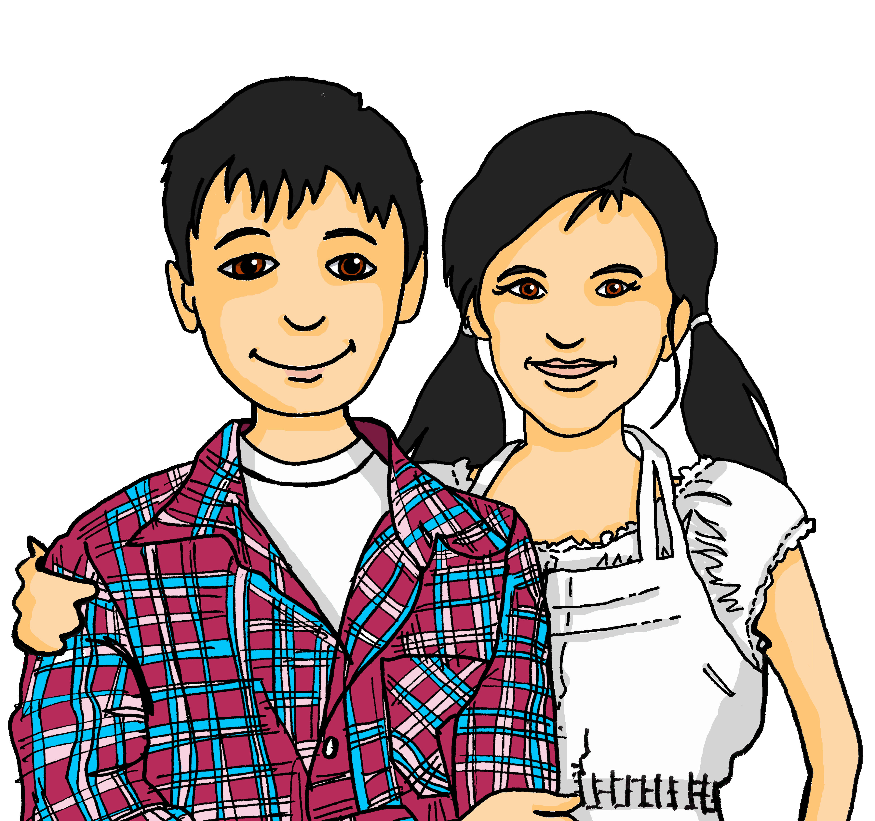
Experiences at home and away
Wir helfen zu Hause
grün
Follow ups 1-5
Term 3 Week 7
Notes:
Artwork by Steve Clarke. Pronoun pictures from NCELP (www.ncelp.org). All additional pictures selected from Pixabay and are available under a Creative Commons license, no attribution required.
Phonics: revisit [ei] and [ie]
Vocabulary: backen [4640] holen [547] kochen [1481] müssen, ich muss, du musst, er/sie/es muss [43] Bett [659] Boden [536] Brot [2095] sauber [2026] warum? [192] glossed: Salat [n/a]
Revisit 1: laufen [252] lesen [288] schlafen [679] sehen [79] sprechen [161]
Revisit 2: einkaufen [2877] gehen [66] kommen [62] schwimmen [1863] sein [3] Land2 [134] Markt [476] Straße [391] auf [16] nach Hause [n/a]
Jones, R.L & Tschirner, E. (2019). A frequency dictionary of German: Core vocabulary for learners. London: Routledge.
The frequency rankings for words that occur in this PowerPoint which have been previously introduced in these resources are given in the SOW and in the resources that first introduced and formally re-visited those words.
For any other words that occur incidentally in this PowerPoint, frequency rankings will be provided in the notes field wherever possible.
Remember that at the start of the course (first three lessons of Rot/Gelb) pupils learnt language (for greetings and register taking) that can still be part of the lesson routines in upper KS2 (Blau/Grün). They are not re-taught, as we anticipate that teachers have built these in from early in lower KS2.

Slide 2
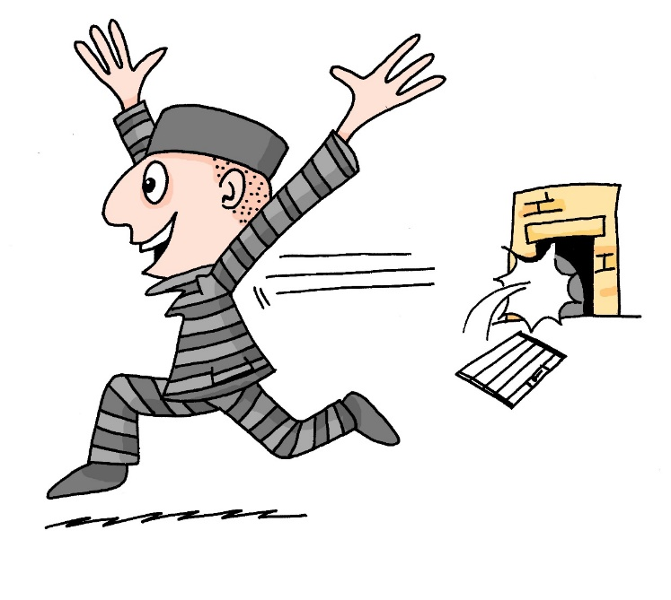
aussprechen
[ei]
[ie]
…
free
frei
Liebe
Notes:
Timing: 1 minute
Aim: to revisit the SSC [ei] and [ie].
Procedure:
Re-present the SSC [ei] and present the source word ‘frei’ (with gesture, if using).
Click to bring on the picture and get pupils to repeat the word ‘frei’ (with gesture, if using).
Note:
a gesture for frei’ might be to throw you hands up in the air and pretend to run away.
Re-present the SSC [ie] and present the source word ‘Liebe’ (with gesture, if using).
Click to bring on the picture and get pupils to repeat the word ‘Liebe’ (with gesture, if using).
Note:
A gesture for ‘Liebe’ might be to make a ‘heart’ shape with both hands approximately where your heart is in your body.
Vocabulary:
frei [318] Liebe [844]
Jones, R.L & Tschirner, E. (2019). A frequency dictionary of German: Core vocabulary for learners. London: Routledge.
2

Slide 3
Follow up 1
Lies, hör zu, und schreib.
Person B
Person A

1. Mein Lied heißt ‘Die Tiere sind hier!’.
1. ___________________________
aussprechen

2. __________________________________
2. Sie liest ihr Lieblingsbuch, ‘Heidi’.

3. Siehst du meine vier Bleistifte?
3. __________________________________

4. __________________________________
4. Wie viele Beispiele sieht sie?

5. Deine zwei kleinen Schwestern haben viele Kleidung.
5. __________________________________
____________________________________

6. __________________________________
____________________________________
6. Seid ihr hier in Österreich oder in der Schweiz?
Notes:
Timing: 8 minutes
Aim: to practise aural production, comprehension and written production of the SSCs [ei] and [ie].
Procedure:
Split the class into Person A and Person B pairs.
Person B turns away from the board.
Click to bring up the first item for Person A to read out.
Person B writes down what they have heard, taking care with the [ei] and [ie] SSC’s.
Person B turns around and compares what they have written with the version on the board.
Now Person A turns away from the board.
Click to bring up item 2 for Person B to read.
Person B reads out loud and Person A transcribes.
Then Person A turns around and compares their version with what is on the board.
Continue for items 2-6.
Note: in the audio version of the lesson, click on the writing hand to hear the sentence pronounced.
Translations:
My song is called ‘The animals are here!’.
She is reading her favourite book, ‘Heidi’.
Do you see my four pencils?
How many examples does she see?
Your two little sisters have a lot of clothes.
Are you (all) here in Austria or in Switzerland?

Slide 4
Follow up 2

Schreib auf Englisch.
Can you get at least 15 points?
Wörter
 | einkaufen | die Straße | schwimmen
 | das Land | sein | auf
 | holen | laufen | lesen
 | schlafen | sehen | sprechen
 | backen | er muss | der Boden
 | warum? | kochen | müssen
 | sauber | Brot | das Bett
to shop, shopping
(the) street
to swim, swimming
x3
(the) country(side)
to be, being
on, to, at
to fetch, fetching
to run, running
to read, reading
x2
to sleep, sleeping
to see, seeing
to speak, speaking
to bake, baking
he has to, must
(the) floor
why?
to cook, cooking
to have to, must
x1
clean
(the) bread
(the) bed
Notes:
Timing: 5 minutes
Aim: to practise written production of vocabulary from this and revisited weeks.
Procedure: 1. Give pupils a blank grid. They fill in the English meanings of any of the words they know, trying to reach 15 points in total.
Note: The most recently learnt and practised words are pink, words from the previous week are green and those from week 1 are blue, thus more points are awarded for them, to recognise that memories fade and more effort (heavy lifting!) is needed to retrieve them.

Slide 5
Follow up 2

Schreib auf Deutsch.
Can you get at least 15 points?
Wörter
 | on, to, at | to swim, swimming | (the) street
 | to shop, shopping | (the) country(side) | to be, being
 | to see, seeing | to fetch, fetching | to sleep, sleeping
 | to speak, speaking | to run, running | to read, reading
 | to cook, cooking | (the) floor | why?
 | he has to, must | to bake, baking | (the) bread
 | to have to, must | (the) bed | clean
auf
schwimmen
die Straße
x3
einkaufen
das Land
sein
sehen
holen
schlafen
x2
sprechen
laufen
lesen
kochen
der Boden
warum?
er muss
backen
das Brot
x1
müssen
das Bett
sauber
Notes:
Timing: 5 minutes
Aim: to practise written production of vocabulary from this and revisited weeks.
Procedure: 1. Give pupils a blank grid. They fill in the German meanings of any of the words they know, trying to reach 15 points in total.
Note: The most recently learnt and practised words are pink, words from the previous week are green and those from week 1 are blue, thus more points are awarded for them, to recognise that memories fade and more effort (heavy lifting!) is needed to retrieve them.

Slide 6
Follow up 3
Was ist richtig? Was ist falsch?
lesen
1
gehen
3
sauber machen
Ich muss nach Hause
Ich muss etwas
fahren
sehen
schlafen
lesen
einkaufen
gehen
5
lesen
Er muss das Bett
machen
2
sein
4
machen
Was musst du...?
schlafen
Du musst einen Bleistift
finden
holen
sprechen
benutzen
schlafen
schwimmen
sehen
Notes:
Timing: 5 minutes
Aim: to practise recognition of verbs and vocabulary from this and previous weeks.
Procedure:
Explain to pupils that they need to decide which verbs could be correct enders to each of the 5 sentence starters, based on their meaning. In many cases, more than one verb is possible.
Pupils discuss in pairs and write down 1-5 and the verbs they think work for each sentence.
Elicit answers and click for ticks to appear next to correct verbs. Discuss meanings of each sentence as you correct (translations below).
In the audio version, click on the numbered buttons to hear all the possible sentences. Pupils can be encouraged to join in with the audio.
Note: Ensure pupils know the meanings of the sentence starters in red boxes, as without this knowledge they will struggle to access the task. Additional task suggestions: 1. Pupils make up their own sense and nonsense sentences, and their partner or the class must decide whether or not they make sense.
Translations:
I have to [go (or walk) / drive (or go by transport) / sleep / shop] home.
You have to [be / find / use / swim] a pencil. (Be is not possible because of the grammar - ‘einen’ is not used with sein.
I have to [clean / see / read / go] something.
What do you have to [do / fetch / sleep / see]?
He has to [read / make / sleep / speak] the bed.

Slide 7
Follow up 4:

Schreib auf Deutsch.


schreiben
Ich muss etwas kochen.
Ich muss etwas kochen und das Brot backen.

1 __________________________
2 ____________________________________________
Ich muss etwas kochen, das Brot backen und im Bett schlafen.
3 ________________________________________________________
das Brot
mit Opa
nach Hause
[run]
im Bett
mit dem Zug
auf eine Party
auf dem Markt Salat
nach Österreich
etwas
[fetch]
Notes:
Timing: 10 minutes
Aim: writing activity to practise using ‘ich muss’, focusing on correct word order with the infinitive verb at the end of each clause.
Procedure:
Explain that pupils are going to play a memory game.
Model how this will work by clicking through the example. After the first sentence click to bring up a callout explaining that pupils can choose to use a verb complement, or not (inbuilt differentiation).
Pupils work individually. They choose a phrase from the 9 options at random. They start with ‘ich muss’ and write a sentence.
They exchange papers with their partner, who writes a sentence with two of the pictures, starting with the same one as their partner.
They keep swapping papers and adding sentences until all options are used up.
If there is any time remaining, they take their own original list back and read it to their partner, who acts out the list, doing an action to show comprehension of each sentence.
Note: in the audio version only, click on the verb icons to hear the verb phrase. Transcript: das Brot backen
mit Opa sprechen
nach Hause laufen
im Bett schlafen
mit dem Zug fahren
auf eine Party gehen
etwas kochen
auf dem Markt Salat holen
nach Österreich kommen

Slide 8
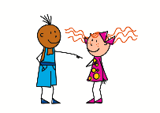
Questions
Remember how to ask yes/no questions with müssen:
Musst du kochen?
?
Du musst kochen.
must
must
Note that the verb müssen swaps with the subject du.
Do the same swap with information questions, too:
Wo musst du kochen?
must
Where do you have to cook?
Was musst du kochen?
must
What do you have to cook?
Wann musst du kochen?
When do you have to cook?
must
Warum musst du kochen?
must
Why do you have to cook?
Notes:
Timing: 2 minutes
Aim: to recap the formation of yes/no questions by swapping the subject and verb and to teach the formation of information questions by swapping the subject and verb.
Procedure:
Click through the animations to recap the formation of yes/no questions and to teach the formation of information questions.
Elicit English translation for the German examples provided line by line.
8

Slide 9
Follow up 5a
Warum musst du…?
Partnerarbeit*!
Warum musst du kochen?
* Partner work
sprechen
Ask your partner why they have to do each of the things below.
Say why you have to do the things your partner asks you about.
Ich muss essen!
Person A
Person B
Englisch
must
Englisch
bald
[late]
Remember! the 2nd verb in German goes to the end. Musst is the 1st verb.
You can use a reason more than once!
Notes:
Slide 1/2
Timing: 8 minutes
Aim: to provide practice (speaking) in asking and answering questions using müssen.
Procedure:
Demonstrate the conversations pupils will have using Sabine’s and Lias’ speech bubbles.
Give pupils time in pairs to both ask and answer all questions, noting down their partner’s answers as they go.
If time allows, hear some of the conversations as a class.
After all questions have been asked, partners swap roles – click for next slide.
Possible question/answer pairs:
Warum musst du nach Hause gehen?
Es ist spät.
Warum musst du schlafen?
Ich bin müde.
Warum musst du Englisch sprechen?
Ich lerne Englisch.
Warum musst du die Gläser holen?
Wir essen bald.

Slide 10
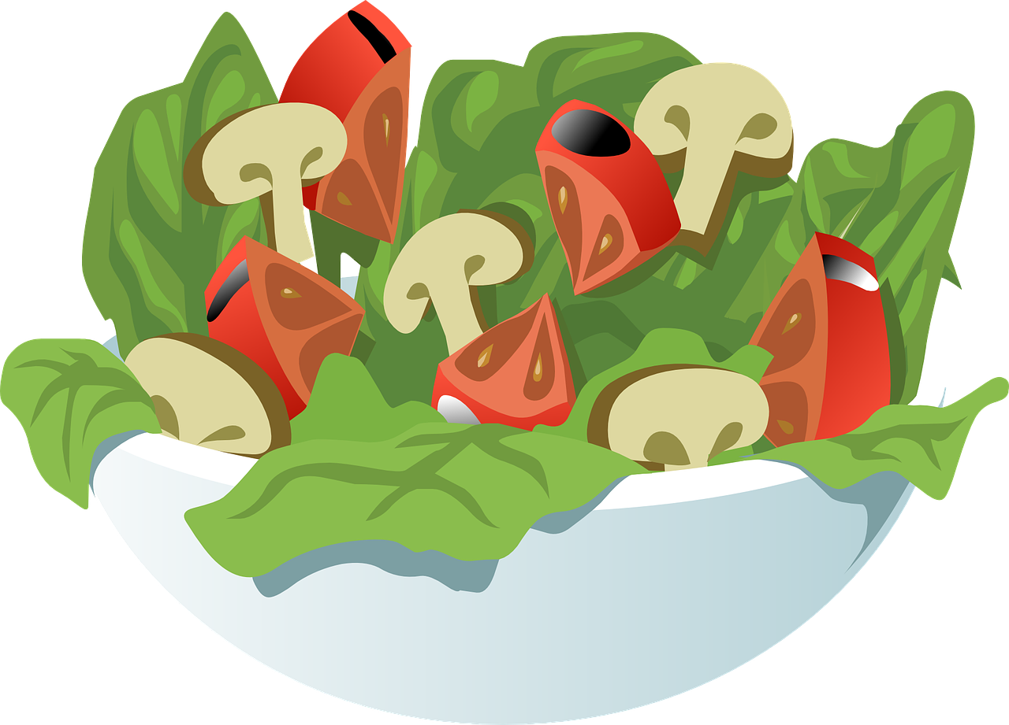
Follow up 5b
Warum musst du…?
Tauscht die Rollen*!
Warum musst du einen Kuchen backen?
* Swap roles!
sprechen
Ask your partner why they have to do each of the things below.
Say why you have to do the things your partner asks you about.
Es ist dein Geburtstag!
Person B
Person A
morgen zur Schule
Ronja
auf den Markt
deine Hausaufgaben
[late]
Remember! the 2nd verb in German goes to the end. Willst is the 1st verb.
You can use a reason more than once!
Notes:
slide 2/2
Partners swap roles.
Click on each verb icon to hear the questions. Click on each answer image to hear reasons.
Possible question/answer pairs:
Warum musst du laufen?
Es ist spät.
Warum musst du nach Hause kommen?
Ich helfe Ronja.
Warum musst auf den Markt gehen?
Ich brauche Salat.
Warum musst du deine Hausaufgaben machen?
Ich gehe morgen zur Schule.

Slide 11
Tschüss!
grün
Notes:
11

Slide 12
Follow up 2

Schreib auf Englisch.
Can you get at least 15 points?
Wörter
 | einkaufen | die Straße | schwimmen
 | das Land | sein | auf
 | holen | laufen | lesen
 | schlafen | sehen | sprechen
 | backen | er muss | der Boden
 | warum? | kochen | müssen
 | sauber | Brot | das Bett
Vokabeln
x3
x2
x1
Notes:
HANDOUT

Slide 13
Follow up 2

Schreib auf Deutsch.
Can you get at least 15 points?
Wörter
 | on, to, at | to swim, swimming | (the) street
 | to shop, shopping | (the) country(side) | to be, being
 | to see, seeing | to fetch, fetching | to sleep, sleeping
 | to speak, speaking | to run, running | to read, reading
 | to cook, cooking | (the) floor | why?
 | he has to, must | to bake, baking | (the) bread
 | to have to, must | (the) bed | clean
Vokabeln
x3
x2
x1
Notes:
HANDOUT

