Slide 1
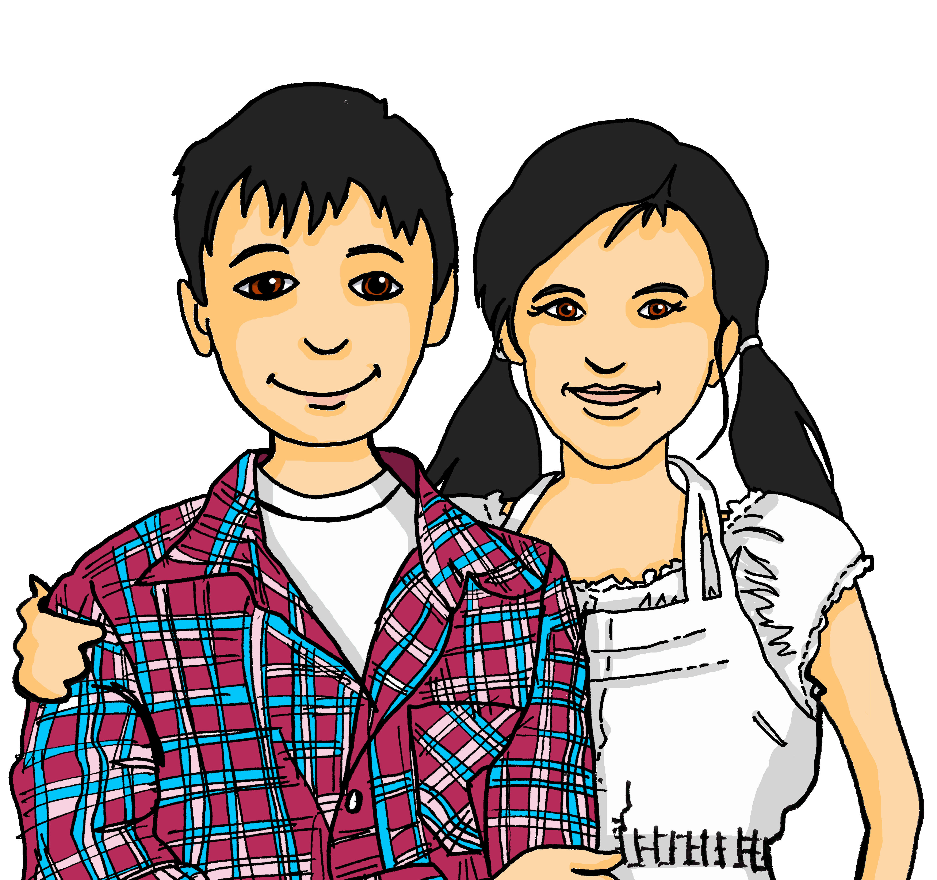
Experiences at home and away
Wir helfen zu Hause
grün
2-verb structures with müssen
SSC [ei] [ie]
Term 3 Week 7
Notes:
Artwork by Steve Clarke. Pronoun pictures from NCELP (www.ncelp.org). All additional pictures selected from Pixabay and are available under a Creative Commons license, no
attribution required.
Phonics: revisit [ei] and [ie]
Vocabulary: backen [4640] holen [547] kochen [1481] müssen, ich muss, du musst, er/sie/es muss [43] Bett [659] Boden [536] Brot [2095] sauber [2026] warum? [192] glossed: Salat [n/a]
Revisit 1: laufen [252] lesen [288] schlafen [679] sehen [79] sprechen [161]
Revisit 2: einkaufen [2877] gehen [66] kommen [62] schwimmen [1863]sein [3] Land2 [134] Markt [476] Straße [391] auf [16] nach Hause [n/a]
Jones, R.L & Tschirner, E. (2019). A frequency dictionary of German: Core vocabulary for learners. London: Routledge.
The frequency rankings for words that occur in this PowerPoint which have been previously introduced in these resources are given in the SOW and in the resources that first
introduced and formally re-visited those words.
For any other words that occur incidentally in this PowerPoint, frequency rankings will be provided in the notes field wherever possible.
Remember that at the start of the course (first three lessons of Rot/Gelb) pupils learnt language (for greetings and register taking) that can still be part of the lesson routines in upper KS2 (Blau/Grün). They are not re-taught, as we anticipate that teachers have built these in from early in lower KS2.
1

Slide 2
aussprechen
[ei]
…
free
frei
Notes:
Timing: 1 minute
Aim: to revisit the SSC [ei].
Procedure:
Re-present the SSC [ei] and present the source word ‘frei’ (with gesture, if using).
Click to bring on the picture and get pupils to repeat the word ‘frei’ (with gesture, if using).
Note:
a gesture for frei’ might be to throw you hands up in the air and pretend to run away.
Vocabulary: frei [318
Jones, R.L & Tschirner, E. (2019). A frequency dictionary of German: Core vocabulary for learners. London: Routledge.
2

Slide 3
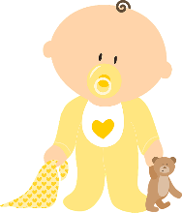
aussprechen
[ei]
…
frei
/a
sein
ein
alone
klein
allein
Notes:
Timing: 1 minute
Aim: to revisit the SSC [ei].
Procedure:
Re-present the SSC and the source word ‘frei’ (with gesture, if using).
Click to bring on the picture and get pupils to repeat the word ‘frei’ (with gesture, if using).
Present the cluster words in the same way, bringing on the picture and getting pupils to pronounce the words.
Vocabulary: frei [318] ein [5] klein [114] sein [3] allein [258]
Jones, R.L & Tschirner, E. (2019). A frequency dictionary of German: Core vocabulary for learners. London: Routledge.

Slide 4
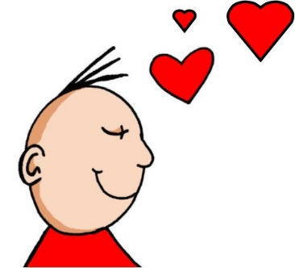
aussprechen
[ie]
…
Liebe
Notes:
Timing: 1 minute
Aim: to revisit the SSC [ie].
Procedure:
Re-present the SSC [ie] and present the source word ‘Liebe’ (with gesture, if using).
Click to bring on the picture and get pupils to repeat the word ‘Liebe’ (with gesture, if using).
Note:
A gesture for ‘Liebe’ might be to make a ‘heart’ shape with both hands approximately where your heart is in your body.
Liebe [844]
Jones, R.L & Tschirner, E. (2019). A frequency dictionary of German: Core vocabulary for learners. London: Routledge.
4

Slide 5
aussprechen
[ie]
…
sie
Liebe
Brief
Notes:
Timing: 1 minute
Aim: to revisit the SSC [ie].
Procedure:
Re-present the SSC and present the source word ‘Liebe’ (with gesture, if using).
Click to bring on the picture and get pupils to repeat the word ‘Liebe’ (with gesture, if using).
Present the cluster words in the same way, bringing on the picture and getting pupils to pronounce the words.
sie [7] Brief [838]
Jones, R.L & Tschirner, E. (2019). A frequency dictionary of German: Core vocabulary for learners. London: Routledge.
5

Slide 6
[ie] [ei]
Hör zu. Wie viele [ei] und [ie] hörst du?
hören
 |  | ei | ie
1 | Eins, zwei, drei, vier, fünf, sechs, sieben | I I I | I I
2 | Ich liebe meine Schwester. Sie heißt Heike. | I I I | I
3 | Wir feiern seinen Geburtstag am Freitag um vier Uhr. | I I I | I
4 | Sein Lieblingstier ist ein Eichhörnchen*. | I I I | I I
5 | Sie hat eine kleine Maus* als Haustier. | I I | I I
6 | Wie viel Geld hast du in deinem Sparschwein? | I I | I I
das Eichhörnchen – squirrel
die Maus – mouse
das Sparschwein – piggy bank
Notes:
Timing: 5 minutes
Aim: to consolidate the SSC [ei] and [ie] in a listening activity.
Procedure:
Explain the task. Pupils are going to hear six sentences which contain a mixture of [ei] and [ie] sounds.
For each sentence they hear, pupils count the number of times they hear each SSC, noting down their answers.
Click to reveal answers.
Transcript:
Eins, zwei, drei, vier, fünf, sechs, sieben.
Ich liebe meine Schwester. Sie heißt Heike.
Wir feiern seinen Geburtstag am Freitag um vier Uhr.
Sein Lieblingstier ist ein Eichhörnchen*.
Sie hat eine kleine Maus* als Haustier.
Wie viel Geld hast du in deinem Sparschwein?
Vocabulary
Eichhörnchen [N/A] Maus [3463]
Vocabulary:
heiß [1195] kriegen [724] reisen [933]
Jones, R.L & Tschirner, E. (2019). A frequency dictionary of German: Core vocabulary for learners. London: Routledge.

Slide 7
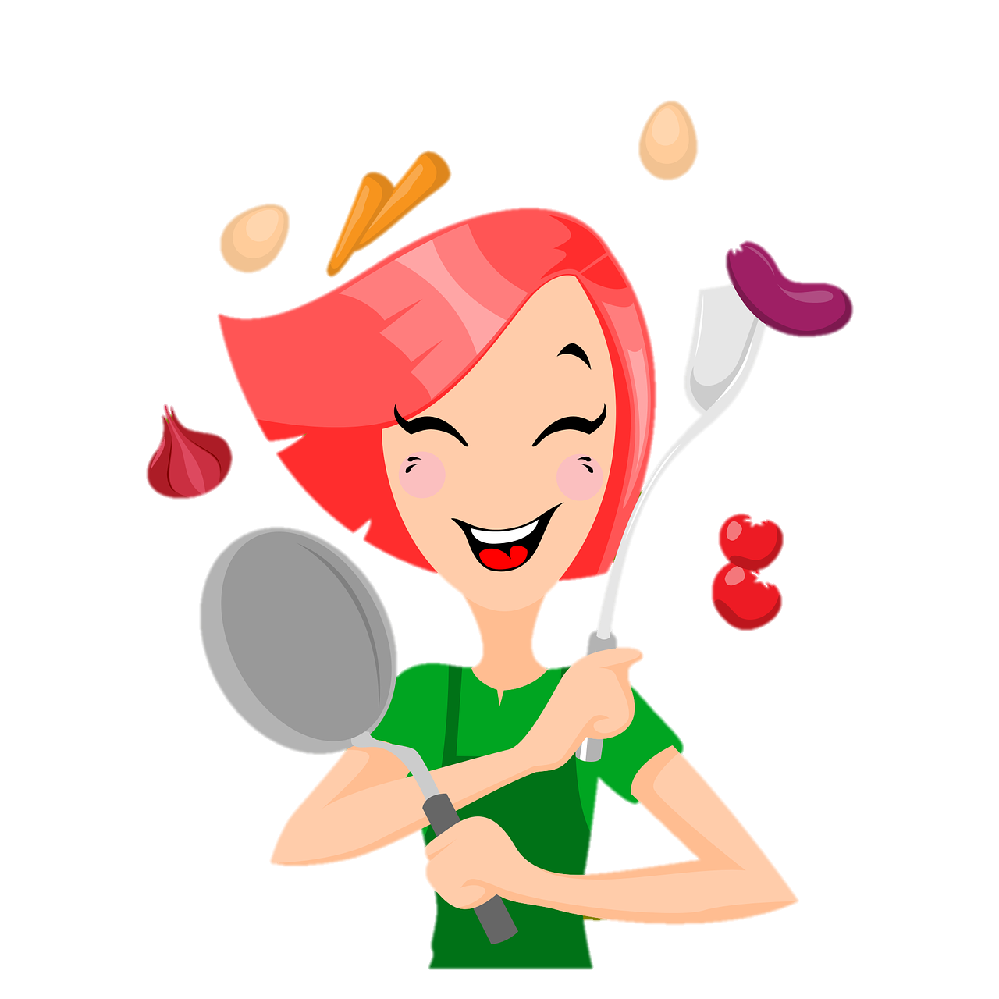
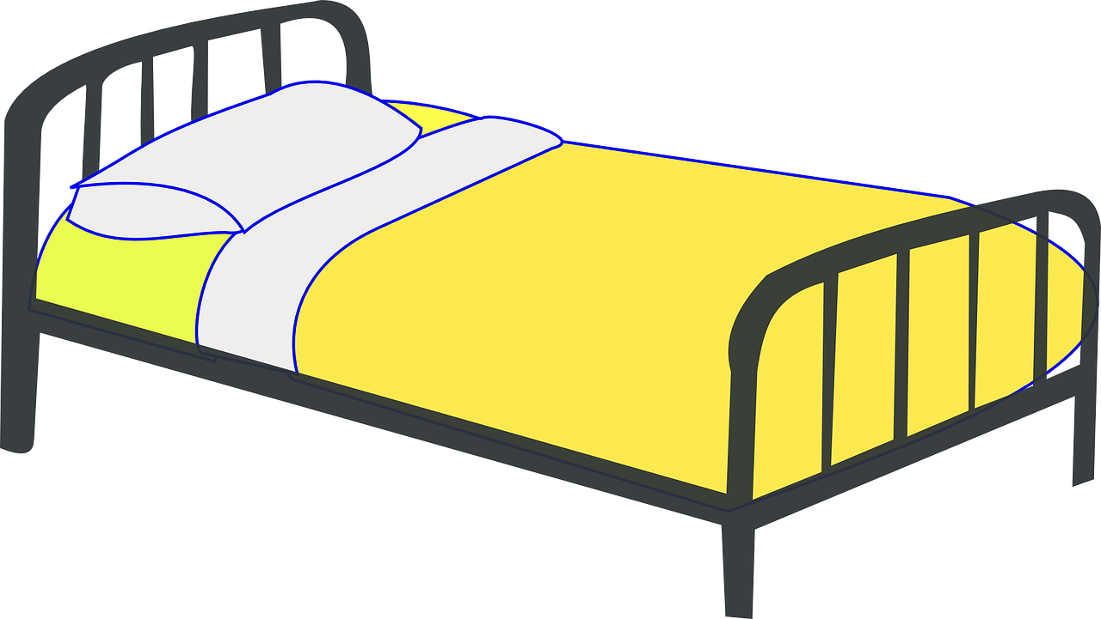
Vokabeln
Vokabeln lernen [1/3]
Wörter
Hör zu und wiederhole.
[to bake, baking]
[to cook, cooking]
[bread]
backen
das Brot
kochen
[clean]
[floor]
[bed]
sauber
der Boden
das Bett
must
[to have to, must]
[why?]
müssen
warum?
Notes:
Timing: 5 minutes (3 slides)
Aim: to present and practise new vocabulary for this week
Procedure:
Click to bring up each German word. In audio versions, the audio is attached to the appear animation. Pupils repeat.
Click to bring up the English meaning and image and pupils say the German again. (This challenges them to retain the pronunciation in their working memory, but they are also supported by the written German version on the slide).
Move to the next slide.
Image of a clean car produced by AI in canva.com
7

Slide 8
Vokabeln
Vokabeln lernen [2/3]
Wörter
Was ist das auf Englisch?
backen
das Brot
kochen
sauber
der Boden
das Bett
must
müssen
warum?
Notes:
[2/3]
Procedure:
Click to hide the English translation of each word in turn. Pupils chorally suggest the English answers.
Move to the next slide.
8

Slide 9
Vokabeln
Vokabeln lernen [3/3]
Wörter
Was ist das auf Deutsch?
backen
das Brot
kochen
sauber
der Boden
das Bett
must
müssen
warum?
Notes:
[3/3]
Procedure:
Click to hide the German word by word in random order. Pupils chorally suggest the German.
Click to reveal answers (with audio attached, in the audio version).
9

Slide 10
müssen – to have to, must
To say what you have to / must do use the verb müssen and a 2nd verb in the infinitive form.
Müssen is irregular. The spelling changes.
Ich muss kochen.
I have to cook.
Du musst backen.
You have to bake.
The 2nd verb always goes to the end of the sentence:
Ich muss für Ronja kochen.
I have to cook for Ronja.
must
Du musst Brot backen.
You have to bake bread.
must
The word order is different from English!
Notes:
Timing: 2 minutes
Aim: to present the 1st and 2nd persons singular of the verb müssen.
Procedure:
Click through the animations to present the new information.
Elicit English translation for the German examples provided.
10

Slide 11
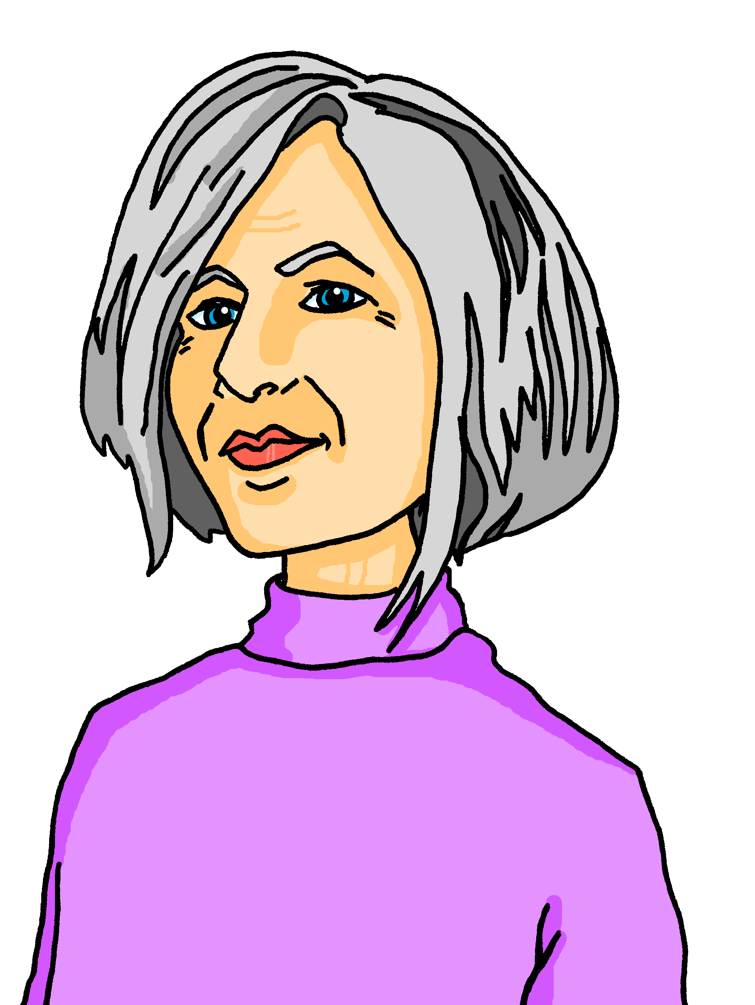
hören
Opa Dieter und Oma Sabine besuchen bald Lothar, Leonie, Ronja und Lias. Wer macht was? Lias (ich) oder Ronja (du)?
Hör zu.
 |  | Lias (ich) | Ronja (du)
 | Du musst Omas Lieblingsbrot backen.
 | Ich muss den Boden sauber machen.
 | Ich muss Opas Lieblingsessen kochen.
 | Du musst den Salat* machen.
 | Du musst in die Stadt gehen.
 | Ich muss das Bett machen.
Wir kommen bald!
1
2
3
4
5
6
der Salat - salad
Notes:
Timing: 5 minutes
Aim: to practise aural identification and comprehension of müssen in first and second persons singular.
Procedure:
Explain the task. Lias and Ronja are planning for their grandparents’ visit (Dieter and Sabine are Lothar’s parents). Lias is summarising what they each have to do.
Pupils listen carefully. If they hear ‘muss’ it is something Lias has to do and they tick Lias. If they hear ‘musst’ then it is something Ronja has to do.
Click to play number 1 as an example. Ask pupils to write either Lias or Ronja.
Click to reveal the answer.
Repeat with items 2-6.
Elicit the answers in English (translations included below).
Transcript:
1. [Du] musst Omas Lieblingsbrot backen. (You have to bake grandma‘s favourite bread)
2. [Ich] muss den Boden sauber machen. (I have to clean the floor)
3. [Ich] muss Opas Lieblingsessen kochen. (I have to cook grandpa’s favourite meal/dish)
4. [Du] musst den Salat machen. (You have to make the salad)
5. [Du] musst in die Stadt gehen. (You have to go into (the) town)
6. [Ich] muss das Bett machen. (I have to make the bed)
Vocabulary:
Salat [N/A]
Jones, R.L & Tschirner, E. (2019). A frequency dictionary of German: Core vocabulary for learners. London: Routledge.
11

Slide 12
müssen – to have to, must
Remember how to say what you have to / must do with the verb müssen:
Ich muss in die Stadt gehen.
I have to go into town.
must
Du musst in die Stadt gehen.
You have to go into town.
Note! muss = have to / must for ich, er, sie, xier and es. This is different from most German verbs you know.
must
To say he/she can, use:
Er muss in die Stadt gehen.
He has to go into town.
must
Sie muss in die Stadt gehen.
She has to go into town.
must
Notes:
Timing: 2 minutes
Aim: to present the 3rd person singular of müssen.
Procedure:
Click through the animations to present the new information.
Elicit English translation for the German examples provided.
Click to bring up the callout about the third person and person version of ‘müssen’ being the same ‘muss’. This also mentions that ‘es’ and ‘xier’ would follow the same pattern as ‘er’ and ‘sie’.
12

Slide 13
lesen
Lias schreibt SMS mit Ronja.
Ist das Lias (ich), Vati/Lothar (er), oder Ronja (du)?
aussehen – to look (e.g. clean)
Vati muss das Zimmer sauber machen. Oma und Opa kommen!
you
Vati muss nach Hause kommen. Er muss Mutti helfen.
1
you
4
he
he
Du musst auf den Markt gehen. Du musst Salat holen.
Warum musst du backen? Wir können das Brot kaufen.
he
I
2
you
5
you
Warum muss ich den Boden sauber machen? Er sieht* sauber aus!
Ich muss ins Bett gehen. Ich bin müde und muss schlafen!
I
you
3
6
you
I
Notes:
1/2
Timing: 5 minutes
Aim: to practise written comprehension of this week’s verbs and vocabulary in the present tense.
Procedure:
Read and ensure pupils understand the context and the instruction. Lias is writing messages to Ronja, talking about what Vati/Lothar (er), Lias (ich) and Ronja (du) have to do.
Pupils write 1-6 and the correct English pronoun from the two options given. They use their knowledge of müssen in the present tense to determine which pronoun is missing.
Click to reveal answers.
Elicit English translations (below).
Translations
Dad has to clean the room. Grandma and grandpa are coming!
You have to go to the market. You need to fetch/pick up salad.
Why do I need to clean the floor? It looks clean!
Dad has to come home. He has to help mum.
Why do you need to bake? We can buy the bread.
I have to go to bed. I’m tired and have to sleep!
Vocabulary
aussehen [277]
Jones, R.L & Tschirner, E. (2019). A frequency dictionary of German: Core vocabulary for learners. London: Routledge.
13

Slide 14
lesen
Warum muss Lias, Vati oder Ronja das machen?
Schreib auf Englisch.
Warum muss Vati das Zimmer sauber machen?
Vati muss das Zimmer sauber machen. Oma und Opa kommen!
Warum muss Vati nach Hause kommen?
Vati muss nach Hause kommen. Er muss Mutti helfen.
1
4
Grandma and Grandpa are coming.
He needs to help mum.
Du musst auf den Markt gehen. Du musst Salat holen.
Warum muss Ronja auf den Markt gehen?
Warum musst du backen? Wir können das Brot kaufen.
Warum muss Ronja nicht backen?
2
5
She has to fetch salad.
They can buy the bread.
Warum muss ich den Boden sauber machen? Er sieht* sauber aus!
Warum muss Lias den Boden nicht sauber machen?
Ich muss ins Bett gehen. Ich bin müde und muss schlafen!
Warum muss Lias ins Bett gehen?
3
6
He is tired and has to sleep!
It looks clean!
Notes:
2/2
Timing: 5 minutes
Aim: to practise written comprehension of the singular forms of müssen and vocabulary in the present tense.
Procedure:
Read the items, which are the same as on the previous slide.
Pupils write 1-6 and answer the question in English, as this is a comprehension task.
14

Slide 15
Tschüss!
grün
Notes:
15

