Slide 1
Interacting
Wir gehen nach draußen
grün
Follow ups 1-5
Term 3 Week 8
Notes:
Artwork by Steve Clarke. Pronoun pictures from NCELP (www.ncelp.org). All additional pictures selected from Pixabay and are available under a Creative Commons license, no attribution required.
Phonics:
[th] Theater [1086] Bibliothek [2366] Mathematik [1636]
Vocabulary: liegen [107] Lust haben [n/a] Rad fahren [n/a] Sonne [864] wichtig [144] draußen [884]
Revisit 1: fahren [215] Berg [934] Dorf [959] Europa [294] Haus [147] Meer [854] Österreich [707] Schweiz [763] See [1317] dort [139] bald [503] nach [34] zu [21] nach Hause [n/a]
Revisit 2: Language from Term 2
Jones, R.L & Tschirner, E. (2019). A frequency dictionary of German: Core vocabulary for learners. London: Routledge.
The frequency rankings for words that occur in this PowerPoint which have been previously introduced in these resources are given in the SOW and in the resources that first introduced and formally re-visited those words.
For any other words that occur incidentally in this PowerPoint, frequency rankings will be provided in the notes field wherever possible.
Remember that at the start of the course (first three lessons of Rot/Gelb) pupils learnt language (for greetings and register taking) that can still be part of the lesson routines in upper KS2 (Blau/Grün). They are not re-taught, as we anticipate that teachers have built these in from early in lower KS2.

Slide 2
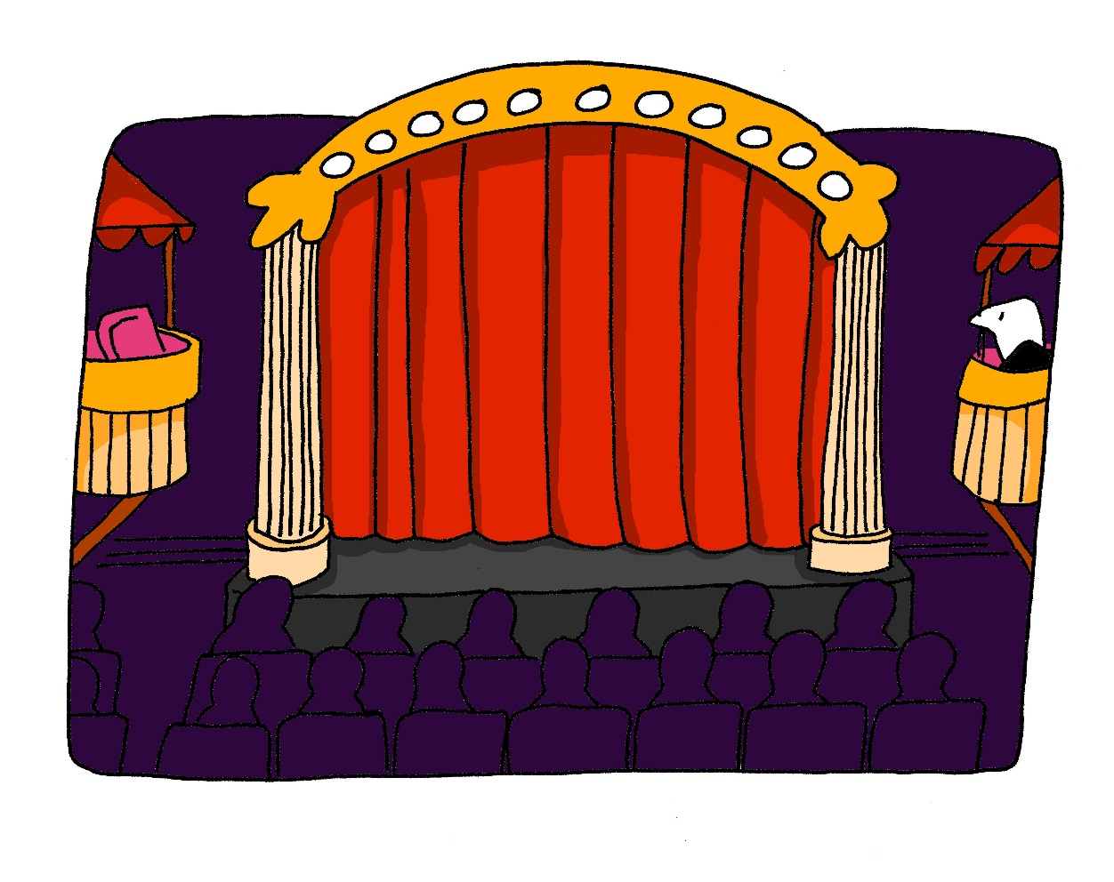
aussprechen
[th]
…
Theater
Notes:
Timing: 1 minute
Aim: to present the SSC [th].
Procedure:
1. Present the letter and say the [th] sound first, on its own. Pupils repeat it with you. 2. Bring up the word ”Theater” on its own, say it, pupils repeat it, so that they have the opportunity to focus all of their attention on the connection between the written word and its sound.
3. Click to bring up the picture and introduce the gesture, if using. Pupils repeat the word again.
4. Roll back the animations and work through 1-3 again, but this time, dropping your voice completely to listen carefully to the Pupils saying the [th] sound, pronouncing ”Theater” and, if using, doing the gesture.
Note: A possible gesture for this would be to mime the opening of a theatre’s curtains, by drawing your hands away from each other quickly, in front of your body. This is very much like the gesture for ‘play’ in charades.
Frequency: Theater [1086]
Jones, R.L & Tschirner, E. (2019). A frequency dictionary of German: Core vocabulary for learners. London: Routledge.
2

Slide 3
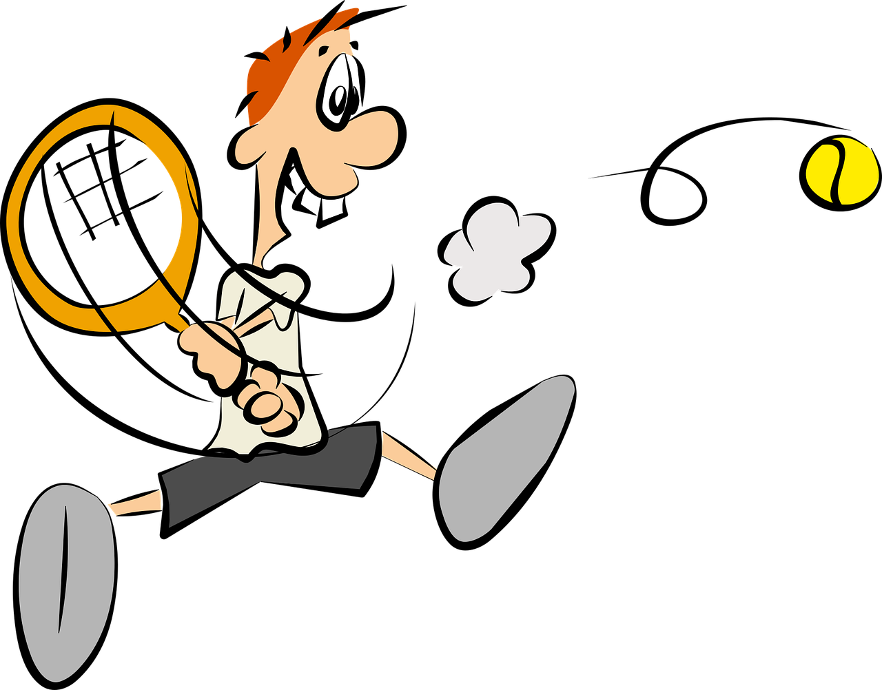
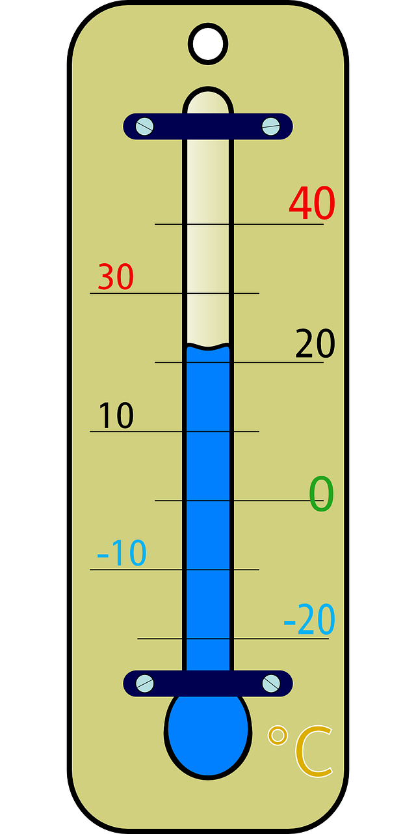
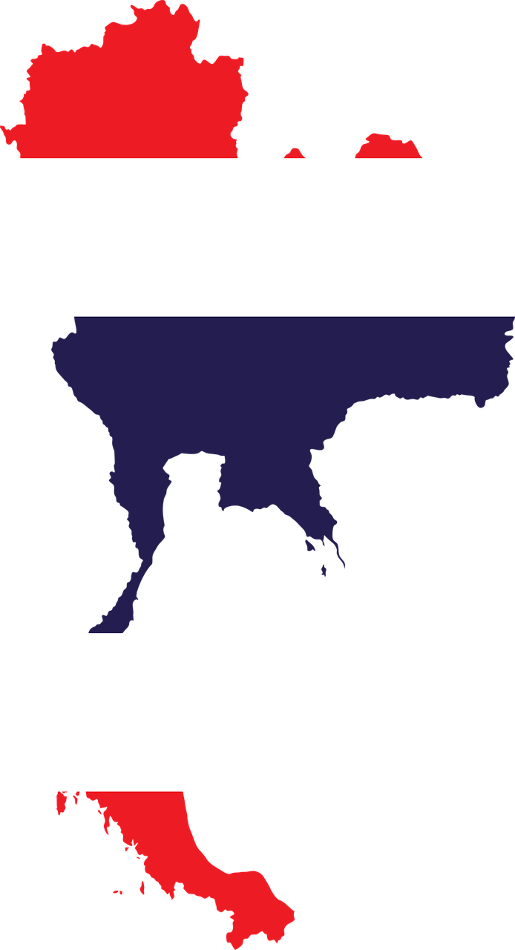
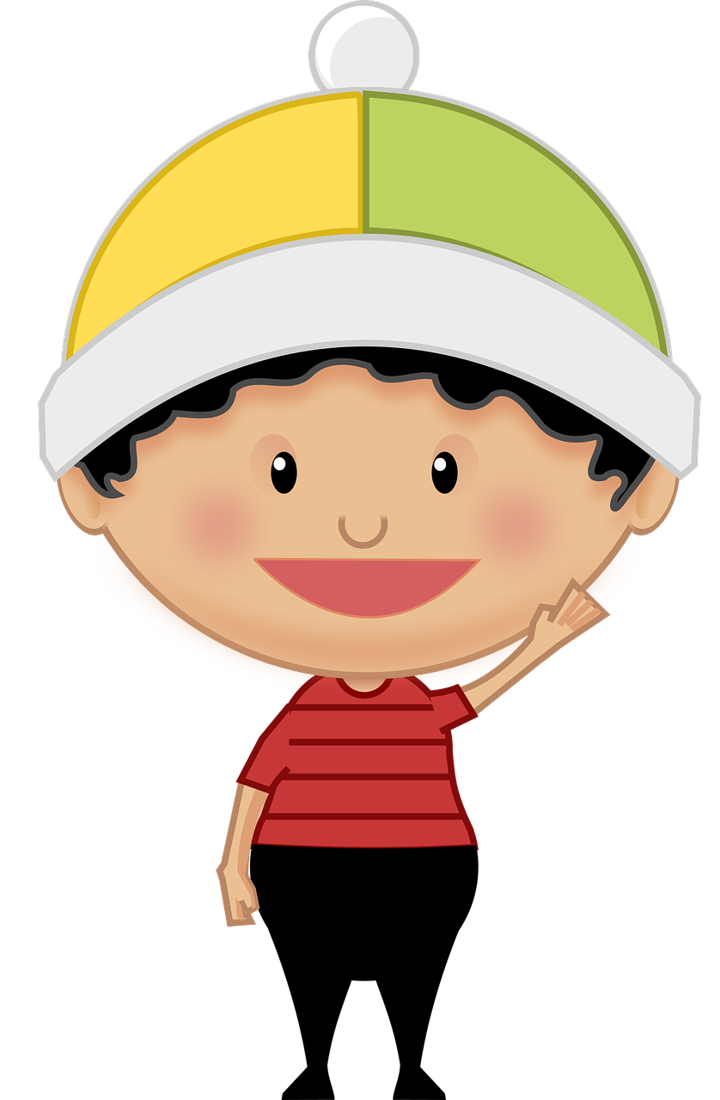
hören
Follow up 1
Hör zu. Ist es ‘t’ oder ‘th’?
German ‘th’ sounds the same as ‘t’. All of these words are cognates. How do you spell the English word? With ‘t’ or ‘th’?
 | t | th |  |  | t | th
 | Tennis |  |  |  |  | Thermometer
 |  | Thailand |  |  | Tourist
 | Taxi |  |  |  |  | Theodor
 | Tiger |  |  |  |  | Athletik
1
5
2
6
Mein Name ist...
3
7
4
8
Notes:
Timing: 5 minutes
Aim: to practise applying knowledge of [th] and to cognates and contrasting it with [t].
Note: This exercise only contains cognates, emphasising a cross-linguistic difference between English and German
Procedure: 1. Remind pupils that although ‘th’ and ‘t’ are pronounced differently in English, they sound the same in German – even when the word is borrowed from English (or another language). Pupils will therefore have to draw on English to match what they hear with a known word, relying on knowledge of English spelling to work out the answer.
2. Click on the audio buttons to hear a native speaker say each word. Drawing on their knowledge of English, pupils write down the word either with [th] or [t]. The pictures are there to help them arrive at the English word more easily. Hint for pupils: if they don’t recognise the word they hear, try replacing the ‘t’ sound with an English ‘th’.
3. Click to reveal the answers. Before revealing the answers, play the audio again and ask pupils which English word it sounds like.
Tennis
Thailand
Taxi
Tiger
Thermometer
Tourist
Theodor
Athletik (athletics)
Vocabulary
Tennis [4671] Thailand [N/A] Taxi [2999] Tiger [N/A] Thermometer [N/A] Tourist [1318] Theodor [N/A] Athletik [N/A]
3

Slide 4
Follow up 2
Hör zu. Ist die Antwort A, B oder C?
A
B
C
1
It’s great going to this village. | It’s great living in this town. | It’s great living in this village.
hören
2
You have to go home soon. | You (all) have to go home soon. | You have to stay at home soon.
3
They feel like lying outside in the sun. | She feels like lying outside in the sun. | She has time to lie out in the sun.
4
It is important to cycle in the mountains. | It is good to cycle in the countryside. | It is good to cycle in the mountains.
It is important to stay at home. | It is important to go home. | It is good to stay home.
5
You (all) can walk to Austria. | You (all) can go to Switzerland with the train. | You (all) can go to Austria with the train.
6
Notes:
Timing: 5 minutes
Aim: to practise aural comprehension of sentences containing two verbs (with and without ‘zu’).
Procedure:
Click on the first audio button to hear a sentence. Pupils listen carefully and decide whether option A, B or C contains the correct answer. NB: they may need to listen to each sentence more than once.
Repeat for questions 2-6.
Click to reveal the answers.
Transcript: 1. Es ist toll, in diesem Dorf zu wohnen.
2. Du musst bald nach Hause fahren.
3. Sie hat Lust, draußen in der Sonne zu liegen.
4. Es ist gut, in den Bergen Rad zu fahren.
5. Es ist wichtig, zu Hause zu bleiben.
6. Ihr könnt mit dem Zug nach Österreich fahren.

Slide 5
Follow up 3
…
Wie sagt man das auf Englisch?
Wie sagt man das auf Deutsch?
lesen
sprechen
Europa
das Haus
das Meer
die Schweiz
Europe
(the) house
(the) sea
Switzerland
der See
dort
nach
oben
(the) lake
there
to(wards)
up, above
unten
normalerweise
die Kunst
der Müll
down, below
normally
(the) art
(the) rubbish
das Projekt
tragen
laufen
kaufen
to wear, wearing
to run, running
to buy, buying
(the) project
zusammen
spät
die Straße
auf
together
late
(the) street
on, to, at
Notes:
Timing: 5 minutes
Aim: this slide practises read aloud, meaning and spoken production of revisited words from Term 2, plus words from revisit 1.
Procedure:
The activity is designed like a scratch card. On clicks, the English translation appears following the horizontal (left to right) order of the display.
Click to select a word (the word will change colour). Pupils read the word aloud.
Ask ‘Wie sagt man das auf Englisch?’ and click again to trigger a 6-second ‘scratch’ animation, which slowly reveals the English equivalent. Pupils turn to their partner and say the word meaning before it is revealed.
Ask ‘Wie sagt man das auf Deutsch?’ to elicit the German meaning again.
When all English meanings are displayed, if time allows, ask Wie sagt man [late] auf Deutsch? etc. to elicit oral recall of a few of the German meanings again, but in a jumbled order this time, to increase the challenge incrementally.

Slide 6
Follow up 4:

Schreib auf Englisch.
Can you get at least 15 points?
Wörter
 | einkaufen | das Museum | der Laden
 | wohin? | um zwölf Uhr | finden
 | fahren | nach Hause | der Berg
 | zu | das Dorf | bald
 | Österreich | die Schweiz | der See
 | liegen | draußen | Lust haben
 | wichtig | Rad fahren | die Sonne
to shop, shopping
(the) museum
(the) shop
Vokabeln
x3
where (to)?
at twelve o’clock
to find, finding
to go (transport)
(to) home
(the) hill, mountain
x2
to
(the) village
soon
Austria
Switzerland
(the) lake
to lie, lying
outside
to feel like (doing sth)
x1
important
cycling
(the) sun
Notes:
Timing: 5 minutes
Aim: to practise written production of vocabulary from this and revisited weeks.
Procedure: 1. Give pupils a blank grid. They fill in the English meanings of any of the words they know, trying to reach 15 points in total.
Note: The most recently learnt and practised words are pink, words from the previous week are green and those from week 1 are blue, thus more points are awarded for them, to recognise that memories fade and more effort (heavy lifting!) is needed to retrieve them.

Slide 7
Follow up 4:

Schreib auf Deutsch.
Can you get at least 15 points?
Wörter
 | (the) shop | at twelve o’clock | to find, finding
 | (the) museum | to shop, shopping | where (to)?
 | (the) village | Austria | (the) lake
 | (to) home | to | Switzerland
 | to go (transport) | (the) hill, mountain | soon
 | cycling | to feel like (doing sth) | important
 | to lie, lying | (the) sun | outside
der Laden
um zwölf Uhr
finden
Vokabeln
x3
das Museum
einkaufen
wohin?
das Dorf
Österreich
der See
x2
nach Hause
zu
die Schweiz
fahren
der Berg
bald
Rad fahren
Lust haben
wichtig
x1
liegen
die Sonne
draußen
Notes:
Timing: 5 minutes
Aim: to practise written production of vocabulary from this and revisited weeks.
Procedure: 1. Give pupils a blank grid. They fill in the German meanings of any of the words they know, trying to reach 15 points in total.
Note: The most recently learnt and practised words are pink, words from the previous week are green and those from week 1 are blue, thus more points are awarded for them, to recognise that memories fade and more effort (heavy lifting!) is needed to retrieve them.

Slide 8
Follow up 5 [1/6]
⚠ Note that you need to change the form of some words – e.g., haben → hast, in → ins.
…
Wie sagt man das auf Deutsch?
sprechen
Do you feel like going (in)to the museum?
20
Hast du Lust, ins Museum zu gehen?
S
zu
haben
können
Lust,
Museum (nt)
in
du
gehen
0
⚠ You do not need all of the words!
START
Notes:
Time: 5 minutes (6 slides)
Aim: to practise guided spoken sentence building. Targeted features: 2-verb structures, with and without ‘zu’.
Procedure:
Do this first sentence with pupils as an example.
Click for English sentence and German prompt words.
Support pupils to select from the words given to create and say the sentence out loud before the time elapses.
Click to remind pupils that they might need to change the form of the word to match the subject, e.g. haben → hast.
Click for the German sentence to appear.
6. Continue with items 2-6.

Slide 9
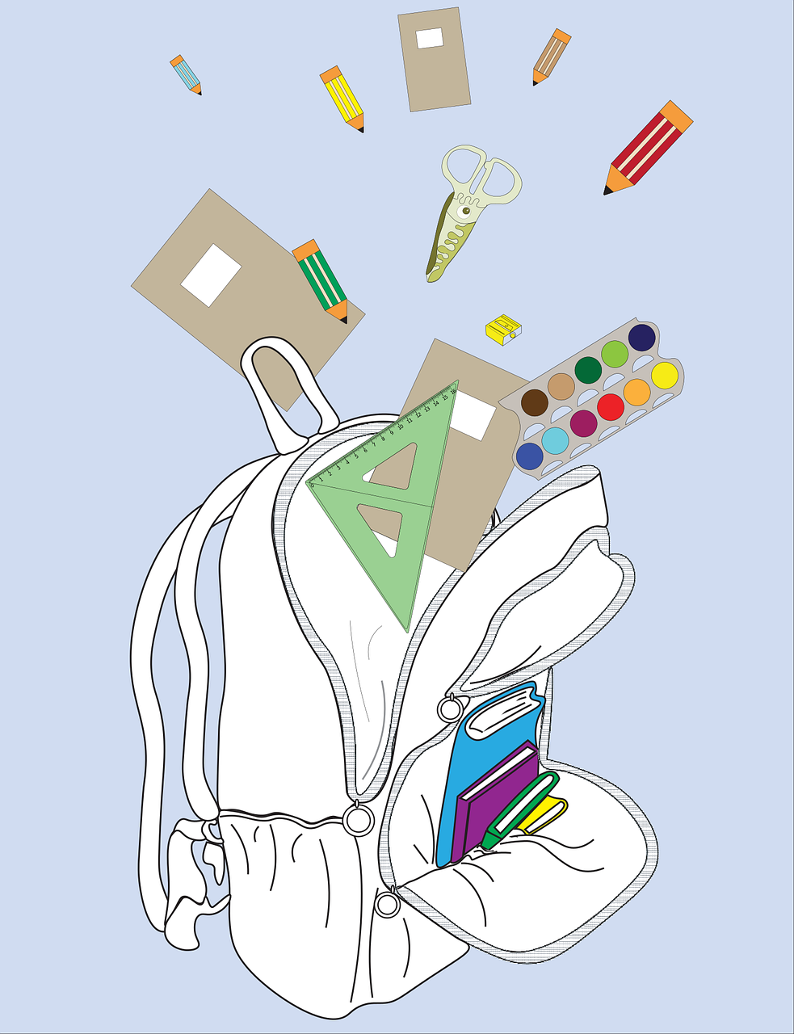
Follow up 5 [2/6]
…
Wie sagt man das auf Deutsch?
sprechen
You have to fetch your school things.
20
Du musst deine Schulsachen holen.
S
nehmen
möchten
du
dein
holen
müssen
Schulsachen (pl)
bringen
0
⚠ You do not need all of the words!
START
Notes:
2/6

Slide 10
Follow up 5 [3/6]
…
Wie sagt man das auf Deutsch?
sprechen
I am happy/glad to see Leon.
20
Ich bin froh, Leon zu sehen.
S
spät
ich
Leon
sehen
sein
gehen
zu
froh,
0
⚠ You do not need all of the words!
START
Notes:
3/6

Slide 11
Follow up 5 [4/6]
…
Wie sagt man das auf Deutsch?
sprechen
We can bake a cake.
20
Wir können einen Kuchen backen.
S
Kuchen (m)
müssen
können
wichtig
ein
wir
kochen
backen
0
⚠ You do not need all of the words!
START
Notes:
4/6

Slide 12
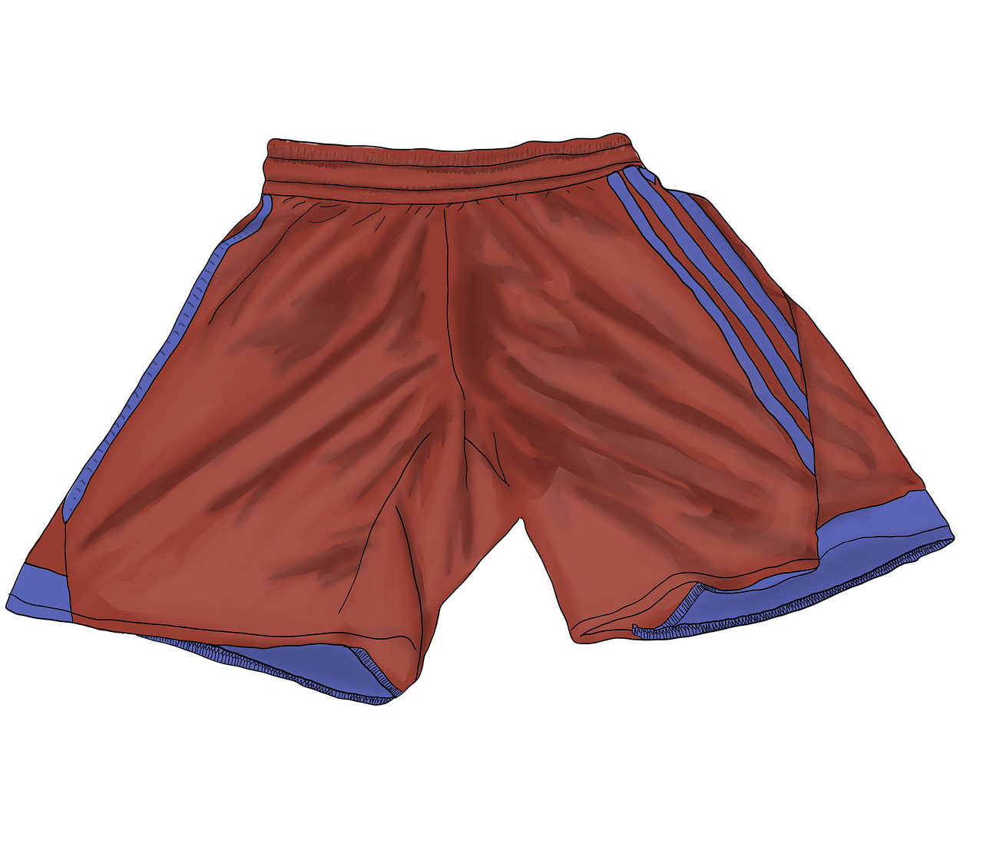
Follow up 5 [5/6]
…
Wie sagt man das auf Deutsch?
sprechen
It is important to wear sports clothes.
20
Es ist wichtig, Sportkleidung zu tragen.
S
wichtig,
zu
es
kommen
tragen
sein
können
Sport-kleidung
0
⚠ You do not need all of the words!
START
Notes:
5/6

Slide 13
Follow up 5 [6/6]
…
Wie sagt man das auf Deutsch?
sprechen
We have to sleep soon.
20
Wir müssen bald schlafen.
S
zu
können
müssen
gehen
schlafen
bald
wir
spät
0
⚠ You do not need all of the words!
START
Notes:
6/6

Slide 14
Tschüss!
grün
Notes:
14

Slide 15
Follow up 4:

Schreib auf Englisch.
Can you get at least 15 points?
 | einkaufen | das Museum | der Laden
 | wohin? | um zwölf Uhr | finden
 | fahren | nach Hause | der Berg
 | zu | das Dorf | bald
 | Österreich | die Schweiz | der See
 | liegen | draußen | Lust haben
 | wichtig | Rad fahren | die Sonne
Vokabeln
x3
x2
x1
Notes:
HANDOUT

Slide 16
Follow up 4:

Schreib auf Deutsch.
Can you get at least 15 points?
 | (the) shop | at twelve o’clock | to find, finding
 | (the) museum | to shop, shopping | where (to)?
 | (the) village | Austria | (the) lake
 | (to) home | to | Switzerland
 | to go (transport) | (the) hill, mountain | soon
 | cycling | to feel like (doing sth) | important
 | to lie, lying | (the) sun | outside
Vokabeln
x3
x2
x1
Notes:
HANDOUT

