Slide 1


Experiences at home and away
Wir gehen nach draußen*
grün
Using infinitive clauses with ‘zu’
SSC [th]
draußen - outside
Term 3 Week 8
Notes:
Artwork by Steve Clarke. Pronoun pictures from NCELP (www.ncelp.org). All additional pictures selected from Pixabay and are available under a Creative Commons license, no
attribution required.
Phonics:
[th] Theater [1086] Bibliothek [2366] Mathematik [1636]
Vocabulary: liegen [107] Lust haben [n/a] Rad fahren [n/a] Sonne [864] wichtig [144] draußen [884]
Revisit 1: fahren [215] Berg [934] Dorf [959] Europa [294] Haus [147] Meer [854] Österreich [707] Schweiz [763] See [1317] dort [139] bald [503] nach [34] zu [21] nach Hause [n/a]
Revisit 2: Language from Term 2
Jones, R.L & Tschirner, E. (2019). A frequency dictionary of German: Core vocabulary for learners. London: Routledge.
The frequency rankings for words that occur in this PowerPoint which have been previously introduced in these resources are given in the SOW and in the resources that first
introduced and formally re-visited those words.
For any other words that occur incidentally in this PowerPoint, frequency rankings will be provided in the notes field wherever possible.
Remember that at the start of the course (first three lessons of Rot/Gelb) pupils learnt language (for greetings and register taking) that can still be part of the lesson routines in upper KS2 (Blau/Grün). They are not re-taught, as we anticipate that teachers have built these in from early in lower KS2.
1

Slide 2

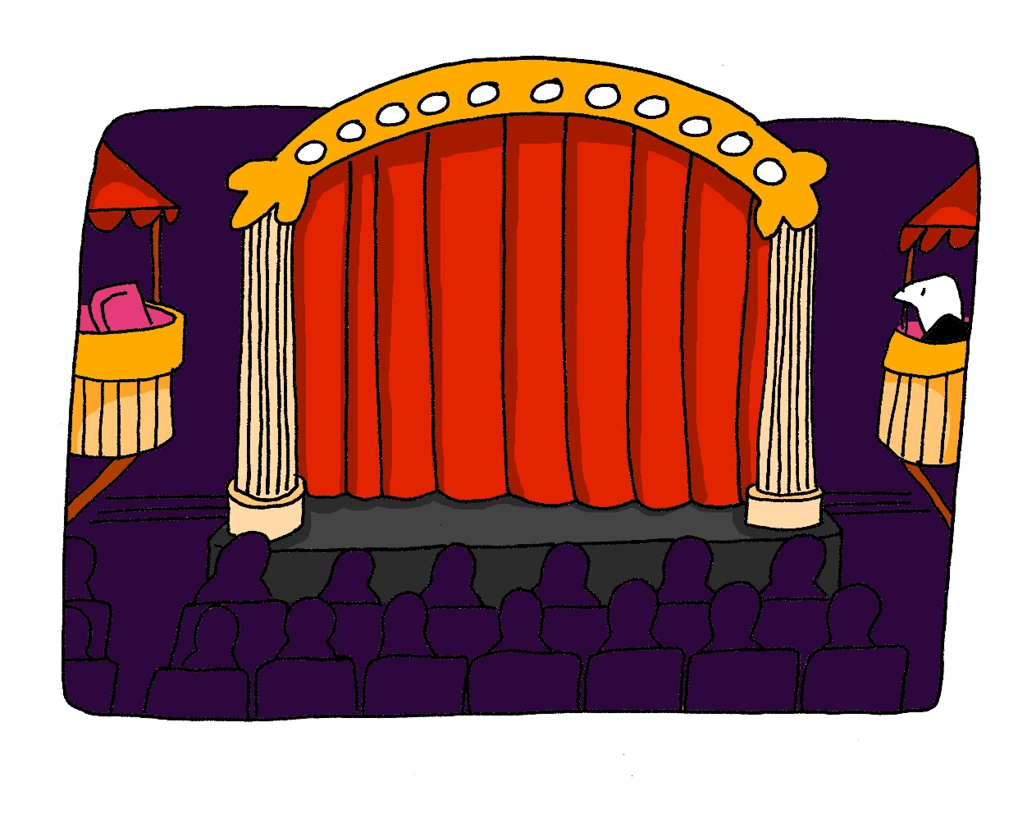
aussprechen
[th]
…
Theater
Notes:
Timing: 1 minute
Aim: to present the SSC [th].
Procedure:
1. Present the letter and say the [th] sound first, on its own. Pupils repeat it with you.
2. Bring up the word ”Theater” on its own, say it, pupils repeat it, so that they have the opportunity to focus all of their attention on the connection between the written word and its sound.
3. Click to bring up the picture and introduce the gesture, if using. Pupils repeat the word again.
4. Roll back the animations and work through 1-3 again, but this time, dropping your voice completely to listen carefully to the Pupils saying the [th] sound, pronouncing ”Theater” and, if using, doing the gesture.
Note: A possible gesture for this would be to mime the opening of a theatre’s curtains, by drawing your hands away from each other quickly, in front of your body. This is very much like the gesture for ‘play’ in charades.
Frequency:
Theater [1086]
Jones, R.L & Tschirner, E. (2019). A frequency dictionary of German: Core vocabulary for learners. London: Routledge.
2

Slide 3
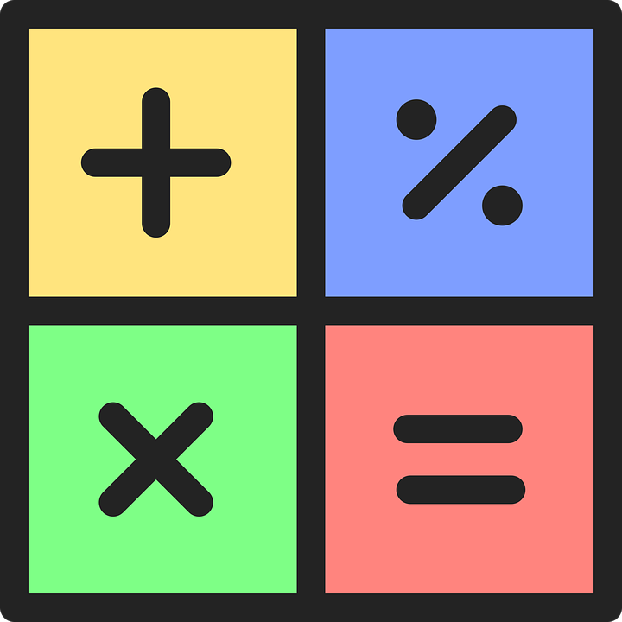

aussprechen
[th]
…
Mathematik is often shortened to Mathe.
Theater
Mathematik
Bibliothek
Mathe
Notes:
Timing: 1 minute
Aim: to consolidate the SSC [th].
Procedure:
Re-present the SSC and the source word ‘Theater’ (with gesture, if using).
Click to bring on the picture and get pupils to repeat the word ‘Theater’ (with gesture, if using).
Present the cluster words in the same way, bringing on the picture and getting pupils to pronounce the words.
Click to bring up a callout abut Mathematik.
Vocabulary: Theater [1086] ] Mathematik [1636] Bibliothek [2366]
Jones, R.L & Tschirner, E. (2019). A frequency dictionary of German: Core vocabulary for learners. London: Routledge.

Slide 4




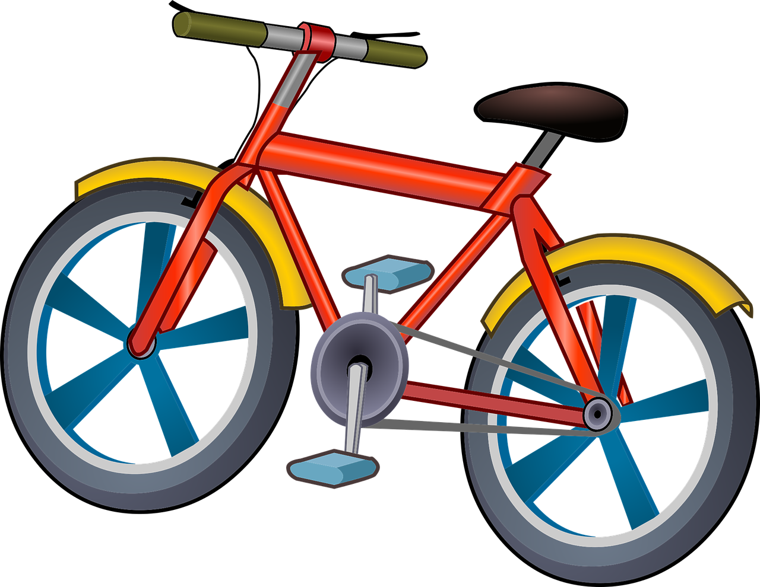

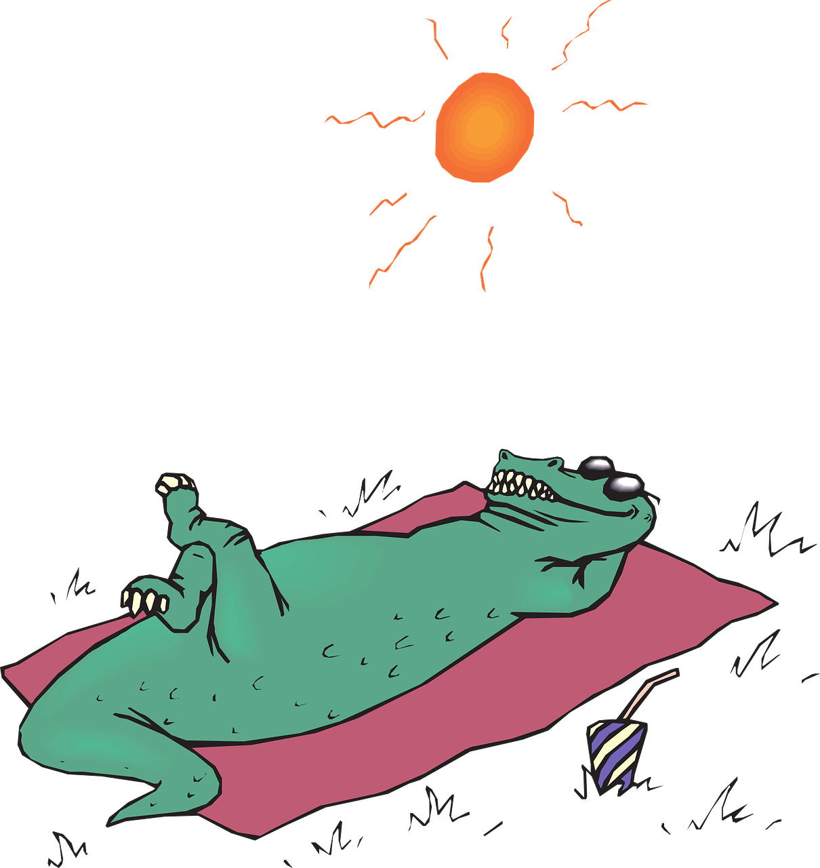


Vokabeln
Vokabeln lernen
Wörter
Hör zu und wiederhole.
die Sonne
wichtig
You’ve seen the next two words and phrases before. Can you fill in the blanks?
[(the) sun]
Rad
fahren
Lust haben
R_ _
f_ _ _ _ _
[to feel like
(doing
something)]
Like in English, this verb also means to lie, e.g. lie in the sun.
[to cycle, ride a bike]
draußen
liegen
l_ _ _ _ _
[outside]
[to lie,
be located]
[to lie]
Notes:
Timing: 3 minutes
Aim: to present and practise new vocabulary items for this week
Procedure:
Click to bring up word number 1 and an image to illustrate the meaning.
Pupils repeat the pronounciation (play recording or say the word).
Click to bring up the English meaning.
Continue for the remaining words.
4

Slide 5

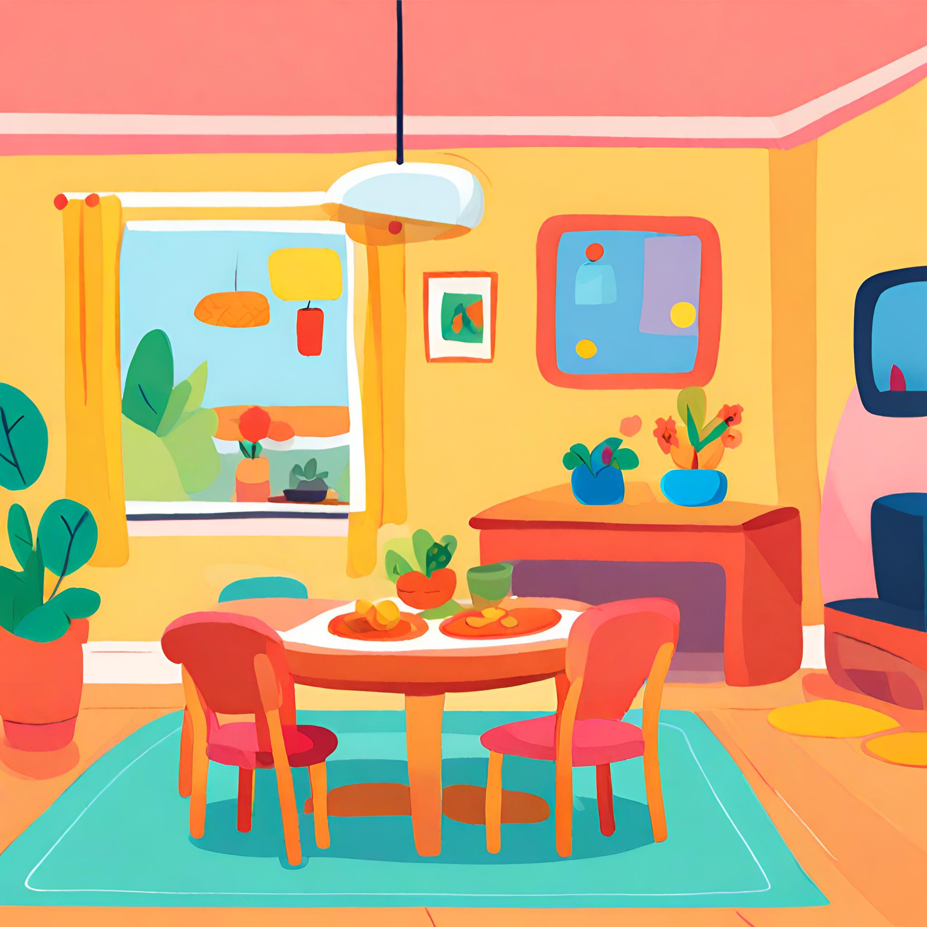
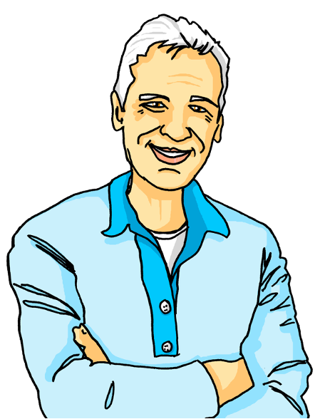
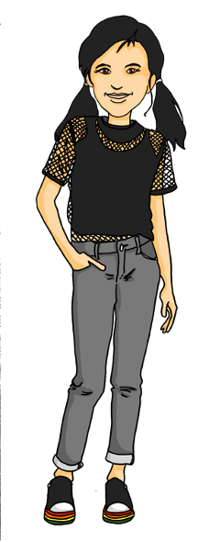
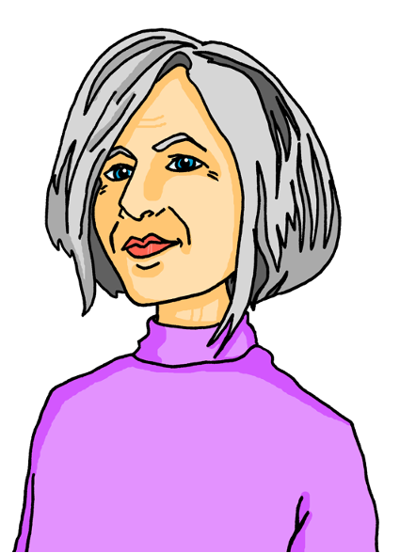
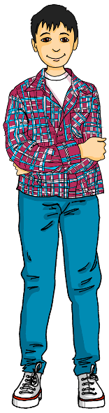
Ein sonniger* Tag
sonnig – sunny
Lies den Comic.
lesen
Ronja, Lias, Oma Sabine und Opa Dieter sitzen am Tisch.
Ich auch nicht.
Was machen wir heute, Kinder?
Ich weiß nicht...
Notes:
[1/4]
Timing: 2 minutes
Aim: to introduce the vocabulary in context and practise reading skills.
Procedure:
Read the text with the class (or play the recording).
Elicit the meaning after each scene (four in total).
Translation:
Ronja, Lias and Grandma Sabine and Grandpa Dieter are sitting at the table.
Dieter: What are we going to do today, children?
Ronja: I don’t know...
Lias: I don’t know either.
Vocabulary:
sonnig [N/A]
Jones, R.L & Tschirner, E. (2019). A frequency dictionary of German: Core vocabulary for learners. London: Routledge.
Image of living room generated with AI on canva.com
5

Slide 6
Ein sonniger Tag
scheinen – to shine
vielleicht - maybe
lesen
Oma Sabine hat eine Idee.
Heute ist das Wetter toll. Die Sonne scheint.* Habt ihr Lust, nach draußen zu gehen?
Gute Idee. Wir können draußen Fußball spielen. Ich hole meinen Fußball!
OK, ihr Kinder spielt Fußball und wir liegen in der Sonne.
Wir? Du vielleicht*! Aber ich spiele Fußball mit Ronja und Lias!
Notes:
[2/4]
Timing: 2 minutes
Aim: to introduce the vocabulary in context and practise reading skills.
Procedure:
Read the text with the class (or play the recording).
Elicit the meaning after each scene (four in total).
Translation:
Grandma Sabine has an idea.
Sabine: The weather is great today. The sun is shining. Do you (all) feel like going outside?
Ronja: Good idea. We can play football outside. I’m going to fetch/get my football!
Dieter: OK, you children play football and we’ll lie in the sun.
Sabine: We? You maybe! But I’m going to play football with Ronja and Lias.
Vocabulary:
scheinen [275] vielleicht [145]
Jones, R.L & Tschirner, E. (2019). A frequency dictionary of German: Core vocabulary for learners. London: Routledge.
6

Slide 7
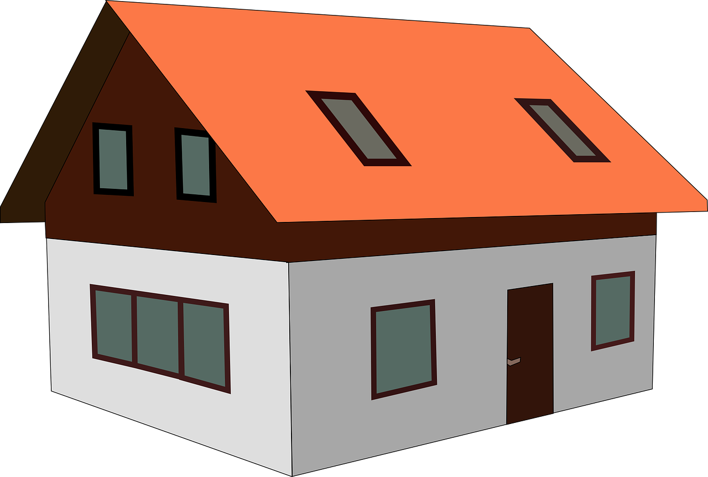
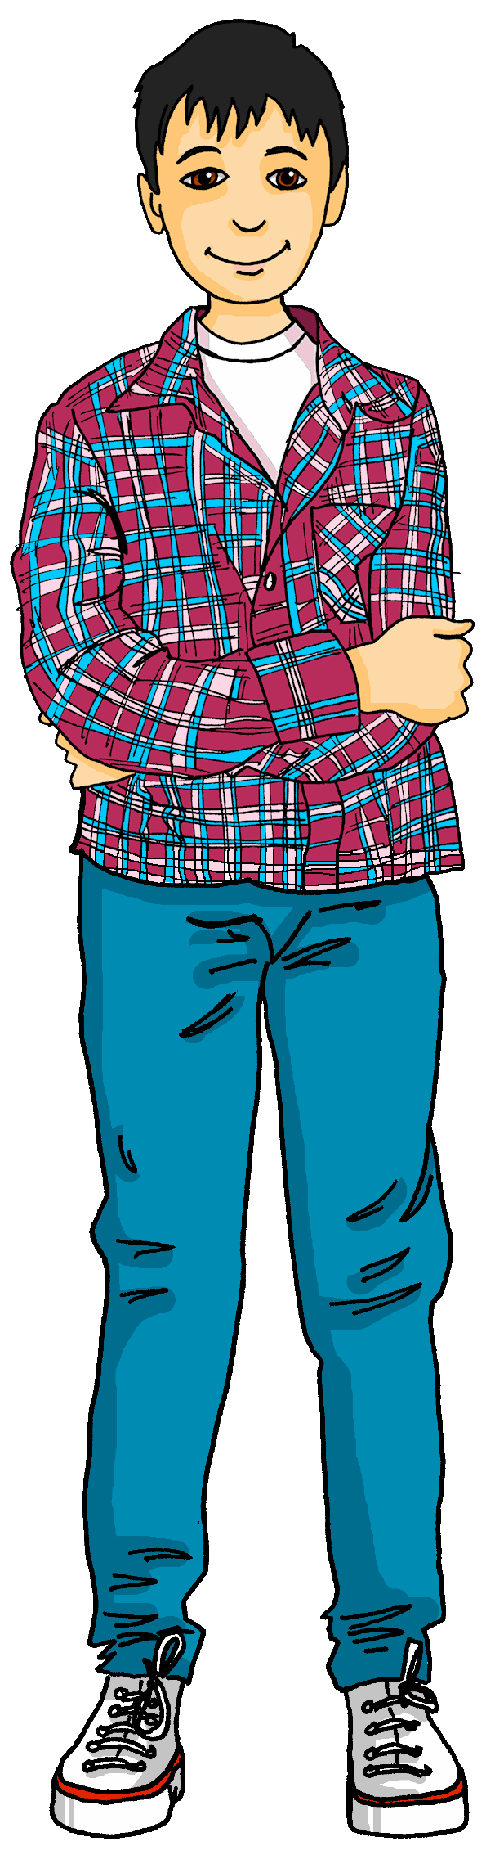
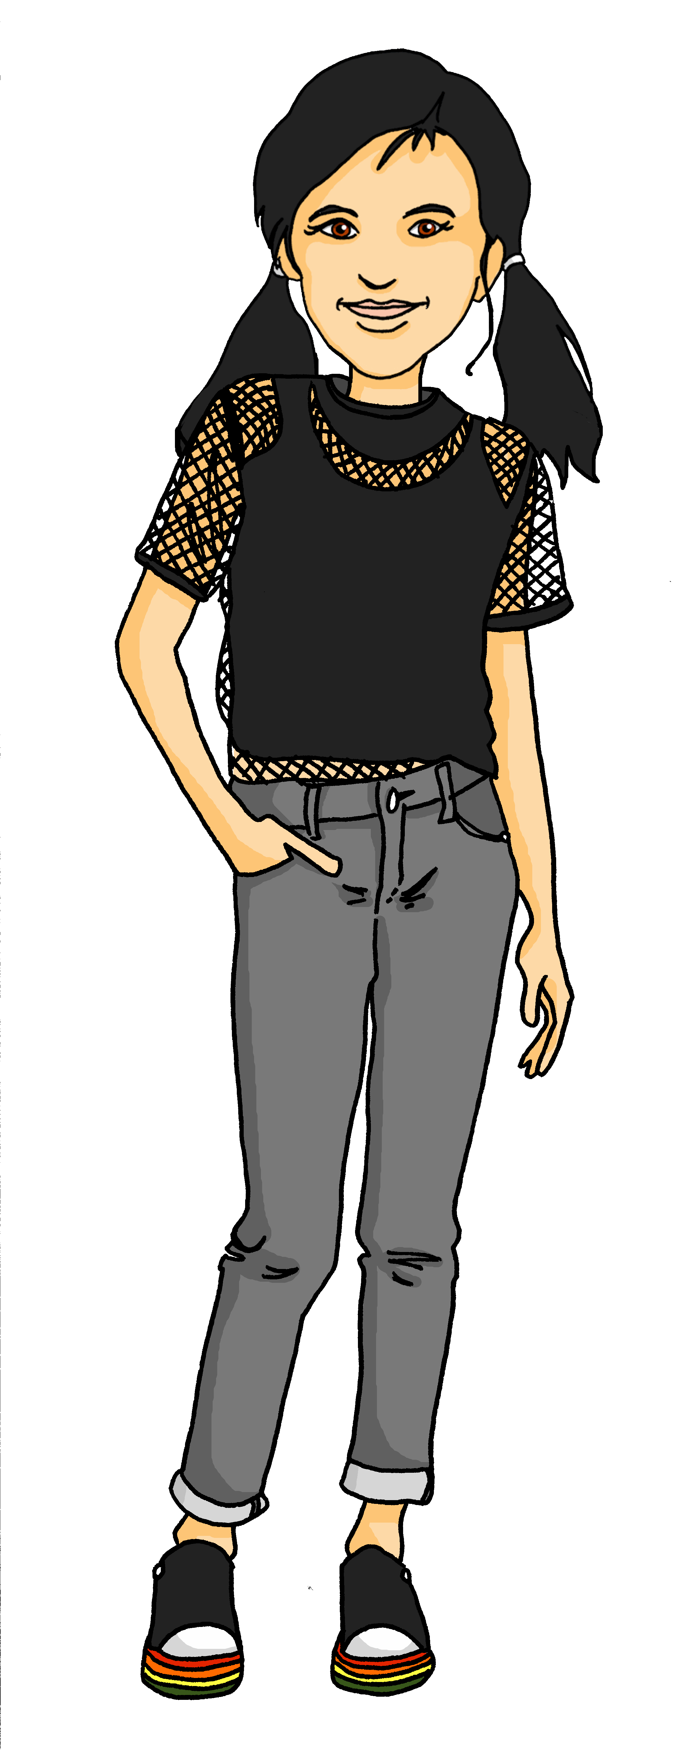

Ein sonniger Tag
die Creme – cream
natürlich – of course
lesen
Ronja, Lias, Oma und Opa gehen nach draußen.
Oma, nimmst du die Sonnencreme* mit?
Ja, natürlich*. Sonnencreme ist sehr wichtig!
Notes:
[3/4]
Timing: 2 minutes
Aim: to introduce the vocabulary in context and practise reading skills.
Procedure:
Read the text with the class (or play the recording).
Elicit the meaning after each scene (four in total).
Translation:
Ronja, Lias, Grandma and Grandpa are going outside.
Ronja: Grandma, are you taking the sun cream with you?
Sabine: Yes, of course. Sun cream is very important!
Vocabuarly:
Creme [N/A] natürlich [137]
Jones, R.L & Tschirner, E. (2019). A frequency dictionary of German: Core vocabulary for learners. London: Routledge.
7

Slide 8
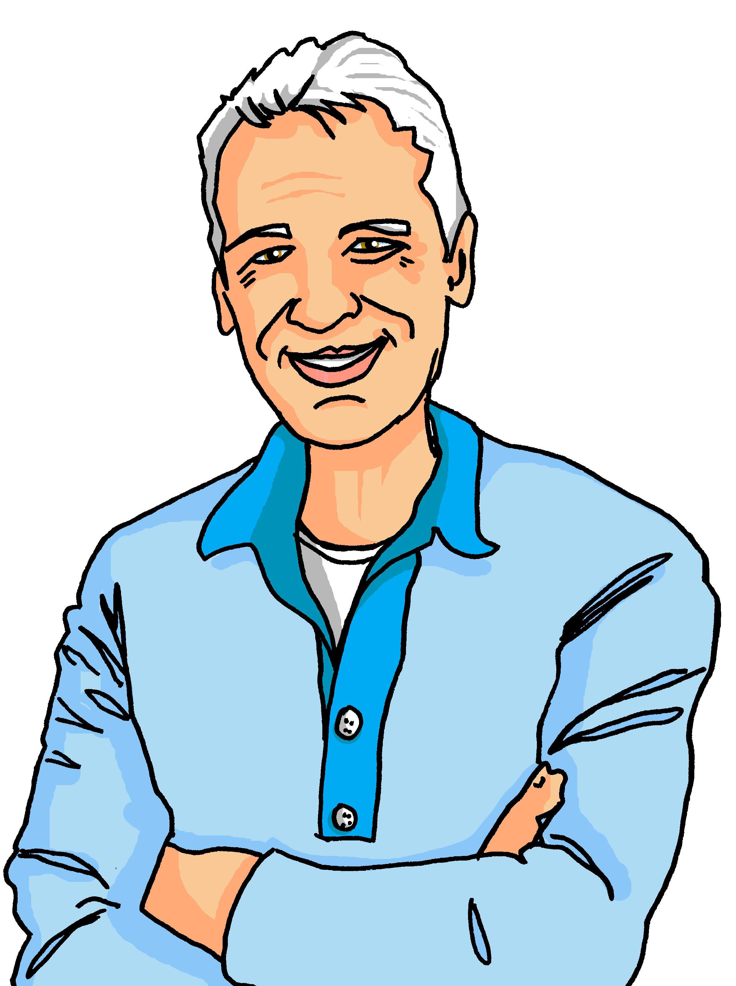


Ein sonniger Tag
später – later
mir – to me
lesen
Eine Stunde später*...Opas Kopf wird rot!
Du hast recht. Gibst du mir* bitte die Sonnencreme?
Opa! Dein Kopf wird rot! Es ist wichtig, Sonnencreme zu benutzen!
SPF 30
Notes:
[4/4]
Timing: 2 minutes
Aim: to introduce the vocabulary in context and practise reading skills.
Procedure:
Read the text with the class (or play the recording).
Elicit the meaning after each scene (four in total).
Translation:
One hour later...Grandpa’s head is turning red!
Lias: Grandpa! Your head is turning red! It’s important to use sun cream!
Dieter: You’re right. Please can you give me the sun cream, please?
Vocabulary:
später [N/A] mir [63]
Jones, R.L & Tschirner, E. (2019). A frequency dictionary of German: Core vocabulary for learners. London: Routledge.
8

Slide 9


Infinitive clauses with ‘zu’
Remember to use modal verbs like müssen (to have to, must) and können (can) with a 2nd verb in infinitive:
Wir müssen draußen bleiben.
We have to stay outside.
Wir können Fußball spielen.
We can play football.
When you use other verbs and phrases, add ‘zu’ before the 2nd infinitive verb:
Wir helfen Opa, das Essen zu kochen.
We are helping grandpa to cook the meal.
Es ist wichtig, nach draußen zu gehen.
It is important to go outside.
Ich habe Lust, Rad zu fahren.
I feel like riding a bike.
The word order is different from English! What would the German sentences sound like in English if you kept the German word order? E.g. ‘We have to outside stay.’
Notes:
Timing: 2 minutes
Aim: to recap how to use müssen and können; to present infinitive clauses with ‘zu’.
Procedure:
Click through the animations to present the new information.
Elicit English translation for the German examples provided.
The answers to how the sentences would sound like translated into English keeping the German word order are:
‘We have to outside stay.’
‘We can football play.’
‘We are helping grandpa, the meal to cook.’
‘It is important, outside to go.’
‘I feel like, bike to ride.’
Highlight that the second verb goes to the end, unlike in English.
9

Slide 10
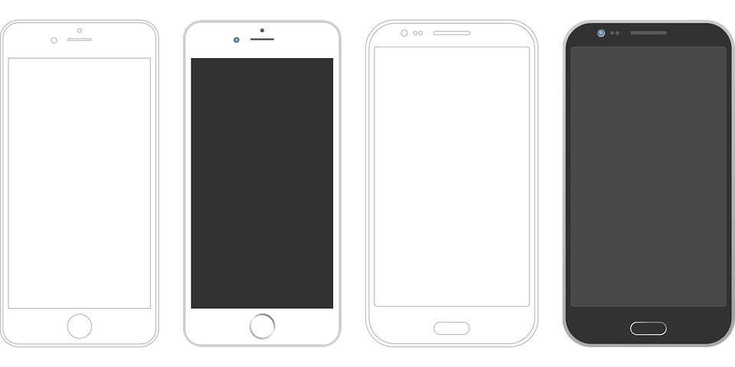


lesen
Ronja und Lias sind im Park mit Oma und Opa. Sie bekommen viele SMS von Vati/Lothar.
Schreib 1-6 und A oder B.
1
Seid ihr im Park? Es ist gut, draußen in der Sonne sein / zu sein.
3
Toll! Aber Opa kann schon* Fußball spielen / zu spielen.
5
    OK...Wann kommt ihr nach Hause? Habt ihr Lust, Pizza essen / zu essen?
2
Ja, wir sind im Park. Opa lernt, Fußball spielen / zu spielen!
4
Wirklich*?! Er sagt, er spielt kein Fußball...und wir müssen ihm* helfen / zu helfen!
6
Ja!!!!!!!! Wir kommen bald. Wir können den Salat machen / zu machen.
schon – already
wirklich – really
ihm - him
Notes:
Timing: 7 minutes
Aim: to practise written comprehension of 2-verb sentences with modal verbs können and müssen, and ‘zu’ clauses with other verbs and phrases.
Procedure:
Pupils write 1-6 and the correct verb choice (with or without ‘zu’).
Click anywhere to reveal answers in turn.
In the audio version, click numbers 1-6 to play the recording of the correct sentence.
Go to the next slide for the comprehension part of the task.
Vocabulary
schon [61] wirklich [189]
Jones, R.L & Tschirner, E. (2019). A frequency dictionary of German: Core vocabulary for learners. London: Routledge.
10

Slide 11
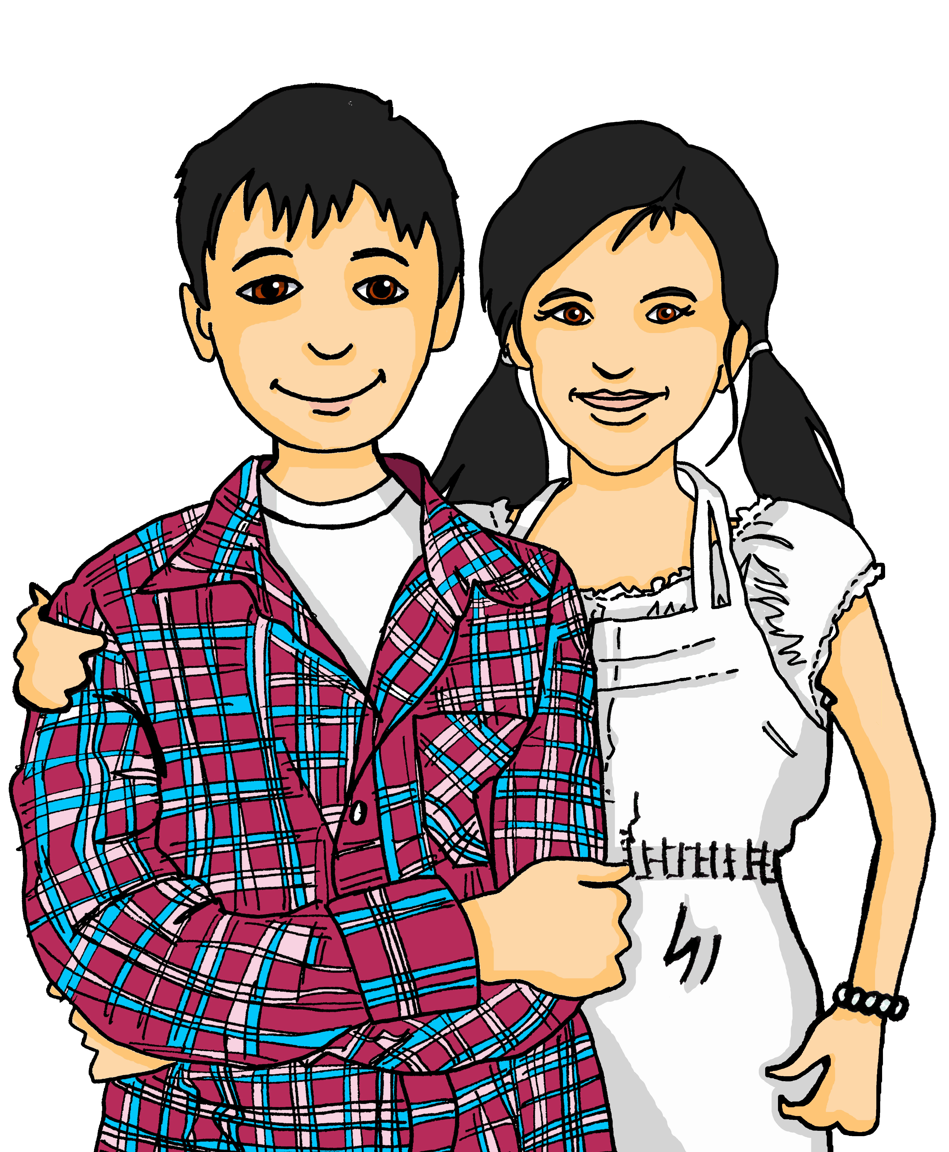


lesen
Schreib 1-6 und R (richtig) oder F (F)falsch.
Seid ihr im Park? Es ist gut, draußen in der Sonne zu sein.
Wirklich?! Er sagt, er spielt kein Fußball...und wir müssen ihn helfen.
1
4
Ronja and Lias:
don’t want to eat pizza
are outside
offer to help with dinner
are helping their grandpa
said their grandpa could play football
are coming home late
F
Ja, wir sind im Park. Opa lernt, Fußball zu spielen!
OK...Wann kommt ihr nach Hause? Habt ihr Lust, Pizza zu essen?
R
R
2
5
R
F
Toll! Aber Opa kann schon Fußball spielen.
Ja!!!!!!!! Wir kommen bald! Wir können den Salat machen.
3
6
F
Notes:
Timing: 8 minutes
Aim: to practise written comprehension of 2-verb sentences with modal verbs können and müssen, and ‘zu’ clauses with other verbs and phrases.
Procedure:
This is the correct version of the sentences form the previous slide. Pupils read the sentences again.
The read the true/false statements on the right (they are not in order of the sentences). Pupils write 1-6 and R (richtig) or F (falsch).
Click to reveal answers.
If time, ask pupils to translate the sentences into English. Translations below.
Translations
Are you (all) at/in the park? It’s good to be outside in the sun.
Yes, we’re in/at the park. Grandpa is learning how to play football!
Great! But Grandpa can already play football.
Really?! He says he doesn’t play football...and we have to help him.
OK...When are you (all) coming home? Do you (all) feel like eating pizza?
Yes!!!!!!!! We’re coming soon! We can make the salad.
11

Slide 12
Tschüss!
grün
Notes:
12

