Slide 1
Talking about activities and events
Ich wiederhole!
gelb
Vocabulary & Grammar quiz
Term 3 Week 10
Notes:
Word frequency (1 is the most frequent word in German):
Jones, R.L & Tschirner, E. (2019). A frequency dictionary of German: Core vocabulary for learners. London: Routledge.
The frequency rankings for words that occur in this PowerPoint which have been previously introduced in these resources are given in the SOW and in the resources that first introduced and formally re-visited those words. For any other words that occur incidentally in this PowerPoint, frequency rankings will be provided in the notes field wherever possible.
1

Slide 2
Vocabulary
A For each question, put a cross (x) under the English meaning that matches what you hear. You will hear each German word twice. Choose one correct answer only. (4 marks on this slide)
hören
A | B | C | D
 | Wednesday | place | month | week
 | ☐ | ☐ | ☐ | ☐
 | I would like | you would like | she would like | it would like
 | ☐ | ☐ | ☐ | ☐
 | help | homework | list | group
 | ☐ | ☐ | ☐ | ☐
 | Saturday | Tuesday | Thursday | Monday
 | ☐ | ☐ | ☐ | ☐
1
2
3
4
Notes:
1/2
Timing: 20-25 minutes (all assessment slides)
Aim: to practise aural comprehension of vocabulary taught in terms 1 and 2 of the course.
Procedure:
1. Click the audio buttons to play each item. (The words are recorded twice with a pause to allow pupils to process the information).
2. Pupils can either write 1C, etc.. or if they have the assessment on a print out they can put a X in the correct box.
3. After items 1-4, continue to the next slide to complete the remainder of the task.
Transcript:
die Woche
es möchte
die Hilfe
Donnerstag
2

Slide 3
Vocabulary
A For each question, put a cross (x) under the English meaning that matches what you hear. You will hear each German word twice. Choose one correct answer only. (4 marks on this slide)
hören
A | B | C | D
 | grey | white | black | green
 | ☐ | ☐ | ☐ | ☐
 | minute | hour | day | year
 | ☐ | ☐ | ☐ | ☐
 | January | May | February | June
 | ☐ | ☐ | ☐ | ☐
 | three | one | eleven | twelve
 | ☐ | ☐ | ☐ | ☐
5
6
7
8
Notes:
2/2
Transcript
5. weiß
6. der Tag
7. Januar
8. eins
3

Slide 4
Vocabulary
B For each question, put a cross (x) under the type of word you hear. You will hear each German word twice. Choose one correct answer only. (5 marks)
hören
This word is a good example of …
 | A | B | C | D
 | a day | an animal | a time period | a place
 | ☐ | ☐ | ☐ | ☐
 | an activity | a person | a question word | a time period
 | ☐ | ☐ | ☐ | ☐
 | a month | a number | a day | a place
 | ☐ | ☐ | ☐ | ☐
 | a person | a question word | a colour | an animal
 | ☐ | ☐ | ☐ | ☐
 | a question word | a greeting | a place | a day
 | ☐ | ☐ | ☐ | ☐
1
2
3
4
5
Notes:
1/1
Aim: to practise aural comprehension of vocabulary taught in terms 1 and 2 of the course.
Procedure:
1. Click the audio buttons to play each item. (The words are recorded twice with a pause to allow pupils to process the information).
2. Pupils can either write 1C, etc.. or if they have the assessment on a print out they can put a X in the correct box.
Transcript:
der Monat
der Schüler
Juli
wann?
Sonntag
4

Slide 5
Vocabulary
C Translate the underlined German word to complete each English sentence. (12 marks)
lesen
1. Ich bin sechs Jahre alt. I am __________ ___________ old. (2)
2. Ich mache Sport mit Ben. I do sport ___________ Ben. (1)
3. Du hast eine Geschichte. You have ___________ ___________. (2)
4. Wie sagt man das? ________ ________ ________ _________ that? (3)
5. Wo ist das Haus? ___________ is the house? (1)
6. Er ist jung. He is ___________. (1)
7. Ich bin müde. I am ___________. (1)
8. Ich bleibe heute zu Hause. I ___________ ___________ at home today. (1)
Notes:
1/1
Aim: to practise written recall of previously taught vocabulary.
Procedure:
Ensure that the task is clear.
Pupils could write 1 – 8 and the individual English word meanings (or they could fill in if they have printed assessment sheets).
5

Slide 6
Vocabulary
D For each question, put a cross (x) under the word that best fits each category. Choose one correct answer only. (5 marks)
lesen
 | This word is a good example of …
 |  | A | B | C | D
1. | a month | Auf Wiedersehen ☐ | März ☐ | Montag ☐ | Ding ☐
2. | a number | neun ☐ | oder ☐ | mit ☐ | rund ☐
3. | a family member | Mai ☐ | Farbe ☐ | Vater ☐ | Person ☐
4. | a day | Spiel ☐ | Oktober ☐ | Idee ☐ | Samstag ☐
5. | a question word | nein ☐ | wer ☐ | falsch ☐ | ja ☐
Notes:
1/1
Aim: to practise written recall of previously taught vocabulary.
Procedure:
Ensure that the task is clear.
Pupils can either write 1C, etc.. or if they have the assessment on a print out they can put a X in the correct box.
6

Slide 7
Vocabulary
E Translate the underlined English words to complete the German sentence. (18 marks)
schreiben
1. Today is Wednesday. ___________ ist Mittwoch. (Write one word.)
2. My mother is quiet. Meine ___________ ist ruhig. (Write one word.)
3. Tomorrow is Friday. Morgen ist ___________. (Write one word.)
4. Hello, Mrs Fischer! ___________, Frau Fischer! (Write one word.)
5. The (female) player is new. Die ___________ ist neu. (Write one word.)
6. He would like to visit. Er möchte ___________. (Write one word.)
7. Would she like to play? Möchte sie ___________? (Write one word.)
8. What is your favourite number? Was ist deine ___________nummer? (Write one word.)
9. The plan is totally bad. Der Plan ist _________ ________. (Write two words.)
10. Are you called Lena? ___________ ___________ Lena? (Write two words.)
Notes:
1/1
Aim: to practise written recall of previously taught vocabulary.
Procedure:
Ensure that the task is clear.
Pupils could write 1 – 10 and the German translations (or they could fill in if they have printed assessment sheets).
7

Slide 8
Grammar
A Put a (X) next to the person the sentence is about. (4 marks)
lesen
1 | ☐ I ☐ you _{[singular]} ☐ she/he | … bist lieb.
2 | ☐ I ☐ you _{[singular]} ☐ she/he | … wohnt.
3 | ☐ I ☐ you _{[singular]} ☐ she/he | … hat einen Computer.
4 | ☐ I ☐ you _{[singular]} ☐ she/he | … arbeite.
Notes:
1/1
Aim: to practise written understanding of previously taught grammar features (verb endings for 1st, 2nd, 3rd person with familiar verbs).
Procedure:
Ensure that the task is clear.
Pupils could write 1 – 4 and the correct English pronoun (or they could fill in if they have printed assessment sheets).
8

Slide 9
Grammar
B Put a (X) next to the person the sentence is about. (2 marks)
lesen
1 | ☐ I ☐ you _{[singular]} | … möchte eine Minute bleiben.
2 | ☐ you _{[singular]} ☐ she/he | … möchtest fahren..
Notes:
1/1
Aim: to practise written understanding of previously taught grammar features (subject-verb agreement with möcht-).
Procedure:
Ensure that the task is clear.
Pupils could write 1 – 2 and the correct English pronoun (or they could fill in if they have printed assessment sheets).
9

Slide 10
Grammar
C Put a (X) next to the English meaning of the German sentence. (4 marks)
lesen
1 | Sie ist nicht meine Partnerin. | ☐ She is my partner. ☐ She is not my partner.
2 | Ich benutze das Papier. | ☐ I use the paper. ☐ I do not use the paper.
3 | Du schreibst nicht. | ☐ You write. ☐ You don’t write.
4 | Ich habe keinen Grund. | ☐ I have a reason. ☐ I don’t have a reason.
Notes:
1/1
Aim: to practise written understanding of previously taught grammar features (negation)
Procedure:
Ensure that the task is clear.
Pupils could write 1 – 4 and 1 (top) or 2 (bottom) for each answer (or they could fill in if they have printed assessment sheets).
10

Slide 11
Grammar
D Write the correct determiner in the blanks to complete the German translations. (8 marks)
schreiben
1 | _________ Familie (f) | the family
2 | _________ Opa (m) | a granddad
3 | Das ist _________ Brief. (m) | That is your letter.
4 | Hier ist _________ Fahrrad. (nt) | Here is my bicycle.
5 | Du bekommst _________ Baum. (m) | You receive the tree.
6 | Oma hat _________ Gitarre. (f) | Grandma has a guitar.
7 | Das ist _________ Ball. (m) | That is her ball.
8 | Da ist _________ Uhr. (f) | There is his watch.
Notes:
1/1
Aim: to practise written recall of previously taught grammar features (articles).
Procedure:
Ensure that the task is clear.
Pupils could write 1 – 8 and the target word (or they could fill in if they have printed assessment sheets).
11

Slide 12
Grammar
E Write the plural version of each noun in the table below. (2 marks)
schreiben
Notes:
1/1
Aim: to practise written recall of previously taught grammar features (plurals).
Procedure:
Ensure that the task is clear.
Pupils could write 1 – 2 and the target word (or they could fill in if they have printed assessment sheets).
12

Slide 13
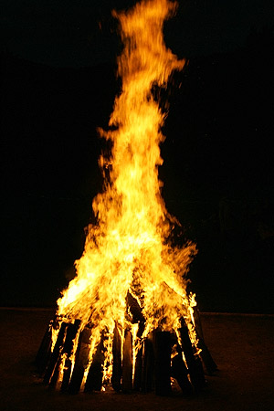
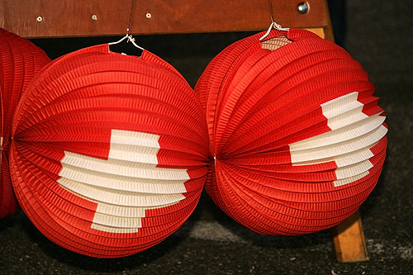
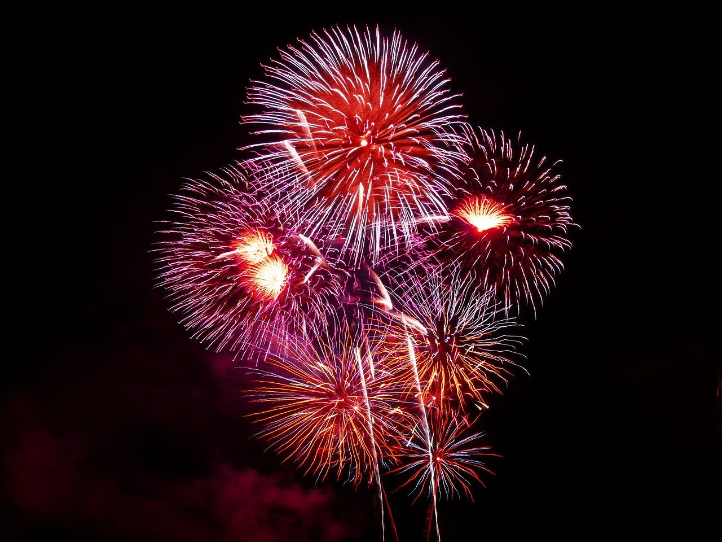
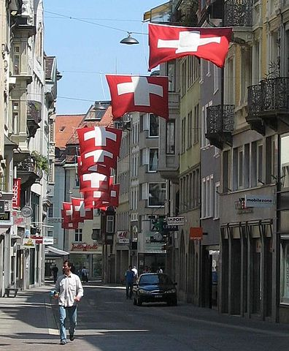
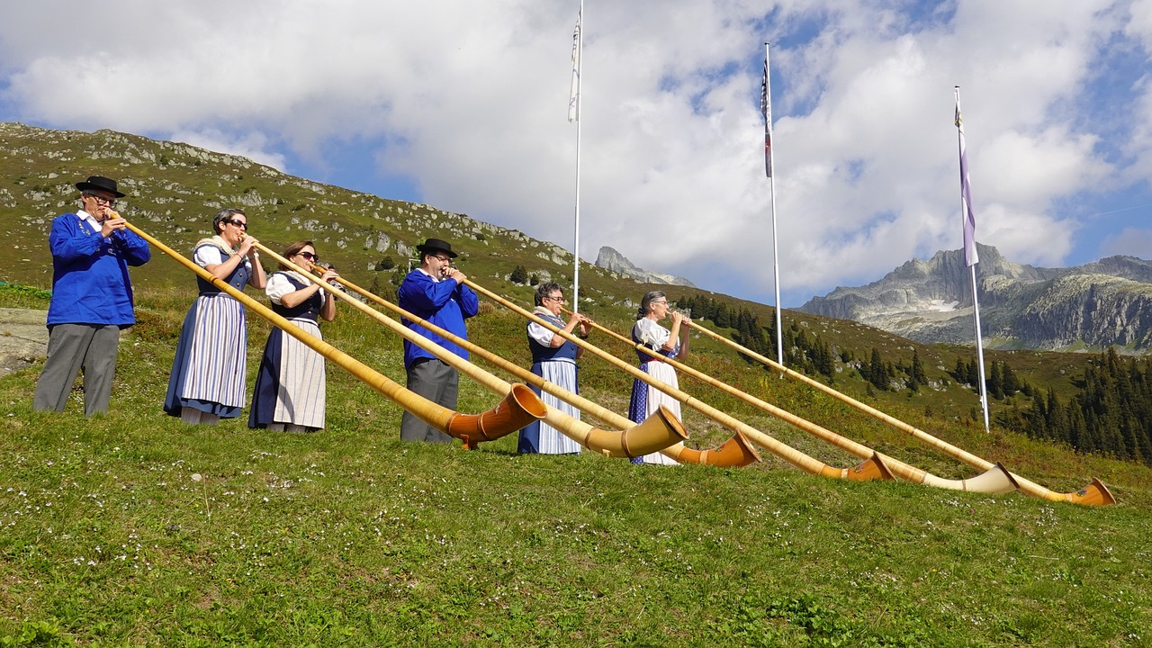
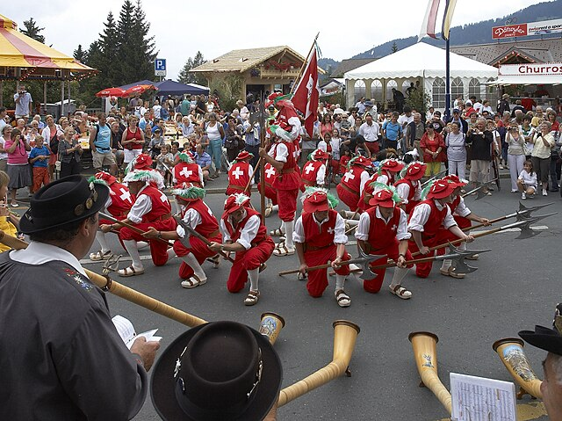
hören
Nationalfeiertag
Was macht man am 1. August?
The 1st of August is Switzerland’s National Day. How do people celebrate?
lesen
Lampions
Feuerwerke
Höhenfeuer
_
_
_
Children carry Chinese lanterns.
People watch firework displays.
People light tall bonfires on mountains and hilltops.
Alphörner
Paraden
Fahnen
_ _
_
_
Musicians play alphorns.
There are parades, and people wear traditional clothes.
The Swiss flag is proudly displayed.
Notes:
Timing: 5 minutes
Aim: to practise aural comprehension of several of this year’s SSCs; to learn about Switzerland’s National Day.
Procedure:
1. Ask pupils to say Nationalfeiertag aloud. It contains 3 SSCs from this term [tion] [-er] [-g]. Click on the word to hear it pronounced by a native speaker.
2. Click on each of the blue text boxes to hear each word. Pupils listen carefully and transcribe the missing SSC. Click to reveal answers.
3. Click to reveal further information about how people celebrate.
Word frequency:
Alphorn [>5000] Fahne [4206] Feuerwerk [>5000] Höhenfeuer [>5000] Lampion [>5000] Parade [>5000]
Source: Jones, R.L. & Tschirner, E. (2019). A frequency dictionary of German: core vocabulary for learners. Routledge
Image Attribution
Lampions: Par Roland Zumbühl (Picswiss), Arlesheim (Commons:Picswiss project) — [1]. If this link does not work (URLs are subject to changes), you can find the picture starting from the canton of the subject: http://www.picswiss.ch/geo.html then the location., CC BY-SA 3.0, https://commons.wikimedia.org/w/index.php?curid=1211596
Höhenfeuer: Par Roland Zumbühl (Picswiss), Arlesheim (Commons:Picswiss project) — [1]. If this link does not work (URLs are subject to changes), you can find the picture starting from the canton of the subject: http://www.picswiss.ch/geo.html then the location., CC BY-SA 3.0, https://commons.wikimedia.org/w/index.php?curid=1211587
Fahnen: Di Schweizerflaggen_St._Gallen.JPG: de:Benutzer:BenjIIderivative work: Ultimate Destiny (talk) - Schweizerflaggen_St._Gallen.JPG, CC BY-SA 3.0, https://commons.wikimedia.org/w/index.php?curid=7443879
Paraden: Von Wouter Hagens - Eigenes Werk, CC BY-SA 3.0, https://commons.wikimedia.org/w/index.php?curid=4539682
13

Slide 14
lesen
Nationalfeiertag
Was ist richtig? Was ist falsch?
Paraden
Fahrrad
spielen
Fahnen
Höhenfeuer
Feuerwerke
Sport
Lampions
Gitarre spielen
Alphörner
schreiben
Familie
Notes:
Timing: 5 minutes
Aim: to learn more about Nationalfeiertag in Switzerland
Procedure:
Pupils read the blue words in the bubbles. Ensure they understand all the vocabulary. Unknown words have an accompanying picture to aid comprehension.
Click on this link to play a video showing celebrations in Switzerland. https://www.youtube.com/watch?v=7b_G8O7xyEE
Pupils watch the video, and decide which of the words in the bubbles appear in the video and which don’t. Click to reveal answers.
Word frequency:
Alphorn [>5000] Fahne [4206] Feuerwerk [>5000] Höhenfeuer [>5000] Lampion [>5000] Parade [>5000]
Source: Jones, R.L. & Tschirner, E. (2019). A frequency dictionary of German: core vocabulary for learners. Routledge
Image Attribution
Lampions: Par Roland Zumbühl (Picswiss), Arlesheim (Commons:Picswiss project) — [1]. If this link does not work (URLs are subject to changes), you can find the picture starting from the canton of the subject: http://www.picswiss.ch/geo.html then the location., CC BY-SA 3.0, https://commons.wikimedia.org/w/index.php?curid=1211596
Höhenfeuer: Par Roland Zumbühl (Picswiss), Arlesheim (Commons:Picswiss project) — [1]. If this link does not work (URLs are subject to changes), you can find the picture starting from the canton of the subject: http://www.picswiss.ch/geo.html then the location., CC BY-SA 3.0, https://commons.wikimedia.org/w/index.php?curid=1211587
Fahnen: Di Schweizerflaggen_St._Gallen.JPG: de:Benutzer:BenjIIderivative work: Ultimate Destiny (talk) - Schweizerflaggen_St._Gallen.JPG, CC BY-SA 3.0, https://commons.wikimedia.org/w/index.php?curid=7443879
Paraden: Von Wouter Hagens - Eigenes Werk, CC BY-SA 3.0, https://commons.wikimedia.org/w/index.php?curid=4539682
14

Slide 15
Tschüss!
gelb
Notes:
15

Slide 16
Vocabulary
A For each question, put a cross (x) under the English meaning that matches what you hear. You will hear each German word twice. Choose one correct answer only. (4 marks on this slide)
hören
A | B | C | D
 | Wednesday | place | month | week
 | ☐ | ☐ | ☐ | ☒
 | I would like | you would like | she would like | it would like
 | ☐ | ☐ | ☐ | ☒
 | help | homework | list | group
 | ☒ | ☐ | ☐ | ☐
 | Saturday | Tuesday | Thursday | Monday
 | ☐ | ☐ | ☒ | ☐
1
2
3
4
Notes:
ANSWERS
Transcript:
die Woche
es möchte
die Hilfe
Donnerstag
16

Slide 17
Vocabulary
A For each question, put a cross (x) under the English meaning that matches what you hear. You will hear each German word twice. Choose one correct answer only. (4 marks on this slide)
hören
A | B | C | D
 | grey | white | black | green
 | ☐ | ☒ | ☐ | ☐
 | minute | hour | day | year
 | ☐ | ☐ | ☒ | ☐
 | January | May | February | June
 | ☒ | ☐ | ☐ | ☐
 | three | one | eleven | twelve
 | ☐ | ☒ | ☐ | ☐
5
1
6
2
7
3
8
4
Notes:
2/2
Transcript
5. weiß
6. der Tag
7. Januar
8. eins
17

Slide 18
Vocabulary
B For each question, put a cross (x) under the type of word you hear. You will hear each German word twice. Choose one correct answer only. (5 marks)
hören
This word is a good example of …
 | A | B | C | D
 | a day | an animal | a time period | a place
 | ☐ | ☐ | ☒ | ☐
 | an activity | a person | a question word | a time period
 | ☐ | ☒ | ☐ | ☐
 | a month | a number | a day | a place
 | ☒ | ☐ | ☐ | ☐
 | a person | a question word | a colour | an animal
 | ☐ | ☒ | ☐ | ☐
 | a question word | a greeting | a place | a day
 | ☐ | ☐ | ☐ | ☒
1
2
3
4
5
Notes:
ANSWERS
Transcript:
der Monat
der Schüler
Juli
wann?
Sonntag
18

Slide 19
Vocabulary
C Translate the underlined German word to complete each English sentence. (12 marks)
lesen
1. Ich bin sechs Jahre alt. I am six years old. (2)
2. Ich mache Sport mit Ben. I do sport with Ben. (1)
3. Du hast eine Geschichte. You have a story. (2)
4. Wie sagt man das? How do you say that? (3)
5. Wo ist das Haus? Where is the house? (1)
6. Er ist jung. He is young. (1)
7. Ich bin müde. I am tired. (1)
8. Ich bleibe heute zu Hause. I am staying at home today. (1)
Notes:
ANSWERS
19

Slide 20
Vocabulary
D For each question, put a cross (x) under the word that best fits each category. Choose one correct answer only. (5 marks)
lesen
 | This word is a good example of …
 |  | A | B | C | D
1. | a month | Auf Wiedersehen ☐ | März ☒ | Montag ☐ | Ding ☐
2. | a number | neun ☒ | oder ☐ | mit ☐ | rund ☐
3. | a family member | Mai ☐ | Farbe ☐ | Vater ☒ | Person ☐
4. | a day | Spiel ☐ | Oktober ☐ | Idee ☐ | Samstag ☒
5. | a question word | nein ☐ | wer ☒ | falsch ☐ | ja ☐
Notes:
ANSWERS
20

Slide 21
Vocabulary
E Translate the underlined English words to complete the German sentence. (18 marks)
schreiben
1. Today is Wednesday. Heute ist Mittwoch. (Write one word.)
2. My mother is quiet. Meine Mutter ist ruhig. (Write one word.)
3. Tomorrow is Friday. Morgen ist Freitag. (Write one word.)
4. Hello, Mrs Fischer! Hallo, Frau Fischer! (Write one word.)
5. The (female) player is new. Die Spielerin ist neu. (Write one word.)
6. He would like to visit. Er möchte besuchen. (Write one word.)
7. Would she like to play? Möchte sie spielen? (Write one word.)
8. What is your favourite number? Was ist deine Lieblingsnummer? (Write one word.)
9. The plan is totally bad. Der Plan ist total schlecht. (Write two words.)
10. Are you called Lena? Heißt du Lena? (Write two words.)
Notes:
ANSWERS
21

Slide 22
Grammar
A Put a (X) next to the person the sentence is about. (4 marks)
lesen
1 | ☐ I ☒ you _{[singular]} ☐ she/he | … bist lieb.
2 | ☐ I ☐ you _{[singular]} ☒ she/he | … wohnt.
3 | ☐ I ☐ you _{[singular]} ☒ she/he | … hat einen Computer.
4 | ☒ I ☐ you _{[singular]} ☐ she/he | … arbeite.
Notes:
ANSWERS
22

Slide 23
Grammar
B Put a (X) next to the person the sentence is about. (2 marks)
lesen
1 | ☒ I ☐ you _{[singular]} | … möchte eine Minute bleiben.
2 | ☒ you _{[singular]} ☐ she/he | … möchtest fahren..
Notes:
ANSWERS
23

Slide 24
Grammar
C Put a (X) next to the English meaning of the German sentence. (4 marks)
lesen
1 | Sie ist nicht meine Partnerin. | ☐ She is my partner. ☒ She is not my partner.
2 | Ich benutze das Papier. | ☒ I use the paper. ☐ I do not use the paper.
3 | Du schreibst nicht. | ☐ You write. ☒ You don’t write.
4 | Ich habe keinen Grund. | ☐ I have a reason. ☒ I don’t have a reason.
Notes:
ANSWERS
24

Slide 25
Grammar
D Write the correct determiner in the blanks to complete the German translations. (8 marks)
schreiben
1 | die Familie (f) | the family
2 | ein Opa (m) | a granddad
3 | Das ist dein Brief. (m) | That is your letter.
4 | Hier ist mein Fahrrad. (nt) | Here is my bicycle.
5 | Du bekommst den Baum. (m) | You receive the tree.
6 | Oma hat eine Gitarre. (f) | Grandma has a guitar.
7 | Das ist ihr Ball. (m) | That is her ball.
8 | Da ist seine Uhr. (f) | There is his watch.
Notes:
ANSWERS
25

Slide 26
Grammar
E Write the plural version of each noun in the table below. (2 marks)
schreiben
Notes:
ANSWERS
26

