Slide 1
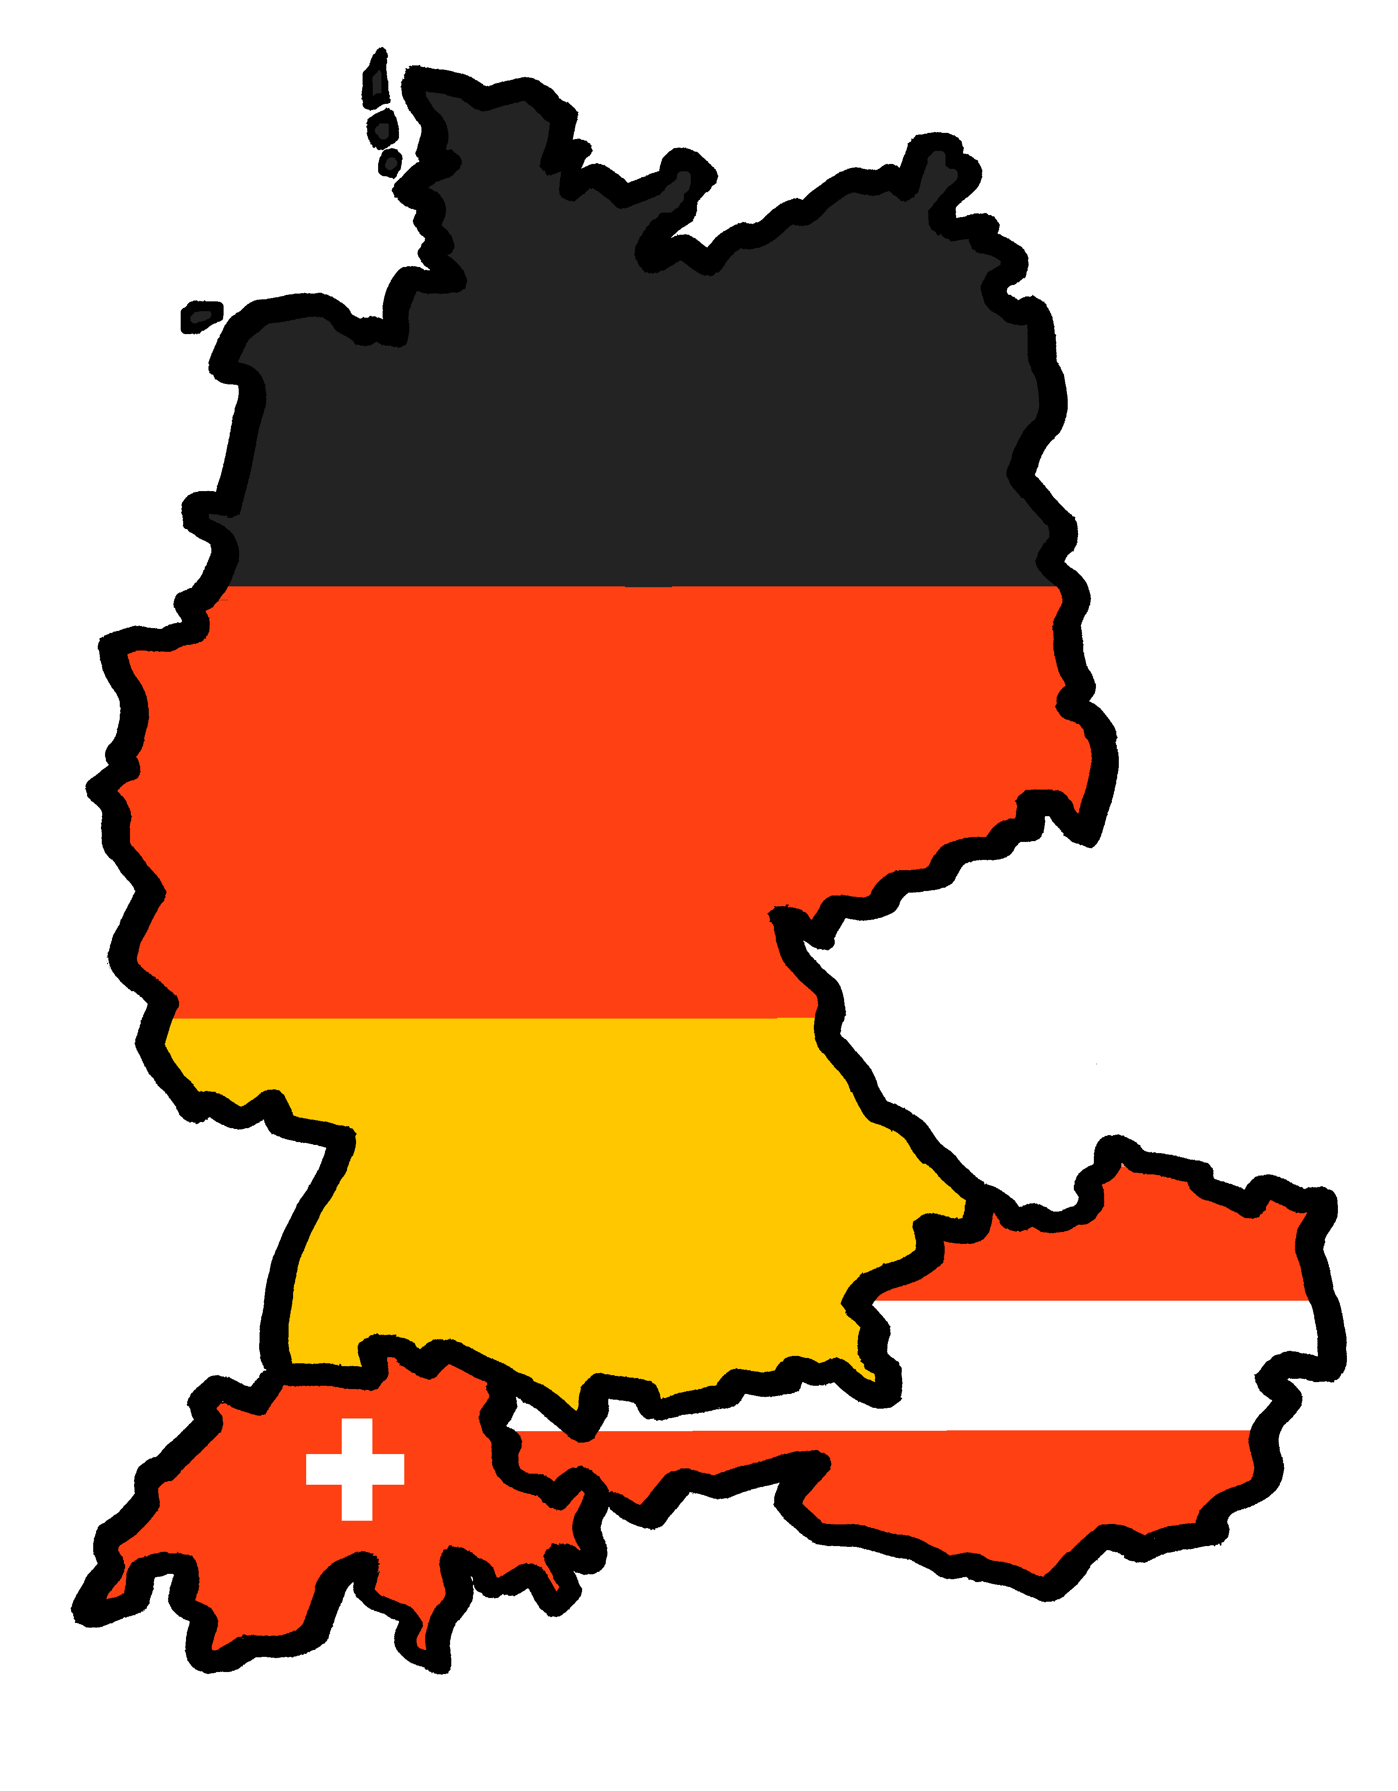
Talking about activities and events
Ich wiederhole!
gelb
Phonics quiz
Term 3 Week 11
Notes:
Word frequency (1 is the most frequent word in German):
Jones, R.L & Tschirner, E. (2019). A frequency dictionary of German: Core vocabulary for learners. London: Routledge.
The frequency rankings for words that occur in this PowerPoint which have been previously introduced in these resources are given in the SOW and in the resources that first introduced and formally re-visited those words. For any other words that occur incidentally in this PowerPoint, frequency rankings will be provided in the notes field wherever possible.
1

Slide 2
consonantal [r]
[v]
aussprechen
aussprechen
[try]
versuchen
trinken
Notes:
Phonics quiz 1/7
Timing: flexible during Week 11 Procedure:
Print out one set of these 14 phonics cards.
Working with one pupil at a time, elicit the pronunciation of each word.
Say: You have not learnt these words, but you have learnt how to read aloud these sounds, so just have a go at reading each word aloud.
Focus only on the accurate pronunciation of the target SSC and tolerate any other inaccuracies.
Use the pupil scoring sheet at the end of this presentation to assess SSC knowledge and give feedback.
Note: Whilst working with individual children, others can be doing the activities at the end of this presentation.
2

Slide 3
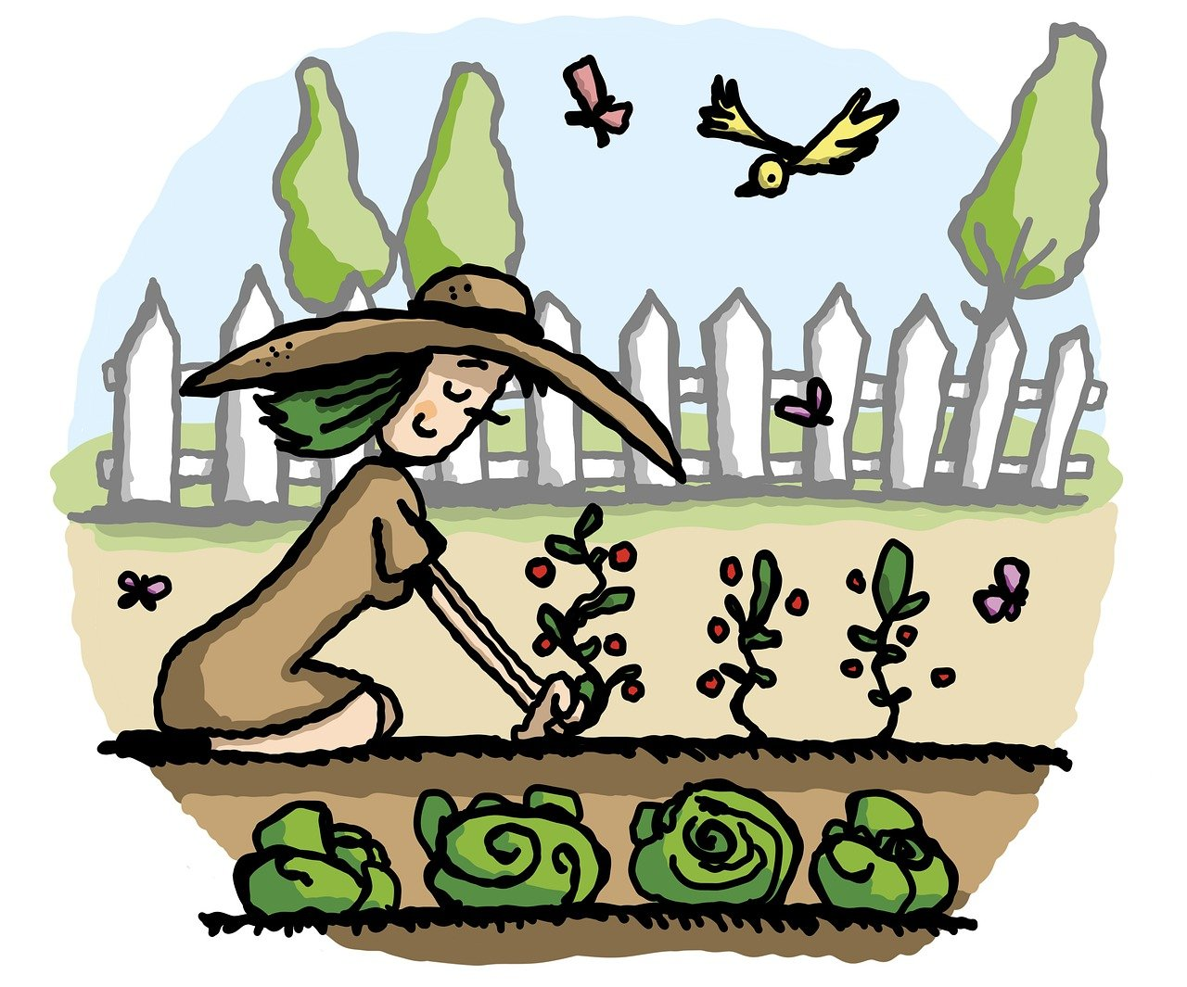
vocalic [r]
[-er]
aussprechen
aussprechen
[always]
Garten
immer
Notes:
3/7
3

Slide 4
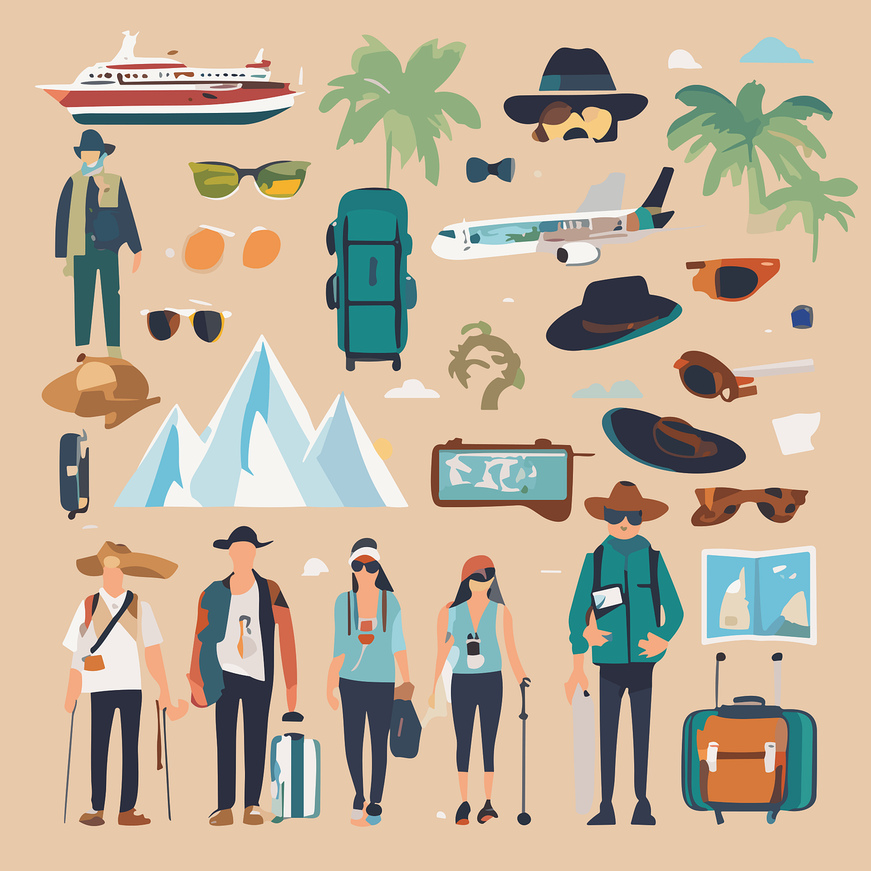
[ig]
[-g]
aussprechen
aussprechen
[little]
wenig
Ausflug
Notes:
4/7
4

Slide 5
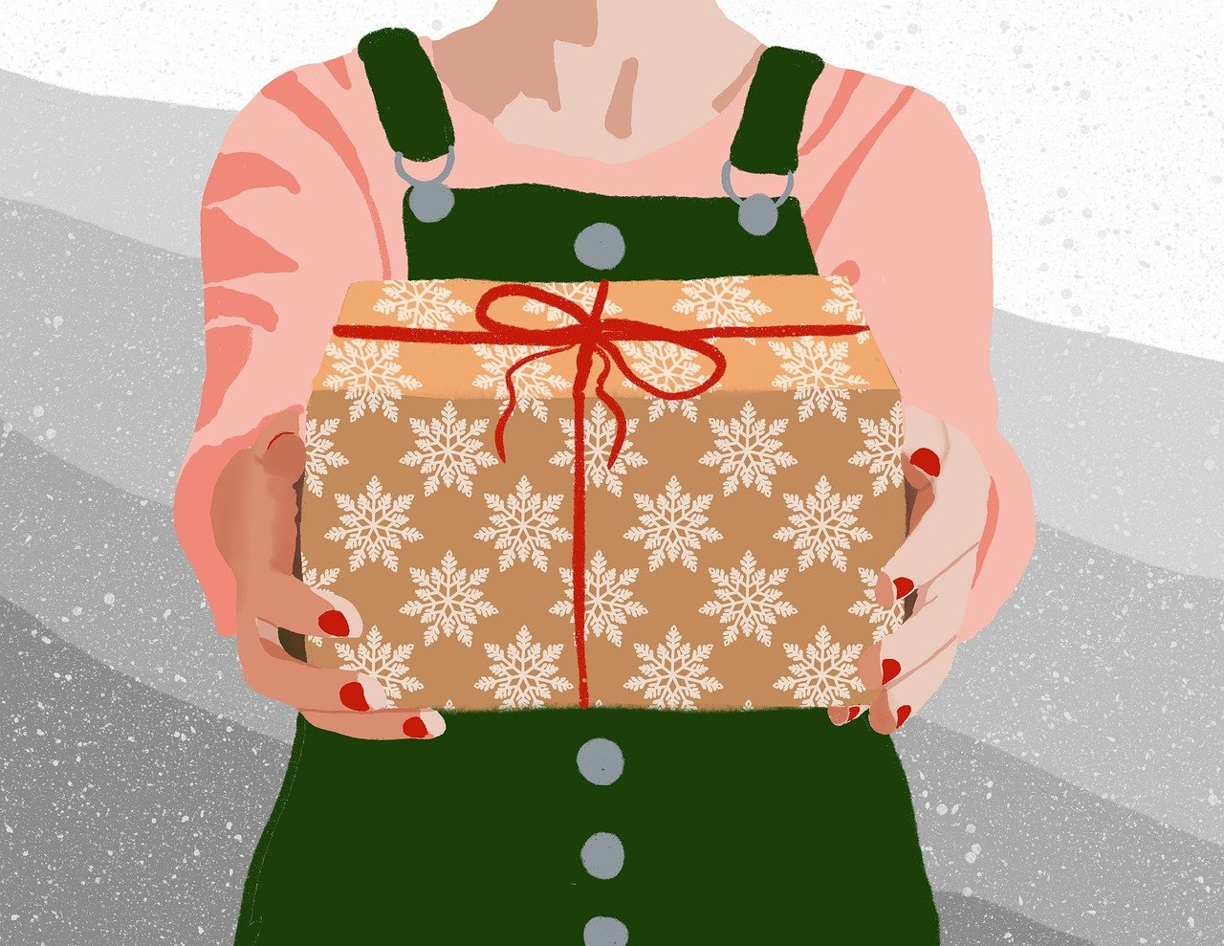
[-b]
[th]
aussprechen
aussprechen
gab
Theorie
Notes:
5/7
5

Slide 6
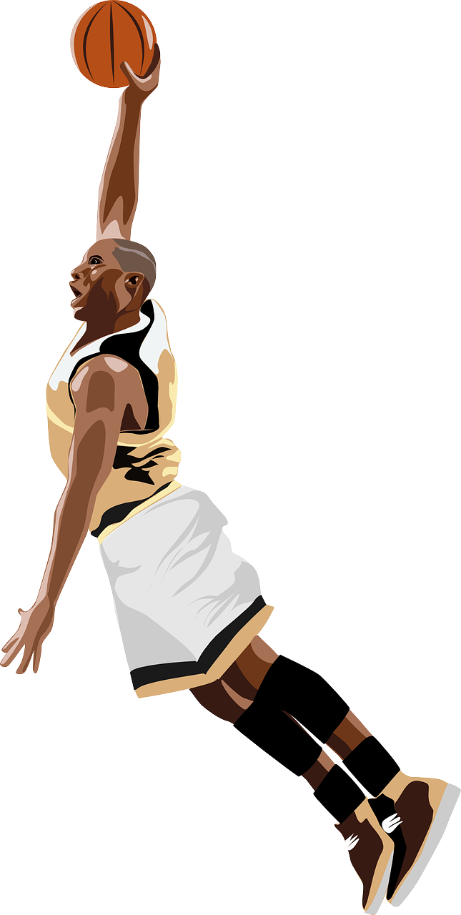
[ö]
[sp]
aussprechen
aussprechen
mögen
Sportler
Notes:
6/7
6

Slide 7
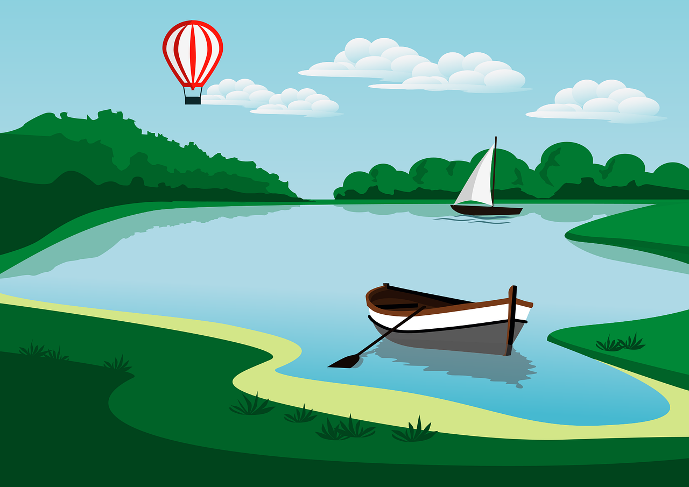
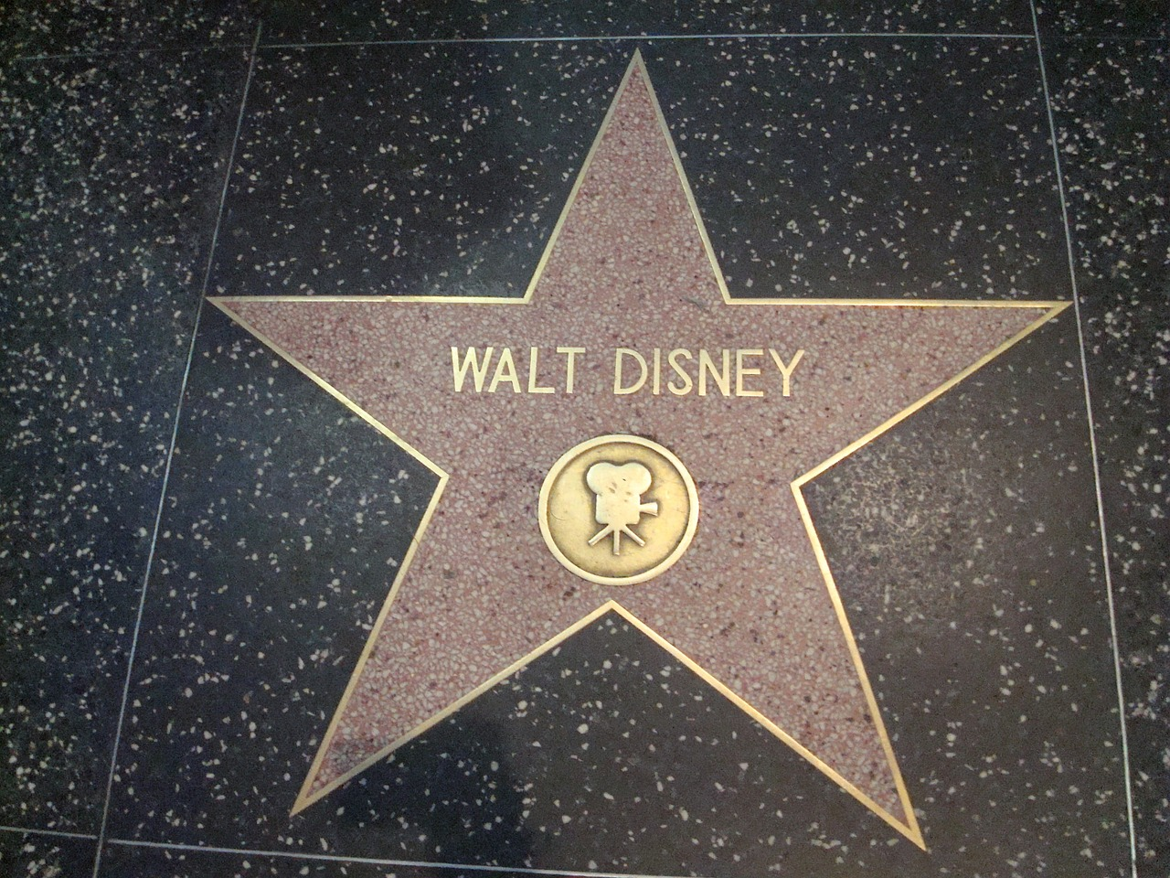
[s-]
short [a]
aussprechen
aussprechen
See
bekannt
Notes:
7/7
7

Slide 8
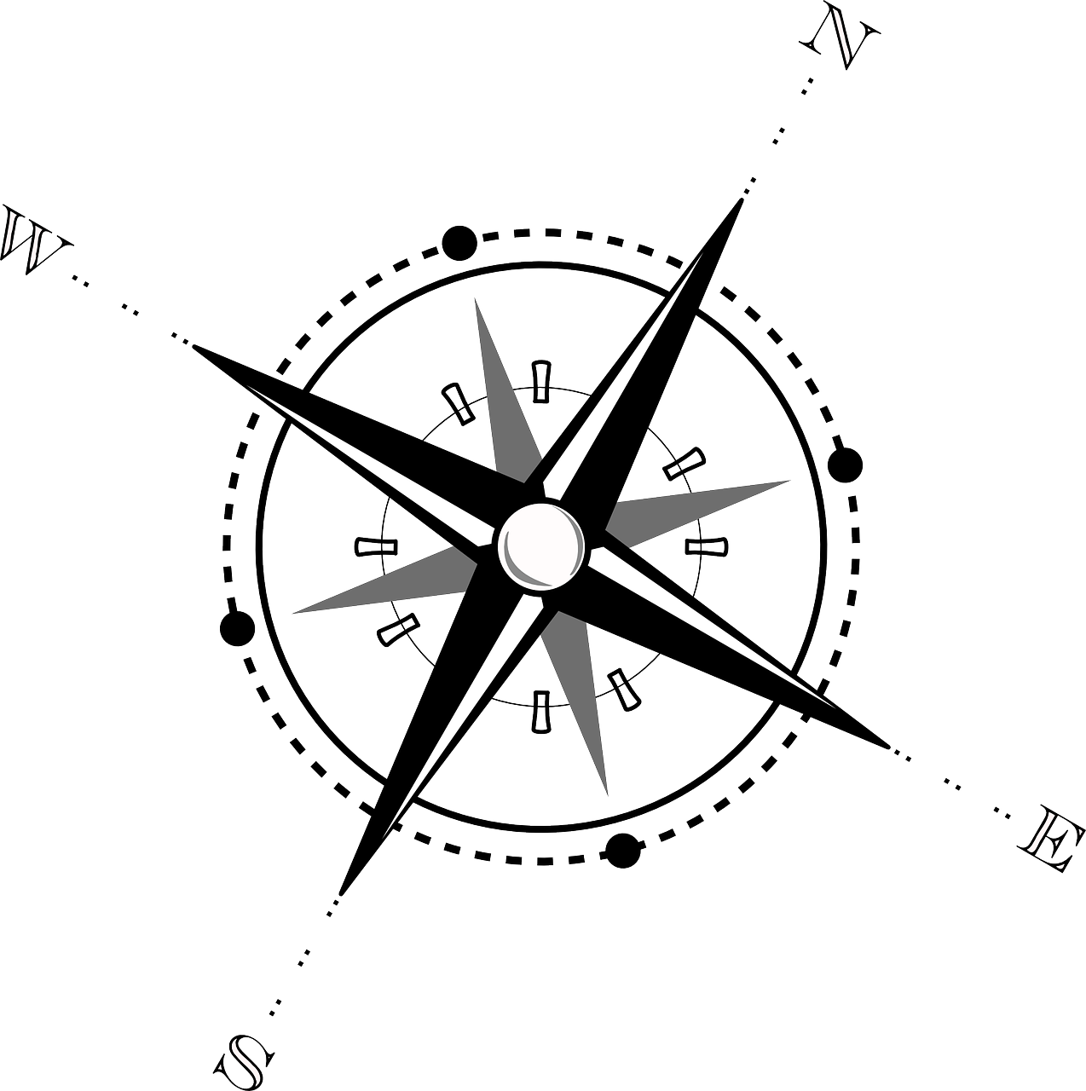
short [o]
long [e]
aussprechen
aussprechen
Osten
gehen
Notes:
8/7
8

Slide 9
pronunciar
Pupil name:
Pupil name:
SSC and word | px
versuchen
trinken
Garten
immer
wenig
Ausflug
gab
Theorie
mögen
Sportler
See
bekannt
Osten
gehen
SSC and word | px
versuchen
trinken
Garten
immer
wenig
Ausflug
gab
Theorie
mögen
Sportler
See
bekannt
Osten
gehen
Notes:
Pupil feedback and assessment sheet
9

Slide 10
Teacher audio version
SSC and word | px
versuchen
trinken
Garten
immer
wenig
Ausflug
gab
SSC and word | px
Theorie
mögen
Sportler
See
bekannt
Osten
gehen
Notes:
Teacher audio version for preparation
10

Slide 11
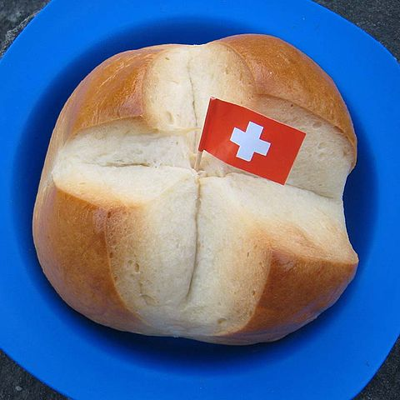
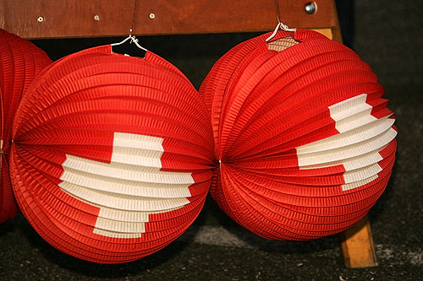
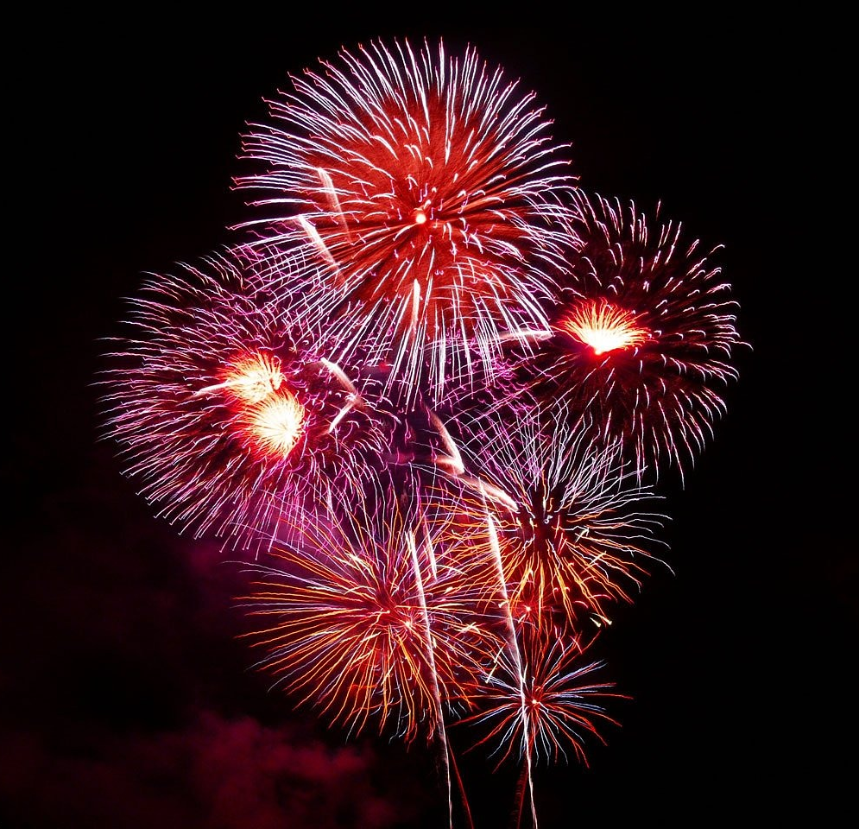
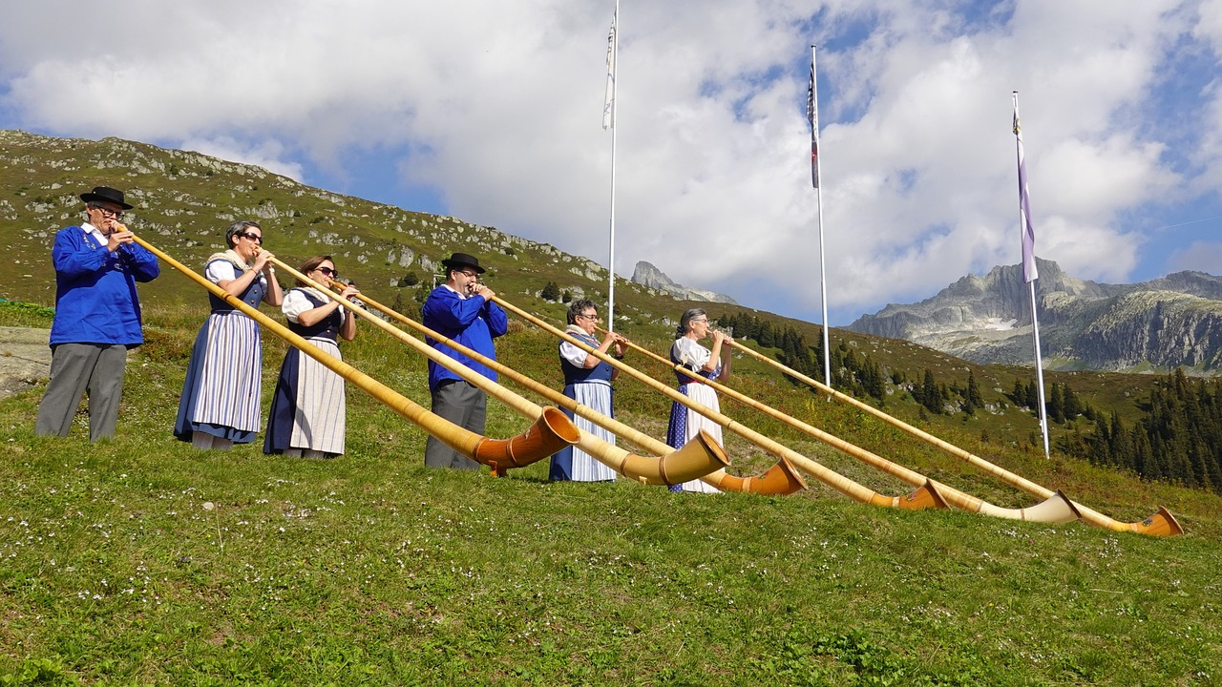
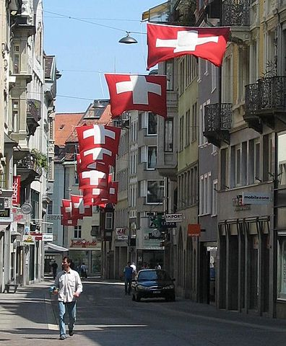
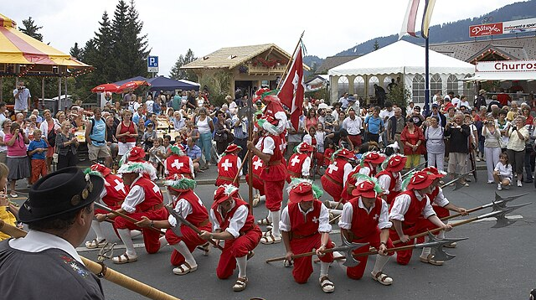
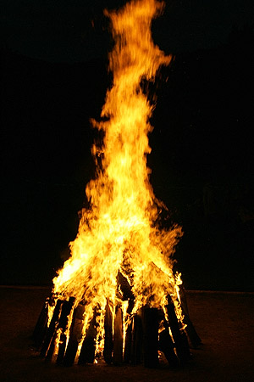
lesen
Nationalfeiertag
*Foto – photo
Ronja (ich) oder Lias (du)?
…habe ein Butterbrot.
…möchte einen Lampion haben.
…mache ein Foto*!
…spielst ein Alphorn.
…hast eine Fahne.
…bin müde. Die Parade ist lang!
…möchtest bleiben – das Höhenfeuer ist wunderbar!
Ich
Du
Notes:
Timing: 5 minutes
Aim: to practise written comprehension of a variety of verbs in the first and second persons.
Procedure:
Pupils read the sentences, and based on the form of the verb they see, decide who is doing the activity. Ronja is speaking, so she will be ich, and Lias will be du. Note, pupils are not expected to remember the vocabulary related to Nationalfeiertag from last week; pictures have been included to aid understanding.
Click to reveal answers.
Image attribution:
Swiss bread: By David Edgar - Own work, CC BY-SA 3.0, https://commons.wikimedia.org/w/index.php?curid=7726516
Lampions: Par Roland Zumbühl (Picswiss), Arlesheim (Commons:Picswiss project) — [1]. If this link does not work (URLs are subject to changes), you can find the picture starting from the canton of the subject: http://www.picswiss.ch/geo.html then the location., CC BY-SA 3.0, https://commons.wikimedia.org/w/index.php?curid=1211596
Höhenfeuer: Par Roland Zumbühl (Picswiss), Arlesheim (Commons:Picswiss project) — [1]. If this link does not work (URLs are subject to changes), you can find the picture starting from the canton of the subject: http://www.picswiss.ch/geo.html then the location., CC BY-SA 3.0, https://commons.wikimedia.org/w/index.php?curid=1211587
Fahnen: Di Schweizerflaggen_St._Gallen.JPG: de:Benutzer:BenjIIderivative work: Ultimate Destiny (talk) - Schweizerflaggen_St._Gallen.JPG, CC BY-SA 3.0, https://commons.wikimedia.org/w/index.php?curid=7443879
Paraden: Von Wouter Hagens - Eigenes Werk, CC BY-SA 3.0, https://commons.wikimedia.org/w/index.php?curid=4539682
11

Slide 12
lesen
Nationalfeiertag
Ronja wants to write about the day in English. She has made a start, but she has got stuck on some words. Can you help her out?
Ronja schreibt
I __________ have a lamp.
möchte
I ______ ____ _______
habe ein
Butterbrot
You _______ an alp horn.
spielst
You _______ a flag.
I ____ ______. Die Parade __ ____!
hast
bin müde
ist lang
You ________________ – das Höhenfeuer ist __________!
möchtest bleiben
Ich
wunderbar
Du
Notes:
Timing: 5 minutes (2 slides)
Aim: to practise written comprehension of a variety of verbs and vocabulary.
Procedure:
Using Ronja’s notes, pupils translate each sentence into English.
Reveal answers on the following slide.
Image attribution:
Swiss bread: By David Edgar - Own work, CC BY-SA 3.0, https://commons.wikimedia.org/w/index.php?curid=7726516
Lampions: Par Roland Zumbühl (Picswiss), Arlesheim (Commons:Picswiss project) — [1]. If this link does not work (URLs are subject to changes), you can find the picture starting from the canton of the subject: http://www.picswiss.ch/geo.html then the location., CC BY-SA 3.0, https://commons.wikimedia.org/w/index.php?curid=1211596
Höhenfeuer: Par Roland Zumbühl (Picswiss), Arlesheim (Commons:Picswiss project) — [1]. If this link does not work (URLs are subject to changes), you can find the picture starting from the canton of the subject: http://www.picswiss.ch/geo.html then the location., CC BY-SA 3.0, https://commons.wikimedia.org/w/index.php?curid=1211587
Fahnen: Di Schweizerflaggen_St._Gallen.JPG: de:Benutzer:BenjIIderivative work: Ultimate Destiny (talk) - Schweizerflaggen_St._Gallen.JPG, CC BY-SA 3.0, https://commons.wikimedia.org/w/index.php?curid=7443879
Paraden: Von Wouter Hagens - Eigenes Werk, CC BY-SA 3.0, https://commons.wikimedia.org/w/index.php?curid=4539682
12

Slide 13
lesen
Nationalfeiertag
Ronja wants to write about the day in English. She has made a start, but she has got stuck on some words. Can you help her out?
Ronja schreibt
I __________ have a lamp.
would like to
I ______ ____ _______
have a
sandwich
You _______ an alp horn.
play
You _______ a flag.
I ____ ______. Die Parade __ ____!
have
am tired
is long
You ________________ – das Höhenfeuer ist __________!
would like to stay
Ich
wonderful
Du
Notes:
[2/2]
13

Slide 14
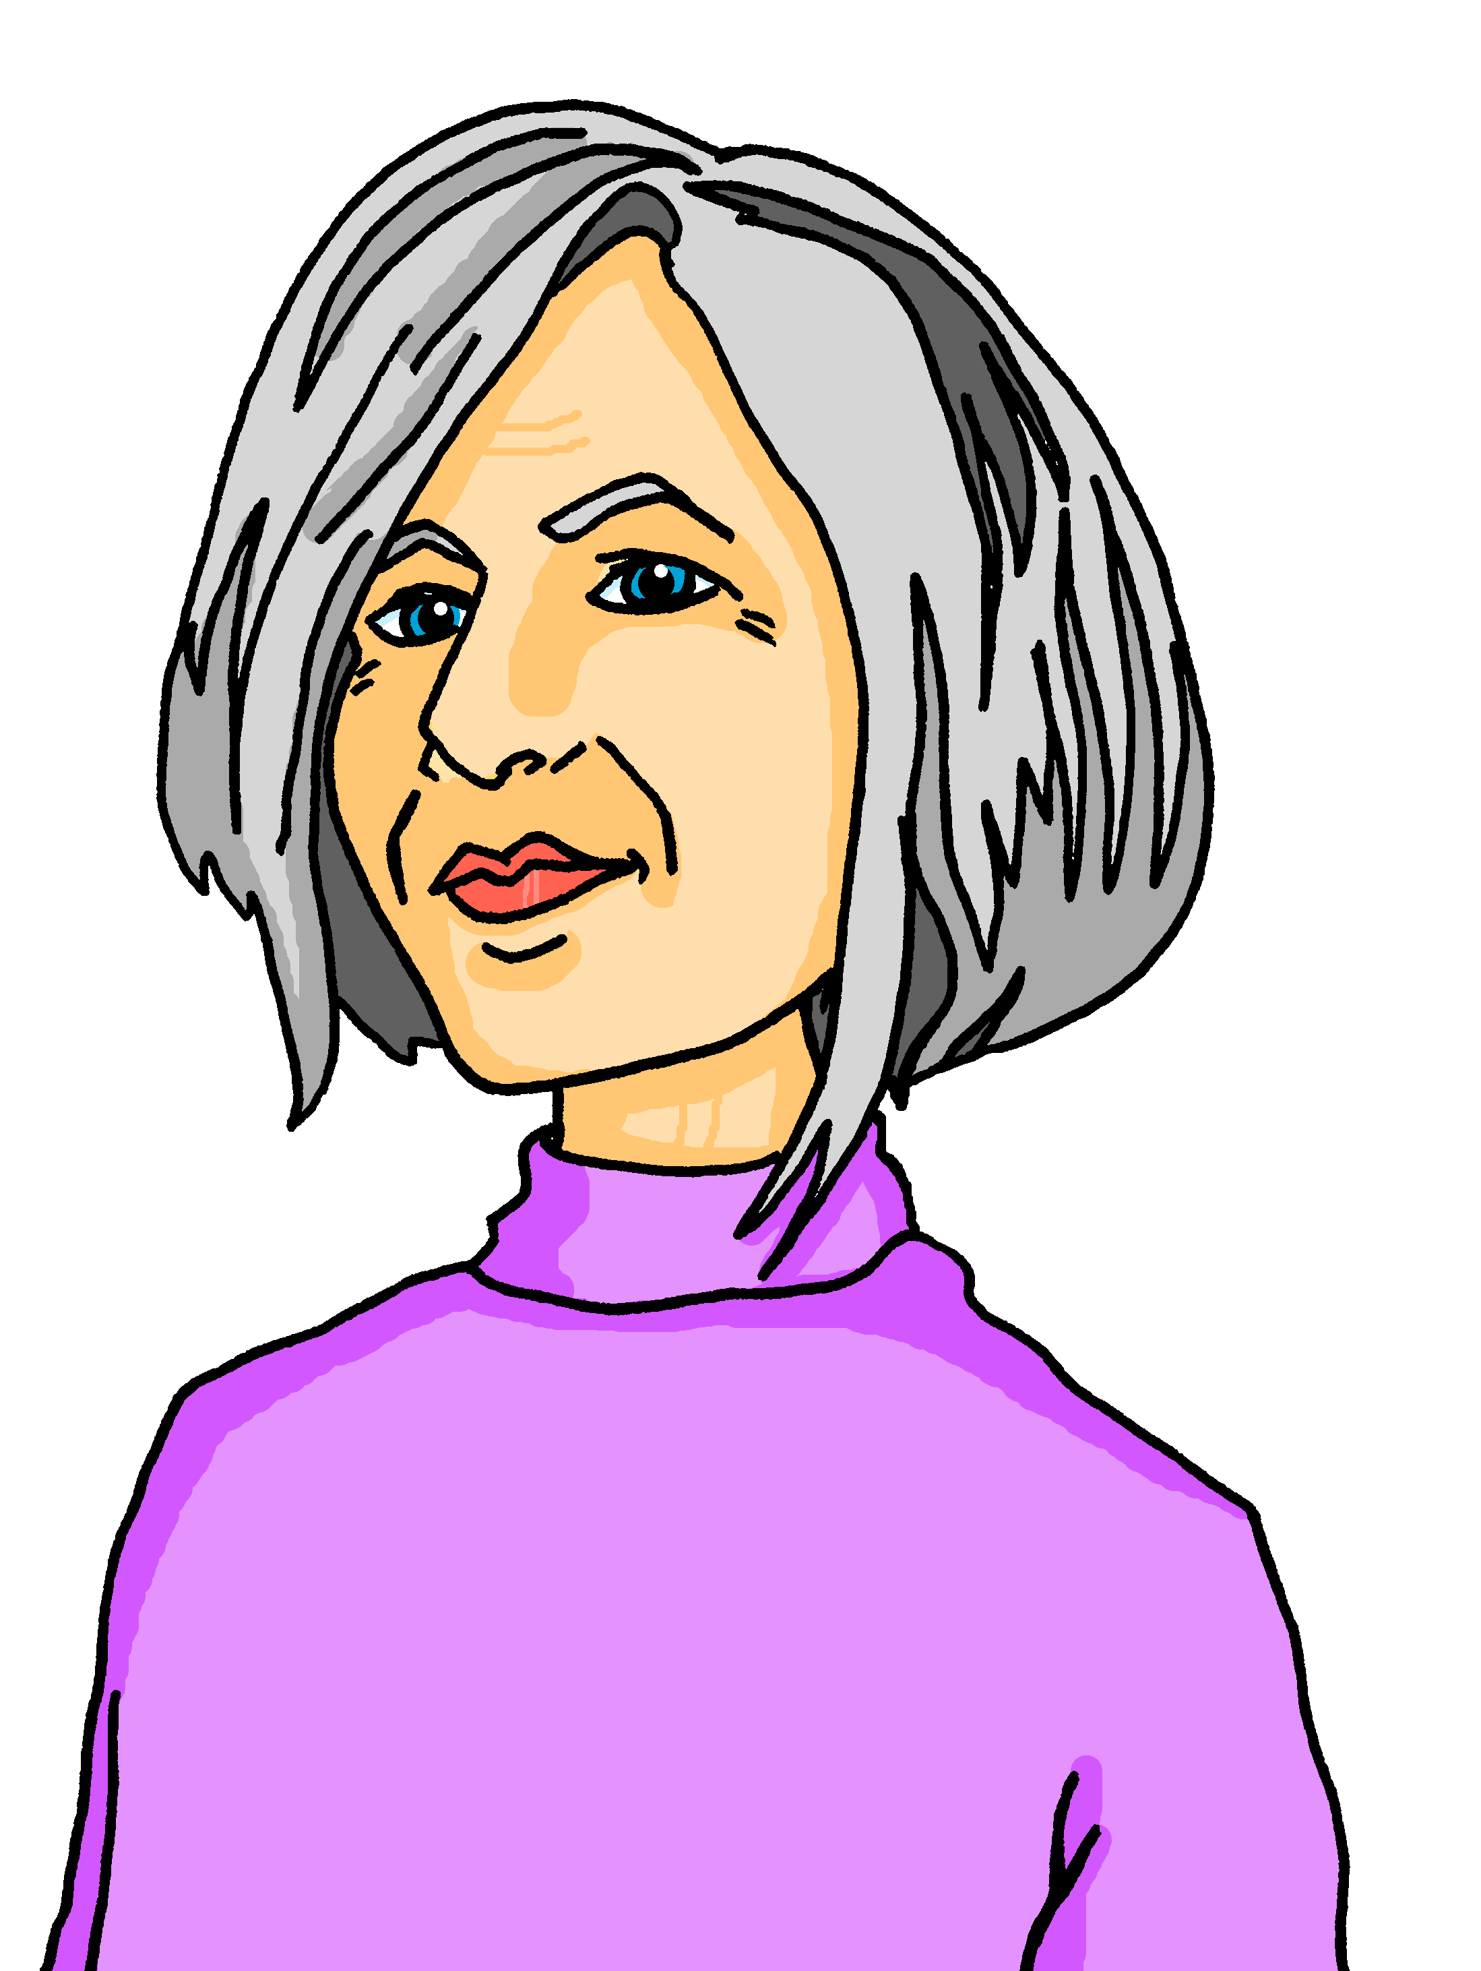
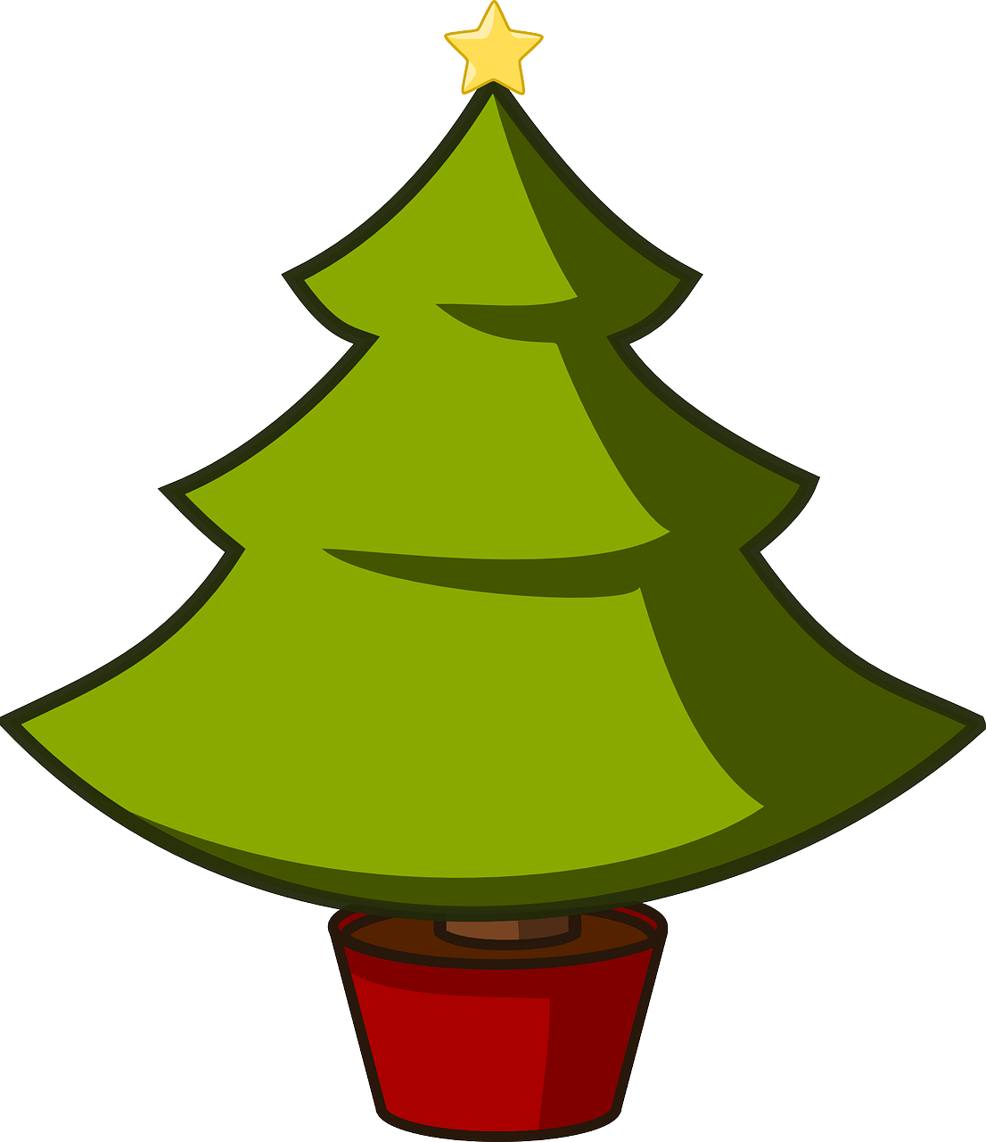
schreiben
Lias Pläne
Lias has made a calendar with his plans.
You can make one too! Write the months in German, draw a picture of your plans, and write any words in German about your plans.
Hast du Pläne?
Ich möchte zu Hause bleiben.
Januar
mit Lias
Oma besucht
Juni
August
Familie
Dezember
Notes:
Timing: 10 minutes (independent)
Aim: to practise written production of the months of the year and some of this year’s vocabulary
Procedure:
Pupils either use the handout or draw a grid of their own. They fill out their calendar with their plans for the year, using Lias’s calendar as inspiration.
14

Slide 15
Tschüss!
gelb
Notes:
15

Slide 16
lesen
Nationalfeiertag
*Foto – photo
Ronja (ich) oder Lias (du)?
…habe ein Butterbrot.
…möchte einen Lampion haben.
…mache ein Foto*!
…spielst ein Alphorn.
…hast eine Fahne.
…bin müde. Die Parade ist lang!
…möchtest bleiben – das Höhenfeuer ist wunderbar!
Ich
Du
Notes:
HANDOUT
16

Slide 17
schreiben
Lias Pläne
Lias has made a calendar with his plans.
You can make one too! Write the months in German, draw a picture of your plans, and write any words in German about your plans.
Hast du Pläne?
Notes:
HANDOUT
17

