Slide 1
Talking about activities and events
gelb
Follow ups 1-5
Term 3 Week 12
Notes:
Artwork by Steve Clarke. Pronoun pictures from NCELP (www.ncelp.org). All additional pictures selected from Pixabay and are available under a Creative Commons license, no attribution required.
Phonics:
[pf] Kopf [279] Pflanze [1667] Apfel [3490]
[kn] Knie [1679] Knochen [1930] knüpfen [4564]
Vocabulary: Revisit vocabulary
Revisit 1: Familie [329] Mutter [218] Opa [2276] Vater [232] ihr1 [27] lieb [897] müde [2000] ruhig [991] sein2 [30]
Revisit 2: arbeiten [234] Grund [249] mit [13]
Jones, R.L & Tschirner, E. (2019). A frequency dictionary of German: Core vocabulary for learners. London: Routledge.
The frequency rankings for words that occur in this PowerPoint which have been previously introduced in these resources are given in the SOW and in the resources that first introduced and formally re-visited those words. For any other words that occur incidentally in this PowerPoint, frequency rankings will be provided in the notes field wherever possible.
Note that the first three lessons of the year teach language that can be continuously recycled as lesson routine every lesson in Y3/4.
The idea would be that the class teacher (whether or not s/he teaches the class German can re-use the language as part of the daily routine with the class.
Picture attribution:
Original cover: Original artist is unknown/uncredited. (Signed "W C 84"), Public domain, via Wikimedia Commons

Slide 2
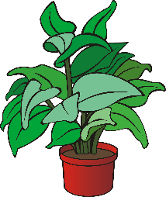
aussprechen
[pf]
…
Kopf
Pflanze
Apfel
Notes:
Timing: 1 minute
Aim: to consolidate the SSC [pf].
Procedure:
Re-present the SSC and the source word ‘Kopf’ (with gesture, if using).
Click to bring on the picture and get pupils to repeat the word ‘Kopf’ (with gesture, if using).
Present the cluster words in the same way, bringing on the picture and getting pupils to pronounce the words.
Frequency: Kopf [250] Pflanze [1667] Apfel [3490]
Jones, R.L & Tschirner, E. (2019). A frequency dictionary of German: Core vocabulary for learners. London: Routledge.

Slide 3
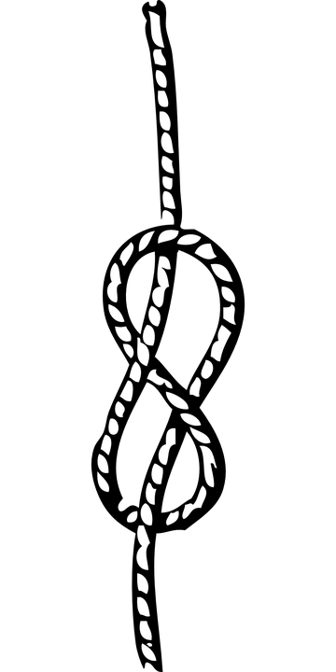
aussprechen
[kn]
…
Knie
Knochen
knüpfen
Notes:
Timing: 1 minute
Aim: to consolidate the SSC [kn].
Procedure:
Re-present the SSC and the source word ‘Knie’ (with gesture, if using).
Click to bring on the picture and get pupils to repeat the word ‘Knie’ (with gesture, if using).
Present the cluster words in the same way, bringing on the picture and getting pupils to pronounce the words.
Frequency: Knie [1679] Knochen [1930] knüpfen [4564]
Jones, R.L & Tschirner, E. (2019). A frequency dictionary of German: Core vocabulary for learners. London: Routledge.

Slide 4
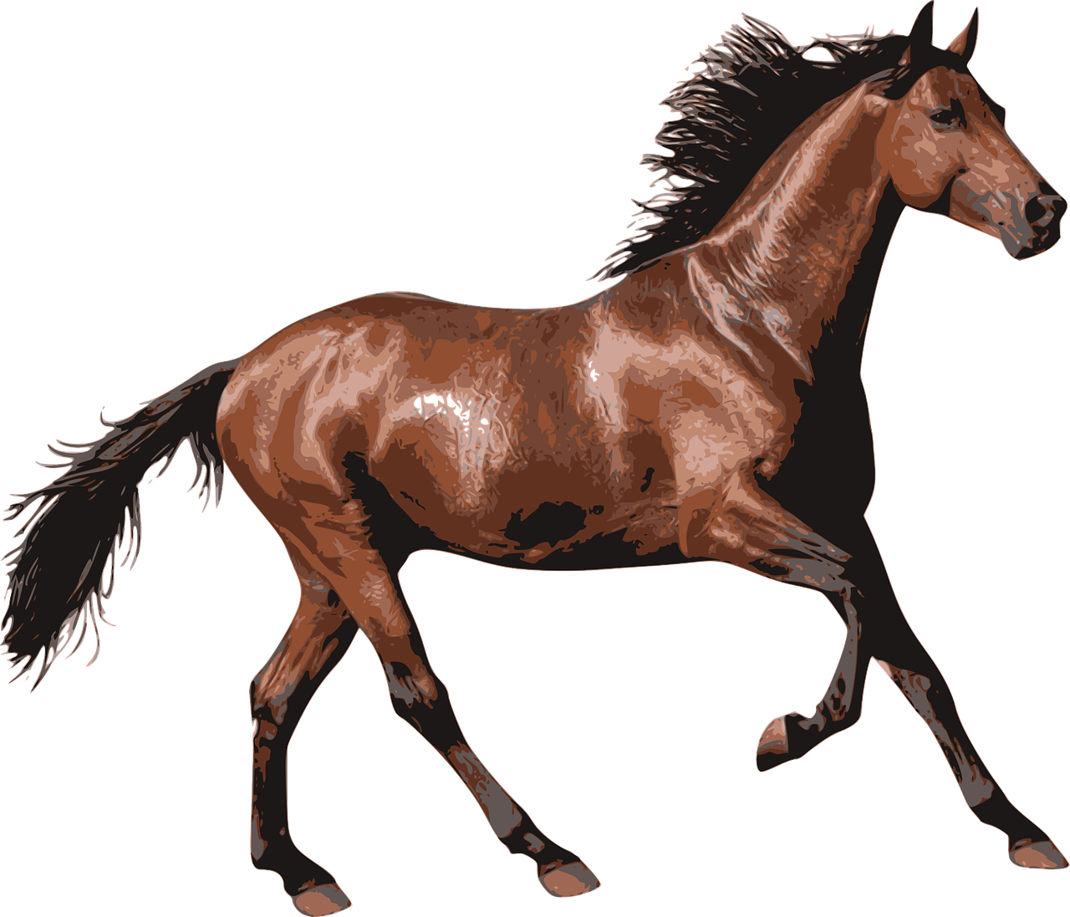
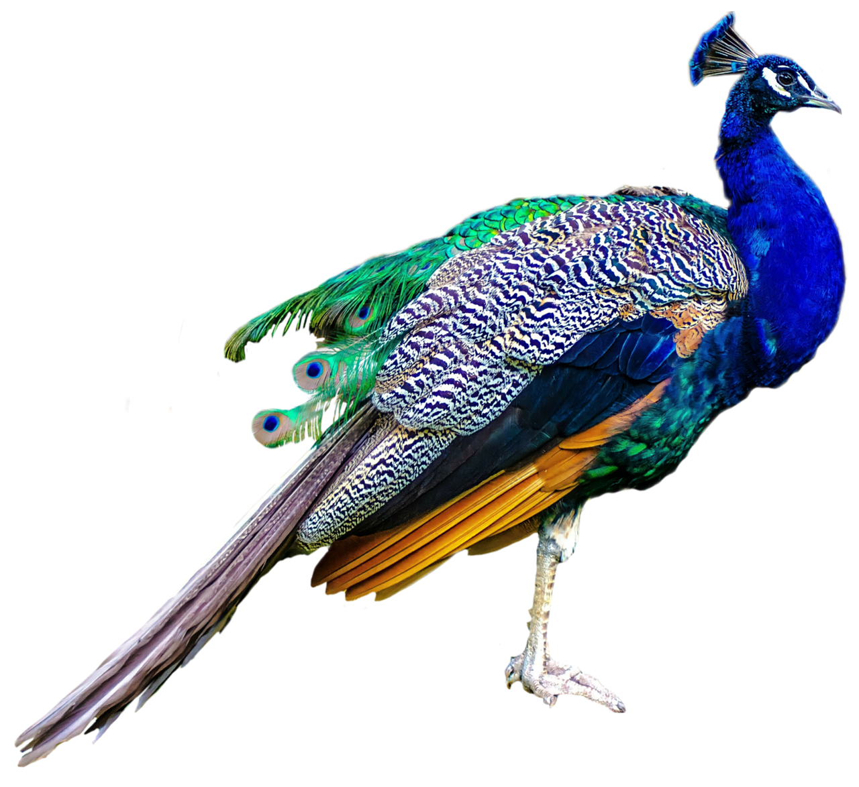
Follow up 1
Hör zu. Was möchte ich machen?
aussprechen
1
Ich möchte die Pfauen und die Pferde pflegen.
I would like to care for the peacocks and the horses.
2
3
Notes:
Timing: 5 minutes (4 slides)
Aim: to practise applying knowledge of [pf] and [kn] to unknown words.
Procedure: 1. Pupils read the sentence and the English translation.
2. Click on the 3 audio buttons to hear the sentence read at increasing speeds.
3. Click to reveal the following slide. Teacher clicks on the 30 second timer, and pupils try to say the sentence before the timer runs out. Repeat for the 20 second and 15 second timers.
4. Repeat steps 1-3 for the next two slides.
Frequency: Knecht [>5000] Knurren [>5000] hören [146] Pfau [>5000] Pferd [1504] pflegen [1842]
Jones, R.L & Tschirner, E. (2019). A frequency dictionary of German: Core vocabulary for learners. London: Routledge.

Slide 5
Follow up 1
Sag den Satz.
aussprechen
How quickly can you say the sentence?
Ich möchte die Pfauen und die Pferde pflegen.
30
S
20
15
S
S
0
0
0
START
START
START
Notes:
[2/4]

Slide 6
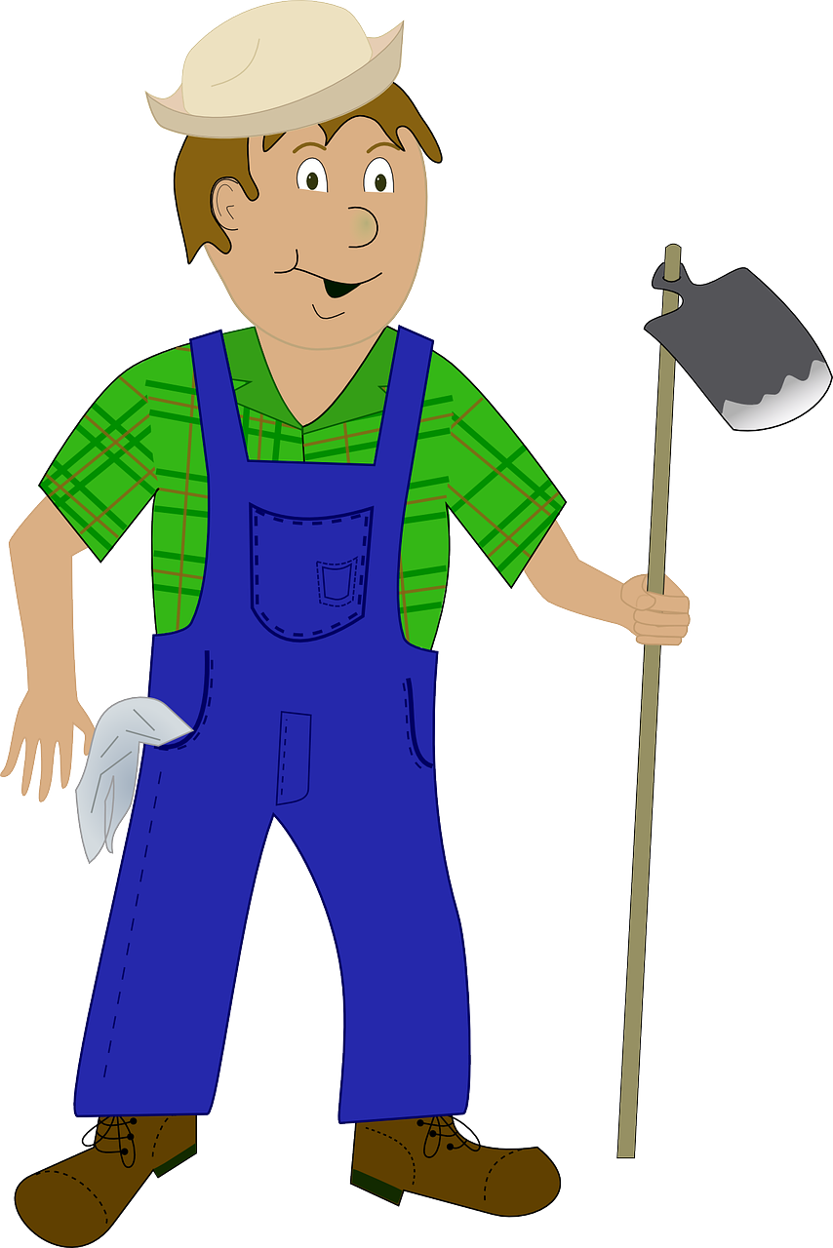
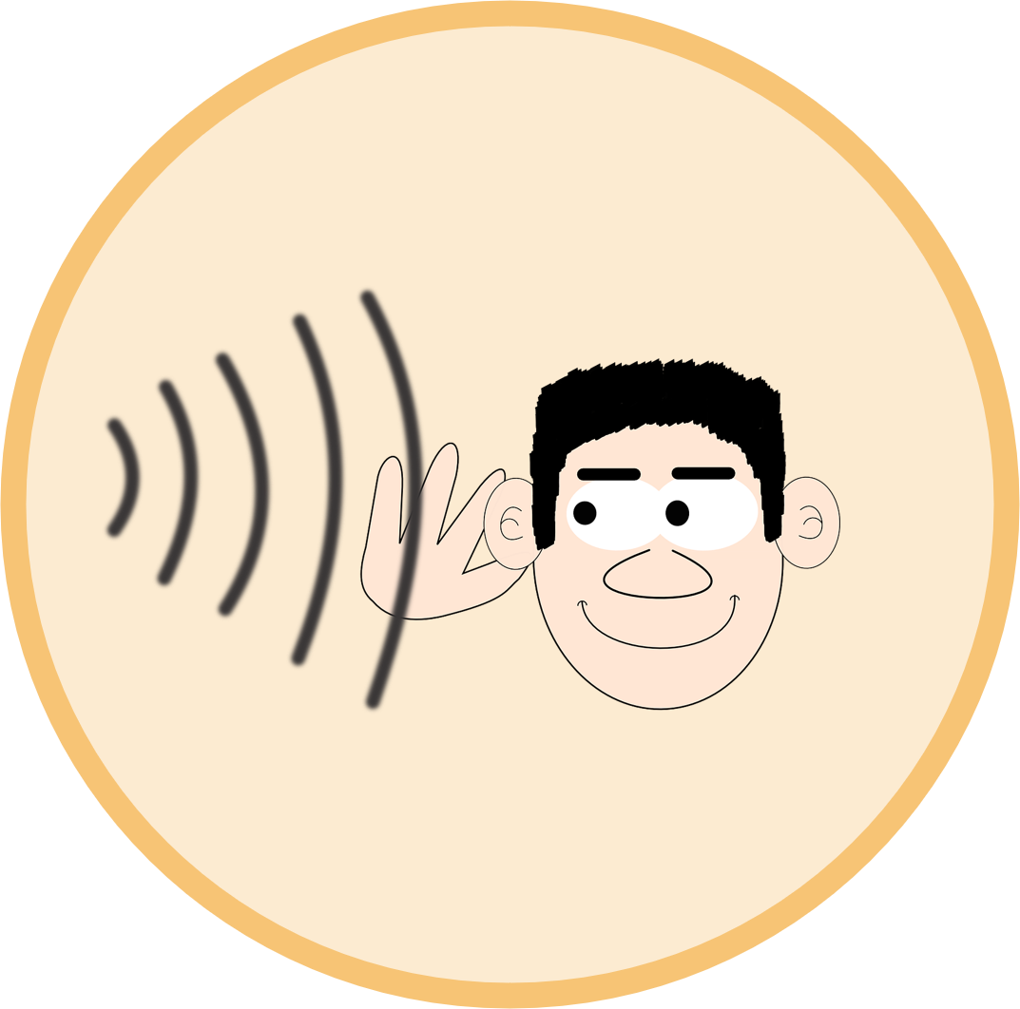
Follow up 1
Hör zu. Was möchte der Knecht machen?
aussprechen
1
Der Knecht möchte kein Knurren hören.
The farm worker wouldn’t like to hear growling.
2
3
Notes:
[3/4]

Slide 7
Follow up 1
Sag den Satz.
aussprechen
How quickly can you say the sentence?
Der Knecht möchte kein Knurren hören.
30
S
20
15
S
S
0
0
0
START
START
START
Notes:
[4/4]

Slide 8
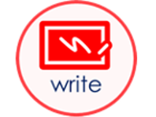
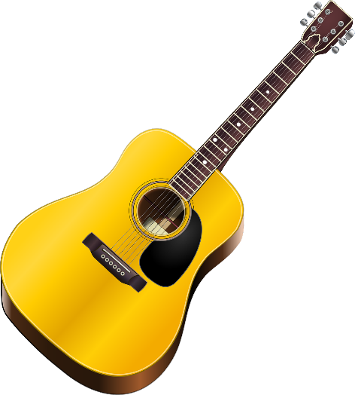
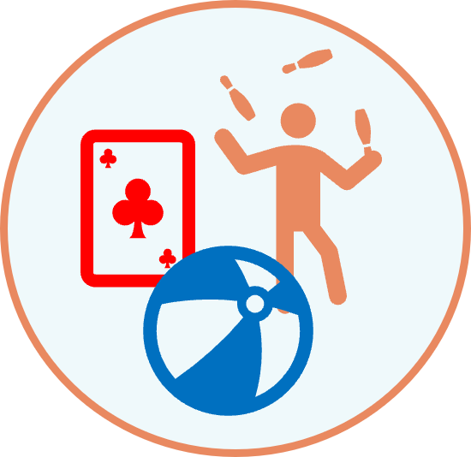
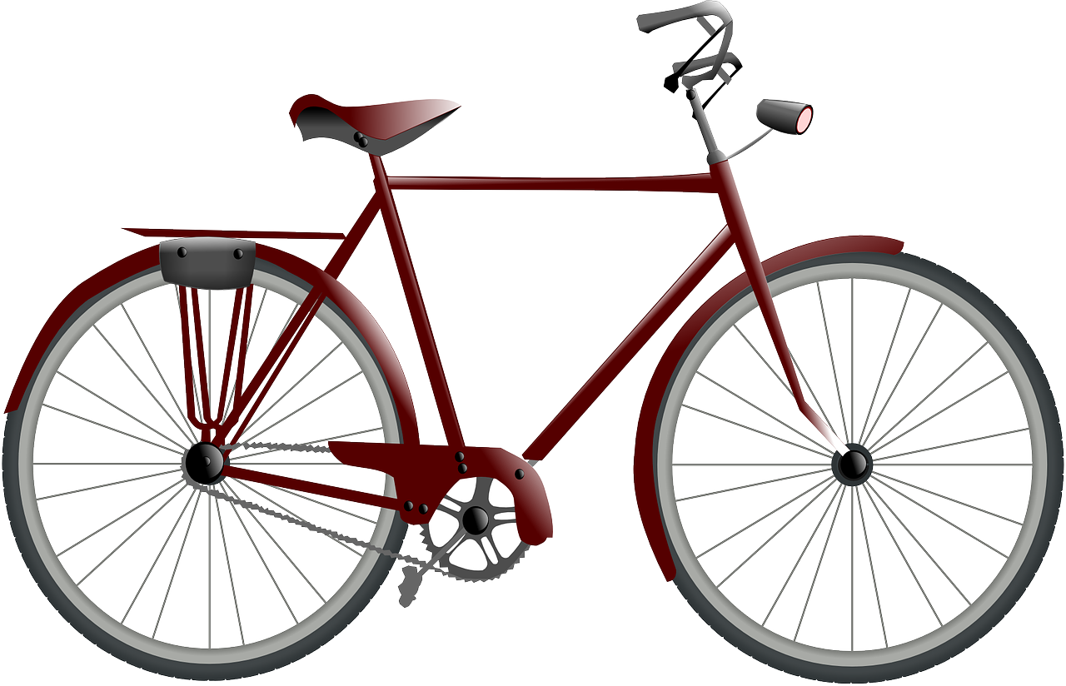
Möcht-
How is the word order different from English?
To say wouldn’t like to with nouns and möcht-, put the noun before the infinitive verb:
Er möchte keinen Grund schreiben.
He wouldn’t like to write a reason.
Du möchtest keine Gitarre spielen.
You wouldn’t like to play guitar.
Ich möchte kein Fahrrad bekommen.
I wouldn’t like to receive a bicycle.
Notes:
Timing: 3 minutes
Procedure:
Click through the animations to present the information.
Elicit English translation for the German examples provided.
8

Slide 9
Follow up 2
Would oder wouldn’t?
der Freund – friend
sehen – to see
Opa is saying what he thinks Heidi would and wouldn’t like to do.
hören
 | Du möchtest keine Geschichte schreiben. | You would|wouldn’t like to write a story.
 | Du möchtest ein Spiel spielen. | You would|wouldn’t like to play a game.
 | Du möchtest keine Schule besuchen. | You would|wouldn’t like to attend school.
 | Du möchtest kein Papier benutzen. | You would|wouldn’t like to use paper.
 | Du möchtest einen Freund* haben. | You would|wouldn’t like to have a friend.
 | Du möchtest einen Baum sehen* | You would|wouldn’t like to see a tree.
1
2
3
4
5
6
Notes:
Timing: 5 minutes
Aim: To focus on the difference in meaning between ‘einen/eine/ein’ and ‘keinen/keine/kein’ within two-verb sentences with möchtest.
Note: The English translations are provided to allow pupils to focus solely on the difference in form and meaning between ‘ein/kein’ and the equivalent structure in English, which is very different. Pupils have already been taught ‘nicht’ with verbs and ‘kein’ with nouns and practised differentiating between them. However, this is a point of significant cross-linguistic difficulty, and is therefore being revisited here, with different lexis and a different sentence structure.
Procedure:
Pupils should write 1-6 in their books and record ‘would’ or ‘wouldn’t’ for each.
Answers are revealed on separate mouse clicks.
In the audio version, click on the blue buttons to hear a native speaker.

Slide 10
Follow up 3

Remember! If you say ‘can’t’ with a verb only, use ‘nicht’. If your sentence has a noun, use ‘kein’.
Schreib ‘nicht’ oder ‘kein’.
schreiben
Heidi is miserable in Frankfurt. The housekeeper, Frau Rottenmeier, is strict, and calls Heidi “Adelheid”. Heidi has to take lessons and rarely gets to leave the house. She misses home!
Ich möchte eine Aufgabe machen.
Ich möchte mit Frau Rottenmeier arbeiten.
Ich möchte keine Aufgabe machen.
Ich möchte nicht mit Frau Rottenmeier arbeiten.
Ich möchte nicht zu Hause bleiben.
Ich möchte zu Hause bleiben.
Ich möchte Adelheid heißen.
Ich möchte nicht Adelheid heißen.
Ich möchte keinen Text schreiben.
Ich möchte einen Text schreiben.
Notes:
Timing: 5 minutes
Aim: to contrast ‘wouldn’t like’ sentences with verbs only and those with noun verb phrases.
Procedure:
Pupils read the story segment and the speech bubbles.
They change the positive sentences into negatives, using the callout at the top of the slide to help them.
Click to reveal answers.

Slide 11
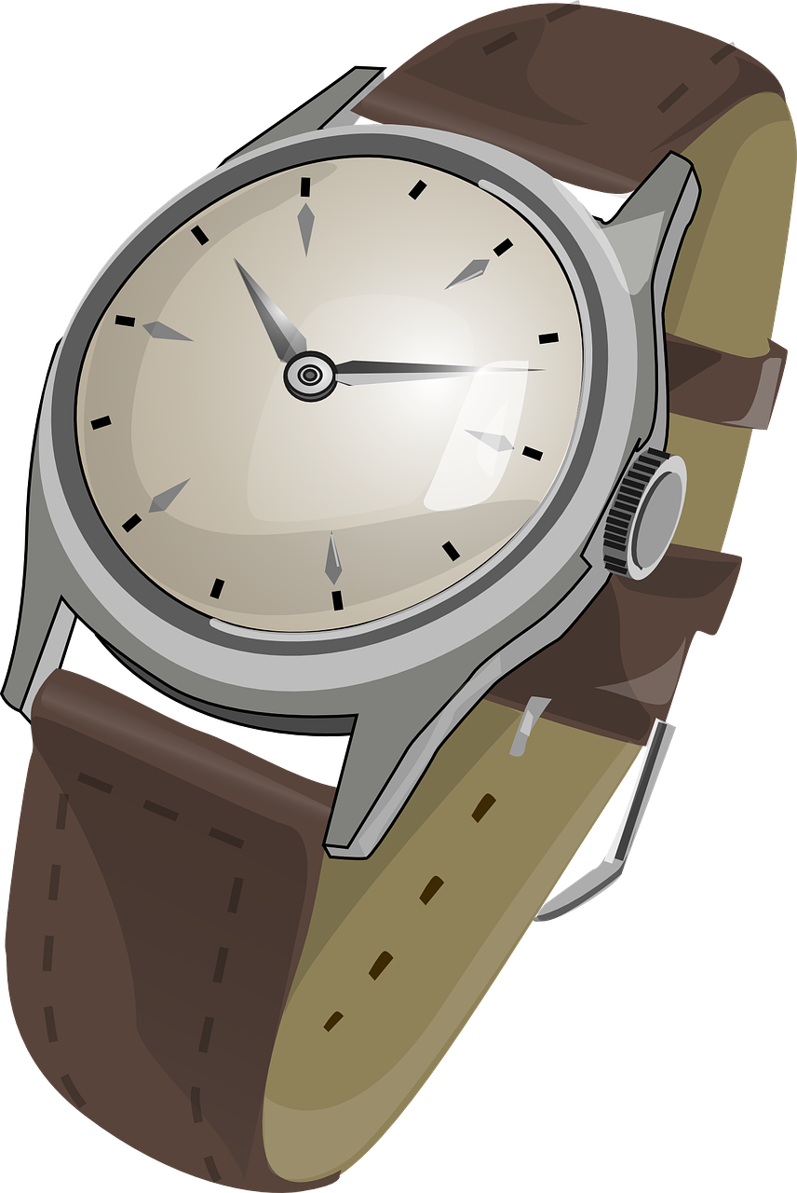
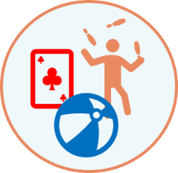
Follow up 4
Ich möchte nicht/ kein…
sprechen
Was möchtest du nicht machen?
Ich möchte nicht bleiben.
Ich möchte nicht bleiben. Ich möchte keinen Brief bekommen.
Ich möchte nicht bleiben. Ich möchte keinen Brief bekommen. Ich möchte keine Aufgabe haben.
to visit
Notes:
Timing: 5 minutes
Aim: to practise using ‘ich möchte nicht/ kein’.
Procedure:
Explain that pupils are going to play a memory game.
Model how this will work by clicking through the example.
Pupils work in pairs. Pupil A chooses one of the 9 options on the slide at random. If they have chosen just a verb, they will say ‘ich möchte nicht…’. If they have chosen a verb with a noun, they will say ‘ich möchte kein…’. Pupil B then repeats what pupil A has said and then adds a second option. Pupils continue adding sentences until they have used all 9 options.

Slide 12
Follow up 5:

Schreib auf Englisch.
Can you get at least 15 points?
Wörter
 | der Grund | arbeiten | mit
 | besuchen | bleiben | machen
 | der Vater | lieb | sein
 | ihr | der Opa | müde
 | die Familie | ruhig | die Mutter
 | er möchte | du möchtest | die Oma
 | fahren | möcht- | ich möchte
(the) reason
to work, working
with
Vokabeln
x3
to remain, stay, remaining, staying
to do, make, doing, making
to visit, visiting
(the) father
kind, dear
his
x2
her
(the) granddad
tired
(the) family
quiet, calm
(the) mother
he would like
you would like
(the) grandma
x1
to go (transport)
would like
I would like
Notes:
Timing: 5 minutes
Aim: to practise written comprehension of vocabulary from this and revisited weeks.
Procedure: 1. Give pupils a blank grid. They fill in the English meanings of any of the words they know, trying to reach 15 points in total. 2. Remind pupils that adjectives can refer to male or female persons and they should note this in their translations. E.g. pleased (f), short (m).
Note: The most recently learnt and practised words are pink, words from the previous week are green and those from week 1 are blue, thus more points are awarded for them, to recognise that memories fade and more effort (heavy lifting!) is needed to retrieve them.

Slide 13
Follow up 5:

Schreib auf Deutsch.
Can you get at least 15 points?
Wörter
 | to remain, stay, remaining, staying | to visit, visiting | (the) reason
 | to do, make, doing, making | with | to work, working
 | (the) granddad | (the) family | kind, dear
 | tired | (the) mother | quiet, calm
 | (the) father | her | his
 | would like | to go (transport) | he would like
 | I would like | (the) grandma | you would like
bleiben
besuchen
der Grund
Vokabeln
x3
machen
mit
arbeiten
der Opa
die Familie
lieb
x2
müde
die Mutter
ruhig
der Vater
ihr
sein
möcht-
fahren
er möchte
x1
ich möchte
die Oma
du möchtest
Notes:
Timing: 5 minutes
Aim: to practise written production of vocabulary from this and revisited weeks.
Procedure: 1. Give pupils a blank grid. They fill in the German meanings of any of the words they know, trying to reach 15 points in total. 2. Remind pupils that adjectives can refer to male or female persons and they should note this in their translations. E.g. pleased (f), short (m).
Note: The most recently learnt and practised words are pink, words from the previous week are green and those from week 1 are blue, thus more points are awarded for them, to recognise that memories fade and more effort (heavy lifting!) is needed to retrieve them.

Slide 14
Tschüss!
gelb
Notes:
14

Slide 15
Follow up 5:

Schreib auf Englisch.
Can you get at least 15 points?
Wörter
 | der Grund | arbeiten | mit
 | besuchen | bleiben | machen
 | der Vater | lieb | sein
 | ihr | der Opa | müde
 | die Familie | ruhig | die Mutter
 | er möchte | du möchtest | die Oma
 | fahren | möcht- | ich möchte
Vokabeln
x3
x2
x1
Notes:
HANDOUT

Slide 16
Follow up 5:

Schreib auf Deutsch.
Can you get at least 15 points?
Wörter
 | to remain, stay, remaining, staying | to visit, visiting | (the) reason
 | to do, make, doing, making | with | to work, working
 | (the) granddad | (the) family | kind, dear
 | tired | (the) mother | quiet, calm
 | (the) father | her | his
 | would like | to go (transport) | she would like
 | I would like | (the) grandma | you would like
Vokabeln
x3
x2
x1
Notes:
HANDOUT

