Slide 1
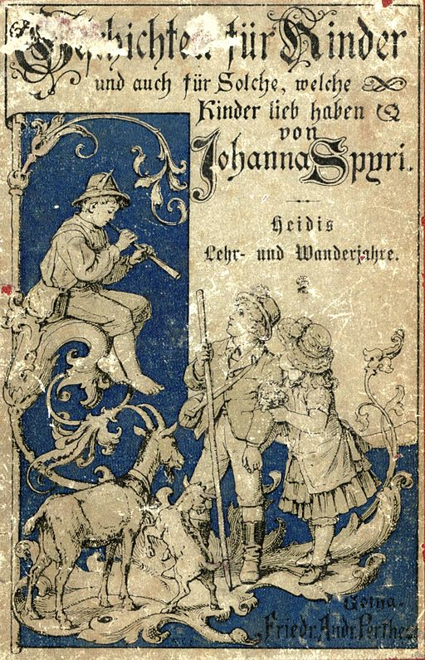
Talking about activities and events
gelb
möcht-
SSC [pf] [kn]
Term 3 Week 12
Notes:
Artwork by Steve Clarke. Pronoun pictures from NCELP (www.ncelp.org). All additional pictures selected from Pixabay and are available under a Creative Commons license, no attribution required.
Phonics:
[pf] Kopf [279] Pflanze [1667] Apfel [3490]
[kn] Knie [1679] Knochen [1930] knüpfen [4564]
Vocabulary: Revisit vocabulary
Revisit 1: Familie [329] Mutter [218] Opa [2276] Vater [232] ihr1 [27] lieb [897] müde [2000] ruhig [991] sein2 [30]
Revisit 2: arbeiten [234] Grund [249] mit [13]
Jones, R.L & Tschirner, E. (2019). A frequency dictionary of German: Core vocabulary for learners. London: Routledge.
The frequency rankings for words that occur in this PowerPoint which have been previously introduced in these resources are given in the SOW and in the resources that first introduced and formally re-visited those words. For any other words that occur incidentally in this PowerPoint, frequency rankings will be provided in the notes field wherever possible.
Note that the first three lessons of the year teach language that can be continuously recycled as lesson routine every lesson in Y3/4.
The idea would be that the class teacher (whether or not s/he teaches the class German can re-use the language as part of the daily routine with the class.
Picture attribution:
Original cover: Original artist is unknown/uncredited. (Signed "W C 84"), Public domain, via Wikimedia Commons
1

Slide 2
aussprechen
[pf]
…
Kopf
Notes:
Timing: 1 minute
Aim: to introduce the SSC [pf].
Procedure:
1. Present the letter and say the [pf] sound first, on its own. Pupils repeat it with you. 2. Bring up the word ”Kopf” on its own, say it, pupils repeat it, so that they have the opportunity to focus all of their attention on the connection between the written word and its sound.
3. Click to bring up the picture and introduce the gesture, if using. Pupils repeat the word again.
4. Roll back the animations and work through 1-3 again, but this time, dropping your voice completely to listen carefully to the students saying the [pf] sound, pronouncing ”Kopf” and, if using, doing the gesture.
Note: A possible gesture for this would be to use the British Sign Language (BSL) sign for head, as here: https://www.signbsl.com/sign/head
Frequency: Kopf [250]
Jones, R.L & Tschirner, E. (2019). A frequency dictionary of German: Core vocabulary for learners. London: Routledge.
2

Slide 3
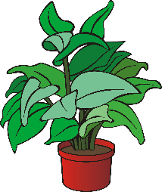
aussprechen
[pf]
…
Kopf
Pflanze
Apfel
Notes:
Timing: 1 minute
Aim: to consolidate the SSC [pf].
Procedure:
Re-present the SSC and the source word ‘Kopf’ (with gesture, if using).
Click to bring on the picture and get pupils to repeat the word ‘Kopf’ (with gesture, if using).
Present the cluster words in the same way, bringing on the picture and getting pupils to pronounce the words.
Frequency: Kopf [250] Pflanze [1667] Apfel [3490]
Jones, R.L & Tschirner, E. (2019). A frequency dictionary of German: Core vocabulary for learners. London: Routledge.

Slide 4
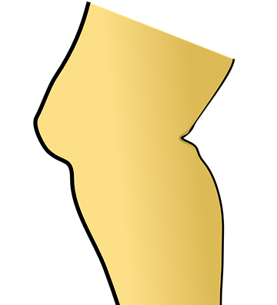
aussprechen
[kn]
In English the k in words starting with kn (e.g. knee, knot) is silent.
In German the k is pronounced, → K-nie.
…
Knie
Notes:
Timing: 1 minute
Aim: to introduce the SSC [kn].
Procedure:
1. Present the letter and say the [kn] sound first, on its own. Pupils repeat it with you. 2. Bring up the word ”Knie” on its own, say it, pupils repeat it, so that they have the opportunity to focus all of their attention on the connection between the written word and its sound.
3. Click to bring up the picture and introduce the gesture, if using. Pupils repeat the word again.
4. Roll back the animations and work through 1-3 again, but this time, dropping your voice completely to listen carefully to the students saying the [kn] sound, pronouncing ”Knie” and, if using, doing the gesture.
Note: A possible gesture for this would be to point to your knee.
Frequency: Kopf [1679]
Jones, R.L & Tschirner, E. (2019). A frequency dictionary of German: Core vocabulary for learners. London: Routledge.
4

Slide 5
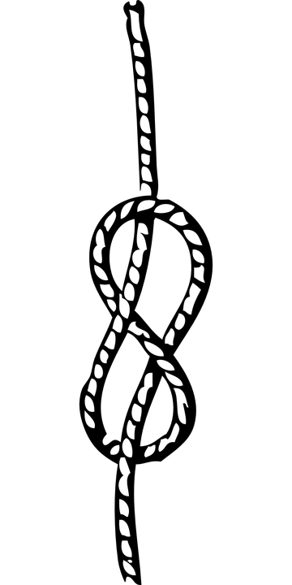
aussprechen
[kn]
…
Knie
Knochen
knüpfen
Notes:
Timing: 1 minute
Aim: to consolidate the SSC [kn].
Procedure:
Re-present the SSC and the source word ‘Knie’ (with gesture, if using).
Click to bring on the picture and get pupils to repeat the word ‘Knie’ (with gesture, if using).
Present the cluster words in the same way, bringing on the picture and getting pupils to pronounce the words.
Frequency: Knie [1679] Knochen [1930] knüpfen [4564]
Jones, R.L & Tschirner, E. (2019). A frequency dictionary of German: Core vocabulary for learners. London: Routledge.

Slide 6
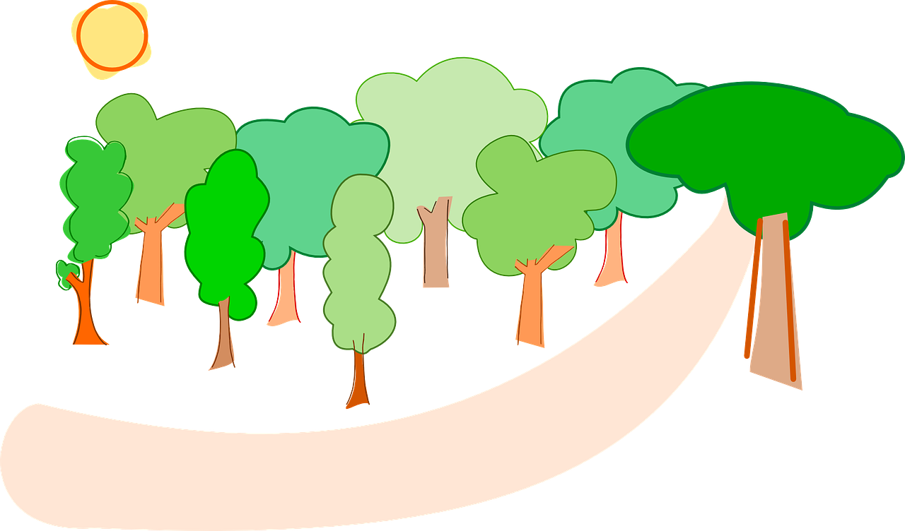
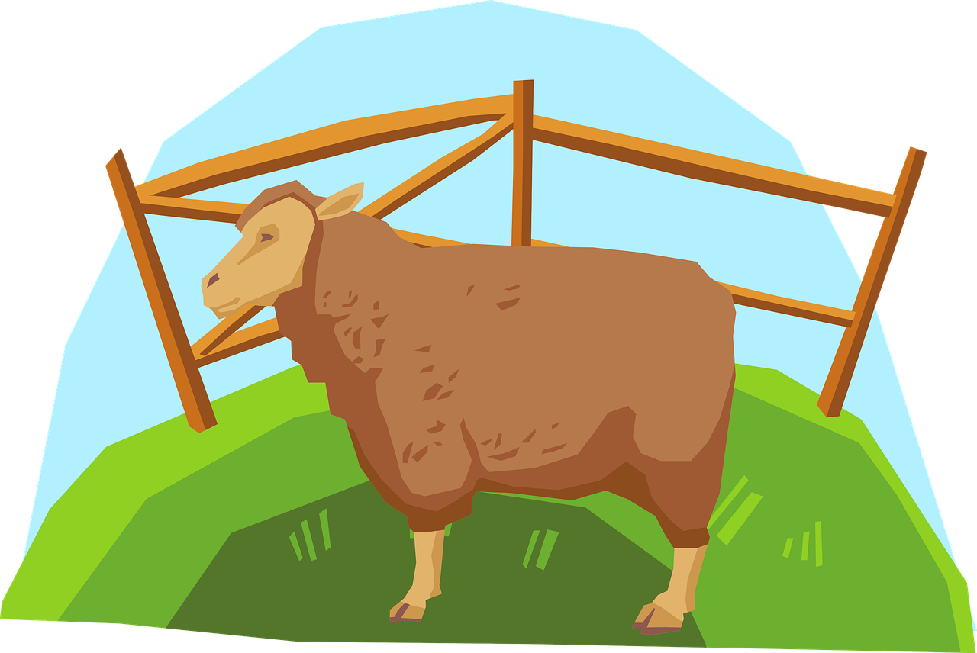
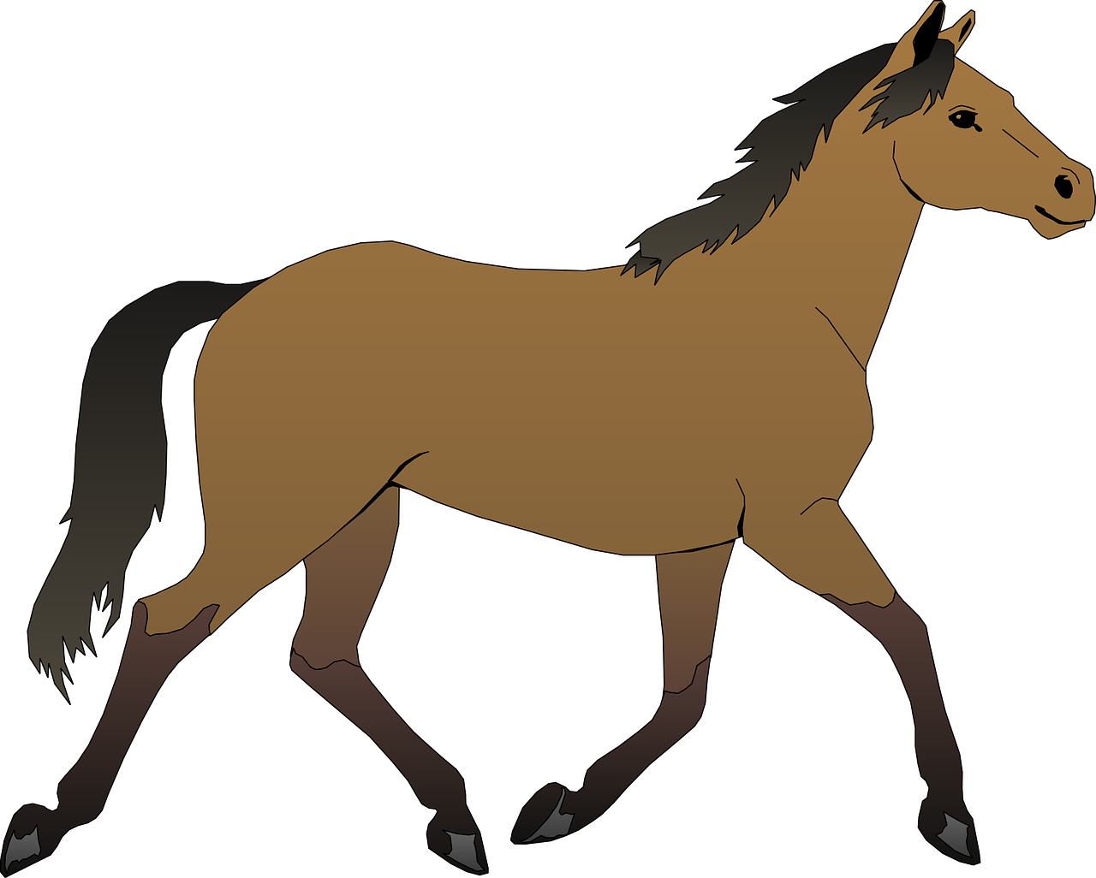
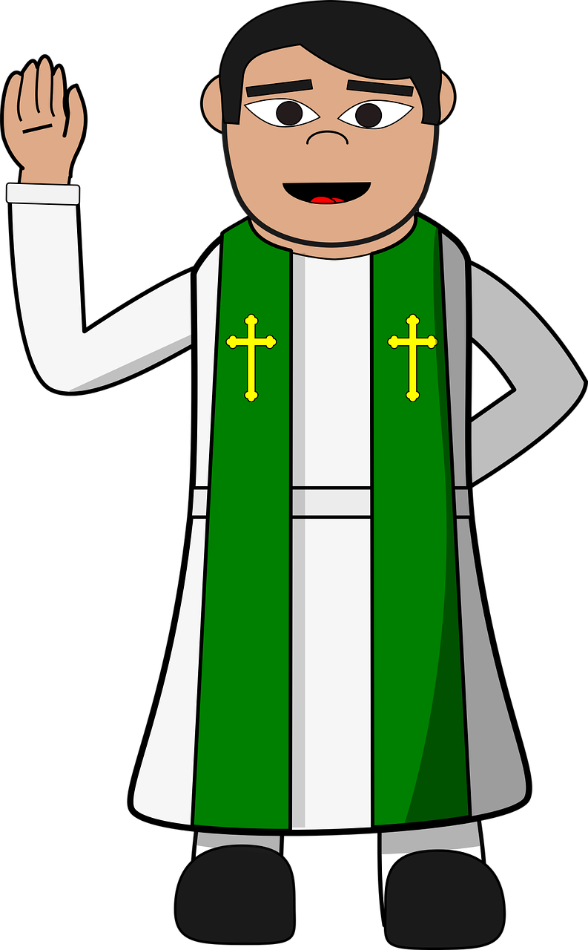
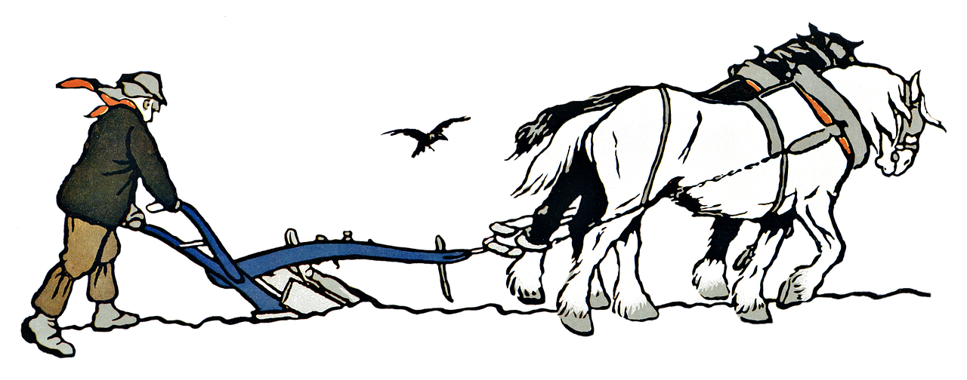
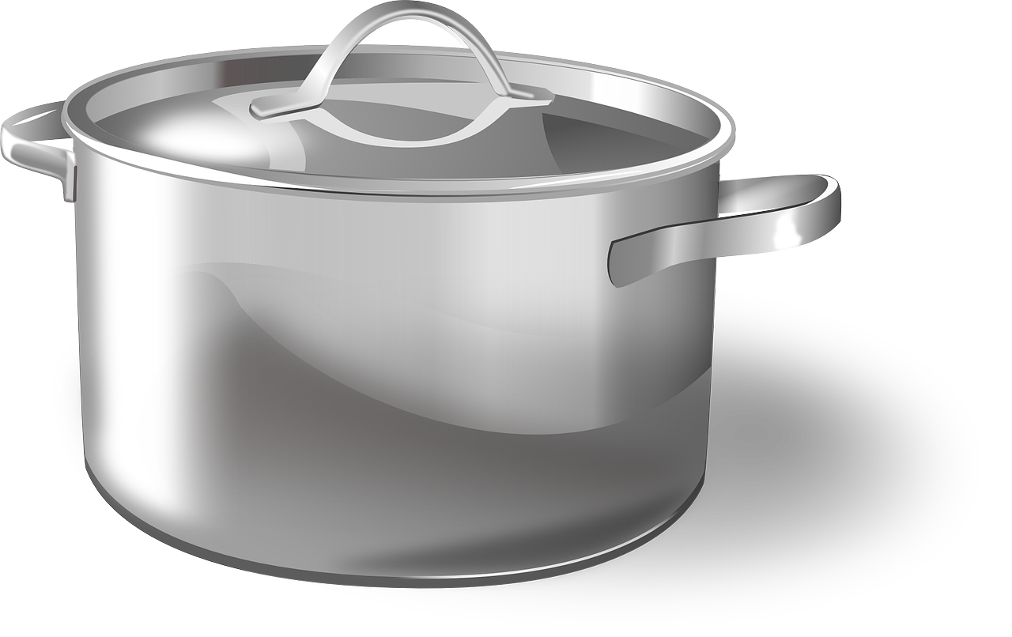
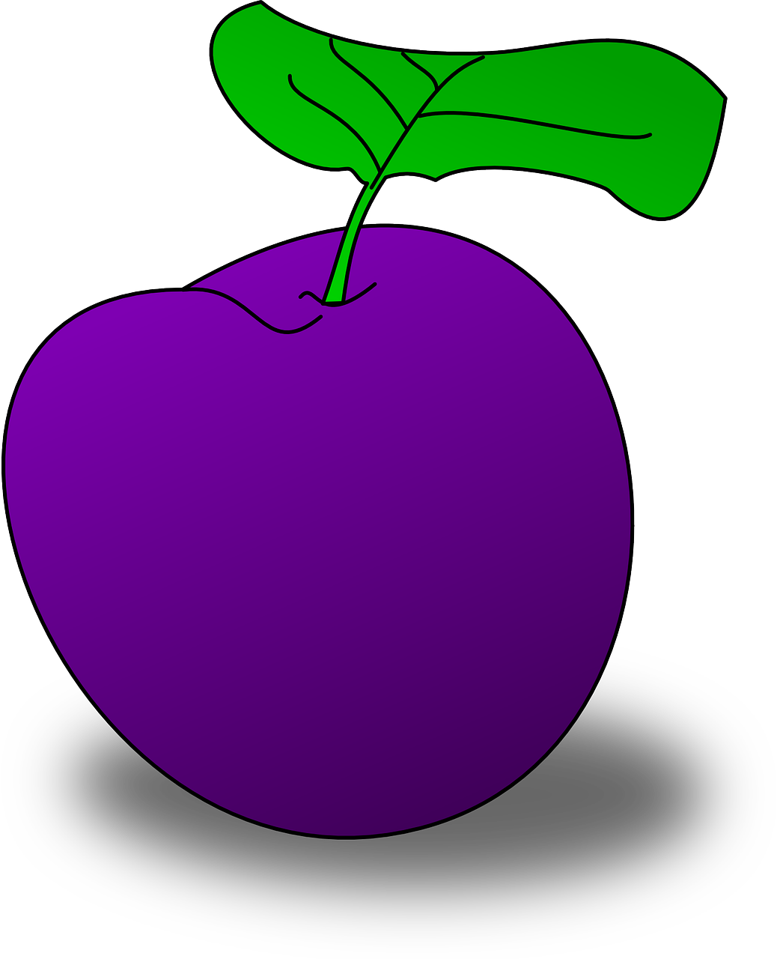
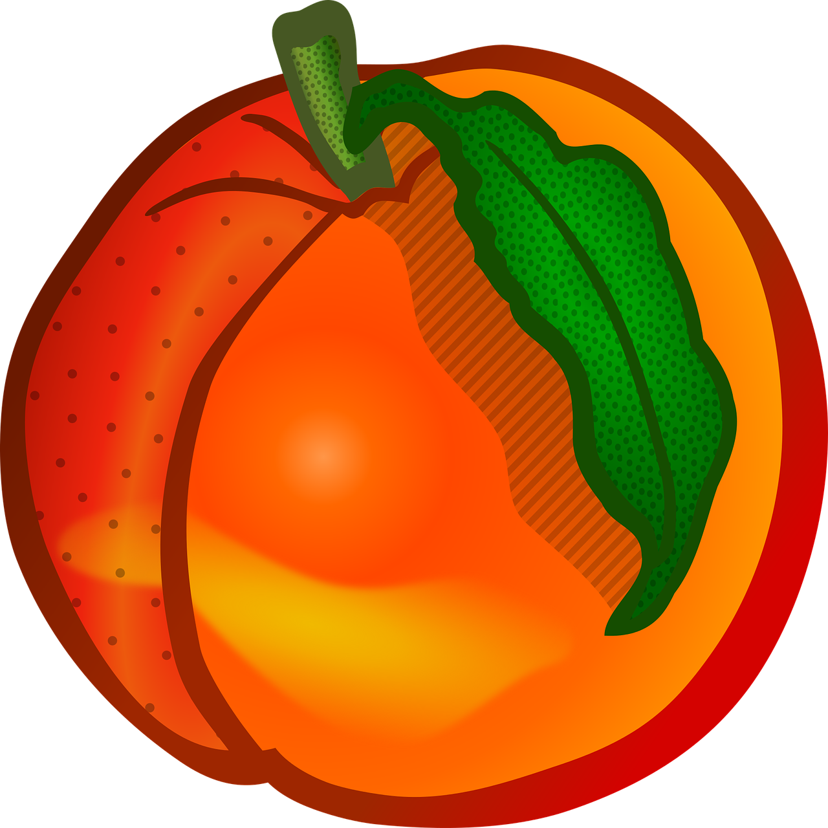
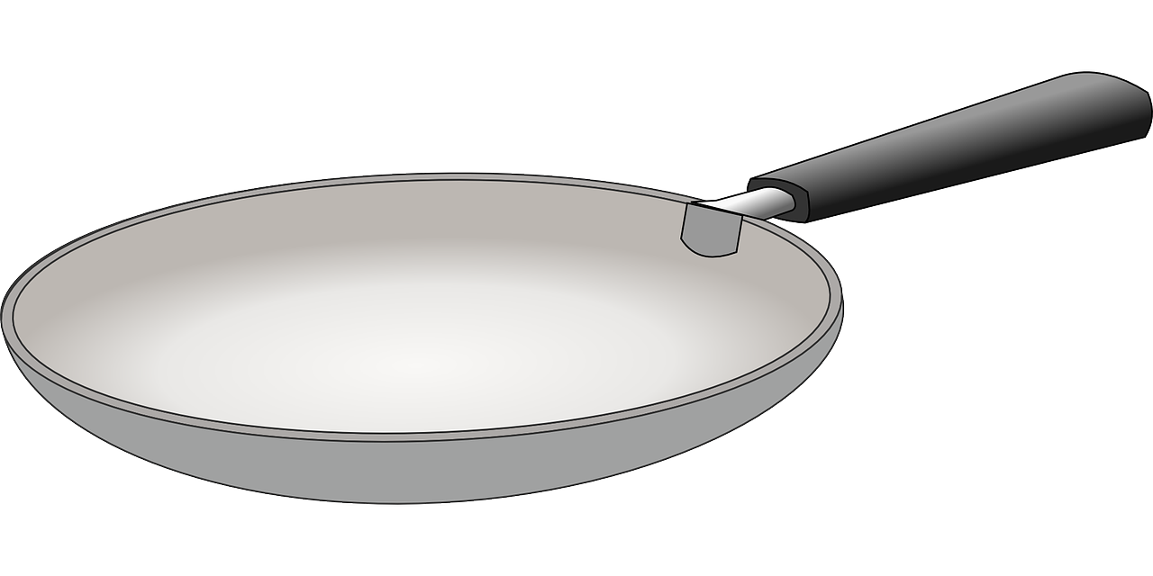
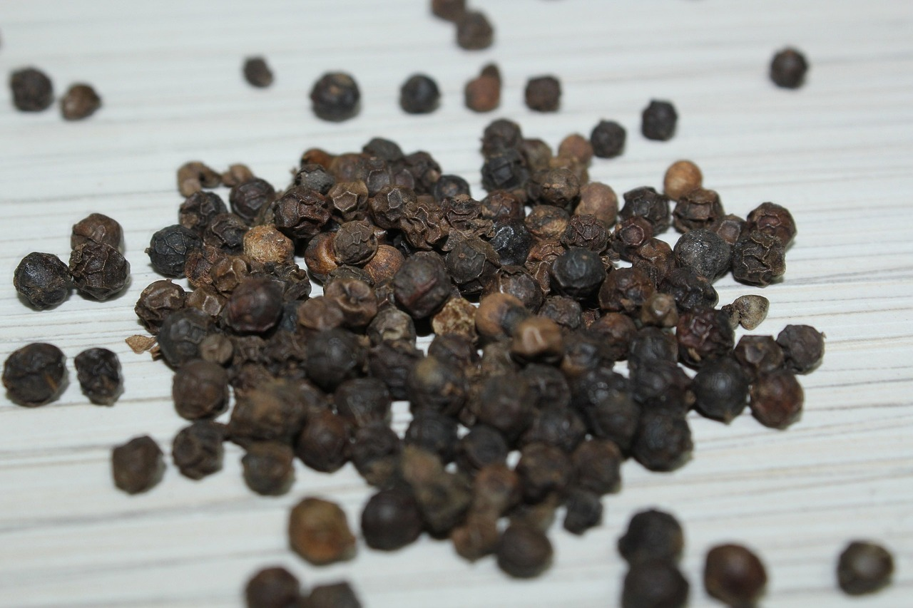
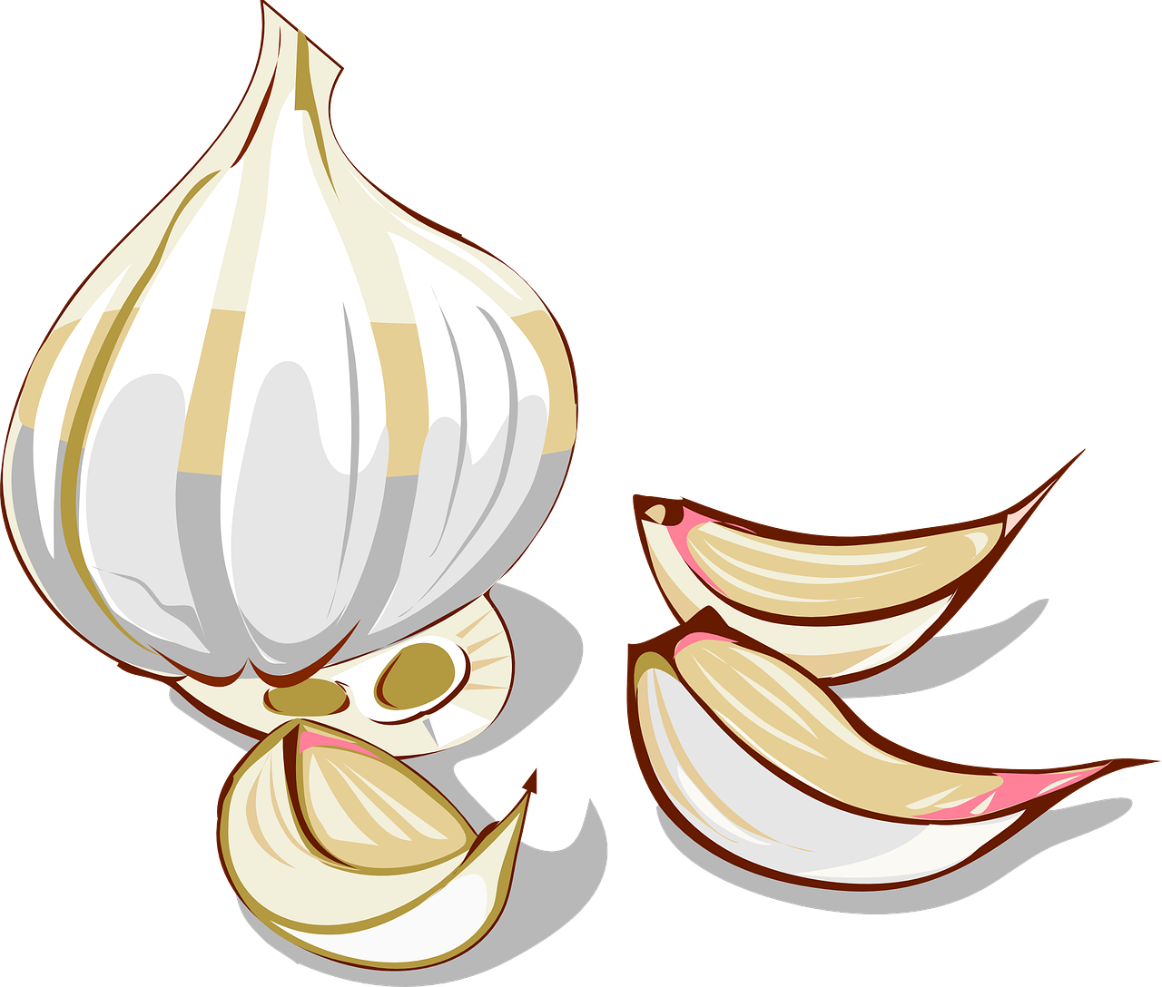
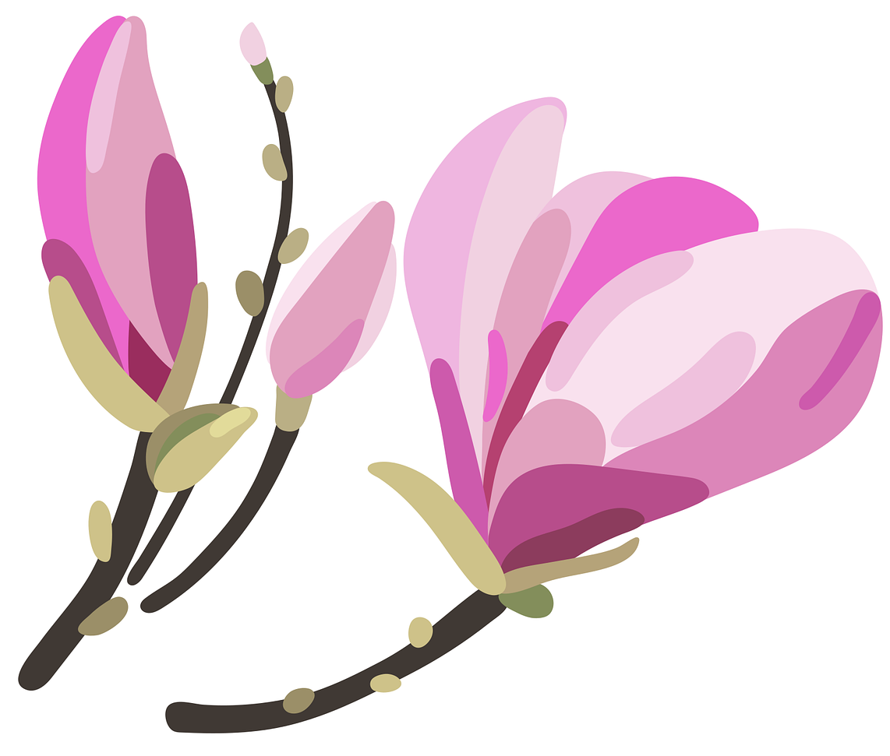
aussprechen
[pf] [kn]
Hör zu. Wie viele [pf] und [kn] hörst du?
 |  | kn | pf
1 | Das Pferd folgt dem Pfad zum Pferch. |  | I I I
2 | Der Pfarrer knabbert an einem Apfel. | I | I I
3 | Der Knabe pflügt mit einem Pflug. | I | I I
4 | Im Topf sind Pflaumen und Pfirsiche. |  | I I I
5 | In der Pfanne sind Pfeffer und knackiger Knoblauch. | I I | I I
6 | Ich pflege die Knospen an den Pflanzen. | I | I I
Notes:
Timing: 5 minutes
Aim: to consolidate the SSCs [pf] and [kn] in a listening activity.
Procedure:
Explain the task. Pupils are going to hear six sentences which contain a mixture of [pf] and [kn] sounds.
For each sentence they hear, pupils count the number of times they hear each SSC, noting down their answers.
Click to reveal answers.
To aid comprehension, pictures are revealed with the answers.
Transcript:
1. Das Pferd folgt dem Pfad zum Pferch.
2. Der Pfarrer knabbert an einem Apfel.
3. Der Knabe pflügt mit einem Pflug.
4. Im Topf sind Pflaumen und Pfirsiche.
5. In der Pfanne sind Pfeffer und knackiger Knoblauch.
6. Ich pflege die Knospen an den Pflanzen.
Frequency: folgen [160] knabbern [>5000] Knabe [>5000] knackig [>5000] Knoblauch [>5000] Knospe [>5000] Pfad [4810] Pfanne [>5000] Pfarrer [3566] Pfeffer [>5000] Pferch [>5000] Pferd [1504] Pfirsich [>5000] Pflanze [1667] Pflaume [>5000] pflegen [1842] Pflüg [>5000] pflügen [>5000] Topf [4136] zu [21]
Jones, R.L & Tschirner, E. (2019). A frequency dictionary of German: Core vocabulary for learners. London: Routledge.

Slide 7
Vokabeln
Vokabeln lernen
Wie sagt man das auf Deutsch?
Wörter
wohnen
spielen
Heidi goes to live in the Alps with her Grandad. She likes to play with her friend Peter and has a wonderful life in the mountains. Heidi would like to read and to write, but her Grandad won’t let her go to school.
One day, Heidi’s Aunt finds her a job in Frankfurt, helping a girl called Klara, who is ill. Klara and Heidi become friends, but Heidi doesn’t want to work in Frankfurt, and she misses home. Heidi wants to stay in the Alps. Heidi returns home and her Grandad lets her go to school. She and Klara like to receive letters from each other. Klara decides to go to the mountains to visit Heidi and gets better in the mountain air.
lesen
schreiben
arbeiten
bleiben
The infinitive
Can you remember what this type of verb is called?
fahren
bekommen
besuchen
Notes:
Timing: 5 minutes
Aim: to practise infinitive verbs in preparation for the following activities. To learn about the story of Heidi in preparation for the following activities.
Procedure:
Explain the context for this week. The Heidi books, written by Johanna Spyri, are set in Switzerland in the late 1800s. Pupils are going to learn about the books, and then write their own short stories about a character who either lives in the Alps or in a city.
Pupils read the text so they are familiar with the plot line of the Heidi stories.
They read the words in bold and translate them into German. They have already learned eight of the verbs, and they will probably be familiar with the ninth verb, lesen, through reading activities.
Click to reveal answers.
Click to bring up a call out to see if pupils can remember what this form of the verb is called. Click to reveal answer.
7

Slide 8
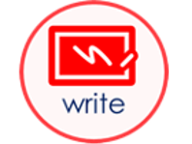
Möcht-
As you know, to say would like with another verb, use möcht- plus an infinitive verb. The second verb is at the end of the sentence:
Sie möchte schreiben
She would like to write
And to say wouldn’t like with verbs, use nicht before the infinitive verb:
Sie möchte nicht schreiben
She wouldn’t like to write
Notes:
Timing: 2 minutes
Procedure:
Click through the animations to present the information.
Elicit English translation for the German examples provided.
8

Slide 9
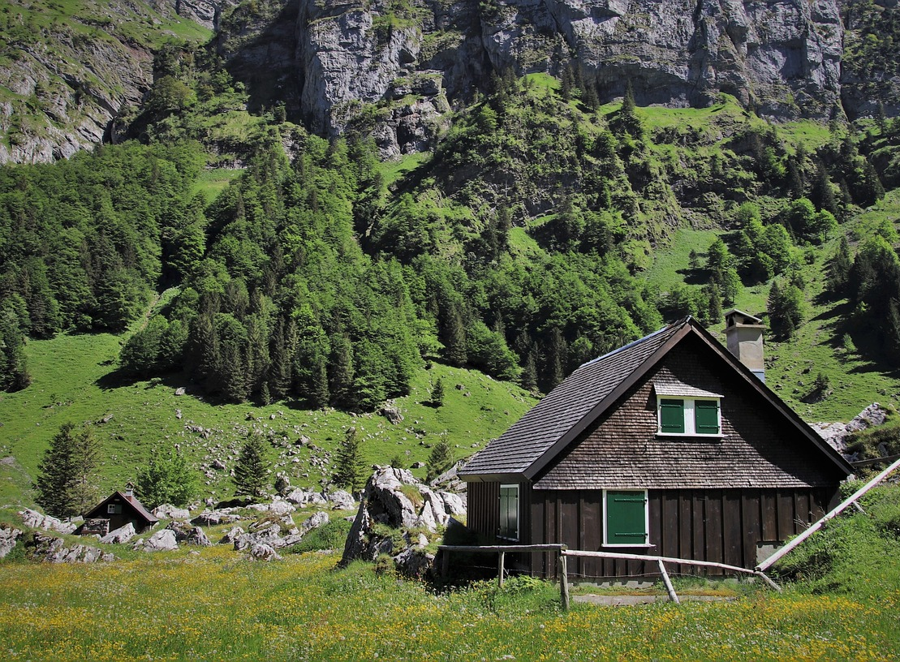
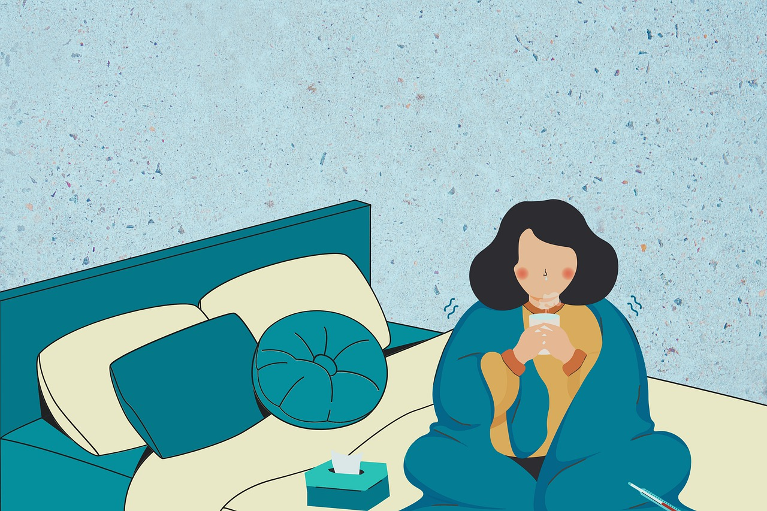
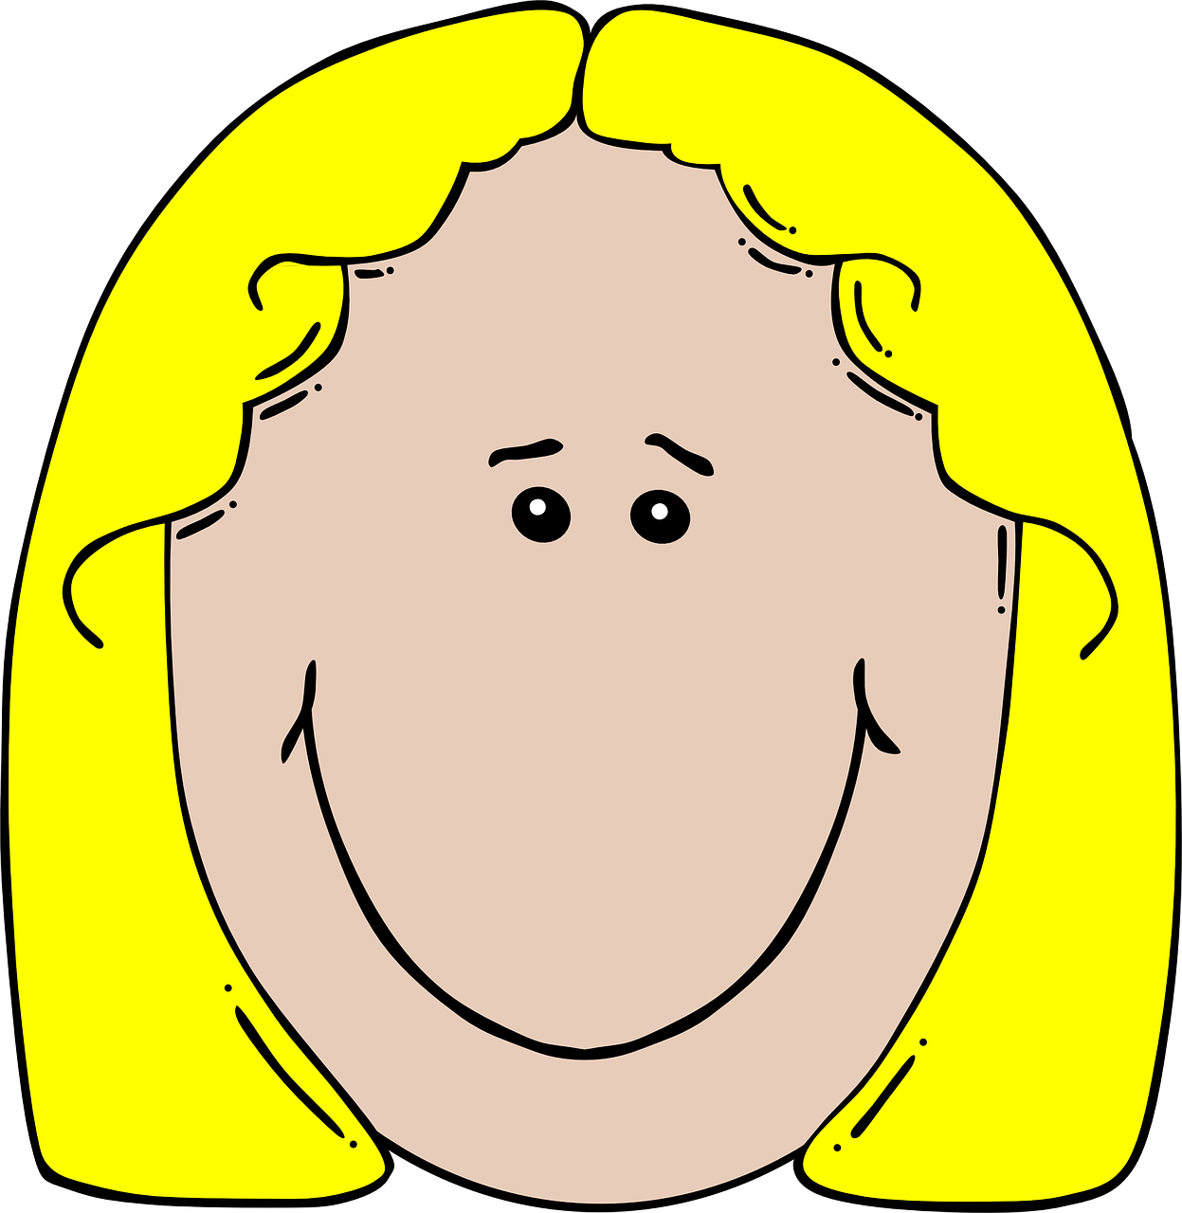
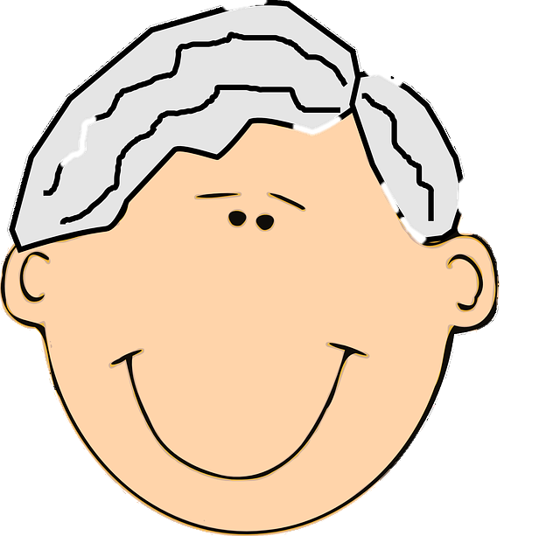
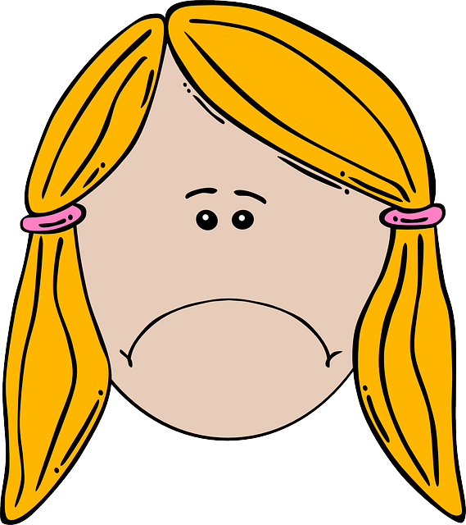
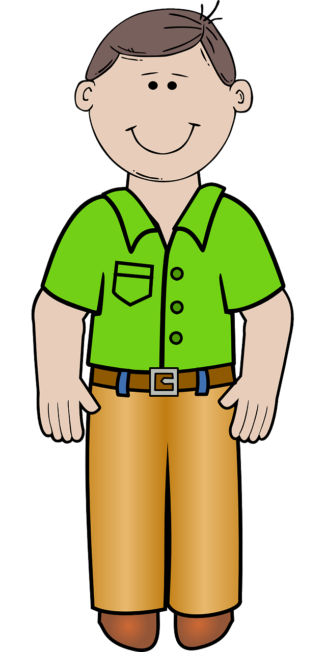
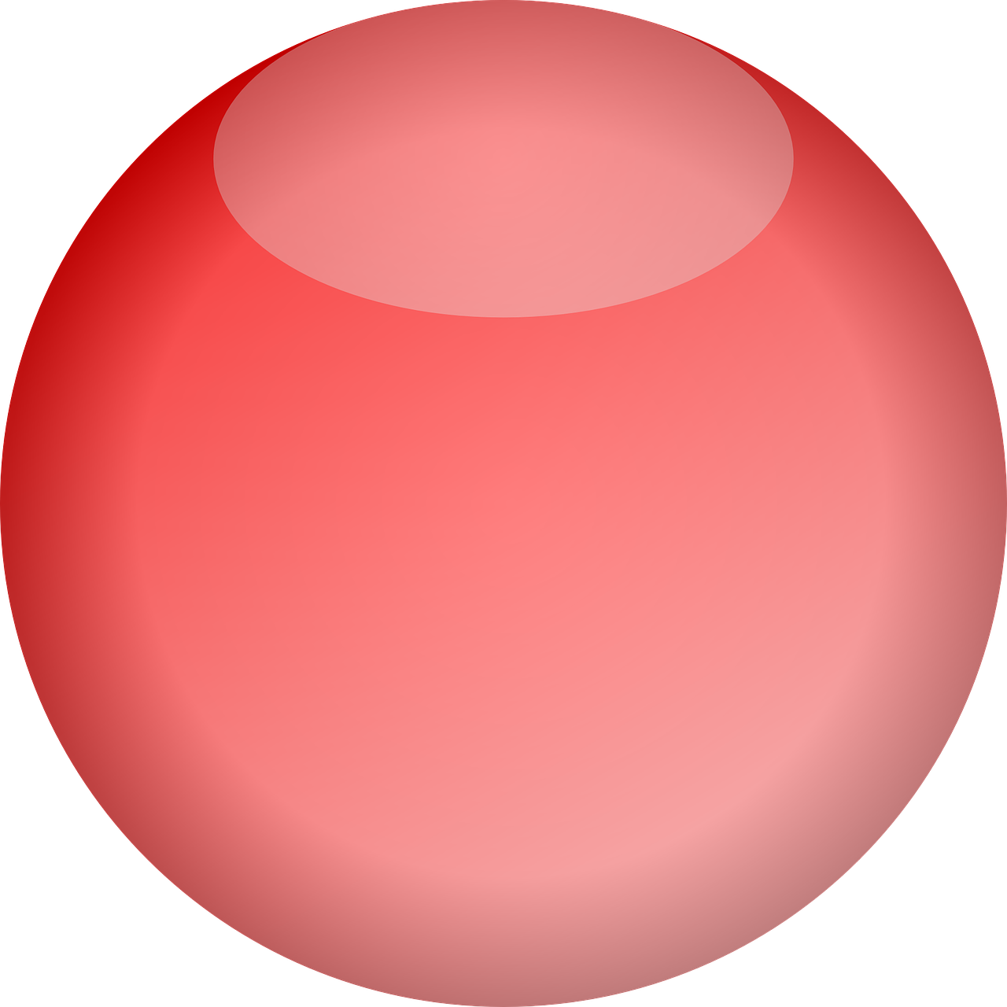
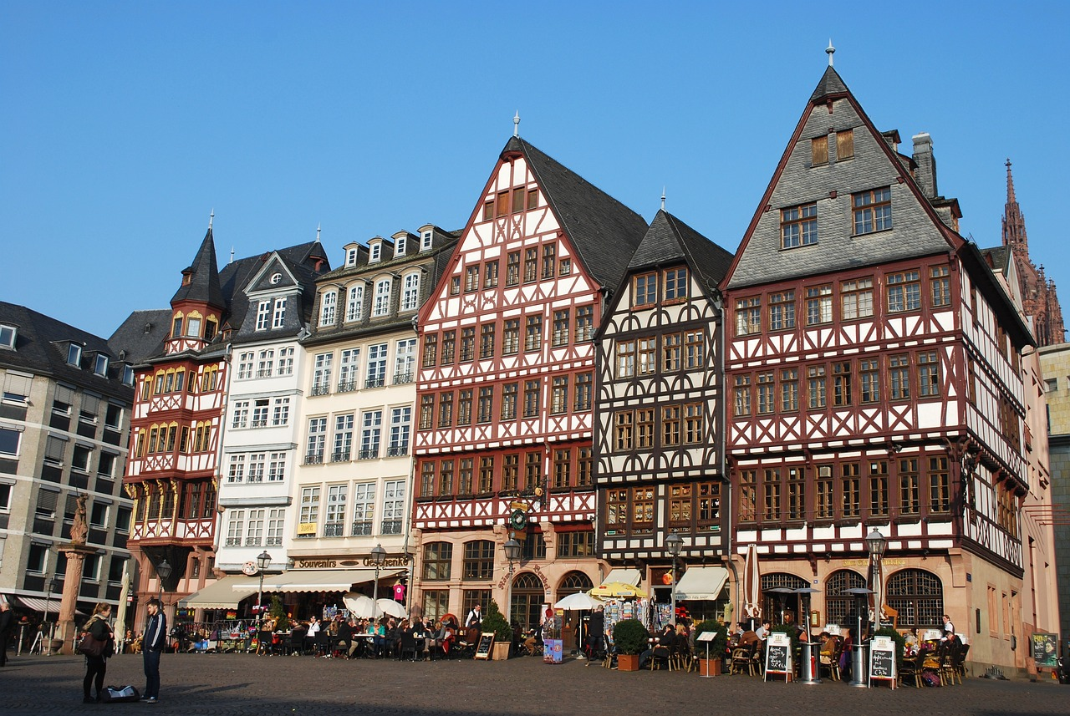
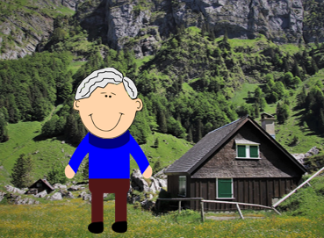
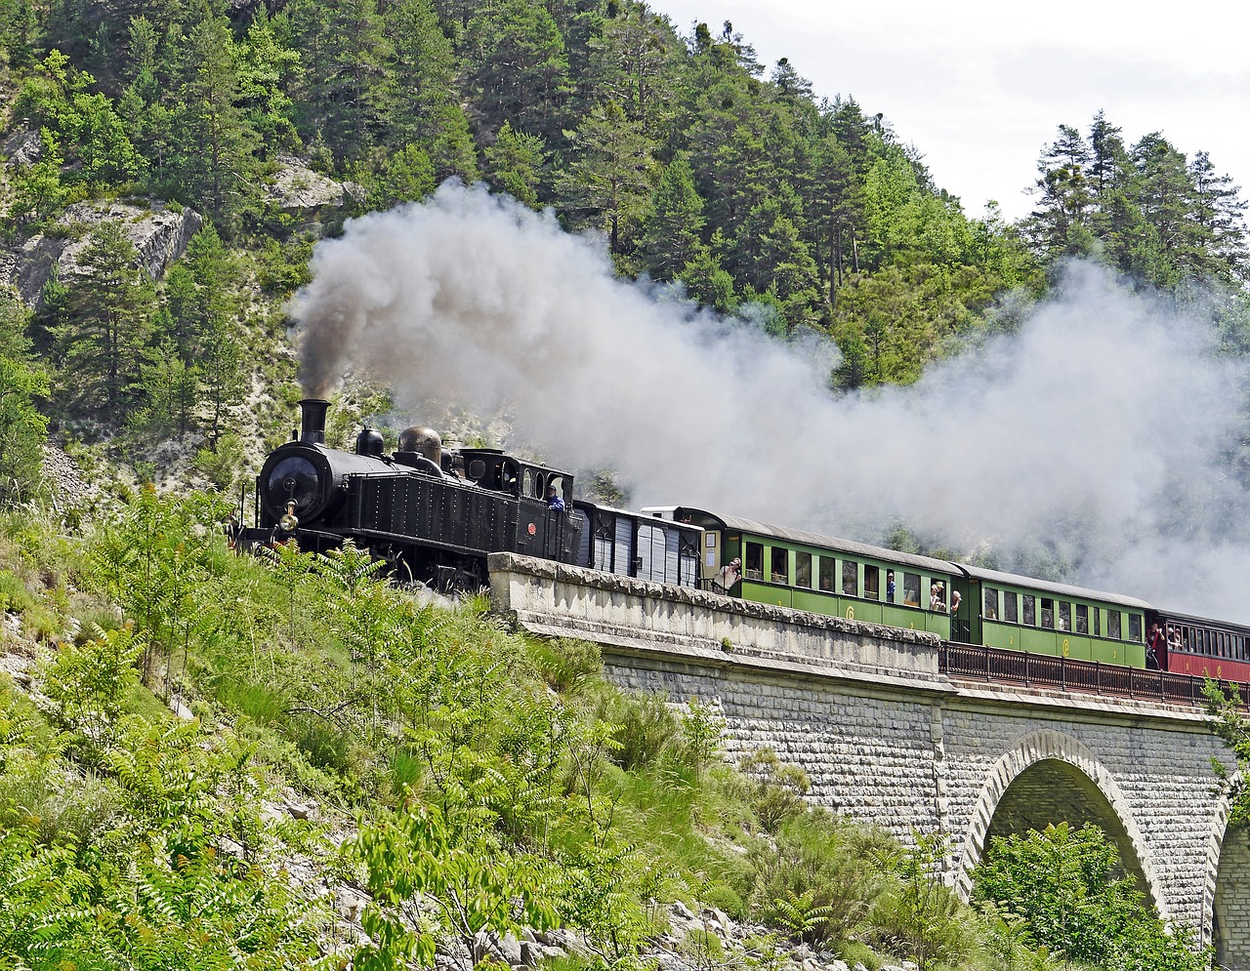
Heidi
Was möchte Heidi machen?
*Alpen - Alps
schreiben
Heidi möchte mit Opa wohnen. | Heidi möchte mit Peter spielen. | Heidi möchte lesen und schreiben. | Heidi möchte nicht in Frankfurt arbeiten.
Heidi möchte nicht in Frankfurt bleiben. | Heidi möchte Opa besuchen. | Heidi möchte in die Alpen* fahren. | Heidi möchte einen Brief bekommen.
Notes:
Timing: 10 minutes
Aim: to provide a reading and writing task based on an authentic story.
Procedure:
Explain the task. Using their knowledge of the Heidi story and the pictures on the slide, pupils are going to complete the missing infinitives in the story board.
Ask pupils in pairs, (or groups with a big piece of A1 sugar paper), to brainstorm the possible infinitives that could be under each dark blue box. [If desired, add an element of competition with a points system - e.g., students could receive two points for a correct infinitive.]
Then reveal each infinitive, one by one, telling pupils to mark off any that they have in common with the story, awarding themselves two points for each infinitive.
Ask pupils which things Heidi would like to do and which she wouldn’t. Click to reveal answers.
Frequency: Alpen [4099]
Jones, R.L & Tschirner, E. (2019). A frequency dictionary of German: Core vocabulary for learners. London: Routledge.
9

Slide 10
Heidi
Was möchte Heidi machen?
*Alpen - Alps
schreiben
Heidi möchte mit Opa wohnen. | Heidi möchte mit Peter spielen. | Heidi möchte lesen und schreiben. | Heidi möchte nicht in Frankfurt arbeiten.
Heidi möchte nicht in Frankfurt bleiben. | Heidi möchte Opa besuchen. | Heidi möchte in die Alpen* fahren. | Heidi möchte einen Brief bekommen.
Heidi would like to live with Grandad.
Heidi would like to play with Peter.
Heidi would like to read and write.
Heidi wouldn’t like to work in Frankfurt.
Heidi wouldn’t like to stay in Frankfurt.
Heidi would like to visit Grandad.
Heidi would like to go to the Alps.
Heidi would like to receive a letter.
Notes:
Timing: 5 minutes
Aim: to practise oral translation of 2-verb structures.
Procedure:
1. In pairs, pupils translate the storyboard orally together into English. Take feedback and click to reveal answers.
Frequency: Alpen [4099]
Jones, R.L & Tschirner, E. (2019). A frequency dictionary of German: Core vocabulary for learners. London: Routledge.
10

Slide 11
Tschüss!
gelb
Notes:
11

