Slide 1
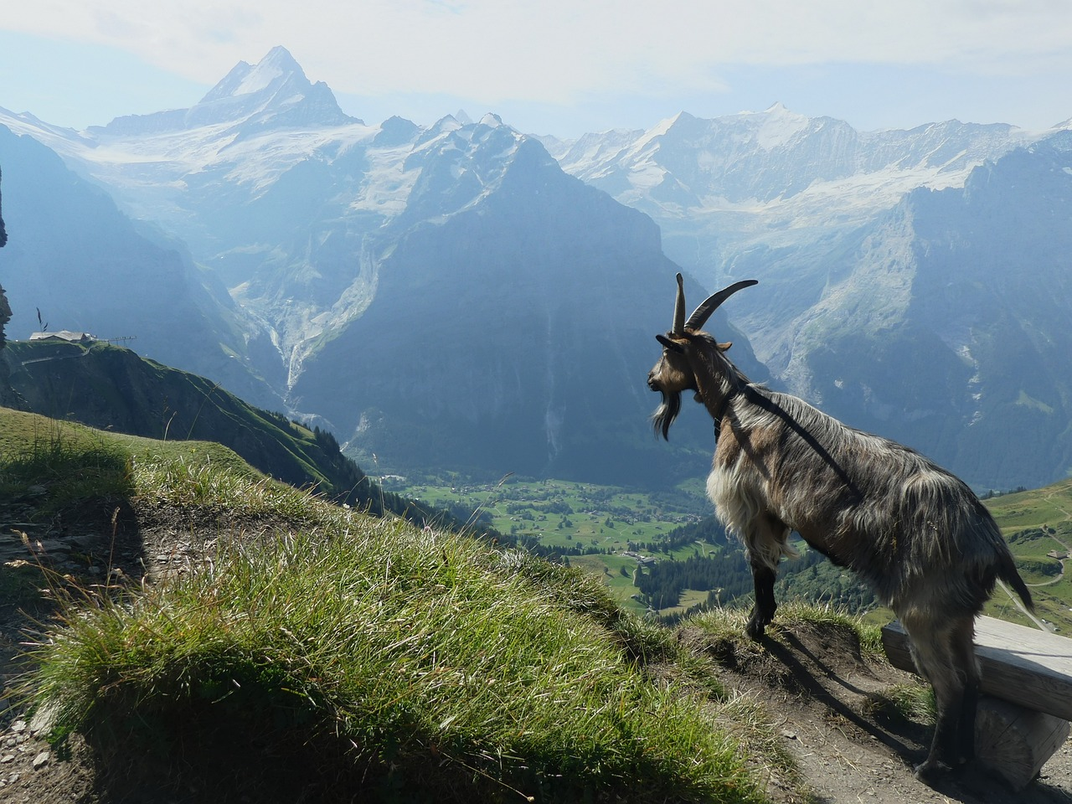
Talking about activities and events
gelb
Follow ups 1-5
Term 3 Week 13
Notes:
Artwork by Steve Clarke. Pronoun pictures from NCELP (www.ncelp.org). All additional pictures selected from Pixabay and are available under a Creative Commons license, no attribution required.
Phonics:
[y] typisch [1109] Rhythmus [3823] Physik [1917]
[qu] Quatsch [1650] bequem [1657] Aquarium [>5000]
Vocabulary: Revisit vocabulary
Revisit 1: heißen [126] wohnen [560] Jahr [53] Minute [324] Stunde [276] jung [199]
Revisit 2: besuchen [820] bleiben [113] Gitarre [n/a] Oma [2175]
Jones, R.L & Tschirner, E. (2019). A frequency dictionary of German: Core vocabulary for learners. London: Routledge.
The frequency rankings for words that occur in this PowerPoint which have been previously introduced in these resources are given in the SOW and in the resources that first introduced and formally re-visited those words.
For any other words that occur incidentally in this PowerPoint, frequency rankings will be provided in the notes field wherever possible.
Note that the first three lessons of the year teach language that can be continuously recycled as lesson routine every lesson in Y3/4.
The idea would be that the class teacher (whether or not s/he teaches the class German can re-use the language as part of the daily routine with the class.

Slide 2
aussprechen
[y]
…
typisch
1 2& 3& 4
Rhythmus
Physik
Notes:
Timing: 1 minute
Aim: to consolidate the SSC [y].
Procedure:
Re-present the SSC and the source word ‘typisch’ (with gesture, if using).
Click to bring on the picture and get pupils to repeat the word ‘typisch’ (with gesture, if using).
Present the cluster words in the same way, bringing on the picture and getting pupils to pronounce the words.
Frequency: typisch [1109] Rhythmus [3823] Physik [1917]
Jones, R.L & Tschirner, E. (2019). A frequency dictionary of German: Core vocabulary for learners. London: Routledge.

Slide 3
aussprechen
[qu]
…
Quatsch!
[comfortable]
bequem
Aquariam
Notes:
Timing: 1 minute
Aim: to consolidate the SSC [qu].
Procedure:
Re-present the SSC and the source word ‘quatsch’ (with gesture, if using).
Click to bring on the picture and get pupils to repeat the word ‘quatsch’ (with gesture, if using).
Present the cluster words in the same way, bringing on the picture and getting pupils to pronounce the words.
Frequency: Quatsch [1650] bequem [1657] Aquarium [>5000]
Jones, R.L & Tschirner, E. (2019). A frequency dictionary of German: Core vocabulary for learners. London: Routledge.

Slide 4
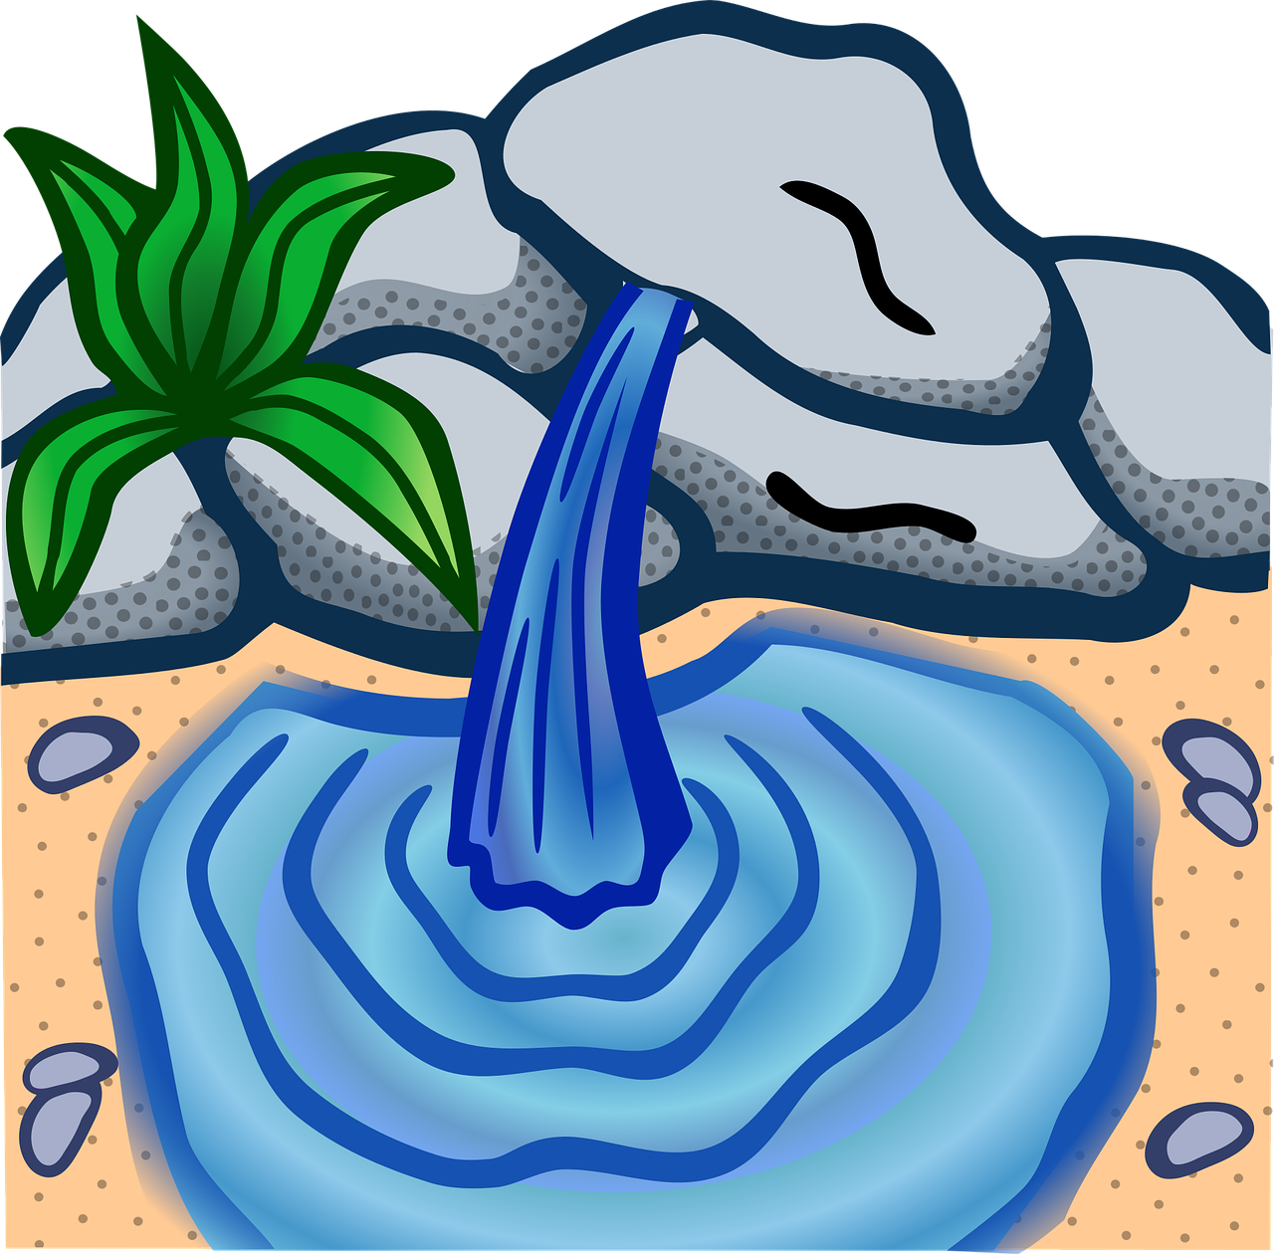
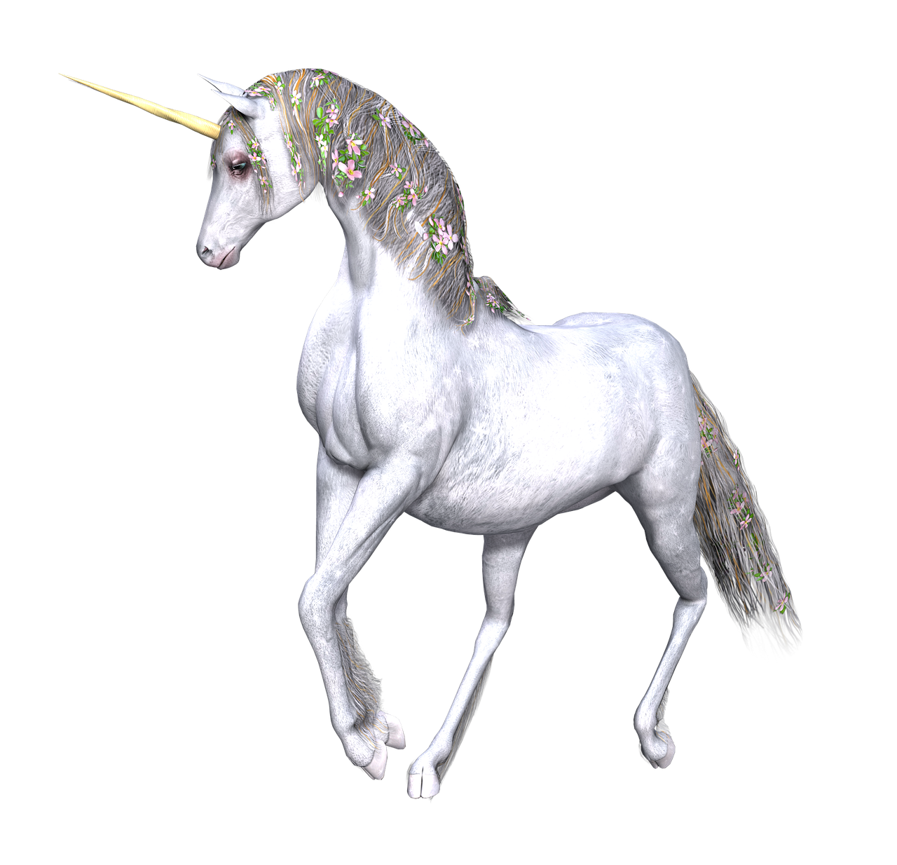
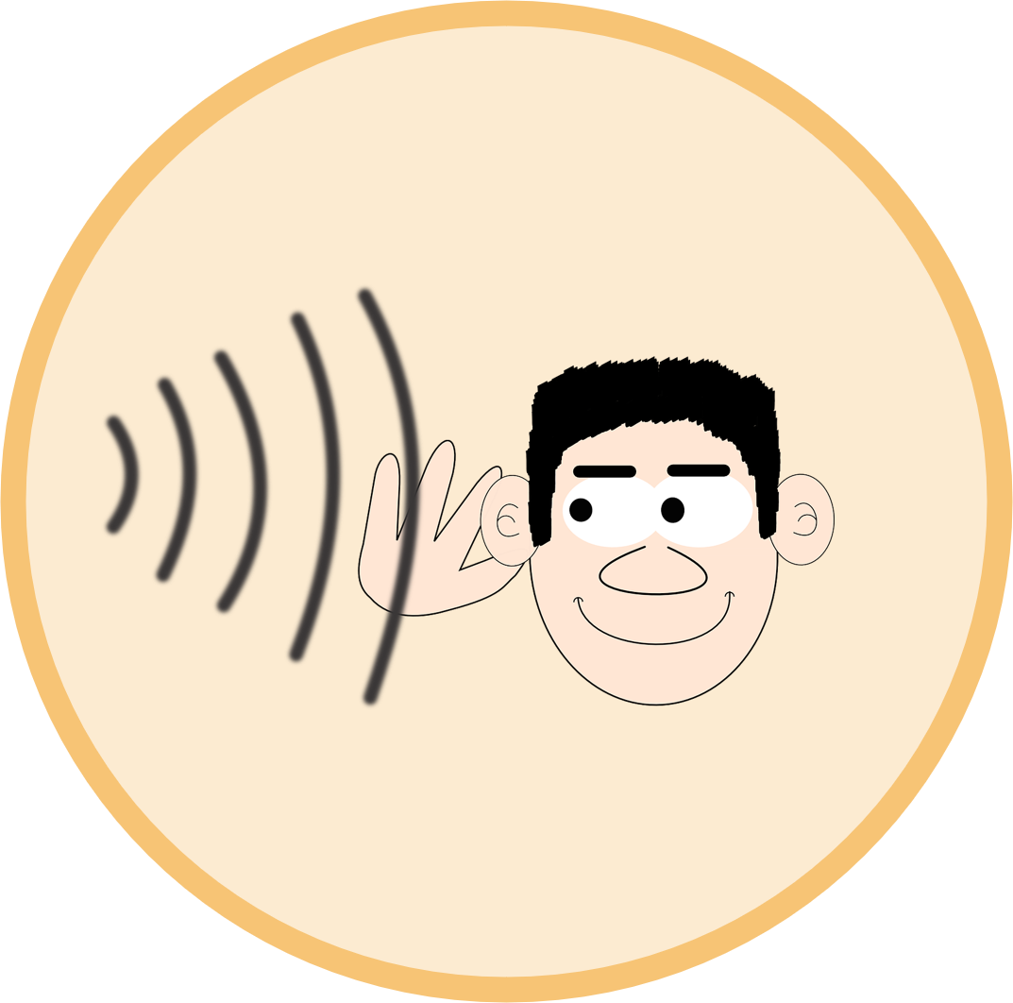
Follow up 1
Wie sagt man das richtig?
aussprechen
Quinn möchte keine Quelle brauchen.
Lydia möchte kein Gymnasium besuchen.
Lydia möchte keinen Mythos lesen.
Quinn möchte kein Quaken hören.
to visit
Quack!
Notes:
Timing: 5 minutes (2 slides)
Aim: to practise applying knowledge of [qu] and [y] to unknown words. To provide inspiration for kein sentences for stories.
Procedure:
Pupils work in pairs. Partner A reads the four sentences on this slide aloud to their partner. Partner B listens closely to Partner A pronounce the letters in bold ([qu] and [y]), and corrects if necessary. Note: some of the words containing these SSCs are cognates with English: pupils will need to be careful to pronounce the words the German way.
Click to reveal the following slide. Partners swap roles.
Frequency: Gymnasium [3081] Lyrik [>5000] Myrte [>5000] Mythos [4576] Quaken [>5000] Quarz [>5000] Quelle [1108] Quitte [>5000]
Jones, R.L & Tschirner, E. (2019). A frequency dictionary of German: Core vocabulary for learners. London: Routledge.

Slide 5
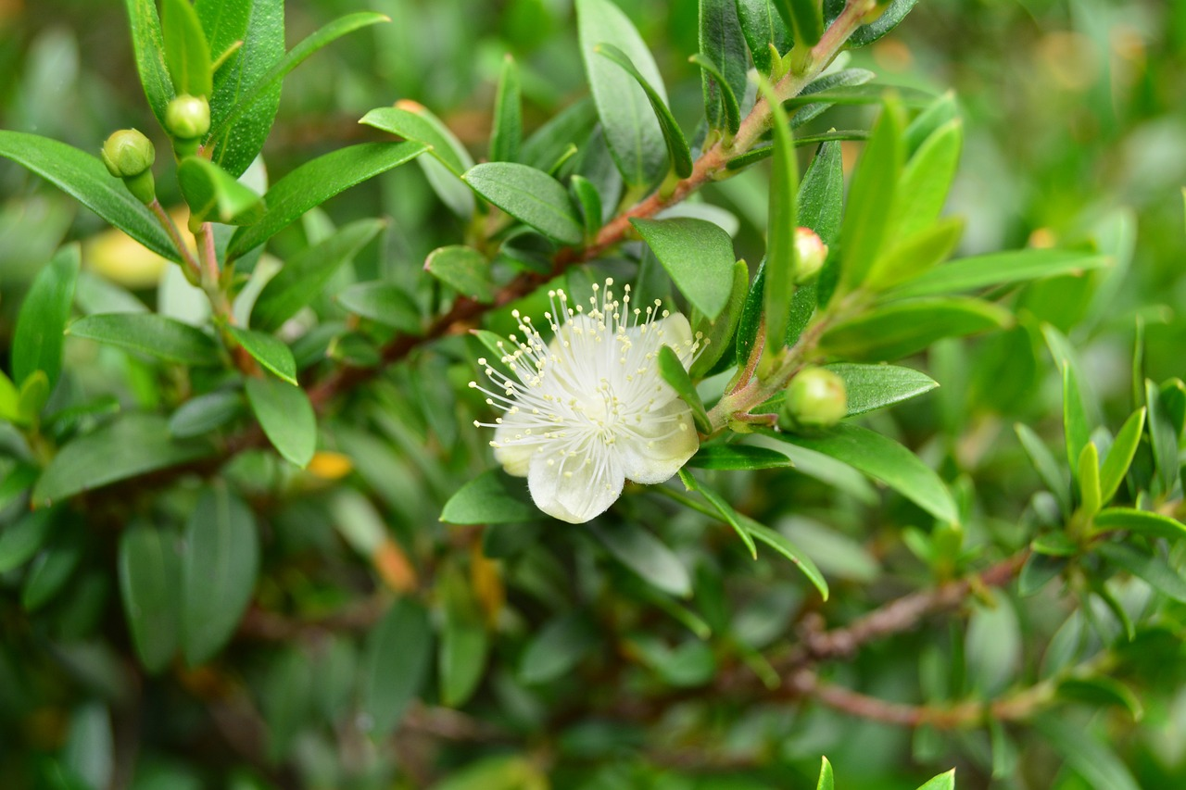
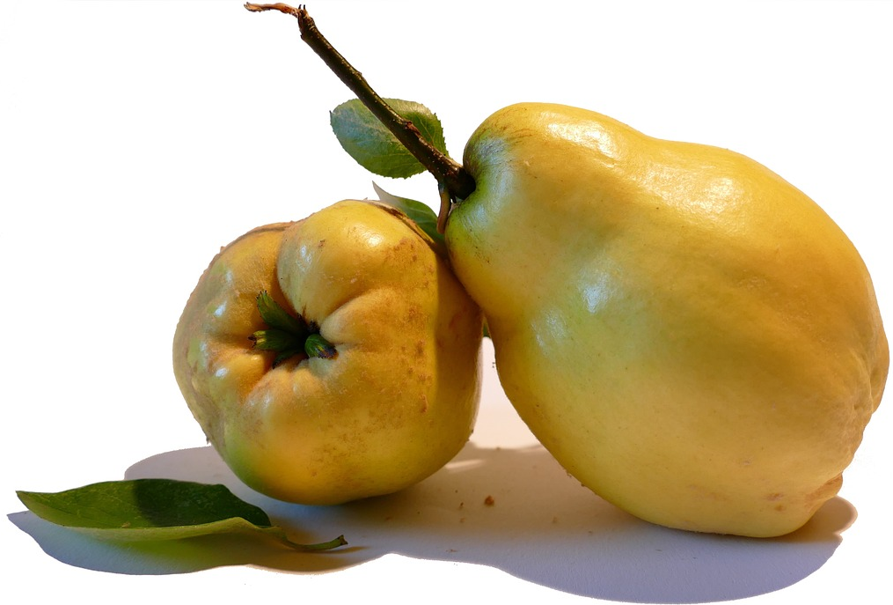
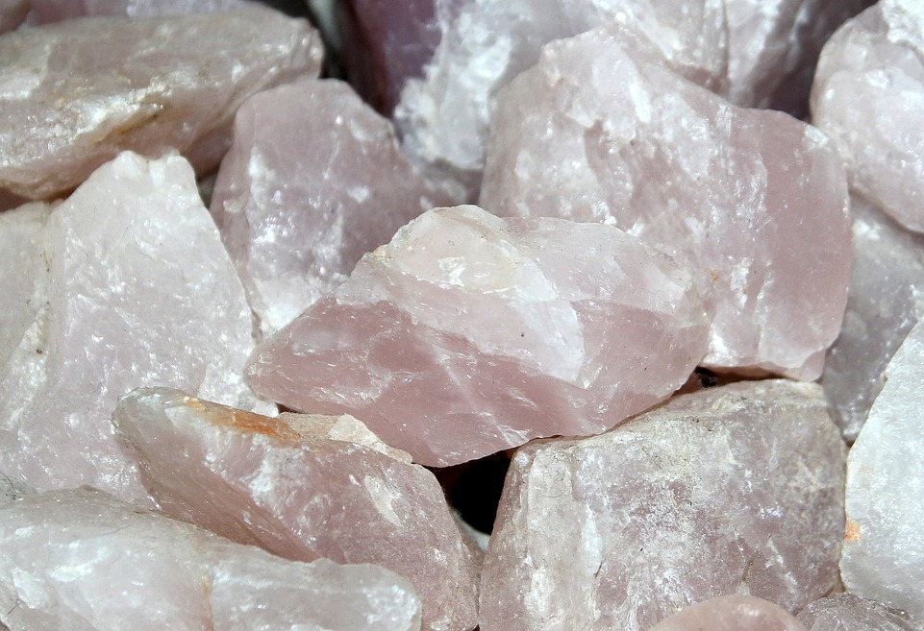
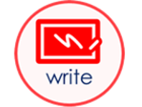
Follow up 1
Wie sagt man das richtig?
aussprechen
Lydia möchte keine Myrte benutzen.
Quinn möchte keine Quitte haben.
Quinn möchte keinen Quarz bekommen.
Lydia möchte keine Lyrik schreiben.
Notes:
[2/2]

Slide 6
Follow up 2:

Schreib auf Englisch.
Can you get at least 15 points?
Wörter
 | die Gitarre | die Oma | bleiben
 | besuchen | kein | nicht
 | das Jahr | heißen | die Stunde
 | die Minute | jung | wohnen
 | das Butterbrot | der Fehler | die Schule
 | der Text | das Papier | die Hausaufgabe
 | haben | benutzen | das Haus
to remain, stay, remaining, staying
(the) guitar
(the) grandma
Vokabeln
x3
to visit, visiting
not a, no (m,nt)
not
(the) year
to be called
(the) hour
x2
(the) minute
young
to live, living
(the) sandwich
mistake, error
(the) school
(the) text
(the) paper
(the) homework
x1
to have, having
to use, using
(the) house
Notes:
Timing: 5 minutes
Aim: to practise written comprehension of vocabulary from this and revisited weeks.
Procedure: 1. Give pupils a blank grid. They fill in the English meanings of any of the words they know, trying to reach 15 points in total. 2. Remind pupils that adjectives can refer to male or female persons and they should note this in their translations. E.g. pleased (f), short (m).
Note: The most recently learnt and practised words are pink, words from the previous week are green and those from week 1 are blue, thus more points are awarded for them, to recognise that memories fade and more effort (heavy lifting!) is needed to retrieve them.

Slide 7
Follow up 2:

Schreib auf Deutsch.
Can you get at least 15 points?
Wörter
 | not a, no (f) | to visit, visiting | (the) guitar
 | not | to remain, stay, remaining, staying | (the) grandma
 | to be called | to live, living | young
 | (the) hour | (the) minute | (the) year
 | (the) paper | (the) text | (the) sandwich
 | to use, using | to have, having | (the) mistake
 | (the) house | (the) homework | (the) school
keine
besuchen
die Gitarre
Vokabeln
x3
nicht
bleiben
die Oma
heißen
wohnen
jung
x2
die Stunde
die Minute
das Jahr
das Papier
der Text
das Butterbrot
benutzen
haben
der Fehler
x1
das Haus
die Hausaufgabe
die Schule
Notes:
Timing: 5 minutes
Aim: to practise written production of vocabulary from this and revisited weeks.
Procedure: 1. Give pupils a blank grid. They fill in the German meanings of any of the words they know, trying to reach 15 points in total. 2. Remind pupils that adjectives can refer to male or female persons and they should note this in their translations. E.g. pleased (f), short (m).
Note: The most recently learnt and practised words are pink, words from the previous week are green and those from week 1 are blue, thus more points are awarded for them, to recognise that memories fade and more effort (heavy lifting!) is needed to retrieve them.

Slide 8
Tschüss!
gelb
Notes:
8

Slide 9
Follow up 2:

Schreib auf Englisch.
Can you get at least 15 points?
Wörter
 | die Gitarre | die Oma | bleiben
 | besuchen | kein | nicht
 | das Jahr | heißen | die Stunde
 | die Minute | jung | wohnen
 | das Butterbrot | der Fehler | die Schule
 | der Text | das Papier | die Hausaufgabe
 | haben | benutzen | das Haus
Vokabeln
x3
x2
x1
Notes:
HANDOUT

Slide 10
Follow up 2:

Schreib auf Deutsch.
Can you get at least 15 points?
Wörter
 | not a, no (f) | to visit, visiting | (the) guitar
 | not | to remain, stay, remaining, staying | (the) grandma
 | to be called | to live, living | young
 | (the) hour | (the) minute | (the) year
 | (the) paper | (the) text | (the) sandwich
 | to use, using | haben | (the) mistake
 | (the) house | (the) homework | (the) school
Vokabeln
x3
x2
x1
Notes:
HANDOUT

