Slide 1
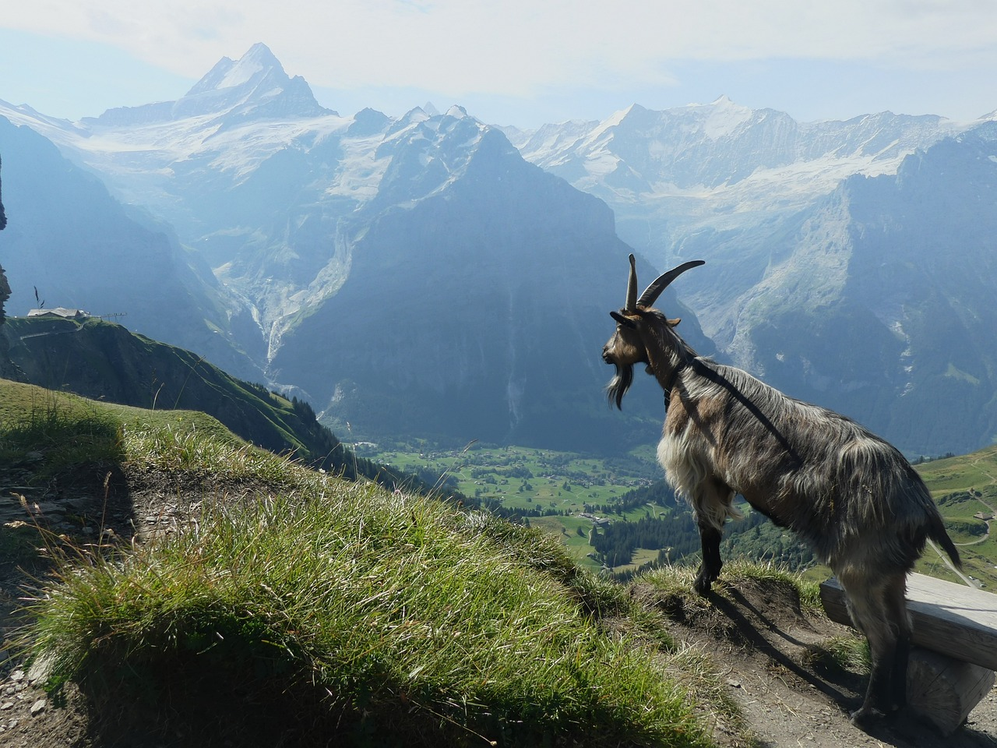
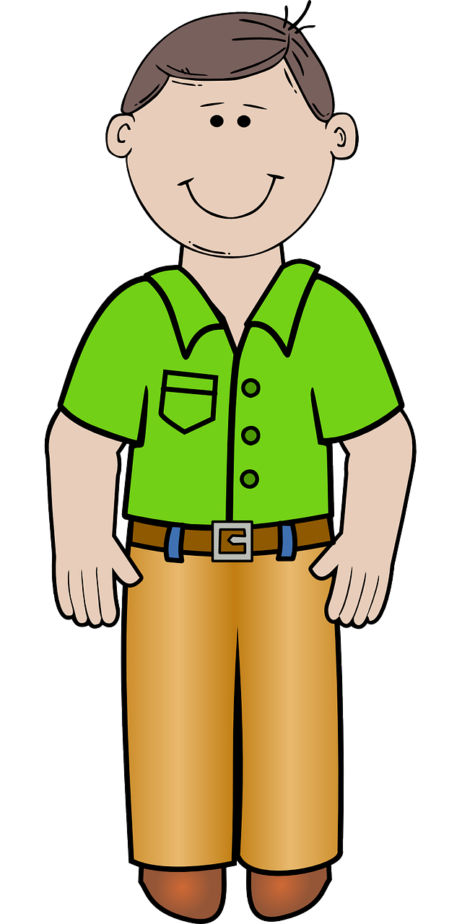
Talking about activities and events
gelb
möcht-
SSC [y] [ü] [qu]
Term 3 Week 13
Notes:
Artwork by Steve Clarke. Pronoun pictures from NCELP (www.ncelp.org). All additional pictures selected from Pixabay and are available under a Creative Commons license, no attribution required.
Phonics:
[y] typisch [1109] Rhythmus [3823] Physik [1917]
[qu] Quatsch [1650] bequem [1657] Aquarium [>5000]
Vocabulary: Revisit vocabulary
Revisit 1: heißen [126] wohnen [560] Jahr [53] Minute [324] Stunde [276] jung [199]
Revisit 2: besuchen [820] bleiben [113] Gitarre [n/a] Oma [2175]
Jones, R.L & Tschirner, E. (2019). A frequency dictionary of German: Core vocabulary for learners. London: Routledge.
The frequency rankings for words that occur in this PowerPoint which have been previously introduced in these resources are given in the SOW and in the resources that first introduced and formally re-visited those words.
For any other words that occur incidentally in this PowerPoint, frequency rankings will be provided in the notes field wherever possible.
Note that the first three lessons of the year teach language that can be continuously recycled as lesson routine every lesson in Y3/4.
The idea would be that the class teacher (whether or not s/he teaches the class German can re-use the language as part of the daily routine with the class.
1

Slide 2
aussprechen
[y]
[y] sounds the same as [ü]
…
typisch
Notes:
Timing: 1 minute
Aim: to introduce the SSC [y].
Procedure:
1. Present the letter and say the [y] sound first, on its own. Pupils repeat it with you. 2. Bring up the word ”Typisch” on its own, say it, pupils repeat it, so that they have the opportunity to focus all of their attention on the connection between the written word and its sound.
3. Click to bring up the picture and introduce the gesture, if using. Pupils repeat the word again.
4. Roll back the animations and work through 1-3 again, but this time, dropping your voice completely to listen carefully to the students saying the [y] sound, pronouncing ”Typisch” and, if using, doing the gesture.
Note: A possible gesture for this would be to mime drinking tea
Frequency: typisch [1109]
Jones, R.L & Tschirner, E. (2019). A frequency dictionary of German: Core vocabulary for learners. London: Routledge.
2

Slide 3
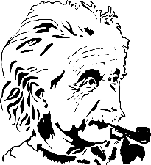
aussprechen
[y]
…
typisch
1 2& 3& 4
Rhythmus
Physik
Notes:
Timing: 1 minute
Aim: to consolidate the SSC [y].
Procedure:
Re-present the SSC and the source word ‘typisch’ (with gesture, if using).
Click to bring on the picture and get pupils to repeat the word ‘typisch’ (with gesture, if using).
Present the cluster words in the same way, bringing on the picture and getting pupils to pronounce the words.
Frequency: typisch [1109] Rhythmus [3823] Physik [1917]
Jones, R.L & Tschirner, E. (2019). A frequency dictionary of German: Core vocabulary for learners. London: Routledge.

Slide 4
aussprechen
[qu]
…
Quatsch!
Notes:
Timing: 1 minute
Aim: to introduce the SSC [qu].
Procedure:
1. Present the letter and say the [qu] sound first, on its own. Pupils repeat it with you. 2. Bring up the word ”Quatsch” on its own, say it, pupils repeat it, so that they have the opportunity to focus all of their attention on the connection between the written word and its sound.
3. Click to bring up the picture and introduce the gesture, if using. Pupils repeat the word again.
4. Roll back the animations and work through 1-3 again, but this time, dropping your voice completely to listen carefully to the students saying the [qu] sound, pronouncing ”Quatsch” and, if using, doing the gesture.
Note: A possible gesture for this would be to shrug your shoulders and hold your arms slightly out, palms of hands facing up.
Frequency: Quatsch [1650]
Jones, R.L & Tschirner, E. (2019). A frequency dictionary of German: Core vocabulary for learners. London: Routledge.
4

Slide 5
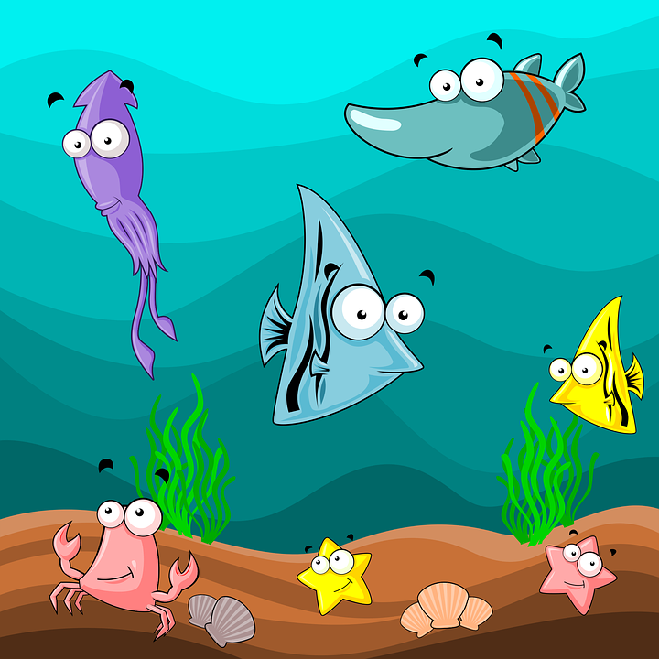
aussprechen
[qu]
…
Quatsch!
[comfortable]
bequem
Aquarium
Notes:
Timing: 1 minute
Aim: to consolidate the SSC [qu].
Procedure:
Re-present the SSC and the source word ‘quatsch’ (with gesture, if using).
Click to bring on the picture and get pupils to repeat the word ‘quatsch’ (with gesture, if using).
Present the cluster words in the same way, bringing on the picture and getting pupils to pronounce the words.
Frequency: Quatsch [1650] bequem [1657] Aquarium [>5000]
Jones, R.L & Tschirner, E. (2019). A frequency dictionary of German: Core vocabulary for learners. London: Routledge.

Slide 6
[y]
Hör zu. Ist das Deutsch oder Englisch?
hören
German [y] is usually pronounced the same as [ü]. However, for words that come from English, initial or final [y] is often pronounced as in English, e.g., das Baby.
1 | Hobby
2 | physisch
3 | Typ
4 | City
5 | Yoga
6 | Symmetrie
Notes:
Timing: 5 minutes Aim: To distinguish between German and English [y]. Procedure: 1. Click sound button, students transcribe word and tick whether they hear German or English [y].
2. Click to reveal transcribed word and tick.
Transcript:
Hobby
physisch
Typ
City
Yoga
Symmetrie
Word frequency (1 is the most frequent word in German): City [2163] Hobby [3608] physisch [3389] Symmetrie [4831] Typ [907] Yoga [>5000]
Source: Jones, R.L. & Tschirner, E. (2019). A frequency dictionary of German: core vocabulary for learners. Routledge

Slide 7
aussprechen
[qu]
Sag die Wörter.
[qu] sounds like ‘kw’ but remember German [w] sounds like English ‘v’.
In German, the letters kw only appear next to each other in different syllables and are said separately:
Minkwal
Where the kw sound is in one syllable it is always written [qu].
Aquarium
Notes:
Timing: 1 minute Aim: to introduce the SSC [qu] and contrast it with kw. Procedure: Click through the animations to present the new information. Pupils say ‘Minkwal’ and ‘Aquarium’ aloud.
Word frequency (1 is the most frequent word in German): Aquarium [>5000] Minkwal [>5000] Source: Jones, R.L. & Tschirner, E. (2019). A frequency dictionary of German: core vocabulary for learners. Routledge

Slide 8
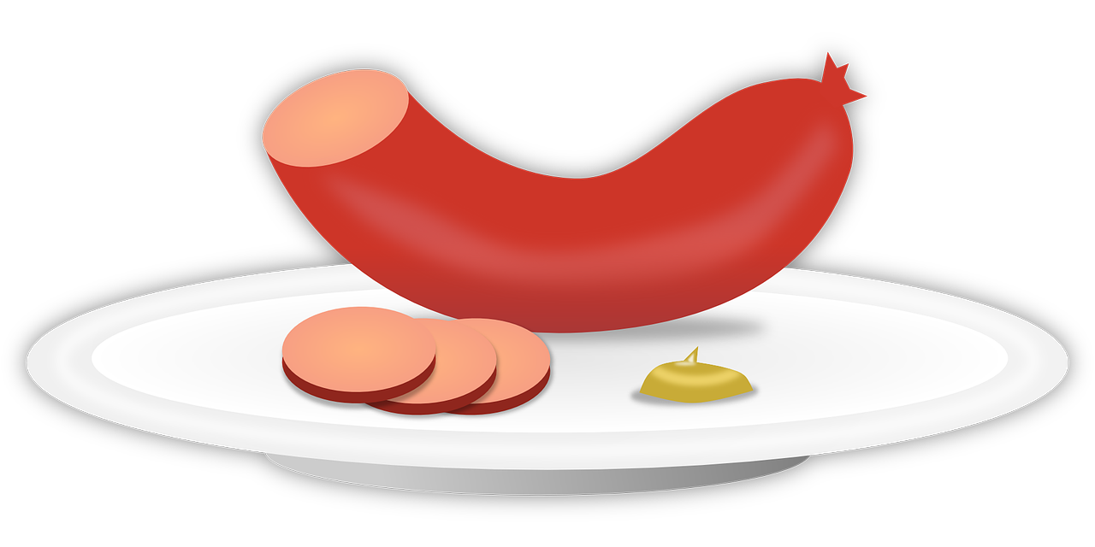
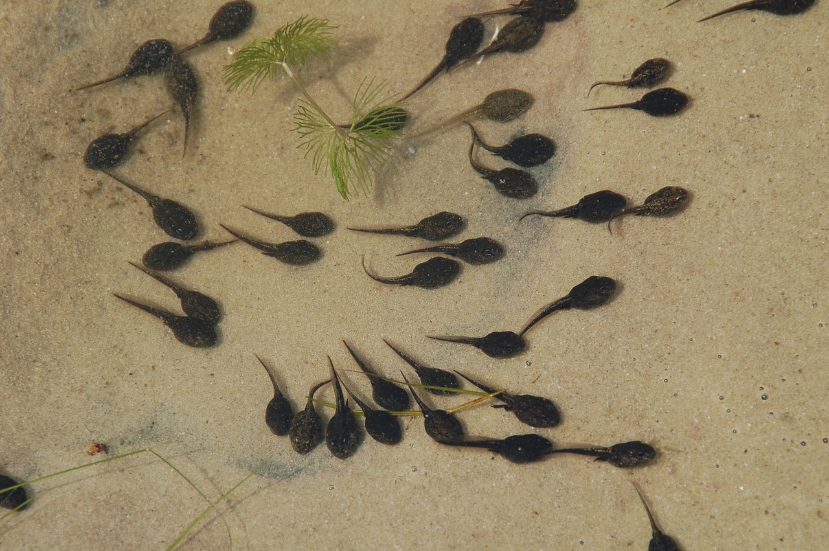
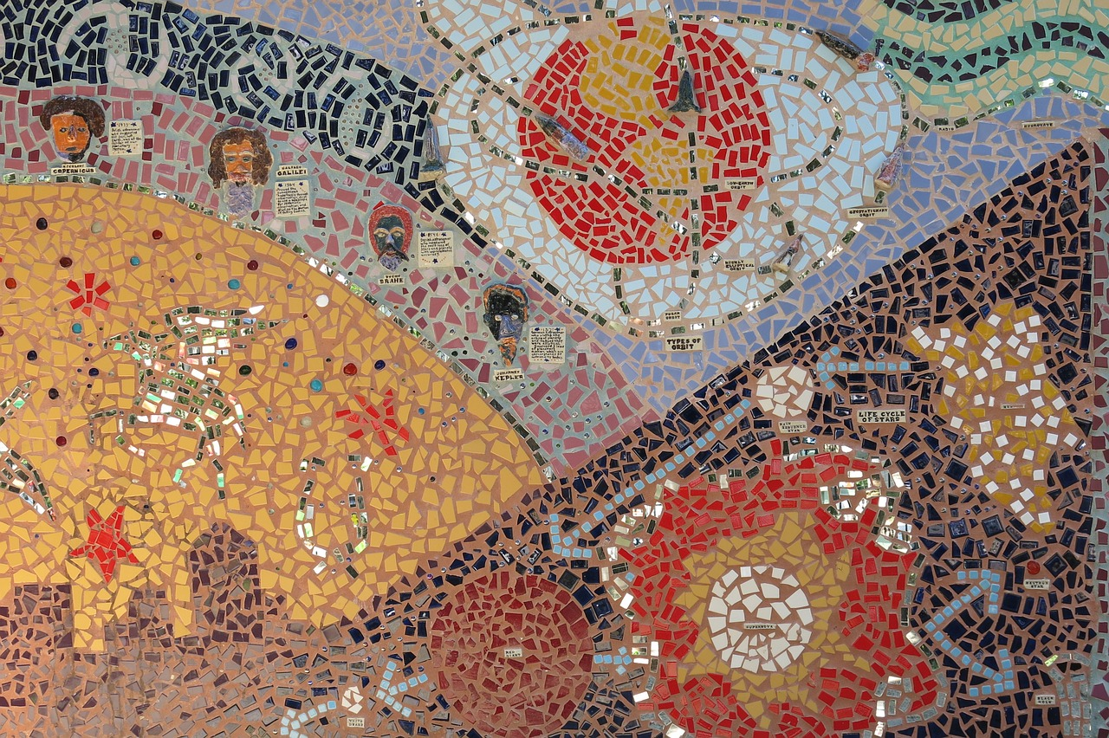
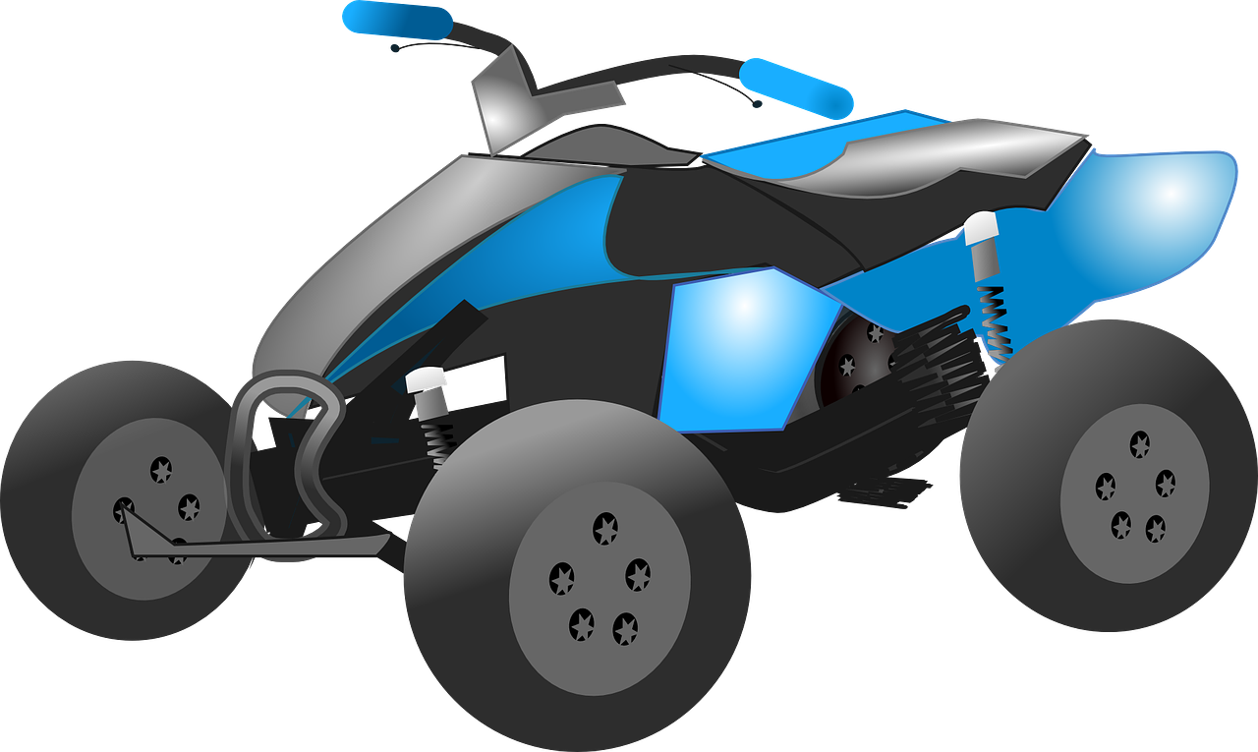
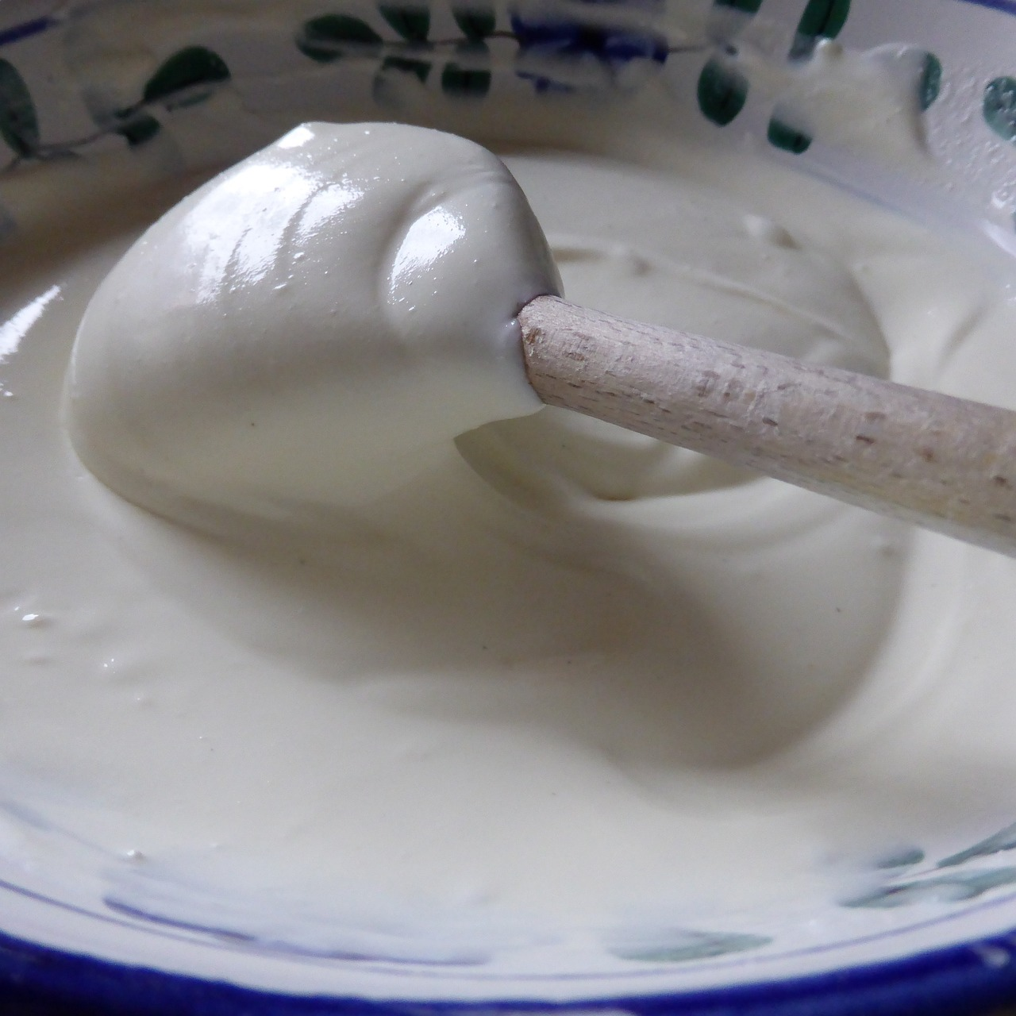
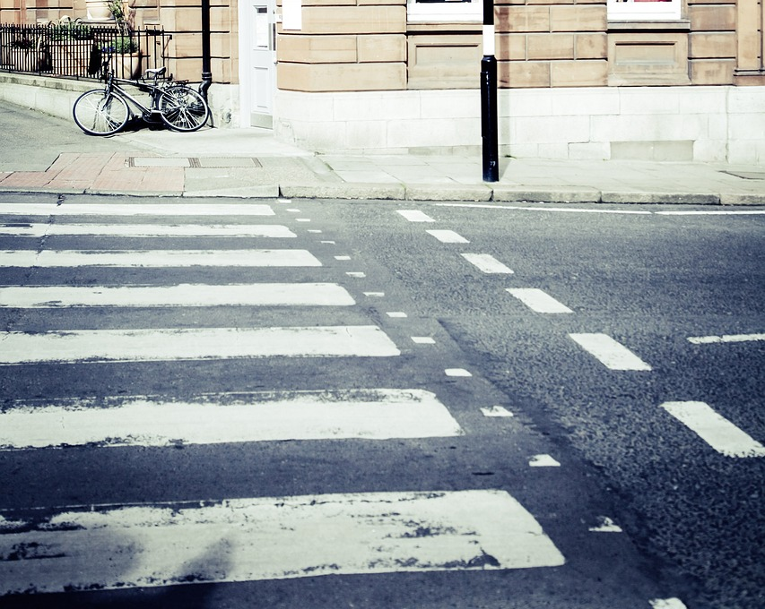
[qu]
Hör zu. Ist das [qu] oder [k] [w]?
Bockwurst | Starkwind | Qualifikation
Kaulquappe | Mosaikwand | Quadfahren
Quark | Überquerung | Trinkwasser
hören
_
_
_
_
_
_
_
_
_
Notes:
Timing: 5 minutes Aim: to differentiate between [qu] and [k] [w]. Procedure: 1. Click on the pictures to hear the words.
2. Students note down whether they hear [qu] or [k] [w] for each gap.
3. Click to reveal answers.
Transcript:
Bockwurst
Starkwind
Qualifikation
Kaulquappe
Mosaikwand
Quadfahren
Quark
Überquerung
Trinkwasser
Word frequency (1 is the most frequent word in German): Bockwurst [>5000] Kaulquappe [>5000] Mosaikwand [>5000] Starkwind [>5000] Trinkwasser [>5000] Überquerung [>5000] Quadfahren [>5000] Qualifikation [3600] Quark [>5000] Source: Jones, R.L. & Tschirner, E. (2019). A frequency dictionary of German: core vocabulary for learners. Routledge

Slide 9
Peter
Was möchte Peter (nicht) machen?
Peter is Heidi’s friend and lives in the Alps near the village of Dorfli. He is a goatherd.
lesen
Remember, after most verbs, masculine kein becomes keinen.
For feminine nouns use keine.
For neuter nouns use kein.
Ein works the same way.
Peter möchte...
1 | eine Stunde|Jahr in Dorfli bleiben.
2 | ein Butterbrot|Gitarre bekommen.
3 | keinen Hausaufgabe|Fehler machen.
4 | keine Haus|Schule besuchen.
5 | keinen Text|Geschichte lesen.
6 | eine Ziege*|Fahrrad haben.
7 | kein Papier |Jacke benutzen.
1
2
3
4
5
6
7
*die Ziege - goat
Notes:
Timing: 5 minutes Aim: to practise sentences using ein and kein in preparation for pupils writing about their own character. To recap using keinen, keine, and kein and einen, eine and ein after verbs. To recap various nouns that pupils could use in their own creations. Procedure: 1. Pupils read the callout reminding them how to use kein and ein after verbs.
2. They then read about Peter and decide which of the two options in each sentence Peter would or wouldn’t like to do, based on the form of kein or ein used and the gender of the nouns.
3. Click to reveal answers.
4. Pupils decide whether each sentence is positive or negative.
5. Click to reveal answers.
Word frequency (1 is the most frequent word in German): Ziege [>5000] Source: Jones, R.L. & Tschirner, E. (2019). A frequency dictionary of German: core vocabulary for learners. Routledge
9

Slide 10
Heidi möchte…
Peter möchte…
schreiben
mit Opa wohnen.
mit Peter spielen.
lesen und schreiben.
in Frankfurt nicht arbeiten.
in Frankfurt nicht bleiben.
Opa besuchen.
in die Alpen* fahren.
einen Brief bekommen.
eine Stunde in Dorfli bleiben.
ein Butterbrot bekommen.
keinen Fehler machen.
keine Schule besuchen.
keinen Text lesen.
eine Ziege* haben.
kein Papier benutzen.
*die Ziege – goat
die Alpen – Alps
Notes:
Timing: as required (there is also more time for this activity in the follow ups)
Aim: to practise productive use of möcht- and the 2-verb rule. To write a story about a character who lives in the mountains or in a city and the things they would or wouldn’t like to do.
Note: Pupils could write about Heidi or Peter, or they could create a new character. Bonus points for creating a name that uses this week’s or last week’s SSCs [pf] [kn] [qu] [y]!
Procedure:
Pupils read each story again for inspiration for their own stories.
They are encouraged to use a mixture of sentences with möchte, möchte nicht and möchte ein and möchte kein in their stories. Bonus points for pupils who use all four structures in their story.
Pupils may use the verb and noun pictures on the following slide for inspiration, and could look up additional nouns in a dictionary should they wish. They could also use the phonics exercises from this week and last week, as they contain some mountain-inspired vocabulary.
Pupils could work alone, in pairs, or small groups. They are encouraged to illustrate their stories. Pupils could write their stories on A3 paper to be displayed in the classroom. Each pupil could contribute a sentence to a class story which then could be performed in assembly. Pupils are encouraged to think of a corresponding action for their sentence.
Word frequency (1 is the most frequent word in German): Alpen [4099] Ziege [>5000] Source: Jones, R.L. & Tschirner, E. (2019). A frequency dictionary of German: core vocabulary for learners. Routledge

Slide 11
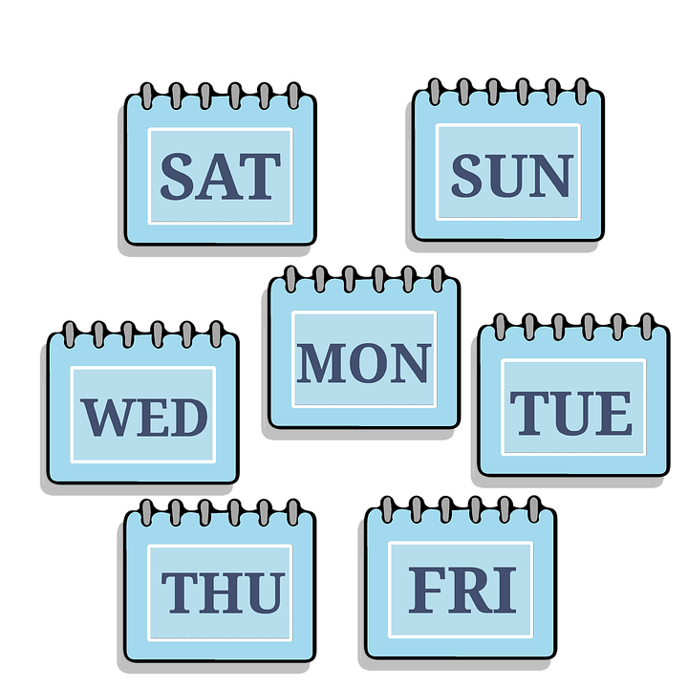
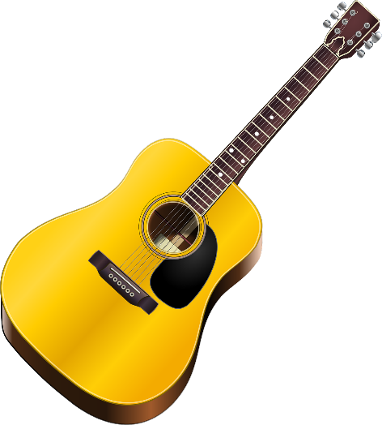
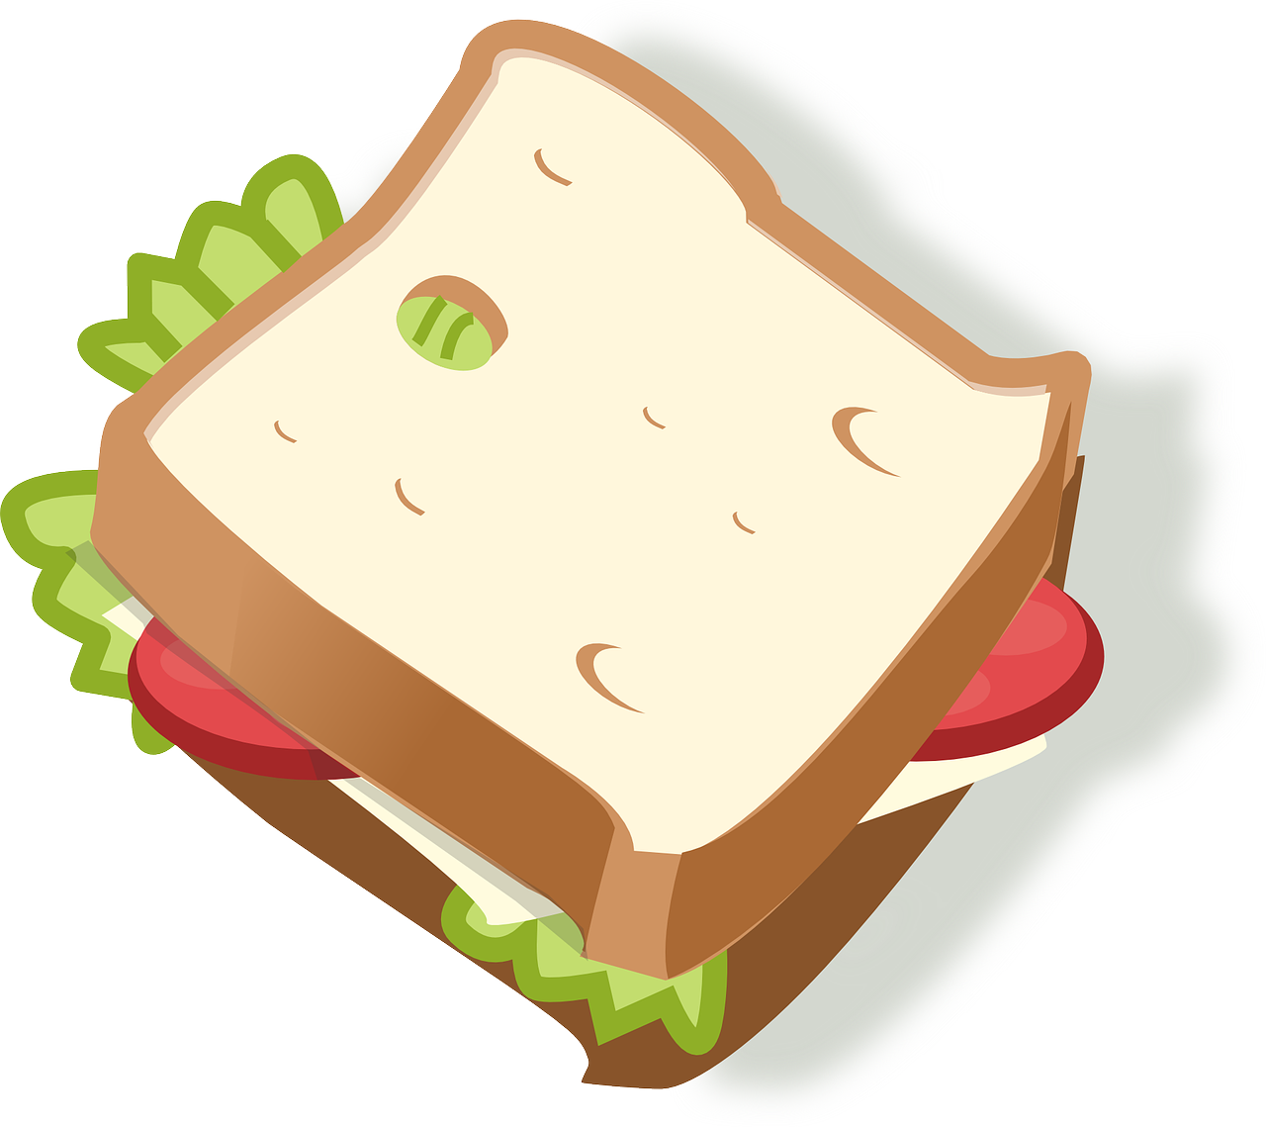
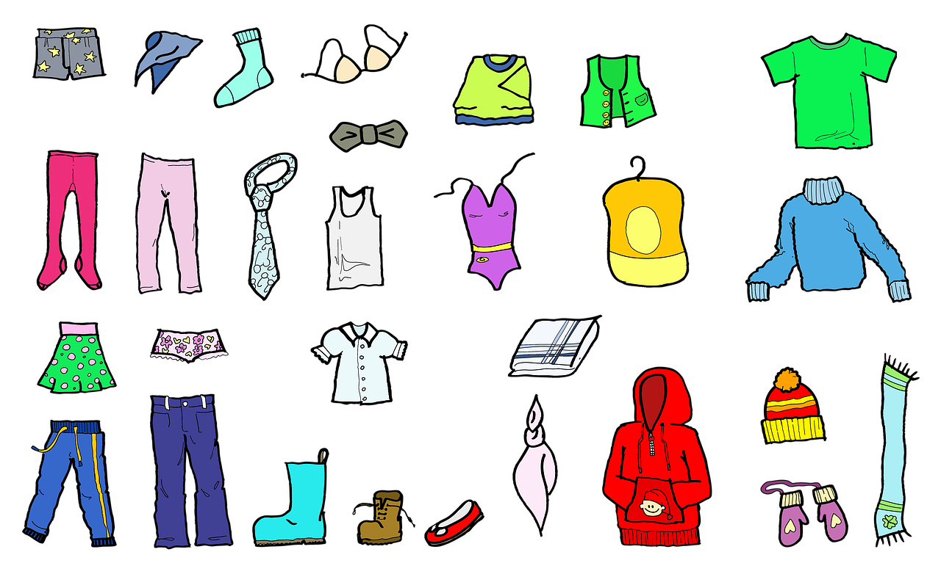
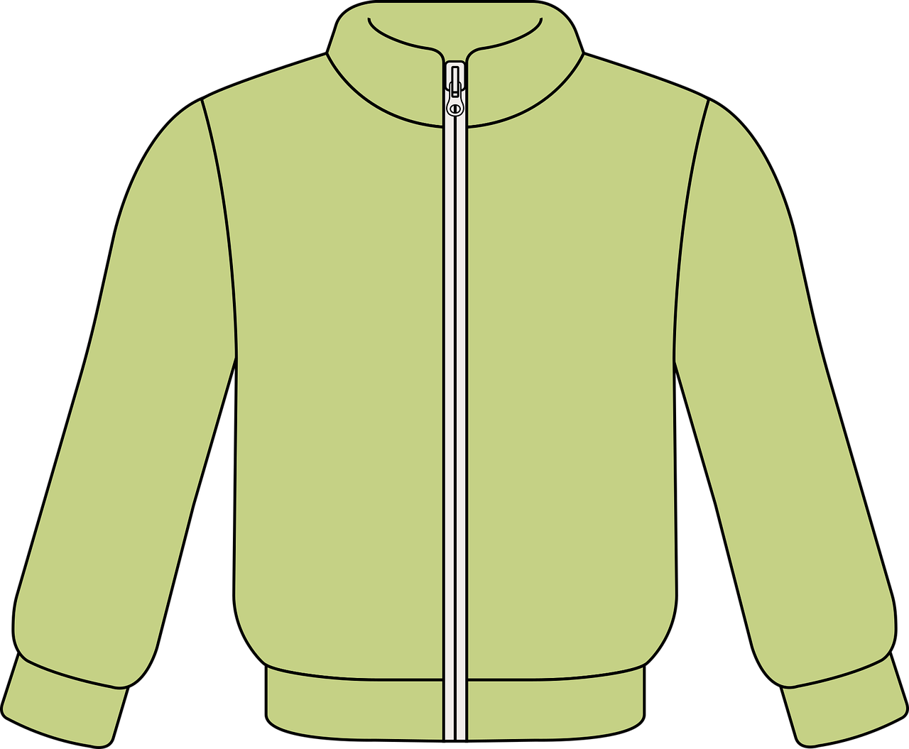
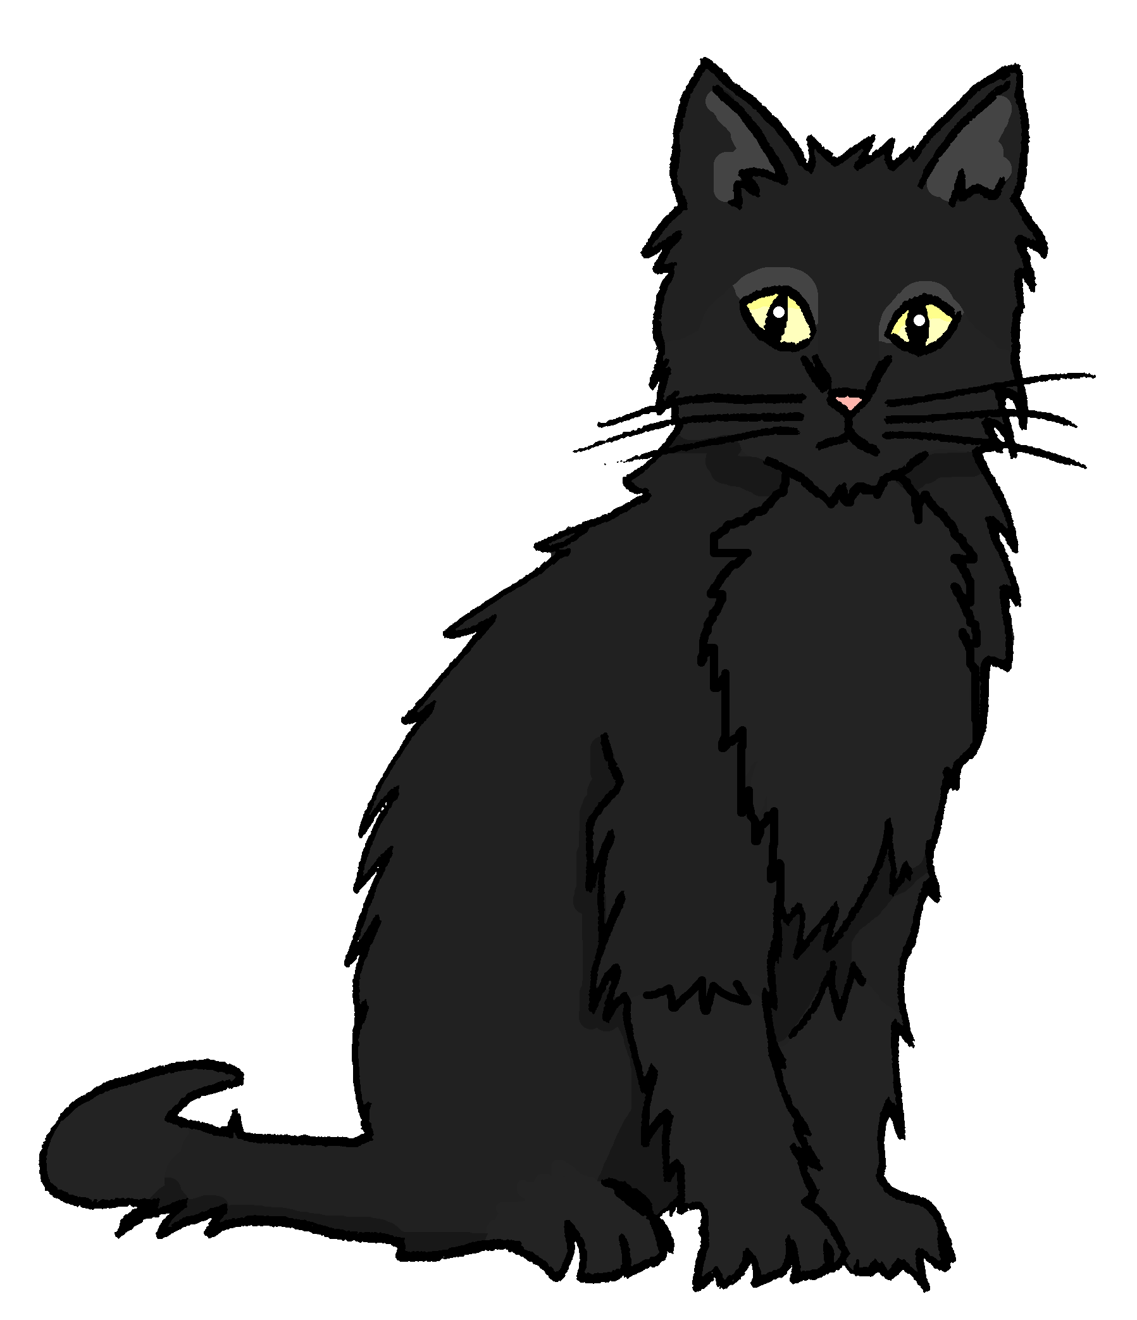
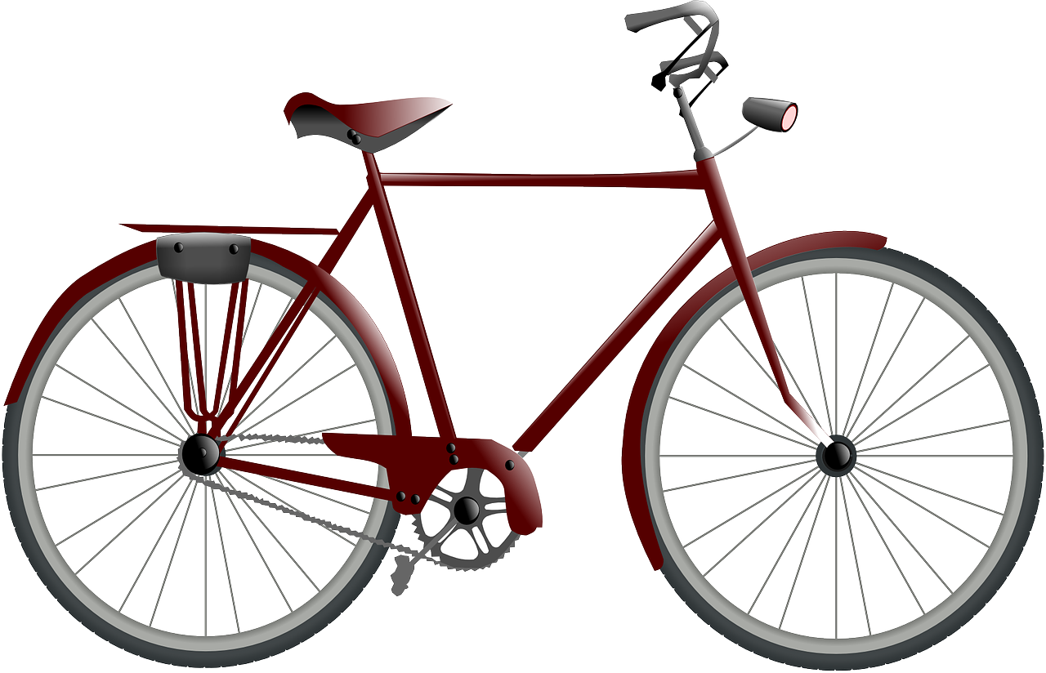
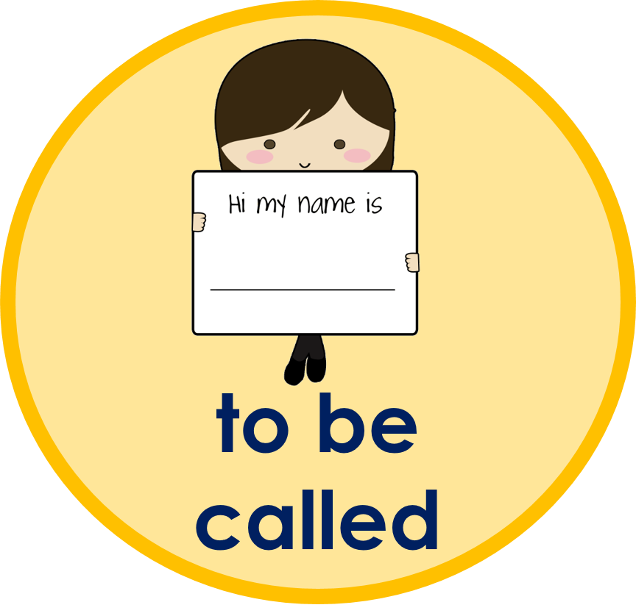
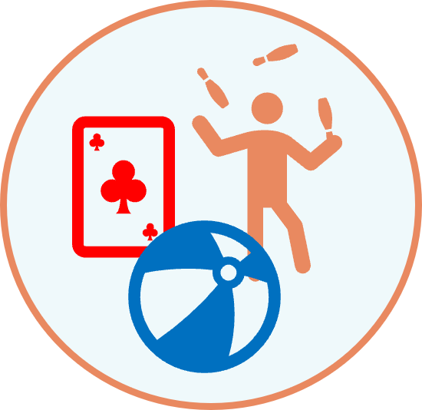
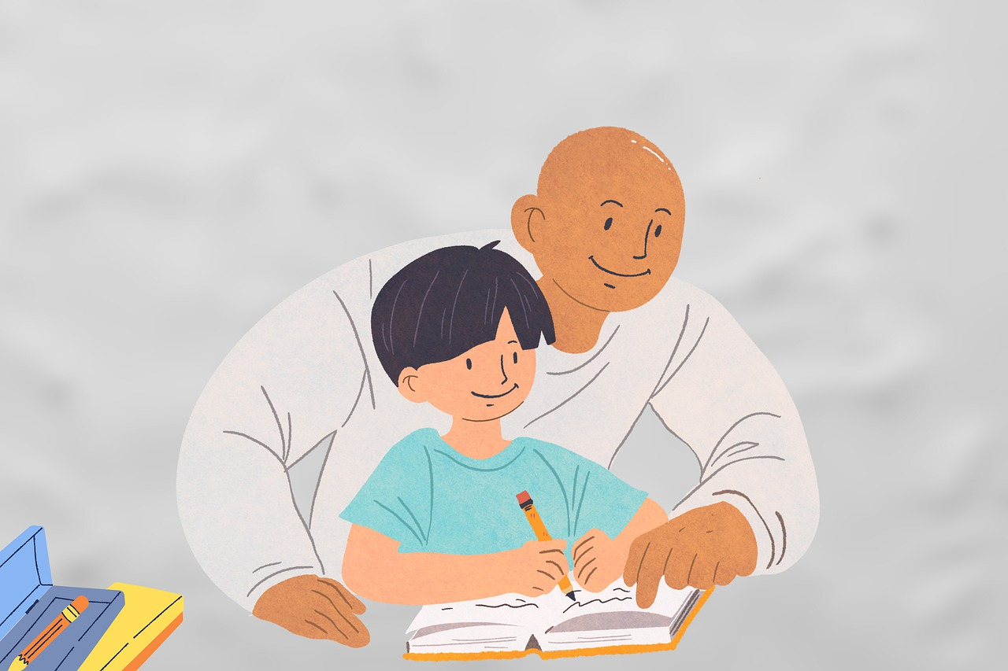
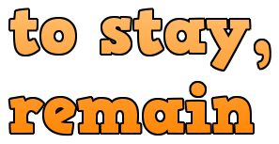
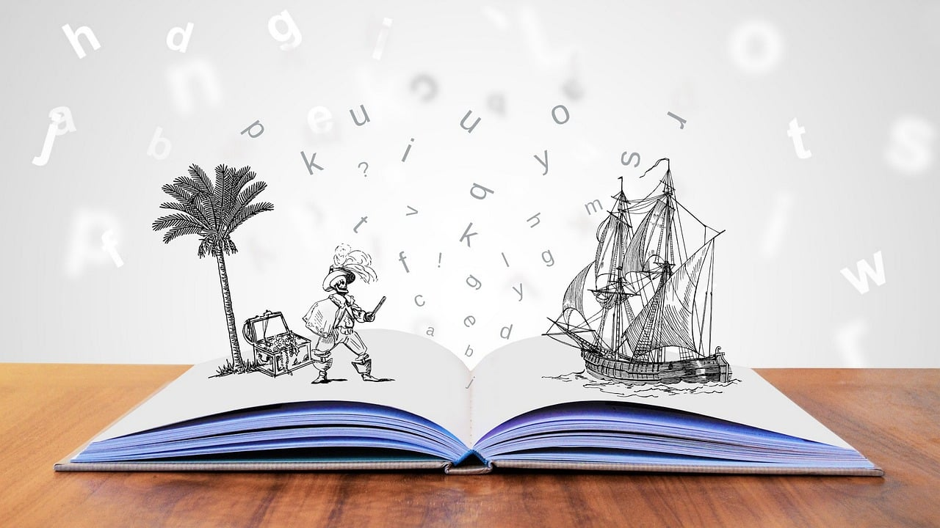
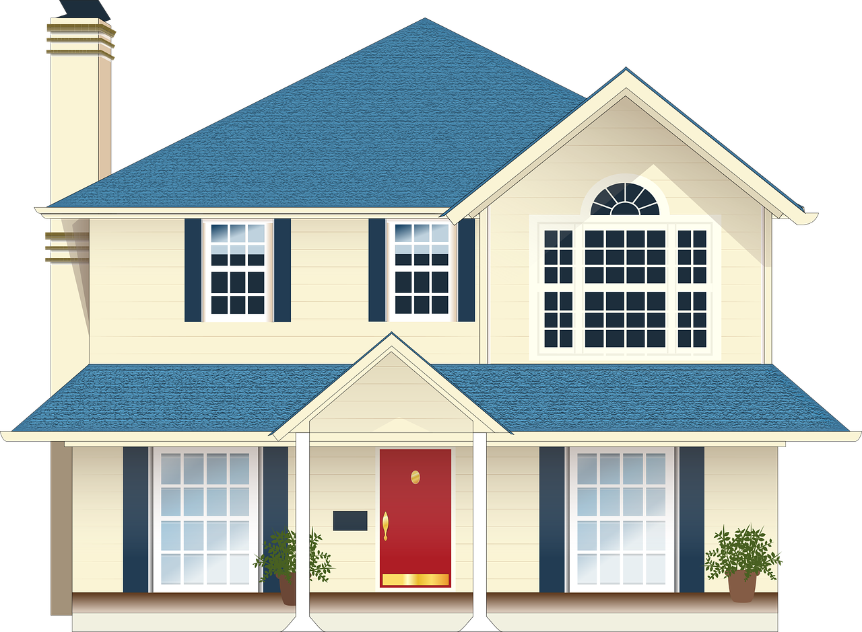
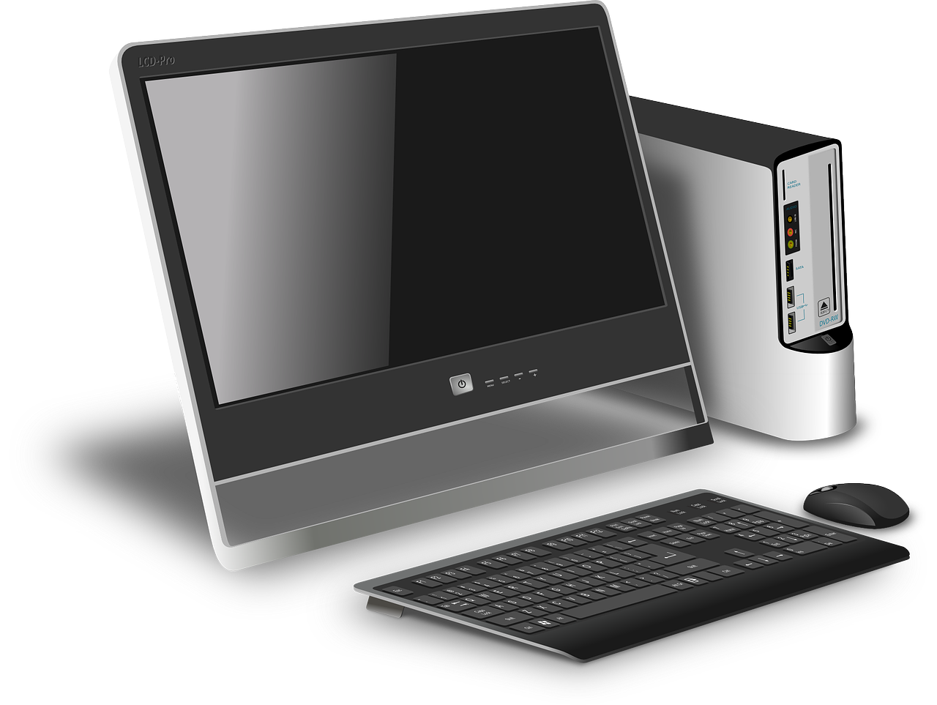
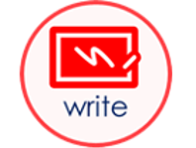
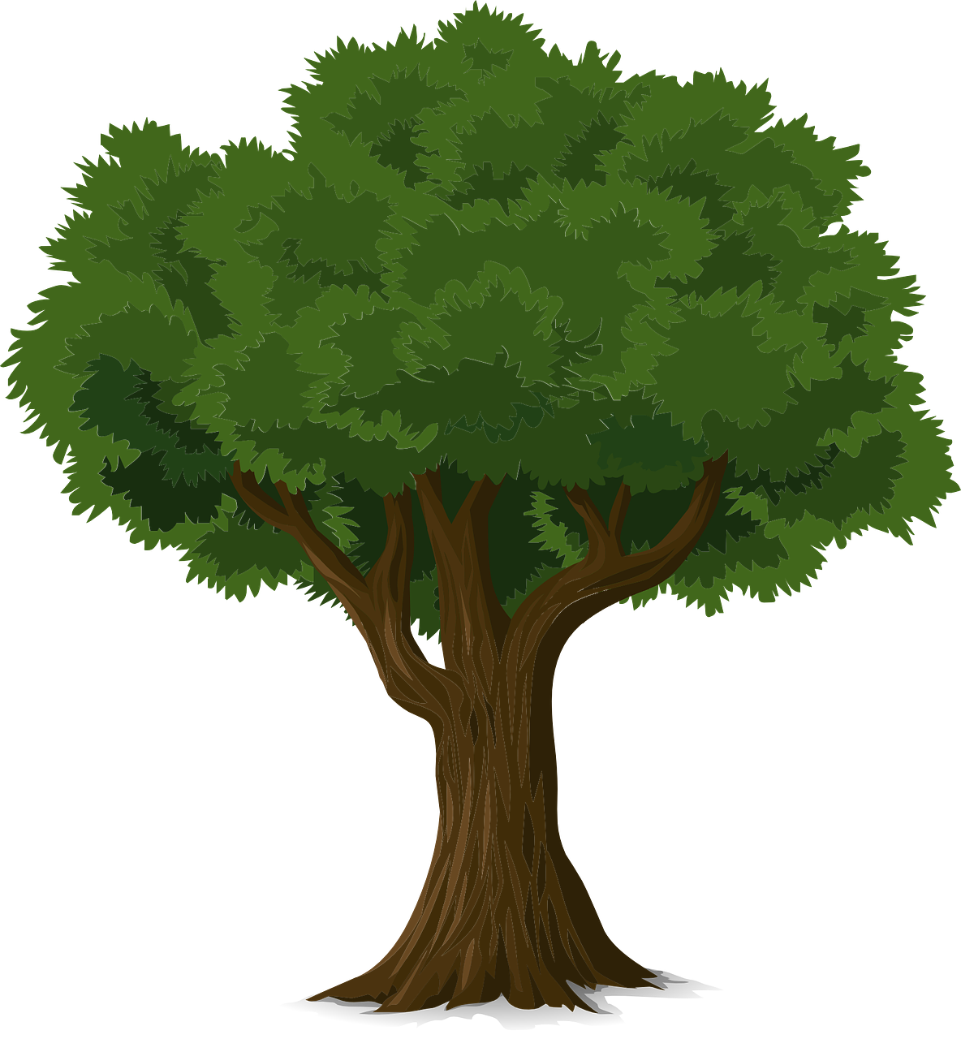
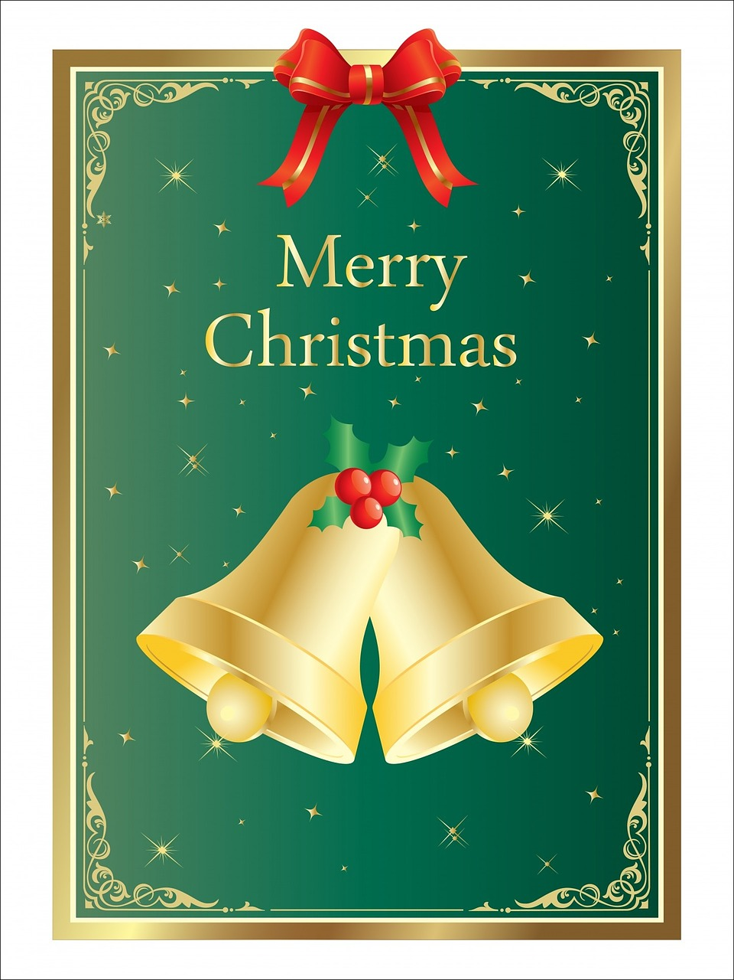
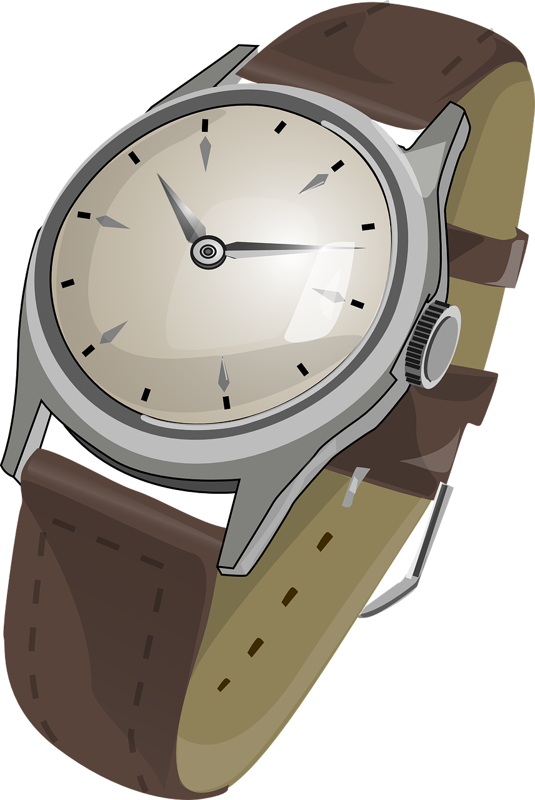
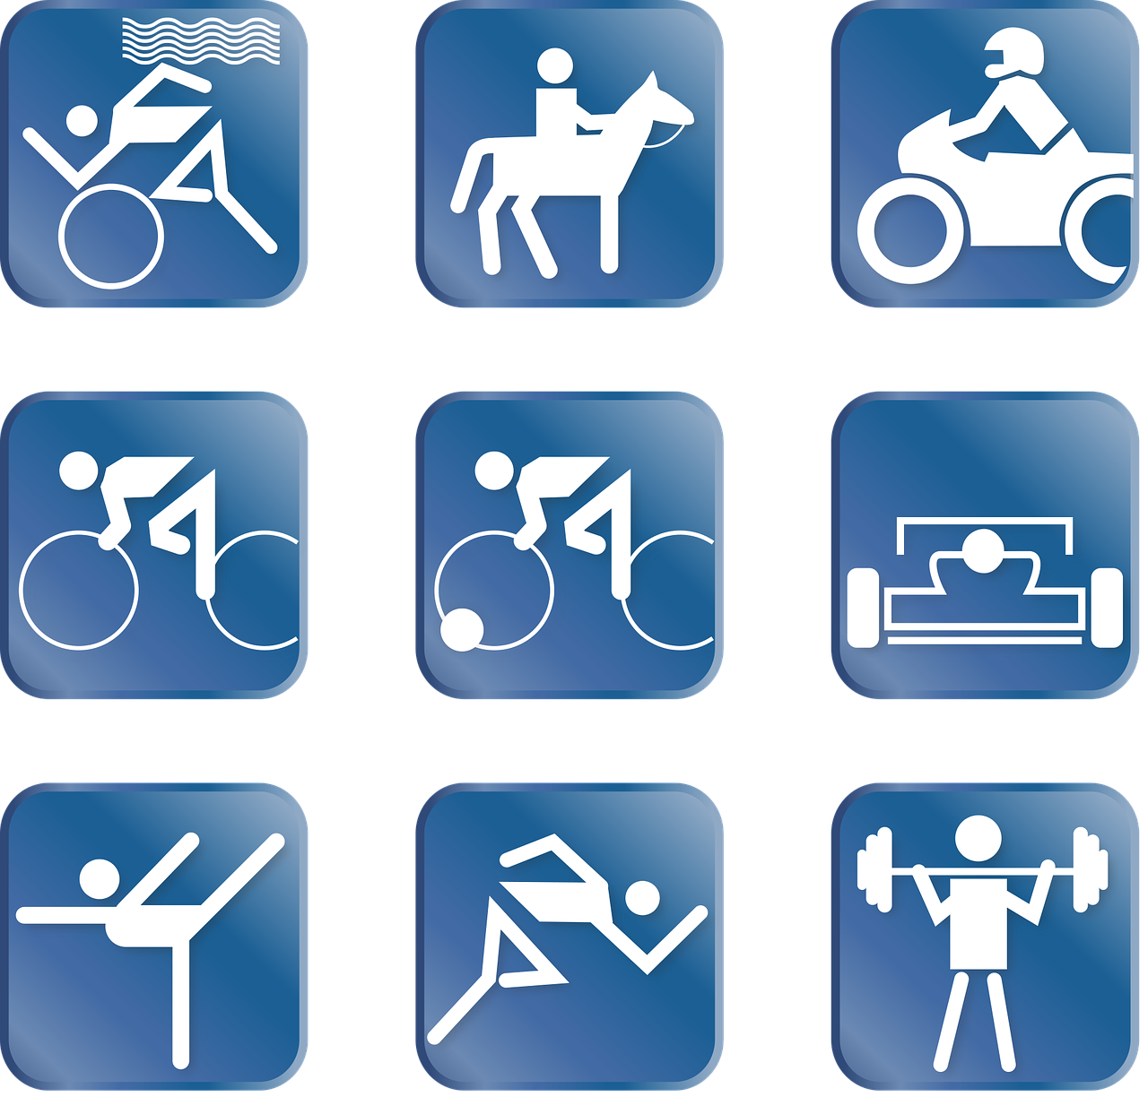
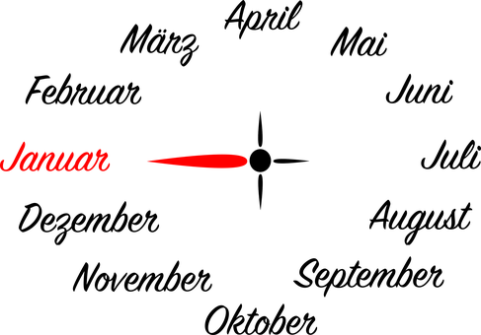
Verbs
Nouns
Notes:
Use these pictures for inspiration

Slide 12
Tschüss!
gelb
Notes:
12

