Slide 1
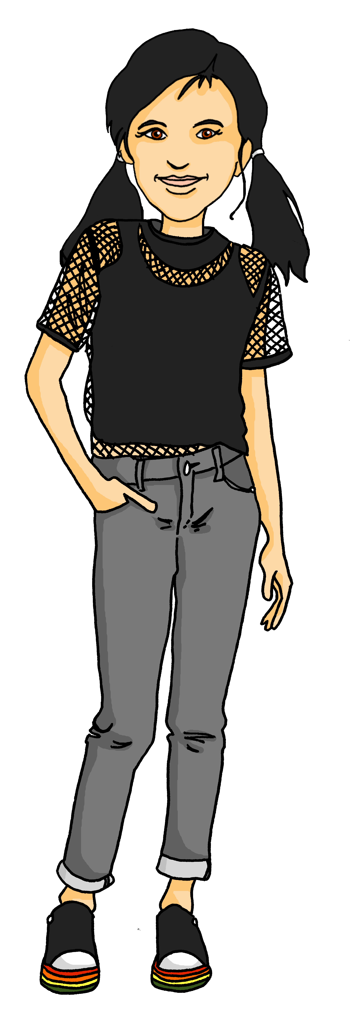
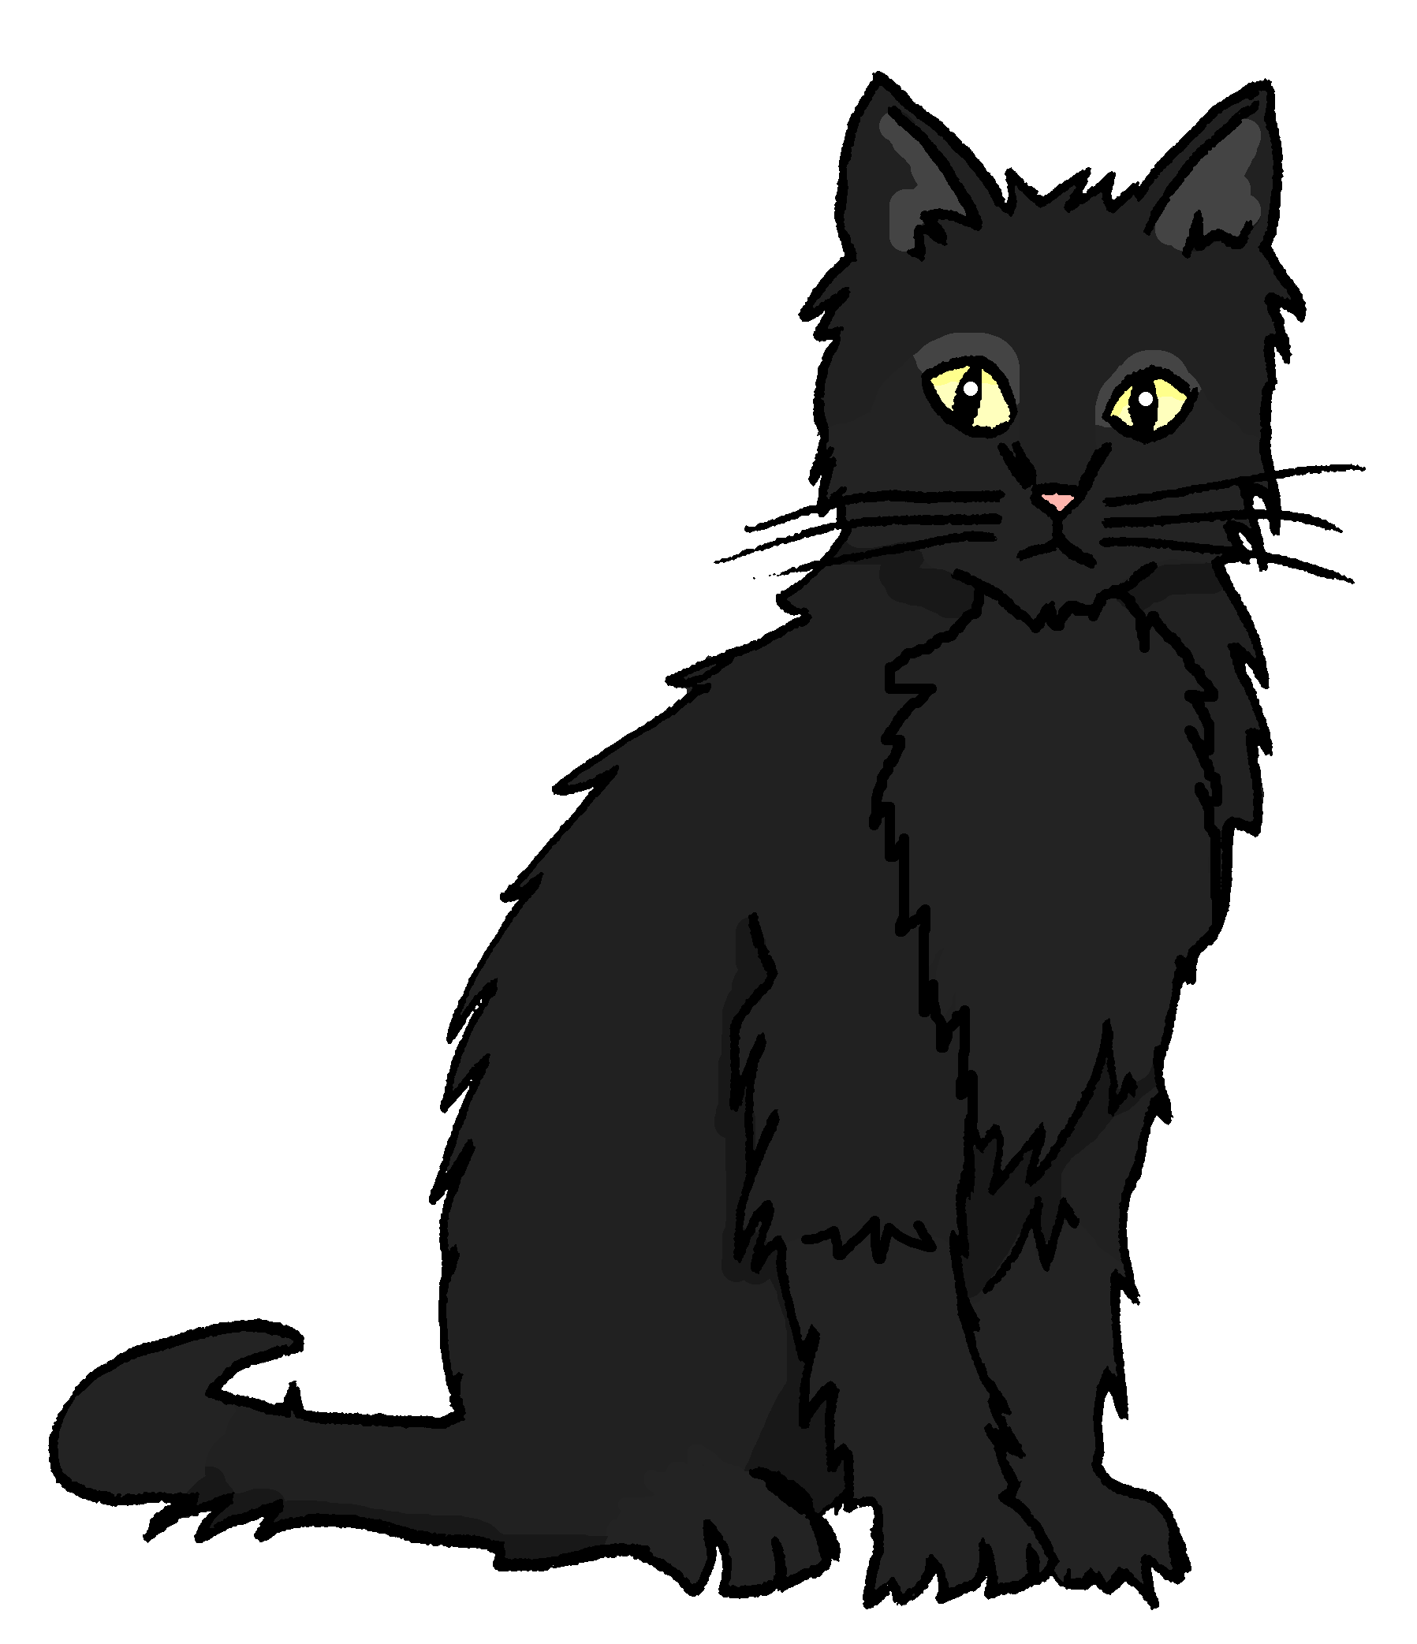
Talking about activities and events
gelb
Follow ups 1-5
Term 3 Week 8
Notes:
Artwork by Steve Clarke. Pronoun pictures from NCELP (www.ncelp.org). All additional pictures selected from Pixabay and are available under a Creative Commons license, no attribution required.
Phonics: [th] Theater [1086] Bibliothek [2366] Mathematik [1636]
Vocabulary: heißen [126] wohnen [560] Jahr [53] Minute [324] Stunde [276] jung [199]
Revisit 1: fahren [215] möcht-, ich möchte, du möchtest [n/a]
Revisit 2: revisit language from Term 2
Jones, R.L & Tschirner, E. (2019). A frequency dictionary of German: Core vocabulary for learners. London: Routledge.
The frequency rankings for words that occur in this PowerPoint which have been previously introduced in these resources are given in the SOW and in the resources that first introduced and formally re-visited those words.
For any other words that occur incidentally in this PowerPoint, frequency rankings will be provided in the notes field wherever possible.
Note that the first three lessons of the year teach language that can be continuously recycled as lesson routine every lesson in Y3/4.
The idea would be that the class teacher (whether or not s/he teaches the class German can re-use the language as part of the daily routine with the class.

Slide 2
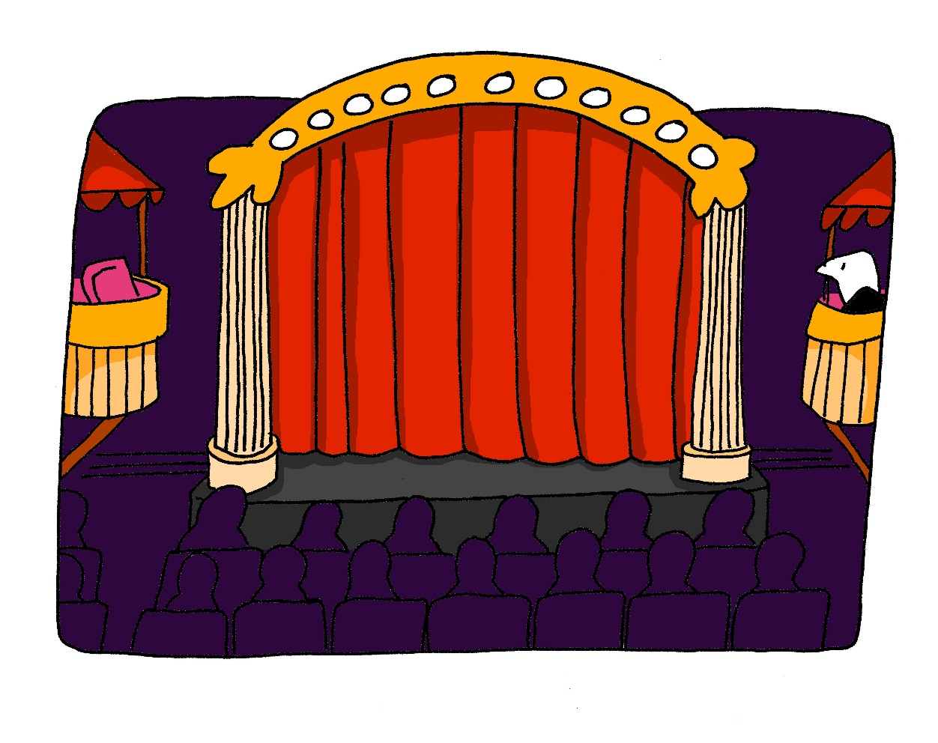
aussprechen
[th]
…
Theater
Notes:
Timing: 1 minute
Aim: to present the SSC [th].
Procedure:
1. Present the letter and say the [th] sound first, on its own. Pupils repeat it with you. 2. Bring up the word ”Theater” on its own, say it, pupils repeat it, so that they have the opportunity to focus all of their attention on the connection between the written word and its sound.
3. Click to bring up the picture and introduce the gesture, if using. Pupils repeat the word again.
4. Roll back the animations and work through 1-3 again, but this time, dropping your voice completely to listen carefully to the students saying the [th] sound, pronouncing ”Theater” and, if using, doing the gesture.
Note: A possible gesture for this would be to mime the opening of a theatre’s curtains, by drawing your hands away from each other quickly, in front of your body. This is very much like the gesture for ‘play’ in charades.
Frequency: Theater [1086]
Jones, R.L & Tschirner, E. (2019). A frequency dictionary of German: Core vocabulary for learners. London: Routledge.
2

Slide 3
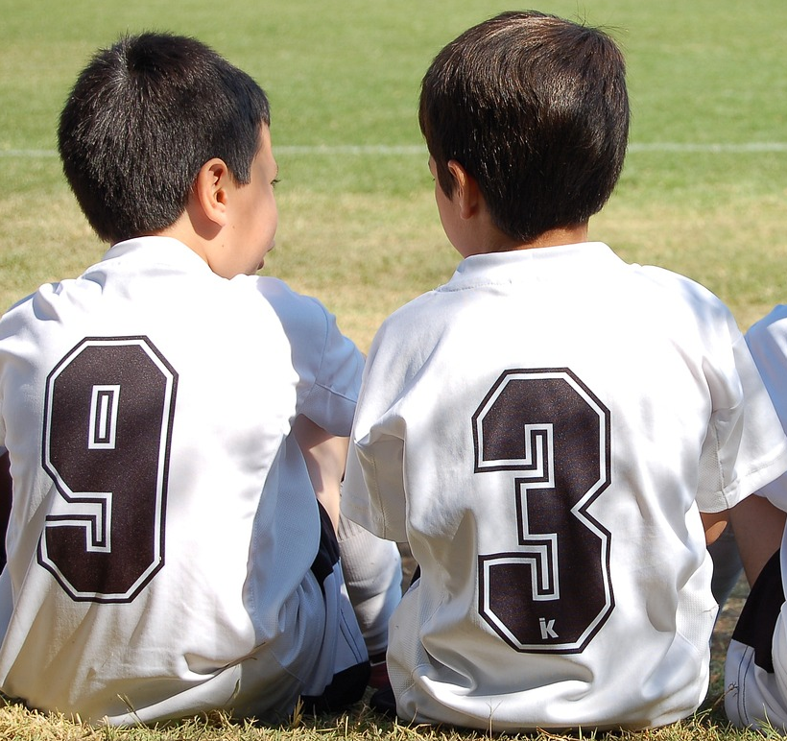
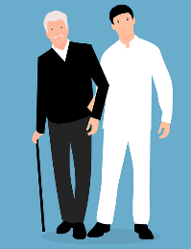
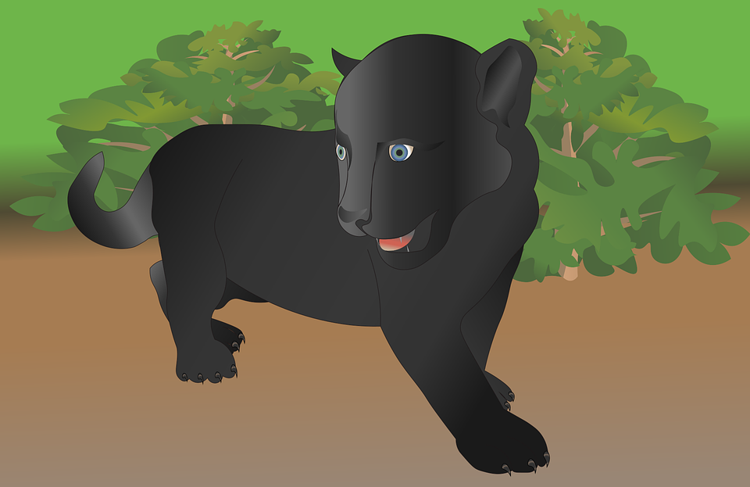
Follow up 1
Hör zu. Ist das [th] oder [t] [h]?
In German, [th] is pronounced ‘t’ when both letters are in the same syllable, like Theater.
In compound words, and when the letters are in different syllables, the ‘t’ and ‘h’ are both pronounced separately, like Sporthalle.
hören
1
2
3
4
Athlet
Discothek
Rathaus
Theorie
5
6
7
8
Sporthemd
Mithilfe
gutheißen
Panther
Notes:
Timing: 5 minutes
Aim: to practise contrasting [th] with [t] [h].
Procedure: 1. Read the explanation and ensure pupils can understand the difference between the [th] in Theater and [t] [h] in Sporthalle.
2. Click on the audio buttons to hear the words. Pupils write 1-8 and note down whether they heard [th] together or [t] [h] separately.
3. Click to reveal answers.
Transcript:
1. Athlet 2. Discothek 3. Rathaus 4. Theorie 5. Sporthemd 6. Mithilfe 7. gutheißen 8. Panther
Word frequency (1 is the most frequent word in German): Athlet [3316] Discothek [>5000] gutheißen [>5000] Mithilfe [>5000] Panther [>5000] Rathaus [3960] Sporthemd [>5000] Theorie [1064] Source: Jones, R.L. & Tschirner, E. (2019). A frequency dictionary of German: core vocabulary for learners. Routledge

Slide 4
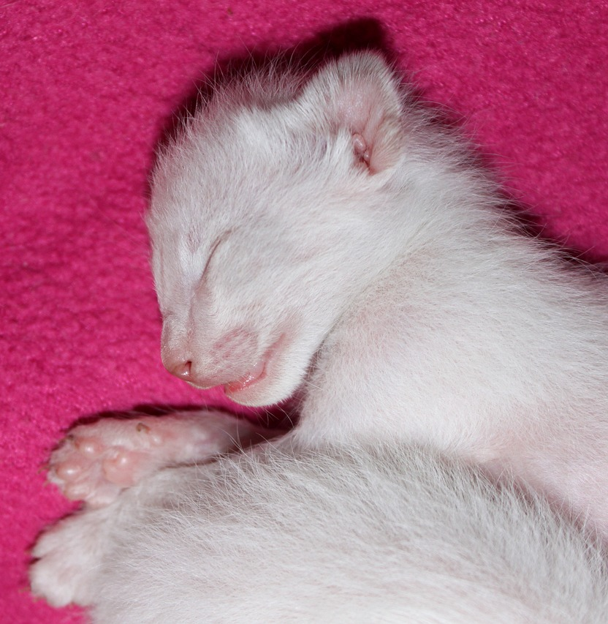
Follow up 2a
Ronja und Olivia
Ist das richtig?
Sie heißt Niesen.
lesen
1
She is Niesen.
She is called Niesen.
2
Sie ist jung.
She is old.
She is young.
3
Sie ist zehn Stunden alt.
4
She is ten months old.
She is ten hours old.
Minze wohnt in Biel.
5
Minze stays in Biel.
Minze lives in Biel.
6
Sie ist vier Jahre alt.
She is four seconds old.
She is four years old.
Notes:
Timing: 5 minutes
Aim: to practise this week’s new vocabulary.
Procedure:
Explain the task. Ronja is telling Olivia about the kittens. She translates her sentences into English for Olivia, but has made some mistakes.
Pupils read each sentence and write down the word that Ronja has translated incorrectly. More proficient pupils may also like to write down the correct translation.
Click to reveal answers.

Slide 5
Follow up 2b
Ronja und Olivia
Was sagt Olivia?
lesen
Sie heißt Niesen.
Wie alt ist sie?
Wo wohnt sie?
Sie ist zehn Stunden alt.
Wie heißt sie?
Minze wohnt in Biel.
In German, we say “how are you called?”
Sie ist vier Jahre alt.
Notes:
Timing: 3 minutes
Aim: to practise asking questions using this week’s new vocabulary, to introduce “Wie heißt…?”
Procedure:
Click to reveal a callout explaining “Wie heißt…?”
Explain the task. Olivia asked Ronja questions about the cats. Pupils read each sentence and decide which of the three questions Olivia asked Ronja.
Click to reveal answers.

Slide 6
Follow up 3:

Schreib auf Englisch.
Can you get at least 15 points?
Wörter
 | das Papier | das Spiel | bekommen
 | spielen | haben | die Katze
 | ich möchte | fahren | möcht-
 | du möchtest | der Monat | alt
 | das Jahr | heißen | die Minute
 | wohnen | jung | die Stunde
(the) paper
(the) game
to receive, receiving
Vokabeln
Vokabeln
x3
to play, playing
to have, having
(the) cat
I would like
to go (transport)
would like
x2
you would like
(the) month
old
(the) year
to be called
(the) minute
x1
to live, living
young
(the) hour
Notes:
Timing: 5 minutes
Aim: to practise written comprehension of vocabulary from this and revisited weeks.
Procedure: 1. Give pupils a blank grid. They fill in the English meanings of any of the words they know, trying to reach 15 points in total. 2. Remind pupils that adjectives can refer to male or female persons and they should note this in their translations. E.g. pleased (f), short (m).
Note: The most recently learnt and practised words are pink, words from the previous week are green and those from week 1 are blue, thus more points are awarded for them, to recognise that memories fade and more effort (heavy lifting!) is needed to retrieve them.

Slide 7
Follow up 3:

Schreib auf Deutsch.
Can you get at least 15 points?
Wörter
 | to have, having | to play, playing | (the) paper
 | (the) cat | to receive, receiving | (the) game
 | (the) month | you would like | I would like
 | old | would like | to go (transport)
 | young | to live, living | (the) year
 | (the) hour | (the) minute | to be called
haben
spielen
das Papier
Vokabeln
x3
die Katze
bekommen
das Spiel
der Monat
du möchtest
ich möchte
x2
alt
möcht-
fahren
jung
wohnen
das Jahr
x1
die Stunde
die Minute
heißen
Notes:
Timing: 5 minutes
Aim: to practise written production of vocabulary from this and revisited weeks.
Procedure: 1. Give pupils a blank grid. They fill in the German meanings of any of the words they know, trying to reach 15 points in total. 2. Remind pupils that adjectives can refer to male or female persons and they should note this in their translations. E.g. pleased (f), short (m).
Note: The most recently learnt and practised words are pink, words from the previous week are green and those from week 1 are blue, thus more points are awarded for them, to recognise that memories fade and more effort (heavy lifting!) is needed to retrieve them.

Slide 8
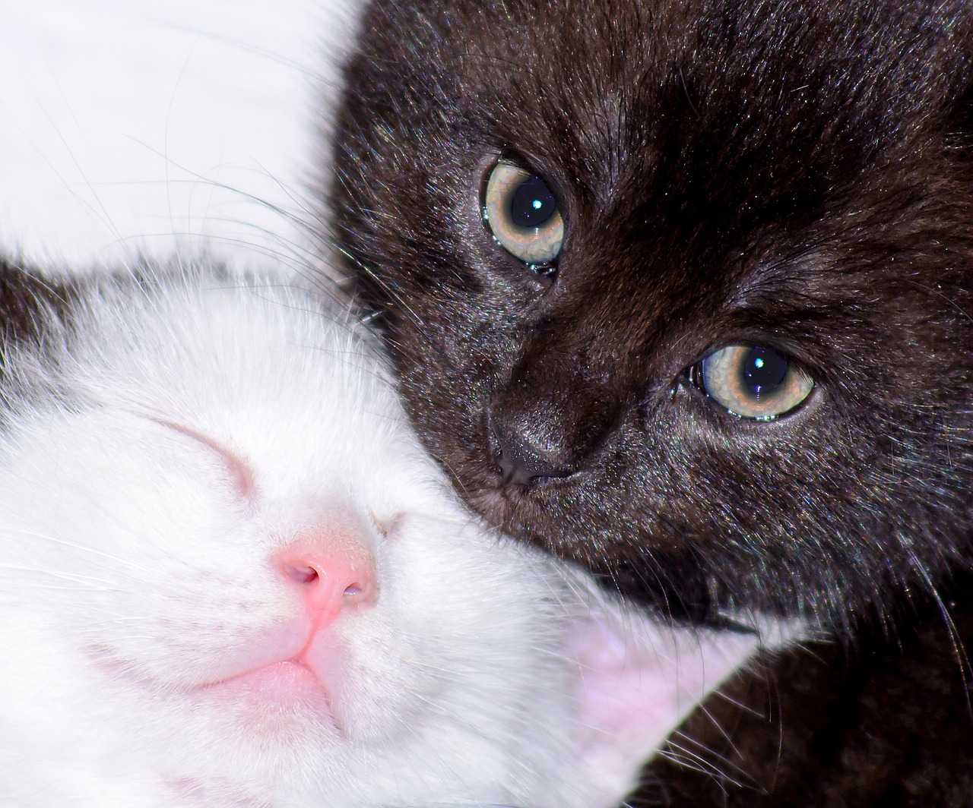
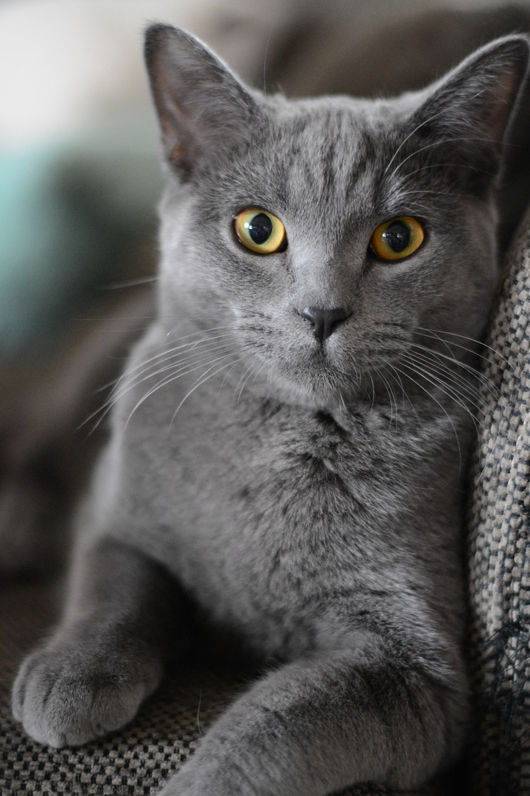
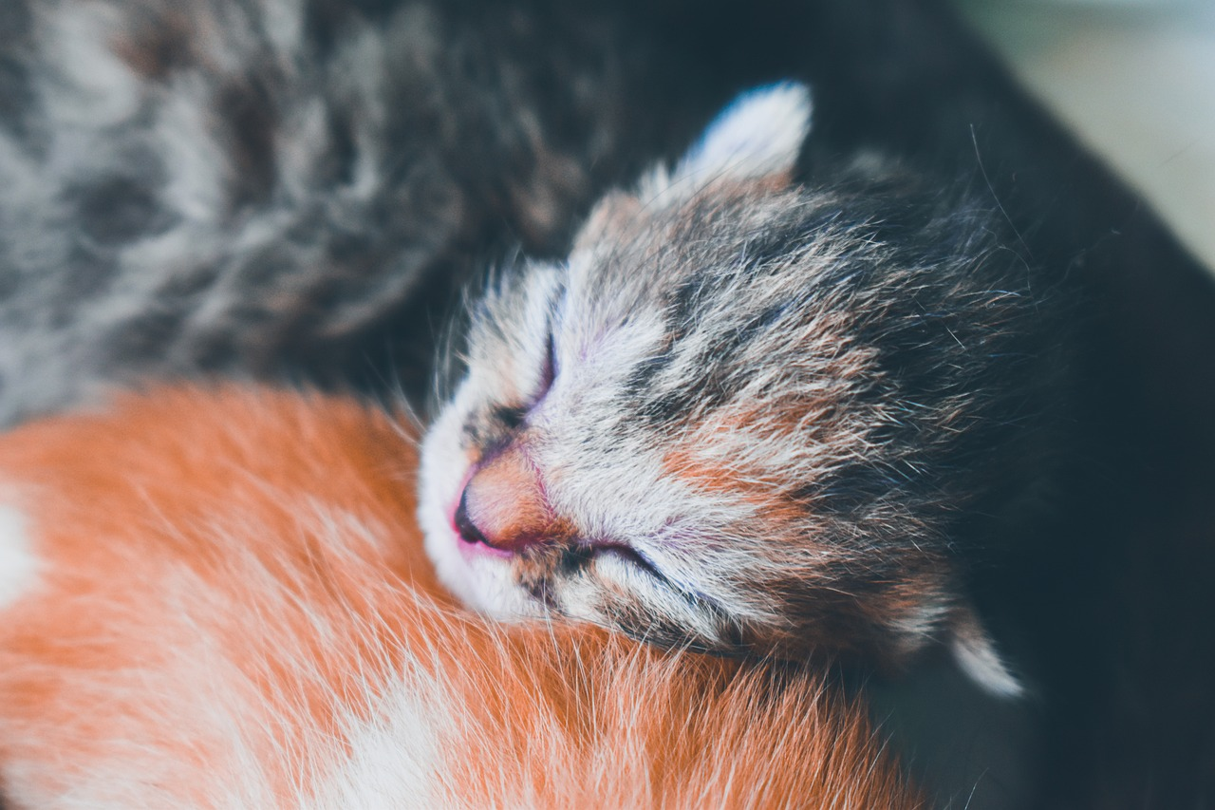
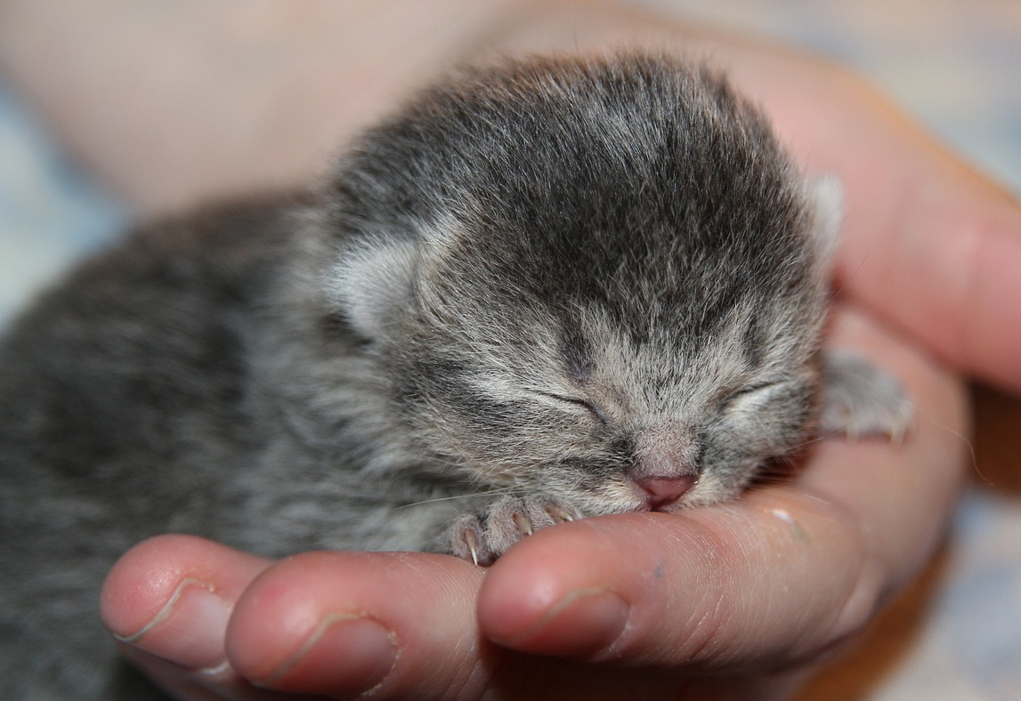
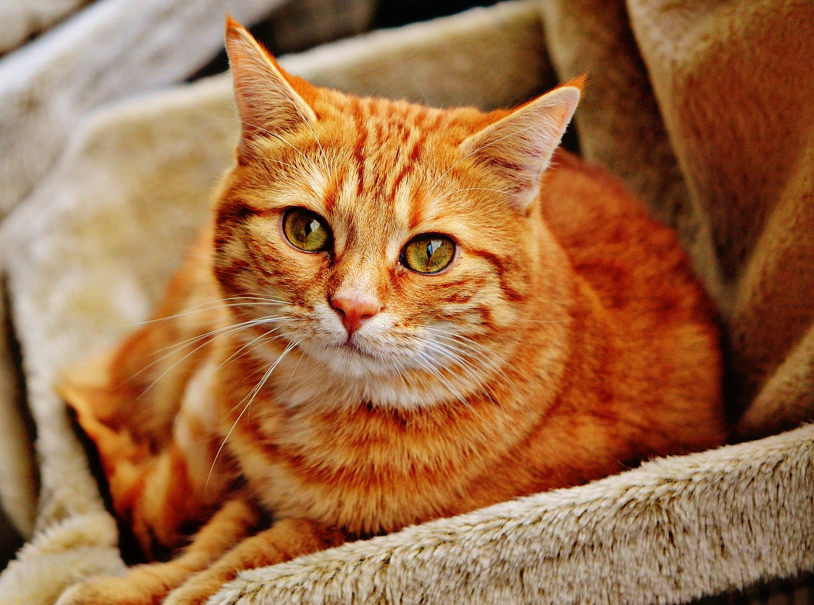
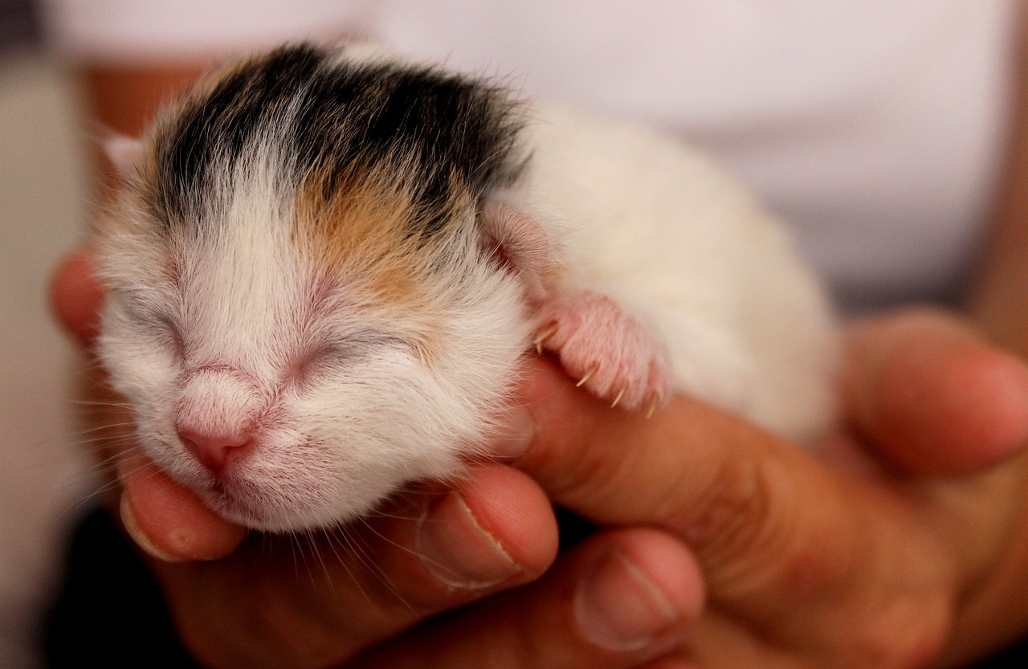
Follow up 4
Wie heißt er? Wie alt ist sie? Wo wohnt er? Was möchte sie machen?
Sie heißt Minze. Sie ist vier Jahre alt. Sie wohnt in Biel. Sie möchte einen Ball haben.
schreiben
Thea
= sie
Niesen
Matthias
= er
Biel
Bern
Winterthur
7 Stunden
11 Jahre
12 Minuten
ein Spiel bekommen
einen Ball haben
mit Papier spielen
Thorsten
Theodor
Rigi
Bern
Winterthur
Biel
11 Jahre
12 Minuten
7 Stunden
einen Ball haben
ein Spiel bekommen
mit Papier spielen
Notes:
Timing: 5 minutes
Aim: to practise written production of this week’s vocabulary and verbs in the third person, and to practise talking about age.
Procedure:
Use the sentences with Minze as an example.
Pupils are going to secretly choose one of the six cats to write about.
Using the prompts in the blue circle, they will write four sentences about their chosen cat.

Slide 9
Follow up 5
Wer bin ich?
Matthias
sprechen
Wo wohnst du?
Bern
Ich wohne in Bern.
11 Jahre
Wie alt bist du?
mit Papier spielen
Ich bin elf Jahre alt.
Thorsten
Was möchtest du machen?
Ich möchte einen Ball haben.
Bern
11 Jahre
Du heißt Thorsten!
einen Ball haben
Ja!
Notes:
Timing: 5 minutes (2 slides)
Aim: to practise spoken production of this week’s vocabulary and verbs in the first and second persons, to practise talking about age, to practise spoken production of [th].
Procedure:
Model the task using the conversation between Ronja and Lias.
Pupils work in pairs and try to work out which cat their partner wrote about in follow up 4 by asking questions in the second person. Their partner will respond as if they are the cat, in the first person.
Display the following slide during the activity, so pupils can see all the details about each cat. Depending upon the ability of the class, the questions pupils should ask each other can be displayed on the slide or hidden.

Slide 10
Follow up 5
Wer bin ich?
Wo wohnst du?
Wie alt bist du?
Was möchtest du machen?
sprechen
Niesen
Matthias
Thea
Biel
Bern
Winterthur
7 Stunden
11 Jahre
12 Minuten
ein Spiel bekommen
einen Ball haben
mit Papier spielen
Thorsten
Theodor
Rigi
Bern
Winterthur
Biel
11 Jahre
12 Minuten
7 Stunden
einen Ball haben
ein Spiel bekommen
mit Papier spielen
Notes:
[2/2]

Slide 11
Tschüss!
gelb
Notes:
11

Slide 12
Follow up 3:

Schreib auf Englisch.
Can you get at least 15 points?
Wörter
 | das Papier | das Spiel | bekommen
 | spielen | haben | die Katze
 | ich möchte | fahren | möcht-
 | du möchtest | der Monat | alt
 | das Jahr | heißen | die Minute
 | wohnen | jung | die Stunde
Vokabeln
Vokabeln
x3
x2
x1
Notes:
HANDOUT

Slide 13
Follow up 3:

Schreib auf Deutsch.
Can you get at least 15 points?
Wörter
 | to have, having | to play, playing | (the) paper
 | (the) cat | to receive, receiving | (the) game
 | (the) month | you would like | I would like
 | old | would like | to go (transport)
 | young | to live, living | (the) year
 | (the) hour | (the) minute | to be called
Vokabeln
x3
x2
x1
Notes:
HANDOUT

