Slide 1
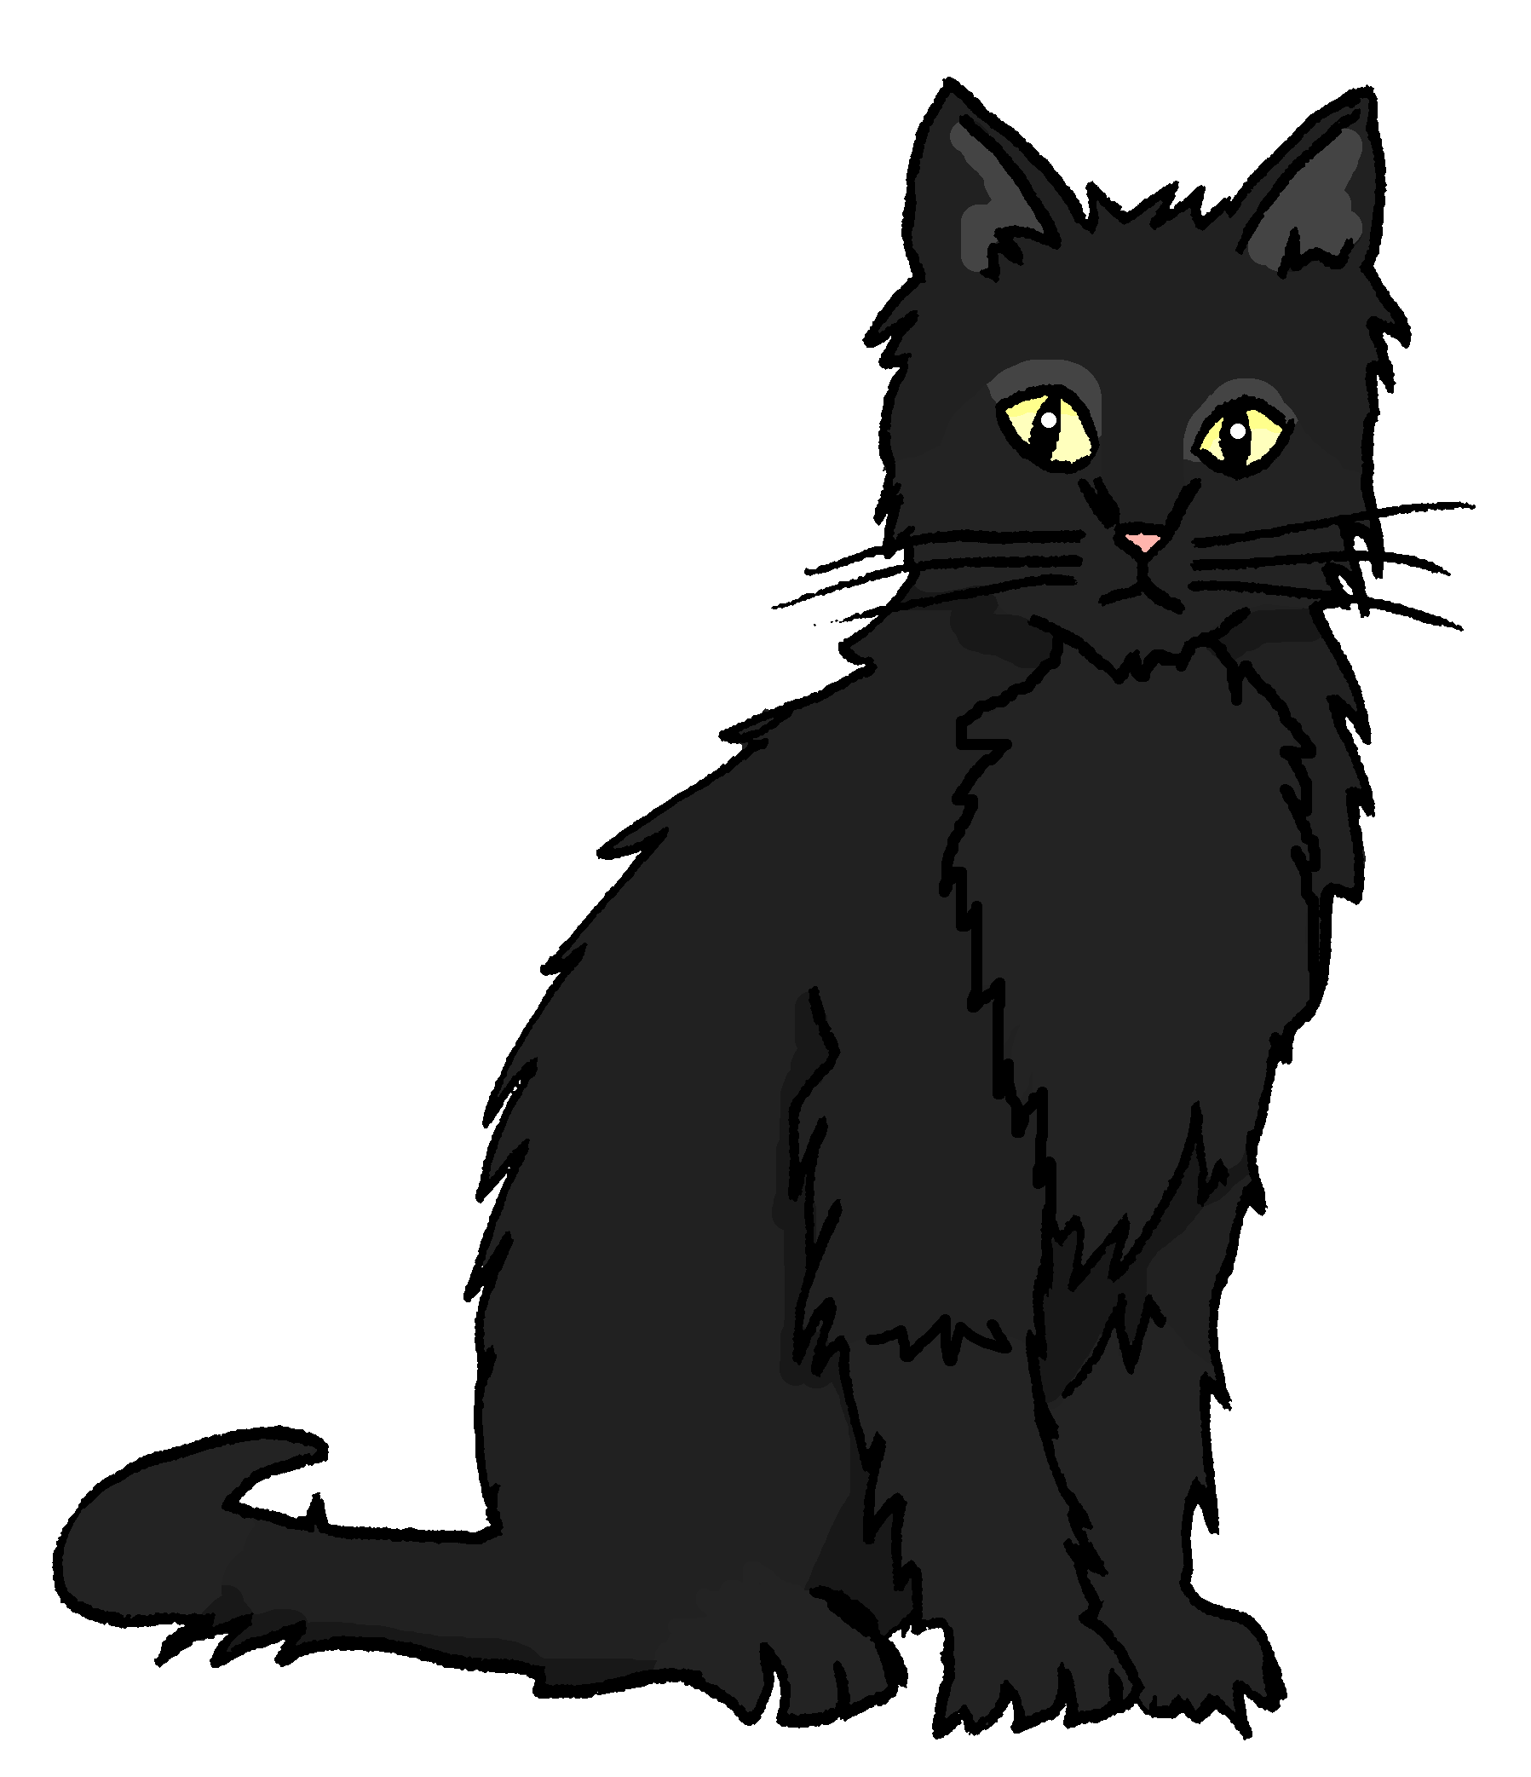
Talking about activities and events
gelb
Using verbs
SSC [th]
Term 3 Week 8
Notes:
Artwork by Steve Clarke. Pronoun pictures from NCELP (www.ncelp.org). All additional pictures selected from Pixabay and are available under a Creative Commons license, no attribution required.
Phonics: [th] Theater [1086] Bibliothek [2366] Mathematik [1636]
Vocabulary: heißen [126] wohnen [560] Jahr [53] Minute [324] Stunde [276] jung [199]
Revisit 1: fahren [215] möcht-, ich möchte, du möchtest [n/a]
Revisit 2: revisit language from Term 2
Jones, R.L & Tschirner, E. (2019). A frequency dictionary of German: Core vocabulary for learners. London: Routledge.
The frequency rankings for words that occur in this PowerPoint which have been previously introduced in these resources are given in the SOW and in the resources that first introduced and formally re-visited those words.
For any other words that occur incidentally in this PowerPoint, frequency rankings will be provided in the notes field wherever possible.
Note that the first three lessons of the year teach language that can be continuously recycled as lesson routine every lesson in Y3/4.
The idea would be that the class teacher (whether or not s/he teaches the class German can re-use the language as part of the daily routine with the class.
1

Slide 2
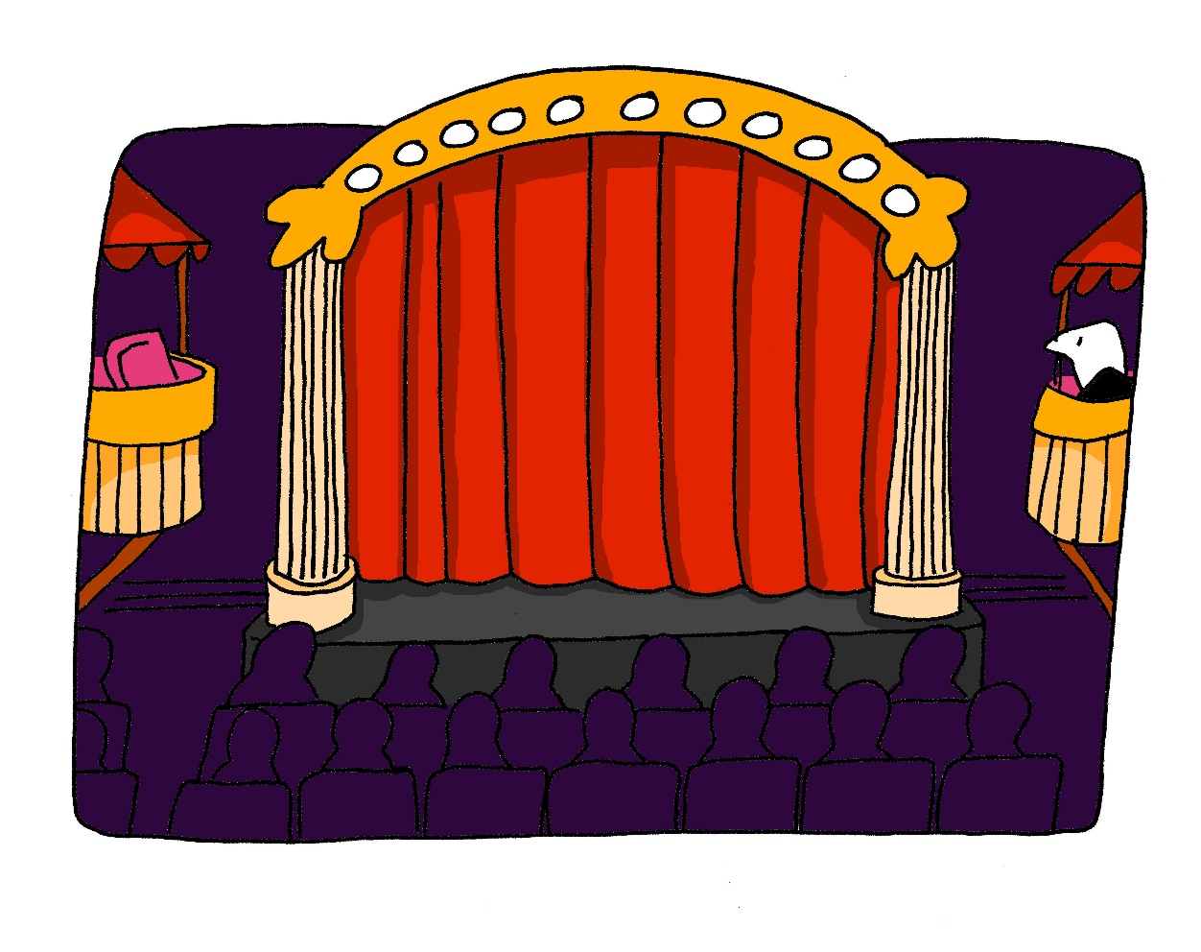
aussprechen
[th]
…
Theater
Notes:
Timing: 1 minute
Aim: to present the SSC [th].
Procedure:
1. Present the letter and say the [th] sound first, on its own. Pupils repeat it with you. 2. Bring up the word ”Theater” on its own, say it, pupils repeat it, so that they have the opportunity to focus all of their attention on the connection between the written word and its sound.
3. Click to bring up the picture and introduce the gesture, if using. Pupils repeat the word again.
4. Roll back the animations and work through 1-3 again, but this time, dropping your voice completely to listen carefully to the Pupils saying the [th] sound, pronouncing ”Theater” and, if using, doing the gesture.
Note: A possible gesture for this would be to mime the opening of a theatre’s curtains, by drawing your hands away from each other quickly, in front of your body. This is very much like the gesture for ‘play’ in charades.
Frequency: Theater [1086]
Jones, R.L & Tschirner, E. (2019). A frequency dictionary of German: Core vocabulary for learners. London: Routledge.
2

Slide 3
aussprechen
[th]
…
Mathematik is often shortened to Mathe.
Theater
Mathematik
Bibliothek
Mathe
Notes:
Timing: 1 minute
Aim: to consolidate the SSC [th].
Procedure:
Re-present the SSC and the source word ‘Theater’ (with gesture, if using).
Click to bring on the picture and get pupils to repeat the word ‘Theater’ (with gesture, if using).
Present the cluster words in the same way, bringing on the picture and getting pupils to pronounce the words.
Click to bring up a callout abut Mathematik.
Vocabulary: Theater [1086] ] Mathematik [1636] Bibliothek [2366]
Jones, R.L & Tschirner, E. (2019). A frequency dictionary of German: Core vocabulary for learners. London: Routledge.

Slide 4
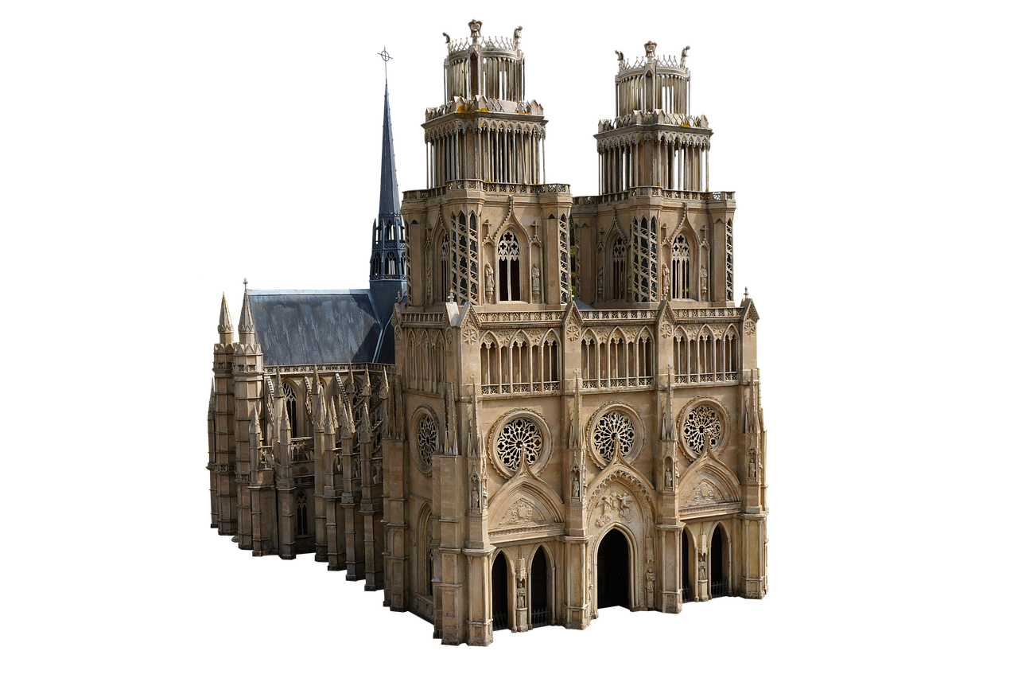
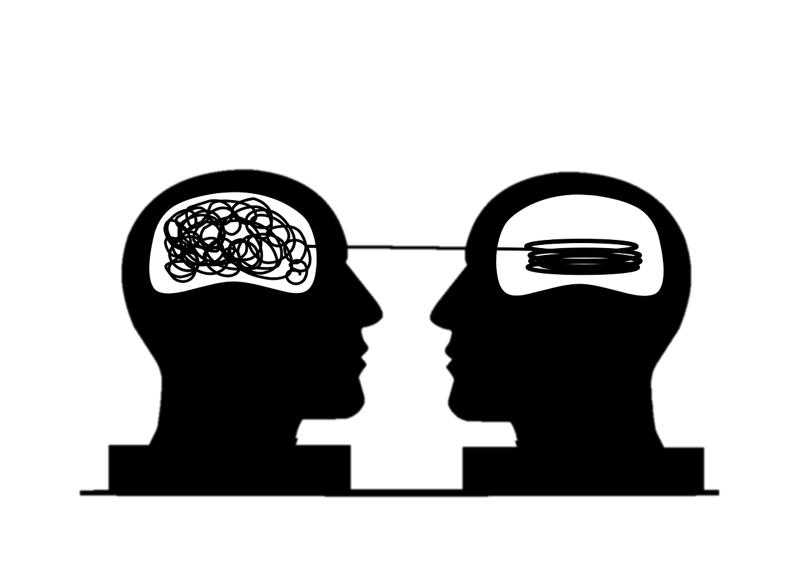
aussprechen
[th]
Wie sagt man das?
All German words containing [th]come from other languages.
You will recognise a lot of the words from English. Stress the underlined syllable – this is often different from English!
45
Theo
S
Kathedrale
Lesotho
Empathie
Thermostat
Marathon
0
Arithmetik
Bibliothek
Enthusiast
Theater
START
Notes:
Timing: 5 minutes
Aim: to consolidate the SSC [th] by practising saying new cognate words containing the SSC.
Note: This is one of a set of four slides with different timer settings. The speed of the exercise can be chosen to match the ability level of the class, or the teacher may wish to start with the slowest speed and increase gradually.
Procedure:
1. Teacher explains to Pupils that the underlined part of the word is the part that must be stressed. The stress position sometimes differs from English, so pupils must pay attention.
2. Pupils work in pairs.
3. Teacher clicks ‘los’.
4. Pupil A reads the list of words out loud to Pupil B. Pupil B listens carefully to their partner’s pronunciation, and stops Pupil A if the [th] sound is pronounced the English way. They only stop their partner if the [th] is pronounced incorrectly. If an incorrect stress or other mispronunciation is noticed, the listening Pupil should note this and correct it at the end of the round.
5. Pupils count how many words Pupil A managed to say correctly. Pupils can say some words twice, if they get to the end with time to spare.
6. Pupils swap roles. The pupil with the most points at the end is the winner.
7. After two rounds, the teacher plays the correct pronunciation by clicking on the audio. Pupils repeat.
Word frequency (1 is the most frequent word in German): Arithmetik [>5000] Bibliothek [2366] Empathie [>5000] Enthusiast [>5000] Kathedrale [>5000] Lesotho [>5000] Marathon [>5000] Mathematik [1636] Theater [1086] Theo [N/A] Thermostat [>5000] Source: Jones, R.L. & Tschirner, E. (2019). A frequency dictionary of German: core vocabulary for learners. Routledge

Slide 5
aussprechen
[th]
Wie sagt man das?
All German words containing [th]come from other languages.
You will recognise a lot of the words from English. Stress the underlined syllable – this is often different from English!
30
Kathedrale
Theo
Lesotho
S
Empathie
Thermostat
Marathon
0
START
Arithmetik
Bibliothek
Enthusiast
Theater
Notes:
[2/4]

Slide 6
aussprechen
[th]
Wie sagt man das?
All German words containing [th]come from other languages.
You will recognise a lot of the words from English. Stress the underlined syllable – this is often different from English!
Theo
20
Kathedrale
Lesotho
S
Empathie
Thermostat
0
Marathon
START
Arithmetik
Bibliothek
Enthusiast
Theater
Notes:
[3/4]

Slide 7
aussprechen
[th]
Wie sagt man das?
All German words containing [th]come from other languages.
You will recognise a lot of the words from English. Stress the underlined syllable – this is often different from English!
Kathedrale
Theo
Lesotho
15
S
0
Empathie
Thermostat
Marathon
START
Arithmetik
Bibliothek
Enthusiast
Theater
Notes:
[4/4]

Slide 8
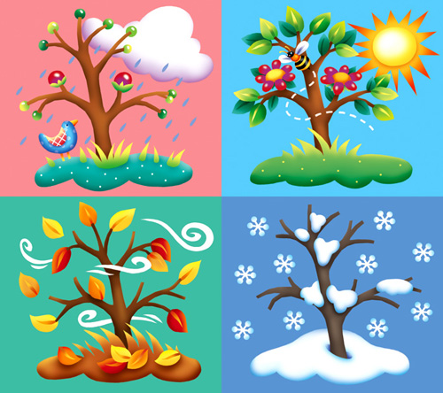
Vokabeln
Vokabeln lernen [1/3]
Wörter
Hör zu und wiederhole.
to live, living
to be called
young
wohnen
heißen
jung
the minute
the hour
the year
die Minute
die Stunde
das Jahr
Notes:
Timing: 5 minutes (3 slides)
Aim: to present and practise new vocabulary for this week
Procedure:
Click to bring up each German word. In audio versions, the audio is attached to the appear animation. Pupils repeat.
Click to bring up the English meaning and image and pupils say the German again. (This challenges them to retain the pronunciation in their working memory, but they are also supported by the written German version on the slide).
Move to the next slide.
8

Slide 9
Vokabeln
Vokabeln lernen [1/3]
Wörter
Hör zu und wiederhole.
to live, living
to be called
young
wohnen
heißen
jung
the minute
the hour
the year
die Minute
die Stunde
das Jahr
Notes:
[2/3]
Procedure:
Click to hide the English translation of each word in turn. Pupils chorally suggest the English answers.
Move to the next slide.
9

Slide 10
Vokabeln
Vokabeln lernen [1/3]
Wörter
Hör zu und wiederhole.
to live, living
to be called
young
wohnen
heißen
jung
the minute
the hour
the year
die Minute
die Stunde
das Jahr
Notes:
[3/3]
Procedure:
Click to hide the German word by word. Pupils chorally suggest the German.
Click to reveal answers (with audio attached, in the audio version).
10

Slide 11
Wie alt bist du? How old are you?
To talk about how old you are in German say ‘ich bin xxx Jahre alt’
To ask someone how old they are say ‘wie alt bist du?’
There is one exception! To say I am one year old say ‘ich bin ein Jahr alt’.
Ich bin vier Jahre alt.
I am four years old.
This also works with Minute and Stunde.
Du bist fünf Minuten alt. You are five minutes old.
Du bist zwei Stunden alt.
You are two hours old.
Du bist acht Jahre alt.
You are eight years old.
Er ist neun Jahre alt.
He is nine years old.
Notes:
Timing: 2 minutes
Aim: to learn how to say how old someone is.
Procedure:
Click through the animations to present the new information.
Elicit English translation for the German examples provided.
11

Slide 12
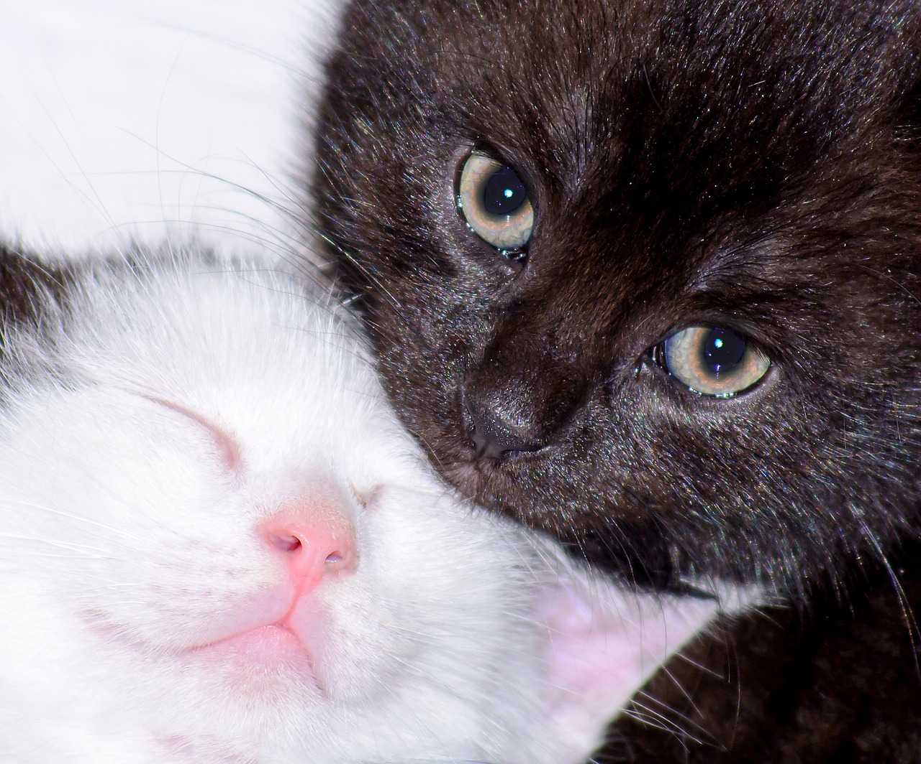
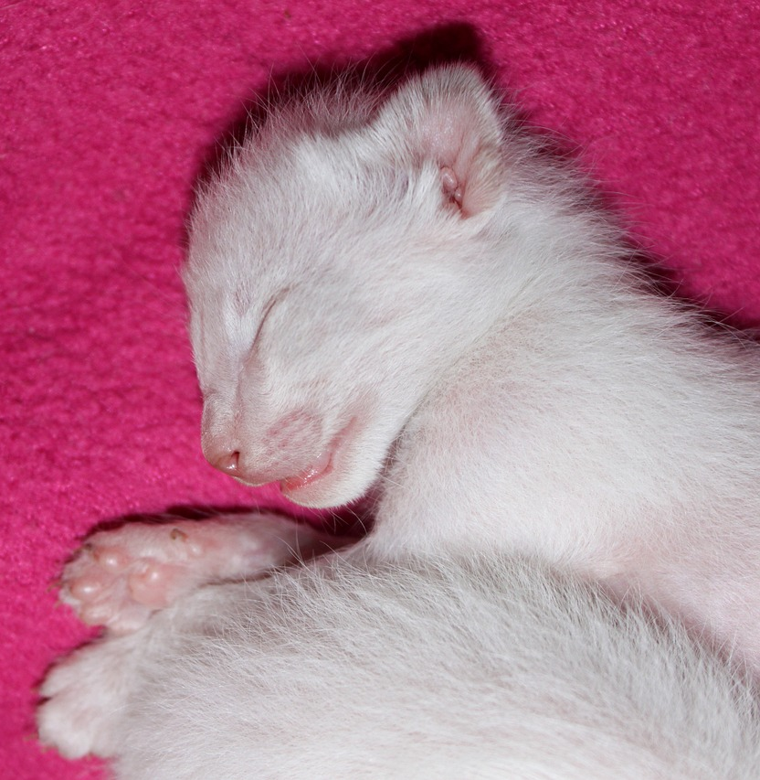
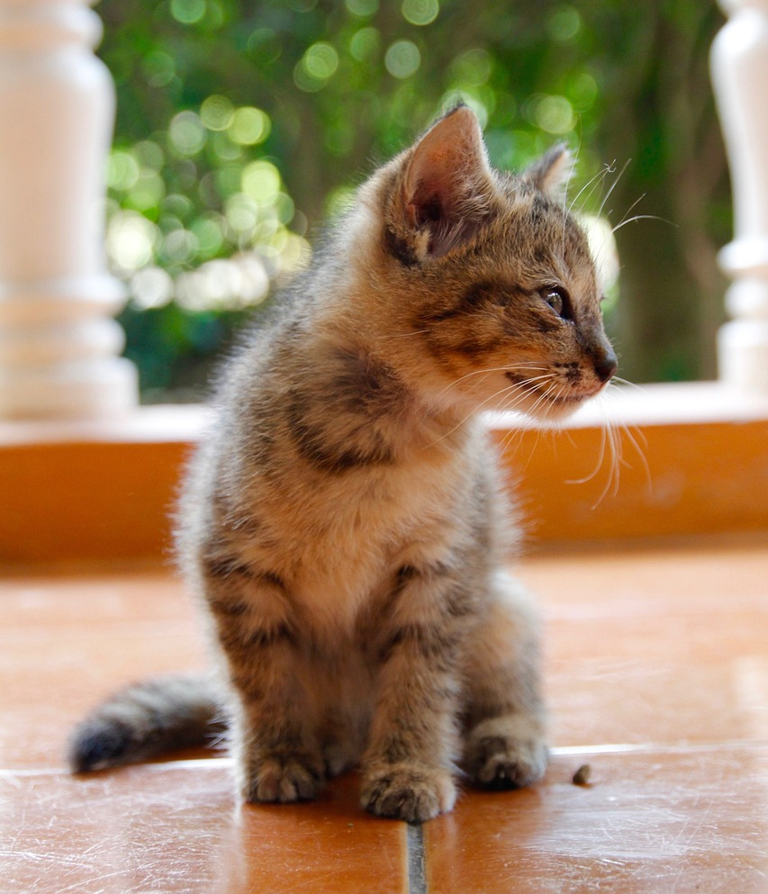
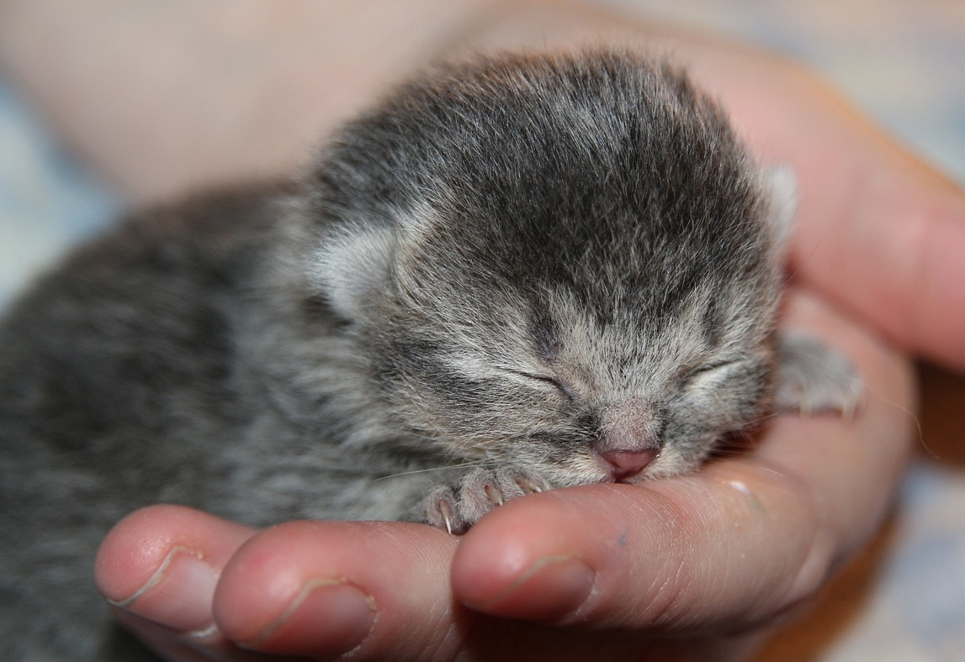
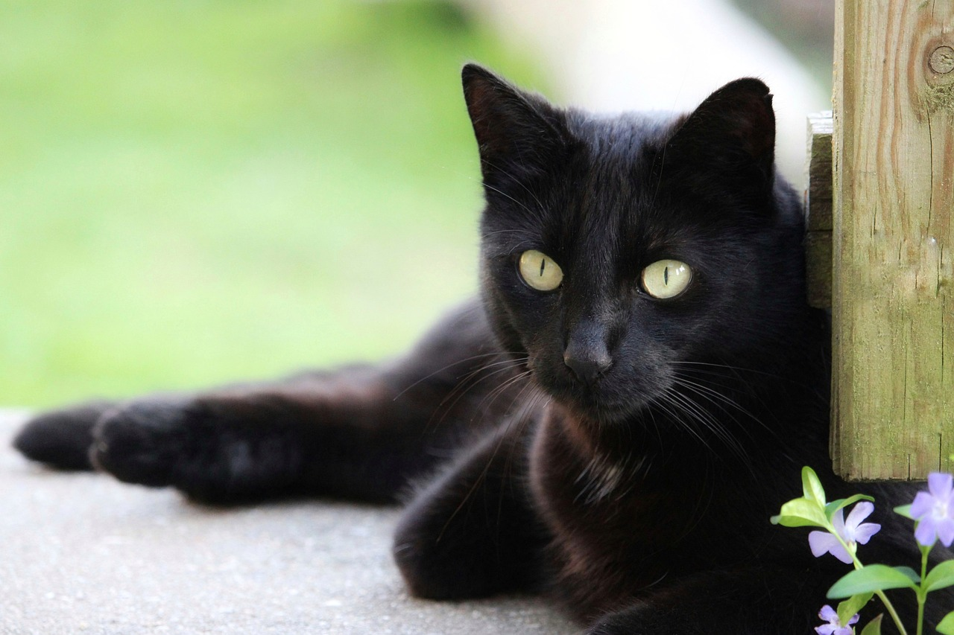
hören
Wie alt ist die Katze?
Hör zu. Ist das richtig oder falsch?
Minze has had kittens! Ronja is making labels for a photo book, but they have got mixed up!
1
4
5 Jahre
11 Minuten
2
5
12 Stunden
2 Monate
3
6
9 Stunden
2 Jahre
Notes:
Timing: 5 minutes
Aim: to practise aural comprehension of ‘Minuten/ Stunden/ Monate/ Jahre alt’ and numbers 1-12 in sentences giving ages.
Procedure:
Explain the context. Minze has had kittens, and Ronja is making a photo book of the kittens and Minze at different ages.
Pupils look at the label for each item.
Click audio button to play audio.
Pupils respond, saying whether the label is right or wrong.
Click to confirm the answer.
Transcript: 1. Minze ist 4 Jahre alt.
2. Niesen ist 12 Minuten alt.
3. Rigi ist 9 Stunden alt.
4. Niesen ist 11 Stunden alt.
5. Rigi ist 2 Monate alt.
6. Minze ist 1 Jahr alt.

Slide 13
Verben: wohnen und heißen
We just add –t to heiß- for the du form, because the ‘ß’ already makes an ‘s’ sound.
Remember that for regular verbs in the present tense we add the following endings:
ich wohne
du wohnst
sie wohnt
I live
you live
she lives
heißen works in the same way, with one exception. Can you spot it?
ich heiße
du heißt
sie heißt
I am called
you are called
she is called
Notes:
Timing: 2 minutes
Aim: to recap how to form singular weak verbs in the present tense.
Procedure:
Click through the animations to present the information.
Elicit English translations for the German examples provided.
Ask pupils to spot which form of heißen follows different rules.
Click to reveal a callout explaining this.
13

Slide 14
lesen
Gabriel möchte eine Katze haben
Ach! Es gibt ein Problem! Ist das Lias (ich), Gabriel (du) oder Rigi (er)?
1
I
Ich wohne in Biel.
??
You
2
4
You
You
Er ist elf Stunden alt.
Du wohnst auch in Biel. Das ist gut!
??
??
He
He
3
5
I
I
Ich spiele heute mit Minze.
??
Er heißt Rigi.
??
??
He
You
Notes:
Timing: 5 minutes
Aim: to practise written comprehension of this week’s verbs and vocabulary in the present tense.
Procedure:
Explain the context. Gabriel would like one of the kittens, Rigi, once he is old enough. Lias is filling Gabriel in on the details.
Pupils write 1-5 and the correct English pronoun from the two options given. They use their knowledge of verbs in the present tense to determine which pronoun is missing.
Click to reveal answers. To hear a native speaker, click on the numbered buttons to the left of each text.
14

Slide 15
Kultur
Namen in der Schweiz
Sag die Namen.
People speak four languages in Switzerland, and people have names from different languages. In Biel, people speak German and French. We can see this in some of our characters’ names.
Ich heiße Lias. Mein Name ist deutsch.
Ich heiße Ronja. Mein Name ist deutsch.
Ich heiße Gabriel. Mein Name ist französisch*.
* französisch - French
Notes:
Timing: 4 minutes
Aim: to learn about names in Switzerland; to see heißen used in the first person singular.
Procedure:
Read the explanation.
Click to reveal 3 characters telling us where their name comes from.
15

Slide 16
Tschüss!
gelb
Notes:
16

