Slide 1
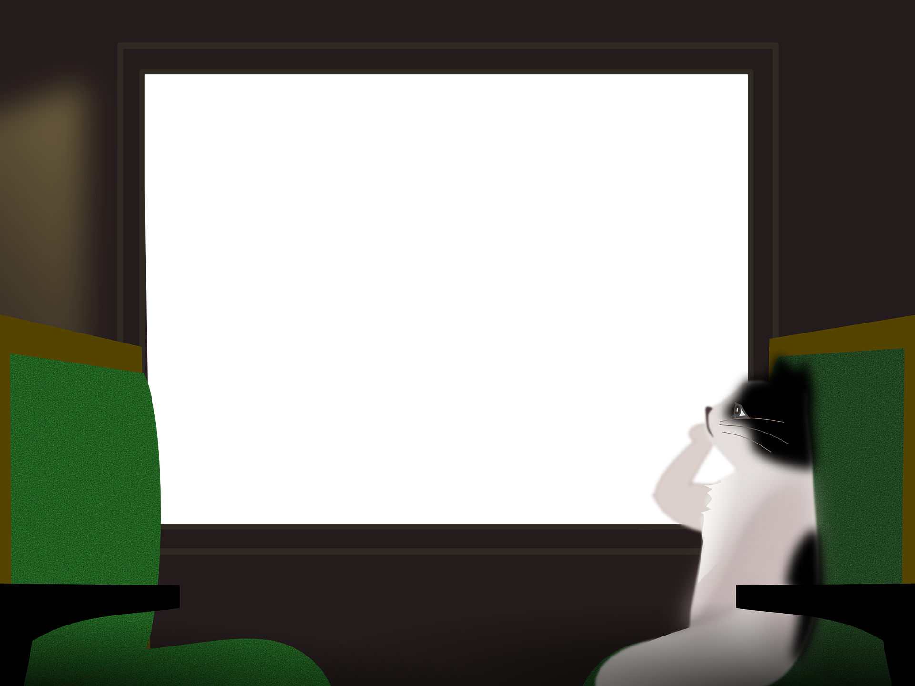
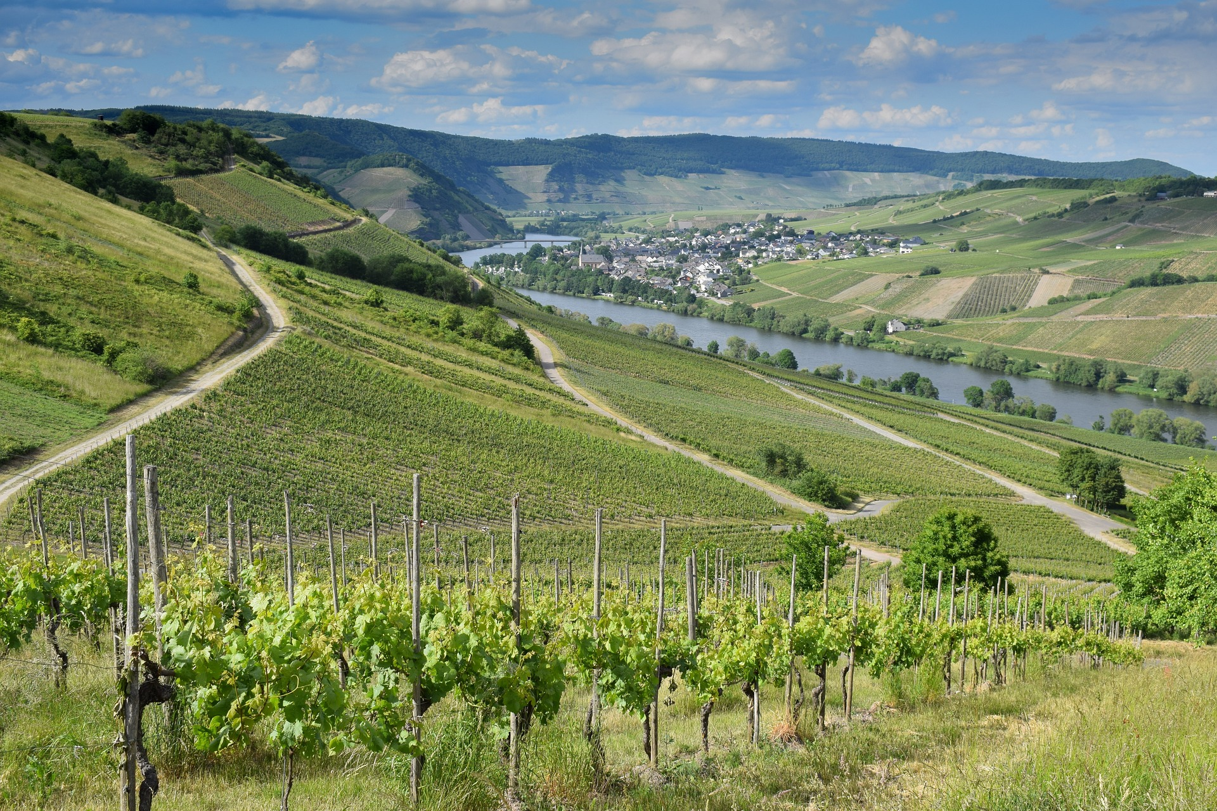
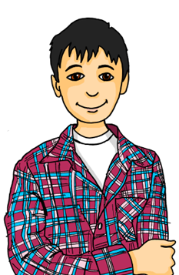
Describing me and others
blau
Follow ups 1-5
Term 3 Week 8
Notes:
Artwork by Steve Clarke. Pronoun pictures from NCELP (www.ncelp.org). All additional pictures selected from Pixabay and are available under a Creative Commons license, no
attribution required.
Phonics: [th] Theater [1086] Bibliothek [2366] Mathematik [1636]
Vocabulary: hoffen [689] versuchen [247] wichtig [144]
Revisit 1: fahren [215] Ausflug [4014] Norden, Nord- [1516] Osten, Ost- [1208] Süden, Süd- [1771] Strand [1966] Wald [1028] Westen, West- [1010] diesmal [1384] dort [139] nach [34] zu [21] nach Hause [n/a]
Revisit 2: revisit Term 2 vocabulary
Jones, R.L & Tschirner, E. (2019). A frequency dictionary of German: Core vocabulary for learners. London: Routledge.
The frequency rankings for words that occur in this PowerPoint which have been previously introduced in these resources are given in the SOW and in the resources that first
introduced and formally re-visited those words.
For any other words that occur incidentally in this PowerPoint, frequency rankings will be provided in the notes field wherever possible.
Remember that at the start of the course (first three lessons of Rot/Gelb) pupils learnt language (for greetings and register taking) that can still be part of the lesson routines in upper KS2 (Blau/Grün). They are not re-taught, as we anticipate that teachers have built these in from early in lower KS2.

Slide 2
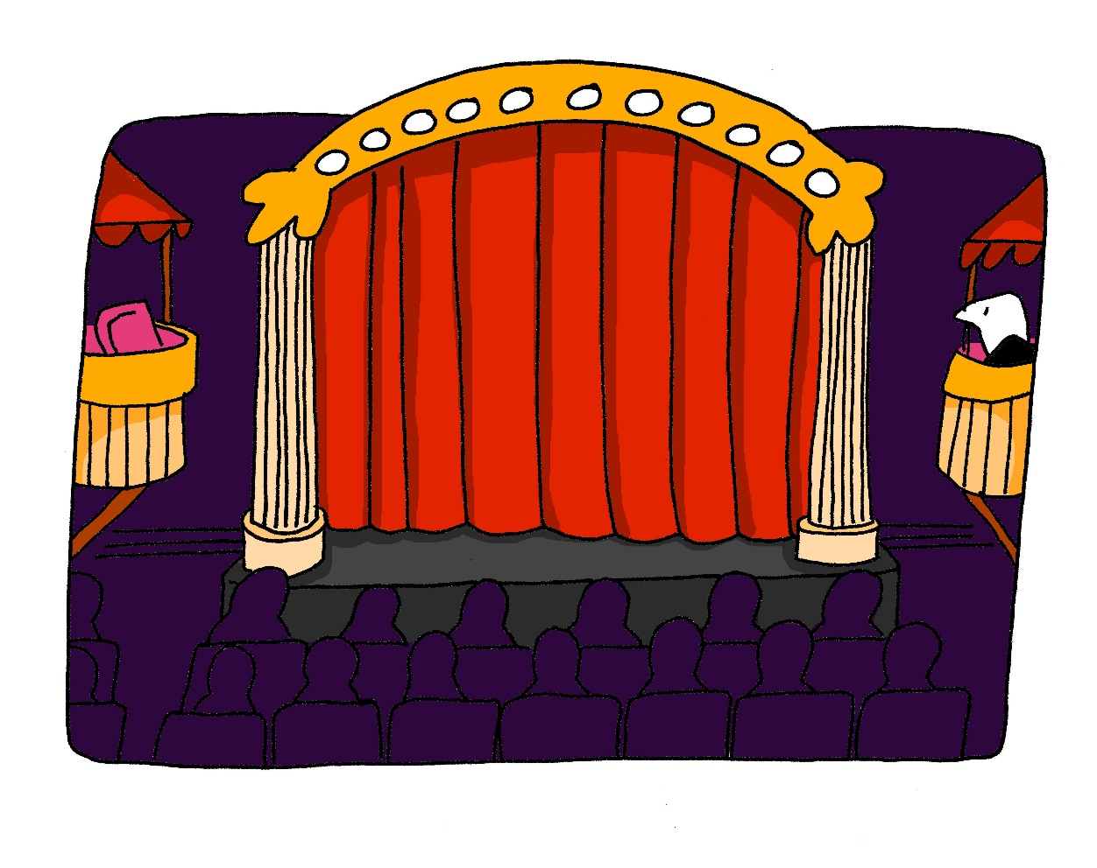
aussprechen
[th]
…
Theater
Notes:
Timing: 1 minute
Aim: to present the SSC [th].
Procedure:
1. Present the letter and say the [th] sound first, on its own. Pupils repeat it with you. 2. Bring up the word ”Theater” on its own, say it, pupils repeat it, so that they have the opportunity to focus all of their attention on the connection between the written word and its sound.
3. Click to bring up the picture and introduce the gesture, if using. Pupils repeat the word again.
4. Roll back the animations and work through 1-3 again, but this time, dropping your voice completely to listen carefully to the Pupils saying the [th] sound, pronouncing ”Theater” and, if using, doing the gesture.
Note: A possible gesture for this would be to mime the opening of a theatre’s curtains, by drawing your hands away from each other quickly, in front of your body. This is very much like the gesture for ‘play’ in charades.
Frequency: Theater [1086]
Jones, R.L & Tschirner, E. (2019). A frequency dictionary of German: Core vocabulary for learners. London: Routledge.
2

Slide 3
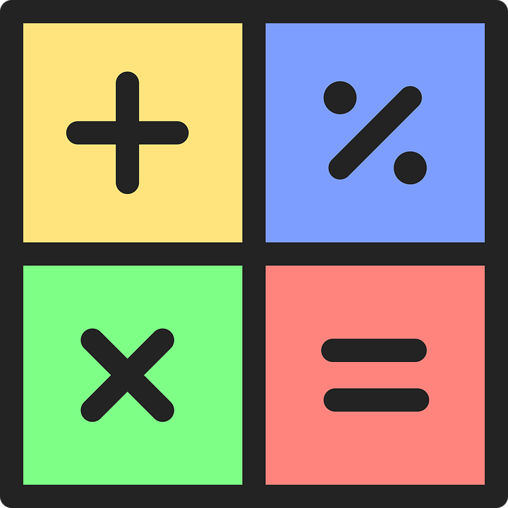
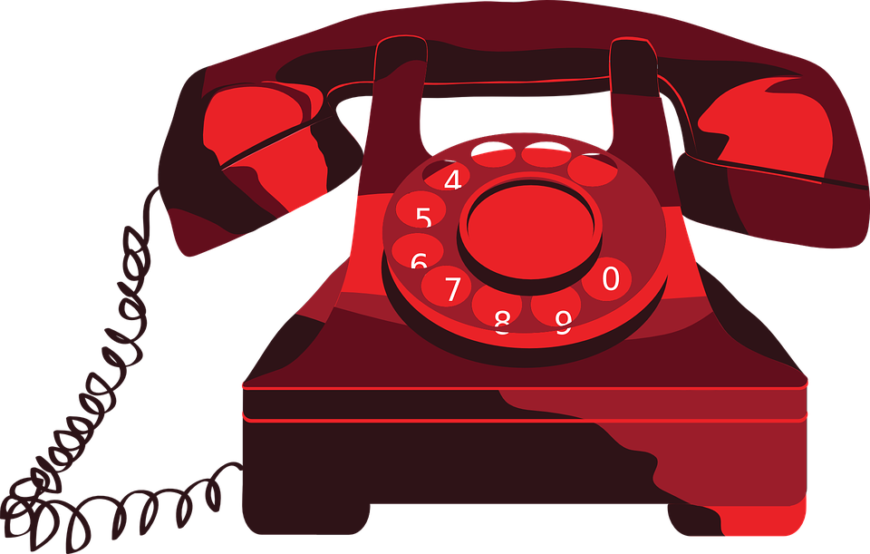
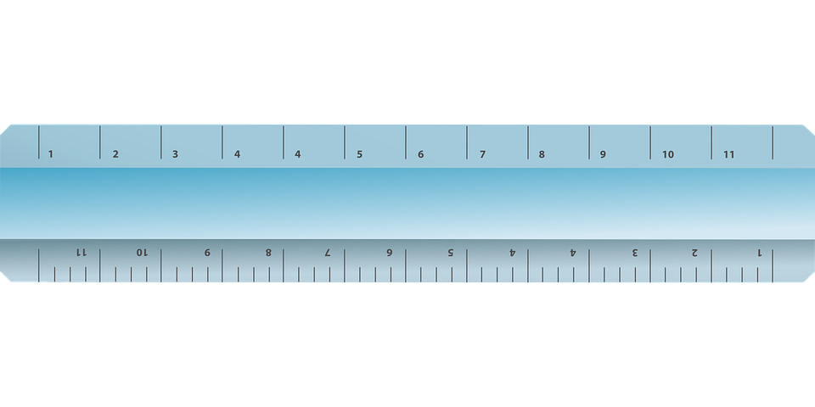
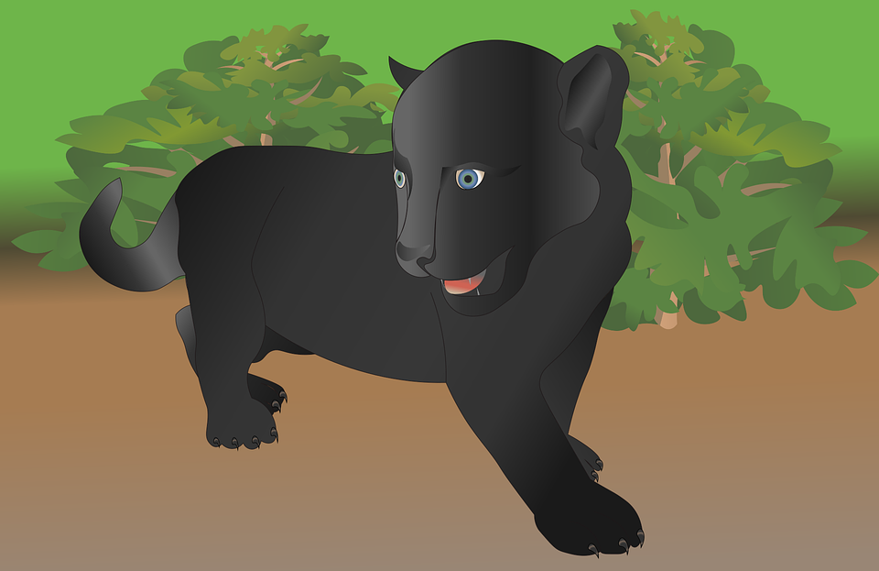
hören
Follow up 1
Hör zu. Ist es ‘t’ oder ‘th’?
German ‘th’ sounds the same as ‘t’. All of these words are cognates. How do you spell the English word? With ‘t’ or ‘th’?
 | t | th |  |  | t | th
 | Hotel |  |  |  |  | katholisch
 |  | Mathe |  |  | Interview
 | Telefon |  |  |  |  | Therapie
 | Meter |  |  |  |  | Panther
1
5
2
6
3
7
4
8
Notes:
Timing: 5 minutes
Aim: to practise applying knowledge of [th] and to cognates and contrasting it with [t].
Note: This exercise only contains cognates, emphasising a cross-linguistic difference between English and German
Procedure: 1. Remind pupils that although ‘th’ and ‘t’ are pronounced differently in English, they sound the same in German – even when the word is borrowed from English (or another language). Pupils will therefore have to draw on English to match what they hear with a known word, relying on knowledge of English spelling to work out the answer.
2. Click on the audio buttons to hear a native speaker say each word. Drawing on their knowledge of English, pupils write down the word either with [th] or [t]. The pictures are there to help them arrive at the English word more easily. Hint for pupils: if they don’t recognise the word they hear, try replacing the ‘t’ sound with an English ‘th’.
3. Click to reveal the answers. Before revealing the answers, play the audio again and ask pupils which English word it sounds like.
1. Hotel 2. Mathe 3. Telefon 4. Meter 5. katholisch 6. Interview 7. Therapie 8. Panther
Word frequency rankings: Telefon [1595]; Therapie [2484]; katholisch [2932]; Meter [479]; Interview [931]; Mathe [1636]; Hotel [772]; Panther [>5000]
3

Slide 4
Follow up 2
Hör zu. Ist die Antwort A, B oder C?
A
B
C
1
We’re planning a trip to the beach. | We want to plan a trip to the beach. | We’re trying to plan a trip to the beach.
hören
2
We want to travel to the West. | Do we want to travel to the West? | We hope to travel to the West.
3
We’re trying to go on a trip to the cathedral in Cologne. | We hope to go on a trip to the library in Cologne. | We hope to travel to Cologne to see the town.
4
It is not nice to wear a uniform. | It is nice not to have a uniform. | It is nice not to wear a uniform.
It is not good to sleep in the theatre. | Is it good to sleep in the theatre? | It is good not to sleep in the theatre.
5
We can sell our car in the summer. | We want to sell our car now. | We can sell our car now.
6
Notes:
Timing: 5 minutes
Aim: to practise aural comprehension of sentences containing ’mein’ and ‘dein’ and this week’s vocabulary.
Procedure:
Click on the first audio button to hear a sentence. Pupils listen carefully and decide whether option A, B or C contains the correct answer. NB: they may need to listen to each sentence more than once.
Repeat for questions 2-6.
Click to reveal the answers.
Transcript: 1. Wir versuchen, einen Ausflug zum Strand zu planen.
2. Wir wollen in den Westen fahren.
3. Wir hoffen, einen Ausflug in die Bibliothek von Köln zu machen.
4. Es ist schön, keine Uniform zu tragen.
5. Es ist nicht gut, im Theater zu schlafen.
6. Wir können jetzt unser Auto verkaufen.

Slide 5
Follow up 3
…
Wie sagt man das auf Englisch?
Wie sagt man das auf Deutsch?
lesen
sprechen
hoffen
versuchen
wichtig
der Ausflug
to hope, hoping
(the) trip, excursion
to try, trying
important
diesmal
nach
zu
waschen
to(wards), after
to wash, washing
this time
to
die Arbeit
Sie
wohin?
nach Hause
(the) work
you (formal)
where (to)?
(to) home
Norden, Nord-
der Fluss
verkaufen
der Wald
to sell, selling
(the) forest, woods
north
(the) river
um
bekannt
dort
schlafen
well-known, famous
there
to sleep, sleeping
at, around
Notes:
Timing: 5 minutes
Aim: this slide practises read aloud, meaning and spoken production of 13 revisited words from Term 2, plus 4 words from revisit 1 and the 3 new words from this week.
Procedure:
The activity is designed like a scratch card. On clicks, the English translation appears following the horizontal (left to right) order of the display.
Click to select a word (the word will change colour). Pupils read the word aloud.
Ask ‘Wie sagt man das auf Englisch?’ and click again to trigger a 6-second ‘scratch’ animation, which slowly reveals the English equivalent. Pupils turn to their partner and say the word meaning before it is revealed.
Ask ‘Wie sagt man das auf Deutsch?’ to elicit the German meaning again.
When all English meanings are displayed, if time allows, ask Wie sagt man [important] auf Deutsch? etc. to elicit oral recall of a few of the German meanings again, but in a jumbled order this time, to increase the challenge incrementally.
Frequency of unknown words and cognates: Wand [828]

Slide 6
Follow up 4:

Schreib auf Englisch.
Can you get at least 15 points?
Wörter
 | der Osten, Ost- | der Nachmittag | der Dom
 | das Kino | die Straße | die Nacht
 | kommen | die Pause | das Fest
 | der Platz | das Auto | für
 | zu | nach | der Ausflug
 | dort | nach Hause | diesmal
 | hoffen | wichtig | versuchen
(the) east
(the) afternoon
(the) cathedral
Vokabeln
(the) cinema
(the) street
(the) night
x3
(the) festival, celebration
to come, coming
(the) break, pause
(the) place, square, room
(the) car
for
to, at
to, towards
trip, excursion
x2
there
(to) home
this time
x1
to hope, hoping
important
to try, trying
Notes:
Timing: 5 minutes
Aim: to practise written production of vocabulary from this and revisited weeks.
Procedure: 1. Give pupils a blank grid. They fill in the English meanings of any of the words they know, trying to reach 15 points in total.
Note: The most recently learnt and practised words are pink, words from the previous week are green and those from week 1 are blue, thus more points are awarded for them, to recognise that memories fade and more effort (heavy lifting!) is needed to retrieve them.

Slide 7
Follow up 4:

Schreib auf Deutsch.
Can you get at least 15 points?
Wörter
 | (the) street | to come, coming | (the) square, place, room
 | (the) break, pause | (the) cinema | (the) festival, celebration
 | for | (the) night | (the) car
 | east | (the) cathedral | (the) afternoon
 | this time | there | (to) home
 | to(wards), after | to | (the) trip, excursion
 | important | to try, trying | to hope, hoping
die Straße
kommen
der Platz
Vokabeln
die Pause
das Kino
das Fest
x3
für
die Nacht
das Auto
der Osten, Ost-
der Dom
der Nachmittag
diesmal
dort
nach Hause
x2
nach
zu
der Ausflug
x1
wichtig
versuchen
hoffen
Notes:
Timing: 5 minutes
Aim: to practise written production of vocabulary from this and revisited weeks.
Procedure: 1. Give pupils a blank grid. They fill in the German meanings of any of the words they know, trying to reach 15 points in total.
Note: The most recently learnt and practised words are pink, words from the previous week are green and those from week 1 are blue, thus more points are awarded for them, to recognise that memories fade and more effort (heavy lifting!) is needed to retrieve them.

Slide 8
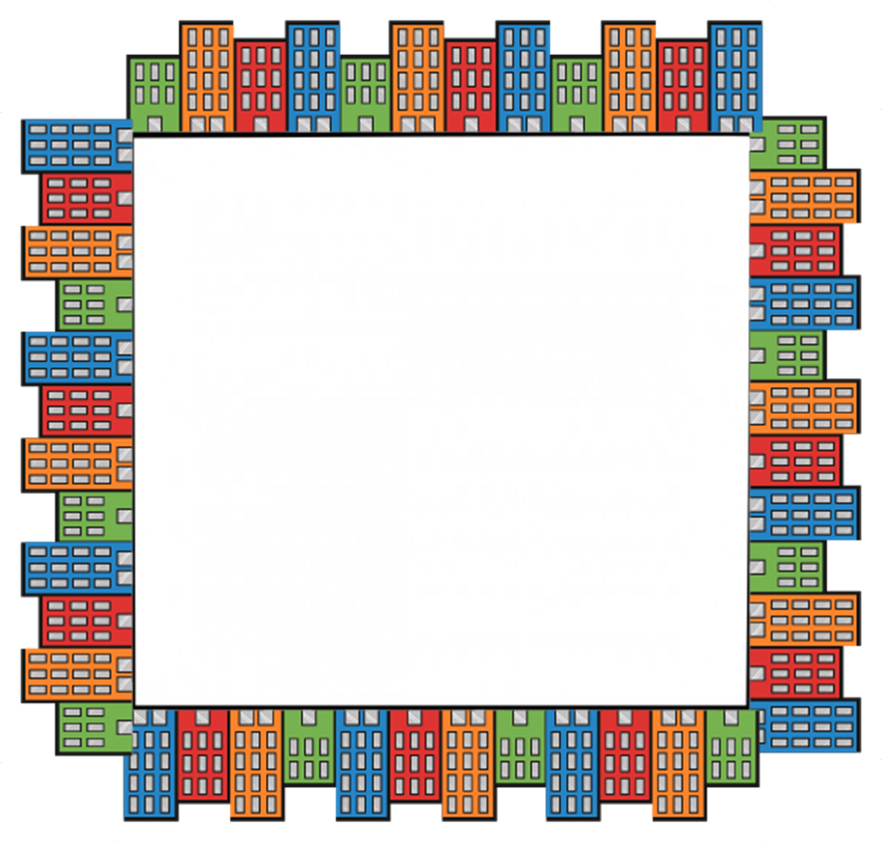
Follow up 5 [1/6]
…
Wie sagt man das auf Deutsch?
sprechen
Wir wollen den Platz besuchen.
We want to visit the square.
20
S
besuchen
wollen
können
sie
Platz (m)
hoffen
zu
wir
0
⚠ You do not need all of the words!
START
Notes:
Time: 5 minutes (6 slides)
Aim: to practise guided spoken sentence building. Targeted features: 2-verb structures, with and without ‘zu’.
Procedure:
1. Click for English sentence and German prompt words. 2. Click Start to start the timer.
3. Pupils select from the words given to create and say the sentence out loud before the time elapses. 4. Click for the German sentence to appear.

Slide 9
Follow up 5 [2/6]
…
Wie sagt man das auf Deutsch?
sprechen
Wir hoffen, auf die Insel zu fahren.
We hope to go to the island.
20
S
fahren
wir
sie
auf
zu
hoffen
wollen
Insel (f)
0
⚠ You do not need all of the words!
START
Notes:
2/6

Slide 10
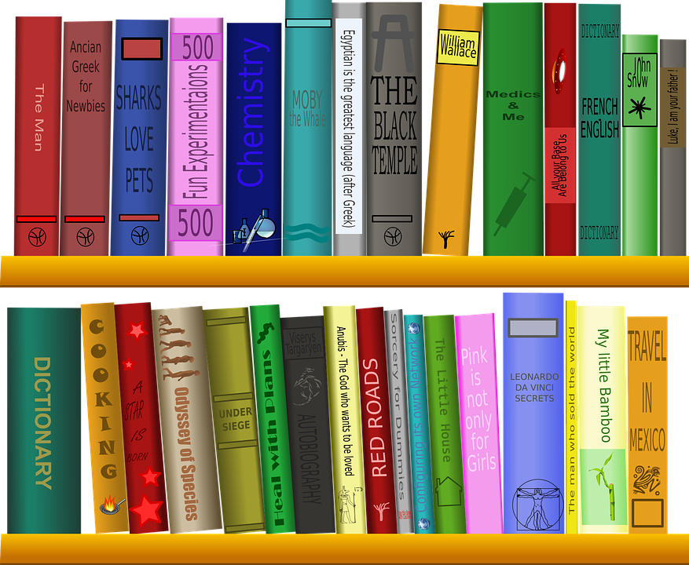
Follow up 5 [3/6]
…
Wie sagt man das auf Deutsch?
sprechen
Sie planen, in der Bibliothek zu lesen.
They plan to read in the library.
20
S
sie
planen
wollen
in
kommen
Bibliothek (f)
zu
lesen
0
⚠ You do not need all of the words!
START
Notes:
3/6

Slide 11
Follow up 5 [4/6]
…
Wie sagt man das auf Deutsch?
sprechen
Wir wollen ins Kino gehen.
We want to go the cinema.
20
S
sie
wollen
ins Kino
wir
gehen
können
zu
besuchen
0
⚠ You do not need all of the words!
START
Notes:
4/6

Slide 12
Follow up 5 [5/6]
…
Wie sagt man das auf Deutsch?
sprechen
This time they can come home late.
Diesmal können sie spät nach Hause kommen.
20
S
wir
zu
sie
kommen
nach Hause
diesmal
können
spät
0
⚠ You do not need all of the words!
START
Notes:
5/6

Slide 13
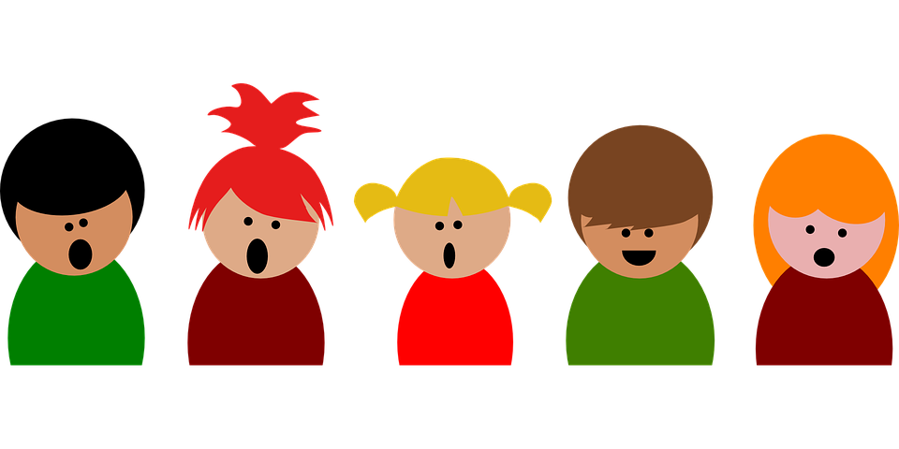
Follow up 5 [6/6]
…
Wie sagt man das auf Deutsch?
sprechen
We’re trying to sing in the evening.
Wir versuchen, am Abend zu singen.
20
S
zu
sie
versuchen
planen
wollen
singen
wir
am Abend
0
⚠ You do not need all of the words!
START
Notes:
6/6

Slide 14
Tschüss!
blau
Notes:
14

Slide 15
Follow up 4:

Schreib auf Englisch.
Can you get at least 15 points?
 | der Osten, Ost- | der Nachmittag | der Dom
 | das Kino | die Straße | die Nacht
 | kommen | die Pause | das Fest
 | der Platz | das Auto | für
 | zu | nach | der Ausflug
 | dort | nach Hause | diesmal
 | hoffen | wichtig | versuchen
Vokabeln
x3
x2
x1
Notes:
HANDOUT

Slide 16
Follow up 4:

Schreib auf Deutsch.
Can you get at least 15 points?
 | (the) street | to come, coming | (the) square, place, room
 | (the) break, pause | (the) cinema | (the) festival, celebration
 | for | (the) night | (the) car
 | east | (the) cathedral | (the) afternoon
 | this time | there | (to) home
 | to(wards), after | to | (the) trip, excursion
 | important | to try, trying | to hope, hoping
Vokabeln
x3
x2
x1
Notes:
HANDOUT

