Slide 1
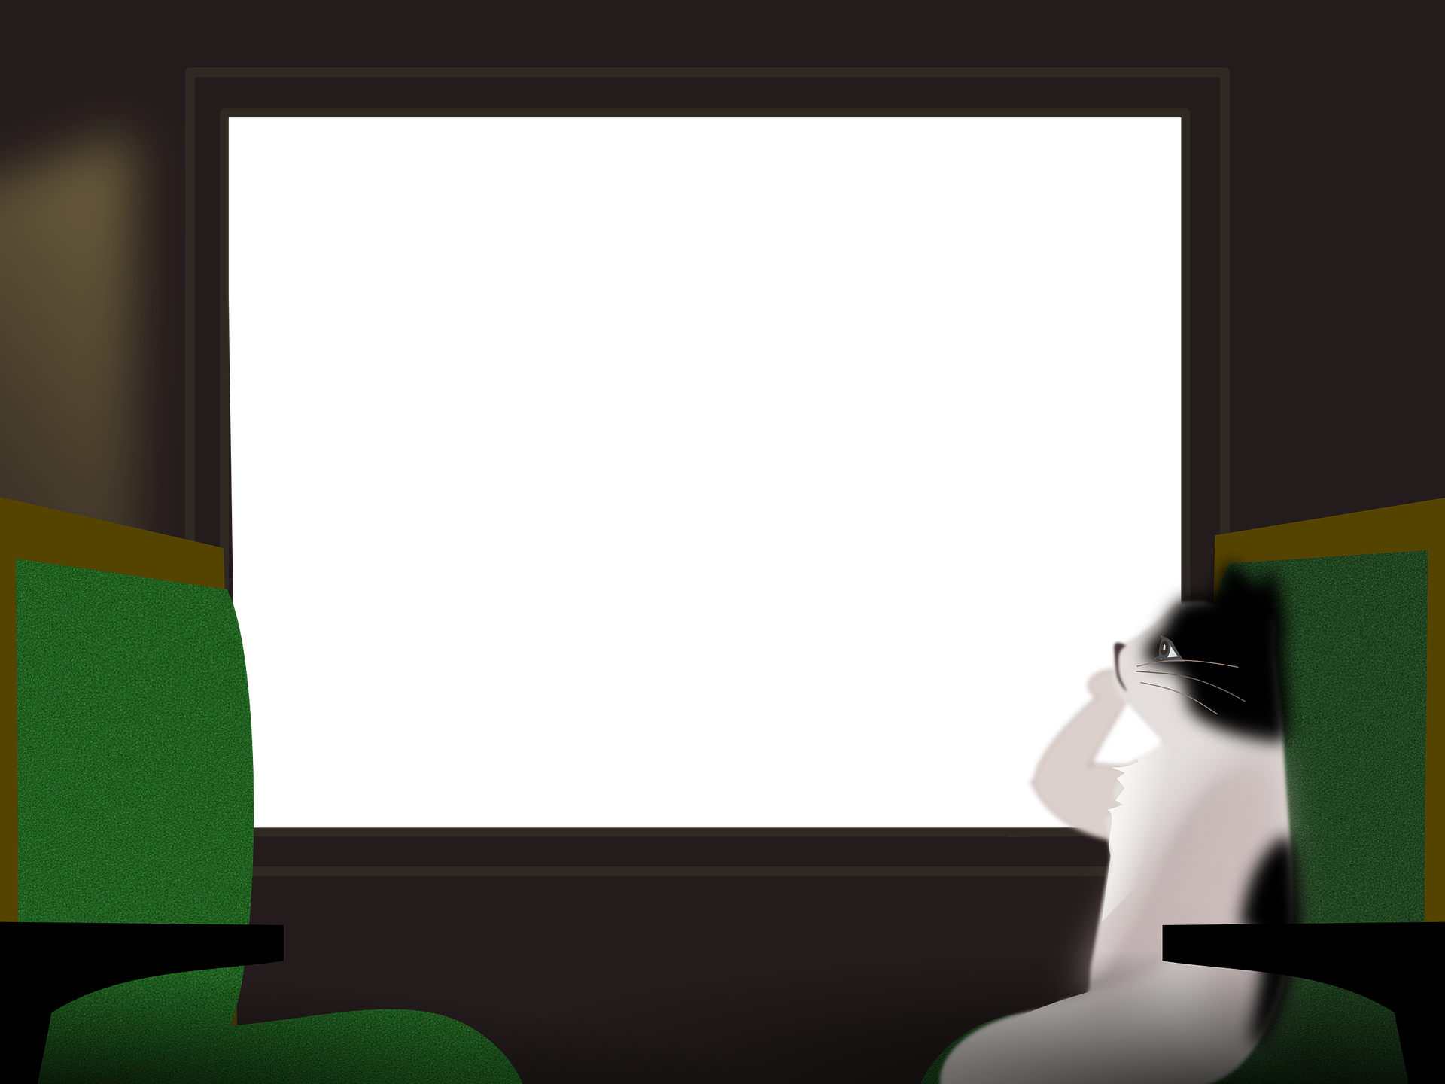
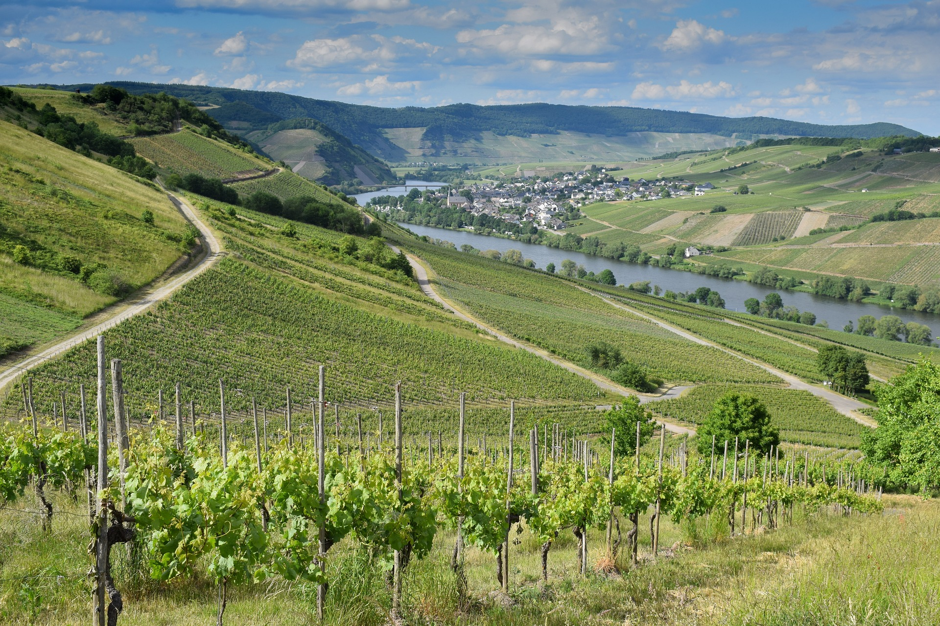
Experiences at home and away
blau
Making plans using infinitive clauses with ‘zu’
SSC [th]
Term 3 Week 8
Notes:
Artwork by Steve Clarke. Pronoun pictures from NCELP (www.ncelp.org). All additional pictures selected from Pixabay and are available under a Creative Commons license, no
attribution required.
Phonics: [th] Theater [1086] Bibliothek [2366] Mathematik [1636]
Vocabulary: hoffen [689] versuchen [247] wichtig [144]
Revisit 1: fahren [215] Ausflug [4014] Norden, Nord- [1516] Osten, Ost- [1208] Süden, Süd- [1771] Strand [1966] Wald [1028] Westen, West- [1010] diesmal [1384] dort [139] nach [34] zu [21] nach Hause [n/a]
Revisit 2: revisit Term 2 vocabulary
Jones, R.L & Tschirner, E. (2019). A frequency dictionary of German: Core vocabulary for learners. London: Routledge.
The frequency rankings for words that occur in this PowerPoint which have been previously introduced in these resources are given in the SOW and in the resources that first
introduced and formally re-visited those words.
For any other words that occur incidentally in this PowerPoint, frequency rankings will be provided in the notes field wherever possible.
Remember that at the start of the course (first three lessons of Rot/Gelb) pupils learnt language (for greetings and register taking) that can still be part of the lesson routines in upper KS2 (Blau/Grün). They are not re-taught, as we anticipate that teachers have built these in from early in lower KS2.
1

Slide 2
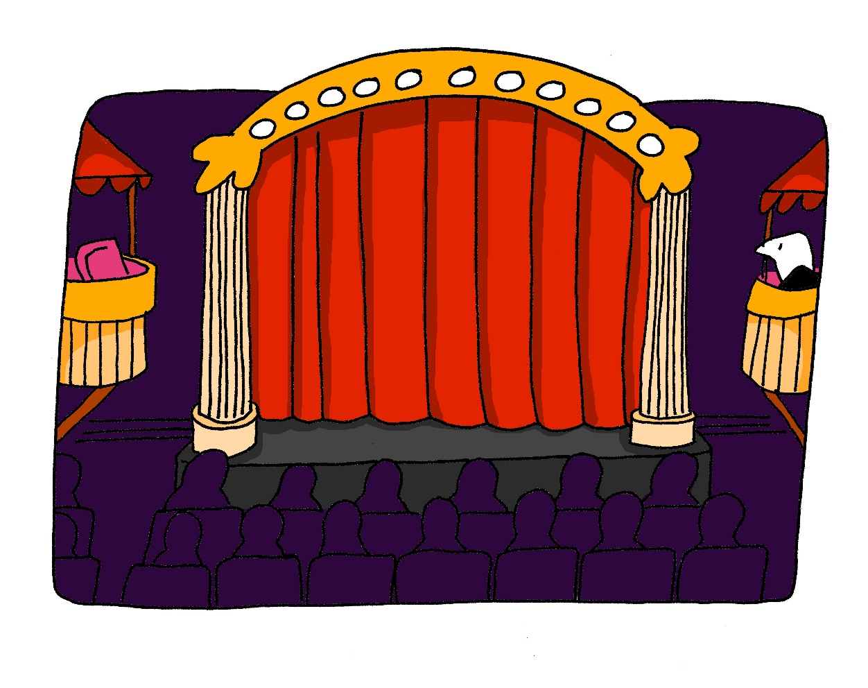
aussprechen
[th]
…
Theater
Notes:
Timing: 1 minute
Aim: to present the SSC [th].
Procedure:
1. Present the letter and say the [th] sound first, on its own. Pupils repeat it with you. 2. Bring up the word ”Theater” on its own, say it, pupils repeat it, so that they have the opportunity to focus all of their attention on the connection between the written word and its sound.
3. Click to bring up the picture and introduce the gesture, if using. Pupils repeat the word again.
4. Roll back the animations and work through 1-3 again, but this time, dropping your voice completely to listen carefully to the Pupils saying the [th] sound, pronouncing ”Theater” and, if using, doing the gesture.
Note: A possible gesture for this would be to mime the opening of a theatre’s curtains, by drawing your hands away from each other quickly, in front of your body. This is very much like the gesture for ‘play’ in charades.
Frequency: Theater [1086]
Jones, R.L & Tschirner, E. (2019). A frequency dictionary of German: Core vocabulary for learners. London: Routledge.
2

Slide 3
aussprechen
[th]
…
Mathematik is often shortened to Mathe.
Theater
Mathematik
Bibliothek
Mathe
Notes:
Timing: 1 minute
Aim: to consolidate the SSC [th].
Procedure:
Re-present the SSC and the source word ‘Theater’ (with gesture, if using).
Click to bring on the picture and get pupils to repeat the word ‘Theater’ (with gesture, if using).
Present the cluster words in the same way, bringing on the picture and getting pupils to pronounce the words.
Click to bring up a callout abut Mathematik.
Vocabulary: Theater [1086] ] Mathematik [1636] Bibliothek [2366]
Jones, R.L & Tschirner, E. (2019). A frequency dictionary of German: Core vocabulary for learners. London: Routledge.

Slide 4
Vokabeln
Vokabeln lernen
Wörter
Hör zu und wiederhole.
hoffen
versuchen
wichtig
Notes:
Timing: 1 minute
Aim: to present and practise 3 new vocabulary items for this week
Procedure:
Click to bring up word number 1 and an image to illustrate the meaning.
Pupils repeat the pronounciation (play recording or say the word).
Click to bring up the English meaning.
Continue for words 2 and 3.
Move to the next slide for more vocab practice (combined with phonics).
4

Slide 5
lesen
Lies den Text. Schreib 1-8. Was ist das auf Englisch?
Ronja und Lias kommen heute, und diesmal haben wir keinen Unterricht! Kein Mathe, kein Deutsch, kein Englisch und keine Hausaufgaben – hurra!
1
Es ist wichtig, die Woche gut zu planen. Wir wollen zusammen ins Theater gehen und auch zum Zoo. Dort gibt es eine neue Pantherfamilie! Wir hoffen, am Freitag zum Strand zu fahren. Es wird super sein.
2
3
4
Es ist toll, keine Schule zu haben. Wir machen morgens einen langsamen Rhythmus, und versuchen, jeden Tag etwas Schönes zu machen. Ich vergesse auch nicht, am Wochenende mit Ronja und Lias einen Ausflug in die Stadt, zur Therme* und zur Bibliothek zu machen – kein Thema!
5
6
7
8
“Kein Thema” is used like “kein Problem!”
____
____
____
____
1
Maths
2
together
3
Theatre
4
Panther family
____
slow
every day
____
8
trip, excursion
5
____
6
____
7
at the weekend
*Therme – spa pool
Notes:
Timing: 5 minutes
Aim: to practise written comprehension of previously taught vocabulary that we will need this lesson; to listen and read several examples of the SSC [th].
Note: this text contains examples of the new sentence structure (zu + infinitive) but here the focus is on revisiting vocabulary. The explicit explanation and practice of the new sentence structure follow.
Procedure:
Read the text or play each of the three sections of the recording. NB Audio is attached to the three sections of the text for the audio-version.
Clarify the meaning of any words in section 1, if necessary.
After playing section 2, click to highlight two of the three new words for this week. Elicit their meaning and the meaning of the rest of the section.
Play section 3, and click to highlight ‘versuchen’ and elicit the meaning. In English we would most likely say ‘we’ll try’ here.
When you come to “Kein Thema” at the end, click to bring up a callout to explain the meaning. Click again to disappear the callout.
Elicit the meanings of each of the bold words – it will work best to do this with the class altogether, to maintain lesson pace.
Click in turn to reveal answers.
Vocabulary:
Rhythmus [3824]
Jones, R.L & Tschirner, E. (2019). A frequency dictionary of German: Core vocabulary for learners. London: Routledge.
5

Slide 6
Infinitive clauses with ‘zu’
Remember to use wollen (want) and können (can) with a 2nd verb in infinitive:
Note: with wollen and können you don’t need ‘zu’. ☺
Wir wollen Skateboard fahren.
We want to go skateboarding.
Wir können Fußball spielen.
We can play football.
With other verbs, add ‘zu’ before the 2nd infinitive verb:
Wir hoffen, Skateboard zu fahren.
We hope to go skateboarding.
Wir versuchen, Fußball zu spielen.
We are trying to play football.
The word order is different from English!
Notes:
Timing: 2 minutes
Aim: to recap how to use wollen and können; to present infinitive clauses with ‘zu’.
Procedure:
Click through the animations to present the new information.
Elicit English translation for the German examples provided.
6

Slide 7
lesen
Ronja und Lias sitzen im Zug. Sie bekommen viele SMS von Johanna.
Was schreibt sie?
*ankommen - to arrive
Hallo! Wie geht’s? Wo seid ihr? …
Was macht ihr im Zug?...
Wann kommt ihr an*? Nicht so spät, oder? Um sechs Uhr?...
Notes:
Timing: 1 minute
Aim: to revise a few more previously taught words; to set the context for the next activity.
Procedure:
1. Pupils read the messages from Johanna.
2. Teacher elicits the meanings orally from the class. Note: Click on each message to hear it, if required. Message meanings: 1. Hello! How’s it going? Where are you? 2. What are you doing on the train? 3. When are you arriving? Not too late, right? At 6 o’clock?
7

Slide 8
lesen
Ronja und Lias sitzen im Zug. Sie bekommen viele SMS von Johanna.
Schreib 1-6 und A oder B.
1
3
5
Wir a) hoffen, b) können viel machen. Wir haben diesmal keinen Unterricht! ☺
Wir a) planen, b) wollen ins Kino gehen. Es macht Spaß!
Wir a) planen b) wollen keine Hausauf-gaben zu machen. Wir haben jetzt keine Schule!
Wir a) hoffen, b) wollen in den Süden von Dortmund zu fahren. Da ist es schön.
Wir a) möchten b) hoffen, Borussia Dortmund* zu sehen. Wir mögen Fußball!
4
6
2
Wir a) wollen b) versuchen, einen Ausflug zum Fluss zu machen. Wir können dort auch schwimmen.
*Borussia Dortmund - Dortmund football team
Notes:
Timing: 5 minutes
Aim: to practise written comprehension of 2-verb sentences with modal verbs können and wollen, and ‘zu’ clauses with hoffen, versuchen, planen.
Procedure:
Pupils write 1-6 and the correct verb choice A or B (depending on the presence or absence of ‘zu’).
Click anywhere to reveal answers in turn.
In the audio version, click numbers 1-6 to play the recording of the correct sentence.
Go to the next slide for the comprehension part of the task.
8

Slide 9
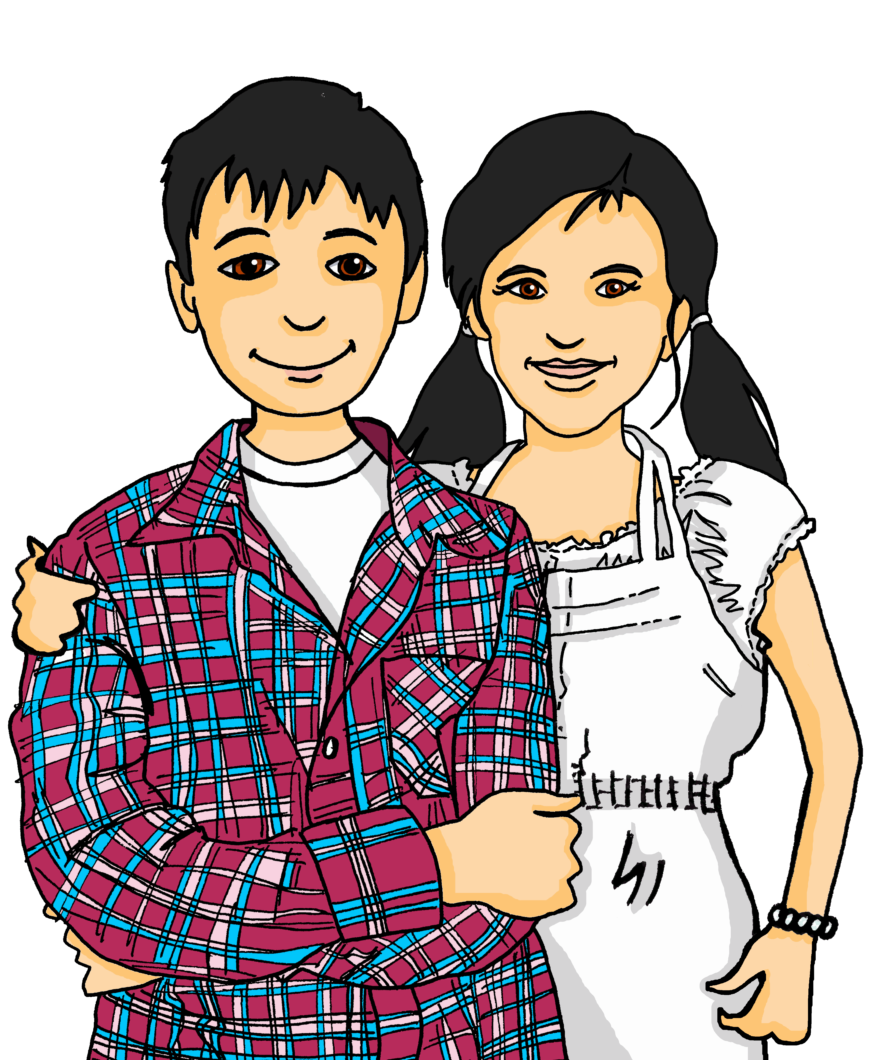
lesen
Schreib 1-6 und R (richtig) oder F (F)falsch.
Wir können viel machen. Wir haben diesmal keinen Unterricht! ☺
Wir hoffen, in den Süden von Dortmund zu fahren. Da ist es schön.
1
4
This week the cousins plan to:
not do a lot
go to the river
play football
swim in the river
travel to the West of Dortmund
go to the cinema
see a match
do homework
F
Wir versuchen, einen Ausflug zum Fluss zu machen. Wir können dort auch schwimmen.
Wir planen, keine Hausauf-gaben zu machen. Wir haben jetzt keine Schule!
R
F
2
5
R
F
R
Wir hoffen, Borussia Dortmund* zu sehen. Wir mögen Fußball!
Wir wollen ins Kino gehen. Es macht Spaß!
R
F
3
6
Notes:
Timing: 5 minutes
Aim: to practise written comprehension of 2-verb sentences with modal verbs können and wollen, and ‘zu’ clauses with hoffen, versuchen, es ist + adjective.
Procedure:
This is the correct version of the sentences form the previous slide. Pupils read the sentences again.
The read the true/false statements on the right (they are not in order of the sentences). Pupils write 1-6 and R (richtig) or F (falsch).
Click to reveal answers.
9

Slide 10
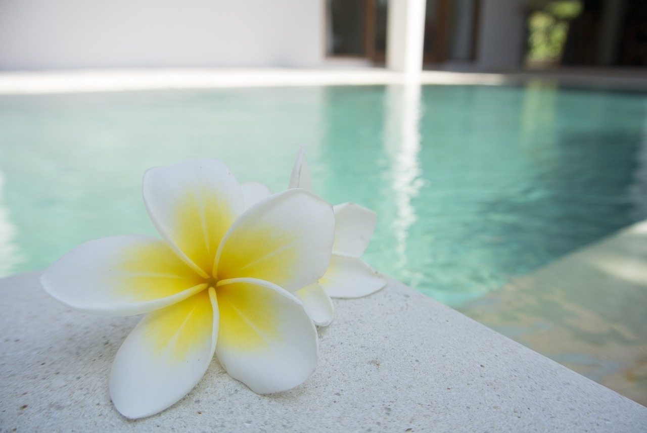
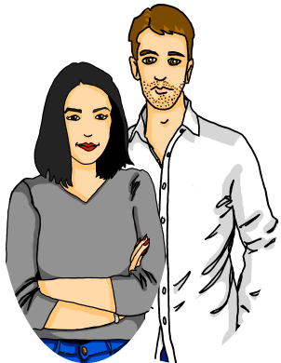
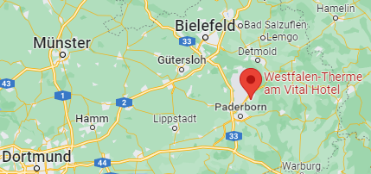
Kultur
Thermen und Wellness
Lothar und Leonie wollen in die Therme gehen.
In Deutschland gibt es viele Orte mit Wellness-Thermen. “Thermo” heißt: warm! So wie in “Thermometer”. Man kann dort im warmen Wasser schwimmen.
Die Therapie ist sympathisch - Athleten und auch normale Menschen mögen diese Methode.
Lothar und Leonie wollen einen langsamen Rhythmus finden. Sie planen, in die Westfalen-Therme zu gehen. Das liegt nicht weit von Dortmund.
Die Theorie ist, im Thermopool zu relaxen, und ein Buch aus der Bibliothek zu lesen.
Wie finden Lias und Ronja das? Kein Thema! Sie machen kein Theater*, und wünschen Lothar und Leonie viel Spaß!
*Theater machen - make a drama out of it
Notes:
If time is short, omit this and use as a follow up during the week.
Timing: 5 minutes
link for Westfalentherme (this is a real place): https://www.westfalen-therme.de/
Aim: to present cultural information, combined with SSC [th] practice.
Procedure:
Read the text or play the recording. Pupils read along and try to work out the meaning.
Elicit meaning and explain where appropriate. If time, Explore the Westfalen-Therme via the link to the website (see link above). NB this is a family place.
Pupils could read the text aloud, focusing on the bold [th] words.
Vocabulary:
Athlet [3317] Methode [797] Rhythmus [3824] sympathisch [3855] theoretisch [1130] Theorie [1065] Therapie [N/A] Therme [N/A] Thermo [N/A] Thermometer [N/A]
10

Slide 11
Tschüss!
blau
Notes:
11

