Slide 1
Exploring
Heute ist Sportfest!
grün
Present tense weak and strong verbs
Time
SSC [sch] [sp-] [st-]
Term 2 Week 6
Notes:
Artwork by Steve Clarke. Pronoun pictures from NCELP (www.ncelp.org). All additional pictures selected from Pixabay and are available under a Creative Commons license, no
attribution required.
Phonics:
[sch] schreiben [245] falsch [638] schnell [233] Mensch [104] schwarz [451]
[sp] spielen [197] Sprache [367] sprechen [157] Sport [845] Spiel [500]
[st] stark [207] Straße [355] stehen [87] verstehen [222] Stadt [186]
Vocabulary: Uhr3 [348] spät [169] um1 [44] zusammen [533] Revisit numbers 1-12
Revisit2: helfen [338] mitnehmen [1459] nehmen [142] sehen [79] Bus [1562] Film [505] Freund [273] Geld [235] Hausaufgabe [n/a] Sachen [318] Zug [675] normalerweise [2062]
Jones, R.L & Tschirner, E. (2019). A frequency dictionary of German: Core vocabulary for learners. London: Routledge.
The frequency rankings for words that occur in this PowerPoint which have been previously introduced in these resources are given in the SOW and in the resources that first
introduced and formally re-visited those words.
For any other words that occur incidentally in this PowerPoint, frequency rankings will be provided in the notes field wherever possible.
Remember that at the start of the course (first three lessons of Rot/Gelb) pupils learnt language (for greetings and register taking) that can still be part of the lesson routines in upper KS2 (Blau/Grün). They are not re-taught, as we anticipate that teachers have built these in from early in lower KS2.
1

Slide 2
aussprechen
[sch]
…
schreiben
Notes:
Timing: 1 minute
Aim: To introduce/consolidate SSC [sch]
Procedure: 1. Present the letter(s) and say the [sch] sound first, on its own. Pupils repeat it with you. 2. Bring up the word ”schreiben” on its own, say it, pupils repeat it, so that they have the opportunity to focus all of their attention on the connection between the written word and its sound.
3. A possible gesture for this would be to mime writing.
4. Roll back the animations and work through 1-3 again, but this time, dropping your voice completely to listen carefully to the pupils saying the [sch] sound, pronouncing ”schreiben” and, if using, doing the gesture. Word frequency (1 is the most frequent word in German):
schreiben [245] Source: Jones, R.L. & Tschirner, E. (2006). A frequency dictionary of German: core vocabulary for learners. Routledge
2

Slide 3
aussprechen
[sch]
…
[fast]
falsch
schnell
schreiben
Mensch
schwarz
Notes:
Timing: 2 minutes
Aim: To introduce/consolidate SSC [sch]
Procedure:
Introduce and elicit the pronunciation of the individual SSC [sch] and then the source word again ‘schreiben’ (with gesture, if using).
Then present and elicit the pronunciation of the four cluster words.
Word frequency (1 is the most frequent word in German): schreiben [245] falsch [638] schnell [233] Mensch [104] schwarz [451] Source: Jones, R.L. & Tschirner, E. (2006). A frequency dictionary of German: core vocabulary for learners. Routledge
3

Slide 4
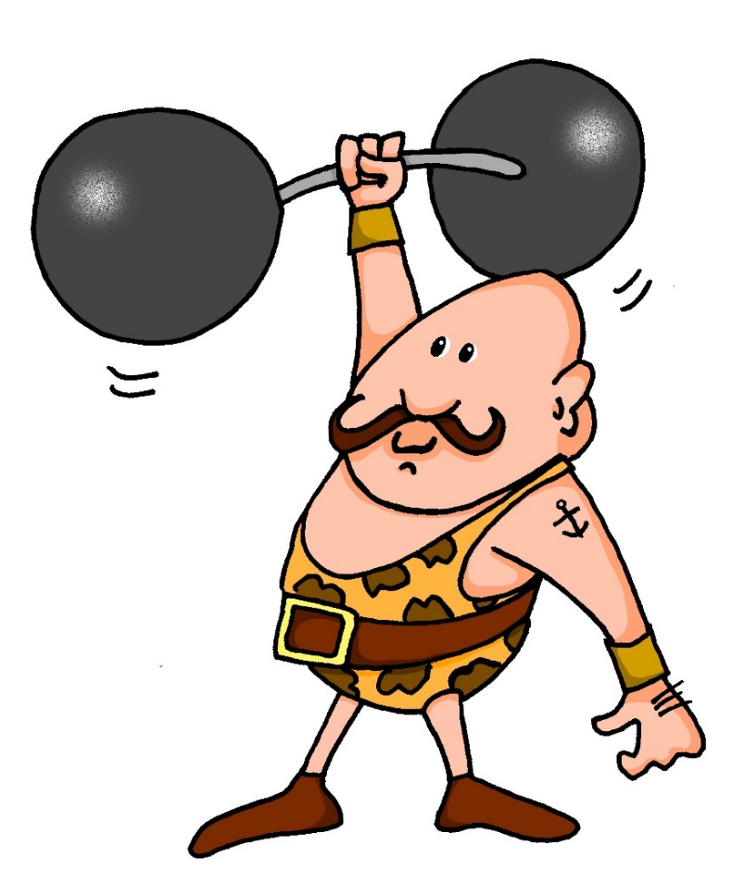
aussprechen
[st]
…
stark
Notes:
Timing: 1 minute
Aim: To introduce/consolidate SSC [st-]
Procedure: 1. Present the letter(s) and say the [st-] sound first, on its own. Pupils repeat it with you. 2. Bring up the word ”stark” on its own, say it, pupils repeat it, so that they have the opportunity to focus all of their attention on the connection between the written word and its sound.
3. A possible gesture for this would be to mime lifting dumbells by clenching your fists and raising them above your head.
4. Roll back the animations and work through 1-3 again, but this time, dropping your voice completely to listen carefully to the pupils saying the [st-] sound, pronouncing ”stark” and, if using, doing the gesture. Word frequency (1 is the most frequent word in German): stark [207] Source: Jones, R.L. & Tschirner, E. (2006). A frequency dictionary of German: core vocabulary for learners. Routledge
4

Slide 5
[st]
…
aussprechen
[to stand]
stehen
Straße
stark
[to understand]
verstehen
Stadt
Notes:
Timing: 2 minutes
Aim: To introduce/consolidate SSC [st-]
Procedure:
Introduce and elicit the pronunciation of the individual SSC [st-] and then the source word again ‘stark’ (with gesture, if using).
Then present and elicit the pronunciation of the five cluster words.
Word frequency (1 is the most frequent word in German): stark [207] Straße [355] stehen [87] verstehen [222] Stadt [186] Source: Jones, R.L. & Tschirner, E. (2006). A frequency dictionary of German: core vocabulary for learners. Routledge

Slide 6
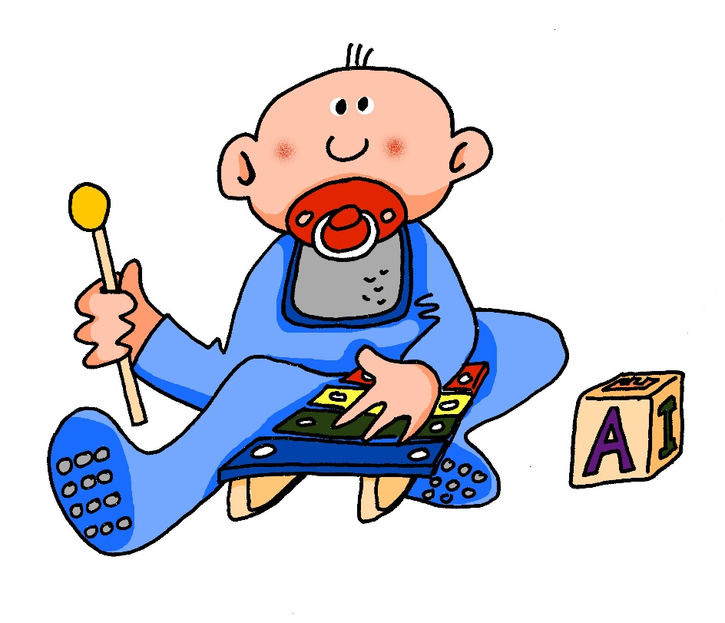
[sp]
…
aussprechen
spielen
Notes:
Timing: 1 minute
Aim: To introduce/consolidate SSC [sp-]
Procedure: 1. Present the letter(s) and say the [sp-] sound first, on its own. Pupils repeat it with you. 2. Bring up the word ”spielen” on its own, say it, pupils repeat it, so that they have the opportunity to focus all of their attention on the connection between the written word and its sound.
3. A possible gesture for this would be to mime playing an instrument or sport.
4. Roll back the animations and work through 1-3 again, but this time, dropping your voice completely to listen carefully to the pupils saying the [sp-] sound, pronouncing ”spielen” and, if using, doing the gesture. Word frequency (1 is the most frequent word in German): spielen [197] Source: Jones, R.L. & Tschirner, E. (2006). A frequency dictionary of German: core vocabulary for learners. Routledge

Slide 7
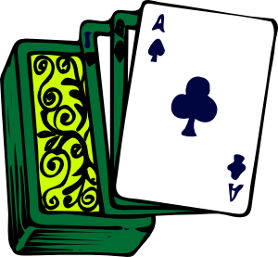
[sp]
…
aussprechen
Sprache
sprechen
spielen
Sport
Spiel
Notes:
Timing: 2 minutes
Aim: To introduce/consolidate SSC [sp]
Procedure:
Introduce and elicit the pronunciation of the individual SSC [sp] and then the source word again ‘spielen’ (with gesture, if using).
Then present and elicit the pronunciation of the five cluster words.
Word frequency (1 is the most frequent word in German): spielen [197] Sprache [367] sprechen [157] Sport [845] Spiel [500] Source: Jones, R.L. & Tschirner, E. (2006). A frequency dictionary of German: core vocabulary for learners. Routledge

Slide 8
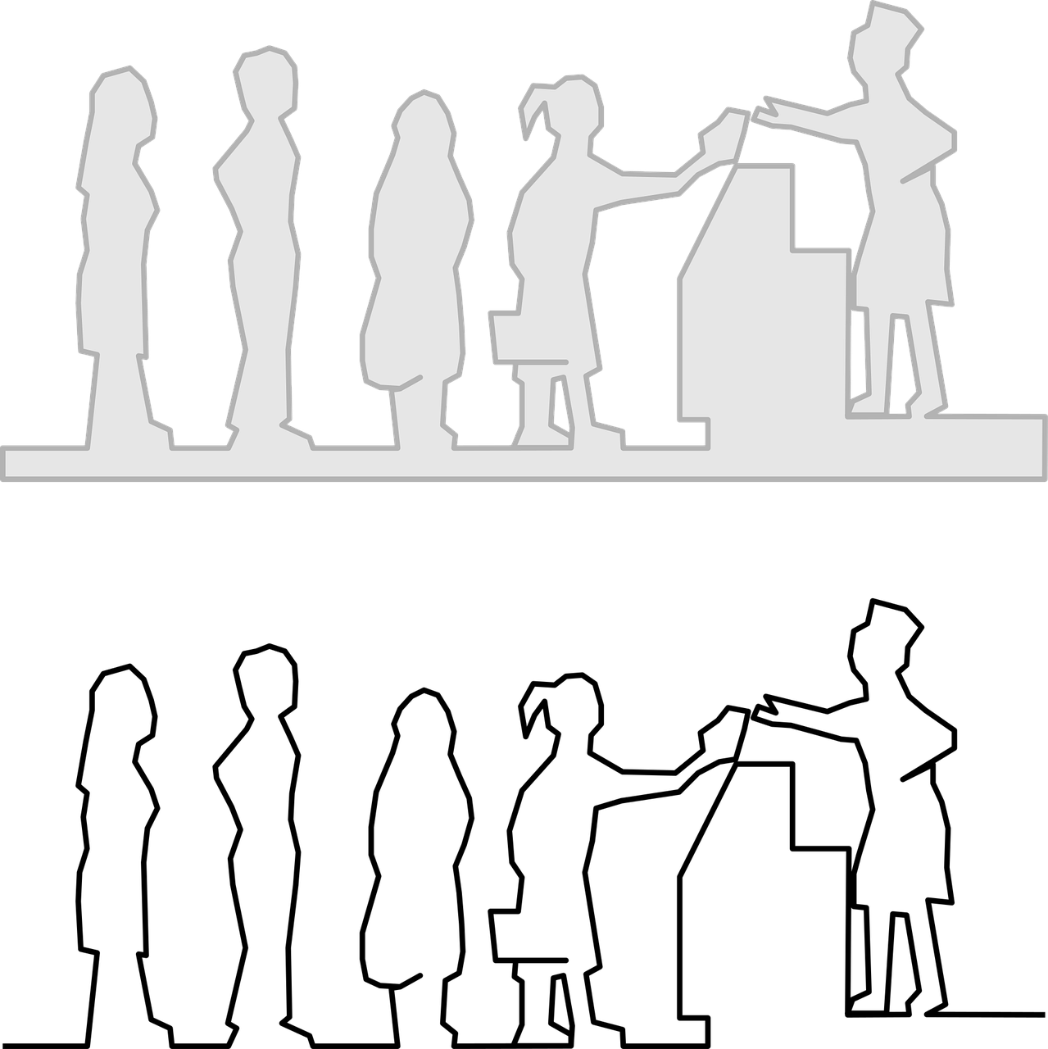
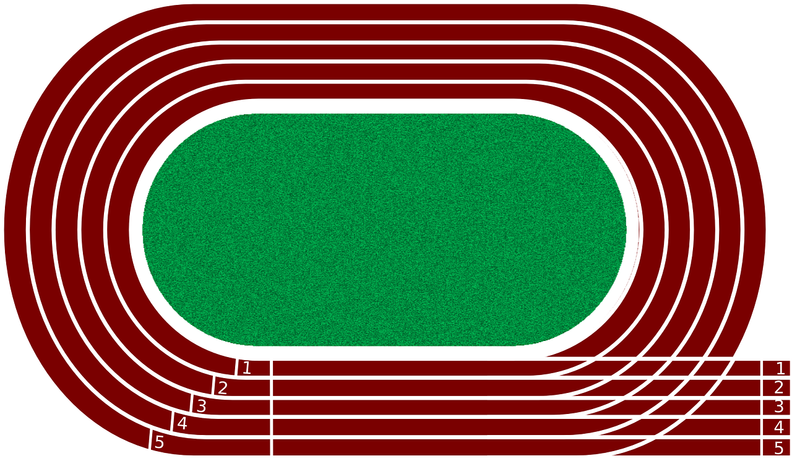
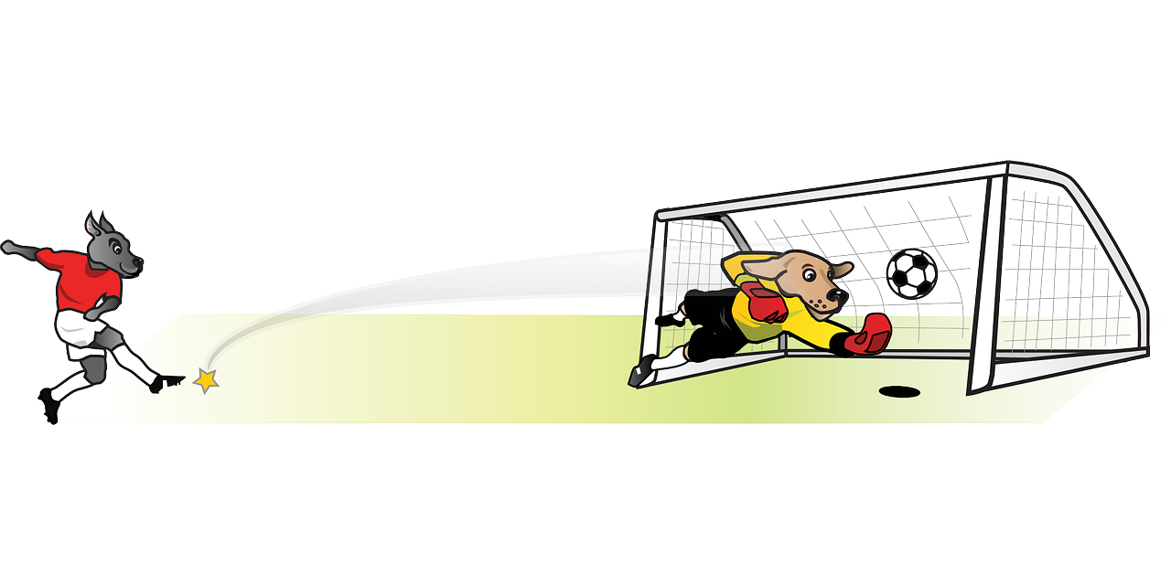
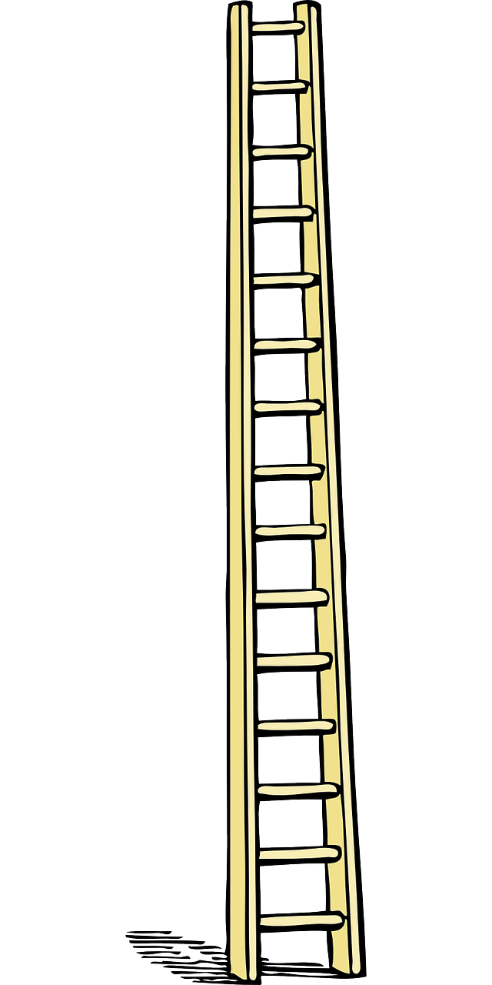
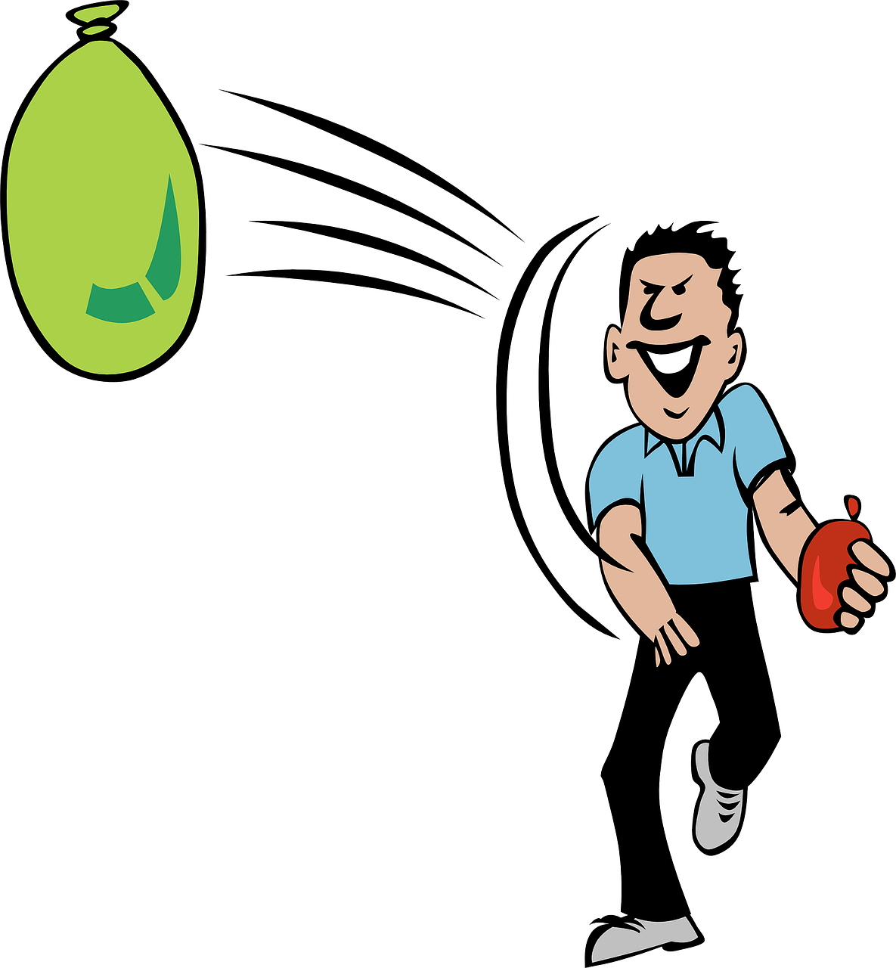
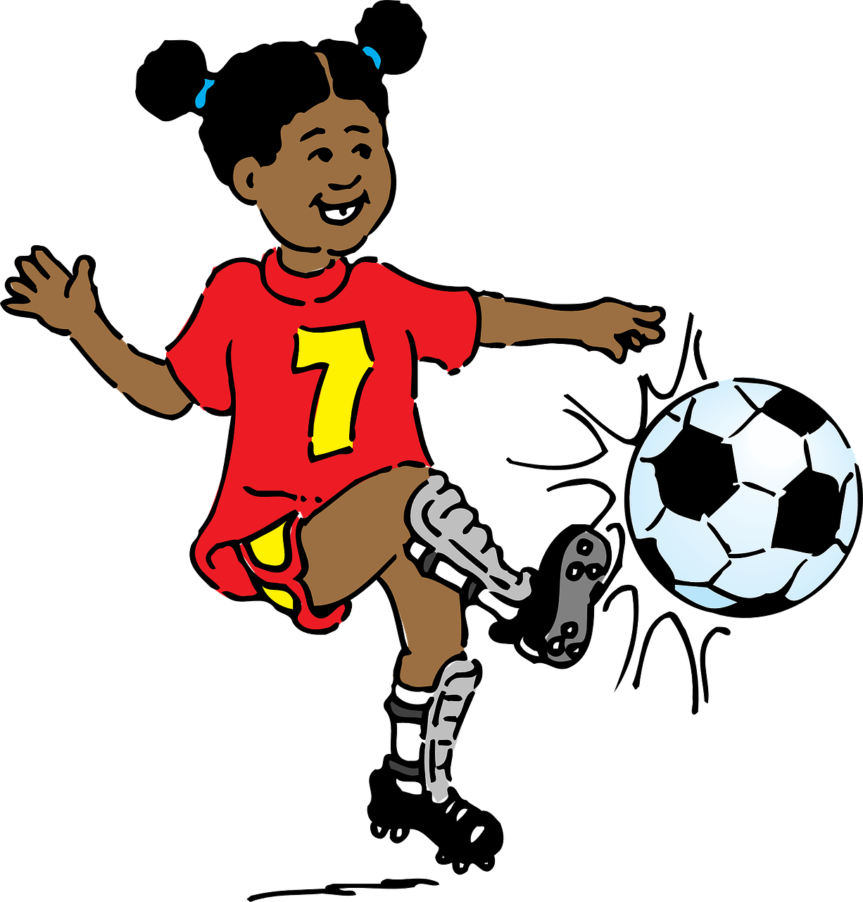
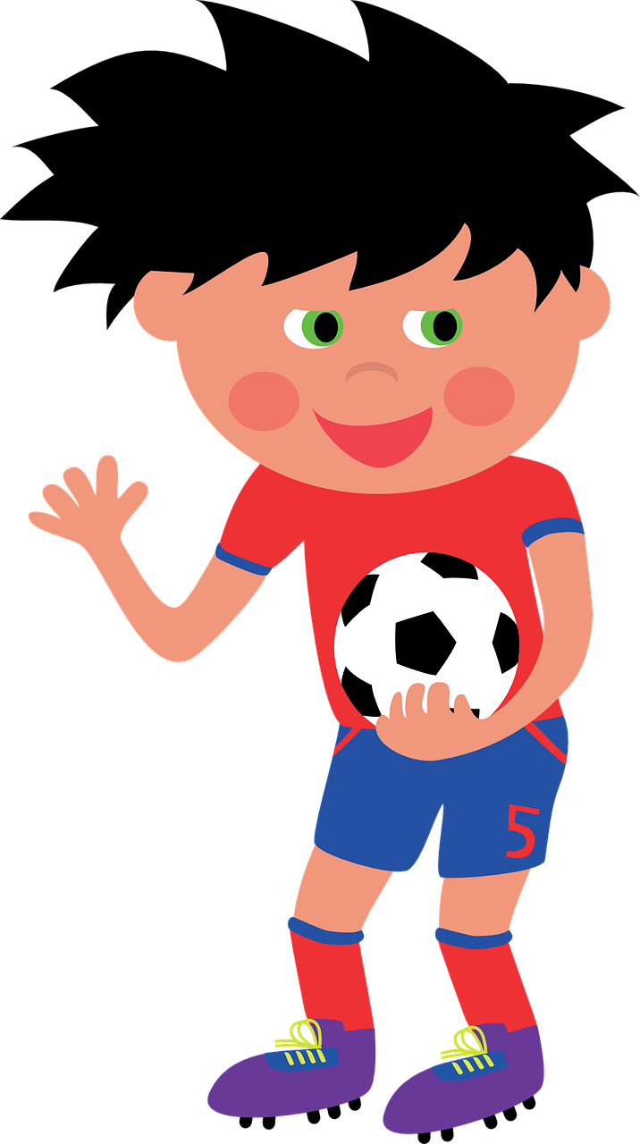
[sp-] [st-] oder [sch-]?
The class are collecting words to do with Sports Day for a display.
Ronja tells Lias. Help him complete the list.
Hör zu. Schreib [sp], [st]
oder [sch].
B.
Sportzeug
__
[sports kit]
Schlange
5
__
__
1
Strecke
[to queue]
[track]
schießen
__
stellen
2
6
__
[to put]
[to shoot]
schneiden
Sprosse
3
__
7
__
[rung]
[to cut]
schmeißen
Spieler
4
__
8
__
[player(s)]
[to throw]
Notes:
Timing: 5 minutes Aim: To practise aural recognition of the three sounds [sch], [sp], and [st]. Procedure: 1. Click the sound button to play B (the example). Pupils must write down sch, sp, or st based on what they hear and which sound they think fills the gap.
2. Click to reveal and check answer.
3. Repeat for items 1-8. Extension: Pupils can challenge themselves to write the whole word by turning away from the board.
Transcript:
Beispiel: Sportzeug
Strecke
schießen
schneiden
schmeißen
Schlange
stellen
Sprosse
Spieler Word frequency (1 is the most frequent word in German):
schießen [1336] schmeißen [n/a] schneiden [2133] Schlange [3601] Sprosse [n/a] stellen [135] Strecke [1456] Zeug [3069]
Source: Jones, R.L. & Tschirner, E. (2019). A frequency dictionary of German: core vocabulary for learners. Routledge

Slide 9
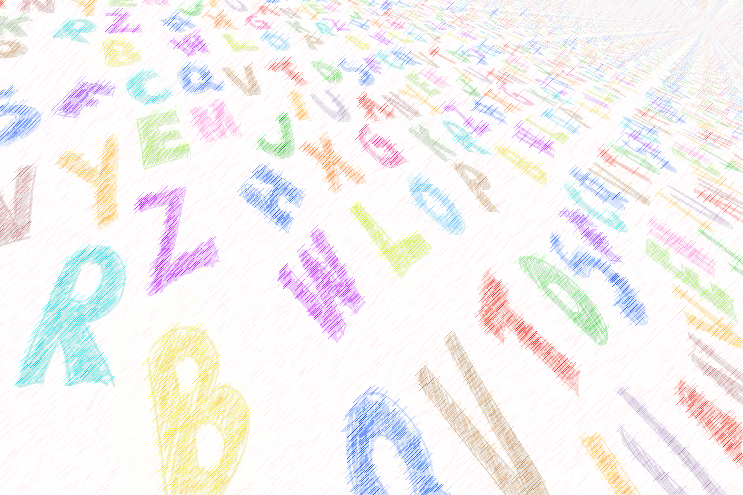
Vokabeln
Wie sagt man das auf Englisch?
Wörter
sechs
vier
six
fünf
four
five
zwei
two
eins
one
eleven
nine
eight
elf
neun
acht
sieben
drei
ten
seven
three
zwölf
zehn
twelve
together
um
zusammen
(the) clock, watch, o’clock
spät
at
die Uhr
late
Notes:
Timing: 5 minutes
Aim: to practise oral recall of vocabulary from this and previous weeks.
Procedure:
1. Pupils sketch a 4x4 grid.
2. Working in pairs, they take turns to choose a word to translate orally into English.
3. Pupils should work as quickly as they can without repeating a word the other has already said. If their partner agrees the given translation is correct, the speaking pupil ‘claims’ the relevant square on the grid by putting their initials in it. If they cannot translate a word, or translate it incorrectly, they do not claim a square and the game moves on.
4. Click to reveal translations one by one.
5. Pupils count up the number of squares they have claimed. The pupil with the most squares wins.
Extension: At the end of the activity, see how many words pupils can recall in German, from the English prompts.
9

Slide 10
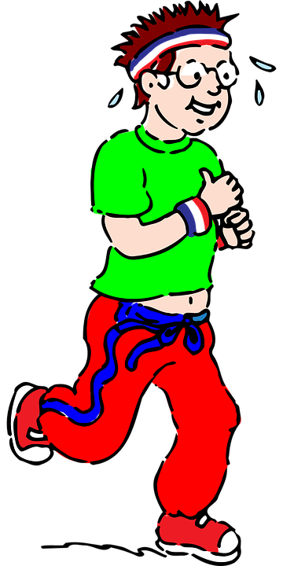
Time
You know Stunde means hour:
60 Minuten
Ich laufe jeden Tag eine Stunde.
I run for an hour every day.
Remember: die Uhr also means watch or clock.
Use Uhr to mean o’clock:
Es ist zwei Uhr.
It is two o’clock.
Um here means ‘at’:
Um drei Uhr – at three o’clock.
Ich laufe um zwei Uhr.
I run at two o’clock.
If you start with the time, swap verb and subject for Word Order 2:
Um zwei Uhr laufe ich.
At two o’clock I run.
Notes:
Timing: 3 minutes
Aim: to introduce 12-hour (on the hour) clock time, remind pupils about the difference between Stunde (hour) and Uhr (o’clock), and about word order 2 after adverbs of time.
Procedure:
Click through the animations to present the information.
Elicit English translation for the German examples provided.
Note: the translation for the last two sentences in English follows the order of the German. ‘At two o’clock I run’, is correct and possible, though much less common. In English we usually opt to put adverbs of time at the end of the sentence.
10

Slide 11
lesen
Heute ist Sportfest!
Ronja organisiert* Aktivitäten für das Sportfest.
Which activities have a time slot and which don’t?
B.
Um neun Uhr
sie trägt Taschen für die Lehrer.
----
Time | Activity
1
----
spricht sie mit Freunden Englisch.
?
carries bags for the teachers.
Um elf Uhr
2
Um zwölf Uhr
11.00
speaks English with friends.
sie kauft Spiele und Kuchen.
----
?
buys games and cakes.
3
Um zwei Uhr
2.00
sings songs in the concert.
singt sie Lieder im Konzert.
----
4.00
runs five kilometers.
4
----
Um vier Uhr
läuft sie fünf Kilometer.
?
cycles in the (a) group
5
Um sieben Uhr
sie fährt Rad in der Gruppe.
----
organisieren – to organise
Notes:
Timing: 8 minutes
Aim: to practise written recognition of Word Order 2 (WO2), and comprehension of times and this week’s and previous vocabulary.
Procedure:
Explain the scenario.
Pupils identify the correct choice for the example, based on the syntax of the second part of the sentence.
Click for the incorrect choice to disappear and to leave only the correct choice visible. EXPLAIN (for the example) that there is no time because if there is a time at the start of the sentence then the verbs comes 2nd, but in the example we have Word Order 1, so this activity hasn’t yet got a time slot.
Elicit oral translation of the item. Click to reveal the written translation with a time OR with a ?.
Pupils complete items 1-6, writing their English translations into the table, including either the time OR a ? where the syntax (i.e., Word Order 1 indicates that there is no time given).
Click to correct with pupils.
Vocabulary: beschreiben [435]
Jones, R.L & Tschirner, E. (2019). A frequency dictionary of German: Core vocabulary for learners. London: Routledge.
11

Slide 12
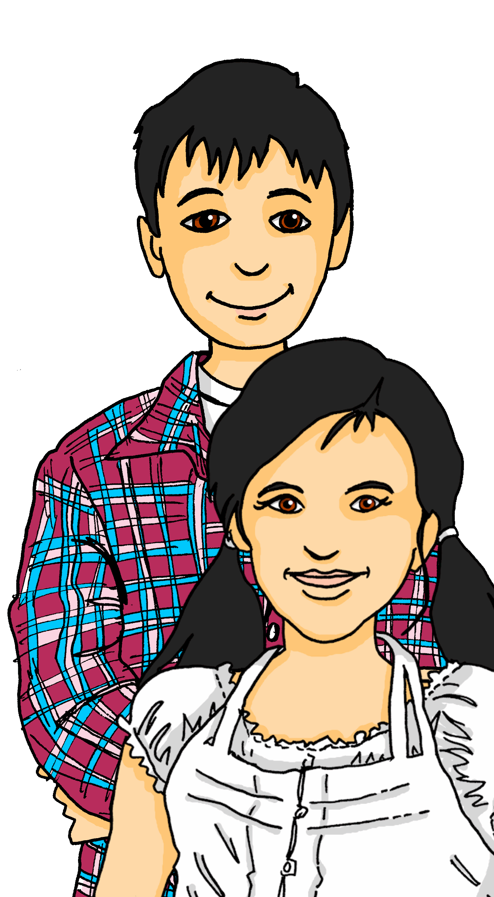
hören
Ronja und Lias sprechen über das Sportfest.
Hör zu. Was sagt Ronja zu Lias?
A | B
Um drei Uhr | _
_ | Um elf Uhr
-- | Um neun Uhr
Um zwei Uhr | _
Um sieben Uhr | --
-- | Um zehn Uhr
Gibt es eine Zeit?
Dann übersetze auf Englisch!
1
At 3 o’clock Leon and Mariem sing songs together in the concert.
2
3
At 9 o’clock you buy the prizes.
4
At 2 o’clock you run three kilometres together.
5
6
At 10 o’clock you take pictures for the football players.
Notes:
Timing: 5 minutes
Aim: to practise aural distinction between WO1 and WO2 and comprehension of this week’s and previous weeks’ vocabulary.
Procedure:
Click to listen to sentences with the beginnings obscured by ‘interference’.
Pupils select the correct beginning – A or B.
Click to elicit and confirm answers.
As a second step, pupils translate the sentence with a time in into English. Click for answers.
Transcript:
[Um vier Uhr] singen Leon and Mariem zusammen Lieder im Konzert.
Leon spricht mit Freunden Englisch.
[Um neun Uhr] kaufst du die Preise.
[Um zwei Uhr] lauft ihr zusammen drei Kilometer.
Ich fahre Rad mit meinen Freunden. Ich gewinne!
[Um zehn Uhr] machst du Fotos für die Fußballspieler.
12

Slide 13
Tschüss!
Tschüss!
Don’t forget this more formal way to say Goodbye!
Auf Wiedersehen!
grün
Notes:
13

