Slide 1
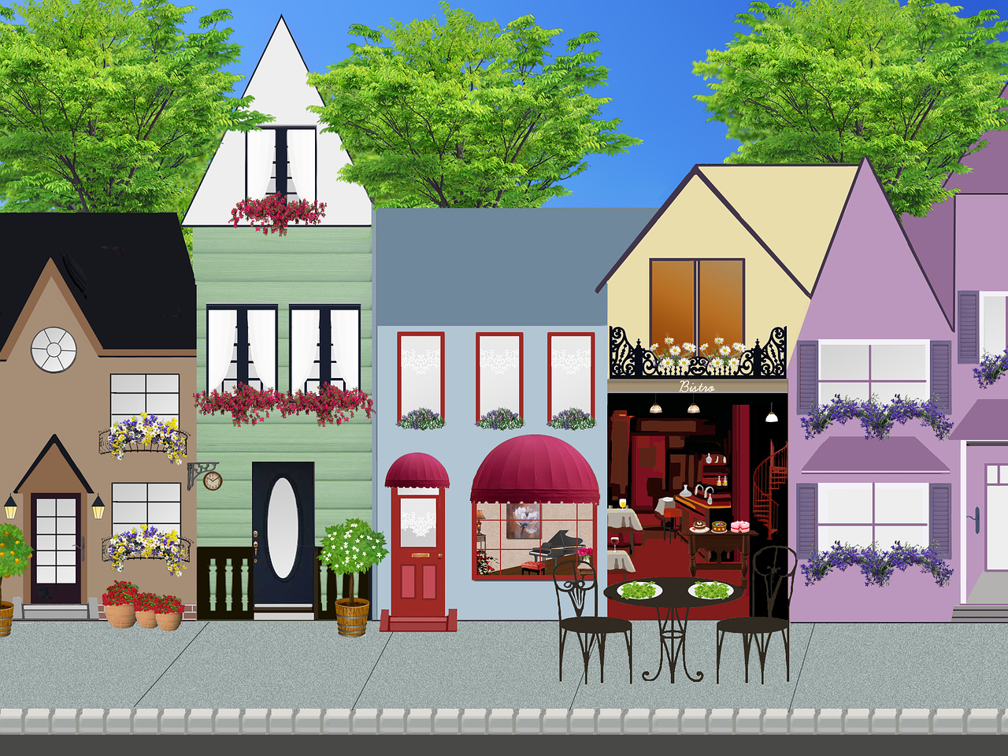
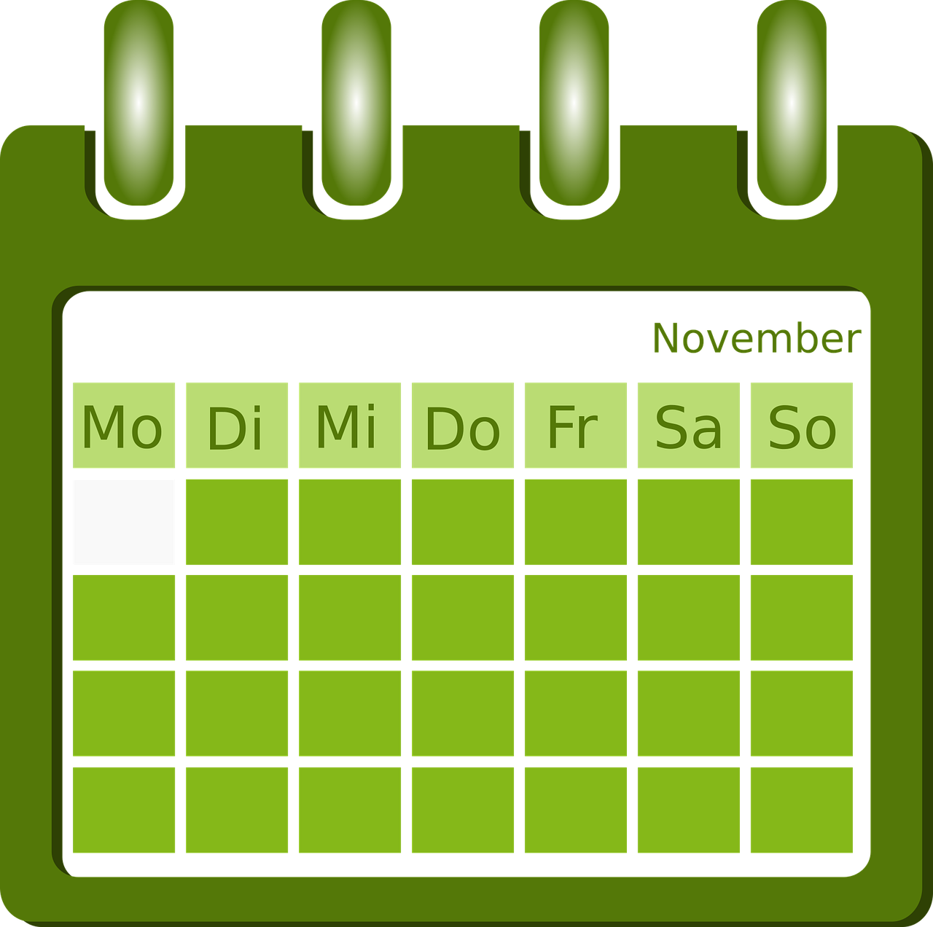
Exploring
Am Wochenende*
grün
auf (R3) location and in (R2) movement
present tense
SSC [ss|ß|-s]
am Wochenende – at the weekend
Term 2 Week 8
Notes:
Artwork by Steve Clarke. Pronoun pictures from NCELP (www.ncelp.org). All additional pictures selected from Pixabay and are available under a Creative Commons license, no attribution required.
Phonics:
[ß] [ss] [-s] groß [67] essen [323] Fußball [1277] tschüss [3766] heißen [126]
Vocabulary: einkaufen [2877] gehen [66] kommen [62] schwimmen [1863]sein [3] Land2 [134] Markt [476] Straße [391] auf [16] nach Hause [n/a]
Revisit 1: kaufen [506] laufen [252] machen [58] Rad fahren [n/a] tragen [271] (Sport)Kleidung [2820]
Revisit 2: Language from Term 1
Jones, R.L & Tschirner, E. (2019). A frequency dictionary of German: Core vocabulary for learners. London: Routledge.
The frequency rankings for words that occur in this PowerPoint which have been previously introduced in these resources are given in the SOW and in the resources that first introduced and formally re-visited those words.
For any other words that occur incidentally in this PowerPoint, frequency rankings will be provided in the notes field wherever possible.
Remember that at the start of the course (first three lessons of Rot/Gelb) pupils learnt language (for greetings and register taking) that can still be part of the lesson routines in upper KS2 (Blau/Grün). They are not re-taught, as we anticipate that teachers have built these in from early in lower KS2.
1

Slide 2
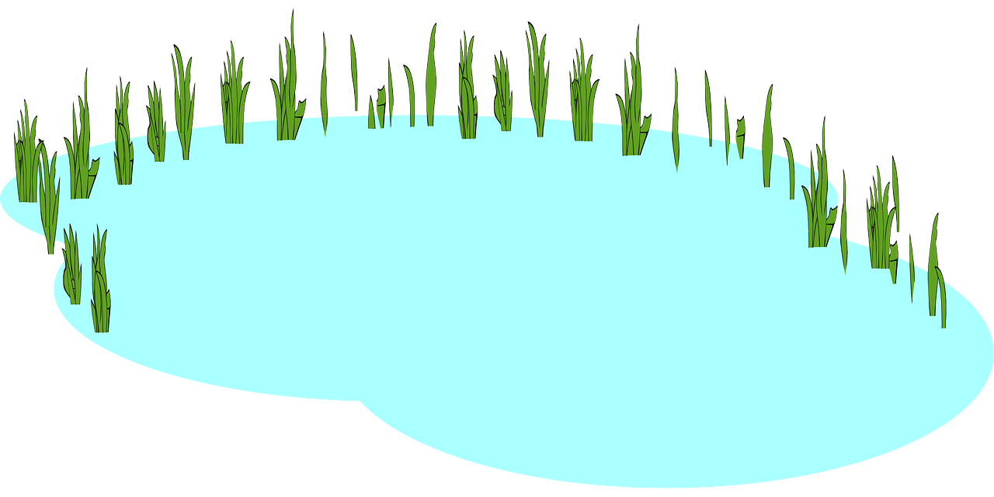
Follow up 1:
[s] [ss] [ß]
…
Wer macht was am Wochenende?
Lies die Sätze.
aussprechen
aussprechen
The cat sat on the mat.
Lucas
Jonas
Isabelle
Sebastian
Vanessa
Sophia
1
2
3
Sophia
Lucas
Isabelle
…isst ein großes österreichisches Essen.
…geht am Samstag ins Restaurant.
…hört am Sonntag klassische* Musik.
Sebastian
Vanessa
6
4
5
Jonas
…schreibt sechs Sätze für seine Hausaufgabe.
…singt das Geburtstagslied für Isa.
…springt in den See und spielt im Wasser.
klassisch - classical
Notes:
Timing: 5 minutes
Aim: Consolidation of SSCs [s], [ss] and [ß] in a read-aloud activity.
Procedure:
Pupils read the phrases aloud in pairs and match them to each person.
Click on buttons to play the audio.
Pupils listen and check their answers.
Click to reveal answers.
NB: Pupils may point out that Hausaufgabe has the ‘s’ in front of a vowel but it doesn’t sound like ‘z’. This is because the word is a compound – made up of two nouns – Haus + Aufgabe. Therefore the ‘s’ is counted as being at the end of the word Haus rather than in the middle and before the vowel ‘a’ from Aufgabe.
Vocabulary
klassisch [882]
Jones, R.L & Tschirner, E. (2019). A frequency dictionary of German: Core vocabulary for learners. London: Routledge.

Slide 3
Follow up 2
Hör zu. Was ist das auf Englisch? A, B oder C?
 | A | B | C
 | She is going to the countryside. | They are going to the countryside. | She is at/in the countryside.
 | He is coming home. | I am at home. | They are coming home.
 | You (all) are running onto the street. | They are running onto the street. | You are running in the street.
 | We are in the museum. | We are going into museum. | You (all) are going into the museum.
 | I am jumping into the lake. | I am swimming in the lake. | I am jumping into the sea.
 | They are going to the market. | She is going to the market. | They are at the market.
hören
B.
1
2
3
4
5
Notes:
Timing: 5 minutes
Aim: to practise aural comprehension of a range of the new language learnt so far in the course.
Procedure: 1. Read the teacher instruction for the activity.
2. Click to listen to the first item
3. Pupils write down the correct letter (A. B or C) of the English translation.
4. Click to reveal the correct column A, B or C.
5. Complete items 1-5 and click to correct.
Transcript: B. Sie ist auf dem Land.
Er kommt nach Hause.
Sie laufen auf die Straße.
Ihr geht in das Museum.
Ich springe in den See.
Sie sind auf dem Markt.

Slide 4
Follow up 3
Adjective, verb or noun?
…
Person B: Write 3 words in German from the table below. Person A: Ask yes/no questions in German to work out the words.
sprechen
Ist es ein Adjektiv*?
Nein!
das Adjektiv - adjective
das Substantiv – noun
Ist es ein Verb?
Nein!
Person A
Person B
Ist es ein Substantiv*?
Ja!
Then swap roles and play again!
Ist es ‘der Zug’?
Ja!
kaufen | müde | machen | das Mädchen
laufen | der Zug | das Konzert | tragen
schön | der See | fertig | das Land
der Park | das Schwimmbad | mitbringen | ruhig
Notes:
Timing: 5 minutes
Aim: to practise asking and answering yes/no questions to identify previously taught vocabulary and the new vocabulary from this week. Procedure:
Pupil B chooses 3 words and writes them down secretly.
Pupil A asks yes/no questions using the categories adjective, verb or noun and then asks ‘Ist es…’ until they work out the 3 words on B’s list.
Then pupils swap roles and play again. Vocabulary
Adjektiv [3682] Substantiv [N/A]
Jones, R.L & Tschirner, E. (2019). A frequency dictionary of German: Core vocabulary for learners. London: Routledge.

Slide 5
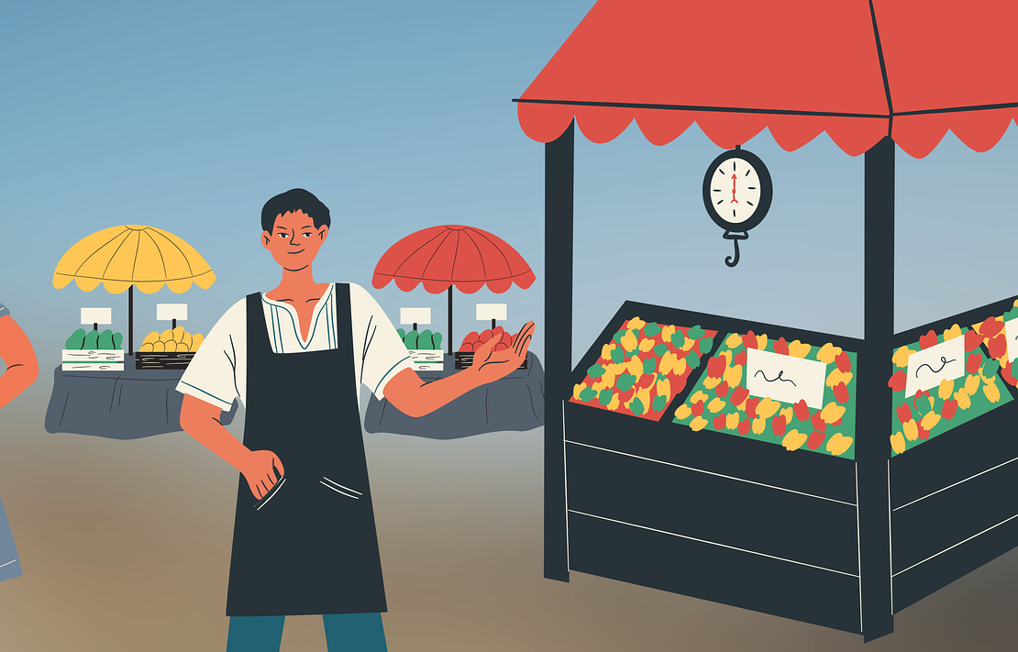
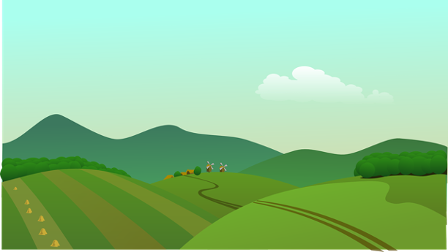
Follow up 4:
Ronja schreibt an Olivia.
She draws pictures for some of the words for Olivia to practise her German.
Hallo Olivia! Wie geht’s?
schreiben
Wir sind heute in Bern. Im Moment*
sind wir in der Stadt und wir gehen auf den Markt.
1
2
Heute gibt es Zwiebel*markt!! Diesen Markt gibt es hier jeden* November. Wir essen dort Zwiebelkuchen und nehmen viele Zwiebeln mit nach Hause. Meine Tasche ist sehr schwer!!
3
4
Remember! aufs is short for auf das.
Morgen fahren wir aufs Land und wir fahren Rad. Olivia, was machst du am Wochenende?
Deine Ronja
5
6
im Moment – at the moment
die Zwiebel – onion
jede – every
to do, make
Notes:
Timing: 5 minutes
Aim: to practise written comprehension of vocabulary and structures from this week and revisited weeks.
Procedure:
Pupils use the visual prompts to complete Ronja’s letter to Olivia. Ensure these are clear and provide hints in English where necessary.
Click to reveal the answers.
Help pupils to translate the postcard into English.
Translation
Hello, Olivia! How are you?
We’re in Bern today. At the moment we’re in the town and we’re going to the market.
Today there’s an onion market!! This market happens/is every November. We eat/are eating onion cake there and take/are taking lots of onions with us home. My bag is very heavy!
Tomorrow we are cycling in the countryside. Olivia, what do you do/are you doing at the weekend? Your Ronja.
Vocabulary
Moment [358] Zwiebel [N/A] jede [87].
Jones, R.L & Tschirner, E. (2019). A frequency dictionary of German: Core vocabulary for learners. London: Routledge.

Slide 6
Follow up 5:

Schreib auf Englisch.
Can you get at least 15 points?
Wörter
 | das Geld | erklären | holen
 | die Seen | normalerweise | reden
 | kaufen | die (Sport)Kleidung | laufen
 | tragen | machen | Rad fahren
 | einkaufen | nach Hause | kommen
 | auf | der Markt | die Straße
(the) money
to explain, explaining
to fetch, fetching
Vokabeln
x3
(the) lakes
normally
to talk, talking
to buy, buying
(the) (sports) clothing
to run, running
x2
to wear, to carry
to do, to make
to cycle, cycling
to shop, shopping
(to) home
to come, coming
x1
on, to, at
(the) market
(the) street
Notes:
Timing: 5 minutes
Aim: to practise written production of vocabulary from this and revisited weeks.
Procedure: 1. Give pupils a blank grid. They fill in the English meanings of any of the words they know, trying to reach 15 points in total.
Note: The most recently learnt and practised words are pink, words from the previous week are green and those from week 1 are blue, thus more points are awarded for them, to recognise that memories fade and more effort (heavy lifting!) is needed to retrieve them.

Slide 7
Follow up 5:

Schreib auf Deutsch.
Can you get at least 15 points?
Wörter
 | (the) lakes | normally | (the) money
 | to fetch, fetching | to explain, explaining | to talk, talking
 | to do, to make | to wear, to carry | to cycle, cycling
 | to run, running | (the) (sports) clothing | to buy, buying
 | (the) street | to come, coming | (to) home
 | (the) market | on, to, at | to shop, shopping
die Seen
normalerweise
das Geld
Vokabeln
x3
holen
erklären
reden
machen
tragen
Rad fahren
x2
laufen
die (Sport)Kleidung
kaufen
die Straße
kommen
nach Hause
x1
der Markt
auf
einkaufen
Notes:
Timing: 5 minutes
Aim: to practise written production of vocabulary from this and revisited weeks.
Procedure: 1. Give pupils a blank grid. They fill in the German meanings of any of the words they know, trying to reach 15 points in total.
Note: The most recently learnt and practised words are pink, words from the previous week are green and those from week 1 are blue, thus more points are awarded for them, to recognise that memories fade and more effort (heavy lifting!) is needed to retrieve them.

Slide 8
Tschüss!
grün
Notes:
8

Slide 9
Follow up 5:

Schreib auf Englisch.
Can you get at least 15 points?
Wörter
 | das Geld | erklären | holen
 | die Seen | normalerweise | reden
 | kaufen | die (Sport)Kleidung | laufen
 | tragen | machen | Rad fahren
 | einkaufen | nach Hause | kommen
 | auf | der Markt | die Straße
Vokabeln
x3
x2
x1
Notes:
HANDOUT

Slide 10
Follow up 5:

Schreib auf Deutsch.
Can you get at least 15 points?
Wörter
 | (the) lakes | normally | (the) money
 | to fetch, fetching | to explain, explaining | to talk, talking
 | to do, to make | to wear, to carry | to cycle, cycling
 | to run, running | (the) (sports) clothing | to buy, buying
 | (the) street | to come, coming | (to) home
 | (the) market | on, to, at | to shop, shopping
Vokabeln
x3
x2
x1
Notes:
HANDOUT

