Slide 1
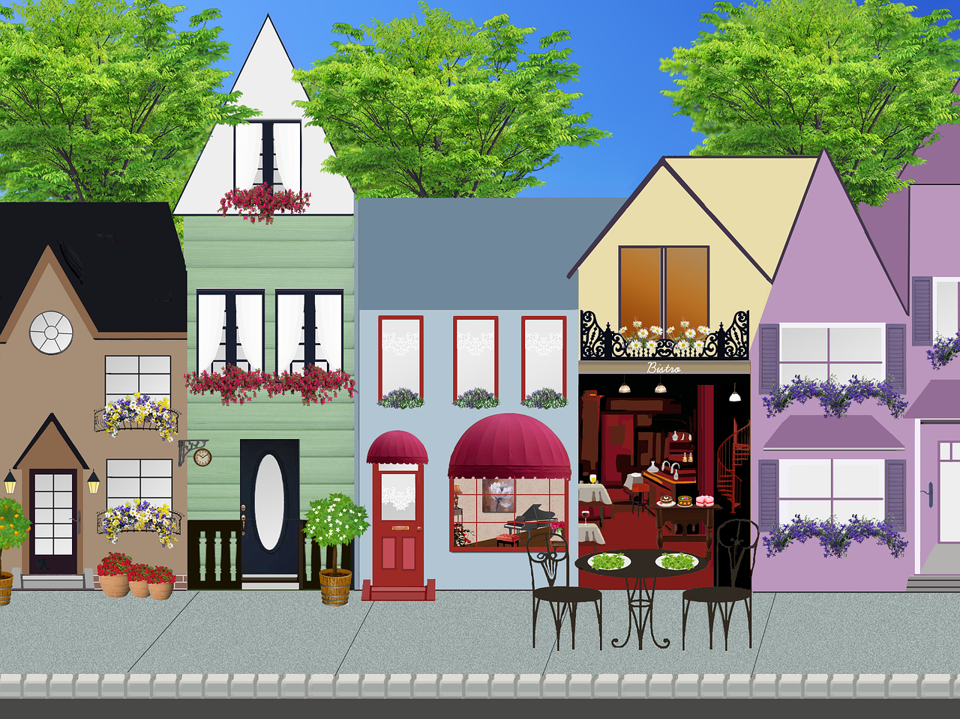
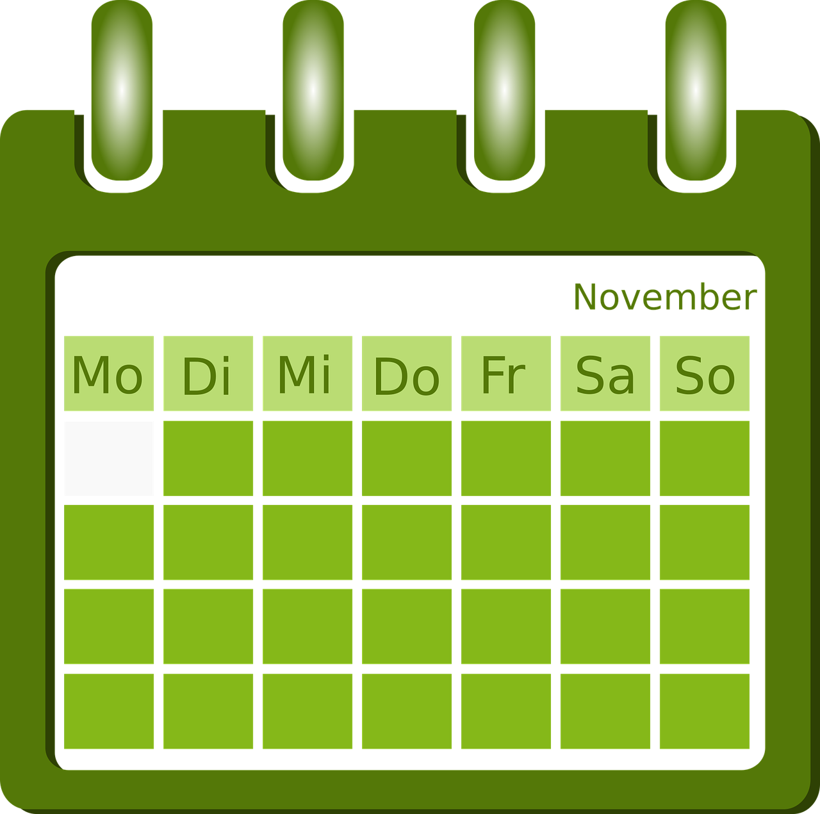
Exploring
Am Wochenende*
grün
auf (R3) location and in (R2) movement
present tense
SSC [ss|ß|-s]
am Wochenende – at the weekend
Term 2 Week 8
Notes:
Artwork by Steve Clarke. Pronoun pictures from NCELP (www.ncelp.org). All additional pictures selected from Pixabay and are available under a Creative Commons license, no attribution required.
Phonics:
[ß] [ss] [-s] groß [67] essen [323] Fußball [1277] tschüss [3766] heißen [126]
Vocabulary: einkaufen [2877] gehen [66] kommen [62] schwimmen [1863]sein [3] Land2 [134] Markt [476] Straße [391] auf [16] nach Hause [n/a]
Revisit 1: kaufen [506] laufen [252] machen [58] Rad fahren [n/a] tragen [271] (Sport)Kleidung [2820]
Revisit 2: Language from Term 1
Jones, R.L & Tschirner, E. (2019). A frequency dictionary of German: Core vocabulary for learners. London: Routledge.
The frequency rankings for words that occur in this PowerPoint which have been previously introduced in these resources are given in the SOW and in the resources that first introduced and formally re-visited those words.
For any other words that occur incidentally in this PowerPoint, frequency rankings will be provided in the notes field wherever possible.
Remember that at the start of the course (first three lessons of Rot/Gelb) pupils learnt language (for greetings and register taking) that can still be part of the lesson routines in upper KS2 (Blau/Grün). They are not re-taught, as we anticipate that teachers have built these in from early in lower KS2.
1

Slide 2
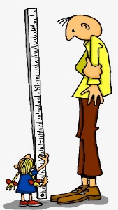
aussprechen
[s][ss][ß]
…
You know that ‘s’ in front of a vowel sounds like the English ‘z’.
ß is just a special way of writing ‘ss’ after a long vowel.
At all other times German ‘s’, ‘ss’ and ‘ß’ sound like English ‘s’.
groß
[big, tall]
Notes:
Timing: 1 minute
Aim: To introduce SSC [s/ss/ß] when not in front of a vowel.
Procedure:
Introduce the SSC and say the [s/ss/ß] sound first, on its own. Pupils repeat it with you.
Present the source word ‘groß’ (with gesture, if using).
Click to bring on the picture and get pupils to repeat the word ‘groß’ (with gesture, if using).
Use the callouts to emphasise the difference between ‘s’ in front of a vowel and ‘s’ at all other times and to explain about the new letter ß.
Note:
A gesture for this could be to reach high above your head.
groß [67]
Jones, R.L & Tschirner, E. (2019). A frequency dictionary of German: Core vocabulary for learners. London: Routledge.
2

Slide 3
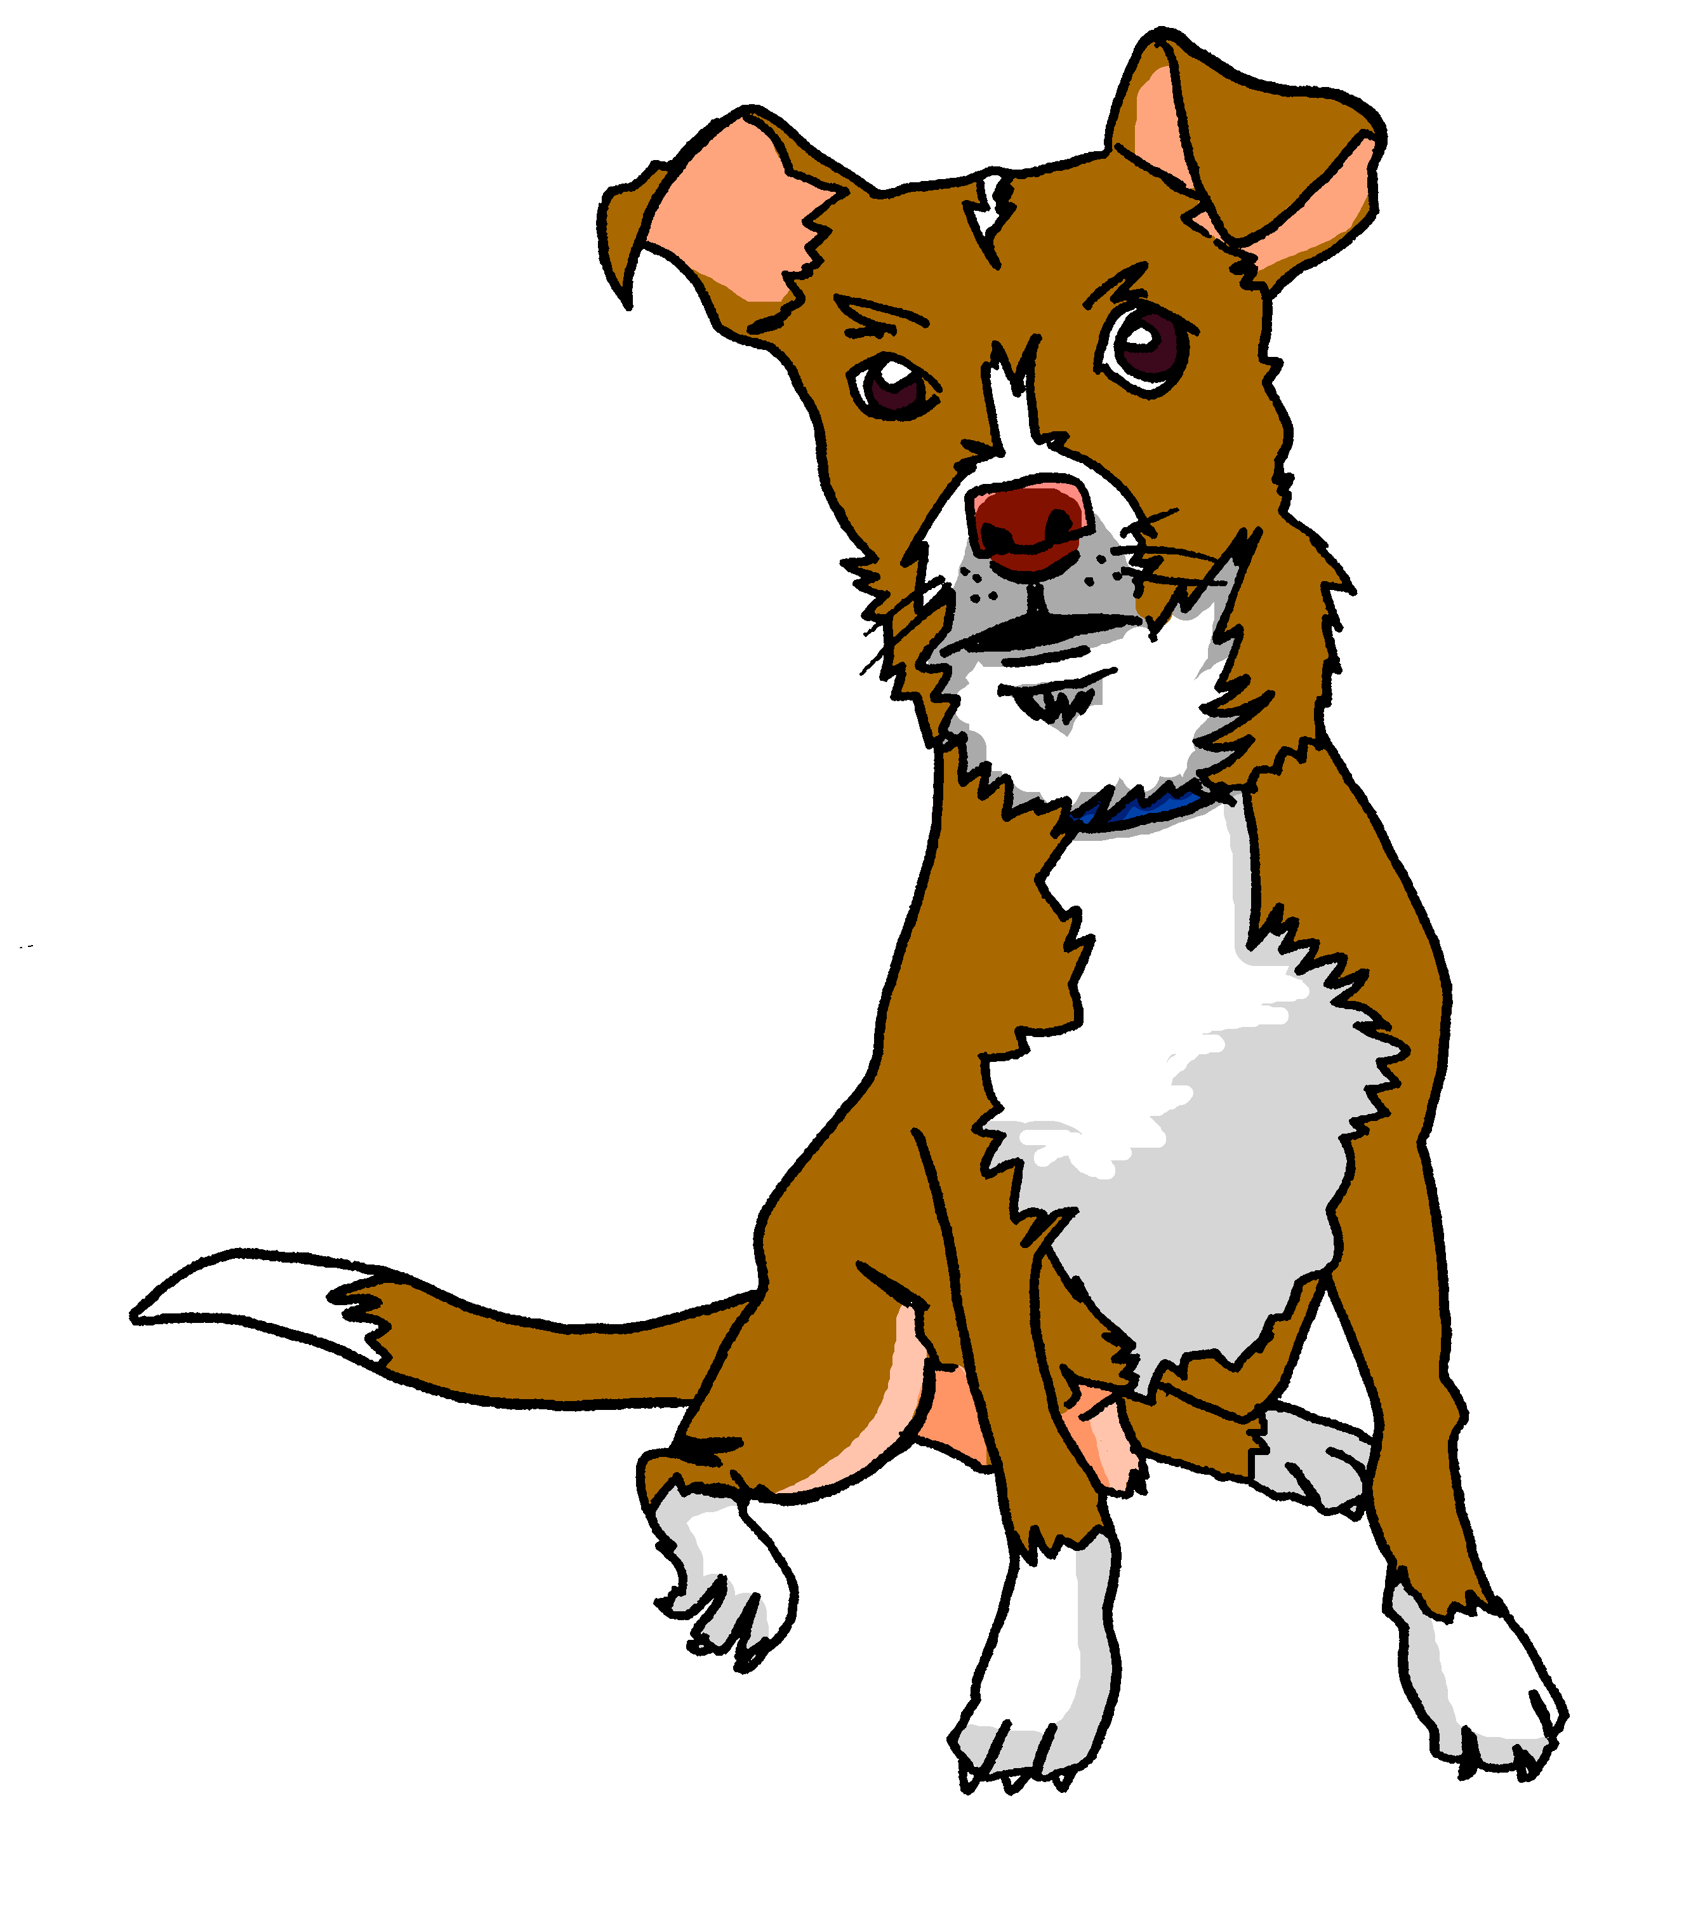
aussprechen
[s][ss][ß]
…
Tasso
Fußball
heißen
groß
essen
tschüss
This can be written with ‘s’ or ‘ss’ at the end.
[to eat, eating]
Notes:
Timing: 1 minute
Aim: to introduce the SSC [s/ss/ß].
Procedure:
Re-present the SSC and the source word ‘groß’ (with gesture, if using).
Click to bring on the picture and get pupils to repeat the word ‘groß’ (with gesture, if using).
Present the cluster words in the same way, bringing on the pictures and getting pupils to pronounce the words.
Note: It’s very important that pupils start to recognise ß as an ‘s’ sound, and don’t confuse it with a B.
essen [323] Fußball [1277] tschüss [3766] heißen [126]
Jones, R.L & Tschirner, E. (2019). A frequency dictionary of German: Core vocabulary for learners. London: Routledge.
3

Slide 4
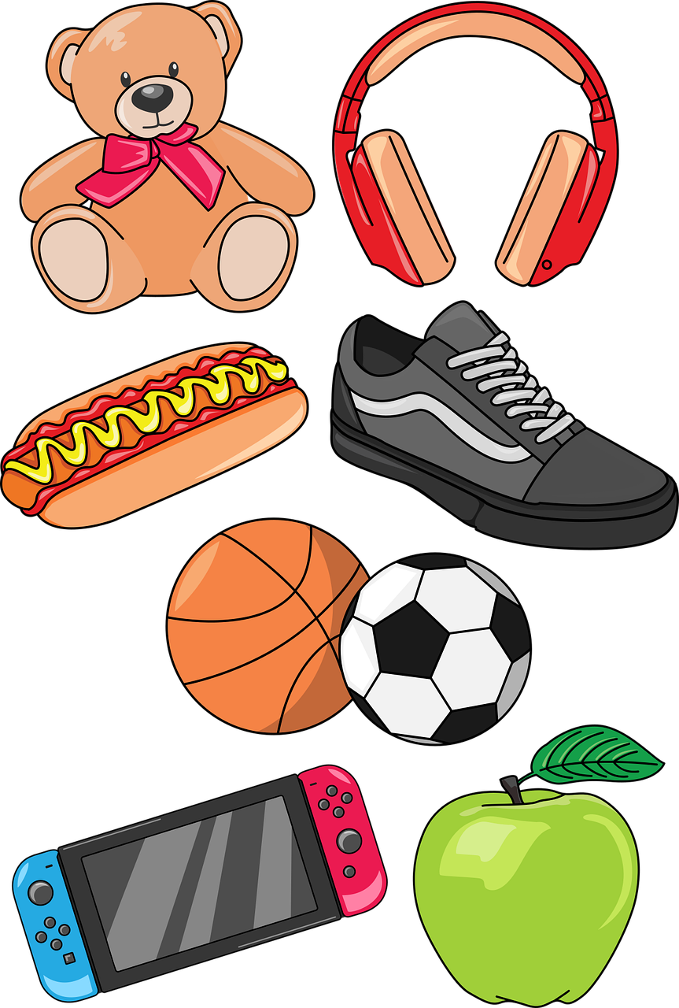
hören
Hör zu.
Ist es [s] oder [ss]?
 | b e ss e r
 | K l a ss e
 | S a c h e n
 | E ss e n
 | S e p t e m b e r
 | S i n g e n
 | S o m m e r
[s] | [ss]
 |  | [better]
 |  | [summer]
B.
__
1
__
2
__
3
__
4
__
September
5
__
6
__
Notes:
Timing: 5 minutes
Aim: to practise aural identification of [s] versus [ss] in known and unknown words.
Procedure:
1. Click on the sound buttons to play the recording. B stands for Beispiel (example).
2. Elicit the answer. Click to bring up the answer tick and image.
Transcript:
Beispiel: besser
Klasse
Sachen
Essen
September
singen
Sommer
Vocabulary: besser [N/A] Klasse [961] Sachen [318] Essen [323] September [1035] singen [1063] Sommer [771]
Jones, R.L & Tschirner, E. (2019). A frequency dictionary of German: Core vocabulary for learners. London: Routledge.
4

Slide 5
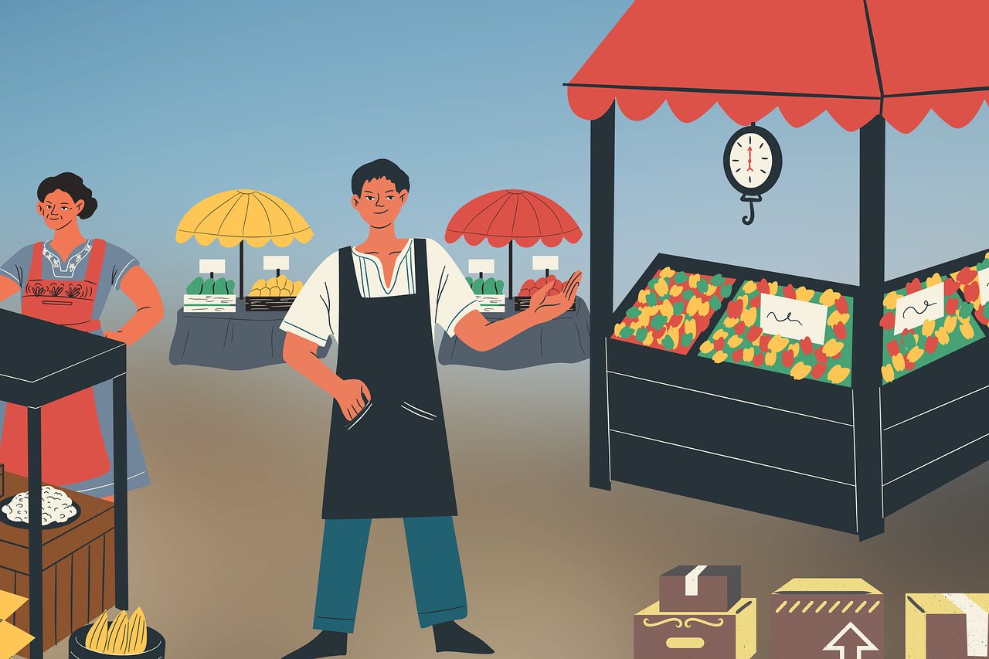
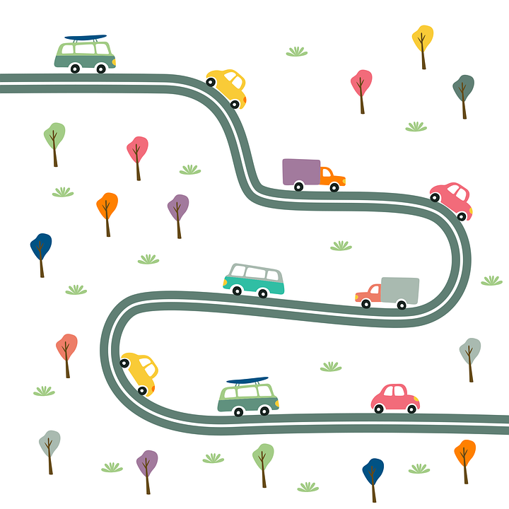
Vokabeln
Vokabeln lernen
Wörter
to come
einkaufen is a separable verb like mitnhemen and mitbringen.
e.g. Ich kaufe heute ein.
[to come, coming]
[to go, going,
to walk, walking]
[on, to, at]
[(to) home]
kommen
gehen
auf
nach Hause
to shop
[(the) market]
[(the) street]
[to shop, shopping]
der Markt
die Straße
einkaufen
Notes:
Timing: 5 minutes
Aim: to present and practise written comprehension and read aloud of the new vocabulary for this week.
Procedure: 1. Click for a German word. Elicit pronunciation from pupils.
2. Click for the English meaning and picture prompt. Elicit the German word again.
3. Present all six words like this, in order.
4. Click for one English meaning to disappear. Elicit the English meaning from pupils. Continue with the remaining items.
5. Click for the German word to disappear. Elicit the German from pupils. Continue with the remaining items.
5

Slide 6
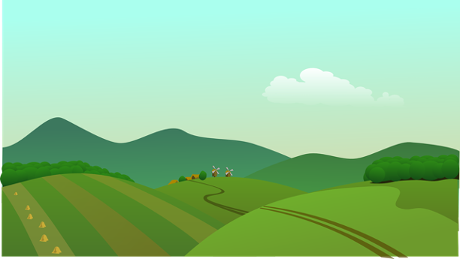
schreiben
Schreib ‘the’ auf Deutsch.
Welcher Buchstabe* ist es?
der Buchstabe - letter
das Land means the countryside and the country.
das
_________ Land
_________ Schule
_________ Museum
_________ Markt
_________ Stadt
_________ Laden
_________ Restaurant
_________ Straße
_________ Park
_________ Schwimmbad
d
a
b
c
die
a
das
i
der
h
d
e
f
g
die
b
der
g
das
f
die
c
h
j
i
der
e
das
j
Notes:
Timing: 5 minutes
Aim: to practise written production of the correct definite articles and their association with some previously taught nouns.
Procedure:
1. Read the instruction in German.
2. Pupils to identify the gender of the nouns and write the correct definite article.
3. Pupils match the pictures to the words to reinforce their understanding.
Transcript:
das Land
die Schule
das Museum
der Markt
die Stadt
der Laden
das Restaurant
die Straße
der Park
das Schwimmbad
Vocabulary:
Buchstabe [2905]
Jones, R.L & Tschirner, E. (2019). A frequency dictionary of German: Core vocabulary for learners. London: Routledge.
6

Slide 7
sprechen
Was ist das?
…
sprechen
der
die
das
Notes:
Timing: 3 minutes Aim: To practise use of the definite article with new nouns from this week, without gender or word support. Procedure: 1. Ask ‘Was ist das?’ 2. Elicit ‘Das ist der/die/das…’ Words are triggered so that students can respond in any order and volunteer those they are most confident with first. 3. Click on the words to make them ‘fly’ into the appropriate gender ‘bin’ at the bottom.
7

Slide 8
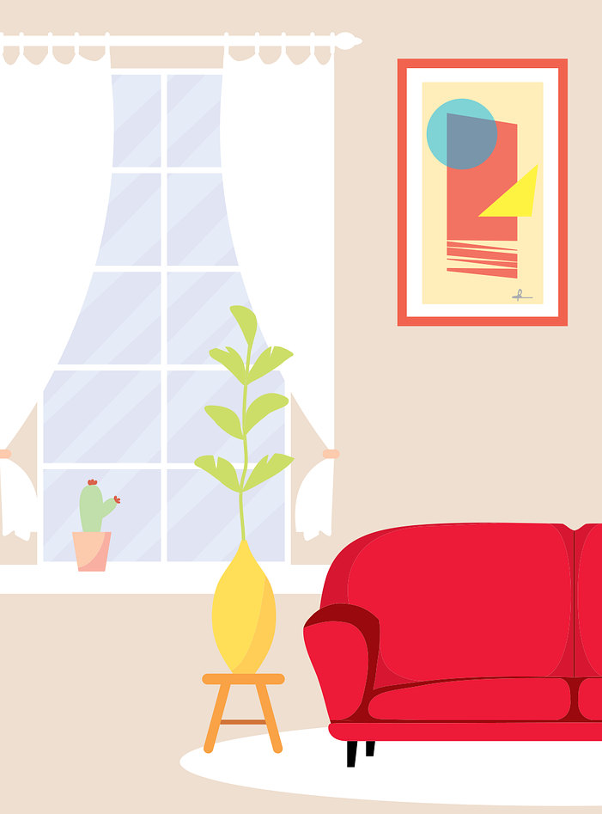
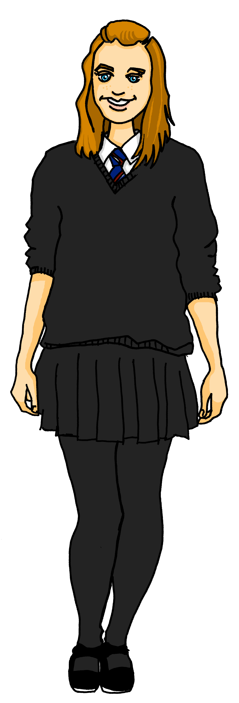
Olivia sendet Ronja ein Video.
Hier ist mein Hund, Max. Er ist sehr aktiv*!
aktiv - active
Notes:
Aim: to provide context for the following activities.
Olivia introduces her pet dog, Max.
Vocabulary:
Video [1963] aktiv [790]
Jones, R.L & Tschirner, E. (2019). A frequency dictionary of German: Core vocabulary for learners. London: Routledge.

Slide 9
The preposition ‘auf’ (onto, on)
We shorten ‘auf das‘ to ‘aufs’.
Auf (on, onto) works the same as in (in, into) in German.
For ‘onto’ (movement):
masculine
feminine
neuter
Max springt…
auf den Computer
auf die Liste
auf das Fahrrad
Max jumps/
is jumping…
onto the computer
onto the list
onto the bicycle
Compare ‘on’ (location):
Max sitzt…
auf dem Computer
auf der Liste
auf dem Fahhrad
Max sits/is sitting…
on the computer
on the list
on the bicycle
Notes:
Timing: 2 minutes
Aim: to introduce the preposition ‘auf’.
Procedure:
Click through the animations to present the grammar of ‘auf’.
9

Slide 10
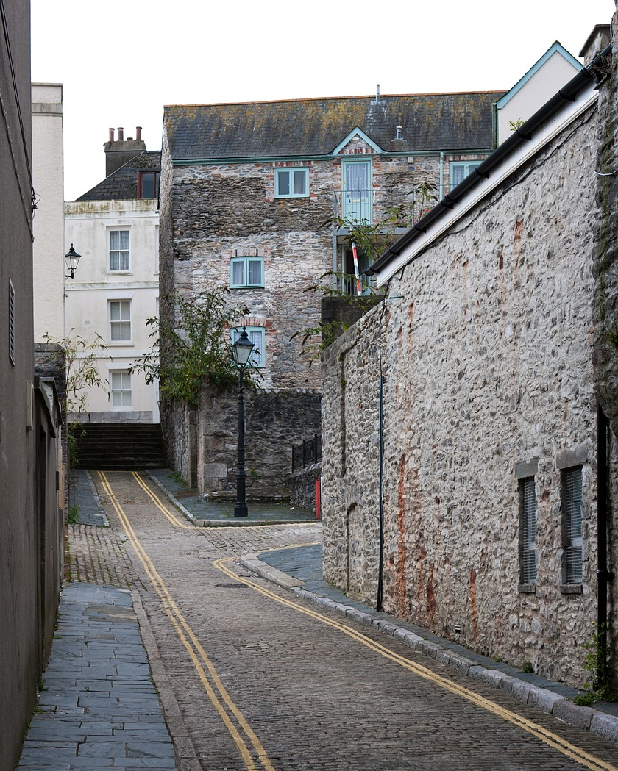
hören
Olivia und Max sind in der Stadt. Olivia schickt Sprachnachrichten*.
Hör zu. Wo springt Max oder wo sitzt Max?
springen | sitzen
B.
1
2
3
4
5
6
die Sprachnachricht – voice message
die Einkaufsliste – the shopping list
Notes:
Timing: 5 minutes
Aim: to practise aural comprehension of the articles used with auf with movement (accusative) and without movement
Procedure:
Make sure the context is clear. Olivia is sending Ronja voice messages about Max’s day in the town.
Click the audio button for the example to play the recording.
Elicit the answer. Is Max jumping or sitting? Pupils decide, based on the article.
Click to bring up the answer tick.
Continue for items 1-6.
Transcript:
Beispiel: Wir sind im Sportladen. Max [springt] auf die Fußbälle.
Er [sitzt] auf dem Rucksack.
Wir sind im Markt. Max [sitzt] auf der Einkaufsliste.
Er [springt] auf den Tisch.
Wir gehen in den Park. Max [sitzt] auf dem Müll!
Er [springt] auf das Mädchen.
Wir gehen nach Hause, aber Max [sitzt] auf der Straße. Komm, Max!
10

Slide 11
The preposition ‘auf’ (at, to)
We shorten ‘auf das‘ to ‘aufs’.
Auf can also mean ‘at’ or ‘to’ for open spaces or events:
masculine
feminine
neuter
Ich gehe…
auf den Markt
auf die Straße
auf das Land
I’m going/I go…
to the market
(on)to the street
to the countryside
Ich bin…
auf dem Markt
auf der Straße
auf dem Land
I am…
at the market
on the street
at the countryside
Notes:
Timing: 2 minutes
Aim: to introduce more complex grammar for the preposition ‘auf’.
Procedure:
Click through the animations to present the grammar of ‘auf’.
11

Slide 12
lesen
Was machen Olivia und Max dieses Wochenende?
Tick the correct meaning of ‘auf’.
der Verkäufer - seller
1
on
4
on
Wir gehen auf das Land.
Wir kaufen auf dem Markt ein.
onto
onto
at
at
to
Notice how ‘einkaufen’ is separated into kaufen...ein.
to
2
on
5
on
Wir spielen auf der Straße.
onto
Max springt auf den Verkäufer*.
onto
at
at
to
You have learnt the phrase ‘nach Hause’ earlier this lesson!
to
3
on
6
on
Wir gehen auf den Markt.
onto
Wir kommen nach Hause.
onto
at
at
to
(to)
Notes:
Timing: 5 minutes
Aim: to practise written comprehension of the articles used with movement and without movement following ‘auf’.
Procedure:
Ensure the context is clear: Olivia is sending messages about what her and Max are doing at the weekend.
Pupils write 1-6 and the correct English meaning from the four options given.
Click to reveal answers.
Translation
We go/are going to the countryside.
We play/are playing on the street.
We go/ are going to the market.
We shop/are shopping at the market.
Max jumps/is jumping onto the seller.
We come/are coming home.
Note: German also uses the present tense to talk about the future so it’s possible to translate any of these texts to be about the future e.g. ‘We are going to go to the countryside’.
12

Slide 13
Tschüss!
grün
Notes:
13

