Slide 1
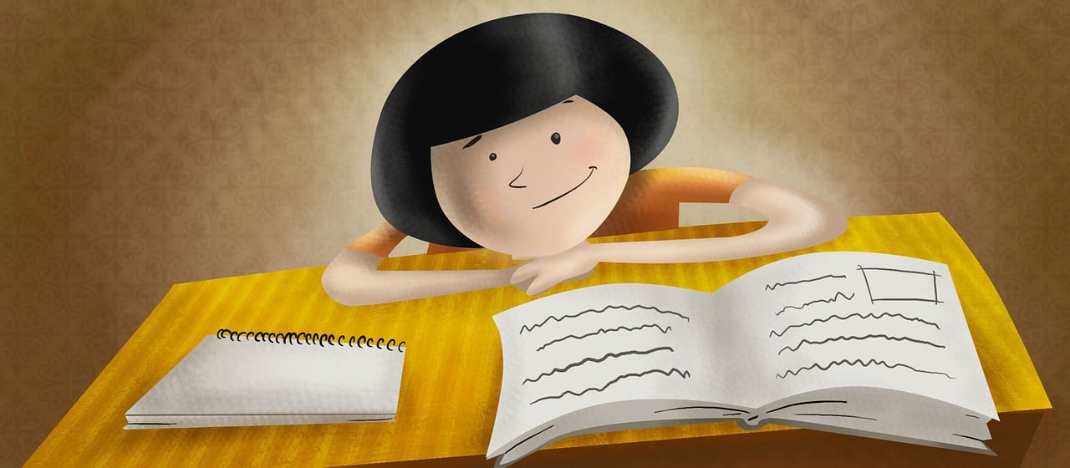
Talking about things and things to do
Ich kann das!
grün
Phonics, Vocabulary
and Grammar revision
Term 2 Week 9
Notes:
Artwork by Steve Clarke. Pronoun pictures from NCELP (www.ncelp.org). All additional pictures selected from Pixabay and are available under a Creative Commons license, no attribution required.
Phonics: revisit SSC [ä] [ö] [ü] [au] [eu | äu] [sch] [sp] [st] [s-] [-s-] [ß] [ss] [-s]
Vocabulary: revisit words from term 2
Revisit 1: Uhr3 [348] spät [169] um1 [44] zusammen [533] Revisit numbers 1-12
Revisit 2: liegen [107] Berg [934] Dorf [959] Europa [294] Haus [147] Leute [224] Meer [854] See [1317] Wetter [1881] kalt [887] da [48] dort [139] hier [68] links [893] oben [417] rechts [829] unten [710]
Jones, R.L & Tschirner, E. (2019). A frequency dictionary of German: Core vocabulary for learners. London: Routledge.
The frequency rankings for words that occur in this PowerPoint which have been previously introduced in these resources are given in the SOW and in the resources that first
introduced and formally re-visited those words.
For any other words that occur incidentally in this PowerPoint, frequency rankings will be provided in the notes field wherever possible.
1

Slide 2
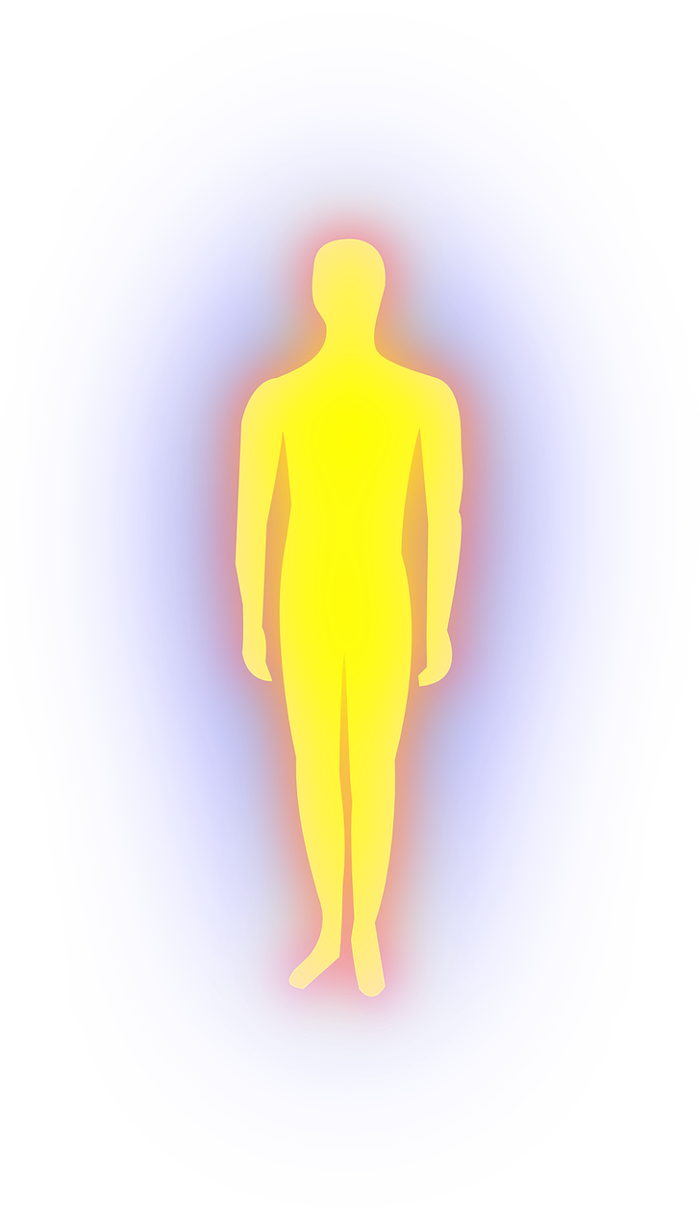
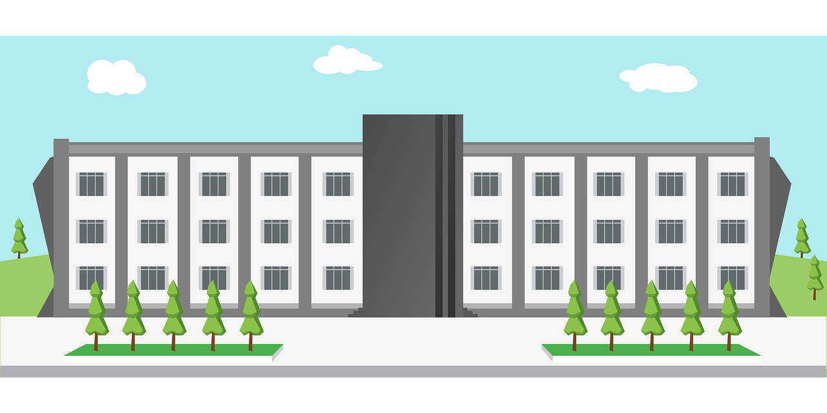
aussprechen
Follow up 1
[ä]
[ö]
Körper
Universität
[body]
Notes:
1/6
Timing: 5 minutes (six slides)
Aim: to practise read aloud of SSCs learnt so far with unknown words.
Procedure:
Tell pupils that they are going to practise the sounds of German that they have learnt this year.
Click to bring up the first ‘flashcard’.
Elicit the SSC first. (To bring all pupils in together, teachers could use a silent 3-2-1 countdown gesture with their fingers).
Elicit the word, using the same countdown procedure.
Click to bring up the 2nd flashcard and repeat steps 3-4.
Word frequency (1 is the most frequent word in German):
Universität [415] Körper [488]
Jones, R.L & Tschirner, E. (2019). A frequency dictionary of German: Core vocabulary for learners. London: Routledge.
2

Slide 3
aussprechen
[au]
[äu|eu]
schauen
teuer
[to look]
[expensive]
Notes:
[2/6]
Word frequency (1 is the most frequent word in German):
schauen [510] teuer [950]
3

Slide 4
aussprechen
[sch]
[sp]
Sprecher
wünschen
[to wish, wishing]
[speaker]
Notes:
3/6
Word frequency (1 is the most frequent word in German):
Sprecher [999] wünschen [630]
4

Slide 5
aussprechen
[st]
[-s-]
Student
Insel
[island]
Notes:
4/6
Word frequency (1 is the most frequent word in German):
Insel [1029] Student [1017]
5

Slide 6
aussprechen
[ss]
[-s]
Schluss
Ereignis
[end]
[event]
Notes:
5/6
Word frequency (1 is the most frequent word in German):
Schluss [1030] Ereignis [1067]
6

Slide 7
aussprechen
[ß]
heiß
[hot]
Notes:
6/6
Word frequency (1 is the most frequent word in German):
heiß [1195]
7

Slide 8
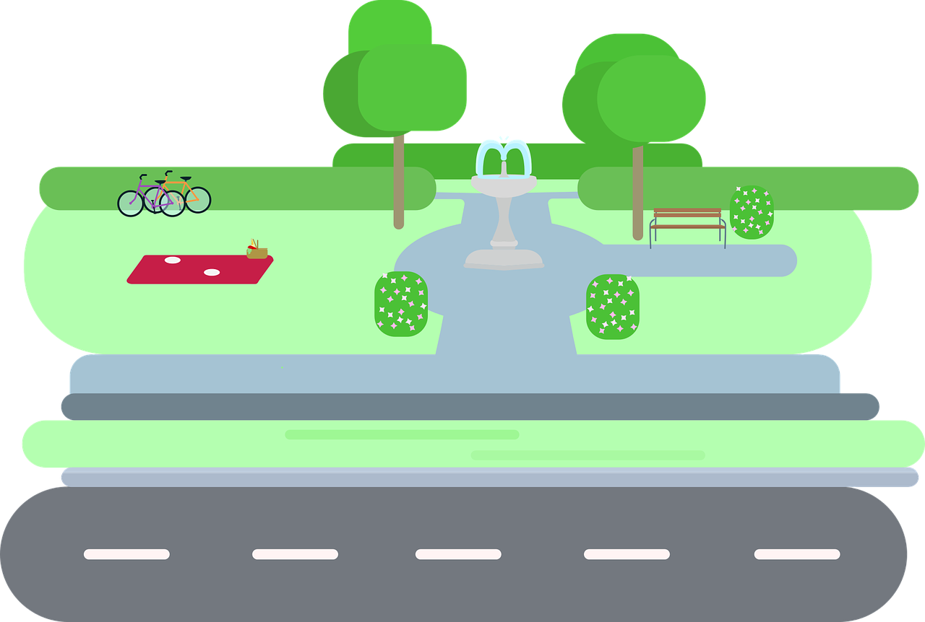
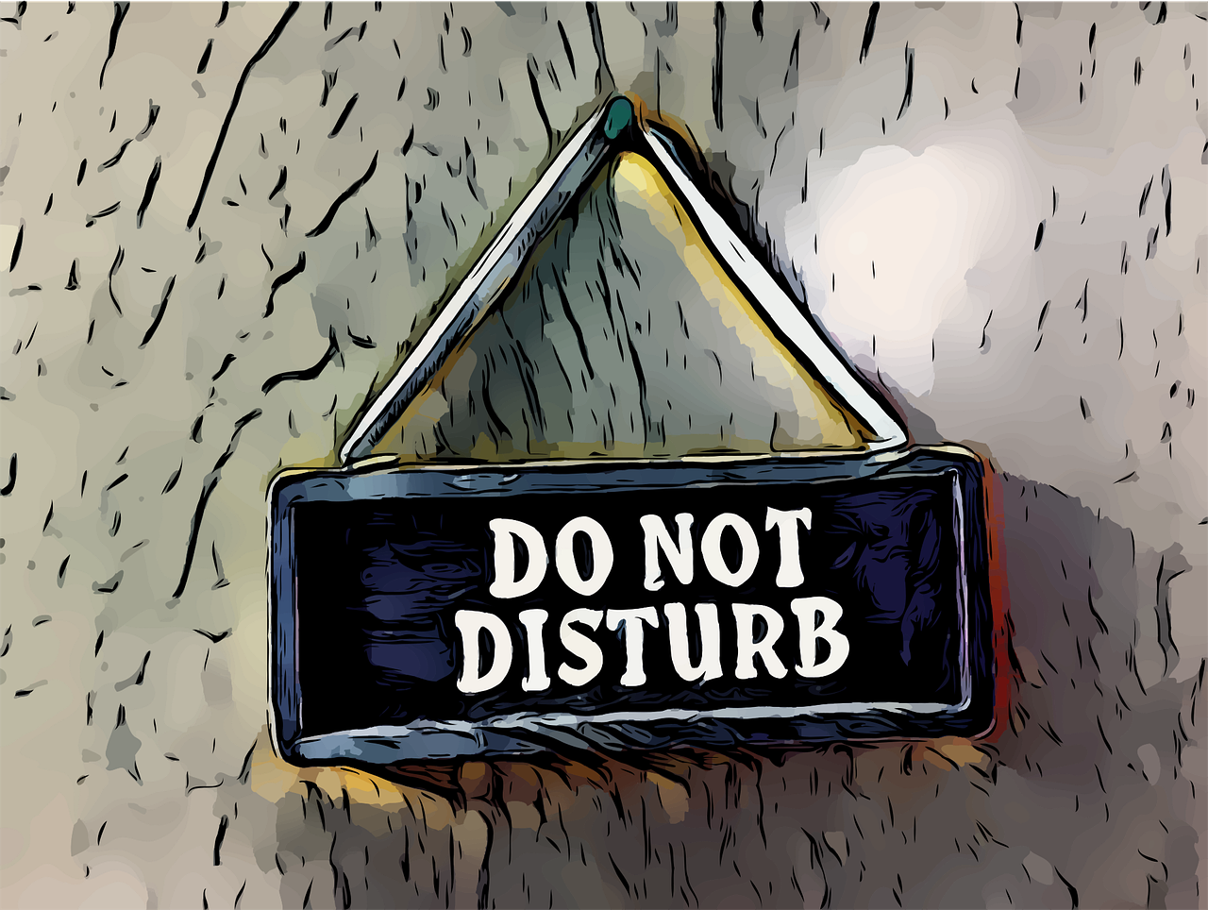
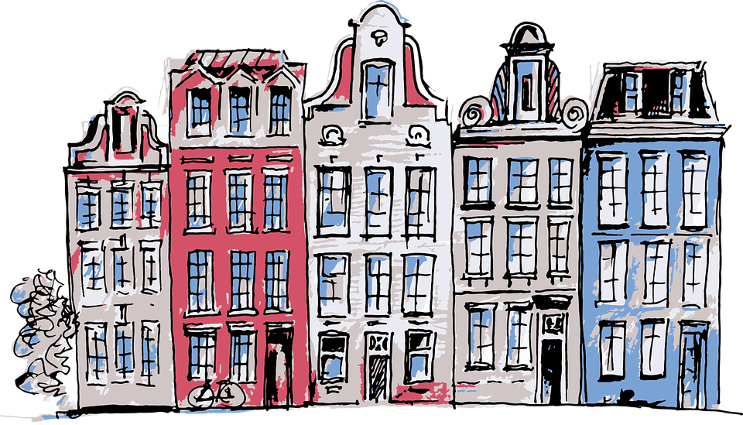
Follow up 2: Sag die Wörter.
aussprechen
weiß
spielen
zwölf
sodass
60
[so that]
reißen
Fläche
neu
stören
S
[to tear, tearing]
[area]
[to disturb, bother]
Preis
schwarz
Gebäude
grau
0
[building]
[grey]
START
Notes:
Timing: 5 minutes
Aim: to practise applying knowledge of previously learnt SSCs to known and unknown words.
Procedure: 1. Start the timer. Pupil A tries to read aloud all of the words taking care with their pronounciation of the highlighted SSC’s, within the 60 seconds allowed.
2. Pupil B listens. If Pupil A makes a slip, Pupil B can direct him/her to start again from the beginning. 3. They swap roles and repeat the task.
Word frequency for unknown words: (1 is the most frequent word in German):
Fläche [1608] Gebäude [1386] grau [1560] reißen [1519] sodass [1512] stören [1188]

Slide 9
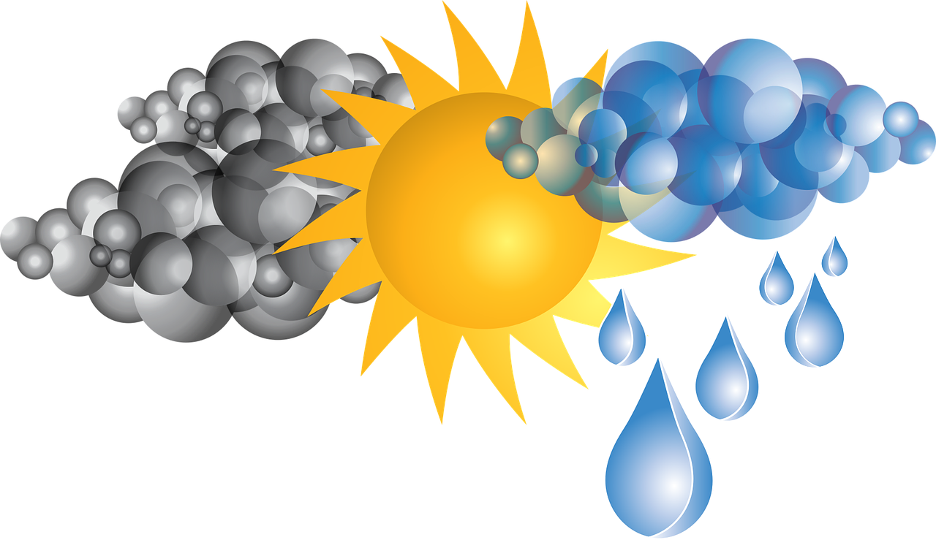
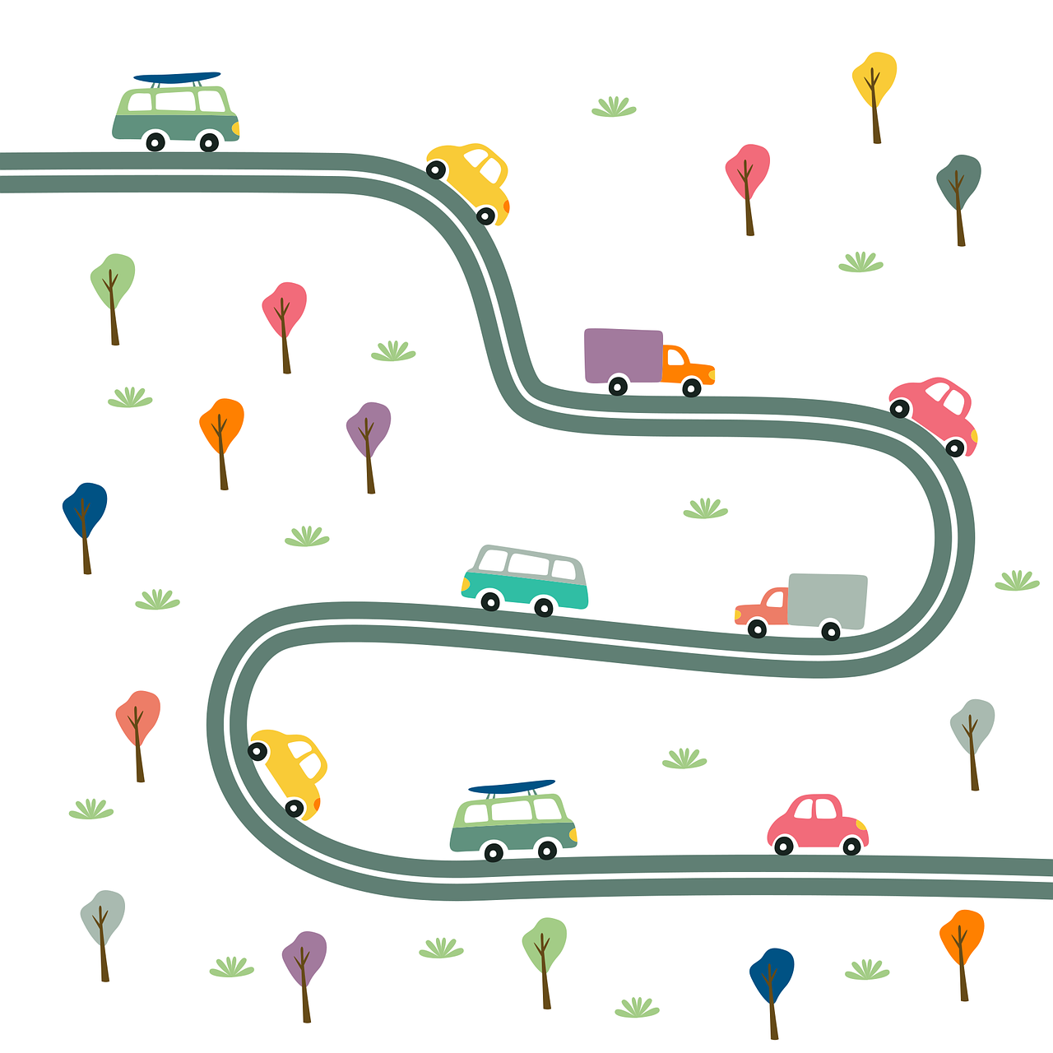
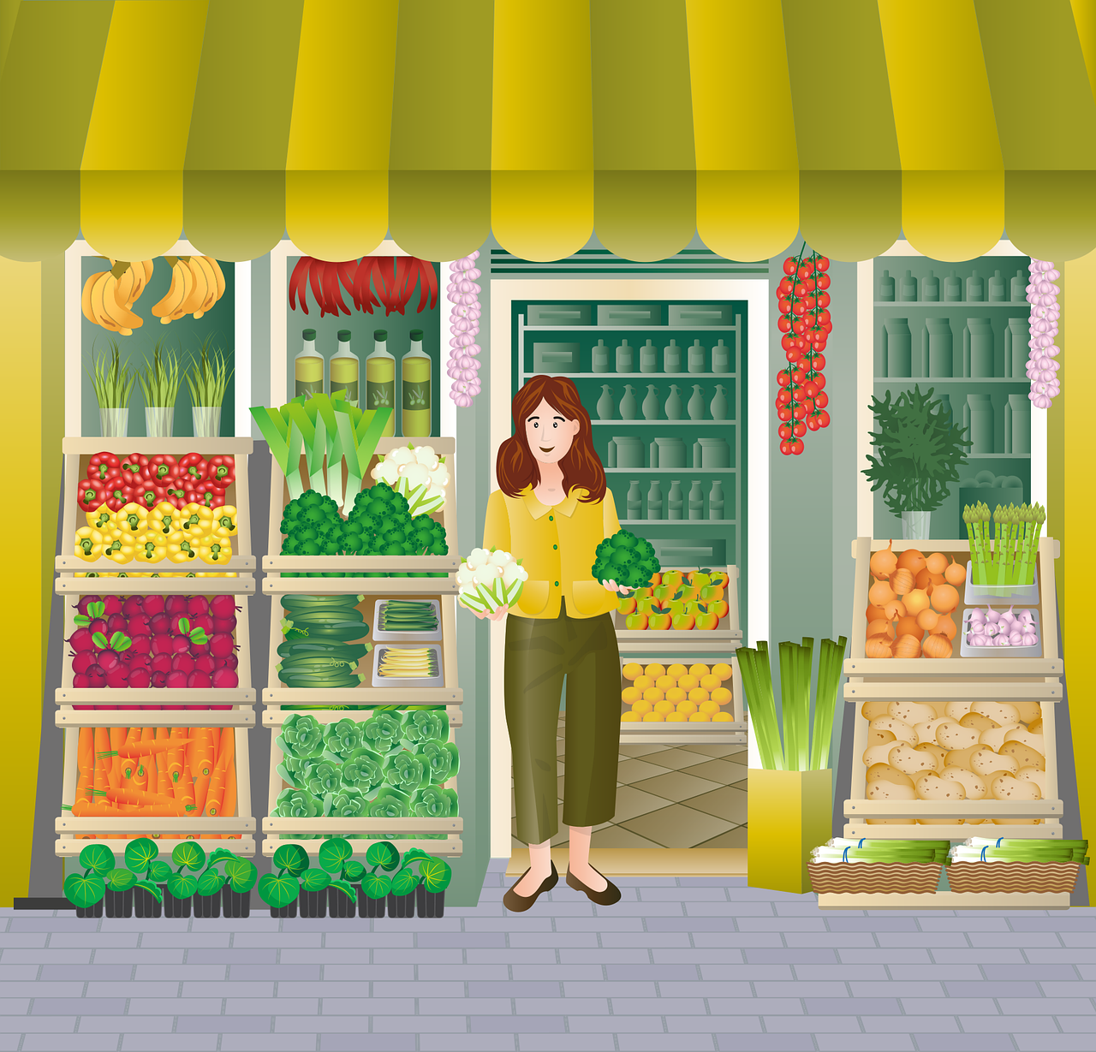
Follow up 3
Sag die Wörter.
sprechen
sprechen
der
das
die
Notes:
Timing: 5 minutes
Aim: to practise spoken production of a range of vocabulary and practise applying gendered articles.
Procedure:
Click to bring up the image. Pupils say the words aloud with the appropriate article.
Click again for the words to disappear into the appropriate ‘pacperson’.
Continue for the rest of the items.
Items in order:
die Schweiz
das Essen
die Kunst
die Uhr
der Berg
das Wetter
die Straße
das Meer
die Stadt
der Müll
der Laden
das Museum
der Markt

Slide 10
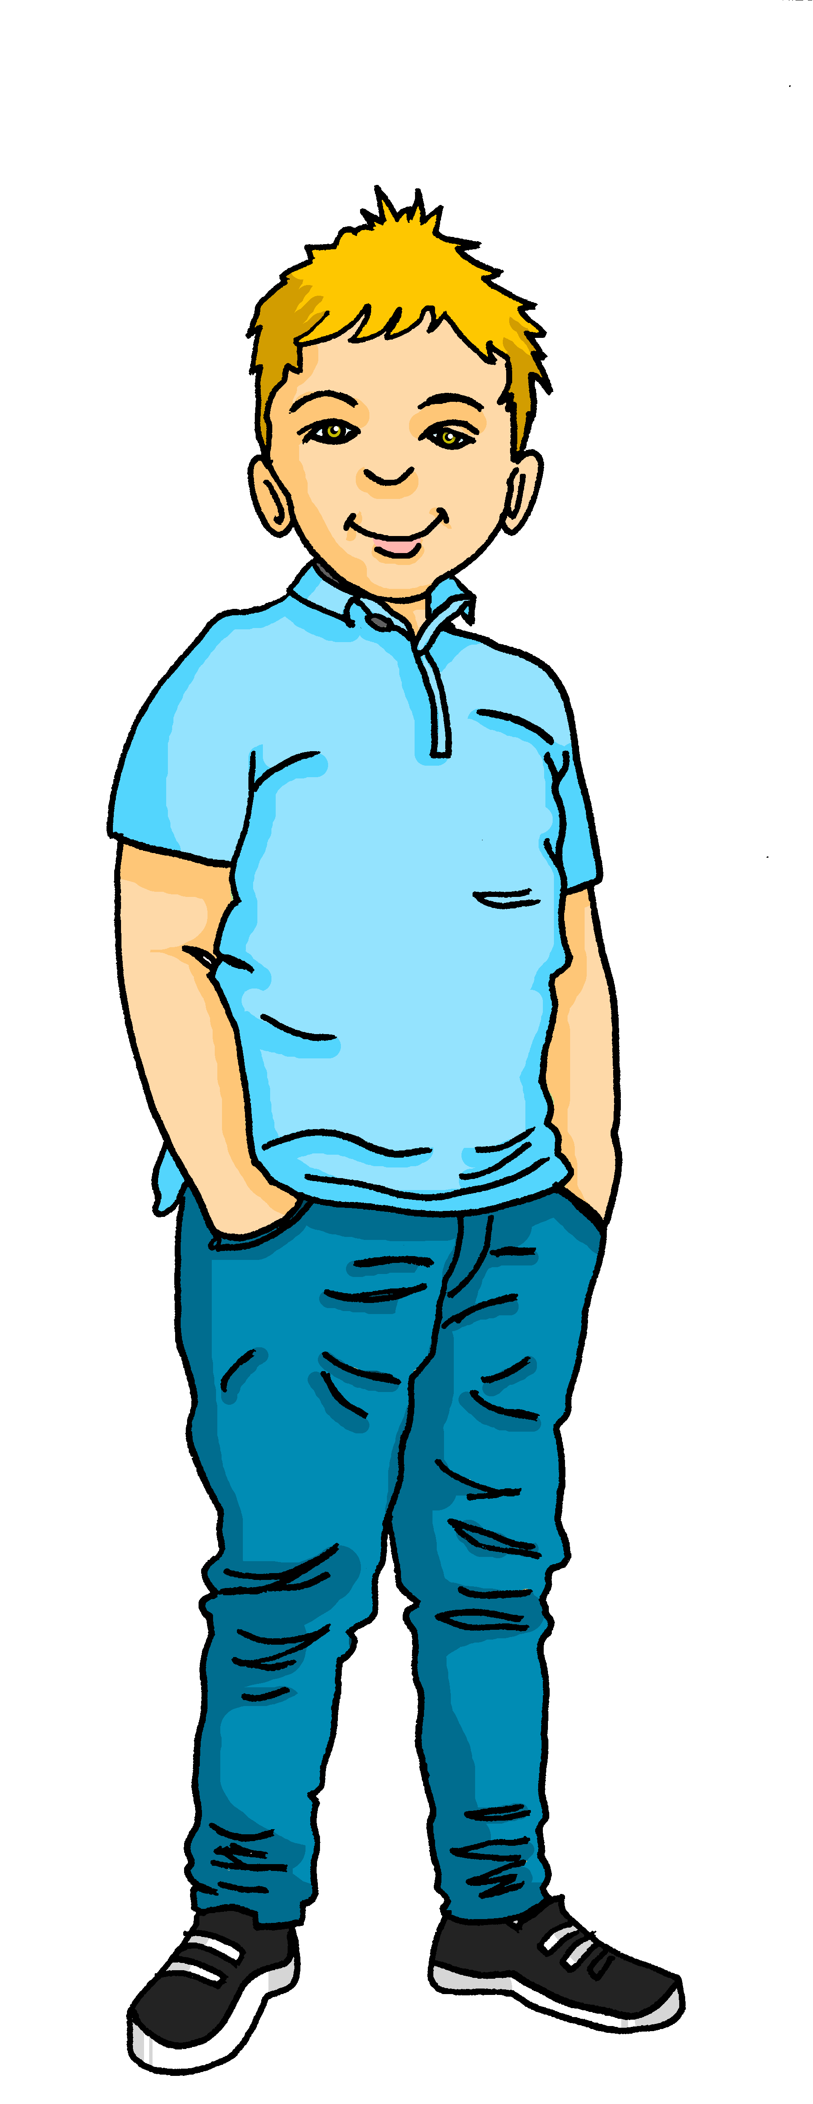
Follow up 4
Can you help Gabriel with his German?
lesen
Put an (X) next to the noun that completes each sentence.
1. | Mittwochs | ☐ spiele ich Fußball. ☐ ich spiele Fußball.
2. |  | ☐ ich gehe nach Hause. ☐ gehe ich nach Hause.
3. | Am Sportfest | ☐ ich laufe füng Kilometer. ☐ laufe ich fünf Kilometer.
4. | Auf dem Markt | ☐ ich kaufe ein. ☐ kaufe ich ein.
5. |  | ☐ ich trage keine Sportkleidung. ☐ trage ich keine Sportkleidung.
1
2
3
4
5
Notes:
Timing: 4-5 minutes
Aim: to practise written understanding of WO2 after adverbs of time and place.
Note: the audio version of this resource has the audio attached the answer cross (click on the green cross for each item, once it has appeared).
Procedure:
Pupils select the correct choice out of two for items 1-5.
Elicit answers.
Click for answers.

Slide 11
Follow up 5
Gabriel has forgotten some of his German. Can you help him?
Sometimes you have to tick more than one box!
 |  | A: finden | B: trägst | C: geht | D: mag | E: gebt | F: bin
1 | ich
2 | du
 | er/sie
 | wir
 | ihr
 | sie (pl.)
 | Sie
lesen
1
2
3
4
5
6
Danke!
7
Notes:
Timing: 6 minutes
Aim: to revise the person/verb agreement with all persons for weak and strong verbs.
Procedure:
Pupils write out 1-9, and write down all possible combinations (between one and three per item/grammatical person).
Click to bring up answer ticks in turn.
If time, elicit English translations for the verb forms.

Slide 12
Tschüss!
grün
Notes:
12

