Slide 1
Interacting
grün
Phonics quiz
Term 3 Week 11
Notes:
Artwork by Steve Clarke. Pronoun pictures from NCELP (www.ncelp.org). All additional pictures selected from Pixabay and are available under a Creative Commons license, no attribution required.
This lesson contains a phonics assessment to check progress in the SSCs introduced and practised in the first 12 weeks of this year’s course, as well as those from the previous two years.
The ratio of old to new SSCs in the quiz is approximately 50:50.
1

Slide 2
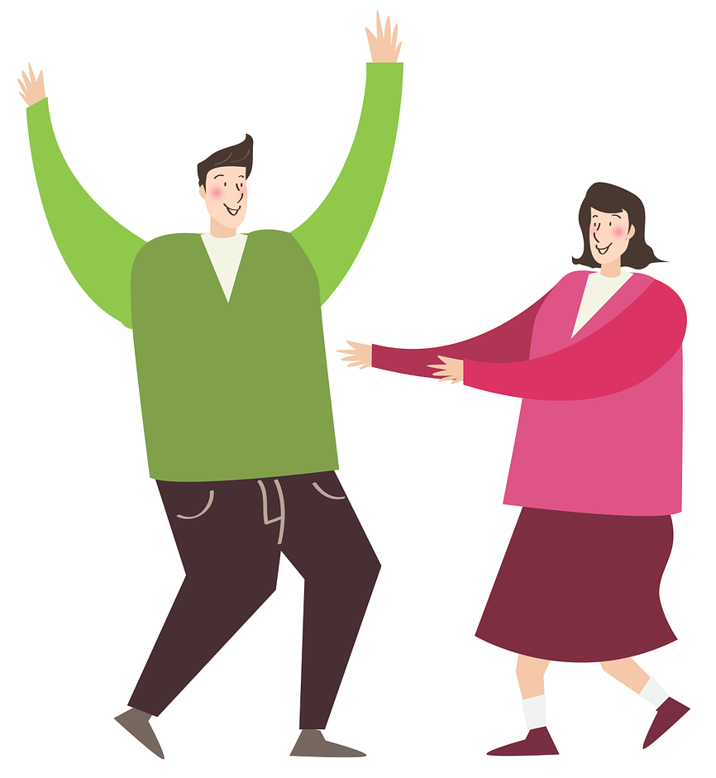
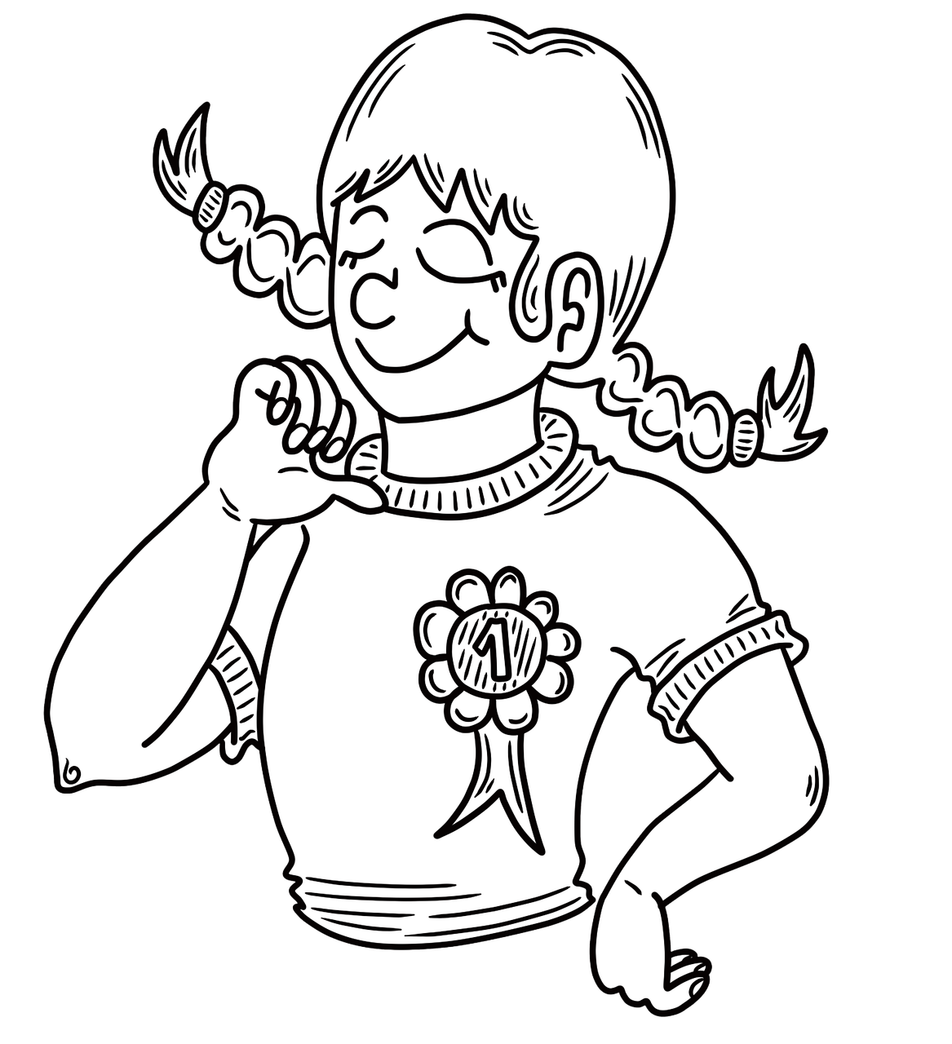
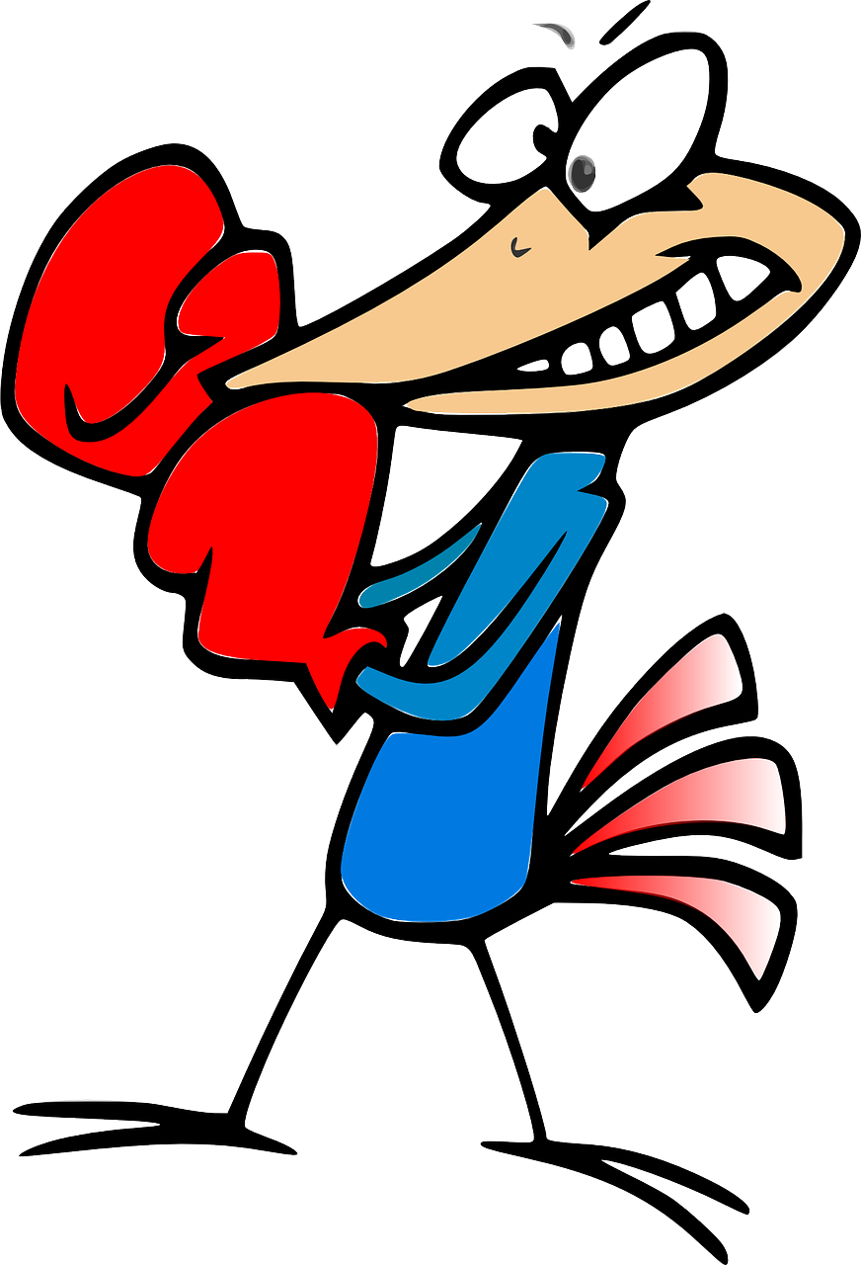
Read aloud the German words. You have not learnt these words so just use what you know about how to pronounce German. ☺ Concentrate on the underlined letters.
Phonics
…
1 rund | 2 jeder | 3 Freude | 4 Wunsch
5 lustig | 6 national | 7 stolz | 8 Reihe
9 Kampf | 10 Syrien | 11 Geist | 12 wahr
aussprechen
Notes:
Visual of the pupil handout (printable version of pupil and teacher handouts at the end of this slide deck)
This slide can also be used to share the answers to the assessment once the children have completed it. Click on each photo to hear the word.

Slide 3
Tschüss!
grün
Notes:
3

Slide 4
Phonics Read aloud the German words.
Phonics Read aloud the German words.
…
…
You have not learnt these words so just use what you know about how to pronounce German. ☺
Concentrate on the underlined letters.
You have not learnt these words so just use what you know about how to pronounce German. ☺
Concentrate on the underlined letters.
aussprechen
aussprechen
1 rund | 2 jeder | 3 Freude | 4 Wunsch
5 lustig | 6 national | 7 stolz | 8 Reihe
9 Kampf | 10 Syrien | 11 Geist | 12 wahr
1 rund | 2 jeder | 3 Freude | 4 Wunsch
5 lustig | 6 national | 7 stolz | 8 Reihe
9 Kampf | 10 Syrien | 11 Geist | 12 wahr
Notes:
Pupil handout To copy and cut in half

Slide 5
Phonics Read aloud the German words.
…
Pupil name: ___________________________________
Total score: _____ / 12
You have not learnt these words so just use what you know about how to pronounce German. ☺
Concentrate on the underlined letters.
aussprechen
 | Animal | SSC [sound-symbol correspondence] | p/ x
1 | rund | consonantal [r]
2 | jeder | [-er]
3 | Freude | [eu]
4 | Wunsch | [w]
5 | lustig | [-ig]
6 | national | [-tion]
7 | stolz | [st]
8 | Reihe | [ei]
9 | Kampf | [pf]
10 | Syrien | [y]
11 | Geist | [-s-]
12 | wahr | long [a]
1 rund | 2 jeder | 3 Freude | 4 Wunsch
5 lustig | 6 national | 7 stolz | 8 Reihe
9 Kampf | 10 Syrien | 11 Geist | 12 wahr
Notes:
Teachers award one point for each SSC, as per SSC list above.
Notes:
Teacher handout
Click on each picture to hear the word.

