Slide 1
Experiences at home and away
Viel Glück!
Wie sagt man...?
grün
Present tense – du and ihr
SSC [r]
Term 3 Week 2
Notes:
Artwork by Steve Clarke. Pronoun pictures from NCELP (www.ncelp.org). All additional pictures selected from Pixabay and are available under a Creative Commons license, no attribution required.
Phonics:
consonantal [r] rot [477] drei [106] rechts [829] Frage [157] warum? [192]
vocalic [r] Ort [341] Uhr [348] lernen [288] Antwort [522] Farbe [1079]
Vocabulary: werden, werde, wirst, wird [8] Frohe Weihnachten [n/a] Gute Besserung [n/a] Herzlichen Glückwunsch zum Geburtstag [n/a] viel Glück [n/a]
Revisit 1: einkaufen [2877] gehen [66] kommen [62] schwimmen [1863]sein [3] Land2 [134] Markt [476] Straße [391] auf [16] nach Hause [n/a]
Revisit 2: Revisit language from Term 1 & Term 2 Week 2
Jones, R.L & Tschirner, E. (2019). A frequency dictionary of German: Core vocabulary for learners. London: Routledge.
The frequency rankings for words that occur in this PowerPoint which have been previously introduced in these resources are given in the SOW and in the resources that first introduced and formally re-visited those words.
For any other words that occur incidentally in this PowerPoint, frequency rankings will be provided in the notes field wherever possible.
Remember that at the start of the course (first three lessons of Rot/Gelb) pupils learnt language (for greetings and register taking) that can still be part of the lesson routines in upper KS2 (Blau/Grün). They are not re-taught, as we anticipate that teachers have built these in from early in lower KS2.
1

Slide 2
aussprechen
[r]
…
[r] before a vowel is a roll from the back of your throat. Open your mouth, tongue flat, lips still and growl ‘rrrr’.
Touch your throat and feel the vibration!
rot
Notes:
Timing: 1 minute
Aim: to introduce the SSC [r] before a vowel.
Procedure:
Introduce the SSC and present the source word ‘rot’ (with gesture, if using).
Click to bring on the picture and get pupils to repeat the word ‘rot’ (with gesture, if using).
Note:
a gesture for ‘rot’ might be to hold up some red classroom items e.g. a pen/book/flag/clothing.
2

Slide 3
aussprechen
[r]
…
3
Why?
warum?
drei
rot
?
Frage
rechts
[question]
Notes:
Timing: 1 minute
Aim: to consolidate the SSC [r] before a vowel.
Procedure:
Re-present the SSC and the source word ‘rot’ (with gesture, if using).
Click to bring on the picture and get pupils to repeat the word ‘rot’ (with gesture, if using).
Present the cluster words in the same way, bringing on the picture and getting pupils to pronounce the words.
Word frequency: rot [477] drei [106] rechts [829] Frage [157] warum? [192]
Jones, R.L & Tschirner, E. (2019). A frequency dictionary of German: Core vocabulary for learners. London: Routledge.
3

Slide 4
aussprechen
…
[r]
[r] after a vowel sounds like ‘uh’!
Ort
[place]
Notes:
Timing: 1 minute
Aim: to consolidate the SSC [r] after a vowel
Procedure:
Re-present the SSC and the source word ‘Ort’ (with gesture, if using).
Click to bring on the picture and get pupils to repeat the word ‘Ort’ (with gesture, if using).
Note:
a gesture for ‘Ort’ might be to point to a particular place on a map.

Slide 5
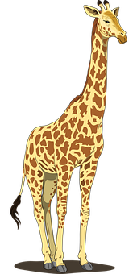
aussprechen
…
[r]
Farbe
lernen
Ort
[place]
When ‘h’ follows a vowel, it makes a long vowel sound.
Uhr
Tier
[clock, watch, o’clock]
Notes:
Timing: 1 minute
Aim: to consolidate the SSC [r] after a vowel
Procedure:
Re-present the SSC and the source word ‘Ort’ (with gesture, if using).
Click to bring on the picture and get pupils to repeat the word ‘Ort’ (with gesture, if using).
Present the cluster words in the same way, bringing on the picture and getting pupils to pronounce the words.
Note: ‘Uhr’ is a slight exception as the ‘r’ does not directly follow the vowel. However, ‘h’ following a vowel makes a long vowel sound, so the ‘r’ sound here is the same as after a vowel.
Word frequency: Ort [341] Uhr [348] Tier [614] lernen [288] Farbe [1079]
Jones, R.L & Tschirner, E. (2019). A frequency dictionary of German: Core vocabulary for learners. London: Routledge.

Slide 6
hören
Hör zu. Schreib A oder B. Dann schreib das Wort!
 | A: [r] like [rot] | B: [r] like [Ort] | Wort
 |  |  | Markt
 |  |  | lernen
 |  |  | Straße
 |  |  | brauchen
 |  |  | Park
 |  |  | Gruppe
 |  |  | Instrument
 |  |  | dreizehn
1
2
3
4
5
6
7
8
Notes:
Timing: 8 minutes
Aim: to consolidate the SSC [r] by identifying known words with [r] before and after a vowel.
Procedure:
1. Pupils write down numbers 1-8. They will write down ‘A’ (r before a vowel) or ‘B’ (r after a vowel) for each answer. As an extra task they could try to transcribe the word they hear.
2. Click audio button 1 and discuss whether it is like rot or like Ort. Click to reveal answer. Click again to reveal correct spelling of the word.
3. Repeat for items 2-8.
Transcript:
Markt (market)
lernen (to learn, learning)
Straße (street)
brauchen (to need, needing)
Park (park)
Gruppe (group)
Instrument (instrument)
dreizehn (thirteen)
6

Slide 7
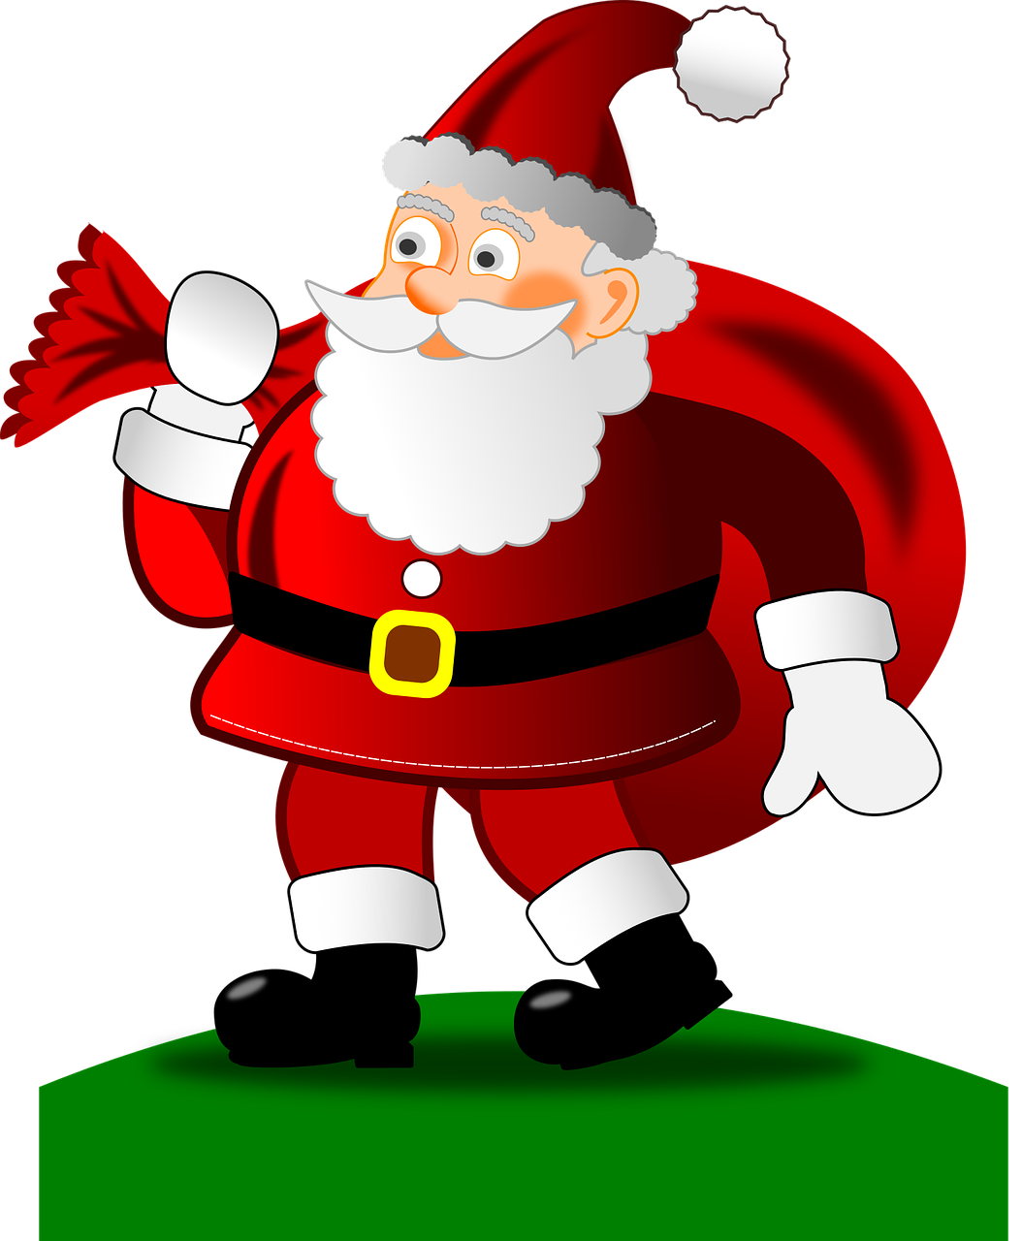
Vokabeln
Werden changes its spelling in du and er/sie/es forms: du wirst – you become, get er/sie es wird - s/he, it becomes, gets
Vokabeln lernen
Wörter
[Happy Birthday]
[Happy Christmas]
Frohe Weihnachten
Herzlichen Glückwunsch zum Geburtstag
[Get well soon]
[Good luck, lots of luck]
Gute Besserung
viel Glück
werden
Notes:
Timing: 3 minutes (two slides)
Aim: to introduce the new items of vocabulary for this week.
Procedure 1. Click to introduce the new words and their pictures. You might want to point out that pupils know the word for happy (froh) and so ‘Frohe Weihnachten’ means Happy Christmas. However, note that Happy Birthday doesn’t use ‘froh’.
2. Check that pupils are clear what the words mean in English.
3. Draw attention to the callout.
4. Practise pronouncing the new words as a class and individually. 5. Then, on the next slide, pupils try to match the German and the pictures, then try to recall the German words.
7

Slide 8
Vokabeln
Vokabeln lernen
Herzlichen Glückwunsch zum Geburtstag
Gute Besserung
Viel Glück
Vokabeln
werden
Frohe Weihnachten
2
3
1
4
5
Notes:
2/2
Aim: to provide written recognition and read aloud practice of the new vocabulary.
Procedure: 1. Pupils match the German nouns to the pictures in their heads.
2. The teacher gives the pupils a number and the pupils must say the correct word in German. The number prompts are the trigger (i.e. click on the number) for the lines to connect the correct word to the picture.
3. Click to make each German word disappear in turn. Can pupils say the German words aloud?

Slide 9
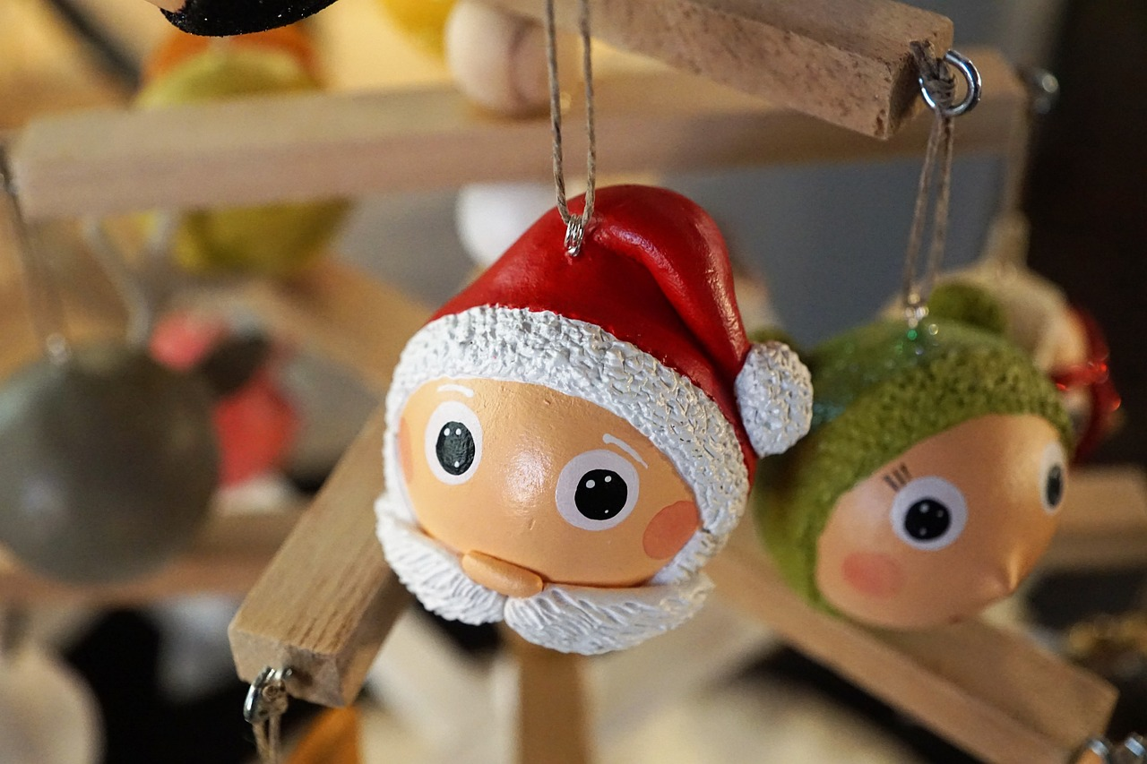
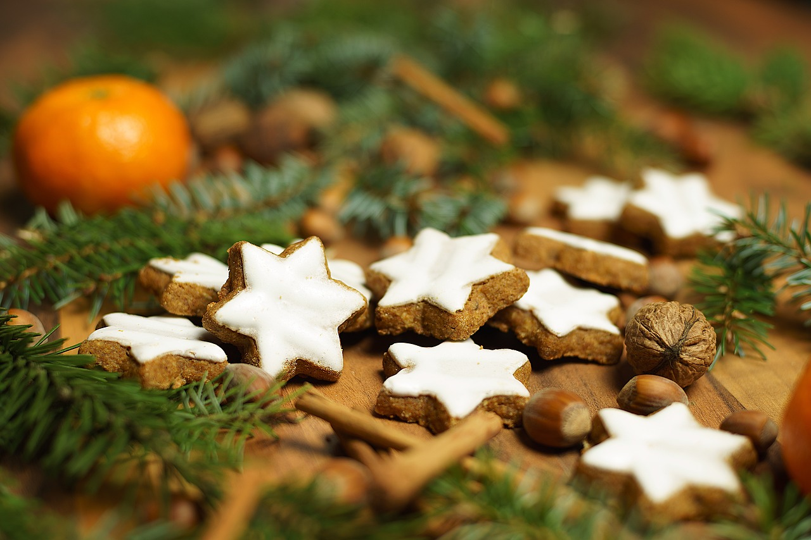
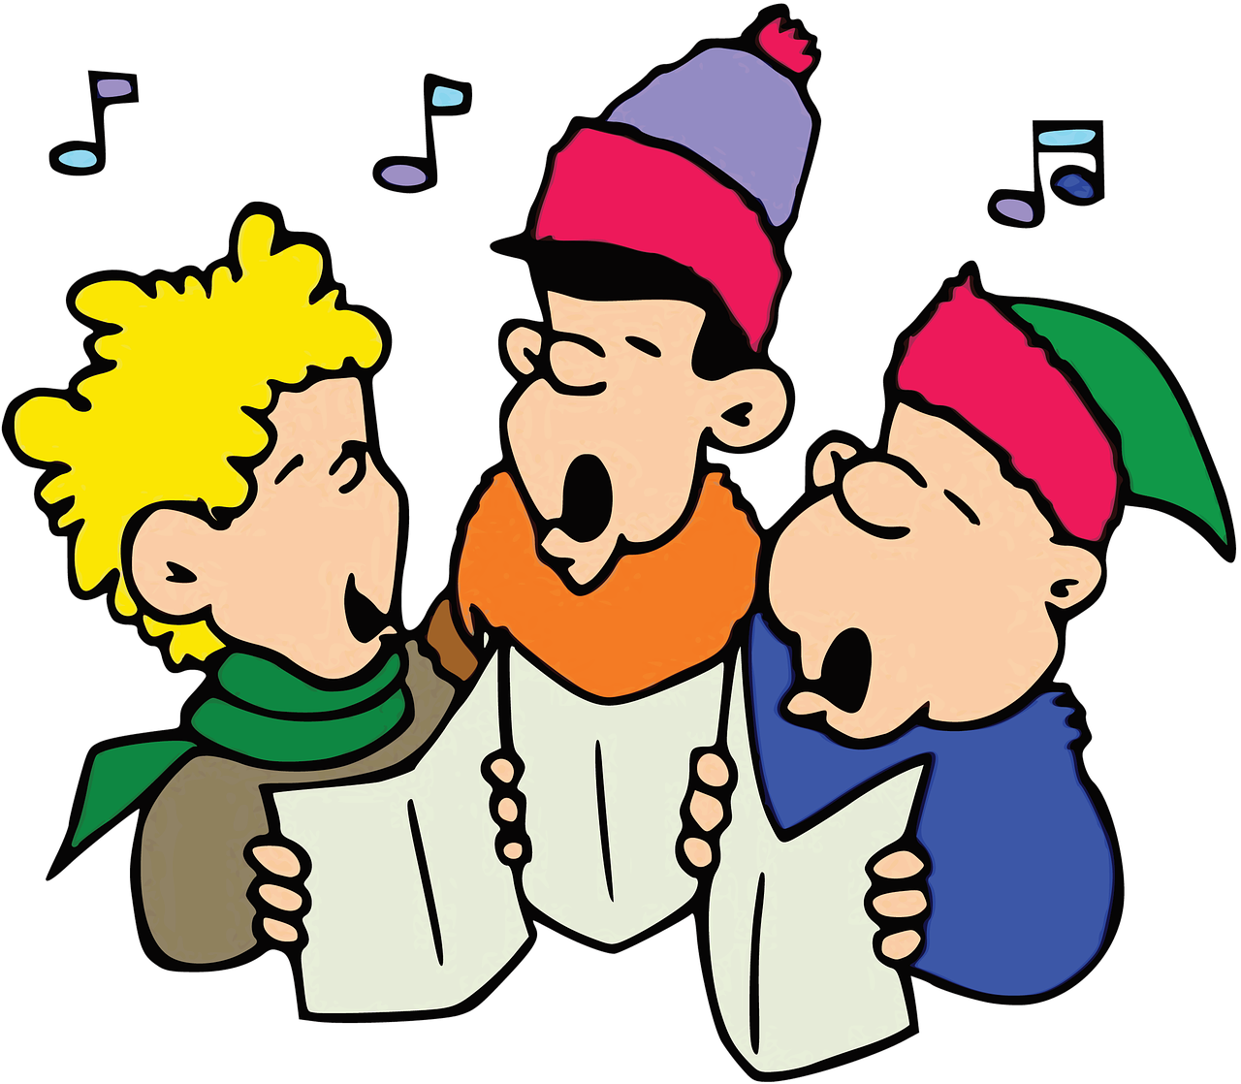
Kultur
Weihnachten in der Schweiz
An Weihnachten gibt es in der Schweiz viele Weihnachtsmärkte. Dort kaufen Leute Weihnachtssachen, zum Beispiel Figuren* für den Weihnachtsbaum oder Lebkuchen*.
Leute singen Weihnachtslieder und schmücken ihre Häuser. Sie sagen ‘Frohe Weihnachten’ oder ‘Schöni Wiehnachte’ auf Schweizerdeutsch.
Kinder bekommen am 24. Dezember Geschenke. Auf Schweizerdeutsch heißen Geschenke ’Gschänkli’.
die Figur - figure
der Lebkuchen - gingerbread
Notes:
Timing: 5 minutes
Aim: to present a mix of culture and new vocabulary in the Christmas context setting.
Procedure:
Read the context text with the class (or, if using the audio version, click on the text boxes to play the audio). Elicit the meaning in English. If necessary, support pupils in their understanding by telling them that Weihnachts- means Christmas- and that Märkte is the plural of a word they already know...(Markt = market).
Remind students that in Switzerland, Swiss German is spoken (although standard German is also spoken in some situations). This sounds quite different from standard German as can be seen from the two examples of Swiss German in the text. If time, you could show part of this video to hear some Swiss German at a Christmas market: https://youtu.be/BOFAhzVia-I?feature=shared&t=116 – in this clip the reporter is asking a small child what they want for Christmas.
Translation:
At Christmas in Switzerland there are lots of Christmas markets. There people buy Christmas things, for example, figures for the Christmas tree or gingerbread.
People sing Christmas songs and decorate their houses. They say ‘Frohe Weihnachten’ (Happy Christmas)’ or ‘Schöni Wiehnachte’ (Happy Christmas) in Swiss German.
Children get presents on 24th December. In Swiss German ‘presents’ are called ‘Gschänkli’.
Vocabulary:
Figur [1285] Lebkuchen [N/A]
9

Slide 10
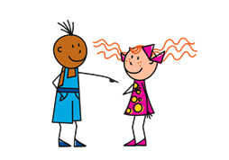
Present tense: du (you) | ihr (you all)
Remember! To mean ‘you’ to one person, use du:
Du bekommst Geschenke.
You get presents.
To mean ‘you all’ or ‘you both’, use ihr:
Ihr bekommt Geschenke.
You (all) get presents.
Notes:
Timing: 1 minute
Aim: to recap the 2nd person singular (‘you’) and plural form (‘you all’) of regular present tense.
Procedure:
Click through the animations to present the information.
Elicit English translation for the German examples provided.
10

Slide 11
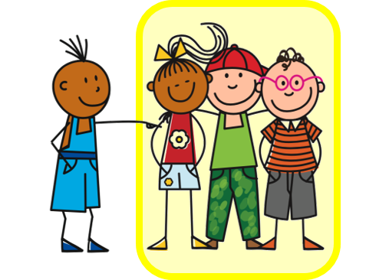
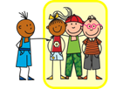
Present tense: strong verbs
You know that strong verbs change the vowel in singular forms du and er/sie/es:
Du gibst Geschenke.
You are giving presents.
Du liest ein Buch.
You are reading a book.
Du isst Lebkuchen.
You are eating gingerbread.
Remember that all other forms (I, you all, we, they) keep the original vowel:
Ihr gebt Geschenke.
You (all) are giving presents.
Ihr lest ein Buch.
You (all) are reading a book.
Ihr esst Lebkuchen.
You (all) are eating gingerbread.
Notes:
Timing: 3 minutes (two slides)
Aim: to recap singular forms of strong verbs change.
Procedure:
Click through the animations to present the information.
Elicit English translation for the German examples provided.
11

Slide 12
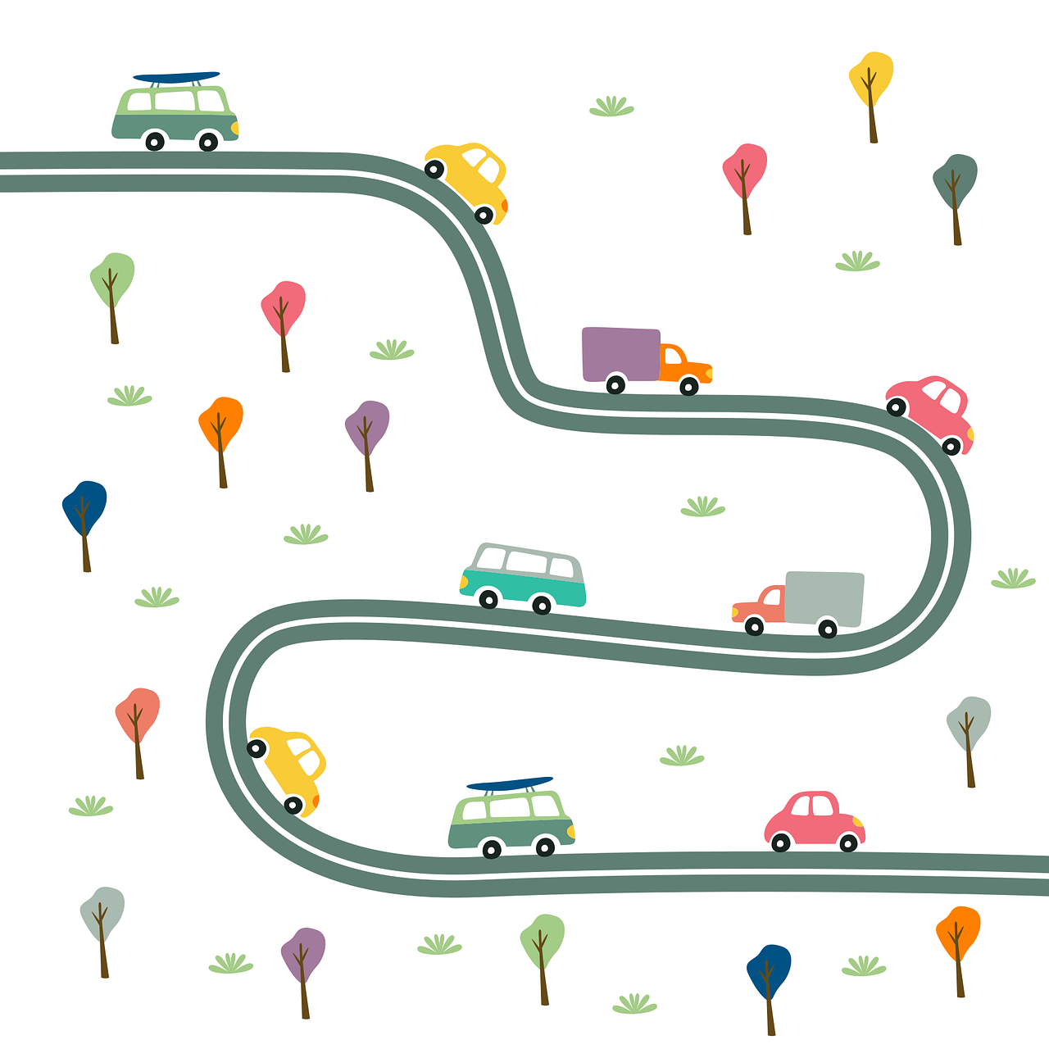
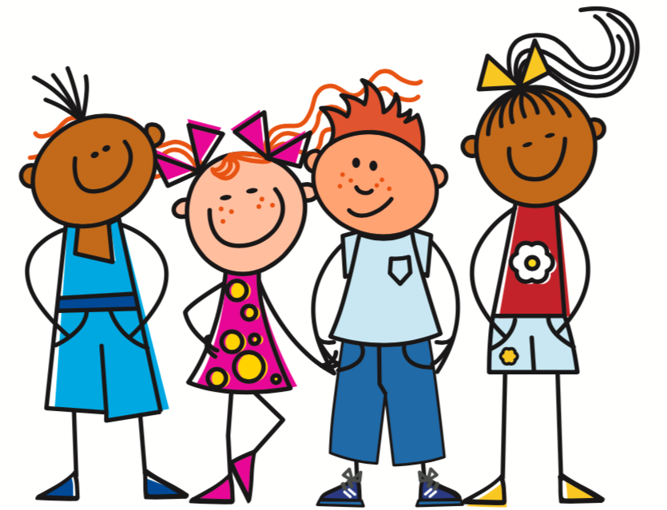
werden - to become, get
Remember that werden also changes:
Du wirst groß.
You get / are getting tall.
Ihr werdet groß.
You (all) get / are getting tall.
Die Straße wird ruhig.
The street is becoming quiet.
Die Straßen werden ruhig.
The streets are becoming quiet.
Wirst du bald* 10?
Are you going to be 10 soon?
Ja, ich werde heute 10! Heute ist mein Geburtstag!
Yes, I’m turning 10 today! Today is my birthday!
Herzlichen Glückwunsch zum Geburtstag!
Happy Birthday!
bald – soon
Notes:
Timing: 3 minutes (two slides)
Aim: to explain vowel change in werden, and to showcase use of werden.
Procedure:
Click through the animations to present the information.
Elicit English translation for the German examples provided.
After the grammar examples, click for mini (grammar) dialogue and translations to appear in turn.
Vocabulary
bald [503]
Jones, R.L & Tschirner, E. (2019). A frequency dictionary of German: Core vocabulary for learners. London: Routledge.
12

Slide 13
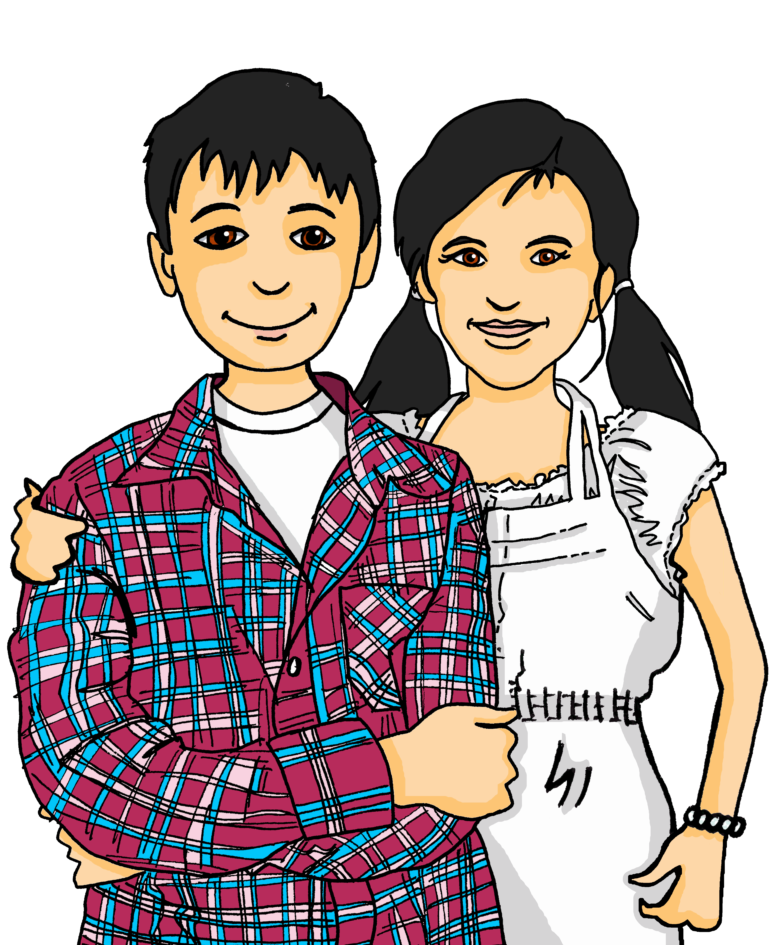
hören
Olivia spricht mit Ronja und Lias über Skype
Spricht Olivia mit Ronja, oder mit Ronja UND Lias?
 | Ronja | Ronja und Lias
Was heißt das auf Englisch?
You (both) are going to the Christmas market.
You (both) are buying beautiful Christmas things.
You are getting a great present.
You are getting ill. Get well soon!
You (both) have an exam tomorrow. Good luck!
You (both) are coming to England in January, right?
1
2
3
4
5
6
Notes:
1/2
Timing: 10 minutes (3 slides)
Aim: to practise aural identification of plural and singular verb forms.
Procedure:
1. Explain the scenario. Olivia is talking to Ronja and Lias on Skype. Is she speaking to just Ronja or Ronja and Lias? Pupils decide, based on the verb form – the pronoun is bleeped out.
2. Click on the audio buttons to play the recordings.
3. Elicit the answers.
4. Click to bring up the green answer ticks.
5. Click to listen again. This time pupils write the message in English. Click to reveal the answers in English.
Transcript:
[Ihr] geht auf den Weihnachtsmarkt.
[Ihr] kauft schöne Weihnactssachen.
[Du] bekommst ein tolles Geschenk.
[Du] wirst krank. Gute Besserung!
[Ihr] habt morgen eine Prüfung. Viel Glück!
[Ihr] kommt im Januar nach England, oder?
13

Slide 14
lesen
Was sagt Leonie zu Lias und Ronja?
jetzt – now
 | Leonie | … | Englisch
 | Ihr werdet heute elf… | Herzlichen Glückwunsch zum Geburtstag | You (both) are turning 11 today...
 | Du gibst morgen ein Konzert... | Viel Glück | You are giving a concert tomorrow...
 | Ihr werdet krank… | Gute Besserung | You (both) are getting sick/ill…
 | Heute hört ihr das Lied ’Zum Geburtstag viel Glück’ | Herzlichen Glückwunsch zum Geburtstag | Today you’ll hear the song ‘Happy Birthday to You’
 | Du bekommst jetzt* dein Weihnachtsgeschenk... | Frohe Weihnachten | You are getting your Christmas present now…
 | Ihr habt heute eine Prüfung... | Viel Glück | You (both) have an exam/test today…
1
2
3
4
5
6
Frohe Weihnachten
Gute Besserung
Herzlichen Glückwunsch zum Geburtstag
Viel Glück
Notes:
2/2
Aim: to practise written comprehension of singular/plural verb forms and common phrases for particular situations.
Procedure:
1. Pupils read what Leonie says and select the best fit to each statement from the four phrases at the bottom, i.e. something that would follow logically. NB each phrase can be used more than once.
2. Elicit the phrases and click to reveal the answers.
3. Elicit the English meanings and click to reveal the translations.
4. If desired, click to hear the full sentences in the audio version.
14

Slide 15
Tschüss!
grün
Notes:
15

