Slide 1
What do I know now?
Wir wiederholen!
☺
grün
Revisiting sounds, words and structures
Term 3 Week 9
Notes:
Artwork by Steve Clarke. Pronoun pictures from NCELP (www.ncelp.org). All additional pictures selected from Pixabay and are available under a Creative Commons license, no
attribution required.
Phonics:
Revisit [v] [w] [r] [er-] [-er] [-ig] [-g] [-d] [-b] [-tion] [z] [ei] [ie] [th] [pf] [kn]
Vocabulary: Revisit language from Term 3
Revisit 1: Papier [1163] Sachen [318] Schuh [1678]
Revisit 2: Angst (vor) [392] Bein [884] Glück [641] Kopf [250] Prüfung [1827] Recht [242] Schmerzen [1483] Unfall [1955] froh [1424] krank [1321] bitte [471] danke [877]
Jones, R.L & Tschirner, E. (2019). A frequency dictionary of German: Core vocabulary for learners. London: Routledge.
The frequency rankings for words that occur in this PowerPoint which have been previously introduced in these resources are given in the SOW and in the resources that first
introduced and formally re-visited those words.
For any other words that occur incidentally in this PowerPoint, frequency rankings will be provided in the notes field wherever possible.
Remember that at the start of the course (first three lessons of Rot/Gelb) pupils learnt language (for greetings and register taking) that can still be part of the lesson routines in upper KS2 (Blau/Grün). They are not re-taught, as we anticipate that teachers have built these in from early in lower KS2.
1

Slide 2
Follow up 1 – Tolle Museen in der Schweiz
Welches Museum möchtest du besuchen?
Ballenberg
Man geht draußen auf das Land und lernt, Käse und Kleidung zu machen!
kommunizieren – to communicate
denn – because
um – in order to
der Spielplatz - playground
ab - from
aussprechen
FIFA Museum
Hier kann man viel über
Fußball lernen. Man kann auch Videos von Sportlern sehen und coole Spiele spielen.
Landesmuseum
Man sieht ein altes Dorf, alte Kleidung und viel Kunst. Es gibt auch tolle Aktivitäten für Kinder ab* vier Jahren.
Museum für Kommunikation
Mann kann Telefone finden und Spiele mit Freunden spielen. Man muss zusammen gut kommunizieren*, denn* das ist wichtig, um* die Spiele zu gewinnen!
Appenzeller Schaukäserei
Magst du Käse? Hier lernt man, Käse zu machen. Man kann auch den Käse essen! Draußen gibt es einen Spielplatz*. Dort kann man spielen.
Notes:
Timing: 5 minutes
Aim: to practise read aloud of a range of SSC from this term.
Procedure:
Click to bring up the description of each museum including the highlighting of the SSCs. Elicit the pronunciation of the words highlighted.
Teacher says to confirm pronunciation or in audio version, click on the text to hear the full text being read aloud including the highlighted SSCs.
If time, elicit the English translation of the museum descriptions and ask pupils which one they would like to visit. (‘Welches Musuem möchtest du besuchen?’)
Translation: Ballenberg: You go outside in the countryside and learn to make cheese and clothes!
FIFA museum: Here you can learn a lot about the history of football. You can also see videos of sportspeople and play cool games.
Museum for communication: You can find telephones and play games with friends. You have to communicate well together because it’s important in order to win the games!
Appenzeller Schaukäserei (show dairy): Do you like cheese? Here you learn to make cheese. You can also eat the cheese! Outside there is a playground. There you can play.
Landesmuseum (national museum): You see an old village, old clothes and lots of art. There are also great activities for children from four years old.
Vocabulary:
des [N/A] kommunizieren [3812] um [44] Spielplatz [N/A] ab [544]
Jones, R.L & Tschirner, E. (2019). A frequency dictionary of German: Core vocabulary for learners. London: Routledge.

Slide 3
lesen
Follow up 2
Lies den Text. Was sagt Martin?
Hallo!
Wie geht’s? Mein Name ist Martin und ich wohne mit meiner Familie in Basel. Das ist in der Schweiz. Hier spricht man Deutsch aber ich spreche zu Hause auch Spanisch. Es gibt in Basel viele Museen, auch ein Papiermuseum!
1. What language do people in Basel speak?
German
2. What does Martin say about the museums in Basel (2 details)?
There are lots of museums
including a paper museum.
3. Why do people come to Basel in February?
Im Februar kommen viele Leute nach Basel, denn* wir haben die beste Fasnacht in der Schweiz! Viele Leute tragen Partykleidung und gehen durch die Straßen. Sie spielen Musik, tanzen und singen.
They have the best carnival in Switzerland.
4. What do people do at that time? (5 details)
Wear party clothes; walk through the streets; play music; dance; and sing.
5. What are Martin’s hobbies? (2 details)
Was sind deine Hobbys? Ich spiele Fußball und Eishockey. Aber ich habe oft Unfälle beim* Eishockeyspielen und heute habe ich Schmerzen im Bein!
Football and ice-hockey
6. What is a negative thing about one of his hobbies?
He often has accidents playing ice
hockey.
Wohin fährst du im August dieses Jahr? Oder bleibst du zu Hause?
7. What two questions does Martin ask at the end?
Where are you going in August this year?
Or are you staying home?
denn – because bei – while doing
Notes:
Timing: 8 minutes
Aim: to practise written comprehension of vocabulary and grammar from Term 3 in a longer text.
Procedure:
Pupils read what Martin has written, and then answer the questions to the right in English.
Click to reveal answers.
There are 14 points available for the task.
In the audio version, click on the four paragraphs to hear each section of text, as required.
Alternative suggestion:
For more challenge, this activity could also be done as a unimodal listening activity, if pupils turn away from the board and have a copy of the questions for each paragraph in sight, as they listen.
Vocabulary:
bei [29] wegen [243]
Jones, R.L & Tschirner, E. (2019). A frequency dictionary of German: Core vocabulary for learners. London: Routledge.
3

Slide 4
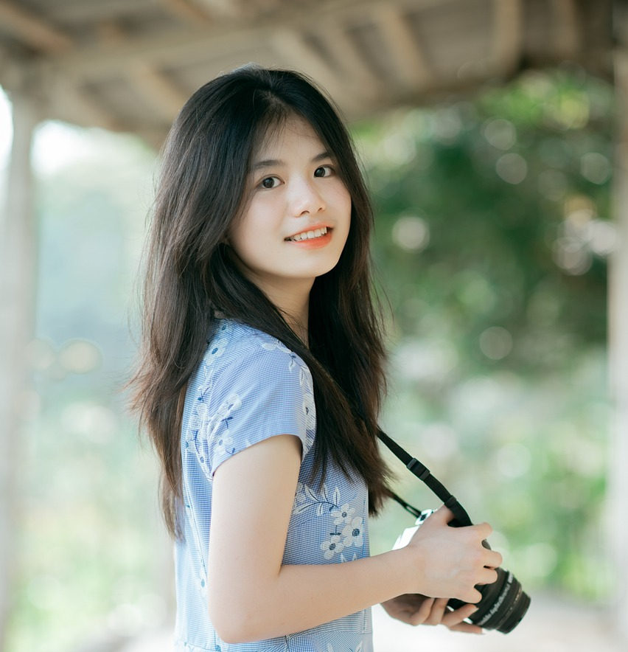
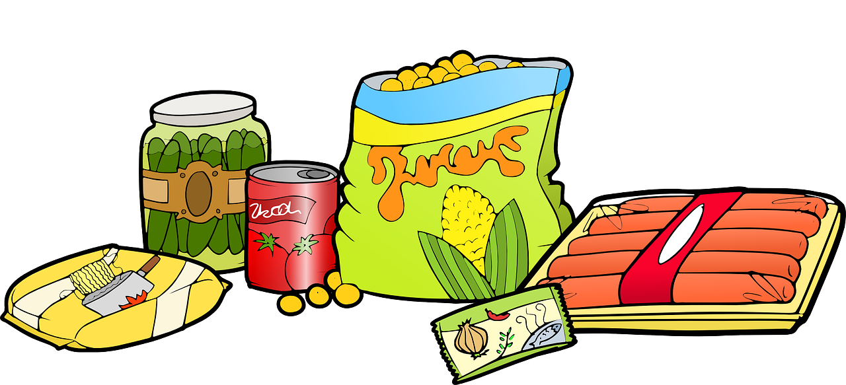
Vokabeln
Follow up 3a
Lies den Text. Schreib Vokabeln auf Deutsch.
Just have a go! Write any of these English words or phrases in German. You can add different words, too.
Wörter
Hello! I am Tina. I live in Switzerland! How are you?
What is your school called? My school is called ‘Primarschule Bruderholz’. My school is in (the) town but I live in a village. I take the train to school. I love my school. Do you like your school?
What is your favourite food? I like fondue with bread.
Do you have to help at home? I have to make my bed and I often help dad with the cooking.
Bye, Tina
England
school
to be called
food
at home
favourite
to help
Notes:
Timing: 5 minutes
Aim: to practise written production of this term’s vocabulary.
Note: This is a more straightforward version of the activity, asking pupils for individual words. A more challenging version can be found on the following slide, where pupils are encouraged to write a mixture of sentences and words.
Procedure:
Pupils read the message in English from Tina (in the middle).
Pupils use Tina’s message and the words and pictures on the notebook to the right as inspiration. They use the lines on the left to write any words in German that they could use to reply to Tina. They could use any of the words on the notebook, and any other words they know.
4

Slide 5
schreiben
Follow up 3b
Write a message to Tina in German. Write anything you like. You can write short sentences or words or a mixture.
Schreib auf Deutsch.
Hello! I am Tina. I live in Switzerland! How are you?
What is your school called? My school is called ‘Primarschule Bruderholz’. My school is in (the) town but I live in a village. I take the train to school. I love my school. Do you like your school?
What is your favourite food? I like fondue with bread.
Do you have to help at home? I have to make my bed and I often help dad with the cooking.
Bye, Tina
England
school
to be called
food
at home
favourite
to help
Notes:
Timing: 8 minutes
Aim: to practise written production of this term’s vocabulary and to practise written production of short sentences.
Note: This is a more challenging version of the activity, where pupils are encouraged to write a mixture of sentences and words. A more straightforward version of the activity can be found on the previous slide, where pupils are asked to write individual words.
Procedure:
Pupils read the message from Tina in the middle. Pupils use Tina’s message and the words and pictures on the notebook to the right as inspiration to write a reply to her in German.
5

Slide 6
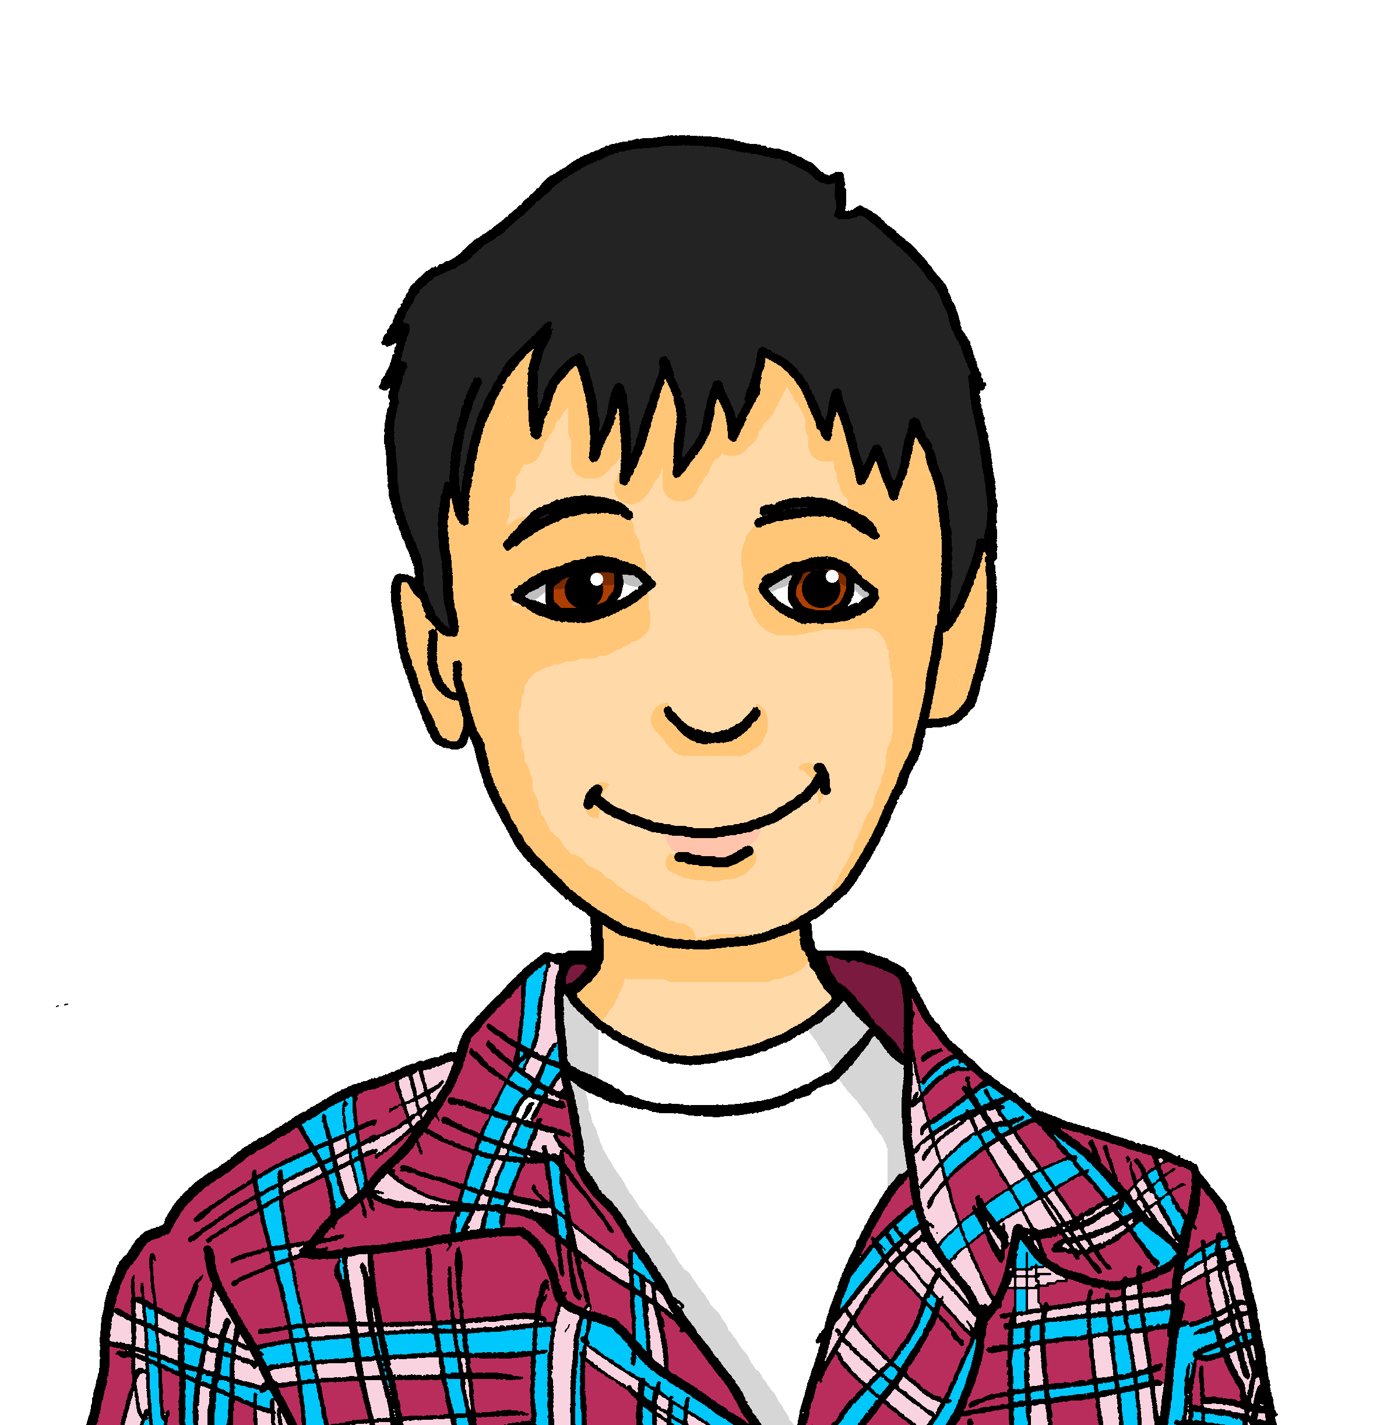
Fragen und Antworten
Follow up 4
Partnerarbeit: Auf Deutsch sprechen.
Wie heißt du?
Ich heiße Lias.
sprechen
Er heißt Lias.
Was
Wo
Wann
Wie
Warum
Welches
Geschenk möchtest du?
hast du eine Prüfung?
bist du froh?
backst du?
sagt man ‘Gute Besserung’?
schläfst du?
musst du machen?
kannst du machen?
heißt du?
geht’s?
Notes:
Timing: 10 minutes
Aim: to practise building questions using a variety of question words and verbs; to practise using a variety of verbs in 1st, 2nd, 3rd persons; to practise some of this term’s vocabulary.
Procedure:
Pupils work in pairs. Partner A matches a blue question starter and with a yellow question ender and asks Partner B the question. Partner B responds.
Click to model how this would work with Leon and Lias.
Once partners have asked and answered all possible questions, they then write down their partner’s answers in the third person. Click to model this with Leon.
In the audio version, audio is attached to the text boxes.

Slide 7
Follow up 5
Rede mit deinem Partner/deiner Partnerin.
Ich…
Reaktionen! 😃
sprechen
1
… habe Angst vor Prüfungen.
… bin krank.
… spreche Englisch und Deutsch.
… muss den Boden sauber machen.
… finde es wichtig, zu Hause zu helfen.
… habe heute Geburtstag.
… finde es gut, in der Sonne zu spielen.
… habe eine Prüfung.
… wohne in Europa.
… bekomme heute Weihnachtsgeschenke.
… kann ein Instrument spielen.
2
A
B
Ich habe Angst vor Prüfungen.
Ich auch!
3
4
5
6
7
Frohe Weihnachten!| ich auch | Herzlichen Glückwunsch zum Geburtstag!| viel Glück| Gute Besserung!|
8
9
10
11
Notes:
There are two versions of this activity: This is the more scaffolded one.
It would be possible to do this activity and then the next version to provide increasing challenge/progression.
Timing: 3 minutes
Aim: to practise reading comprehension of both newly introduced and revisited vocabulary and choose appropriate phrases to respond to the statements.
Procedure:
Click twice to bring up the speech bubbles and model the conversation.
Pupils take turns to read the statements (in any order) and react to them according to their own opinion using the phrases in the box to help them. They can use other phrases if they like too, e.g. Oh nein! or Das ist gut.
In the audio version, click on the numbers to hear the audio of each phrase.

Slide 8
Follow up 5
Rede mit deinem Partner/deiner Partnerin.
I …
Reaktionen! 😃
sprechen
1
A
… am scared of exams.
… am ill.
… speak English and German.
… have to clean the floor (‘make the floor clean’).
… think (‘find’) it important to help at home.
… have a birthday today (it’s my birthday today).
… think (‘find’) it’s good to play in the sun.
… have an exam.
… live in Europe.
… get Christmas presents today.
… can play an instrument.
Ich habe Angst vor Prüfungen.
B
2
Ich auch!
3
4
5
Frohe Weihnachten!| ich auch | Herzlichen Glückwunsch zum Geburtstag!| viel Glück| Gute Besserung!|
6
7
8
9
10
11
Notes:
There are two versions of this activity: This is the more challenging one.
Timing: 3 minutes
Aim: to practise spoken production of both newly introduced and revisited vocabulary and choose appropriate phrases to respond to the statements.
Procedure:
Click twice to bring up the speech bubbles and model the conversation.
Pupils take turns to read the statements (in any order) and react to them according to their own opinion using the phrases in the box to help them. They can use other phrases if they like too, e.g. Oh nein! or Das ist gut.
In the audio version, click on the numbers to hear the audio of each phrase. Alternatively, check answers by showing the previous slide.

Slide 9
Extra follow up:

Schreib auf Englisch.
Can you get at least 15 points?
Wörter
 | das Bein | (die) Angst (vor) | danke
 | das Glück | der Unfall | die Schmerzen
 | froh | die Prüfung | recht
 | das Papier | die Sachen | der Schuh
 | Lust haben | wichtig | müssen
 | liegen | der Kopf | das Land
 | bitte | dann | bald
(the) leg
(the) fear (of)
thank you
Vokabeln
x3
(the) luck
(the) accident
(the) pain(s)
glad, happy
(the) exam, test
right, correct
x2
(the) paper
(the) things
(the) shoe
to feel like (doing sth)
important
to have to, must
to lie, lying
(the) head
(the) country(side)
x1
please
then
soon
Notes:
Timing: 5 minutes
Aim: to practise written production of vocabulary from this and revisited weeks.
Procedure: 1. Give pupils a blank grid. They fill in the English meanings of any of the words they know, trying to reach 15 points in total.
Note: The most recently learnt and practised words are pink, words from the previous week are green and those from week 1 are blue, thus more points are awarded for them, to recognise that memories fade and more effort (heavy lifting!) is needed to retrieve them.

Slide 10
Extra follow up:

Schreib auf Deutsch.
Can you get at least 15 points?
Wörter
 | (the) accident | (the) pain(s) | right, correct
 | thank you | (the) fear (of) | (the) luck
 | (the) leg | happy, glad | (the) exam, test
 | (the) shoe | (the) paper | (the things)
 | (the) head | please | soon
 | then | important | to feel like (doing sth)
 | to lie, lying | to have to, must | (the) country(side)
der Unfall
die Schmerzen
recht
Vokabeln
x3
danke
(die) Angst (vor)
das Glück
das Bein
froh
die Prüfung
x2
der Schuh
das Papier
die Sachen
der Kopf
bitte
bald
dann
wichtig
Lust haben
x1
liegen
müssen
das Land
Notes:
Timing: 5 minutes
Aim: to practise written production of vocabulary from this and revisited weeks.
Procedure: 1. Give pupils a blank grid. They fill in the German meanings of any of the words they know, trying to reach 15 points in total.
Note: The most recently learnt and practised words are pink, words from the previous week are green and those from week 1 are blue, thus more points are awarded for them, to recognise that memories fade and more effort (heavy lifting!) is needed to retrieve them.

Slide 11
Tschüss!
grün
Notes:
11

Slide 12
Extra follow up:

Schreib auf Englisch.
Can you get at least 15 points?
Wörter
 | das Bein | (die) Angst (vor) | danke
 | das Glück | der Unfall | die Schmerzen
 | froh | die Prüfung | recht
 | das Papier | die Sachen | der Schuh
 | Lust haben | wichtig | müssen
 | liegen | der Kopf | das Land
 | bitte | dann | bald
Vokabeln
x3
x2
x1
Notes:
HANDOUT

Slide 13
Extra follow up:

Schreib auf Deutsch.
Can you get at least 15 points?
Wörter
 | (the) accident | (the) pain(s) | right, correct
 | thank you | (the) fear (of) | (the) luck
 | (the) leg | happy, glad | (the) exam, test
 | (the) shoe | (the) paper | (the things)
 | (the) head | please | soon
 | then | important | to feel like (doing sth)
 | to lie, lying | to have to, must | (the) country(side)
Vokabeln
x3
x2
x1
Notes:
HANDOUT

