Slide 1
What do I know now?
Wir wiederholen!
☺
grün
Revisiting sounds, words and structures
Term 3 Week 9
Notes:
Artwork by Steve Clarke. Pronoun pictures from NCELP (www.ncelp.org). All additional pictures selected from Pixabay and are available under a Creative Commons license, no
attribution required.
Phonics:
Revisit [v] [w] [r] [er-] [-er] [-ig] [-g] [-d] [-b] [-tion] [z] [ei] [ie] [th] [pf] [kn]
Vocabulary: Revisit language from Term 3
Revisit 1: Papier [1163] Sachen [318] Schuh [1678]
Revisit 2: Angst (vor) [392] Bein [884] Glück [641] Kopf [250] Prüfung [1827] Recht [242] Schmerzen [1483] Unfall [1955] froh [1424] krank [1321] bitte [471] danke [877]
Jones, R.L & Tschirner, E. (2019). A frequency dictionary of German: Core vocabulary for learners. London: Routledge.
The frequency rankings for words that occur in this PowerPoint which have been previously introduced in these resources are given in the SOW and in the resources that first
introduced and formally re-visited those words.
For any other words that occur incidentally in this PowerPoint, frequency rankings will be provided in the notes field wherever possible.
Remember that at the start of the course (first three lessons of Rot/Gelb) pupils learnt language (for greetings and register taking) that can still be part of the lesson routines in upper KS2 (Blau/Grün). They are not re-taught, as we anticipate that teachers have built these in from early in lower KS2.
1

Slide 2
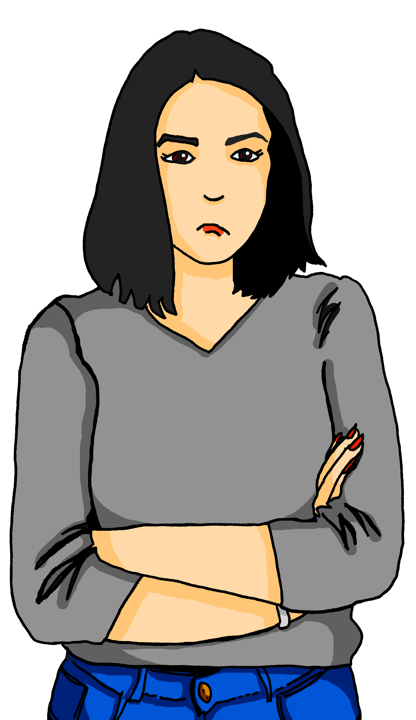
Phonetik – Wo hast du Schmerzen?
Ich habe so viele Schmerzen!
der Kopf
aussehen – to look
fertig – finished (= exhausted)
Ronja, du siehst fertig aus*.
aussprechen
Oh! Warum? Brauchst du einen Physiotherapeuten*?
die Schulter
der Physiotherapeut - physiotherapist
Ich kann das erklären... zu viel Sport am Montag!
der Arm
die Hand
Aha! Also, du brauchst keine Operation! Ab* Donnerstag wird alles wieder gut.
das Knie
das Bein
der Zeh
ab - from
Notes:
Timing: 3 minutes
Aim: to practise several SSCs ( [v] [w] [r] [er-] [-er] [-ig] [-g] [-d] [-b] [-tion] [z] [ei] [ie] [th] [pf] [kn]).
Procedure:
Explain the context. Ronja is looking exhausted and her mum is trying to find out what’s wrong.
Click to highlight the different SSCs one by one and elicit choral read aloud.
Teacher pronounces to confirm correct pronunciation of each word (in audio version, the audio can also be played for each speech bubble/label.
Vocabulary:
aussehen [277] Physiotherapeut [N/A] ab [544] Schulter (shoulder) [1023] Arm [1475] Hand [180] Zeh (toe) [N/A]
Jones, R.L & Tschirner, E. (2019). A frequency dictionary of German: Core vocabulary for learners. London: Routledge.

Slide 3
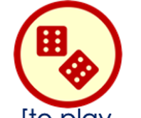
hören
Was mache ich?
Ich wiederhole Vokabeln!
Hör zu. Dann schreib das Verb auf Deutsch.
 | das Verb auf Deutsch
werden
schreiben
1
2
kochen
sprechen
3
in der Sonne spielen
4
nach England fahren
5
Lust haben, ein Buch zu lesen
6
Notes:
Timing: 5 minutes
Aim: to practise aural comprehension of some previously taught phrases for different occasions, associating them with a relevant verb, which students then write in German, practising written production, too.
Procedure:
1. Ask pupils if they can guess what any of the verbs and phrases are in the circle.
2. Click to listen to each phrase.
3. Pupils identify it and the associated verb/verb phrase and write those in German.
4. Click to correct.
Transcript:
werden
kochen
sprechen
in der Sonne spielen
nach England fahren
Lust haben, ein Buch zu lesen
3

Slide 4
hören
Hör zu. Schreib die Wörter.
Ich wiederhole Vokabeln!
The 2nd verb is at the end of the sentence in German.
So you will hear these details in the middle of the sentence.
A | B | C
a place ☐ | a vehicle ☐ | clothing ☐
an object ☐ | a place ☐ | a sport ☐
a person ☐ | a day of the week ☐ | food ☐
clothing ☐ | a food ☐ | an animal ☐
an adjective ☐ | a place ☐ | a language ☐
a time ☐ | a day ☐ | a place ☐
B
I|you|she|he|it _____ _______...
I|you|she|he|it _____ _______...
I|you|she|he|it _____ _______...
I|you|she|he|it _____ _______...
I|you|she|he|it _____ _______...
I|you|she|he|it _____ _______...
party clothes
have to
wear
1
my shoe
is important
to find
2
bread
can
bake
3
salad
is good
to eat
4
German
can
speak
5
soon
has to
sleep
Notes:
Timing: 5 minutes
Aim: to practise aural comprehension of term 3 vocabulary and structures, particularly sentences with two verbs.
Procedure:
1. Listen once for the subject and the two verbs.
2. Click to correct this part.
3. Listen again to identify the object of the sentence – either just the category or the full details.
4. Click to provide both elements of each answer.
Transcript:
Ich muss Partykleidung tragen.
Es ist wichtig, meinen Schuh zu finden.
Du kannst Brot backen.
Es ist gut, Salat zu essen.
Sie kann Deutsch sprechen.
Er muss bald schlafen.
4

Slide 5
lesen
Schreib die Wörter auf Deutsch.
Ich wiederhole Vokabeln!
⬇
1. please
3. outside
5. thank you
6. have to, must
7. good luck
9. clean
➡
2. where (to)?
4. soon
8. to lie
10. get well soon
11. why?
12. to (e.g. a country)
¹
B
²
W
O
H
I
N
³
D
T
⁵
⁶
R
⁷
⁴
B
A
L
D
M
V
T
A
Ü
A
⁸
L
I
E
G
E
N
⁹
S
N
S
U
E
A
K
S
ß
L
¹⁰
G
U
T
E
B
E
S
S
E
R
U
N
G
B
N
N
L
E
Ü
¹¹
W
A
R
U
M
¹²
N
A
C
H
K
Notes:
Timing: 5 minutes
Aim: to revisit vocabulary from previous weeks.
Procedure: 1.Teachers model the task by drawing pupils’ attention to the clues on the left-hand side of the slide. 2. Pupils work in pairs and try to translate as many as they can.
3. Elicit meaning from pupils and click to bring up the answers in numerical order.
4. For the audio version, click on the first letter of each word to play the recording.
NB. Further rounds of learning can be facilitated by one pupil turning away from the board, and his/her partner asking him/her the meanings (‘Wie sagt man XXX auf Deutsch?’). This activity can work from English to German or German to English.
5

Slide 6
lesen
Schreib 1-6 und das Wort.
Ich wiederhole Grammatik!
1. | Man _________ Angst vor Prüfungen. People are scared of exams. | ☐ hat ☐ ist ☐ habe
2. | ________ du Schmerzen? Are you in pain? | ☐ hast ☐ bist ☐ ist
3. | Wir ________ alle froh. We are all happy/glad. | ☐ haben ☐ sind ☐ bin
4. | _________ ihr krank? Are you all ill? | ☐ seid ☐ sind ☐ habt
5. | Sie ______ Glück. She is lucky. | ☐ ist ☐ hat ☐ hast
6. | Er __________ zu Hause. He is at home. | ☐ hat ☐ ist ☐ bist
1
2
3
4
5
6
Notes:
Timing: 5 minutes
Aim: to practise written recognition of the correct verb for several sentences, some of which do not have word-for-word translations, and where the meaning of ‘haben’ is, essentially ‘be’ not ‘have’.
Procedure:
Explain the task and do the first one together to model it.
Remind pupils that although we say ‘people are scared’ in English in German we literally say ‘people have fear’.
Give pupils time to complete items 2-6 and click to correct.
6

Slide 7
lesen
Schreib 1-6 und das Wort.
Remember, the present tense in German can be used for both present tenses in English and the future tense!
Dann schreib den Satz auf English.
1. | Meine Schwester findet _________ Schuh. My sister _________________________. | ☐ mein ☐ meine ☐ meinen
2. |  | ☐ ihr ☐ seine ☐ sein
3. |  | ☐ zu ☐ nach ☐ in
4. |  | ☐ ins ☐ zum ☐ nach
 |  | ☐ deinen ☐ deine ☐ dein
6. |  | ☐ ins ☐ zum ☐ nach
1
finds / is finding my shoe
2
Geht ihr morgen auf _________ Party?
going to his party tomorrow
Are you ____________________________?
3
Er fährt am Dienstag ________ Hause.
is going home on Tuesday
He __________________________.
4
Ihr geht mittwochs _________ Schwimmbad
go to the swimming pool on Wednesdays
You (all) _________________________________________.
5
Das ist _________ Haus.
is your house
That _____________.
6
Wir fahren mit dem Bus ______ Deutschland.
are going to Germany by bus
We ______________________________.
Notes:
Timing: 5 minutes
Aim: to practise written comprehension of possessive pronouns, different meanings of the present tense and prepositions.
Procedure:
Explain the task and do the first one together to model it.
Students write 1-6 and the missing word, then write down the meaning in English.
Remind pupils that the present tense, e.g. ich finde, can be translated three different ways, depending on context: I find (present simple), I am finding (present continuous) or I will find/am going to find (future)
Give pupils time to complete items 2-6 and click to correct – first the missing word, then the meaning in English.
7

Slide 8
Tschüss!
grün
Notes:
8

