Slide 1
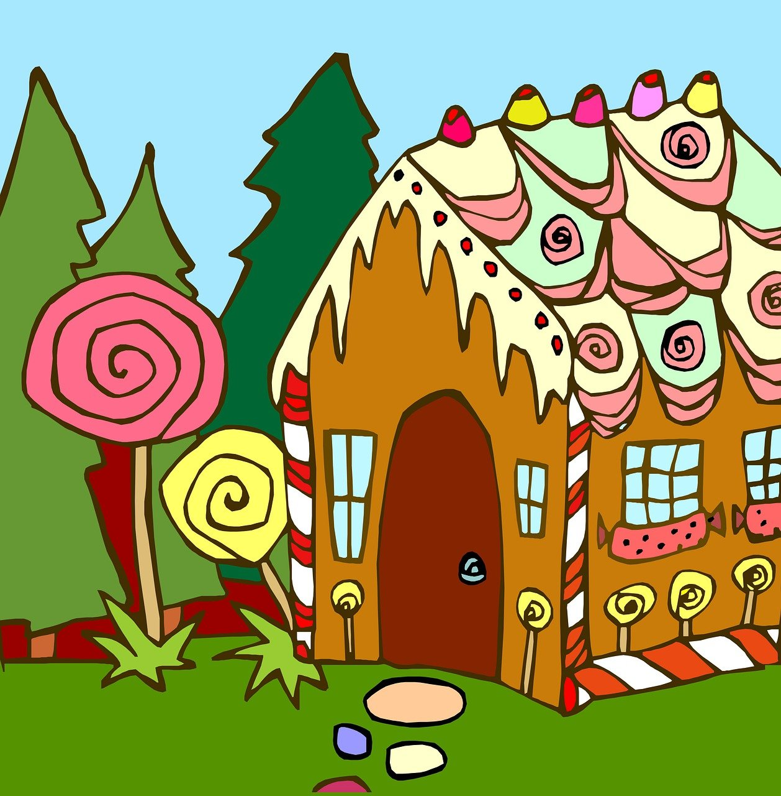
Hänsel und Gretel
grün
Follow ups 1-5
Term 3 Week 12
Notes:
Artwork by Steve Clarke. Pronoun pictures from NCELP (www.ncelp.org). All additional pictures selected from Pixabay and are available under a Creative Commons license, no attribution required.
Phonics:
[pf] Kopf [279] Pflanze [1667] Apfel [3490]
[kn] Knie [1679] Knochen [1930] knüpfen [4564]
Vocabulary: Revisit vocabulary
Revisit 1: backen [4640] holen [547] kochen [1481] müssen, ich muss, du musst, er/sie/es muss [43] Bett [659] Boden [536] Brot [2095] sauber [2026] warum? [192] glossed: Salat [n/a]
Revisit 2: werden, werde, wirst, wird [8] Frohe Weihnachten [n/a] Gute Besserung [n/a] Herzlichen Glückwunsch zum Geburtstag [n/a] viel Glück [n/a]
Jones, R.L & Tschirner, E. (2019). A frequency dictionary of German: Core vocabulary for learners. London: Routledge.
The frequency rankings for words that occur in this PowerPoint which have been previously introduced in these resources are given in the SOW and in the resources that first introduced and formally re-visited those words.
For any other words that occur incidentally in this PowerPoint, frequency rankings will be provided in the notes field wherever possible.
Remember that at the start of the course (first three lessons of Rot/Gelb) pupils learnt language (for greetings and register taking) that can still be part of the lesson routines in upper KS2 (Blau/Grün). They are not re-taught, as we anticipate that teachers have built these in from early in lower KS2.

Slide 2
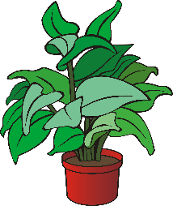
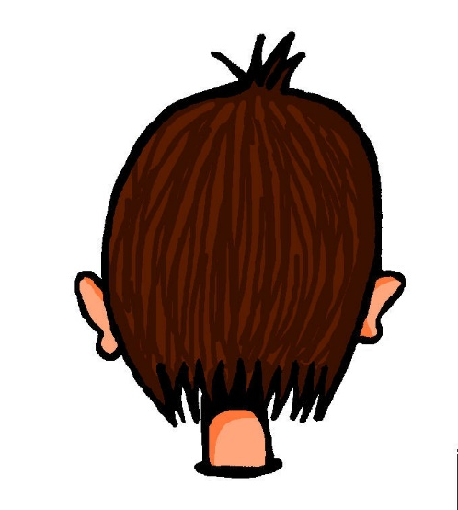
aussprechen
[pf]
…
Kopf
Pflanze
Apfel
Notes:
Timing: 1 minute
Aim: to consolidate the SSC [pf].
Procedure:
Re-present the SSC and the source word ‘Kopf’ (with gesture, if using).
Click to bring on the picture and get pupils to repeat the word ‘Kopf’ (with gesture, if using).
Present the cluster words in the same way, bringing on the picture and getting pupils to pronounce the words.
Frequency: Kopf [250] Pflanze [1667] Apfel [3490]
Jones, R.L & Tschirner, E. (2019). A frequency dictionary of German: Core vocabulary for learners. London: Routledge.

Slide 3
aussprechen
[kn]
…
Knie
Knochen
knüpfen
Notes:
Timing: 1 minute
Aim: to consolidate the SSC [kn].
Procedure:
Re-present the SSC and the source word ‘Knie’ (with gesture, if using).
Click to bring on the picture and get pupils to repeat the word ‘Knie’ (with gesture, if using).
Present the cluster words in the same way, bringing on the picture and getting pupils to pronounce the words.
Frequency: Knie [1679] Knochen [1930] knüpfen [4564]
Jones, R.L & Tschirner, E. (2019). A frequency dictionary of German: Core vocabulary for learners. London: Routledge.

Slide 4
Follow up 1
Hör zu. Was sagt die Hexe?
aussprechen
1
Knusper, knusper, knäuschen,
wer knuspert an meinem Häuschen?
2
Nibble, nibble, gnaw,
who is nibbling at my little house?
3
die Hexe - witch
Notes:
Timing: 5 minutes (4 slides)
Aim: to practise applying knowledge of [pf] and [kn] to unknown words.
Procedure: 1. Pupils read the sentence and the English translation.
2. Click on the 3 audio buttons to hear the sentence read at increasing speeds.
3. Click to reveal the following slide. Teacher clicks on the 30 second timer, and pupils try to say the sentence before the timer runs out. Repeat for the 20 second and 15 second timers.
4. Repeat steps 1-3 for the next two slides.
Frequency: Pfeife [>5009] pfeifen [4545] knacken [4657] knistern [>5000]
Jones, R.L & Tschirner, E. (2019). A frequency dictionary of German: Core vocabulary for learners. London: Routledge.

Slide 5
Follow up 1
Sag den Satz.
aussprechen
How quickly can you say the sentence?
Knusper, knusper, knäuschen,
wer knuspert an meinem Häuschen?
30
S
20
15
S
S
0
0
0
START
START
START
Notes:
[2/4]

Slide 6
Follow up 1
Hör zu. Was sagt die Hexe?
aussprechen
1
Hänsel, Hänsel du musst essen! Pfefferiges Pfeffersteak kocht im Pfännchen!
2
Hansel, Hansel, you have to eat!
Peppery pepper steak is cooking in the little pan.
3
Notes:
[3/4]

Slide 7
Follow up 1
Sag die Sätze.
aussprechen
How quickly can you say the sentences?
Hänsel, Hänsel du musst essen!
Pfefferiges Pfeffersteak kocht im Pfännchen!
30
S
20
15
S
S
0
0
0
START
START
START
Notes:
[4/4]

Slide 8
Follow ups 2 & 3 Hänsel und Gretel
Lies und spiel den Text.
Erzähler*: Hänsel und Gretel sind draußen und brauchen Essen.
Hänsel: Ich habe Bauch*schmerzen! Ich muss etwas essen!
Gretel: Ich auch!
Erzähler: Aber dann finden sie etwas…
Gretel: Hänsel! Was ist das? Ist das ein Haus?
Hänsel: Ja, das ist ein Haus! Ein Lebkuchen*haus! Wir können essen!
Erzähler: Sie laufen zum Haus und essen. Sie sind sehr froh! Aber dann hören sie eine alte Hexe. Die Hexe ist im Haus.
Hexe: Knusper, knusper, knäuschen, wer knuspert an meinem Häuschen?
Erzähler: Hänsel und Gretel haben Angst!
der Erzähler – narrator
Bauch – stomach
Lebkuchen - gingerbread
Notes:
Timing: 2 x 10-15 mins (more if desired)
Aim: to consolidate vocabulary, grammar and phonics learnt this term through acting out a scene from a play
Procedure:
Read through the lines in this play.
Ensure comprehension. Note that all vocabulary is re-used from previously taught vocabulary, except the starred words.
Divide the class into groups of four. Ask the pupils to each choose a role or assign them if necessary.
Pupils practise. Encourage pupils to use their best acting skills for each character.
In the next follow-up session, choose one or more groups to perform in front of the class.
Extra: Watch this scene from the video from 5:04-6:34: https://www.youtube.com/watch?v=0Ah4y8gCA-Q
Translation:
Narrator: Hansel and Gretel are outside and need food.
Hansel: I have stomach ache! I have to eat something!
Gretel: Me too!
Narrator: But then they find something...
Gretel: Hansel! What is that? Is that a house?
Hansel: Yes, that is a house! A gingerbread house! We can eat!
Narrator: They run to the house and eat. They are very happy! But then they hear an old witch. The witch is in the house.
Witch: Nibble, nibble, gnaw, who is nibbling at my house?
Narrator: Hansel and Gretel are scared!

Slide 9
Follow up 4:

Schreib auf Deutsch.
A Write down in German the missing word in brackets.
1 | [Why] müssen Hänsel und Gretel essen?
2 | Viel [luck]!
3 | Frohe [Christmas]!
4 | Sie macht den Boden [clean].
5 | Er [is getting] müde.
schreiben
Warum
Why do Hansel and Gretel have to eat?
Glück!
Good luck!
Weihnachten!
Happy Christmas!
sauber.
She cleans the floor.
wird
He is getting tired.
B Now translate the sentences into English.
Notes:
Timing: 5 minutes
Aim: to practise written comprehension and production of this week’s revised vocabulary and grammar.
Procedure:
pupils write the missing words.
Then they translate the sentences into English.

Slide 10
Follow up 5:

Schreib auf Englisch.
Can you get at least 10 points?
Wörter
 | du wirst | werden | Herzlichen Glückwunsch zum Geburtstag
 | Gute Besserung | ich werde | Frohe Weihnachten
 | viel Glück | es wird | sie wird
 | backen | sauber | holen
 | er muss | müssen | kochen
 | das Brot | das Bett | der Boden
you become, get
to become, get
Happy Birthday
Vokabeln
x2
Get well soon
I become, get
Happy Christmas
Good luck
it becomes, gets
sie becomes, gets
to bake, baking
clean
to fetch, get
he has to, must
have to, must
to cook, cooking
x1
(the) bread
(the) bed
(the) floor
Notes:
Timing: 5 minutes
Aim: to practise written comprehension of vocabulary from this and revisited weeks.
Procedure: 1. Give pupils a blank grid. They fill in the English meanings of any of the words they know, trying to reach 15 points in total.
Note: The most recently learnt and practised words are pink, words from the previous week are green and those from week 1 are blue, thus more points are awarded for them, to recognise that memories fade and more effort (heavy lifting!) is needed to retrieve them.

Slide 11
Follow up 5:

Schreib auf Deutsch.
Can you get at least 10 points?
Wörter
 | Happy Birthday | Good luck | I become, get
 | Happy Christmas | to become, get | Get well soon
 | you become, get | she becomes, get | it becomes, gets
 | he has to, must | (the) bread | to cook, cooking
 | to fetch, get | to bake, baking | (the) floor
 | to have to, must | clean | (the) bed
Herzlichen Glückwunsch zum Geburtstag
Vokabeln
viel Glück
ich werde
x2
Frohe Weihnachten
werden
Gute Besserung
du wirst
sie wird
es wird
er muss
das Brot
kochen
holen
backen
der Boden
x1
müssen
sauber
das Bett
Notes:
Timing: 5 minutes
Aim: to practise written comprehension of vocabulary from this and revisited weeks.
Procedure: 1. Give pupils a blank grid. They fill in the German meanings of any of the words they know, trying to reach 15 points in total.
Note: The most recently learnt and practised words are pink, words from the previous week are green and those from week 1 are blue, thus more points are awarded for them, to recognise that memories fade and more effort (heavy lifting!) is needed to retrieve them.

Slide 12
Tschüss!
grün
Notes:
12

Slide 13
Follow up 5:

Schreib auf Englisch.
Can you get at least 10 points?
Wörter
 | du wirst | werden | Herzlichen Glückwunsch zum Geburtstag
 | Gute Besserung | ich werde | Frohe Weihnachten
 | viel Glück | es wird | sie wird
 | backen | sauber | holen
 | er muss | müssen | kochen
 | das Brot | das Bett | der Boden
Vokabeln
x2
x1
Notes:
HANDOUT

Slide 14
Follow up 5:

Schreib auf Deutsch.
Can you get at least 10 points?
Wörter
 | Happy Birthday | Good luck | I become, get
 | Happy Christmas | to become, get | Get well soon
 | you become, get | she becomes, get | it becomes, gets
 | he has to, must | (the) bread | to cook, cooking
 | to fetch, get | to bake, baking | (the) floor
 | to have to, must | clean | (the) bed
Vokabeln
x2
x1
Notes:
HANDOUT

