Slide 1
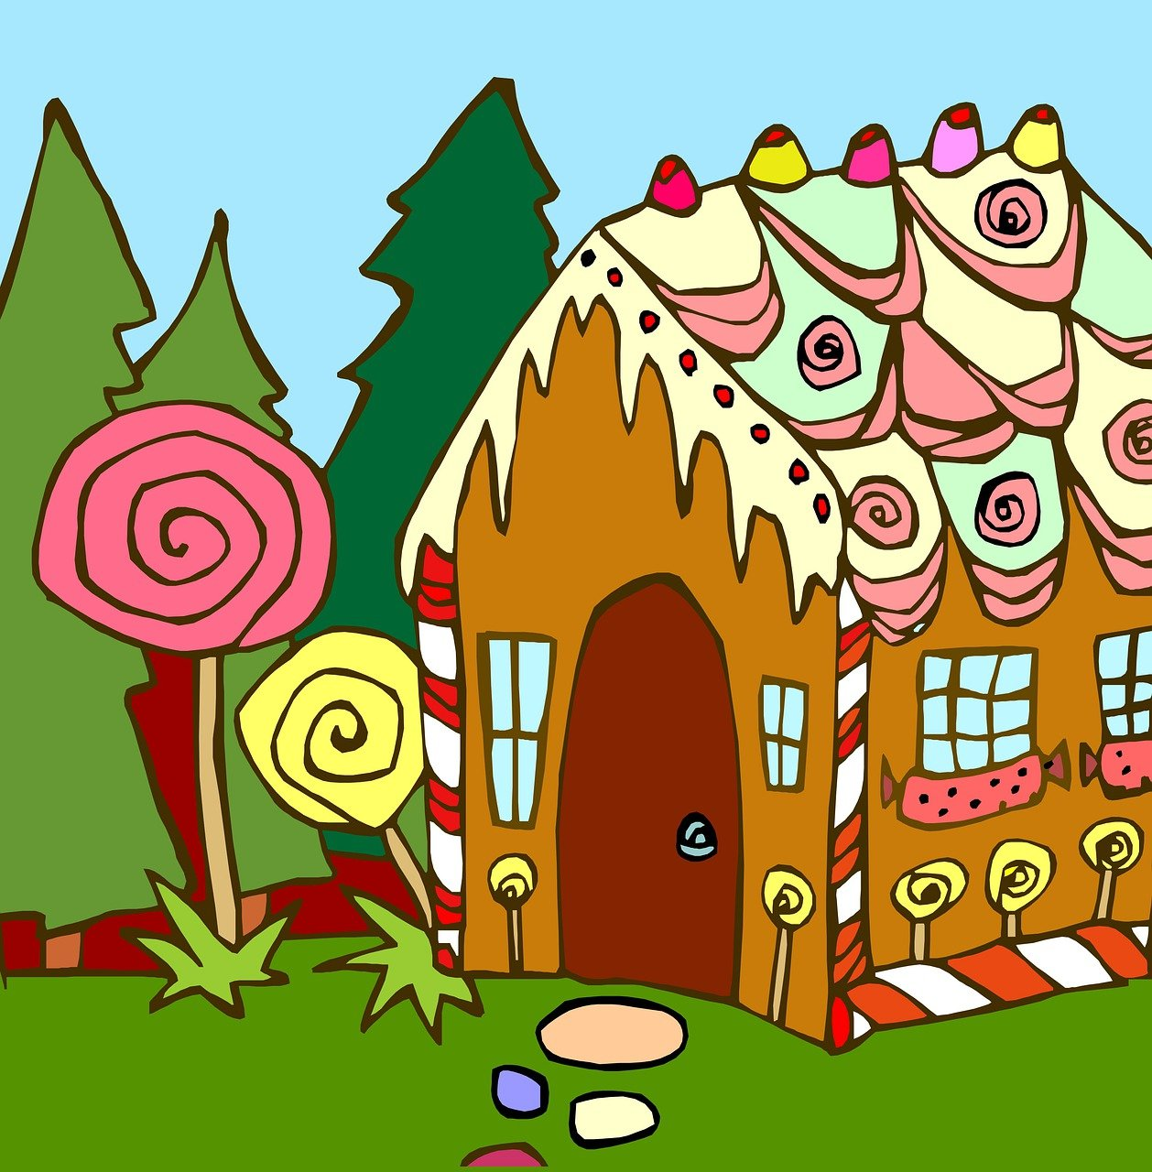
Hänsel und Gretel
grün
SSC [pf] [kn]
Term 3 Week 12
Notes:
Artwork by Steve Clarke. Pronoun pictures from NCELP (www.ncelp.org). All additional pictures selected from Pixabay and are available under a Creative Commons license, no attribution required.
Phonics:
[pf] Kopf [279] Pflanze [1667] Apfel [3490]
[kn] Knie [1679] Knochen [1930] knüpfen [4564]
Vocabulary: Revisit vocabulary
Revisit 1: backen [4640] holen [547] kochen [1481] müssen, ich muss, du musst, er/sie/es muss [43] Bett [659] Boden [536]Brot [2095] sauber [2026] warum? [192] denn [93] glossed: Salat [n/a]
Revisit 2: werden, werde, wirst, wird [8] Frohe Weihnachten [n/a] Gute Besserung [n/a] Herzlichen Glückwunsch zum Geburtstag [n/a] viel Glück [n/a]
Jones, R.L & Tschirner, E. (2019). A frequency dictionary of German: Core vocabulary for learners. London: Routledge.
The frequency rankings for words that occur in this PowerPoint which have been previously introduced in these resources are given in the SOW and in the resources that first
introduced and formally re-visited those words.
For any other words that occur incidentally in this PowerPoint, frequency rankings will be provided in the notes field wherever possible.
Remember that at the start of the course (first three lessons of Rot/Gelb) pupils learnt language (for greetings and register taking) that can still be part of the lesson routines in upper KS2 (Blau/Grün). They are not re-taught, as we anticipate that teachers have built these in from early in lower KS2.
1

Slide 2
aussprechen
[pf]
…
Kopf
Notes:
Timing: 1 minute
Aim: to introduce the SSC [pf].
Procedure:
1. Present the letter and say the [pf] sound first, on its own. Pupils repeat it with you. 2. Bring up the word ”Kopf” on its own, say it, pupils repeat it, so that they have the opportunity to focus all of their attention on the connection between the written word and its sound.
3. Click to bring up the picture and introduce the gesture, if using. Pupils repeat the word again.
4. Roll back the animations and work through 1-3 again, but this time, dropping your voice completely to listen carefully to the pupils saying the [pf] sound, pronouncing ”Kopf” and, if using, doing the gesture.
Note: A possible gesture for this would be to use the British Sign Language (BSL) sign for head, as here: https://www.signbsl.com/sign/head
Frequency: Kopf [250]
Jones, R.L & Tschirner, E. (2019). A frequency dictionary of German: Core vocabulary for learners. London: Routledge.
2

Slide 3
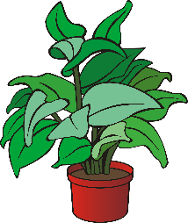
aussprechen
[pf]
…
Kopf
Pflanze
Apfel
Notes:
Timing: 1 minute
Aim: to consolidate the SSC [pf].
Procedure:
Re-present the SSC and the source word ‘Kopf’ (with gesture, if using).
Click to bring on the picture and get pupils to repeat the word ‘Kopf’ (with gesture, if using).
Present the cluster words in the same way, bringing on the picture and getting pupils to pronounce the words.
Frequency: Kopf [250] Pflanze [1667] Apfel [3490]
Jones, R.L & Tschirner, E. (2019). A frequency dictionary of German: Core vocabulary for learners. London: Routledge.

Slide 4
aussprechen
[kn]
In English the k in words starting with kn (e.g. knee, knot) is silent.
In German the k is pronounced, → K-nie.
…
Knie
Notes:
Timing: 1 minute
Aim: to introduce the SSC [kn].
Procedure:
1. Present the letter and say the [kn] sound first, on its own. Pupils repeat it with you. 2. Bring up the word ”Knie” on its own, say it, pupils repeat it, so that they have the opportunity to focus all of their attention on the connection between the written word and its sound.
3. Click to bring up the picture and introduce the gesture, if using. Pupils repeat the word again.
4. Roll back the animations and work through 1-3 again, but this time, dropping your voice completely to listen carefully to the pupils saying the [kn] sound, pronouncing ”Knie” and, if using, doing the gesture.
Note: A possible gesture for this would be to point to your knee.
Frequency: Knie [1679]
Jones, R.L & Tschirner, E. (2019). A frequency dictionary of German: Core vocabulary for learners. London: Routledge.
4

Slide 5
aussprechen
[kn]
…
Knie
Knochen
knüpfen
Notes:
Timing: 1 minute
Aim: to consolidate the SSC [kn].
Procedure:
Re-present the SSC and the source word ‘Knie’ (with gesture, if using).
Click to bring on the picture and get pupils to repeat the word ‘Knie’ (with gesture, if using).
Present the cluster words in the same way, bringing on the picture and getting pupils to pronounce the words.
Frequency: Knie [1679] Knochen [1930] knüpfen [4564]
Jones, R.L & Tschirner, E. (2019). A frequency dictionary of German: Core vocabulary for learners. London: Routledge.

Slide 6
aussprechen
[pf] [kn]
Hör zu. Wie viele [pf] und [kn] hörst du?
 |  | kn | pf
1 | Das Pferd* isst die Pflanze. |  | I I
2 | Herr Pfeiffer kocht ein Pfund* Äpfel. |  | I I I
3 | In Piraten*filmen sieht man oft den Totenkopf mit gekreuzten Knochen*. | I | I
4 | Das Essen braucht Salz* und Pfeffer*. |  | I
5 | Frau Knopf kann ihr Knie nicht knicken*. | I I I
6 | Ich liebe knackige* Äpfel. | I | I
das Pferd – horse | das Pfund – pound | der Pirat – pirate | der Totenkopf mit gekreuzten Knochen – skull and crossbones | das Salz - salt | der Pfeffer – pepper | knicken – to bend | knackig – crunchy
Notes:
Timing: 5 minutes
Aim: to consolidate the SSCs [pf] and [kn] in a listening activity.
Procedure:
Explain the task. Pupils are going to hear six sentences which contain a mixture of [pf] and [kn] sounds.
For each sentence they hear, pupils count the number of times they hear each SSC, noting down their answers.
Click to reveal answers.
To aid comprehension, pictures are revealed with the answers.
Transcript:
Das Pferd isst die Pflanze.
Herr Pfeiffer kocht ein Pfund Äpfel.
In Piratenfilmen sieht man oft den Totenkopf mit gekreutzen Knochen.
Das Essen braucht Salz und Pfeffer.
Frau Knopf kann ihr Knie nicht knicken.
Ich liebe knackige Äpfel.
Frequency: Pferd [1504] Pfund [4163] Topf [4136] Pirat [N/A] Salz [2608] Pfeffer [N/A] knicken [N/A] knackig [N/A]
Jones, R.L & Tschirner, E. (2019). A frequency dictionary of German: Core vocabulary for learners. London: Routledge.

Slide 7
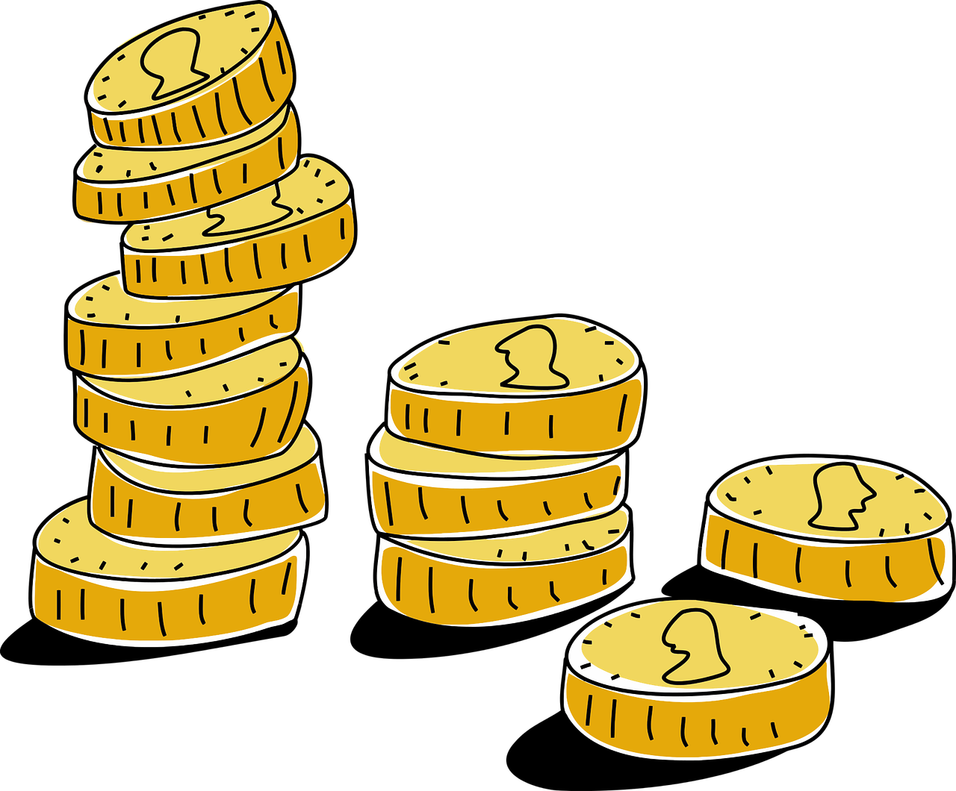
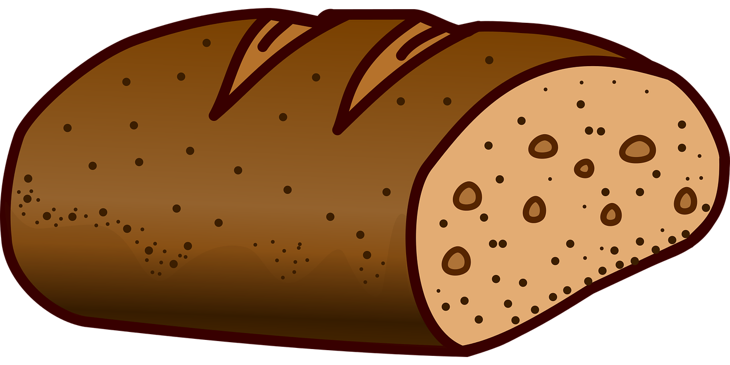
Vokabeln
Vokabeln wiederholen
Wörter
Was ist das auf Deutsch? Schreib die Wörter.
das Haus
d _ _ H _ _ _
draußen
d _ _ _ _ _ _
d _ _ M _ _ _ _ _ _
das Mädchen
das Bett
d _ _ B _ _ _
d _ _ G _ _ _
das Geld
das Brot
d _ _ B _ _ _
schlafen
s _ _ _ _ _ _ _
Notes:
Timing: 3 minutes
Aim: to review some vocabulary which will be used in the story
Procedure:
Pupils write down all the words using the clues from pictures and the letters given.
Check the answers by clicking to reveal each in turn.
Ask learners to repeat the word after the answer is revealed to make sure they’re familiar with the sound (in the audio version, the sound will play as the answer is revealed).
7

Slide 8
Geschichte
Hänsel und Gretel
Hänsel und Gretel
Du siehst einen Film. Hör zu und steh auf* wenn du die Wörter hörst.
Haus
draußen
Mädchen
Bett
Geld
Brot
schlafen
steh auf – stand up, get up
Notes:
Timing: 8-10 minutes
Aim: to identify known words in a well-known story and practise listening to authentic German.
Procedure:
Tell pupils they will be watching the first couple of minutes of a Hansel and Gretel cartoon (in German: Hänsel und Gretel). Each time they hear one of the words they wrote down from the previous slide (also shown on this slide) they should stand up (alternative: raise their hands)
Play the video (also available here: https://youtu.be/0Ah4y8gCA-Q?feature=shared), encouraging pupils to stand up and then sit down again when each word is said (finish at 2 mins 40 seconds). Timings of each word are below.
Play the section again from the beginning and ask pupils if they can recognise any other words they know when they listen again. (e.g. Kuchen – from Lebkuchen – what the house is made of, lieben – the father loves his children, and steh auf – the stepmother tells the children to get up). They should put their hands up when they hear a word they know.
Timings:
Haus: 0:19
Mädchen: 0:45
Geld: 0:51
schlafen: 1:43
draußen: 2:00
Bett: 2:19
Brot: 2:30
Vocabulary:
aufstehen [966]
Jones, R.L & Tschirner, E. (2019). A frequency dictionary of German: Core vocabulary for learners. London: Routledge.
8

Slide 9
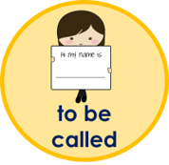
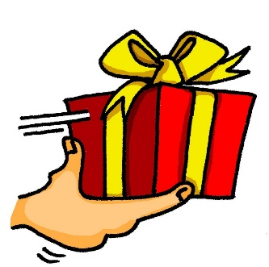
Hänsel und Gretel
Schreib Sätze.
haben
Gretel
es gibt
Notes:
Timing: 5 minutes
Aim: to write some sentences explaining what pupils have just seen in the video.
Procedure:
For each sentence, pupils should choose one image from the left-hand circle and match it to the best one in the right-hand circle to create sentences that retell the story that they have just seen. Make it clear that ‘haben’ and the ‘x’ belong together and ‘to be called’ and ‘Gretel’ belong together.
Suggested answers:
Es gibt ein Haus.
Sie haben kein Geld.
Sie schlafen im Bett.
Sie gibt Hänsel und Gretel Brot.
Er geht nach draußen.
Sie heißt Gretel.
9

Slide 10
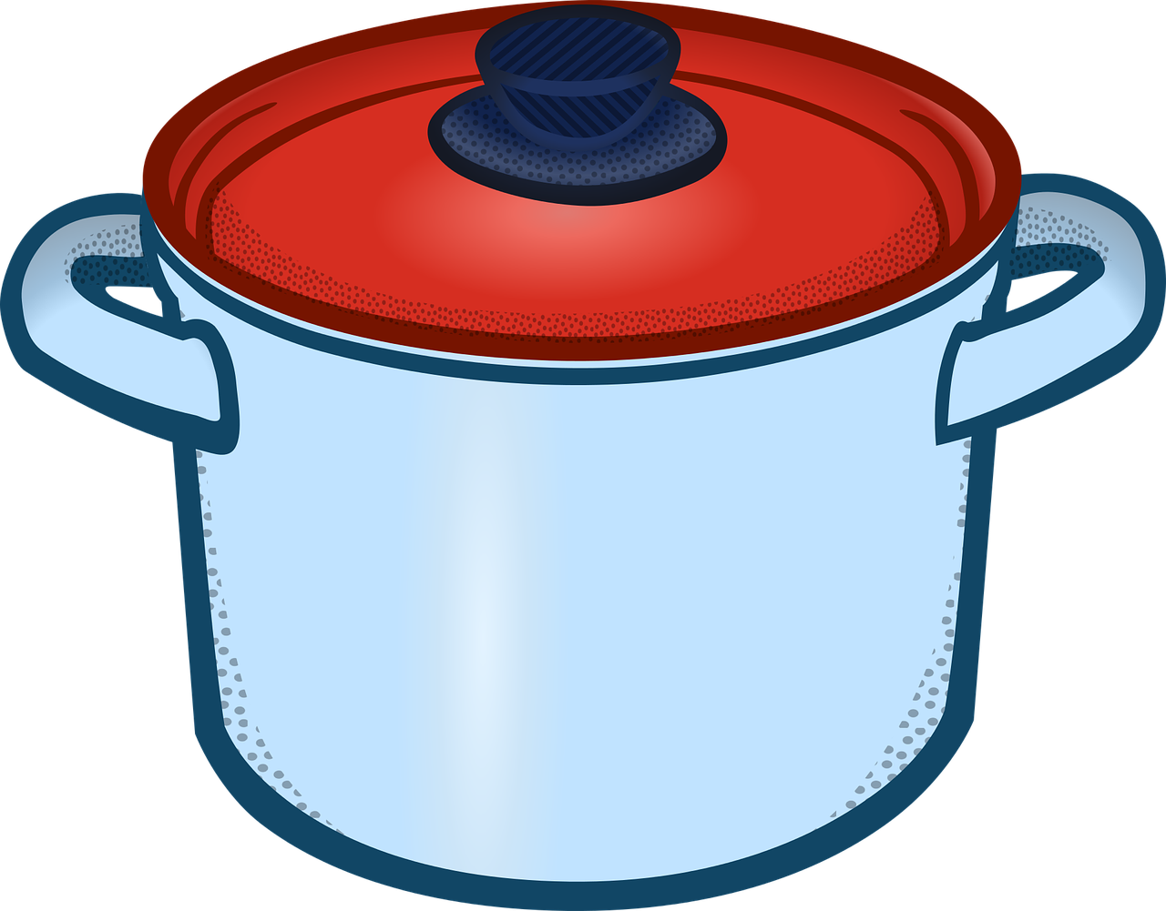
Und dann...
Sag die Wörter. Wie benutzen Hänsel und Gretel den Knochen und den Topf in der Geschichte?
der Knochen
der Topf
Notes:
Timing: 2 minutes
Aim: to prime pupils for the next bit of the story and review the two SSCs presented at the beginning.
Procedure:
Ask learners to say the words.
Ask learners to guess how Hansel and Gretel use these things in the story. If they can, ask them to use some German. Don’t reveal the answers and say they will have to wait until next time to find out!
10

Slide 11
Tschüss!
grün
Notes:
11

