Slide 1
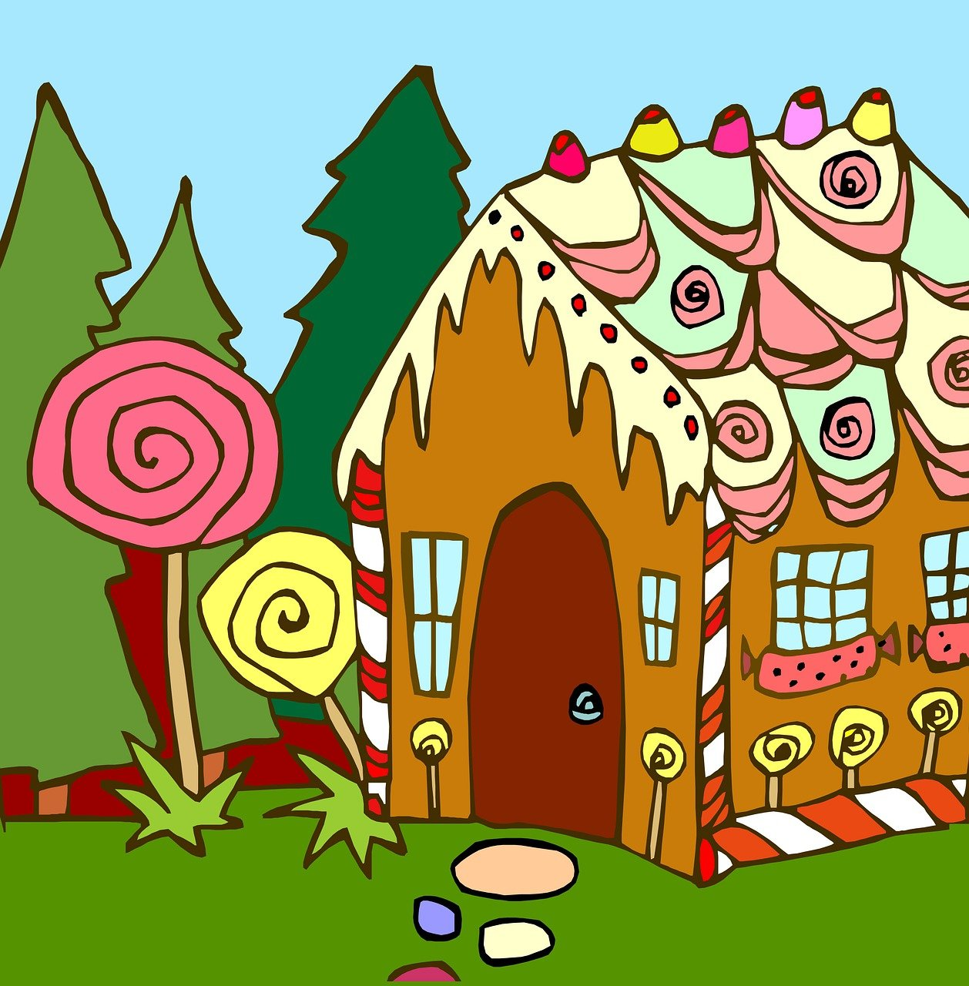
Hänsel und Gretel
grün
Follow ups 1-5
Term 3 Week 13
Notes:
Artwork by Steve Clarke. Pronoun pictures from NCELP (www.ncelp.org). All additional pictures selected from Pixabay and are available under a Creative Commons license, no attribution required.
Phonics:
[y] typisch [1109] Rhythmus [3823] Physik [1917] [ü]
[qu] Quatsch [1650] bequem [1657] Aquarium [>5000]
Vocabulary: Revisit vocabulary
Revisit 1: liegen [107] Lust haben [n/a] Rad fahren [n/a] Sonne [864] wichtig [144] draußen [884]
Revisit 2: essen [323] gehen [66] sehen [79] singen [1063] tanzen [1497] tragen [271] man [32] (Party)Kleidung [2820] dann [41]
Jones, R.L & Tschirner, E. (2019). A frequency dictionary of German: Core vocabulary for learners. London: Routledge.
The frequency rankings for words that occur in this PowerPoint which have been previously introduced in these resources are given in the SOW and in the resources that first introduced and formally re-visited those words.
For any other words that occur incidentally in this PowerPoint, frequency rankings will be provided in the notes field wherever possible.
Remember that at the start of the course (first three lessons of Rot/Gelb) pupils learnt language (for greetings and register taking) that can still be part of the lesson routines in upper KS2 (Blau/Grün). They are not re-taught, as we anticipate that teachers have built these in from early in lower KS2.

Slide 2
Follow ups 1-4a Hänsel und Gretel müssen nach draußen gehen
Lies und spiel den Text.
Erzähler: Es war einmal* eine Familie: ein Vater, eine Stiefmutter*, ein Mädchen, Gretel, und ihr Bruder, Hänsel. Der Vater ist nett, aber die Stiefmutter ist böse*.
Vater: Wir haben nicht viel Geld und wir können nicht essen. Was machen wir?
es war einmal – once upon a time
die Stiefmutter – step mother
böse - bad
Stiefmutter: Ich habe eine Idee! Hänsel und Gretel müssen nach draußen gehen…und sie kommen nicht nach Hause! Ha ha ha…
Vater: Ich weiß nicht…Ich liebe Hänsel und Gretel.
Stiefmutter: Aber wir müssen essen! Ich mache alles…
Erzähler: Hänsel und Gretel schlafen im Bett. Die Stiefmutter kommt ins Schlafzimmer.
Stiefmutter: Ihr müsst nach draußen gehen! Und kommt nicht nach Hause!
Notes:
[1/4]
Timing: 10-15 mins per follow-up session (more if needed)
Aim: to consolidate vocabulary, grammar and phonics learnt this term through acting out a scene from a play. Each group will act out one scene from the play (there are four scenes in total)
Procedure:
Divide the class into groups of 3 or 4. Each group should choose one of the four scenes on these four slides. Please print enough copies of each of these four slides so that each pupil has a copy of their scene. Each of the pupils should have a speaking part (Scene A has 3 speaking parts, Scene B has 4 speaking parts, Scene C has 3 speaking parts, Scene 4 has 3 speaking parts).
Session 1: Pupils choose their roles in their groups and start practising reading their scene, making sure they understand it (translations provided for each scene). For more confident learners, they can change or add to parts of the text if they would like to.
Session 2: Pupils choose how they will act the scene out and what props and/or costumes they will need to bring for the next session. They will need to think about the non-speaking parts e.g. will they use dolls/pictures or ask pupils from the other group to play the non-speaking parts?
Session 3: Dress rehearsal/practice.
Session 4: Choose at least one group for each of the scenes to act out their scene with costumes/props for the class.
Translation, scene A:
Narrator: Once upon a time there was a family: a father, a stepmother, a girl, Gretel and her brother, Hansel. The father is nice but the stepmother is bad.
Father: We don’t have much money and we can’t eat. What do we do?
Stepmother: I have an idea! Hansel and Gretel have to go outside...and they won’t come back home! Ha ha ha...
Father: I don’t know....I love Hansel and Gretel.
Stepmother: But we have to eat! I will do everything...
Narrator: Hansel and Gretel are sleeping in the bed. The stepmother comes into the bedroom.
Stepmother: You have to go outside! And don’t come back home!
Vocabulary:
es war einmal [N/A] Stiefmutter [N/A] böse [1229]
Jones, R.L & Tschirner, E. (2019). A frequency dictionary of German: Core vocabulary for learners. London: Routledge.

Slide 3
Follow ups 1-4b Hänsel und Gretel finden das Lebkuchenhaus
Lies und spiel den Text.
Erzähler: Hänsel und Gretel sind draußen und brauchen Essen.
Hänsel: Ich habe Bauch*schmerzen! Ich muss etwas essen!
Gretel: Ich auch!
Erzähler: Aber dann finden sie etwas…
Gretel: Hänsel! Was ist das? Ist das ein Haus?
Hänsel: Ja, das ist ein Haus! Ein Lebkuchen*haus! Wir können essen!
Erzähler: Sie laufen zum Haus und essen. Sie sind sehr froh! Aber dann hören sie eine alte Hexe. Die Hexe ist im Haus.
Hexe: Knusper, knusper, knäuschen, wer knuspert an meinem Häuschen?
Erzähler: Hänsel und Gretel haben Angst!
Bauch – stomach
Lebkuchen - gingerbread
Notes:
[2/4] NB Pupils already saw this scene last week so it may be more suitable for less confident learners.
Translation, scene B:
Narrator: Hansel and Gretel are outside and need food.
Hansel: I have stomach ache! I have to eat something!
Gretel: Me too!
Narrator: But then they find something...
Gretel: Hansel! What is that? Is that a house?
Hansel: Yes, that is a house! A gingerbread house! We can eat!
Narrator: They run to the house and eat. They are very happy! But then they hear an old witch. The witch is in the house.
Witch: Nibble, nibble, gnaw, who is nibbling at my house?
Narrator: Hansel and Gretel are scared!
Vocabulary:
Bauch [2147] Lebkuchen [N/A]
Jones, R.L & Tschirner, E. (2019). A frequency dictionary of German: Core vocabulary for learners. London: Routledge.

Slide 4
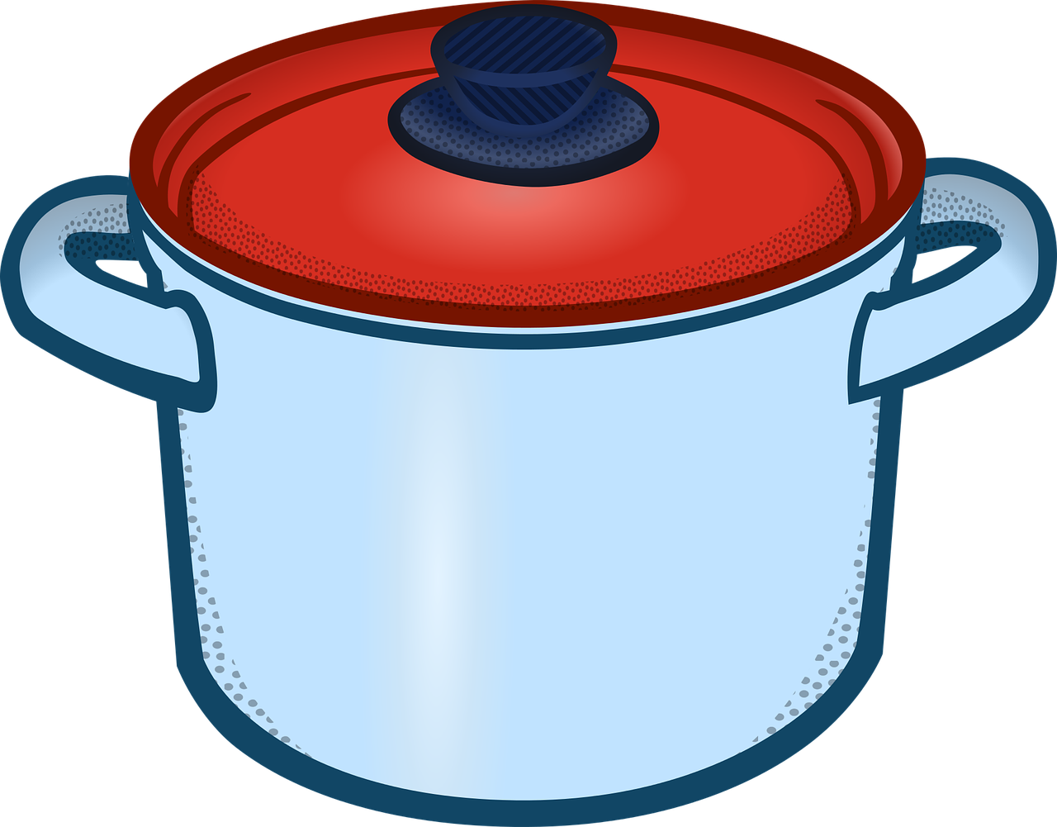
Follow ups 1-4c Die Hexe möchte Hänsel essen
Lies und spiel den Text.
Erzähler: Hänsel und Gretel gehen mit der Hexe ins Haus. Dort können sie viel essen und in bequemen Betten gut schlafen.
Gretel: Es ist toll hier! Diese Frau ist sehr nett.
Erzähler: Aber die Frau ist nicht nett. Sie ist eine böse* Hexe! Sie hat Lust, Hänsel zu essen!
Hexe: Gretel, hol den Topf*! Du musst für deinen Bruder kochen. Er muss viel essen! Dann wird er dicker*! Du bekommst nur altes Brot, Gretel.
Erzähler: Die Hexe kann nicht gut sehen. Nach vier Wochen sagt sie:
Hexe: Hänsel, gib mir deine Finger.
böse – bad
der Topf – pot
dicker – fatter
dünn - thin
Erzähler: Aber Hänsel gibt die Hexe einen Knochen!
Hexe: Oh nein! Er ist zu dünn*. Das ist nicht gut. Ich möchte Hänsel essen!
Notes:
[3/4] NB this scene includes the imperative ‘hol’ (from holen) and ‘gib’ (from geben). You may need to help pupils in this group recognise this meaning.
Translation, scene C:
Narrator: Hansel and Gretel go with the witch into the haus. There they can eat lots and sleep in comfortable beds.
Gretel: It’s great here! This woman is very nice.
Narrator: But the woman is not nice. She is a bad witch! She feels like eating Hansel!
Witch: Gretel, get the the pot! You have to cook for your brother. He has to eat a lot! Then he will get fatter! You will only get old bread, Gretel.
Narrator: The witch can’t see well. After four weeks she says:
Witch: Hansel, give me your finger.
Narrator: But Hansel gives her a bone!
Witch: Oh no! He is too thin! That is not good. I want to eat Hansel!
Vocabulary:
böse [1229] Topf [4136] dick [1074] dünn [1739]
Jones, R.L & Tschirner, E. (2019). A frequency dictionary of German: Core vocabulary for learners. London: Routledge.

Slide 5
Follow ups 1-4d Hänsel und Gretel gehen nach Hause
Lies und spiel den Text.
Erzähler: Die böse Hexe hat einen Plan.
Hexe: Gretel, geh in den Ofen. Ist es heiß?
Gretel: Wie mache ich das? Ich weiß nicht. Kannst du es mir zeigen*?
Hexe: Das ist einfach! Ich zeige es dir.
Erzähler: Die Hexe geht in den Ofen und Gretel schließt* die Tür. Gretel läuft zu Hänsel.
Gretel: Komm, Hänsel, wir gehen nach Hause zu Papa!
Hänsel: Ja! Aber was ist das? Die Hexe hat viel Geld! Wir nehmen das Geld mit nach Hause! Dann können wir alle essen!
der Ofen – oven
heiß – hot
mir zeigen – show me
schließen – to close
Erzähler: Hänsel und Gretel laufen nach Hause. Sie sehen ihren Vater. Sie sind alle sehr froh!
Notes:
[4/4] Translation, scene C:
Narrator: The bad witch has a plan.
Witch: Gretel, go into the oven. Is it hot?
Gretel: How do I do that? I don’t know. Can you show me?
Witch: That’s easy! I’ll show you.
Narrator: The witch goes into the oven and Gretel closes the door. Gretel runs to Hansel.
Gretel: Come, Hansel, we’re going home to dad!
Hansel: Yes! But what is that? The witch has lots of money! We’ll take the money home with us. Then we can all eat!
Narrator: Hansel and Gretel run home. They see their father. They are all very happy!
Vocabulary:
es war einmal [N/A] Stiefmutter [N/A] böse [1229]
Jones, R.L & Tschirner, E. (2019). A frequency dictionary of German: Core vocabulary for learners. London: Routledge.

Slide 6
Follow up 5:

Schreib auf Englisch.
Can you get at least 10 points?
Wörter
Vokabeln
 | essen | dann | die (Party)Kleidung
 | gehen | sehen | tragen
 | man | singen | tanzen
 | liegen | draußen | Lust haben
 | Rad fahren | die Sonne | wichtig
to eat, eating
then
(the) (party) clothes
x2
to go, going
to see, seeing
to wear, wearing
you (general), people
to sing, singing
to dance, dances
to lie, lying
outside
to feel like (doing sth)
x1
cycling
(the) sun
important
Notes:
Timing: 5 minutes
Aim: to practise written comprehension of vocabulary from this and revisited weeks.
Procedure: 1. Give pupils a blank grid. They fill in the English meanings of any of the words they know, trying to reach 15 points in total.
Note: The most recently learnt and practised words are pink, words from the previous week are green and those from week 1 are blue, thus more points are awarded for them, to recognise that memories fade and more effort (heavy lifting!) is needed to retrieve them.

Slide 7
Follow up 5:

Schreib auf Deutsch.
Can you get at least 10 points?
Wörter
Vokabeln
 | (the) (party) clothes | to go, going | you (general), people
 | to wear, wearing | to eat, eating | to dance, dancing
 | to see, seeing | then | to sing, singing
 | to feel like (doing sth) | to lie, lying | (the) sun
 | important | cycling | outside
die (Party)Kleidung
gehen
man
x2
tragen
essen
tanzen
sehen
dann
singen
Lust haben
liegen
die Sonne
x1
wichtig
Rad fahren
draußen
Notes:
Timing: 5 minutes
Aim: to practise written comprehension of vocabulary from this and revisited weeks.
Procedure: 1. Give pupils a blank grid. They fill in the German meanings of any of the words they know, trying to reach 15 points in total.
Note: The most recently learnt and practised words are pink, words from the previous week are green and those from week 1 are blue, thus more points are awarded for them, to recognise that memories fade and more effort (heavy lifting!) is needed to retrieve them.

Slide 8
Tschüss!
grün
Notes:
8

Slide 9
Follow up 5:

Schreib auf Englisch.
Can you get at least 10 points?
Wörter
Vokabeln
 | essen | dann | die (Party)Kleidung
 | gehen | sehen | tragen
 | man | singen | tanzen
 | liegen | draußen | Lust haben
 | Rad fahren | die Sonne | wichtig
x2
x1
Notes:
HANDOUT

Slide 10
Follow up 5:

Schreib auf Deutsch.
Can you get at least 10 points?
Wörter
Vokabeln
 | (the) (party) clothes | to go, going | you (general), people
 | to wear, wearing | to eat, eating | to dance, dancing
 | to see, seeing | then | to sing, singing
 | to feel like (doing sth) | to lie, lying | (the) sun
 | important | cycling | outside
x2
x1
Notes:
HANDOUT

