Slide 1
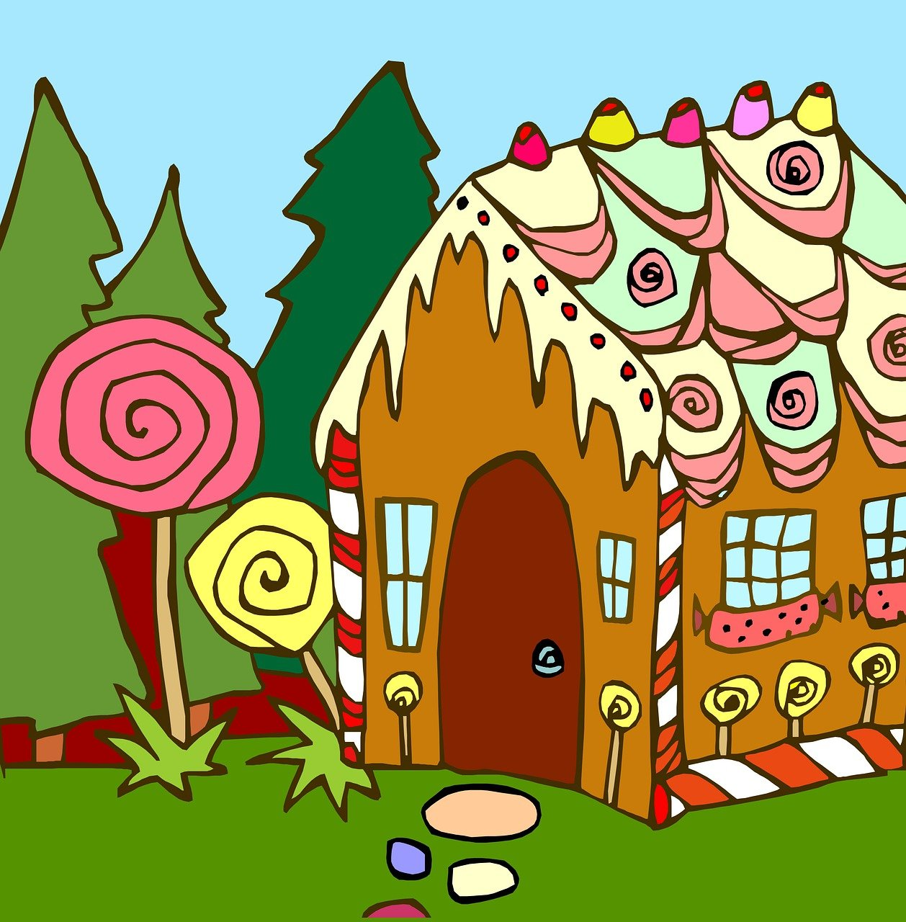
Hänsel und Gretel
grün
SSC [y] [qu]
Term 3 Week 13
Notes:
Artwork by Steve Clarke. Pronoun pictures from NCELP (www.ncelp.org). All additional pictures selected from Pixabay and are available under a Creative Commons license, no
attribution required.
Phonics:
[y] typisch [1109] Rhythmus [3823] Physik [1917] [ü]
[qu] Quatsch [1650] bequem [1657] Aquarium [>5000]
Vocabulary: Revisit vocabulary
Revisit 1: liegen [107] Lust haben [n/a] Rad fahren [n/a] Sonne [864] wichtig [144] draußen [884]
Revisit 2: essen [323] gehen [66] sehen [79] singen [1063] tanzen [1497] tragen [271] man [32] (Party)Kleidung [2820] dann [41]
Jones, R.L & Tschirner, E. (2019). A frequency dictionary of German: Core vocabulary for learners. London: Routledge.
The frequency rankings for words that occur in this PowerPoint which have been previously introduced in these resources are given in the SOW and in the resources that first introduced and formally re-visited those words.
For any other words that occur incidentally in this PowerPoint, frequency rankings will be provided in the notes field wherever possible.
Remember that at the start of the course (first three lessons of Rot/Gelb) pupils learnt language (for greetings and register taking) that can still be part of the lesson routines in upper KS2 (Blau/Grün). They are not re-taught, as we anticipate that teachers have built these in from early in lower KS2.
1

Slide 2
aussprechen
[y]
[y] sounds the same as [ü]
…
typisch
Notes:
Timing: 1 minute
Aim: to introduce the SSC [y].
Procedure:
1. Present the letter and say the [y] sound first, on its own. Pupils repeat it with you. 2. Bring up the word ”Typisch” on its own, say it, pupils repeat it, so that they have the opportunity to focus all of their attention on the connection between the written word and its sound.
3. Click to bring up the picture and introduce the gesture, if using. Pupils repeat the word again.
4. Roll back the animations and work through 1-3 again, but this time, dropping your voice completely to listen carefully to the students saying the [y] sound, pronouncing ”Typisch” and, if using, doing the gesture.
Note: A possible gesture for this would be to mime drinking tea
Frequency: typisch [1109]
Jones, R.L & Tschirner, E. (2019). A frequency dictionary of German: Core vocabulary for learners. London: Routledge.
2

Slide 3
aussprechen
[y]
…
typisch
1 2& 3& 4
Rhythmus
Physik
Notes:
Timing: 1 minute
Aim: to consolidate the SSC [y].
Procedure:
Re-present the SSC and the source word ‘typisch’ (with gesture, if using).
Click to bring on the picture and get pupils to repeat the word ‘typisch’ (with gesture, if using).
Present the cluster words in the same way, bringing on the picture and getting pupils to pronounce the words.
Frequency: typisch [1109] Rhythmus [3823] Physik [1917]
Jones, R.L & Tschirner, E. (2019). A frequency dictionary of German: Core vocabulary for learners. London: Routledge.

Slide 4
aussprechen
[qu]
…
Quatsch!
Notes:
Timing: 1 minute
Aim: to introduce the SSC [qu].
Procedure:
1. Present the letter and say the [qu] sound first, on its own. Pupils repeat it with you. 2. Bring up the word ”Quatsch” on its own, say it, pupils repeat it, so that they have the opportunity to focus all of their attention on the connection between the written word and its sound.
3. Click to bring up the picture and introduce the gesture, if using. Pupils repeat the word again.
4. Roll back the animations and work through 1-3 again, but this time, dropping your voice completely to listen carefully to the students saying the [qu] sound, pronouncing ”Quatsch” and, if using, doing the gesture.
Note: A possible gesture for this would be to shrug your shoulders and hold your arms slightly out, palms of hands facing up.
Frequency: Quatsch [1650]
Jones, R.L & Tschirner, E. (2019). A frequency dictionary of German: Core vocabulary for learners. London: Routledge.
4

Slide 5
aussprechen
[qu]
…
Quatsch!
[comfortable]
bequem
Aquariam
Notes:
Timing: 1 minute
Aim: to consolidate the SSC [qu].
Procedure:
Re-present the SSC and the source word ‘quatsch’ (with gesture, if using).
Click to bring on the picture and get pupils to repeat the word ‘quatsch’ (with gesture, if using).
Present the cluster words in the same way, bringing on the picture and getting pupils to pronounce the words.
Frequency: Quatsch [1650] bequem [1657] Aquarium [>5000]
Jones, R.L & Tschirner, E. (2019). A frequency dictionary of German: Core vocabulary for learners. London: Routledge.

Slide 6
[y]
Hör zu. Ist das ein deutsches [y] oder ein englisches y?
hören
German [y] is usually pronounced the same as [ü]. However, for words that come from English, initial or final [y] is often pronounced as in English, e.g., die Party.
1 | Handy
2 | Symbol
3 | typisch
4 | Hobby
5 | Baby
6 | Symptom
Notes:
Timing: 3 minutes Aim: To distinguish between German and English [y]. Procedure: 1. Click sound button, students transcribe word and tick whether they hear German or English [y].
2. Click to reveal transcribed word and tick.
Transcript:
Handy
Symbol
typisch
Hobby
Baby
Symptom
Word frequency: Symbol [2570] typisch [1109] Baby [2297] Symptom [3030]
Source: Jones, R.L. & Tschirner, E. (2019). A frequency dictionary of German: core vocabulary for learners. Routledge

Slide 7
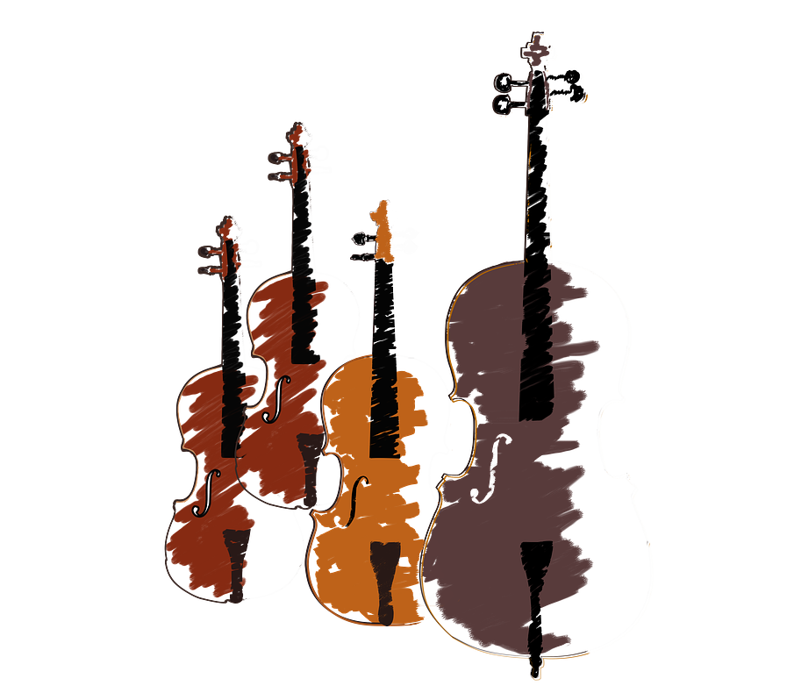
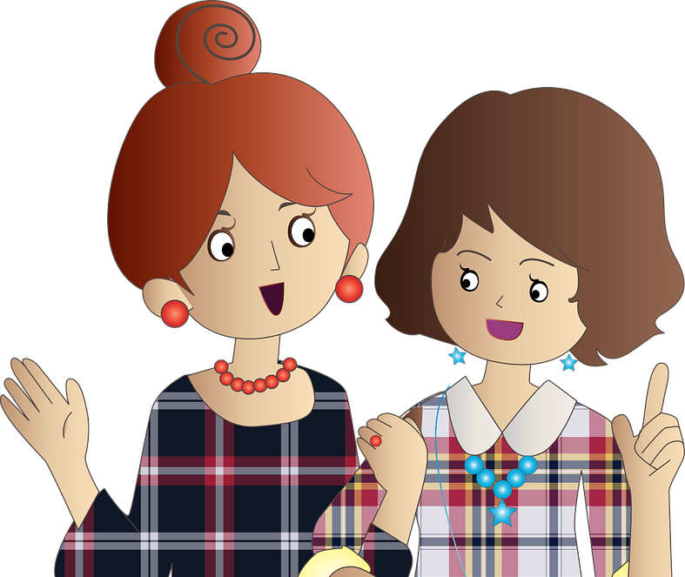
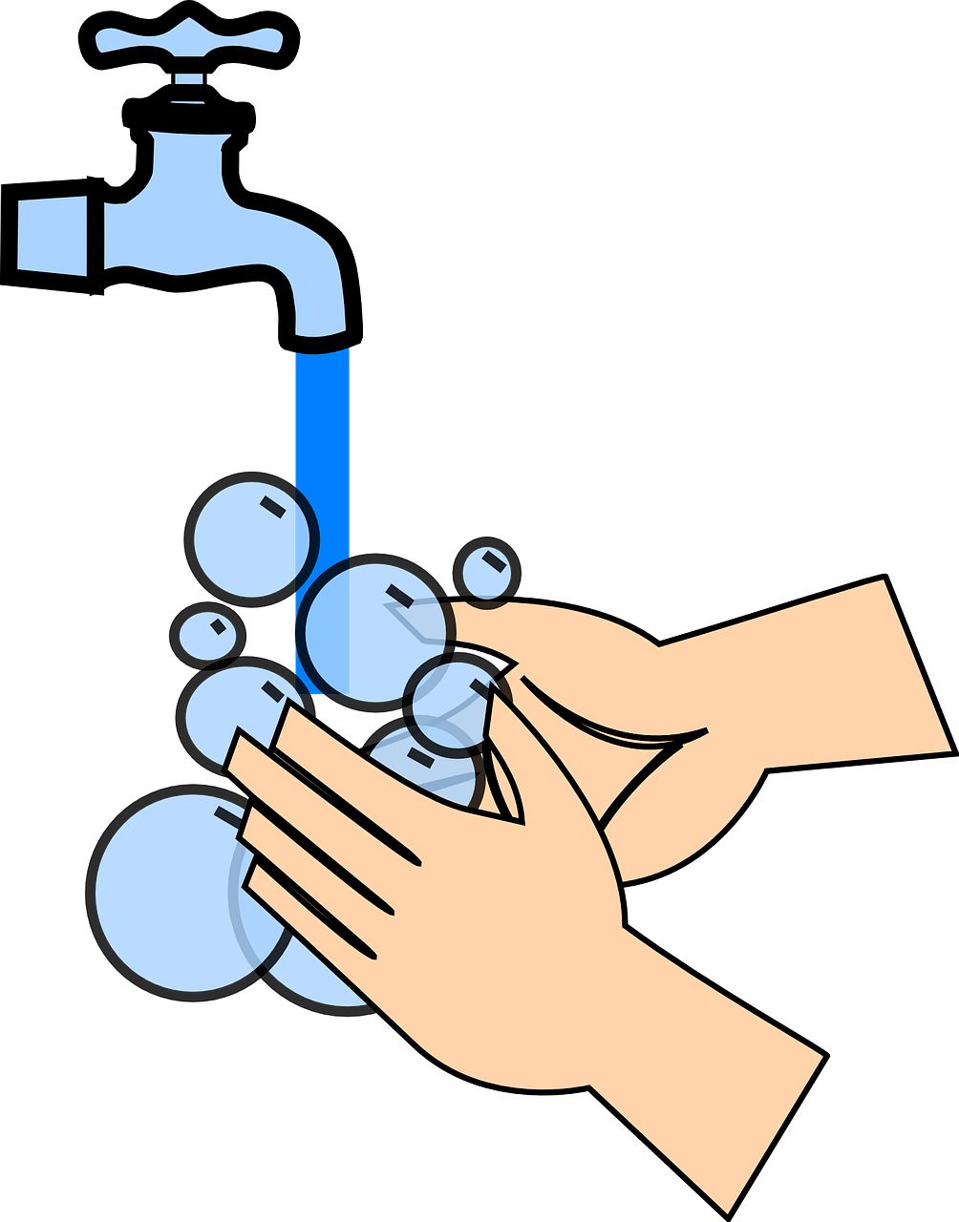
[qu]
Hör zu. Ist das [qu] oder [w]?
hören
quälen wählen | quer wer
Quartett wartet | quatschen waschen
__
__
__
__
__
__
__
__
Notes:
Timing: 3 minutes Aim: to differentiate between minimal pairs with [qu] and [w]. Procedure: 1. Click on the audio buttons to hear the two words.
2. Students note down whether they hear [qu] or [w] for each gap.
3. Click to reveal answers.
Transcript:
quälen (to torment) / wählen (to choose, vote)
wer (who) / quer (diagonally, sideways, across)
wartet (wait) / Quartett (quartet)
quatschen (to gossip) / waschen (to wash)
Word frequency: quälen [3832] wählen [636] wer [149] quer [2708] warten [364] Quartett [N/A] quatschen [N/A] waschen [2315]
Source: Jones, R.L. & Tschirner, E. (2019). A frequency dictionary of German: core vocabulary for learners. Routledge

Slide 8
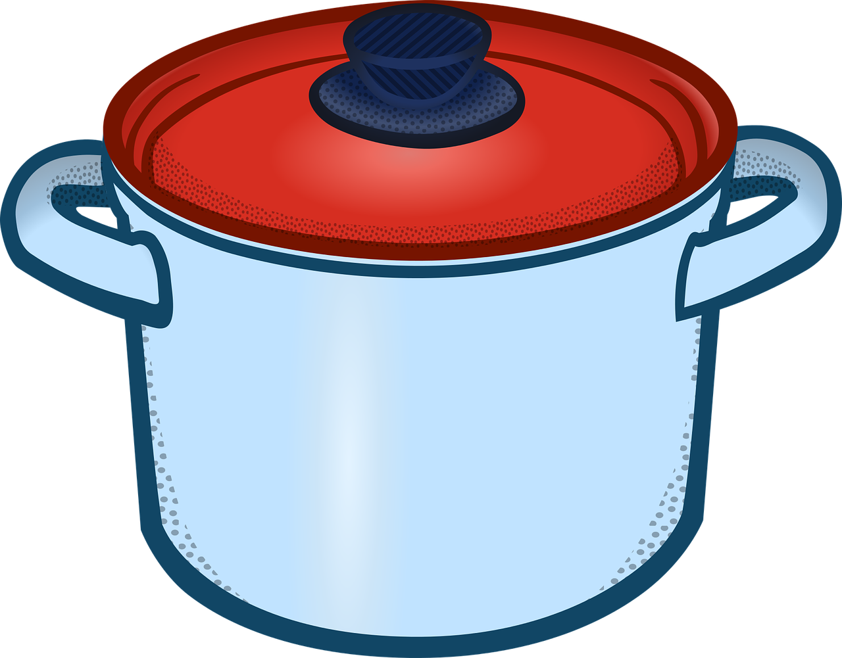
Hänsel und Gretel
Wer macht was? Hänsel, Gretel, die Hexe oder der Vater?
 | Hänsel, Gretel und die Hexe gehen ins Haus.
 | Hänsel und Gretel essen viel und schlafen in bequemen Betten.
 | Gretel muss mit einem Topf für Hänsel kochen.
 | Die Hexe hat Lust, Hänsel zu essen.
 | Die Hexe kann nicht sehen.
 | Hänsel benutzt einen Knochen.
 | Am Ende* sind Hänsel, Gretel und der Vater sehr froh.
1
__________________________
________________
2
3
_____
______
4
_______
______
5
_______
6
_____
7
__________________________
am Ende – at the end
Notes:
Timing: 3 minutes
Aim: to prime pupils for the next bit of the story and review some of the SSCs presented in this and the previous lesson.
Procedure:
Remind learners of what has happened in the story so far (Hansel and Gretel have found a gingerbread house, started eating from it and then heard a witch inside).
Ask learners to use their knowledge of the story and/or guess which characters do what in the last part of the story. There is sometimes more than one answer for a gap (up to three characters per sentence).
Ask pupils to share their answers but say you will not be revealing your answers yet – you’ll be watching the rest of the cartoon to find out.
8

Slide 9
Geschichte
Hänsel und Gretel
Hänsel und Gretel
Du siehst das Filmende. Hör zu. Wer macht was?
Notes:
Timing: 10-15 minutes
Aim: to practise listening to a well-known story in authentic German.
Procedure:
Tell pupils they will now watch the end of the story and check their answers to the questions they answered on the previous slide.
Play the video (https://youtu.be/0Ah4y8gCA-Q?feature=shared&t=394 – it should start at 6:34) and play until the end (11:08). Watch again in full or any part you would like to repeat.
Ask pupils to summarise the story. They can use a mixture of both English and German. E.g. The witch brings the children into the house and gives them lots of nice things to eat and nice beds to sleep in. But the witch is bad and wants to eat Hansel. She locks him in a cage and makes Gretel cook food for him to fatten him up. She keeps checking whether Hansel has put on any weight but as she can’t see well, Hansel uses a chicken bone and sticks it out of the cage to pretend its his finger. So the witch thinks that he isn’t putting on any weight. Eventually, she gets impatient and tries to trick Gretel into climbing in the oven by saying she needs to go in there to check if it’s hot enough to bake bread but Gretel realises what she is trying to do and says she doesn’t know how to and asks the witch to demonstrate. The witch shows her, at which point Gretel pushes her into the oven and closes the door. She frees Hansel and they discover that the witch has lots of jewels which they take back to their father. Now they have no money troubles anymore and they live happily ever after.
9

Slide 10
Hänsel und Gretel
Wer macht was? Hänsel, Gretel, die Hexe oder der Vater?
 | Hänsel, Gretel und die Hexe gehen ins Haus.
 | Hänsel und Gretel essen viel und schlafen in bequemen Betten.
 | Gretel muss mit einem Topf für Hänsel kochen.
 | Die Hexe hat Lust, Hänsel zu essen.
 | Die Hexe kann nicht sehen.
 | Hänsel benutzt einen Knochen.
 | Am Ende* sind Hänsel, Gretel und der Vater sehr froh.
1
__________________________
________________
2
3
_____
______
4
_______
______
5
_______
6
_____
7
__________________________
am Ende – at the end
Notes:
Timing: 3 minutes
Aim: to check the answers about who did what in the story pupils just watched.
Procedure:
Check each of the answers in turn.
If time, ask pupils to translate into English.
Translations:
Hansel, Gretel and the witch go into the house.
Hansel and Gretel eat a lot and sleep in comfortable beds.
Gretel has to cook with a pot for Hansel.
The witch feels like eating Hansel.
The witch cannot see.
Hansel uses a bone.
At the end, Hansel, Gretel and the father are very happy.
10

Slide 11
Hänsel und Gretel
Kannst du die Geschichte auf Deutsch erzählen?
Notes:
Timing: 5 mins
Aim: to set learners up for the follow-ups where they will be telling parts of the story again in German and acting them out. Encourage them that they have all the language they need and that it will be fun! It may be helpful for them to start thinking about any props or costumes they might like to use.

Slide 12
Tschüss!
grün
Notes:
12

