Slide 1
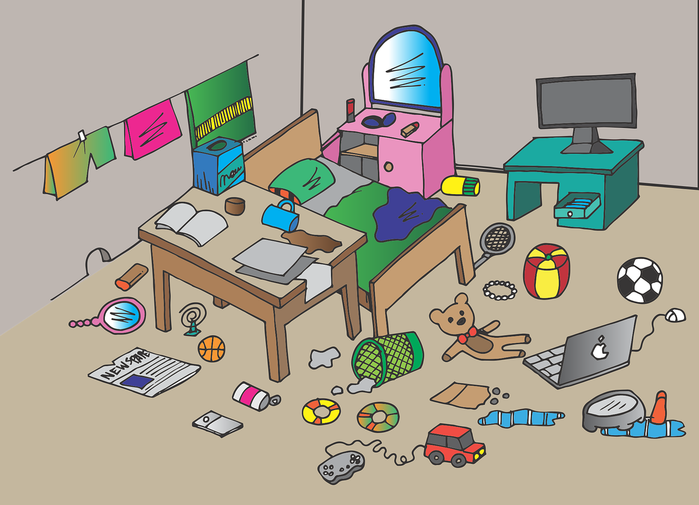
Experiences at home and away
Wir räumen auf*!
grün
Follow ups 1-5
Term 3 Week 6
aufräumen – to tidy up
Notes:
Artwork by Steve Clarke. Pronoun pictures from NCELP (www.ncelp.org). All additional pictures selected from Pixabay and are available under a Creative Commons license, no attribution required.
Phonics:
[-tion] [z] Information [465] funktionieren [677] international [465] Position [944] Tradition [1650]
Vocabulary: Papier [1163] Sachen [318] Schuh [1678]
Revisit 1: essen [323] gehen [66] sehen [79] singen [1063] tanzen [1497] tragen [271] man [32] (Party)Kleidung [2820] dann [41]
Revisit 2: gehen [66] sein [3] Laden [1675] Museum [1078] Park [2141] Restaurant [1802] Schwimmbad [n/a] Schule [359] Stadt [204] Wohin? [1811]
Jones, R.L & Tschirner, E. (2019). A frequency dictionary of German: Core vocabulary for learners. London: Routledge.
The frequency rankings for words that occur in this PowerPoint which have been previously introduced in these resources are given in the SOW and in the resources that first introduced and formally re-visited those words.
For any other words that occur incidentally in this PowerPoint, frequency rankings will be provided in the notes field wherever possible.
Remember that at the start of the course (first three lessons of Rot/Gelb) pupils learnt language (for greetings and register taking) that can still be part of the lesson routines in upper KS2 (Blau/Grün). They are not re-taught, as we anticipate that teachers have built these in from early in lower KS2.

Slide 2
aussprechen
[-tion]
…
Information
Notes:
Timing: 1 minute
Aim: to introduce the SSC [-tion].
Procedure:
1. Present the SSC and say the [-tion] sound first, on its own. Pupils repeat it with you.
2. Present the source word ‘Information’ on its own, say it, pupils repeat it, so that they have the opportunity to focus all of their attention on the connection between the written word and its sound.
3. A possible gesture for this would be to use the British Sign Language (BSL) sign for information, as here: https://www.signbsl.com/sign/information
4. Click to bring up the image and say the word “Information” again with pupils.
Word frequency (1 is the most frequent word in German): Information [465] Source: Jones, R.L. & Tschirner, E. (2019). A frequency dictionary of German: core vocabulary for learners. Routledge
2

Slide 3
aussprechen
[-tion]
…
Tradition
Position
Information
international
funktionieren
Notes:
Timing: 1 minute
Aim: to consolidate the SSC [-tion].
Procedure:
Re-present the SSC and the source word ‘Information’ (with gesture, if using).
Click to bring on the picture and get pupils to repeat the word ‘Information’ (with gesture, if using).
Present the cluster words in the same way, bringing on the picture and getting pupils to pronounce the words.
Word frequency (1 is the most frequent word in German): Information [465] Tradition [1650] Position [944] international [426] funktionieren [677] Source: Jones, R.L. & Tschirner, E. (2019). A frequency dictionary of German: core vocabulary for learners. Routledge

Slide 4
Follow up 1
‘Wir räumen auf’ Lied
Find die Wörter. Dann sing das Lied!
Oh Mann! Was für ein Durcheinander!
Wie soll ich da nur meine ganzen Sachen wiederfinden?
Es gibt da dieses Lied,
bei dem du durch das Zimmer fliegst
Komm, wir räumen jetzt zusammen das ganze Zimmer auf
Socken, Bücher und CDs
liegen kreuz und quer im Weg.
Komm, wir räumen jetzt zusammen das ganze Zimmer auf
Dab, dab, da-ba-dab, da-da-da-dab
Wir putzen das Zimmer und räumen es auf.
Dab, dab, da-ba-dab, da-da-da-dab
Jetzt sieht es besser aus!
Oh man! What a mess!
How am I supposed to find all my things?
There is this song,
where you fly through the room.
Come on, let’s tidy up
the whole room together now.
Socks, books, and CDs
are scattered all over the place.
Come on, let’s tidy up
the whole room together now.
Dab, dab, da-ba-dab, da-da-da-dab.
We clean the room and tidy it up.
Dab, dab, da-ba-dab, da-da-da-dab.
Now it looks better!
Notes:
Timing: 5-10 minutes
Song video: https://www.youtube.com/watch?v=q0FNlxxhtBk
Aim: To practise some known vocabulary on this lesson’s theme through a song. Procedure: 1. Ask pupils to read the English translation of the song lyrics on the right and work out the missing words in the German lyrics (the words in bold in the English version (e.g. things = Sachen).
2. Click to reveal the missing German words.
3. If desired, play the audio of the video while displaying this slide so pupils can follow along (click on the musical notes on the slide to be taken to the video).
4. Watch the video and invite pupils to join in with any words they can remember and join in with the dance if they’d like to.
Extra: as this is a tidy-up song, you could include it regularly as part of any tidy-up routine you might have in your classroom.

Slide 5
Follow up 2
Hör zu. Ist die Antwort A, B oder C richtig?
A
B
C
Do you have my phone or your phone? | Is that your phone or my phone? | Is that my phone or her phone?
hören
1
You eat my apple and I eat your cheesecake. | I eat your apple and you eat his cheesecake. | You eat your apple and I eat my cheesecake.
2
Do you see her school? Where is my school? | Do you see my school? Where is your school? | Do you see your school? Where is your school?
3
4
Do (can) you find my shoe? My jacket is here. | Do (can) you find her shoe? Your jacket is here. | Do (can) you find his shoe? Your jacket is here.
Are you singing my song? Do you like my lyrics? | Are you singing your song? Do you like her lyrics? | Are you singing his song? Do you like his lyrics?
5
He is wearing party clothes and bringing his cake with him. | She is wearing her party clothes and bringing your cake with her. | She is wearing her party clothes and bringing her cake with her.
6
Notes:
Timing: 5 minutes
Aim: to practise aural comprehension of sentences containing ’mein’ and ‘dein’ and this week’s vocabulary.
Procedure:
Click on the first audio button to hear a sentence. Pupils listen carefully and decide whether option A, B or C contains the correct answer. NB: they may need to listen to each sentence more than once.
Repeat for questions 2-6.
Click to reveal the answers.
Transcript: 1. Ist das mein Handy oder ihr Handy?
2. Du isst meinen Apfel und ich esse deinen Käsekuchen.
3. Siehst du meine Schule? Wo ist deine Schule?
4. Findest du seinen Schuh? Deine Jacke ist hier.
5. Singst du mein Lied? Magst du meinen Text?
6. Sie trägt ihre Partykleidung und bringt ihren Kuchen mit.

Slide 6
Follow up 3

Schreib die Wörter auf Deutsch und auf Englisch.
schreiben
Sein Laden ist toll. Er verkauft _____________.
Leon ______ Österreich. Es ist _____ Lieblingsland.
Singst du am Samstag ________ Song?
Vielen Dank für die Kleidung. Ich trage morgen ______ ______.
Nimmst du _____ Kamera* mit ins Museum?
___ _____ is great. He sells party clothes.
Leon loves _______. It is their _________ ________.
Are you singing my song ___ __________?
Many thanks for the clothes. I’m going to ______ your jacket __________.
Are you _______ her camera with you (in)to the museum?
His shop
1
Partykelidung
liebt
xies
Austria
favourite
2
country
meinen
3
on Saturday
4
deine Jacke
wear
tomorrow
ihre
taking
5
die Kamera – the camera
Notes:
Timing: 5-10 minutes
Aim: to practise written production and comprehension of ihr and sein, and this week’s new and revisited vocabulary.
This is a jigsaw translation task.
Procedure:
Students write the missing words in both German and English to complete the sentences.
Teacher clicks to provide the written answers and/or clicks the audio buttons to hear the full German sentences.
Differentiation: 1. For a different challenge (i.e. to practise spelling rather than full written recall of the missing German words), the task could be completed as a transcription task initially, by listening to the full sentences and writing the words.
2. Then pupils could complete the English part of the jigsaw.
Vocabulary
Kamera [1501]
Source: Jones, R.L & Tschirner, E. (2019). A frequency dictionary of German: Core vocabulary for learners. London: Routledge.

Slide 7
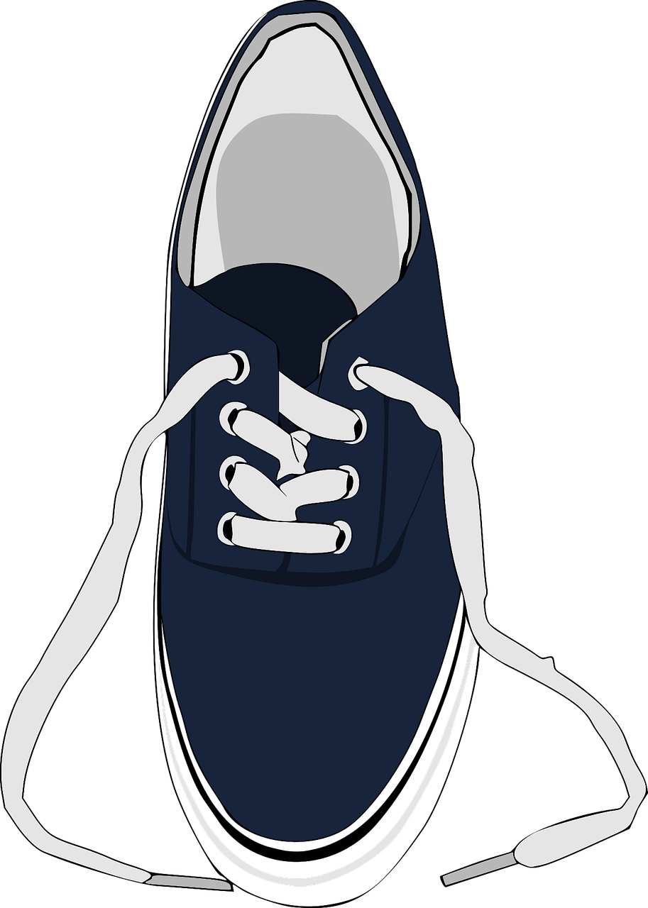
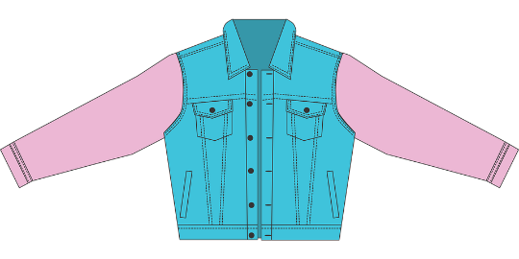
Follow up 4
Was findest du? Was findet dein Partner / deine Partnerin?
…
Benutz mein/e/en, dein/e/en, ihr/e/en, sein/e/en oder xies/e/en.
sprechen
In meinem Zimmer finde ich meinen Schuh!
In meinem Zimmer finde ich meinen Schuh und… ihre Blume!
In meinem Zimmer finde ich meinen Schuh, ihre Blume und...
A
B
Notes:
Timing: 5 minutes
Aim: to revise vocabulary and practise saying nouns with accusative possessive pronouns after a verb. Procedure: 1. This is a variation on the memory game ‘I went to the supermarket and bought...’ Following the examples on the screen, the first player says ‘In meinem Zimmer finde ich…’ and follows it with mein/e/en, dein/e/en, ihr/e/en, sein/e/en or xies/e/en + noun.
2. The second player repeats what the first player said and adds a second item.
3. The next player repeats what the second player said and adds a third item. In the example, the third item is suggested as ‘das Geschenk’, so the third speech bubble would end with ‘und mein/dein/ihr/sein/xies Geschenk’.
4. Play continues until someone forgets an item or gets an article wrong!
Object words from the top left of the image round: der Brief, die Liste, die Blue, das Geld, die Tasche, der Schuh, der (Fuß)ball, das Buch, die Jacke, das Handy, das Spiel, das Geschenk, das Heft, das Papier, der Bleistift, der Apfel, der Kuchen, die Flasche.
The background image of a bedroom was generated by AI in canva.com and modified in PowerPoint.

Slide 8
Follow up 5:

Schreib auf Englisch.
Can you get at least 15 points?
Wörter
Vokabeln
 | das Museum | der Laden | wohin?
 | der Park | die Schule | das Schwimmbad
 | essen | dann | gehen
 | sehen | man | die (Party)Kleidung
 | tanzen | tragen | singen
 | das Papier | der Schuh | die Sachen
(the) museum
(the) shop
where (to)?
x3
(the) park
(the) school
(the) swimming pool
to eat, eating
then
to go, going
to see, seeing
people, you (general)
(the) (party) clothes
x2
to dance, dancing
to wear, wearing
to sing, singing
x1
(the) paper
(the) shoe
(the) things
Notes:
Timing: 5 minutes
Aim: to practise written production of vocabulary from this and revisited weeks.
Procedure: 1. Give pupils a blank grid. They fill in the English meanings of any of the words they know, trying to reach 15 points in total.
Note: The most recently learnt and practised words are pink, words from the previous week are green and those from week 1 are blue, thus more points are awarded for them, to recognise that memories fade and more effort (heavy lifting!) is needed to retrieve them.

Slide 9
Follow up 5:

Schreib auf Deutsch.
Can you get at least 15 points?
Wörter
Vokabeln
 | where (to)? | (the) swimming pool | (the) park
 | (the) shop | (the) museum | (the) school
 | (the) (party) clothes | to sing, singing | to see, seeing
 | to eat, eating | to wear, wearing | then
 | people, you (general) | to go, going | to dance, dancing
 | (the) shoe | (the) things | (the) paper
wohin?
das Schwimmbad
der Park
x3
der Laden
das Museum
die Schule
die (Party)Kleidung
singen
sehen
essen
tragen
dann
x2
man
gehen
tanzen
x1
der Schuh
die Sachen
das Papier
Notes:
Timing: 5 minutes
Aim: to practise written production of vocabulary from this and revisited weeks.
Procedure: 1. Give pupils a blank grid. They fill in the German meanings of any of the words they know, trying to reach 15 points in total.
Note: The most recently learnt and practised words are pink, words from the previous week are green and those from week 1 are blue, thus more points are awarded for them, to recognise that memories fade and more effort (heavy lifting!) is needed to retrieve them.

Slide 10
Tschüss!
grün
Notes:
10

Slide 11
Follow up 5:

Schreib auf Englisch.
Can you get at least 15 points?
Wörter
Vokabeln
 | das Museum | der Laden | wohin?
 | der Park | die Schule | das Schwimmbad
 | essen | dann | gehen
 | sehen | man | die (Party)Kleidung
 | tanzen | tragen | singen
 | das Papier | der Schuh | die Sachen
x3
x2
x1
Notes:
HANDOUT

Slide 12
Follow up 5:

Schreib auf Deutsch.
Can you get at least 15 points?
Wörter
Vokabeln
 | where (to)? | (the) swimming pool | (the) park
 | (the) shop | (the) museum | (the) school
 | (the) (party) clothes | to sing, singing | to see, seeing
 | to eat, eating | to wear, wearing | then
 | people, you (general) | to go, going | to dance, dancing
 | (the) shoe | (the) things | (the) paper
x3
x2
x1
Notes:
HANDOUT

