Slide 1
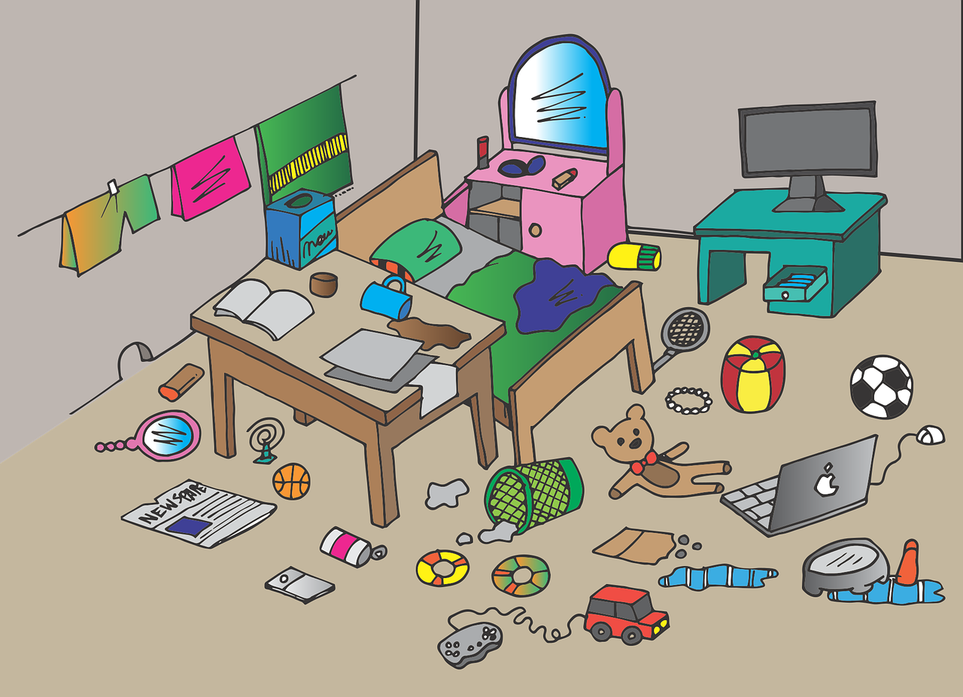
Experiences at home and away
Wir räumen auf*!
grün
Possessive adjectives mein, dein, sein, ihr
SSC [-tion]
aufräumen – to tidy up
Term 3 Week 6
Notes:
Artwork by Steve Clarke. Pronoun pictures from NCELP (www.ncelp.org). All additional pictures selected from Pixabay and are available under a Creative Commons license, no
attribution required.
Phonics:
[-tion] [z] Information [465] funktionieren [677] international [465] Position [944] Tradition [1650]
Vocabulary: Papier [1163] Sachen [318] Schuh [1678]
Revisit 1: essen [323] gehen [66] sehen [79] singen [1063] tanzen [1497] tragen [271] man [32] (Party)Kleidung [2820] dann [41]
Revisit 2: gehen [66] sein [3] Laden [1675] Museum [1078] Park [2141] Restaurant [1802] Schwimmbad [n/a] Schule [359] Stadt [204] Wohin? [1811]
Jones, R.L & Tschirner, E. (2019). A frequency dictionary of German: Core vocabulary for learners. London: Routledge.
The frequency rankings for words that occur in this PowerPoint which have been previously introduced in these resources are given in the SOW and in the resources that first
introduced and formally re-visited those words.
For any other words that occur incidentally in this PowerPoint, frequency rankings will be provided in the notes field wherever possible.
Remember that at the start of the course (first three lessons of Rot/Gelb) pupils learnt language (for greetings and register taking) that can still be part of the lesson routines in upper KS2 (Blau/Grün). They are not re-taught, as we anticipate that teachers have built these in from early in lower KS2.
1

Slide 2
aussprechen
[-tion]
…
Information
Notes:
Timing: 1 minute
Aim: to introduce the SSC [-tion].
Procedure:
1. Present the SSC and say the [-tion] sound first, on its own. Pupils repeat it with you.
2. Present the source word ‘Information’ on its own, say it, pupils repeat it, so that they have the opportunity to focus all of their attention on the connection between the written word and its sound.
3. A possible gesture for this would be to use the British Sign Language (BSL) sign for information, as here: https://www.signbsl.com/sign/information
4. Click to bring up the image and say the word “Information” again with pupils.
Word frequency (1 is the most frequent word in German): Information [465] Source: Jones, R.L. & Tschirner, E. (2019). A frequency dictionary of German: core vocabulary for learners. Routledge
2

Slide 3
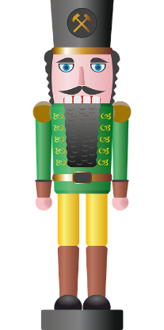
aussprechen
[-tion]
…
Tradition
Position
Information
international
funktionieren
Notes:
Timing: 1 minute
Aim: to consolidate the SSC [-tion].
Procedure:
Re-present the SSC and the source word ‘Information’ (with gesture, if using).
Click to bring on the picture and get pupils to repeat the word ‘Information’ (with gesture, if using).
Present the cluster words in the same way, bringing on the picture and getting pupils to pronounce the words.
Word frequency (1 is the most frequent word in German): Information [465] Tradition [1650] Position [944] international [426] funktionieren [677] Source: Jones, R.L. & Tschirner, E. (2019). A frequency dictionary of German: core vocabulary for learners. Routledge

Slide 4
aussprechen
[-tion]
Karaoke SSC
Sag die Wörter.
Fun fact! If you see a noun that ends in –tion in German, it will almost always be feminine. E.g. die Situation.
60
6
Generation
3
international
2
Situation
1
Reaktion
10
Station
4
Definition
5
Organisation
9
Emotion
8
Operation
7
Option
START
Notes:
Timing: 5 minutes
Aim: to practise read aloud of SSC [-tion] with some unfamiliar cognates. Pronunciation is very different from English, the ‘t’ in –tion like the [-ts] at the end of ‘boots’, plus long German ‘I’ and ‘o’ sounds.
Procedure:
Click to highlight a word.
Say the word out loud, focusing on the SSC.
Click on the number button next to the word to check pronunciation.
Repeat for items 2-10.
Finally, click to bring up the call out to show how nouns ending in –tion tend to be feminine. You can also challenge pupils to find the one word in the list that is not a noun (international). They can tell because the first letter is not capitalised.
Transcript and word frequency (1 is the most frequent word in German):
Reaktion [400] Situation [423] international [426] Definition [1057] Organisation [1113] Generation [1153] Option [3364] Operation [2177] Emotion [2784] Station [2562]
Source: Jones, R.L. & Tschirner, E. (2019). A frequency dictionary of German: core vocabulary for learners. Routledge

Slide 5
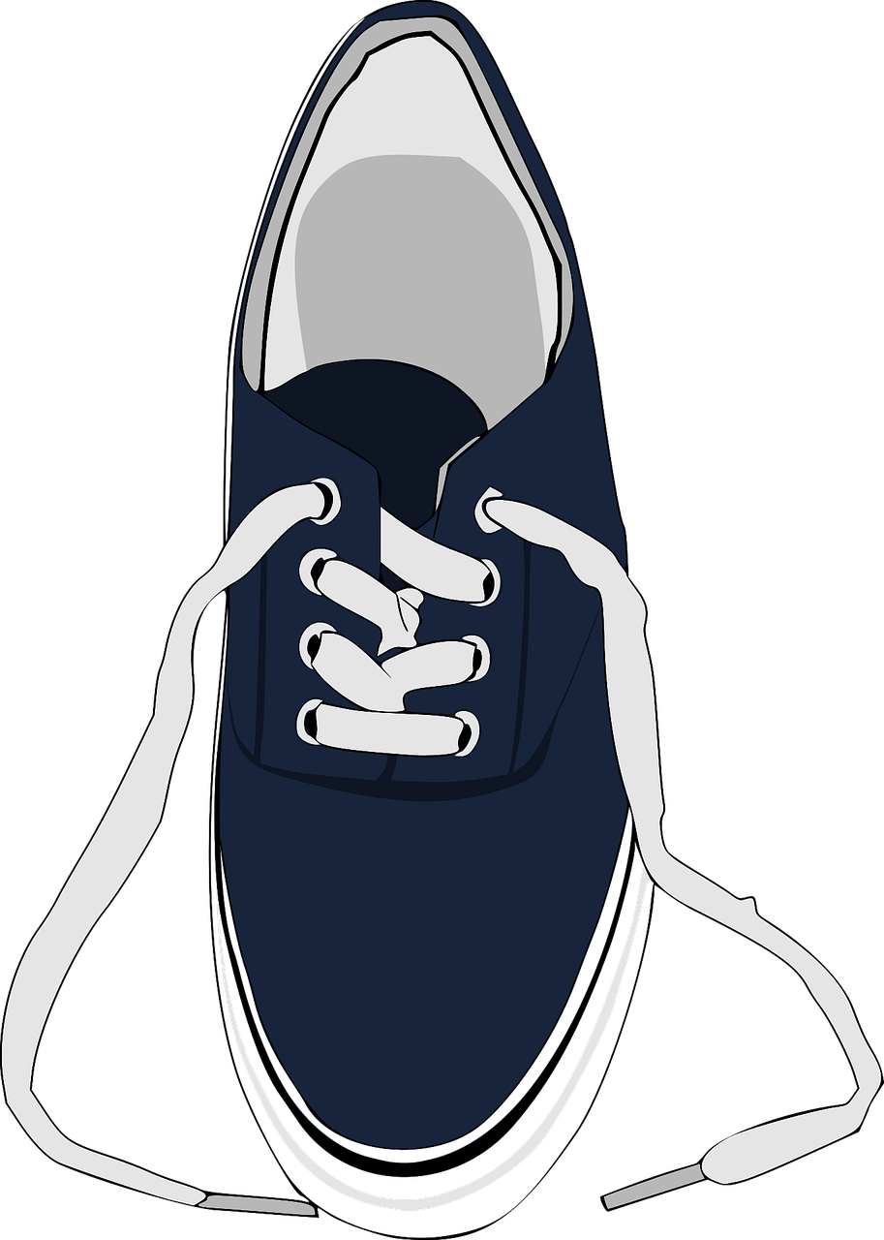
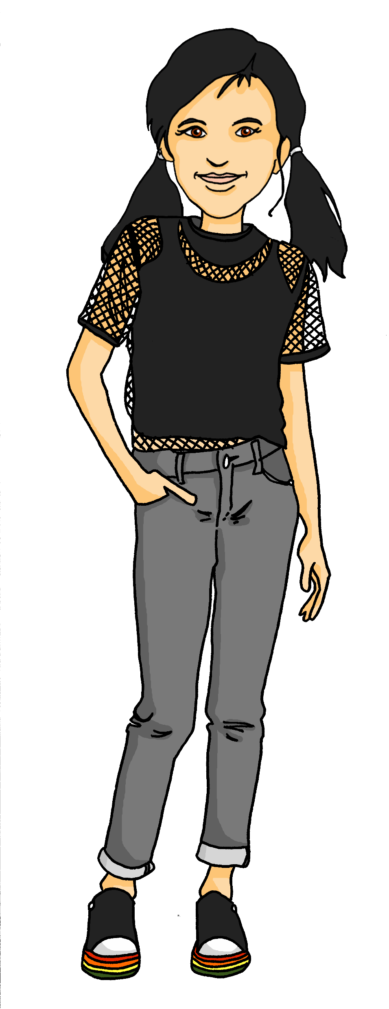
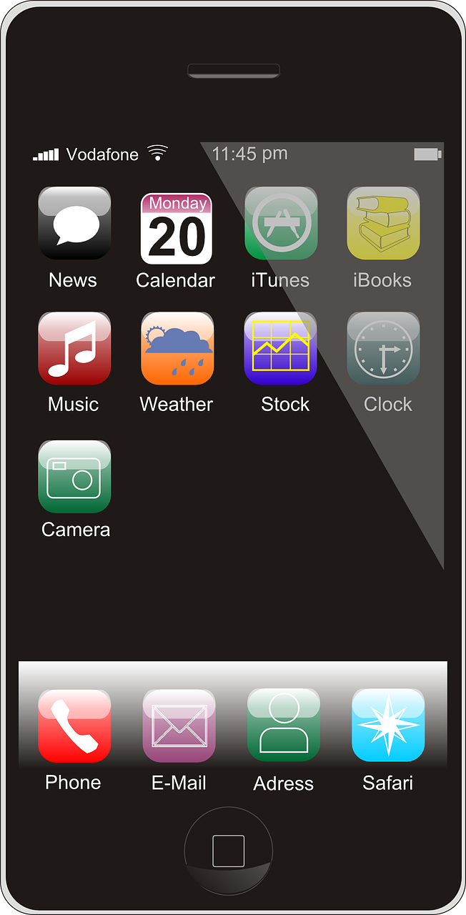
Kultur
Ronja findet nichts in ihrem Zimmer. Kannst du Ronja helfen?
Wörter
Siehst du Ronjas Sachen? Sag wo sie sind.
Wo sind meine Sachen?
Vokabeln
B. Wo ist mein Computer?
der Schuh
der Bleistift
die Flasche
das Heft
das Ding
das Bild
das Foto
der Fußball
die Tasche
das Buch
das Haustier
das Handy
der Hund
die Blume
das Geschenk
das Spiel
der Kuchen
das Instrument
der Apfel
der Ball
die Uhr
die Jacke
das Butterbrot
das Blatt
die Karte
die Liste
die Hausaufgabe
die Kleidung
die Katze
der Computer
das Fahrrad
das Papier
der Brief
das Geld
der Käse
die Sachen
der Müll
das Kunstprojekt
oben links
oben rechts
1. Wo ist mein Papier?
4. Wo ist mein Ball?
Was heißt ’piggy bank’ auf Deutsch?
Das Sparschwein!
(sparen heißt ‘saving’ und Schwein heißt ‘pig’. Also, ‘saving pig’). Hast du ein Sparschwein?
2. Wo ist mein Schuh?
5. Wo ist mein Handy?
links
rechts
3. Wo ist meine Blume?
oben
6. Wo ist mein Geld?
links
rechts
unten
unten
unten
unten rechts
Notes:
Timing: 5 minutes
Aim: to present the context for this week, introduce this week’s vocabulary (der Schuh, die Sachen, das Papier) whilst reviewing some familiar vocabulary.
Procedure:
Make sure the context is clear. The text at the top translates to: ‘Ronja can’t find anything in her room. Can you help Ronja?’ and ‘Do you see Ronja’s things? Say where they are’.
Click to bring up Ronja saying ‘Where are my things?’
Click again to bring up the directions. Explain that they will say where Ronja’s things are on the picture – oben (at the top), rechts (on the right), unten (at the bottom) or links (on the left). Explain that you can also combine them, e.g. bottom left = unten links
Click to bring up the example. Ask pupils to put up their hands when they think they’ve found the computer. Choose a someone to say where it is (’oben rechts’ or ‘Der Computer ist oben rechts’). Click to check.
Continue to click through 1-6 in the same way.
Finally, the last speech bubble is introducing the German word for piggy bank (Sparschwein – literally ‘saving pig’). If there is time, you could ask pupils if they have a piggy bank (Hast du ein Sparschwein?).
Vocabulary:
sparen [2001] Schwein [2975]
Jones, R.L & Tschirner, E. (2019). A frequency dictionary of German: Core vocabulary for learners. London: Routledge.
5

Slide 6
mein | dein (possessive adjectives)
To say ‘my’ use mein or meine:
masculine
feminine
neuter
Das ist…
mein Schuh
e
mein Papier
meine Blume
my shoe
my flower
my paper
The word ‘mein’ must agree with the gender of the noun that follows. The feminine form is ‘meine’.
To say ‘your’ use dein or deine:
Lias! Hier ist…
dein Schuh
deine Blume
dein Papier
e
your shoe
your flower
your paper
Notes:
Timing: 2 minutes
Aim: to recap the possessive adjectives ‘mein’ and ‘dein’.
Procedure:
Click through the animations recap the information.
Elicit English translation for the German examples provided.
6

Slide 7
sein | ihr | xies (possessive adjectives)
To say ‘his’ use sein or seine:
masculine
feminine
neuter
Das ist…
sein Schuh
e
sein Papier
seine Blume
his shoe
his flower
his paper
Leon’s pronouns are they/them in English, so we if were talking about Leon’s belongings we would say their shoe/flower/paper.
Their in German is xies- so we would say:
‘Das ist xies Schuh / xiese Blume / xies Papier.’
The endings are the same as for sein and ihr.
To say ‘her’ use ihr or ihre:
Hier ist…
ihr Schuh
ihre Blume
ihr Papier
e
her shoe
her flower
her paper
Notes:
Timing: 2 minutes
Aim: to recap the possessive adjectives ‘sein’ and ‘ihr’.
Procedure:
Click through the animations recap the information.
Elicit English translation for the German examples provided.
7

Slide 8
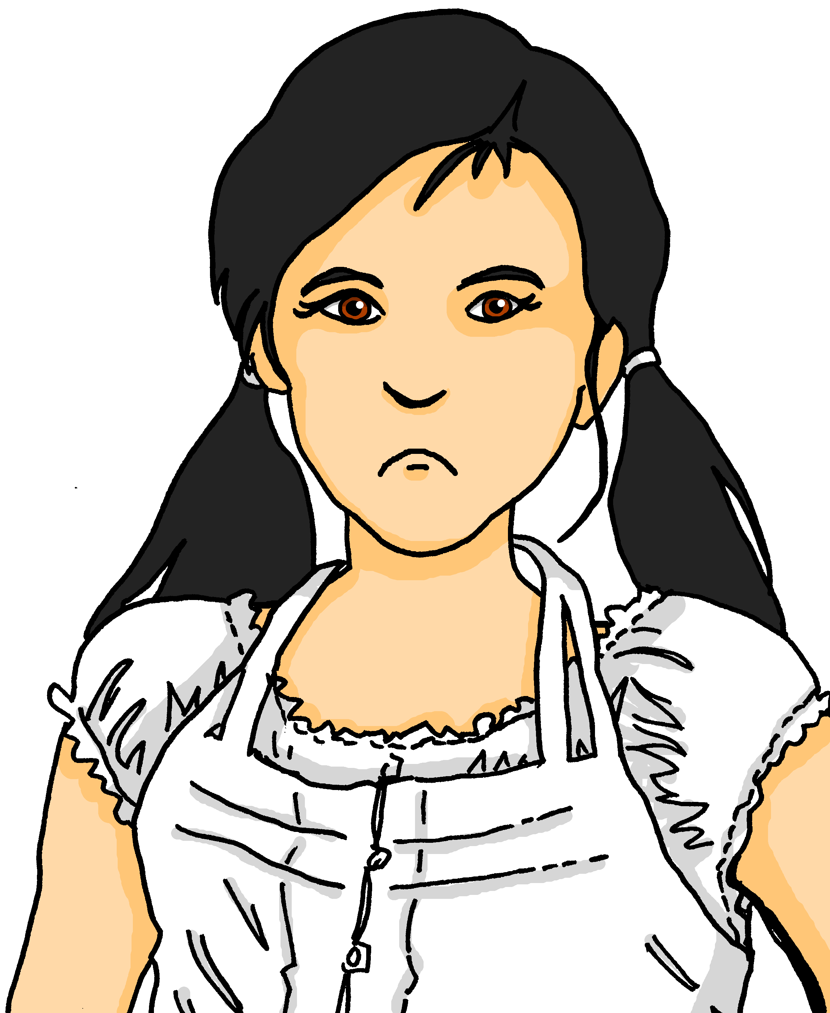
meinen | deinen | seinen | ihren | xiesen
You know the masculine words for ‘the’ and ‘a’ change after most verbs:
Das ist der Schuh.
Du hast den Schuh.
That is the shoe.
You have the shoe.
Das ist ein Schuh.
Du hast einen Schuh.
So after ‘haben’ and many other verbs apart from ‘sein’, you use meinen (my), deinen (your) seinen (his), ihren (her) or xiesen (their)
That is a shoe.
You have a shoe.
This also happens for masculine forms of mein and dein:
Das ist mein Schuh.
Du hast meinen Schuh!
That is my shoe.
You have my shoe!
Feminine and neuter words for ‘the’,‘a’, ‘my’, ‘your’, ‘his’, ‘her’, ‘their’ do not change after a verb.
Notes:
Timing: 2 minutes
Aim: to recap the forms and uses of articles in row 1 (nominative) and row 2 (accusative), and introduce the same pattern for masculine possessive pronouns.
Procedure:
Click through the animations recap the information.
Elicit English translation for the German examples provided.
Ask pupils what would happen if they changed the verb to finden or sehen (this would be the same as haben – Du findest/siehst den Schuh. Du findest/siehst einen Schuh. Du findest/siehst meinen Schuh!)
8

Slide 9
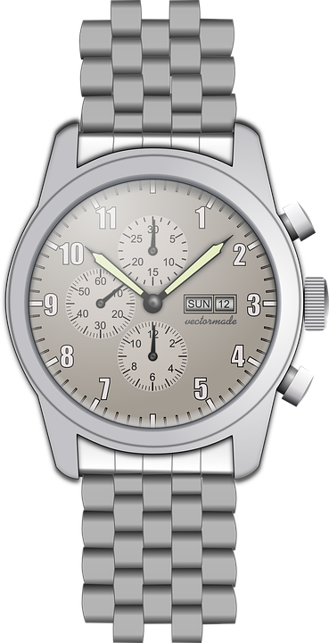
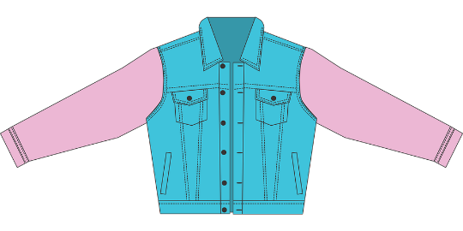
hören
Ronja und Lias räumen das Zimmer auf.
Hör zu. Was ist das? Schreib A oder B, und Ronja (my), Lias (your), Leonie (her) Lothar (his) oder Leon (their).
 | Wer? | A | B
1
2
3
 | Wer? | A | B
1
2
3
1
Ronja
4
Leonie
2
Lothar
5
Leon
3
Lias
6
Lias
Notes:
Timing: 5 minutes
Aim: to practise aural comprehension of possessive adjectives and their connection to nouns of different genders.
Procedure:
Check pupils know the German words and genders for each of the pictures. These are:
das Handy – die Blume
der Ball – das Papier
das Geld – die Flasche
der Schuh – das Spiel
das Heft – die Uhr
die Jacke – der Brief
Click on the first audio box to play the recording. Based on the possessive adjective, pupils write down A or B for the object, and R or L for Ronja/my and Lias/your.
Click to reveal the answer tick for the object that Ronja mentions. Complete sentence audio is attached to each answer tick.
Click again to reveal R or L.
Continue for items 2-6.
Transcript:
Siehst du meine [Blume]?
Hast du seinen [Ball]?
Hier habe ich deine [Flasche].
Ich sehe ihren [Schuh].
Ich finde xiese [Uhr] nicht!
Hey! Was machst du?! Liest du deinen [Brief]? Hilfst du mir, bitte?!
9

Slide 10
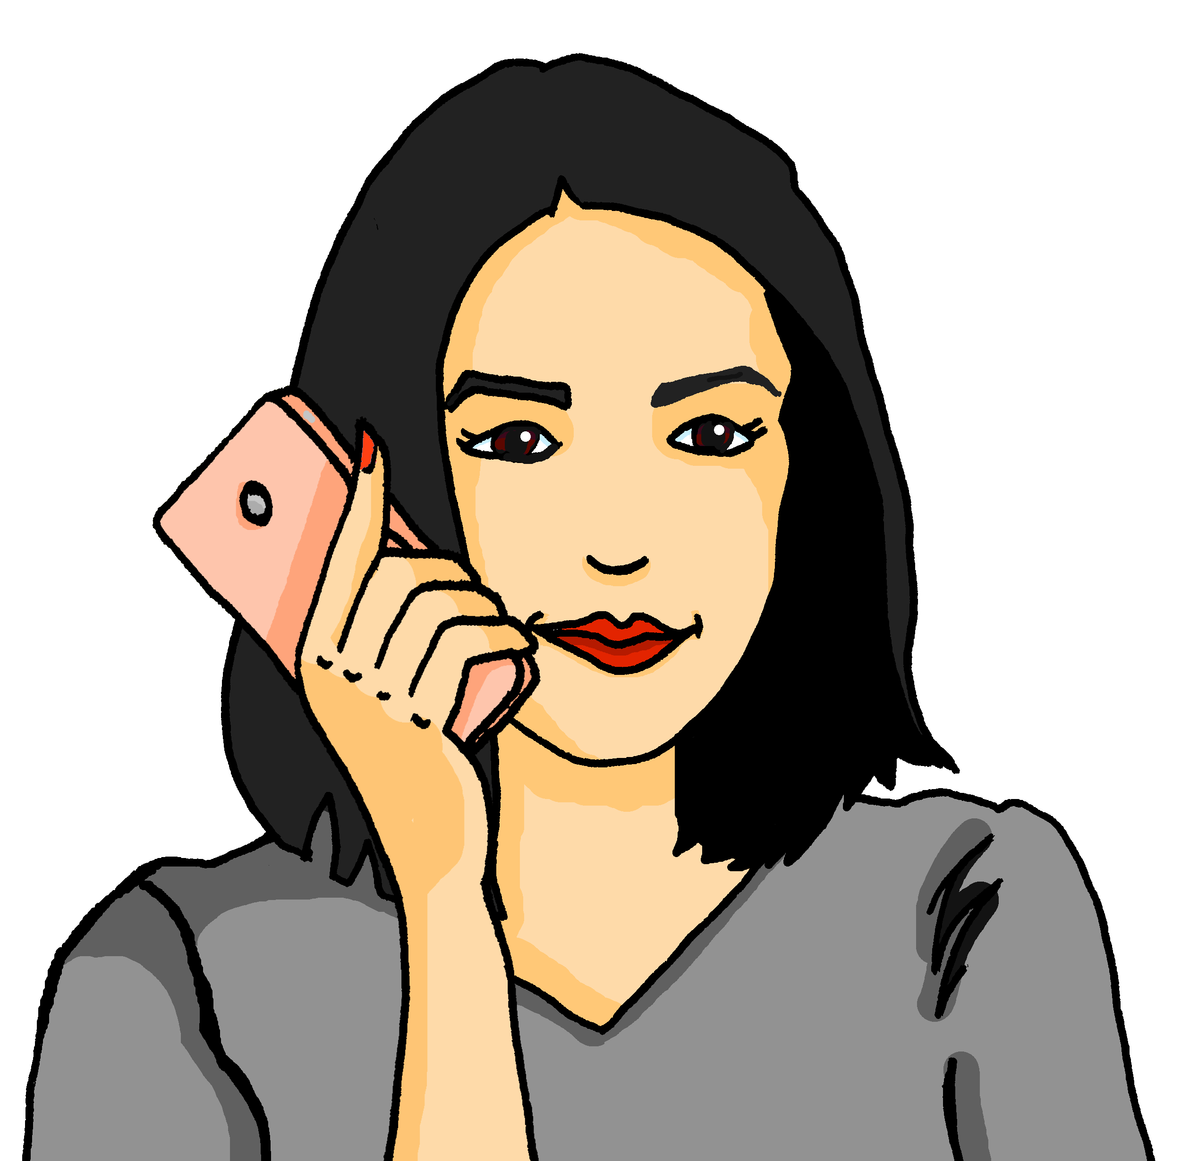
lesen
Ronja findet ihre Sachen nicht.
Ist es mein oder meinen?
1
Mutti, wo ist mein / meinen Fußball?
mein
der Schuh
der Bleistift
die Flasche
das Heft
das Ding
das Bild
das Foto
der Fußball
die Tasche
das Buch
das Haustier
das Handy
der Hund
die Blume
das Geschenk
das Spiel
der Kuchen
das Instrument
der Apfel
der Ball
die Uhr
die Jacke
das Butterbrot
das Blatt
die Karte
die Liste
die Hausaufgabe
die Kleidung
die Katze
der Computer
das Fahrrad
das Papier
der Brief
das Geld
der Käse
die Sachen
der Müll
das Kunstprojekt
meinen
2
4
mein
Hast du mein / meinen Apfel?
mein
Siehst du mein / meinen Kuchen?
meinen
meinen
3
5
mein
Findest du mein / meinen Bleistift?
mein
Mutti...trägst du mein / meinen Schuh?!
meinen
meinen
Notes:
Timing: 5 minutes
Aim: to practise written comprehension of Row 1 and Row 2 masculine nouns by focussing on the possessive adjective ending.
Procedure:
Explain the context – even after tidying away, Ronja can’t find some of her things. She texts her mum for help.
Pupils write 1-5 and the correct option from the two options given – mein or meinen.
Click to reveal answers. Point out that all the verbs used apart from sein need the -en ending for mein/dein.
10

Slide 11
Tschüss!
grün
Notes:
11

