Slide 1
Interacting
blau
Vocabulary & Grammar Quiz
Term 1 Week 13
Notes:
Artwork by Steve Clarke. Pronoun pictures from NCELP (www.ncelp.org). All additional pictures selected from Pixabay and are available under a Creative Commons license, no
attribution required.
This lesson contains vocabulary and grammar assessments to check progress in the words and structures introduced and practised in the first 12 weeks of this year’s
course, as well as those from the previous two years.
The ratio of old to new language in the quiz is very approximately 50:50.
1

Slide 2
hören
Robbie is from another planet. It likes earth and speaking German but often forgets word meanings, spellings and things like gender and verb forms. Help Robbie by answering the questions in this quiz.
A For each question, put a cross (x) under the English meaning that matches what you hear. You will hear each German word twice. Choose one correct answer only.
 | A | B | C | D
1. | 13 | 19 | 16 | 18
 | ☐ | ☐ | ☐ | ☐
2. | he | she | we | you (all)
 | ☐ | ☐ | ☐ | ☐
3. | ice cream | book | tree | dog
 | ☐ | ☐ | ☐ | ☐
4. | who | what | when | where
 | ☐ | ☐ | ☐ | ☐
1
2
3
4
Notes:
Timing: 20-25 minutes (all assessment slides)
Aim: to practise aural comprehension of vocabulary taught in weeks 1-12 of the course.
Procedure:
1. Click the audio buttons to play each item. (The words are recorded twice with a pause to allow pupils to process the information).
2. Pupils can either write 1C, etc.. or if they have the assessment on a print out they can put a X in the correct box.
3. After items 1-4, continue to the next slide to complete the remainder of the task.
Transcript:
achtzehn
wir
Baum
wer
2

Slide 3
hören
A For each question, put a cross (x) under the English meaning that matches what you hear. You will hear each German word twice. Choose one correct answer only.
 | A | B | C | D
5.. | to do | to think | to write | to like
 | ☐ | ☐ | ☐ | ☐
6. | slow | fast | always | sometimes
 | ☐ | ☐ | ☐ | ☐
7. | friendly | nice | young | quiet
 | ☐ | ☐ | ☐ | ☐
8. | to work | to be called | to use | to forget
 | ☐ | ☐ | ☐ | ☐
5
6
7
8
Notes:
[2/2]
Transcript:
5. mögen
6. schnell
7. freundlich
8. heißen
3

Slide 4
hören
B For each question, put a cross (x) under the type of word you hear. You will hear each German word twice. Choose one correct answer only.
This word is a good example of …
 | A | B | C | D
1. | a colour ☐ | an object ☐ | a question word ☐ | an animal ☐
2. | an event ☐ | food ☐ | a month ☐ | a number ☐
3. | a colour ☐ | a day ☐ | a part of the body ☐ | a season ☐
4. | a person ☐ | an animal ☐ | a food ☐ | a question word ☐
1
2
3
4
Notes:
Procedure:
1. Click the audio buttons to play each item. (The words are recorded twice with a pause to allow pupils to process the information).
2. Pupils can either write 1C, etc.. or if they have the assessment on a print out they can put a X in the correct box.
3. After items 1-4, continue to the next slide to complete the remainder of the task.
Transcript:
Blätter
zwanzig
grau
Kuchen
4

Slide 5
hören
B For each question, put a cross (x) under the type of word you hear. You will hear each German word twice. Choose one correct answer only.
This word is a good example of …
 | A | B | C | D
5. | an object ☐ | a part of the week ☐ | a person ☐ | a colour ☐
6. | a season ☐ | a number ☐ | a day ☐ | a month ☐
7. | a place ☐ | a part of the body ☐ | a month ☐ | an event ☐
8. | an animal ☐ | food ☐ | a season ☐ | a day ☐
5
6
7
8
Notes:
[2/2]
Transcript:
5. Wochenende
6. März
7. Schule
8. Sommer
5

Slide 6
C Help Robbie to translate the underlined German word(s) to complete each English sentence.
lesen
1. Das Lied ist nett. The _____________ is _____________.
2. Ich spreche vier Sprachen. I _____________ four _____________.
3. Es gibt viele Blumen. There are _____________ _____________.
4. Wann ist die Party? _____________ is _____________ party?
5. Wir sind in Deutschland. _____________ _____________ in Germany.
6. Ich habe keine Bilder. I have _____________ _____________.
7. Er schreibt eine Geschichte. He is writing _____________ _____________.
8. Wo ist mein Zimmer? Where is _____________ _____________?
Notes:
Aim: to practise written recall of previously taught vocabulary.
Procedure:
Ensure that the task is clear.
Pupils could write 1 – 10 and the individual English word meanings (or they could fill in if they have printed assessment sheets).
6

Slide 7
schreiben
D Help Robbie to translate the underlined English word(s)
to complete each German sentence.
1. I like winter. _____________ _____________ Winter. (write two words)
2. You (all) are in the classroom. Ihr seid in der _____________. (write one word)
3. He would like an example. Er möchte ein _____________. (write one word)
4. Hello! How’s it going? Hallo! _____________ _____________? (write two words)
5. She can dance. _____________ _____________ tanzen. (write two words)
6. The garden is beautiful. Der Garten ist _____________. (write one word)
7. I look for Grandma. Ich _____________ Oma. (write one word)
8. Today is his birthday. Heute ist sein _____________. (write one word)
9. Do you do art? Machst du _____________? (write one word)
10. The child eats slowly. Das _____________ isst _____________. (write two words)
Notes:
Aim: to practise written production of previously taught vocabulary.
Procedure:
Ensure that the task is clear.
Pupils could write 1 – 10 and the individual German word meanings (or they could fill in if they have printed assessment sheets).
7

Slide 8
A Put a (X) next to the person the sentence is about.
lesen
1 | ☐ I ☐ you _{[singular]} ☐ s/he ☐ we | … kauft ein Buch. |  | 4 | ☐ I ☐ they ☐ you _{[singular]} ☐ we | … kann singen.
2 | ☐ you _{[singular]} ☐ they ☐ s/he ☐ you _{[plural]} | … sind im Garten. |  | 5 | ☐ s/he ☐ you _{[plural]} ☐ they ☐ I | … habt viele Fotos.
3 | ☐ I ☐ you _{[singular]} ☐ they ☐ we | … liest. |  | 6 | ☐ I ☐ you _{[singular]} ☐ s/he ☐ we | … planen eine Party.
Notes:
Aim: to practise written understanding of previously taught grammar features.
Procedure:
Ensure that the task is clear.
Pupils could write 1 – 6 and the correct English pronoun (or they could fill in if they have printed assessment sheets).
8

Slide 9
B Put a (X) next to the noun that completes each sentence.
lesen
1. | Welche | ☐ Lied (nt) ☐ Aktivität (f) | ist das?
2. | Dieser | ☐ Kuchen (m) ☐ Geschenk (nt) | ist sehr groß!
3. | Meine | ☐ Familie (f) ☐ Glas (nt) | ist da.
4. | Sein | ☐ Fußball (m) ☐ Liste (f) | ist hier.
5. | Sie hat | kein | ☐ Kleidung (f). ☐ Heft (n).
Notes:
Aim: to practise written understanding of previously taught grammar features.
Procedure:
Ensure that the task is clear.
Pupils could write the answers only (or they could fill in if they have printed assessment sheets).
9

Slide 10
C Put X next to the object that is being described.
lesen
1. | Sie ist lang! | ☐ die Geschichte ☐ der Satz
2. | Es ist einfach! | ☐ der Text ☐ das Problem
D Put X next to the location that completes each sentence.
1. | Ich bin in der | ☐ Baum (m). ☐ Schule (f).
2. | Du bist im | ☐ Garten (m). ☐ Mitte (f).
Notes:
Aim: to practise written understanding of previously taught grammar features.
Procedure:
Ensure that the task is clear.
Pupils could write the answers only (or they could fill in if they have printed assessment sheets).
10

Slide 11
schreiben
E Complete sentence 2 with the plural form of the underlined noun in sentence 1.
 | Sentence 1 | Sentence 2
1. | Hier ist das Glas. | Hier sind die __________ .
2. | Hier ist das Spiel. | Hier sind die __________ .
F Write the German for the English given in brackets. Use the clues to help you.
 |  | Clues
1. | Du ___________ eine Schülerin. (are) | to be = sein
2. | Er ___________ viele Bücher. (has) | to have = haben
3. | Max und Claudia ___________ die Aufgabe. (have) | to have = haben
Notes:
Aim: to practise written production of previously taught grammar features.
Procedure:
Ensure that the task is clear.
Pupils could write the answers only (or they could fill in if they have printed assessment sheets).
11

Slide 12
schreiben
G Write the German article ‘the’. The gender of the noun is provided.
1. | Du magst _____ Song (m).
2. | _____ Instrument (nt) ist hier.
3. | _____ Woche (f) ist lang.
H Write the German article ‘a’. The gender of the noun is provided.
1. | Wir haben ______ Problem (nt).
2. | Hast du ________ Idee? (f)
3. | Das ist ________ Baum (m).
Notes:
Aim: to practise written production of previously taught grammar features.
Procedure:
Ensure that the task is clear.
Pupils could write the answers only (or they could fill in if they have printed assessment sheets).
12

Slide 13
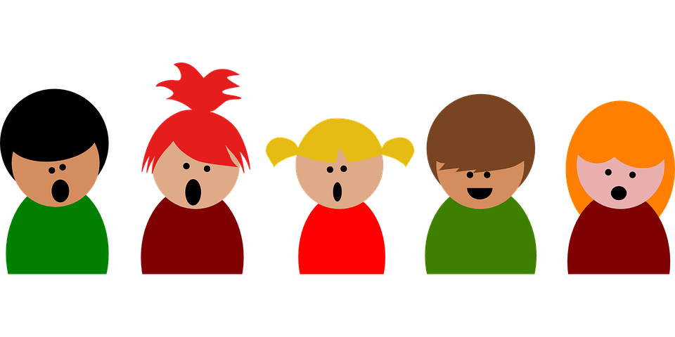
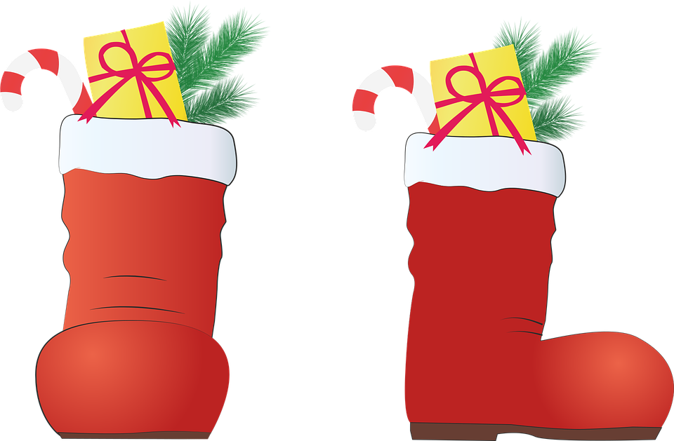
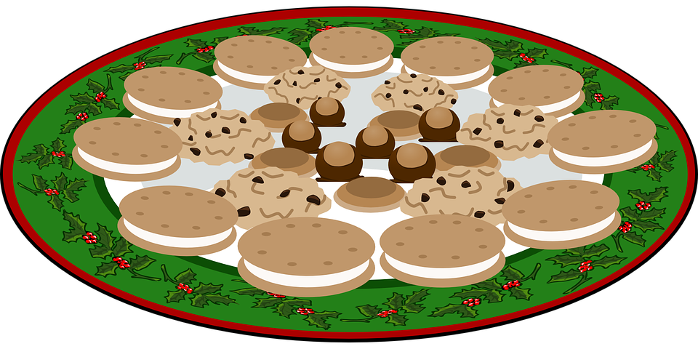
hören
Hör zu und sing mit!
“Lasst uns froh und munter sein”
In the German Christmas tradition, St. Nicholas (Nikolaus) comes on the eve of December 6 (Nikolausabend) to brings present for the children. If they are lucky,
‘der Nikolaus’ will put sweets on their plates and fill their boots with small gifts!
1. Laßt uns froh und munter sein
und uns recht von Herzen freun!
Lustig, lustig, tralalalala!
Bald ist Nikolausabend da,
bald ist Nikolausabend da!
2. Dann stell’ ich den Teller auf,
Nik’laus legt gewiß was drauf.
Lustig, lustig, tralalalala!
Bald ist Nikolausabend da,
bald ist Nikolausabend da!
1. Let‘s be happy and awake
and be joyful in our hearts!
Merry merry tralalalala! Soon Nikolausabend will be here!
soon Nikolausabend will be here!
2. The I set up the plate,
surely Nikolaus will put something on it.
Merry merry tralalalala! Soon Nikolausabend will be here!
soon Nikolausabend will be here!
der Teller –
(the) plate
Notes:
1/2
Traditional German Christmas song for children, sung by children: https://www.youtube.com/watch?v=OkvXugiij3U
Includes karaoke-style lyrics for singing along Procedure: 1. Read the explanation on the slide about the St Nicholas tradition in Germany and several other European countries. In traditional legend ‘der Nikolaus’ would give gifts to those children who have been ‘good’, and beat those who haven’t with a stick! For obvious reasons we left this bit out here.
2. See if pupils can come up with the English for the word Teller (plate). Hint: the clue is in the explanation about where Nikolaus may put the sweets! Click for answer to appear.
3. Pupils listen to the song (YouTube link on the top of these underslide notes) and watch the video, reading along with the words, and the English translation. Click to the next slide for verses 3-5. 4. Play the song again and join in.
13

Slide 14
hören
3. Wenn ich schlaf’, dann träume ich:
Jetzt bringt Nik’laus was für mich.
Lustig, lustig, tralalalala!
Bald ist Nikolausabend da,
bald ist Nikolausabend da!
4. Wenn ich aufgestanden bin,
lauf’ ich schnell zum Teller hin.
Lustig, lustig, tralalalala!
Bald ist Nikolausabend da,
bald ist Nikolausabend da!
5. Nik’laus ist ein guter Mann,
dem man nicht genug danken kann.
Lustig, lustig, tralalalala!
Bald ist Nikolausabend da,
bald ist Nikolausabend da
3. When I‘m sleeping, then I‘ll dream:
Now Nikolaus is bringing something for me!
Merry merry tralalalala! Soon Nikolausabend will be here!
soon Nikolausabend will be here!
4. When I get up,
I will run to my plate.
Merry merry tralalalala! Soon Nikolausabend will be here!
soon Nikolausabend will be here!
5. Nikolaus is a good man
whom we can‘t thank enough.
Merry merry tralalalala! Soon Nikolausabend will be here!
soon Nikolausabend will be here!
Notes:
2/2
versus 3-5.
Little bonus question: ask learners “what does der Teller mean again??” Click for answer.
14

Slide 15
Tschüss!
blau
Notes:
15

Slide 16
hören
Robbie is from another planet. It likes earth and speaking German but often forgets word meanings, spellings and things like gender and verb forms. Help Robbie by answering the questions in this quiz.
A For each question, put a cross (x) under the English meaning that matches what you hear. You will hear each German word twice. Choose one correct answer only.
 | A | B | C | D
1. | 13 | 19 | 16 | 18
 | ☐ | ☐ | ☐ | ☐
2. | he | she | we | you (all)
 | ☐ | ☐ | ☐ | ☐
3. | ice cream | book | tree | dog
 | ☐ | ☐ | ☐ | ☐
4. | who | what | when | where
 | ☐ | ☐ | ☐ | ☐
1
2
3
4
Notes:
ANSWERS
Transcript:
achtzehn
wir
Baum
wer
16

Slide 17
hören
A For each question, put a cross (x) under the English meaning that matches what you hear. You will hear each German word twice. Choose one correct answer only.
 | A | B | C | D
5.. | to do | to think | to write | to like
 | ☐ | ☐ | ☐ | ☐
6. | slow | fast | always | sometimes
 | ☐ | ☐ | ☐ | ☐
7. | friendly | nice | young | quiet
 | ☐ | ☐ | ☐ | ☐
8. | to work | to be called | to use | to forget
 | ☐ | ☐ | ☐ | ☐
5
6
7
8
Notes:
ANSWERS [2/2]
Transcript:
5. mögen
6. schnell
7. freundlich
8. heißen
17

Slide 18
hören
B For each question, put a cross (x) under the type of word you hear. You will hear each German word twice. Choose one correct answer only.
This word is a good example of …
 | A | B | C | D
1. | a colour ☐ | an object ☐ | a question word ☐ | an animal ☐
2. | an event ☐ | food ☐ | a month ☐ | a number ☐
3. | a colour ☐ | a day ☐ | a part of the body ☐ | a season ☐
4. | a person ☐ | an animal ☐ | a food ☐ | a question word ☐
1
2
3
4
Notes:
ANSWERS 1/2
Transcript:
Blätter
zwanzig
grau
Kuchen
18

Slide 19
hören
B For each question, put a cross (x) under the type of word you hear. You will hear each German word twice. Choose one correct answer only.
This word is a good example of …
 | A | B | C | D
5. | an object ☐ | a part of the week ☐ | a person ☐ | a colour ☐
6. | a season ☐ | a number ☐ | a day ☐ | a month ☐
7. | a place ☐ | a part of the body ☐ | a month ☐ | an event ☐
8. | an animal ☐ | food ☐ | a season ☐ | a day ☐
5
6
7
8
Notes:
ANSWERS [2/2]
Transcript:
5. Wochenende
6. März
7. Schule
8. Sommer
19

Slide 20
C Help Robbie to translate the underlined French word(s) to complete each English sentence.
lesen
1. Das Lied ist nett. The song is nice.
2. Ich spreche vier Sprachen. I speak four languages.
3. Es gibt viele Blumen. There are lots of flowers.
4. Wann ist die Party? When is the party?
5. Wir sind in Deutschland. We are in Germany.
6. Ich habe keine Bilder. I have no pictures.
7. Er schreibt eine Geschichte. He is writing a story.
8. Wo ist mein Zimmer? Where is my room?
Notes:
ANSWERS
Procedure:
Ensure that the task is clear.
Pupils could write 1 – 10 and the individual English word meanings (or they could fill in if they have printed assessment sheets).
20

Slide 21
schreiben
D Help Robbie to translate the underlined English word(s)
to complete each German sentence.
1. I like winter. Ich mag Winter. (write two words)
2. You (all) are in the classroom. Ihr seid in der Klasse. (write one word)
3. He would like an example. Er möchte ein Beispiel. (write one word)
4. Hello! How’s it going? Hallo! Wie geht’s? (write two words)
5. She can dance. Sie kann tanzen. (write two words)
6. The garden is beautiful. Der Garten ist schön. (write one word)
7. I look for Grandma. Ich suche Oma. (write one word)
8. Today is his Geburtstag. Heute ist sein Geburtstag. (write one word)
9. Do you do art? Machst du Kunst? (write one word)
10. The child eats slowly. Das Kind isst langsam. (write two words)
Notes:
ANSWERS
Procedure:
Ensure that the task is clear.
Pupils could write 1 – 10 and the individual German word meanings (or they could fill in if they have printed assessment sheets).
21

Slide 22
A Put a (X) next to the person the sentence is about.
lesen
1 | ☐ I ☐ you _{[singular]} ☐ s/he ☐ we | … kauft ein Buch. |  | 4 | ☐ I ☐ they ☐ you _{[singular]} ☐ we | … kann singen.
2 | ☐ you _{[singular]} ☐they ☐ s/he ☐ you _{[plural]} | … sind im Garten. |  | 5 | ☐ s/he ☐you _{[plural]} ☐ they ☐ I | … habt viele Fotos.
3 | ☐ I ☐ you _{[singular]} ☐ they ☐ we | … liest. |  | 6 | ☐ I ☐ you _{[singular]} ☐ s/he ☐ we | … planen eine Party.
Notes:
ANSWERS
Procedure:
Ensure that the task is clear.
Pupils could write 1 – 6 and the correct English pronoun (or they could fill in if they have printed assessment sheets).
22

Slide 23
B Put a (X) next to the noun that completes each sentence.
lesen
1. | Welche | ☐ Lied (nt) ☐ Aktivität (f) | ist das?
2. | Dieser | ☐ Kuchen (m) ☐ Geschenk (nt) | ist sehr groß!
3. | Meine | ☐ Familie (f) ☐ Glas (nt) | ist da.
4. | Sein | ☐ Fußball (m) ☐ Liste (f) | ist hier.
5. | Sie hat | kein | ☐ Kleidung (f). ☐ Heft (n).
Notes:
ANSWERS
Procedure:
Ensure that the task is clear.
Pupils could write the answers only (or they could fill in if they have printed assessment sheets).
23

Slide 24
C Put X next to the object that is being described.
lesen
1. | Sie ist lang! | ☐ die Geschichte ☐ der Satz
2. | Es ist einfach! | ☐ der Text ☐ das Problem
D Put X next to the location that completes each sentence.
1. | Ich bin in der | ☐ Baum (m). ☐ Schule (f).
2. | Du bist im | ☐ Garten (m). ☐ Mitte (f).
Notes:
ANSWERS
Procedure:
Ensure that the task is clear.
Pupils could write the answers only (or they could fill in if they have printed assessment sheets).
24

Slide 25
schreiben
E Complete sentence 2 with the plural form of the underlined noun in sentence 1.
 | Sentence 1 | Sentence 2
1. | Hier ist das Glas. | Hier sind die Gläser .
2. | Hier ist das Spiel. | Hier sind die Spiele .
F Write the German for the English given in brackets. Use the clues to help you.
 |  | Clues
1. | Du bist eine Schülerin. (are) | to be = sein
2. | Er hat viele Bücher. (has) | to have = haben
3. | Max und Claudia haben die Aufgabe. (have) | to have = haben
Notes:
ANSWERS
Procedure:
Ensure that the task is clear.
Pupils could write the answers only (or they could fill in if they have printed assessment sheets).
25

Slide 26
schreiben
G Write the German article ‘the’. The gender of the noun is provided.
1. | Du magst den Song (m).
2. | Das Instrument (nt) ist hier.
3. | Die Woche (f) ist lang.
H Write the German article ‘a’. The gender of the noun is provided.
1. | Wir haben ein Problem (nt).
2. | Hast du eine Idee? (f)
3. | Das ist ein Baum (m).
Notes:
ANSWERS
Procedure:
Ensure that the task is clear.
Pupils could write the answers only (or they could fill in if they have printed assessment sheets).
26

