Slide 1
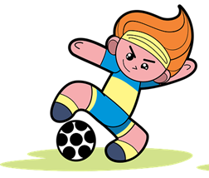
Exploring
Heute ist Sportfest!
grün
Follow ups 1-5
Term 2 Week 6
Notes:
Artwork by Steve Clarke. Pronoun pictures from NCELP (www.ncelp.org). All additional pictures selected from Pixabay and are available under a Creative Commons license, no attribution required.
Phonics:
[sch] schreiben [245] falsch [638] schnell [233] Mensch [104] schwarz [451]
[sp] spielen [197] Sprache [367] sprechen [157] Sport [845] Spiel [500]
[st] stark [207] Straße [355] stehen [87] verstehen [222] Stadt [186]
Vocabulary: Uhr3 [348] spät [169] um1 [44] zusammen [533] Revisit numbers 1-12
Revisit2: helfen [338] mitnehmen [1459] nehmen [142] sehen [79] Bus [1562] Film [505] Freund [273] Geld [235] Hausaufgabe [n/a] Sachen [318] Zug [675] normalerweise [2062]
Jones, R.L & Tschirner, E. (2019). A frequency dictionary of German: Core vocabulary for learners. London: Routledge.
The frequency rankings for words that occur in this PowerPoint which have been previously introduced in these resources are given in the SOW and in the resources that first
introduced and formally re-visited those words.
For any other words that occur incidentally in this PowerPoint, frequency rankings will be provided in the notes field wherever possible.
Remember that at the start of the course (first three lessons of Rot/Gelb) pupils learnt language (for greetings and register taking) that can still be part of the lesson routines in upper KS2 (Blau/Grün). They are not re-taught, as we anticipate that teachers have built these in from early in lower KS2.

Slide 2
aussprechen
[sch]
…
[fast]
falsch
schnell
schreiben
Mensch
schwarz
Notes:
Timing: 2 minutes
Aim: To introduce/consolidate SSC [sch]
Procedure:
Introduce and elicit the pronunciation of the individual SSC [sch] and then the source word again ‘schreiben’ (with gesture, if using).
Then present and elicit the pronunciation of the four cluster words.
Word frequency (1 is the most frequent word in German): schreiben [245] falsch [638] schnell [233] Mensch [104] schwarz [451] Source: Jones, R.L. & Tschirner, E. (2006). A frequency dictionary of German: core vocabulary for learners. Routledge
2

Slide 3
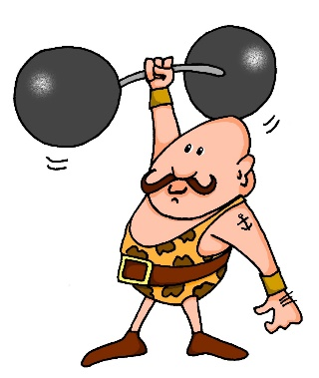
[st]
…
aussprechen
[to stand]
stehen
Straße
stark
[to understand]
verstehen
Stadt
Notes:
Timing: 2 minutes
Aim: To introduce/consolidate SSC [st-]
Procedure:
Introduce and elicit the pronunciation of the individual SSC [st-] and then the source word again ‘stark’ (with gesture, if using).
Then present and elicit the pronunciation of the five cluster words.
Word frequency (1 is the most frequent word in German): stark [207] Straße [355] stehen [87] verstehen [222] Stadt [186] Source: Jones, R.L. & Tschirner, E. (2006). A frequency dictionary of German: core vocabulary for learners. Routledge

Slide 4
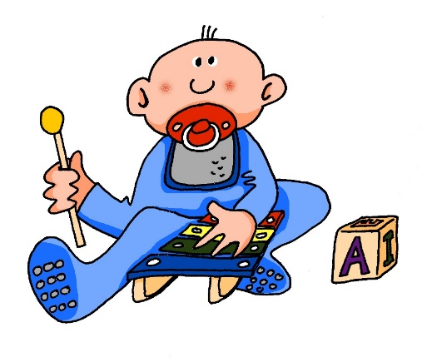
[sp]
…
aussprechen
Sprache
sprechen
spielen
Sport
Spiel
Notes:
Timing: 2 minutes
Aim: To introduce/consolidate SSC [sp]
Procedure:
Introduce and elicit the pronunciation of the individual SSC [sp] and then the source word again ‘spielen’ (with gesture, if using).
Then present and elicit the pronunciation of the five cluster words.
Word frequency (1 is the most frequent word in German): spielen [197] Sprache [367] sprechen [157] Sport [845] Spiel [500] Source: Jones, R.L. & Tschirner, E. (2006). A frequency dictionary of German: core vocabulary for learners. Routledge

Slide 5
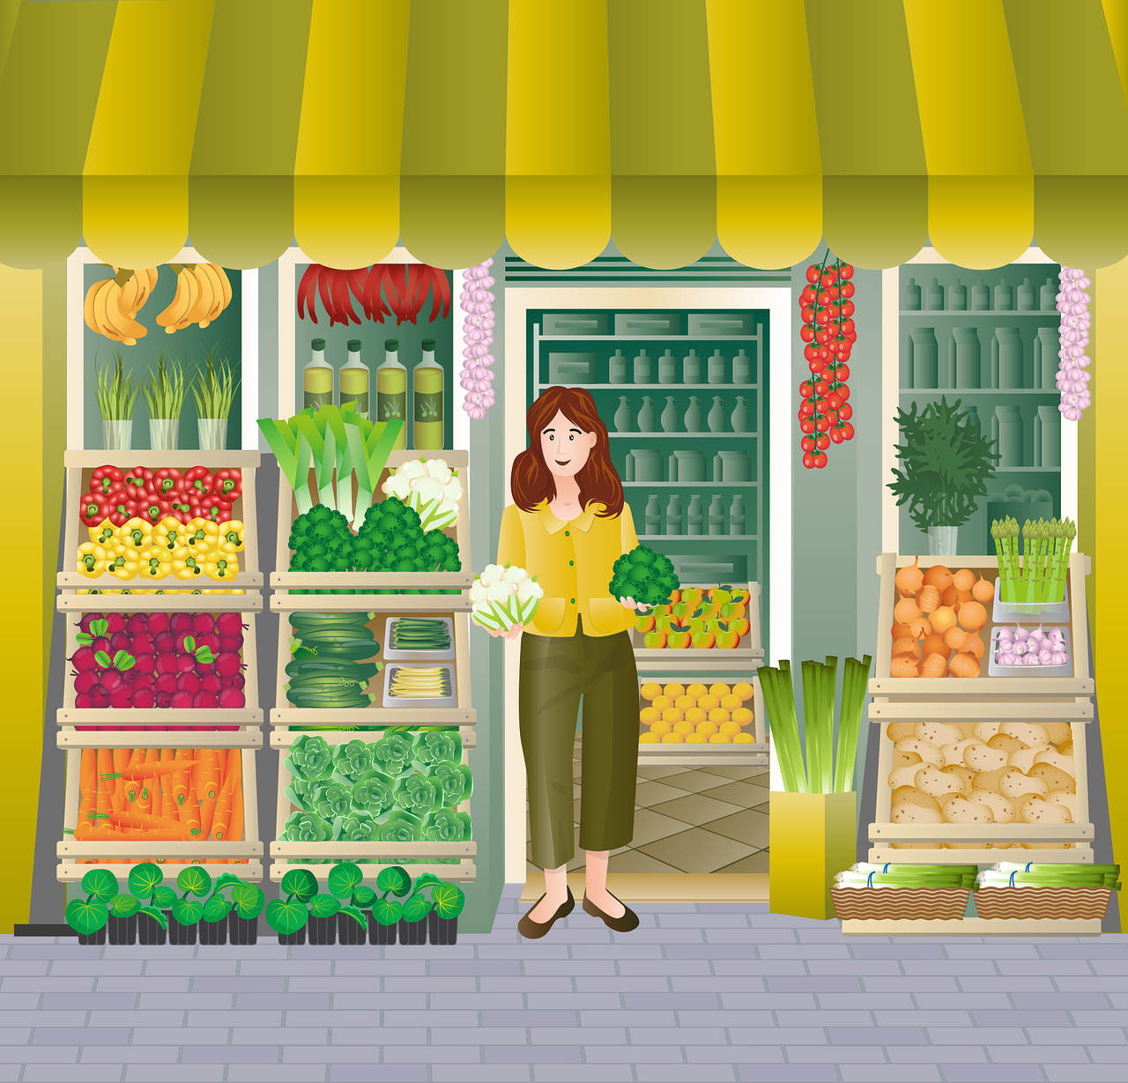
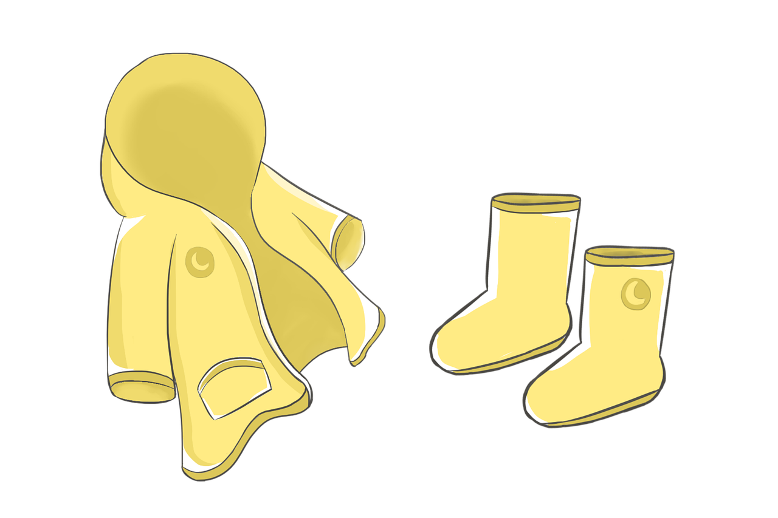
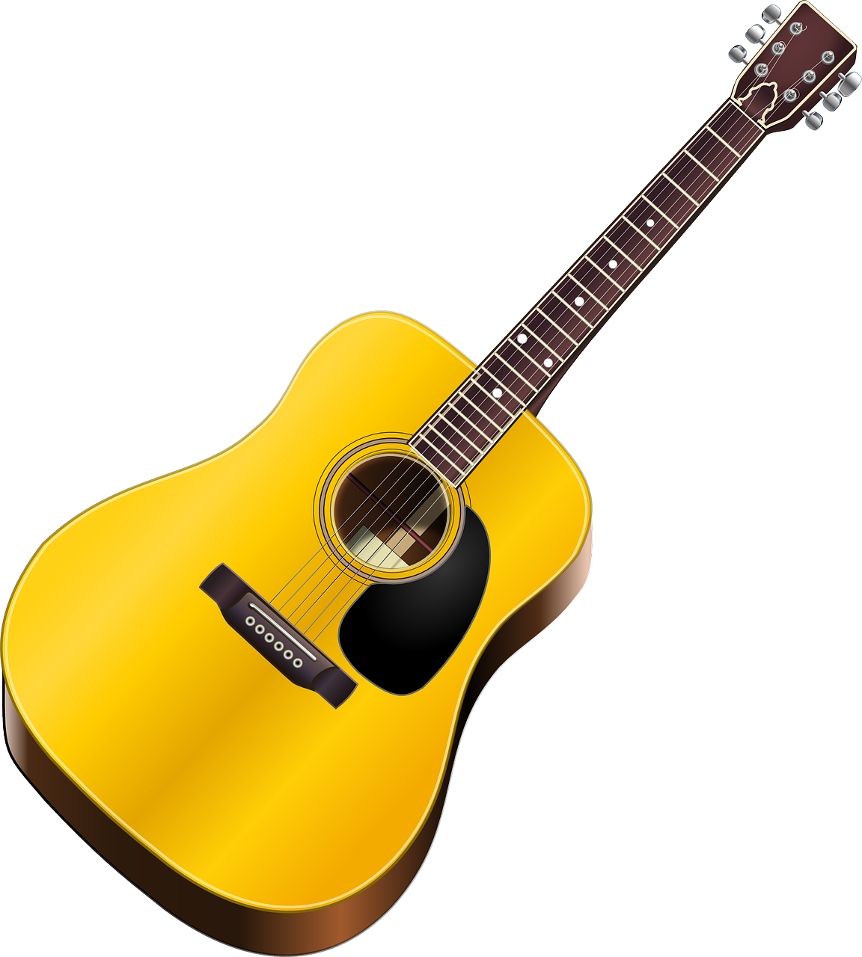
Follow up 1:
Sag die Wörter.
Stoff
Stadt
[material, fabric]
aussprechen
Deutschland
falsch
25
schlimm
Geschäft
stehen
[bad]
[shop]
Gespräch
Flasche
Spiel
S
Schweiz
[conversation]
spät
praktisch
Frühstück
[practical]
Spieler
[breakfast]
Sportler
spüren
Stunde
0
klassisch
[to feel, feeling]
Tisch
[classical]
START
Notes:
Timing: 5 minutes
Aim: to practise applying knowledge of [sch] [st-] [sp-] to mostly known (previously taught) words.
Procedure: 1. Pupil A selects 4 words and writes them without showing.
2. Start the timer. Pupil B tries to say all of A’s chosen words within the time limit (25 seconds). 3. They swap roles and repeat the task. They may play multiple rounds.
Frequency of unknown words:
Frühstück [2600] Gespräch [517] Geschäft [765] klassisch [882] praktisch [840] schlimm [762] spüren [750] Stoff [758]

Slide 6
Follow up 2
Lies die Sätze. Wer macht was?
The word ‘zusammen*’ (together) indicates the right verb option. Who is doing what?
lesen
A
They do/are doing homework together.
Sie macht|Sie machen zusammen Hausaufgaben.
In English, together usually comes at the end. In German, zusammen usually comes after the verb.
B
Wir fahren| Sie fährt Rad.
She cycles/is cycling.
C
Ich laufe | Wir laufen zusammen fünf Kilometer.
We run/ are running 5 kilometres together.
D
Sie finden |Sie findet zusammen ein Kunstprojekt.
They find/ are finding an art project together.
E
Benutzt ihr | Benutzt du den Computer?
Do you use/ are you using the computer?
Notes:
Timing: 6 minutes
Aim: to practise the syntax and use of ‘zusammen’ with plural verb forms.
Procedure:
Click for the instructions.
Elicit the correct answer for A.
Click to blank out incorrect option.
Elicit English translation.
Click to bring up callout drawing attention to the different syntax around zusammen/ together in German/English.
Continue for items B-E.

Slide 7
Follow up 3a
Hör zu.
A
B
 | A, B, C? | when?
 |  | Sports day
 |  | Friday
 |  | 2.00
 |  | sports day
 |  | 10.00
 |  | 2.00
 |  | 10.00
 |  | Friday
Time: __________ They normally wear sports clothes.
Time: __________ Are you (all) helping friends?
hören
1
D
2
G
C
D
E
3
B
Time: __________ She normally wears sports clothes.
Time: __________ I am singing with Opa.
Time: __________ We are playing football.
4
A
5
C
6
H
F
G
H
Time: __________ Are you playing football?
Time: __________ You are singing with Opa.
Time: __________ He is helping friends.
7
F
8
E
Notes:
Scaffolded version. The ‘stretch version’ of this task is on slide 8.
Timing: 8 minutes
Aim: to practise comprehension of times and activities in this week’s context.
Procedure:
Pupils listen to the German audio (click on the audio button) and select the letter of the corresponding English translation.
Pupils number the English or fill in the letter (in the table they have sketched in their books) on the left.
Click for answers to appear in the table.
Second step: Pupils write the times.
Click for answers to appear in the table.
Transcript: 1. Sie trägt normalerweise Sportkleidung am Sportfest.
2. Du singst mit Opa am Freitag.
3. Helft ihr Freunden um zwei Uhr?
4. Sie tragen normalerweise Sportkleidung am Sportfest.
5. Wir spielen Fußball um zehn Uhr.
6. Er hilft Freunden um zwei Uhr.
7. Spielt ihr Fußball um zehn Uhr?
8. Ich singe mit Opa am Freitag.

Slide 8
Follow up 3b
Hör zu.
 | Person | Activity | Time
hören
1
she
normally wears sports clothes
on sports day
2
you
are singing with Opa
Friday
3
you (all)
are helping friends
two o’clock
4
they
normally wear sports clothes
on sports day
5
we
are playing football
ten o’clock
6
he
is helping friends
two o’clock
7
you (all)
are playing football
ten o’clock
8
I
am singing with Opa
Friday
Notes:
‘Stretch’ version. The scaffolded version of this task is on slide 7.
Note: the audio is the same, so pupils in the same class can complete different versions of the same activity at the same time.
Aim: to practise comprehension of times and activities in this week’s context.
Procedure:
Pupils listen to the German audio (click on the audio button) fill in the table for person, activity and time.
Click for answers to appear in table.
Transcript: 1. Sie trägt normalerweise Sportkleidung am Sportfest.
2. Du singst mit Opa am Freitag.
3. Helft ihr Freunden um zwei Uhr?
4. Sie tragen normalerweise Sportkleidung am Sportfest.
5. Wir spielen Fußball um zehn Uhr.
6. Er hilft Freunden um zwei Uhr.
7. Spielt ihr Fußball um zehn Uhr?
8. Ich singe mit Opa am Freitag.

Slide 9
Follow up 4
Wie spät ist es? Rede mit deinem Partner/deiner Partnerin.
Partner A
Person B: Wie spät ist es?
Person A: Es ist zwei Uhr.
2 o’clock
Person B: 🖊 …………………..
Notes:
Timing: 5 minutes (two slides)
Model slide.
Aim: to practise asking and giving times, to practise oral recall and production of numbers 1-12.
Procedure:
Click through animations on this slide to model the task.
Move to next slide.
Transcript:
Wie spät ist es?
Es ist zwei Uhr.

Slide 10
Follow up 4
Wie spät ist es? Rede mit deinem Partner/deiner Partnerin.
sprechen
1
2
1
2
3
3
4
4
5
6
5
6
Notes:
Aim: to practise asking and giving times, to practise oral recall and production of numbers 1-12.
Procedure:
Person B turns away.
Click to bring up 6 x clock faces for Person A.
Person B asks ‘Wie spät ist es? (x 6)
Person A responds (x 6)
Person B writes down the times, then turns back to check the board.
Swap roles and repeat for Round 2.
Click on yellow speaker icon for listen and check.
Transcript:
1. Wie spät ist es?
Es ist neun Uhr.
2. Wie spät ist es?
Es ist sieben Uhr.
3. Wie spät ist es?
Es ist zwölf Uhr.
4. Wie spät ist es?
Es ist zwei Uhr.
5. Wie spät ist es?
Es ist ein Uhr.
6. Wie spät ist es?
Es ist acht Uhr.
1. Wie spät ist es?
Es ist zehn Uhr.
2. Wie spät ist es?
Es ist drei Uhr.
3. Wie spät ist es?
Es ist sechs Uhr.
4. Wie spät ist es?
Es ist vier Uhr.
5. Wie spät ist es?
Es ist fünf Uhr.
6. Wie spät ist es?
Es ist elf Uhr.

Slide 11
Follow up 5:

Schreib auf Englisch.
Can you get at least 15 points?
Wörter
 | der Zug | nehmen | der Freund
 | helfen | normalerweise | die Sachen
 | sehen | das Geld | der Film
 | die Hausaufgaben | der Bus | mitnehmen
 | um vier Uhr | um | (die) Uhr
 | spät | zwölf | zusammen
Vokabeln
(the) train
to take, taking
(the) friend
x3
to help, helping
normally
(the) things
to see, seeing
(the) money
(the) film
x2
(the) homework
(the) bus
to take with, taking with
at (o’clock)
(the) watch,
clock, o’clock
at four o’clock
x1
late
twelve
together
Notes:
Timing: 5 minutes
Aim: to practise written comprehension of vocabulary from this and revisited weeks.
Procedure: 1. Give pupils a blank grid. They fill in the English meanings of any of the words they know, trying to reach 15 points in total.
Note: The most recently learnt and practised words are pink, words from the previous week are green and those from week 1 are blue, thus more points are awarded for them, to recognise that memories fade and more effort (heavy lifting!) is needed to retrieve them.

Slide 12
Follow up 5:

Schreib auf Deutsch.
Can you get at least 15 points?
Wörter
 | to take, taking | (the) friend | (the) train
 | (the) things | normally | to help, helping
 | (the) homework | (the) bus | to see, seeing
 | (the) film | to take with, taking with | (the) money
 | twelve | late | together
 | at (o’clock) | at four o’clock | (the) watch, clock, o’clock
Vokabeln
nehmen
der Freund
der Zug
x3
die Sachen
normalerweise
helfen
die Hausaufgaben
der Bus
sehen
x2
der Film
mitnehmen
das Geld
zwölf
spät
zusammen
x1
um vier Uhr
um
(die) Uhr
Notes:
Timing: 5 minutes
Aim: to practise written comprehension of vocabulary from this and revisited weeks.
Procedure: 1. Give pupils a blank grid. They fill in the German meanings of any of the words they know, trying to reach 15 points in total.
Note: The most recently learnt and practised words are pink, words from the previous week are green and those from week 1 are blue, thus more points are awarded for them, to recognise that memories fade and more effort (heavy lifting!) is needed to retrieve them.

Slide 13
Tschüss!
Tschüss!
Don’t forget this more formal way to say Goodbye!
Auf Wiedersehen!
grün
Notes:
13

Slide 14
Follow up 5:

Schreib auf Englisch.
Can you get at least 15 points?
Wörter
 | der Zug | nehmen | der Freund
 | helfen | normalerweise | die Sachen
 | sehen | das Geld | der Film
 | die Hausaufgaben | der Bus | mitnehmen
 | um vier Uhr | um | (die) Uhr
 | spät | zwölf | zusammen
Vokabeln
x3
x2
x1
Notes:
PRINTOUT.

Slide 15
Follow up 5:

Schreib auf Deutsch.
Can you get at least 15 points?
Wörter
 | to take, taking | (the) friend | (the) train
 | (the) things | normally | to help, helping
 | (the) homework | (the) bus | to see, seeing
 | (the) film | to take with, taking with | (the) money
 | twelve | late | together
 | at (o’clock) | at four o’clock | (the) watch, clock, o’clock
Vokabeln
x3
x2
x1
Notes:
PRINTOUT

