Slide 1
Part 2
Practical Example of
Mixed-Effects Models in R

Slide 2
Mixed-effects models Example 1: Garden paths
Consider a simple experiment with two conditions
(1) Comma (Non Garden-Path)
After Anna dressed, the baby played in the bedroom.
(2) No Comma (Garden-Path)
After Anna dressed the baby played in the bedroom.
Participants included 40 native English speakers who read 24 experimental sentences in a latin-square design
Each participant sees 12 non garden-path and 12 garden-path sentences
Reading times at the critical verb (played) were analysed as the dependent variable

Slide 3
R: Functions and packages
In additon to the base functions in R, additional packages can be installed that provide more advanced functions for various analyses/data visualisations
Some useful packages, some of which we will use today, include
✓lme4 Linear mixed effects models
✓ lmerTest Computes p values for mixed-models
✓ ggplot2 Advanced data visualisation

Slide 4
R: example 1 Loading the data
The data for this example are saved as.txt files
To load the data from a .txt file use the read.table() function
> data.example1 = read.table(file = "Example 1.txt", header = TRUE, sep = "\t", na.strings = ".")
> head(data.example1)
subject item condition rt
1 1 1 no-comma 201
2 1 2 no-comma 276
3 1 3 comma 1043
4 1 4 comma 253
5 1 5 no-comma 347
6 1 6 no-comma 1373

Slide 5
Regression model(s)
y = a + b*x + ε
a: intercept
b: slope – change in unit X in independent variable result in change “b” in dependent variable
ε: error (predicted value by model minus observed value_

Slide 6
R: example 1 Fitting a mixed-effects model
To fit a mixed-effects model, use the lmer() function
> model.example1.1 = lmer(rt ~ condition + (1|subject) + (1|item), data = data.example1)
This creates a mixed-effects model object called model.example1.1
rt is the dependent variable
condition is the independent variable (fixed effect)
(1|subject) + (1|item) specifies crossed random effects for subjects and items

Slide 7
Random intercepts and random slopes
The current model includes random intercepts for subjects and items
This allows the average reaction time for each subject and item to vary
(1|subject) + (1|item)
We can also include random slopes to account for differences in the size of the garden-path effect across subjects/items
Random slopes can be included for any repeated measures variable
(1+condition|subject) + (1+condition|item)

Slide 8
R: example 1 Fitting a mixed-effects model
To see the results of the model, use summary()
> summary(model.example1.1)
Random effects:
Groups Name Variance Std.Dev.
subject (Intercept) 29566 171.9
item (Intercept) 3215 56.7
Residual 133570 365.5
Number of obs: 899, groups: subject, 40; item, 24
Fixed effects:
Estimate Std. Error df t value Pr(>|t|)
(Intercept) 442.67 34.30 58.50 12.908 < 2e-16 ***
conditionno-comma 153.16 24.41 836.60 6.275 5.62e-10 ***
---
Signif. codes: 0 ‘***’ 0.001 ‘**’ 0.01 ‘*’ 0.05 ‘.’ 0.1 ‘ ’ 1

Slide 9
R: example 1 Fitting random slopes
> model.example1.2 = lmer(rt ~ condition + (1+condition|subject) + (1+condition|item), data = data.example1)
> summary(model.example1.2)
Random effects:
Groups Name Variance Std.Dev. Corr
subject (Intercept) 56990 238.72
conditionno-comma 21518 146.69 -0.94
item (Intercept) 7147 84.54
conditionno-comma 3367 58.03 -1.00
Residual 127079 356.48
Number of obs: 899, groups: subject, 40; item, 24
Fixed effects:
Estimate Std. Error df t value Pr(>|t|)
(Intercept) 593.90 44.77 45.50 13.27 < 2e-16 ***
conditionno-comma 148.25 35.30 35.81 4.20 0.000169 ***
---
Signif. codes: 0 ‘***’ 0.001 ‘**’ 0.01 ‘*’ 0.05 ‘.’ 0.1 ‘ ’ 1

Slide 10
R: example 1 Assessing model fit
We can assess whether the random slopes improve model fit using the anova() function
In this case, including random slopes leads to improved fit
> anova(model.example1.1, model.example1.2)
refitting model(s) with ML (instead of REML)
Data: data.example1
Models:
model.example1.1: rt ~ condition + (1|subject) + (1|item)
model.example1.2: rt ~ condition + (1+condition|subject) + (1+condition|item)
Df AIC BIC logLik deviance Chisq Chi Df Pr(>Chisq)
model.example1.1 5 13256 13280 -6622.9 13246
model.example1.2 9 13235 13278 -6608.5 13217 28.88 4 8.267e-06 ***
---
Signif. codes: 0 ‘***’ 0.001 ‘**’ 0.01 ‘*’ 0.05 ‘.’ 0.1 ‘ ’ 1

Slide 11
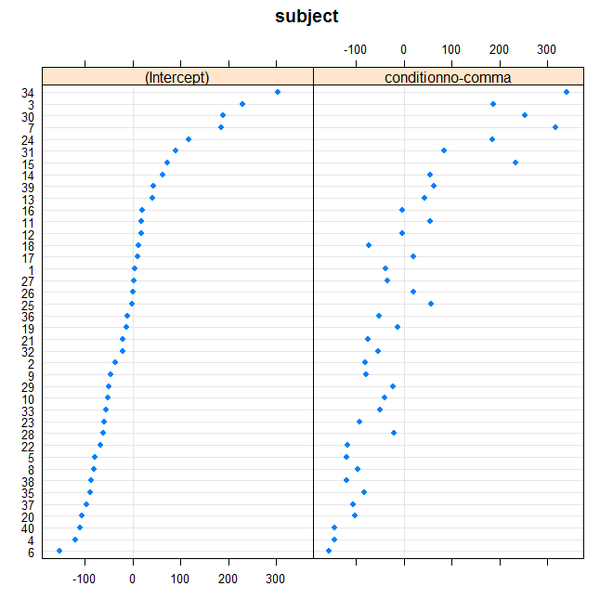
R: Example 1 A closer look at the random effects
We can use the dotplot() function to look at the random effects
> dotplot(ranef(model.example1.2))$subject
Notes:
You may need to require(lattice) for this to work

Slide 12
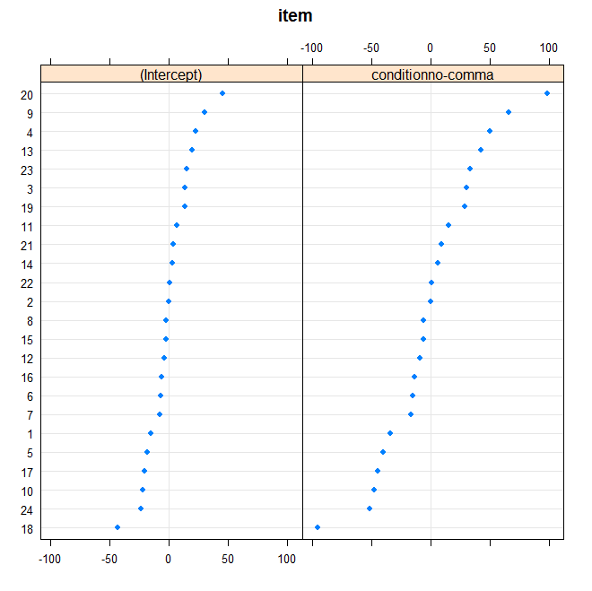
R: Example 1 A closer look at the random effects
We can use the dotplot() function to look at the random effects
> dotplot(ranef(model.example1.2))$item
Notes:
You may need to require(lattice) for this to work

Slide 13
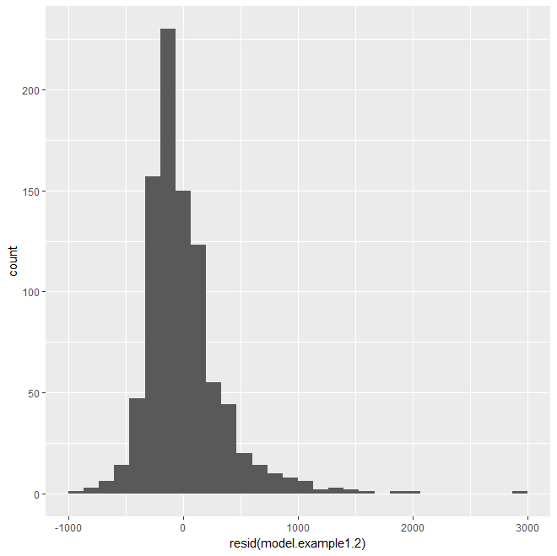
R: example 1 Checking model residuals
Like ANOVA, standard mixed-effects models assume a normal distribution
Technically model residuals need to be normally distributed
> qplot(resid(model.example1.2))

Slide 14
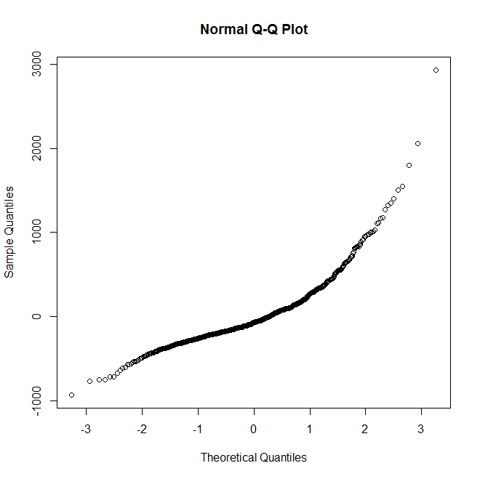
R: example 1 Checking model residuals
Like ANOVA, standard mixed-effects models assume a normal distribution
Technically model residuals need to be normally distributed
> qqnorm(resid(model.example1.2))

Slide 15
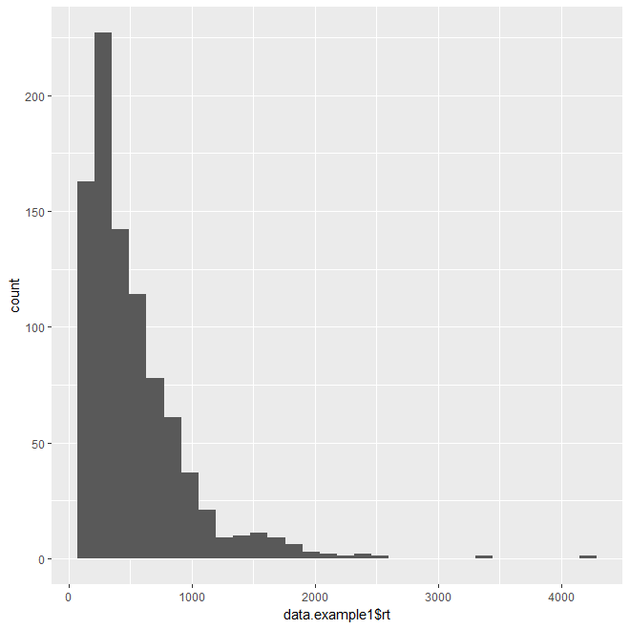
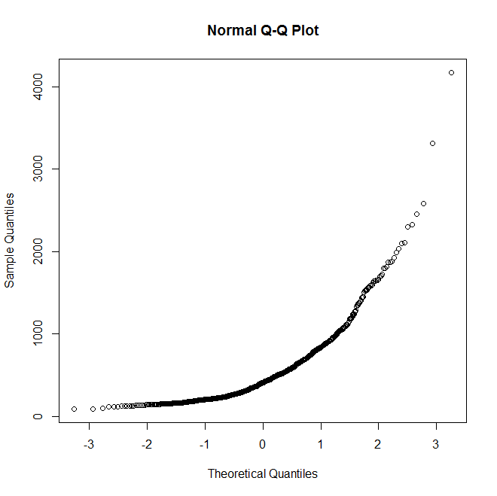
R: example 1 Checking the distribution of the data
If the model residuals are not normally distributed, it might be that the data itself is not normally distributed
> qplot(data.example1$rt)
> qqnorm(data.example1$rt)

Slide 16
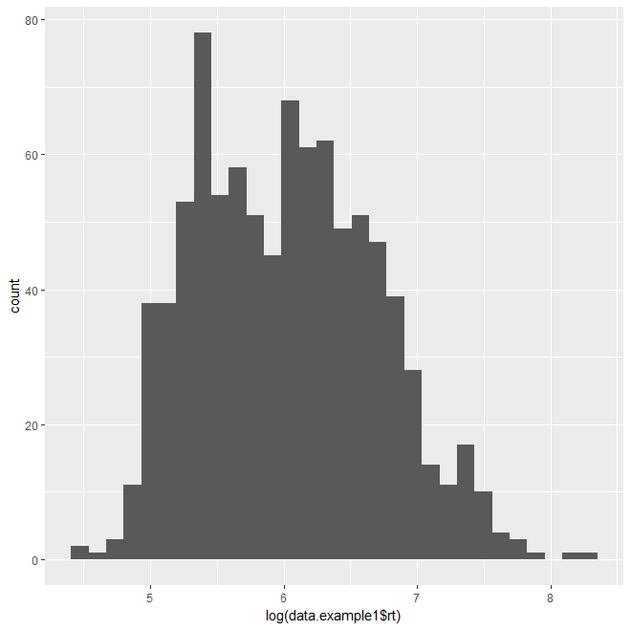
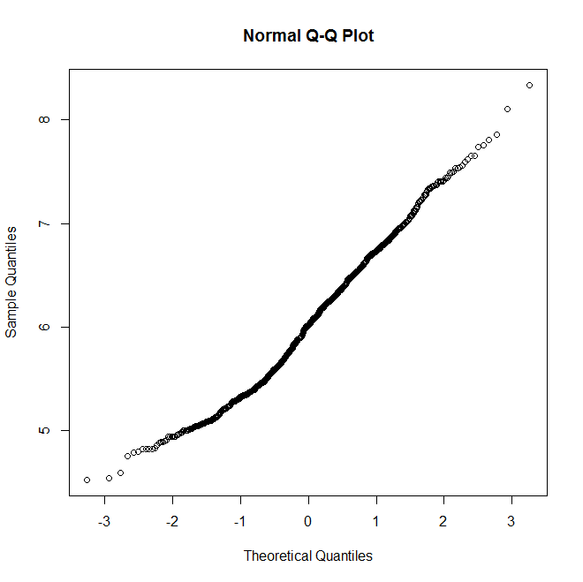
R : example 1 Checking the distribution of the data
The log transformation often reduces skew in reaction times (Vasishth & Nicenboim, 2016)
> qplot(log(data.example1$rt))
> qqnorm(log(data.example1$rt))

Slide 17
R: Example 1 Fitting a model to log reaction times
This suggests we should fit our model to log RTs
model.example1.3 = lmer(log(rt) ~ condition + (1+condition|subject) + (1+condition|item), data = data.example1)
> summary(model.example1.3)
Random effects:
Groups Name Variance Std.Dev. Corr
subject (Intercept) 0.062675 0.25035
conditionno-comma 0.049830 0.22323 0.11
item (Intercept) 0.002276 0.04771
conditionno-comma 0.006108 0.07815 1.00
Residual 0.334793 0.57861
Number of obs: 899, groups: subject, 40; item, 24
Fixed effects:
Estimate Std. Error df t value Pr(>|t|)
(Intercept) 5.89681 0.04921 39.38258 119.838 < 2e-16 ***
conditionno-comma 0.24205 0.05475 32.63767 4.421 0.000102 ***

Slide 18
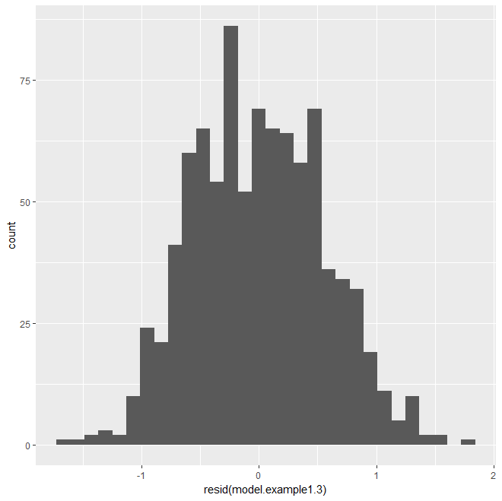
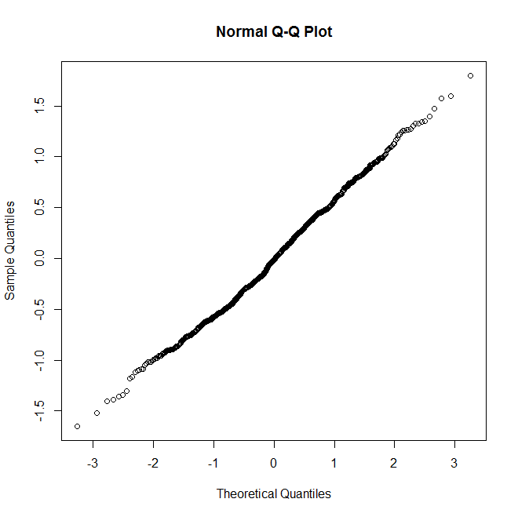
R: example 1 Checking the model residuals
Log RTs lead in this case to more normal residuals
> qplot(resid(model.example1.3))
> qqnorm(resid(model.example1.3))

Slide 19
Mixed-effects models Example 2: binomial response
Imagine the same experiment but with a different dependent variable, this time testing comprehension
(1) Comma (Non Garden-Path)
After Anna dressed, the baby played in the bedroom.
(2) No Comma (Garden-Path)
After Anna dressed the baby played in the bedroom.
Question: Did Anna dress the baby? (Yes/No)
The dependent variable is now a binary response

Slide 20
R: Example 2 Loading the data
> data.example2 = read.table(file = "Example 2.txt", header = TRUE, sep = "\t")
> head(data.example2)
subject item condition response
1 native 1 1 no-comma 1
2 native 1 2 comma 1
3 native 1 3 no-comma 1
4 native 1 4 comma 1
5 native 1 5 no-comma 0
6 native 1 6 comma 1

Slide 21
R: Example 2 Fitting the model
> model.example2.1 = glmer(response ~ condition + (1+condition|subject) + (1+condition|item), data = data.example2, family = "binomial")
The code is similar to previously, with a few exceptions
glmer is used instead of lmer
We specify family = "binomial"

Slide 22
R: Example 2 Model Summary
> summary(model.example2.1)
Random effects:
Groups Name Variance Std.Dev. Corr
subject (Intercept) 0.67923 0.8242
conditionno-comma 0.07954 0.2820 1.00
item (Intercept) 0.20675 0.4547
conditionno-comma 0.39507 0.6285 0.02
Number of obs: 960, groups: subject, 40; item, 24
Fixed effects:
Estimate Std. Error z value Pr(>|z|)
(Intercept) 2.621423 0.001351 1941 <2e-16 ***
conditionno-comma -1.678590 0.001350 -1243 <2e-16 ***
---
optimizer (Nelder_Mead) convergence code: 0 (OK)
Model failed to converge with max|grad| = 0.052506 (tol = 0.002, component 1)

Slide 23
R: Example 2 Removing random slope
model.example2.2 = glmer(response ~ condition + (1|subject) + (1+condition|item), data = data.example2, family = "binomial")
> summary(model.example2.2)
Random effects:
Groups Name Variance Std.Dev. Corr
subject (Intercept) 1.0450 1.0223
item (Intercept) 0.2298 0.4794
conditionno-comma 0.3770 0.6140 -0.03
Number of obs: 960, groups: subject, 40; item, 24
Fixed effects:
Estimate Std. Error z value Pr(>|z|)
(Intercept) 2.7464 0.2810 9.775 < 2e-16 ***
conditionno-comma -1.8275 0.2568 -7.117 1.1e-12 ***
---
Signif. codes: 0 ‘***’ 0.001 ‘**’ 0.01 ‘*’ 0.05 ‘.’ 0.1 ‘ ’ 1

Slide 24
Reporting your analysis
Report which type of mixed-effects model was used
Describe your dependent and independent variables
For your dependent variable, report what data transformation (if any) was used
For your fixed effects, report how they were coded
Report the random effects structure, specifying random intercepts and random slopes (no need to report estimates)
Report how you chose the random effects structure, and what you did in cases of convergence errors
For each fixed effect, minimally report...
The model estimate, SE, t (z) value, p value

Slide 25
Reporting your analysis
Consider making your data and analysis code available to other researchers
e.g. On the OSF website, github etc.
Provide your data in an easily usable format (e.g. .txt)
Include the code for your analysis in a .txt file as well
Some examples:
https://osf.io/fe4us/
https://osf.io/v93wg/

Slide 26
Summary & Conclusions
Bilingualism researchers are often faced with data that pose particular challenges
Heterogeneous participant samples, nested or crossed clusters of observations, missing data etc.
Mixed effects models can help overcome these challenges
Provide a useful tool to analyse a variety of types of data investigated in bilingualism research
Best practice in the use of mixed-effects models is still evolving
Be thorough and precise in reporting your analyses, and consider making your data/code openly available

Slide 27
References
Baayen, H. (2008). Analysing Linguistic Data. Cambridge: CUP.
Baayen, H., Davidson, D., & Bates, D. (2008). Mixed-effects modeling with crossed random effects for subjects and items. Journal of Memory and Language, 59, 390-412.
Barr, D. (2013). Random effects structure for testing interactions in linear mixed-effects models. Frontiers in Psychology, 4, 328.
Barr, D., Levy, R., Scheepers, C. & Tily, H. (2013). Random effects structure for confirmatory hypothesis testing: Keep it maximal. Journal of Memory and Language, 68, 255-278.
Cunnings, I. (2012). An overview of mixed-effects statistical models for second language researchers. Second Language Research, 28, 369-382.
Cunnings, I. & Finlayson, I. (2015). ‘Mixed effects modelling and longitudinal data analysis‘ in Plonsky, L. (ed.), Advancing Quantitative Methods in Second Language Research, pp. 159-181.
Crawley, M. (2007). The R Book. Chicester: John Wiley and Sons.
Dalgaard, P. (2008). Introductory Statistics with R. 2nd edtion. New York: Springer.
Jaeger, T. F. (2008). Categorical data analysis: Away from ANOVAs (transformation or not) and towards mixed logit models. Journal of Memory and Language, 59, 434-446.

Slide 28
References
Linck, J. & Cunnings, I. (2015). The utility and application of mixed-effects models in second language research. Language Learning, 65, 185-207.
Lo, S., Andrews, S. (2015). To transform or not to transform: using generalized linear mixed models to analyse reaction time data. Frontiers in Psychology, 6, 1-16.
Matuschek, H., Kliegl, R., Vasishth, S., Baayen, H. & Bates, D. 92017). Balancing Type I Error and Power in Linear Mixed Models. Journal of Memory and Language, 94. 305-315.
Nicenboim, B. & Vasishth, S. (2016). Statistical methods for linguistic research: Foundational ideas – Part II. Language and Linguistics Compass, 10, 591-613.
Schad, D., Hohenstein, S., Vasishth, S. & Kliegl, R. (2018). How to capitalize on a prior contrasts in linear (mixed) models: A tutorial. https://arxiv.org/abs/1807.10451
Schielzeth, H. & Forstmeier, W. (2009). Conclusions beyond support: Overconfident estimates in mixed models. Behavioral Ecology, 20, 416-420.
Quene, H. & van den Bergh, H. (2008). Examples of mixed-effects modelling with crossed random effects with binomial data. Journal of Memory and Language, 59, 413-425.
Vasishth, S. & Nicenboim, B. (2016). Statistical methods for linguistic research: Foundational ideas – Part 1. Language and Linguistics Compass, 12, 175-200.
The R-Lang Mailing List is an online mailing list for those conducting data analysis in R and can be joined here: https://mailman.ucsd.edu/mailman/listinfo/ling-r-lang-l

Slide 29
Thank you

