Slide 1
Realigning UK Food Production and Trade for Transition to Healthy and Sustainable Diets WP1 - Changes in dietary consumption patterns for transition to HSD Asioli¹, Balcombe¹, Fraser², Nocella¹, Law¹, Srinivasan¹, Xhakollari¹ ¹School of Agriculture, Policy and Development, University of Reading ²School of Economics, University of Kent

Slide 2
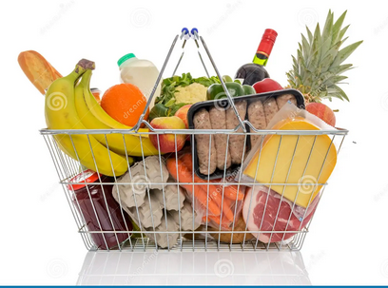
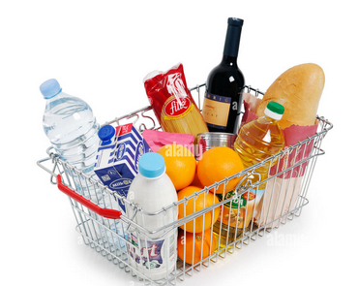
Component 3
Aim: assess the impact of price changes on the healthfulness and environmental sustainability of consumer dietary choices.
How?: Basket Based Choice Experiment (BBCE)
…
…
Creates a real buying environment context
Allows participants to choose one or more combination of food items
Measures complementary patterns (pairing butter with jam)
Measures substitution effects (choosing between cultured meat and meat from animals)
Estimates product level elasticities

Slide 3
Design of the experiment, 1500 participants
Experiment
Screening questions
BBCE
10 food isles
Info on macronutrients composing the basket
102 food products
5 price levels
Quantity for 3 household members
Food purchasing habits
Socio-demographic characteristics
Dietary habits

Slide 4
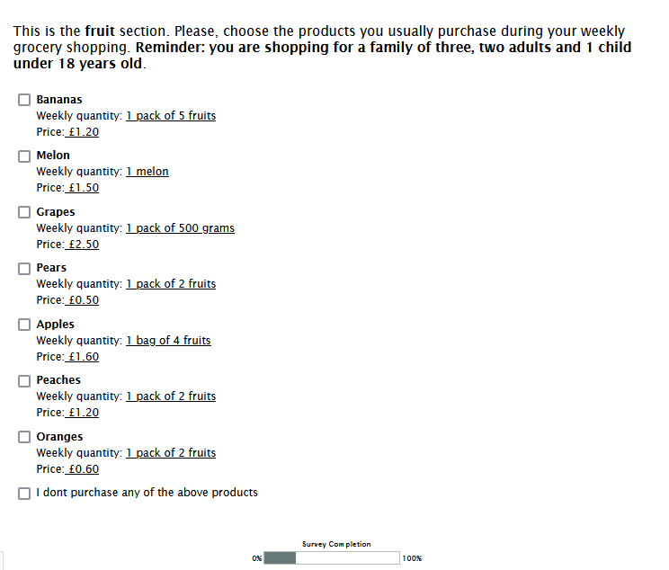
Example of the choice
Shelves
Beverages
Bread
Cereals
Confectionary
Dairy
Fats
Fruit
Other

Slide 5
People are not price sensitive

Slide 6
Reflections
Results may reflect hypothetical bias
Long task people may become bored or tired
May lack the necessary cues about size and price available in a real shopping environment
BUT
May reflect real price insensitivity in “one-off” shopping experiences for items that are commonly purchased
Real price elasticities may be “long-run” phenomena where purchase behaviour is shaped over repeated purchases and the “feedback” that might entail.

